Slide 1
PHYS 1444 – Section 003
Lecture #2
Tuesday, Aug. 30, 2011
Dr. Jaehoon Yu
Some basics …
Chapter 21
  Static Electricity and Charge Conservation
  Charges in Atom, Insulators and Conductors & Induced Charge
  Coulomb’s Law
  The Electric Field & Field Lines
  Electric Fields and Conductors
Today’s homework is homework #2, due 10pm, Tuesday, Sept. 6!!

Slide 2
Announcements
74 of you replied to me in e-mail
  10 haven’t. Please reply and establish the communication!
79/84 have registered for homework
  Wow, amazing!!
  But only 70 have submitted the answer
  Free homework is only till 10pm tonight
  I need to approve, so if you haven’t done this yet, please go ahead and do it ASAP
There will be a quiz on appendices A, B and what we learn today in Ch. 21 on Thursday, Sept. 1.
First department colloquium at 4pm tomorrow, Wednesday, SH 101

Slide 3
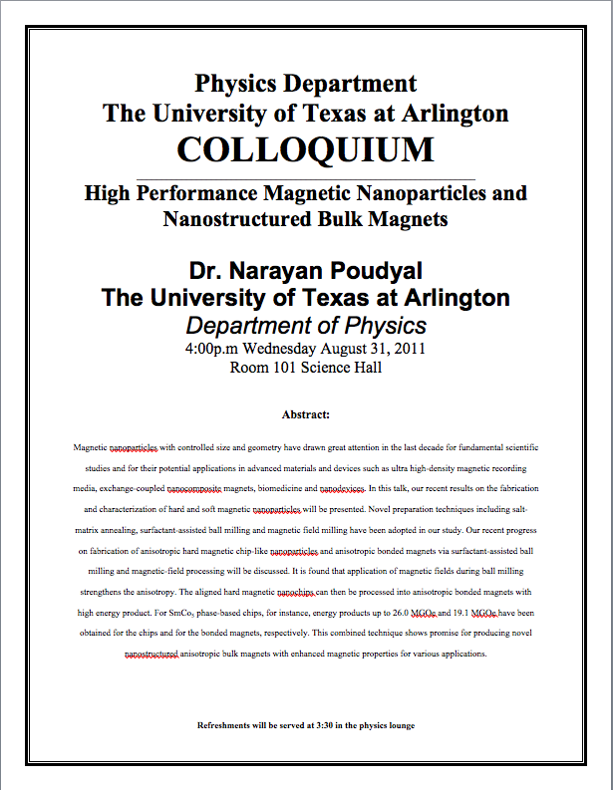

Slide 4
Extra Credit Special Project #1
Compare the Coulomb force to the Gravitational force in the following cases by expressing Coulomb force (F_{C}) in terms of the gravitational force (F_{G})
  Between two protons separated by 1m
  Between two protons separated by an arbitrary distance R
  Between two electrons separated by 1m
  Between two electrons separated by an arbitrary distance R
Five points each, totaling 20 points
BE SURE to show all the details of your work, including all formulae, and properly referring them
Please staple them before the submission
Due at the beginning of the class Tuesday, Sept. 6

Slide 5
SI Base Quantities and Units
Quantity | Unit | Unit Abbrevation
Length | Meter | m
Time | Second | s
Mass | Kilogram | kg
Electric current | Ampere | A
Temperature | Kelvin | k
Amount of substance | Mole | mol
Luminous Intensity | Candela | cd
There are prefixes that scales the units larger or smaller for convenience (see pg. 7)

Slide 6
Prefixes, expressions and their meanings
deca (da): 10¹
hecto (h): 10²
kilo (k): 10³
mega (M): 10⁶
giga (G): 10⁹
tera (T): 10¹²
peta (P): 10¹⁵
exa (E): 10¹⁸
deci (d): 10⁻¹
centi (c): 10⁻²
milli (m): 10⁻³
micro (μ): 10⁻⁶
nano (n): 10⁻⁹
pico (p): 10⁻¹²
femto (f): 10⁻¹⁵
atto (a): 10⁻¹⁸

Slide 7
How do we convert quantities from one unit to another?
Unit 1 =
Conversion factor X
Unit 2
1 inch | 2.54 | cm
1 inch | 0.0254 | m
1 inch | 2.54x10⁻⁵ | km
1 ft | 30.3 | cm
1 ft | 0.303 | M
1 ft | 3.03x10⁻⁴ | km
1 hr | 60 | minutes
1 hr | 3600 | seconds
And many | More | Here….

Slide 8
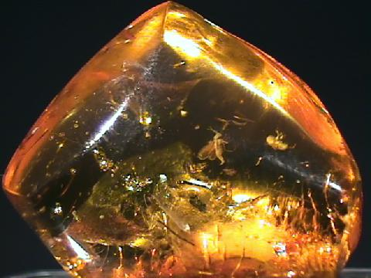
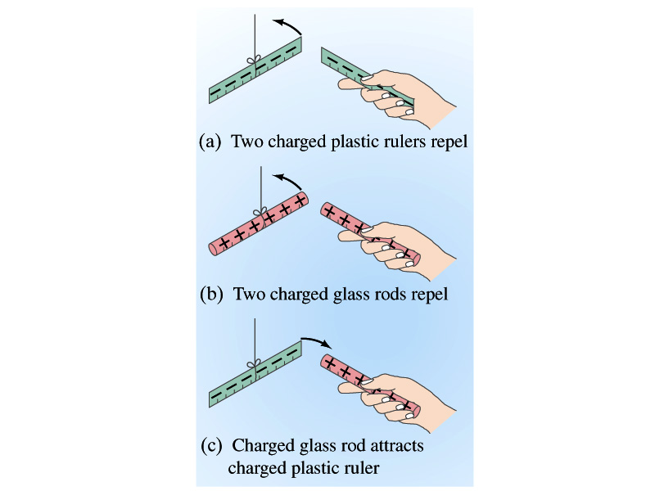
Static Electricity; Electric Charge and Its Conservation
Electricity is from Greek word elecktron=amber, a petrified tree resin that attracts matter if rubbed
Static Electricity: an amber effect
  An object becomes charged or “posses a net electric charge” due to rubbing
  Can you give some examples?
Two types of electric charge
  Like charges repel while unlike charges attract
  Benjamin Franklin referred the charge on glass rod as the positive, arbitrarily. Thus the charge that attracts glass rod is negative. ➔ This convention is still used.

Slide 9
Static Electricity; Electric Charge and Its Conservation
Franklin argued that when a certain amount of charge is produced on one body in a process, an equal amount of opposite type of charge is produced on another body.
  The positive and negative are treated algebraically so that during any process the net change in the amount of produced charge is 0.
    When you comb your hair with a plastic comb, the comb acquires a negative charge and the hair an equal amount of positive charge.
This is the law of conservation of electric charge.
  The net amount of electric charge produced in any process is ZERO!!
    If one object or one region of space acquires a positive charge, then an equal amount of negative charge will be found in neighboring areas or objects.
    No violations have ever been observed.
    This conservation law is as firmly established as that of energy or momentum.

Slide 10
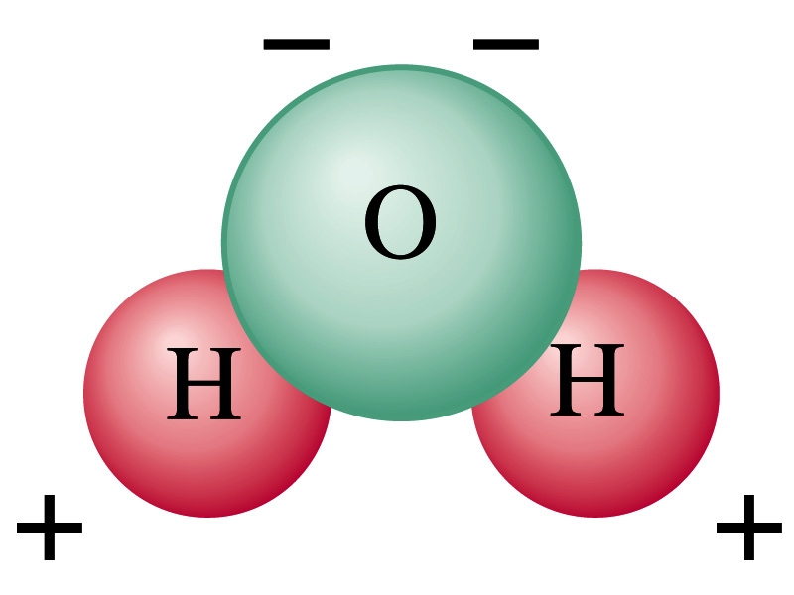
Electric Charge in the Atom
It has been understood through the past century that an atom consists of
  A positively charged heavy core ⬅ What is the name?
    This core is nucleus and consists of neutrons and protons.
  Many negatively charged light particles surround the core ⬅ What is the name of these light particles?
    These are called electrons
    How many of these?
So what is the net electrical charge of an atom?
  Zero!!! Electrically neutral!!!
Can you explain what happens when a comb is rubbed on a towel?
  Electrons from towel get transferred to the comb, making the comb negatively charged while leaving positive ions on the towel.
  These charges eventually get neutralized primarily by water molecules in the air.
As many as the number of protons!!

Slide 11
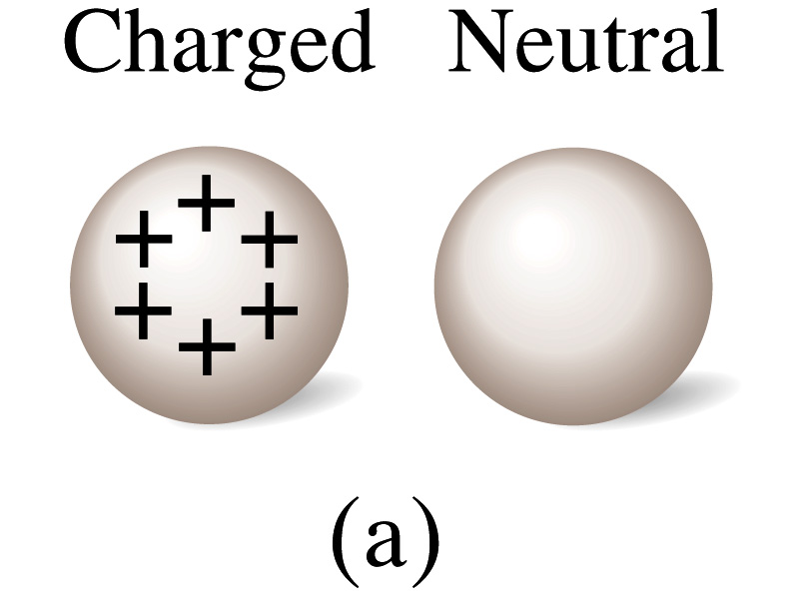
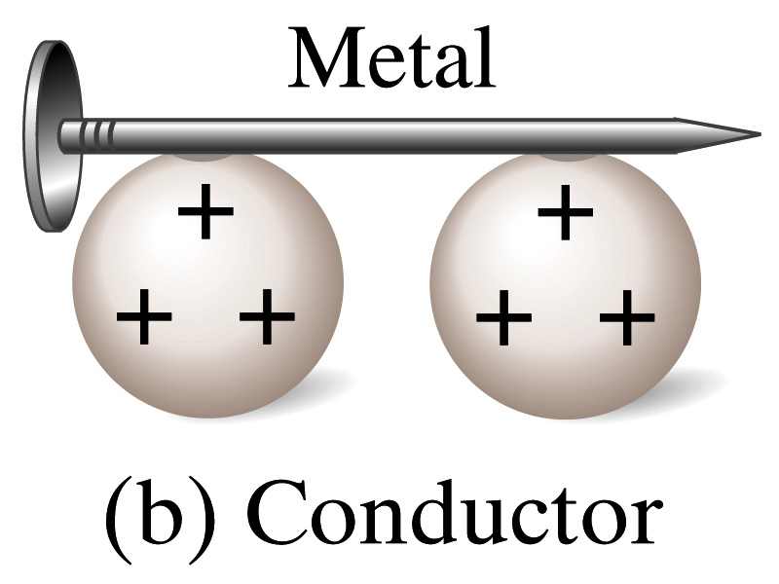
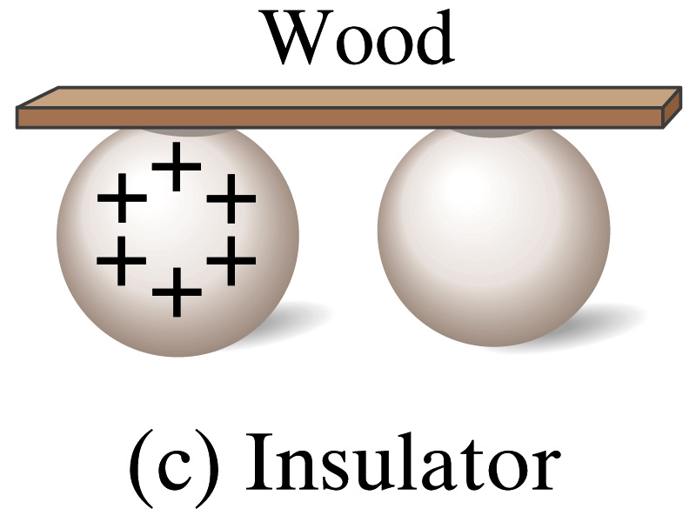
Insulators and Conductors
Let’s imagine two metal balls of which one is charged
What will happen if they are connected by
  A metallic object?
    Some charge is transferred.
    These objects are called conductors of electricity.
  A wooden object?
    No charge is transferred
    These objects are called nonconductors or insulators.
Metals are generally good conductors whereas most other materials are insulators.
  There are third kind of materials called, semi-conductors, like silicon or germanium ➔ conduct only in certain conditions
Atomically, conductors have loosely bound electrons while insulators have them tightly bound!

Slide 12
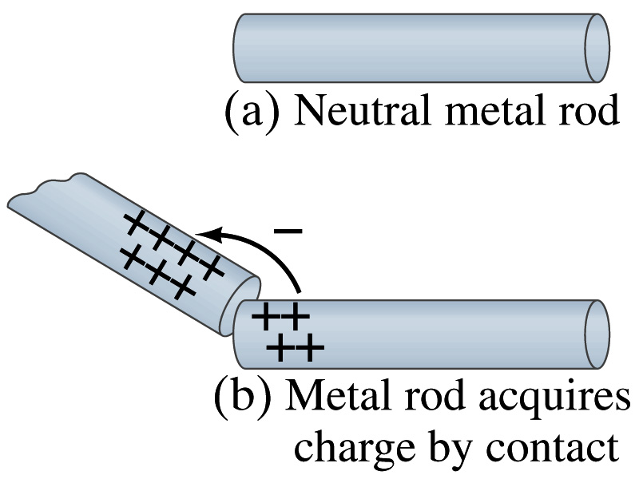
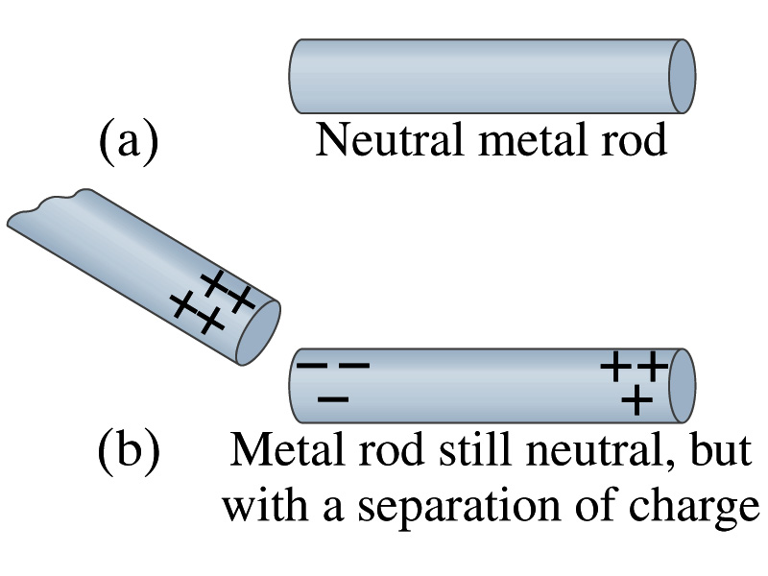
Induced Charge
When a positively charged metal object is brought close to an uncharged metal object
  If two objects touch each other, the free electrons in the neutral ones are attracted to the positively charged object and some will pass over to it, leaving the neutral object positively charged.
  If the objects get close, the free electrons in the neutral ones still move within the metal toward the charged object leaving the opposite of the object positively charged.
    The charges have been “induced” in the opposite ends of the object.

Slide 13
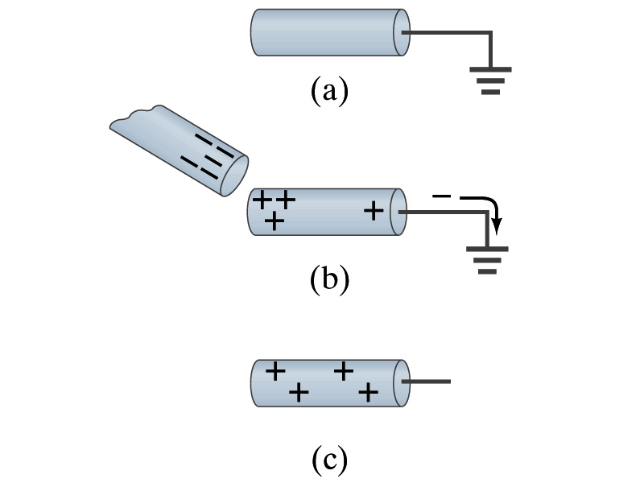
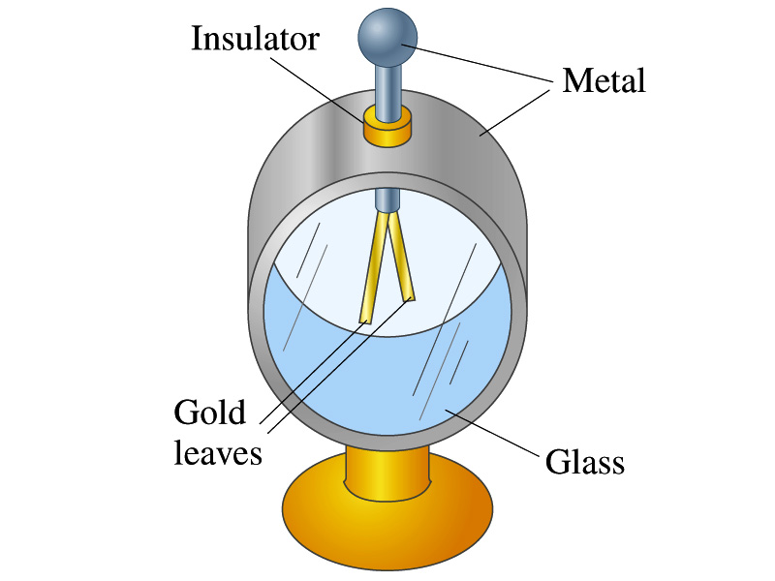
Induced Charge
ground
We can induce a net charge on a metal object by connecting a wire to the ground.
  The object is “grounded” or “earthed”.
Since it is so large and conducts, the Earth can give or accept charge.
  The Earth acts as a reservoir for charge.
If the negative charge is brought close to a neutral metal
  The positive charges will be induced toward the negatively charged metal.
  The negative charges in the neutral metal will be gathered on the opposite side, transferring through the wire to the Earth.
  If the wire is cut, the metal bar has net positive charge.
An electroscope is a device that can be used for detecting charge and signs.
  How does this work?

Slide 14
Coulomb’s Law
Charges exert force to each other. What factors affect the magnitude of this force?
  Any guesses?
Charles Coulomb figured this out in 1780’s.
Coulomb found that the electrical force is
  Proportional to the multiplication of the two charges
    If one of the charges doubles, the force doubles.
    If both the charges double, the force quadruples.
  Inversely proportional to the square of the distances between them.
  Electric charge is a fundamental property of matter, just like mass.
How would you put the above into a formula?

Slide 15
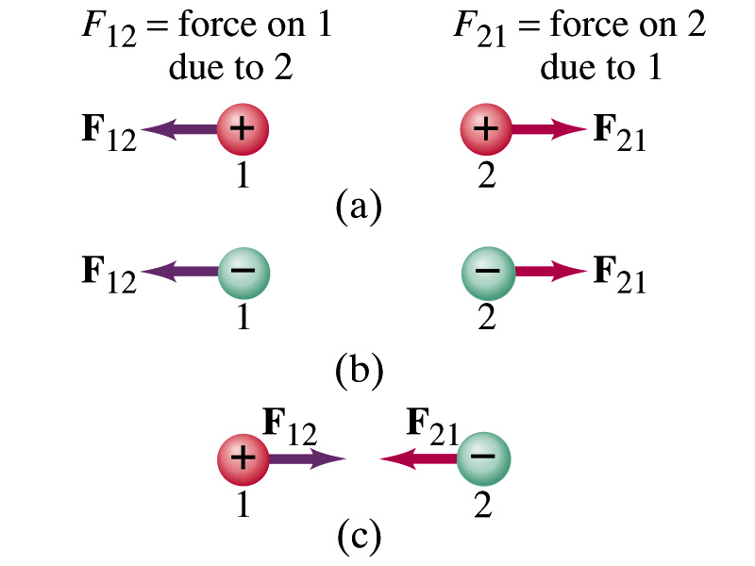
Coulomb’s Law – The Formula
Formula
Is Coulomb force a scalar quantity or a vector quantity? Unit?
  A vector quantity. The unit is Newtons (N)!
The direction of electric (Coulomb) force is always along the line joining the two objects.
  If the two charges are the same: forces are directed away from each other.
  If the two charges are opposite: forces are directed toward each other.
Coulomb force is precise to 1 part in 10¹⁶.
Unit of charge is called Coulomb, C, in SI.
The value of the proportionality constant, k, in SI unit is
Thus, 1C is the charge that gives F~9x10⁹N of force when placed 1m apart from each other.

Slide 16
Electric Force
and Gravitational Force
Extremely
Similar
Does the electric force look similar to another force? What is it?
  Gravitational Force
What are the sources of the forces?
  Electric Force: Electric charges, fundamental properties of matter
  Gravitational Force: Masses, fundamental properties of matter
What else is similar?
  Inversely proportional to the square of the distance between the sources of the force ➔ What is this kind law called?
    Inverse Square Law
What is the difference?
  Gravitational force is always attractive.
  Electric force depends on the type of the two charges.

Slide 17
The Elementary Charge and Permittivity
Elementary charge, the smallest charge, is that of an electron:
  Since electron is a negatively charged particle, its charge is –e.
Object cannot gain or lose fraction of an electron.
  Electric charge is quantized.
    It changes always in integer multiples of e.
The proportionality constant k is often written in terms of another constant, ε₀, the permittivity* of free space. They are related and .
Thus the electric force can be written:
Note that this force is for “point” charges at rest.
*Mirriam-Webster, Permittivity: The ability of a material to store electrical potential energy under the influence of an electric field

Slide 18
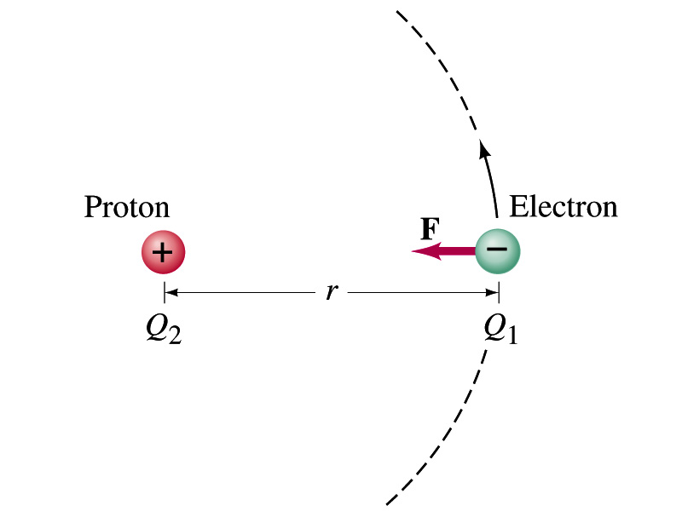
Example 21 – 1
Electric force on electron by proton. Determine the magnitude of the electric force on the electron of a hydrogen atom exerted by the single proton (Q₂=+e) that is its nucleus. Assume the electron “orbits” the proton at its average distance of r=0.53x10⁻¹⁰m.
Using Coulomb’s law
Each charge is
and
So the magnitude of the force is
Which direction?
Toward each other…

