Slide 1
PHYS 1444 – Section 003 Lecture #3
Thursday, Sept. 1, 2011
Dr. Jaehoon Yu
Chapter 21
The Electric Field & Field Lines
Electric Fields and Conductors
Motion of a Charged Particle in an Electric Field
Electric Dipoles

Slide 2
Announcements
80 of you replied to me in e-mail
8 haven’t. Please reply and establish the communication!
Please make sure that your MyMav e-mail is the one you use primarily!
86/88 have registered for homework
Virtually a 100%!!
Good job!
Reading assignment
CH21.7

Slide 3
Extra Credit Special Project #1
Compare the Coulomb force to the Gravitational force in the following cases by expressing Coulomb force (F_{C}) in terms of the gravitational force (F_{G})
Between two protons separated by 1m
Between two protons separated by an arbitrary distance R
Between two electrons separated by 1m
Between two electrons separated by an arbitrary distance R
Five points each, totaling 20 points
BE SURE to show all the details of your work, including all formulae, and properly referring them
Please staple them before the submission
Due at the beginning of the class Tuesday, Sept. 6

Slide 4
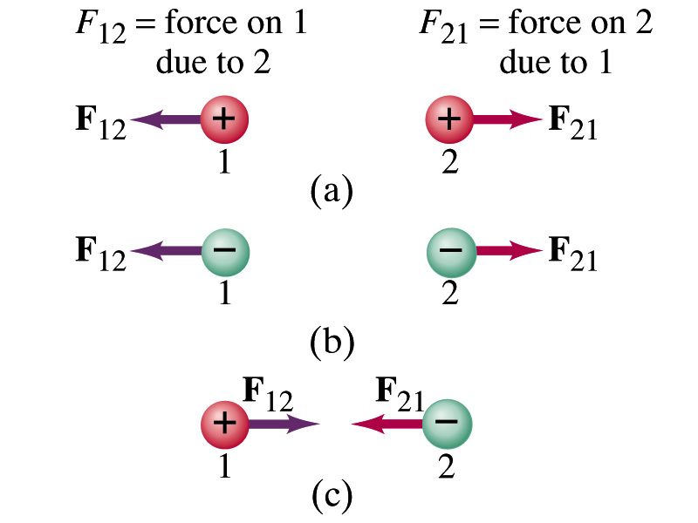
Coulomb’s Law – The Formula
Formula
Is Coulomb force a scalar quantity or a vector quantity? Unit?
A vector quantity. The unit is Newtons (N)!
The direction of electric (Coulomb) force is always along the line joining the two objects.
If the two charges are the same: forces are directed away from each other.
If the two charges are opposite: forces are directed toward each other.
Coulomb force is precise to 1 part in 10¹⁶.
Unit of charge is called Coulomb, C, in SI.
The value of the proportionality constant, k, in SI unit is
Thus, 1C is the charge that gives F~9x10⁹N of force when placed 1m apart from each other.

Slide 5
The Elementary Charge and Permittivity
Elementary charge, the smallest charge, is that of an electron:
Since electron is a negatively charged particle, its charge is –e.
Object cannot gain or lose fraction of an electron.
Electric charge is quantized.
It changes always in integer multiples of e.
The proportionality constant k is often written in terms of another constant, ε₀, the permittivity* of free space. They are related and .
Thus the electric force can be written:
Note that this force is for “point” charges at rest.
*Mirriam-Webster, Permittivity: The ability of a material to store electrical potential energy under the influence of an electric field

Slide 6
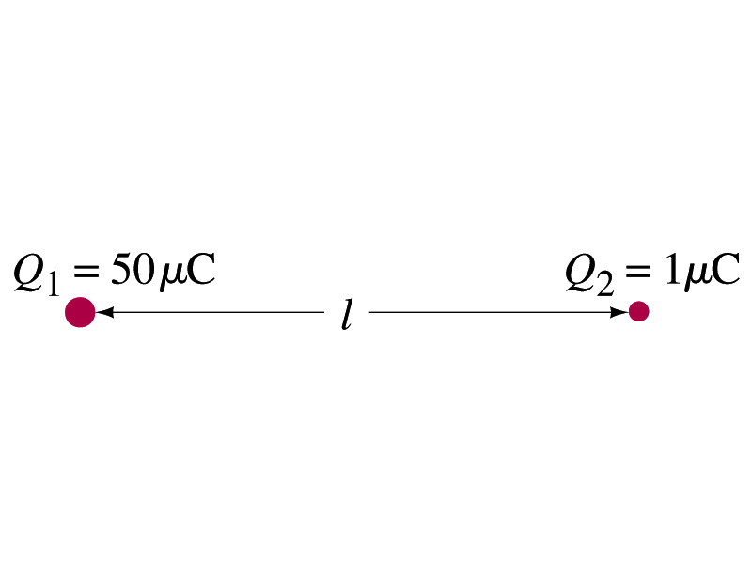
Example 21 – 2
Which charge exerts greater force? Two positive point charges, Q₁=50μC and Q₂=1μC, are separated by a distance L. Which is larger in magnitude, the force that Q₁ exerts on Q₂ or the force that Q₂ exerts on Q₁?
What is the force that Q₁ exerts on Q₂?
What is the force that Q₂ exerts on Q₁?
Therefore the magnitudes of the two forces are identical!!
Well then what is different?
The direction.
Which direction?
Opposite to each other!
What is this law?
Newton’s third law, the law of action and reaction!!

Slide 7
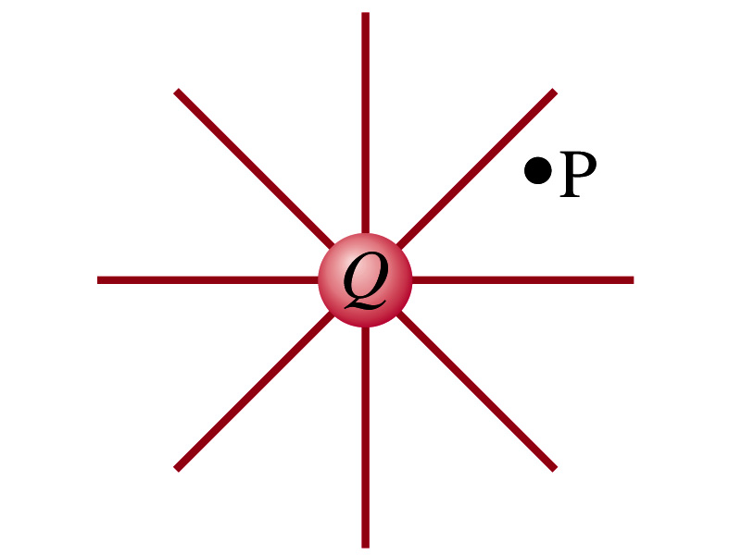
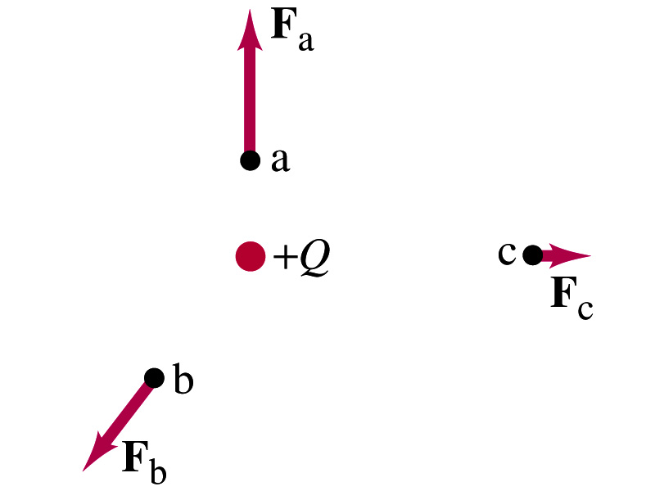
The Electric Field
Both gravitational and electric forces act over a distance without touching objects ➔ What kind of forces are these?
Field forces
Michael Faraday developed an idea of field.
Faraday (1791 – 1867) argued that the electric field extends outward from every charge and permeates through all of space.
Field by a charge or a group of charges can be inspected by placing a small positive test charge in the vicinity and measuring the force on it.

Slide 8
The Electric Field
The electric field at any point in space is defined as the force exerted on a tiny positive test charge divide by magnitude of the test charge
Electric force per unit charge
What kind of quantity is the electric field?
Vector quantity. Why?
What is the unit of the electric field?
N/C
What is the magnitude of the electric field at a distance r from a single point charge Q?

Slide 9
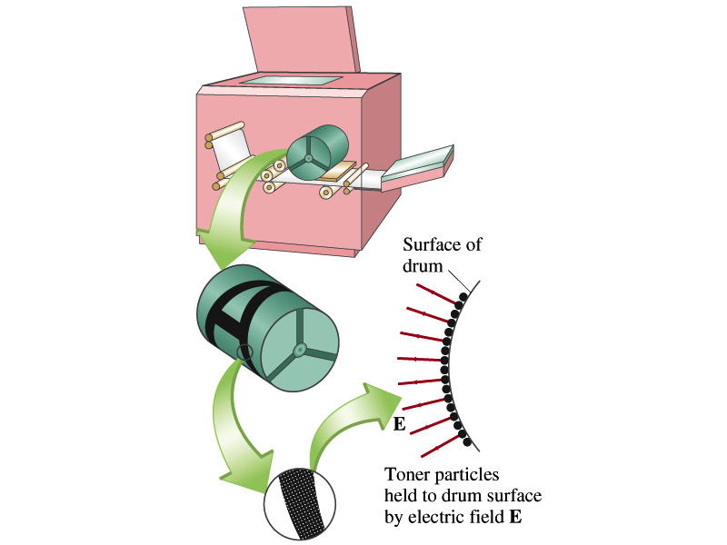
Example 21 – 5
Electrostatic copier. An electrostatic copier works by selectively arranging positive charges (in a pattern to be copied) on the surface of a nonconducting drum, then gently sprinkling negatively charged dry toner (ink) onto the drum. The toner particles temporarily stick to the pattern on the drum and are later transferred to paper and “melted” to produce the copy. Suppose each toner particle has a mass of 9.0x10⁻¹⁶kg and carries the average of 20 extra electrons to provide an electric charge. Assuming that the electric force on a toner particle must exceed twice its weight in order to ensure sufficient attraction, compute the required electric field strength near the surface of the drum.
The electric force must be the same as twice the gravitational force on the toner particle.
So we can write
Thus, the magnitude of the electric field is

Slide 10
Direction of the Electric Field
If there are more than one charge, the individual fields due to each charge are added vectorially to obtain the total field at any point.
This superposition principle of electric field has been verified by experiments.
For a given electric field E at a given point in space, we can calculate the force F on any charge q, F=qE.
What happens to the direction of the force and the field depending on the sign of the charge q?
The two are in the same directions if q>0
The two are in opposite directions if q<0

Slide 11
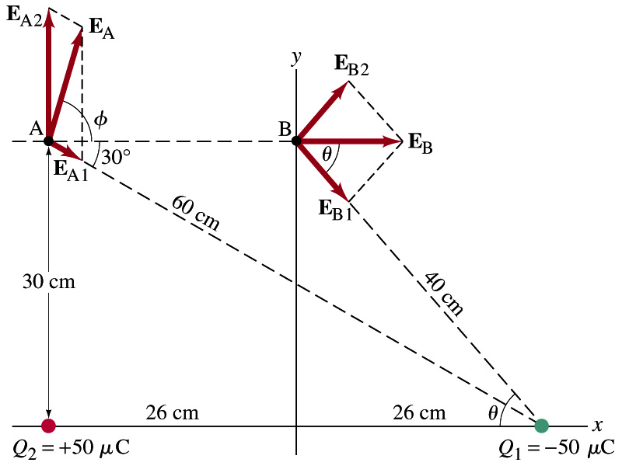
Example 21 – 8
E above two point charges: Calculate the total electric field (a) at point A and (b) at point B in the figure on the right due to the both charges Q₁ and Q₂.
How do we solve this problem?
First, compute the magnitude of fields at each point due to each of the two charges.
Then add them at each point vectorially!
First, the electric field at point A by Q₁ and then Q₂.

Slide 12
Example 21 – 8, cnt’d
Now the components of the electric field vectors by the two charges at point A.
So the electric field at point A is
The magnitude of the electric field at point A is
Now onto the electric field at point B

Slide 13
Example 21 – 8, cnt’d
Electric field at point B is easier due to symmetry!
Since the magnitude of the charges are the same and the distance to point B from the two charges are the same, the magnitude of the electric field by the two charges at point B are the same!!
Now the components!
First, the y-component!
Now, the x-component!
So the electric field at point B is
The magnitude of the electric field at point B

