Slide 1
PHYS 1444 – Section 003 Lecture #4
Tuesday, Sept. 6, 2011
Dr. Jaehoon Yu
Chapter 21
The Electric Field & Field Lines
Electric Fields and Conductors
Motion of a Charged Particle in an Electric Field
Electric Dipoles
Chapter 22 Gauss’s Law
Electric Flux
Today’s homework is homework #3, due 10pm, Tuesday, Sept. 13!!

Slide 2
Announcements
Quiz Results
Class Average: 24/55
Equivalent to 43.6
Top score: 45.6/55
Reading assignments
CH21.12 and CH21.13
No colloquium this week!
SI session begins tomorrow
Husain Lohawala
Mon and Wed, 2 – 3:30pm, SH333

Slide 3
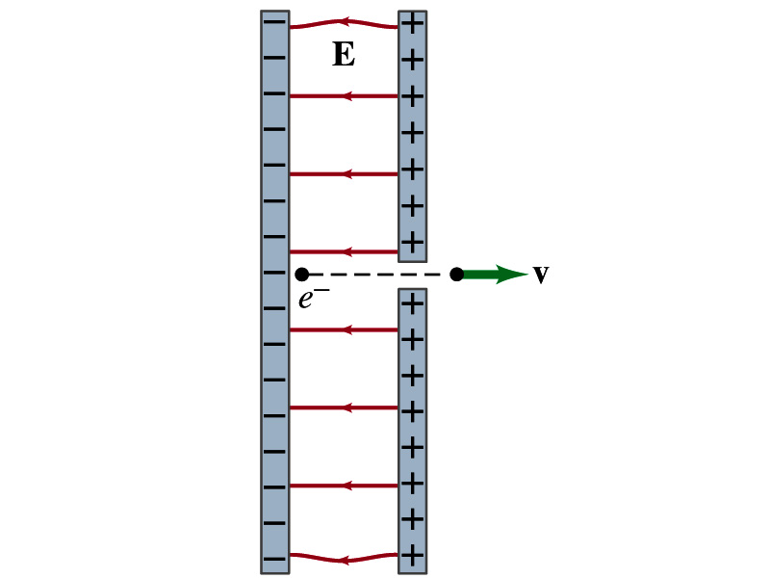
Special Project
Particle Accelerator. A charged particle of mass M with charge -Q is accelerated in the uniform field E between two parallel charged plates whose separation is D as shown in the figure on the right. The charged particle is accelerated from an initial speed v₀ near the negative plate and passes through a tiny hole in the positive plate.
Derive the formula for the electric field E to accelerate the charged particle to fraction f of the speed of light c. Express E in terms of M, Q, D, f, c and v₀.
(a) Using the Coulomb force and kinematic equations. (8 points)
(b) Using the work-kinetic energy theorem. ( 8 points)
© Using the formula above, evaluate the strength of the electric field E to accelerate an electron to 90% of the speed of light. You need to look up the relevant constants, such as mass of the electron, charge of the electron and the speed of light. (5 points)
Due beginning of the class Tuesday, Sept. 13

Slide 4
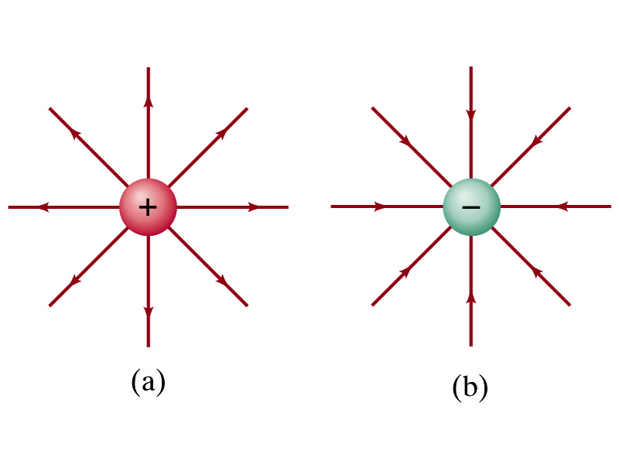
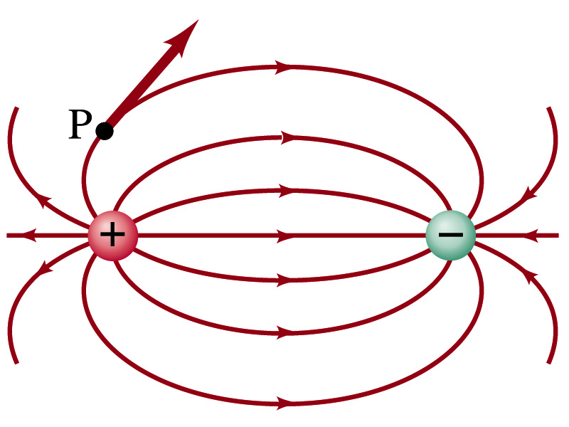
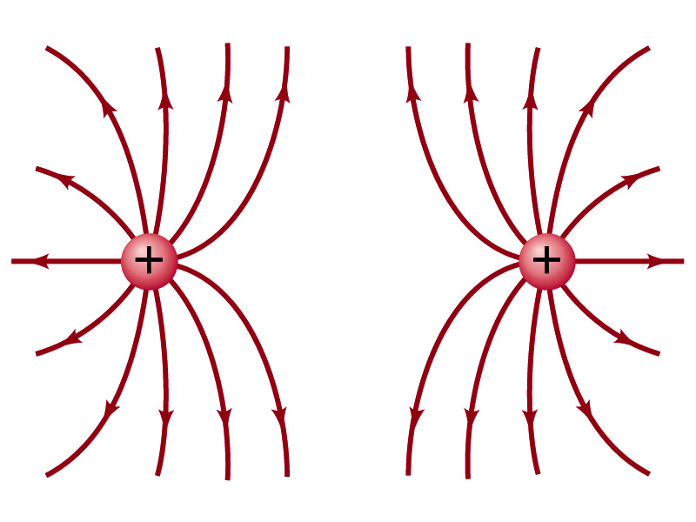
Field Lines
The electric field is a vector quantity. Thus, its magnitude can be expressed as the length of the vector and the direction by the direction the arrowhead points.
Since the field permeates through the entire space, drawing vector arrows is not a good way of expressing the field.
Electric field lines are drawn to indicate the direction of the force due to the given field on a positive test charge.
Start on a positive charge and end on a negative charge.
Number of lines crossing unit area perpendicular to E is proportional to the magnitude of the electric field.
The closer the lines are together, the stronger the electric field in that region.
Earth’s G-field lines

Slide 5
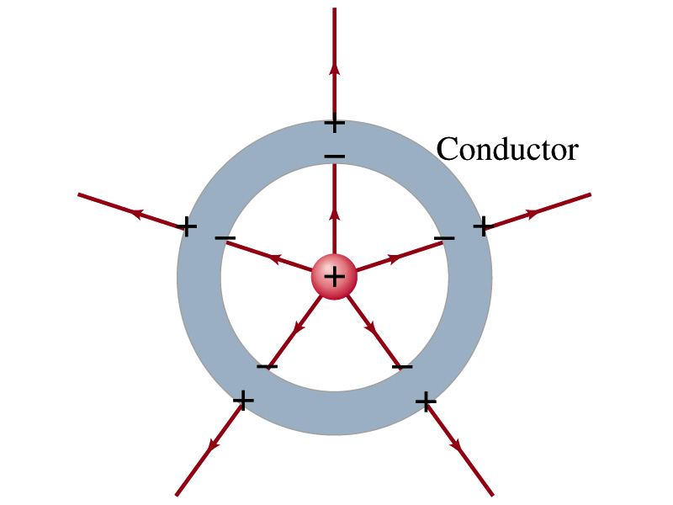
Electric Fields and Conductors
The electric field inside a conductor is ZERO in the static situation. (If the charge is at rest.) Why?
If there were an electric field within a conductor, there would be a force on its free electrons.
The electrons will move until they reached positions where the electric field become zero.
Electric field can, however, exist inside a non-conductor.
Consequences of the above
Any net charge on a conductor distributes itself onto the surface.
Although no field exists inside a conductor, the fields can exist outside the conductor due to induced charges on either surface
The electric field is always perpendicular to the surface outside of a conductor.

Slide 6
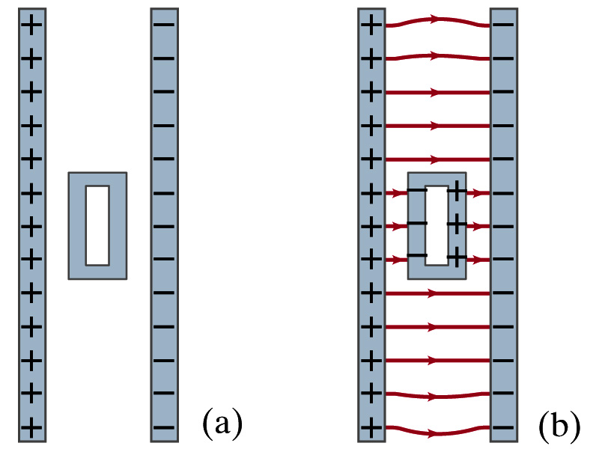
Example 21-13
Shielding, and safety in a storm. A hollow metal box is placed between two parallel charged plates. What is the field like in the box?
If the metal box were solid
The free electrons in the box would redistribute themselves along the surface so that the field lines would not penetrate into the metal.
The free electrons do the same in hollow metal boxes just as well as it did in a solid metal box.
Thus a conducting box is an effective device for shielding. ➔ Faraday cage
So what do you think will happen if you were inside a car when the car was struck by a lightening?

Slide 7
Motion of a Charged Particle in an Electric Field
If an object with an electric charge q is at a point in space where the electric field is E, the force exerting on the object is .
What do you think will happen to the charge?
Let’s think about the cases like these on the right.
The object will move along the field line…Which way?
The charge gets accelerated.

Slide 8
Example 21 – 14
Electron accelerated by electric field. An electron (mass m = 9.1x10⁻³¹kg) is accelerated in the uniform field E (E=2.0x10⁴N/C) between two parallel charged plates. The separation of the plates is 1.5cm. The electron is accelerated from rest near the negative plate and passes through a tiny hole in the positive plate. (a) With what speed does it leave the hole? (b) Show that the gravitational force can be ignored. Assume the hole is so small that it does not affect the uniform field between the plates.
The magnitude of the force on the electron is F=qE and is directed to the right. The equation to solve this problem is
The magnitude of the electron’s acceleration is
Between the plates the field E is uniform, thus the electron undergoes a uniform acceleration

Slide 9
Example 21 – 14
Since the travel distance is 1.5x10⁻²m, using one of the kinematic eq. of motion,
Since there is no electric field outside the conductor, the electron continues moving with this speed after passing through the hole.
(b) Show that the gravitational force can be ignored. Assume the hole is so small that it does not affect the uniform field between the plates.
The magnitude of the electric force on the electron is
The magnitude of the gravitational force on the electron is
Thus the gravitational force on the electron is negligible compared to the electromagnetic force.

