Slide 1
PHYS 1444 – Section 003 Lecture #6
Thursday, Sept. 8, 2011
Dr. Jaehoon Yu
Chapter 21
Electric Dipoles
Chapter 22 Gauss’s Law
Electric Flux

Slide 2
Announcements
Quiz #2
Thursday, Sept. 15
Beginning of the class
Covers: CH21.1 through what we learn on Tuesday, Sept. 13
Reading assignments
CH21.12 and CH21.13

Slide 3
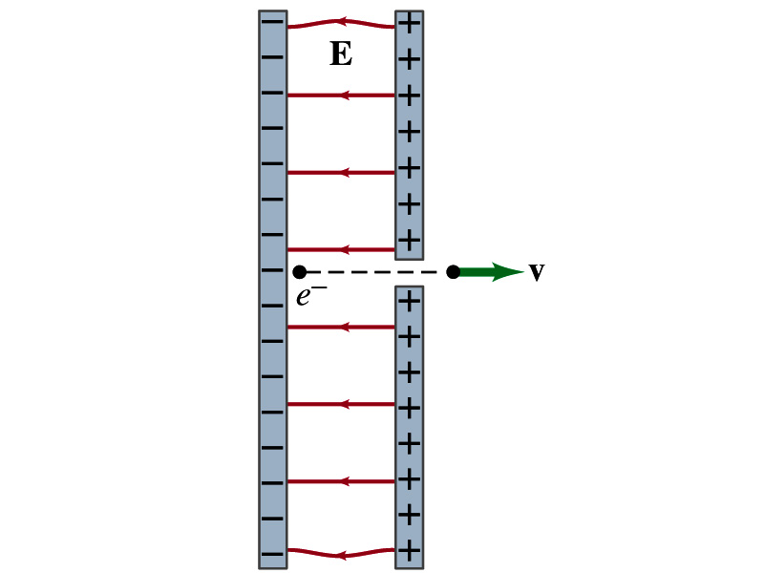
Special Project
Particle Accelerator. A charged particle of mass M with charge -Q is accelerated in the uniform field E between two parallel charged plates whose separation is D as shown in the figure on the right. The charged particle is accelerated from an initial speed v₀ near the negative plate and passes through a tiny hole in the positive plate.
Derive the formula for the electric field E to accelerate the charged particle to fraction f of the speed of light c. Express E in terms of M, Q, D, f, c and v₀.
(a) Using the Coulomb force and kinematic equations. (8 points)
(b) Using the work-kinetic energy theorem. ( 8 points)
© Using the formula above, evaluate the strength of the electric field E to accelerate an electron from 0.1% of the speed of light to 90% of the speed of light. You need to look up the relevant constants, such as mass of the electron, charge of the electron and the speed of light. (5 points)
Due beginning of the class Tuesday, Sept. 13

Slide 4
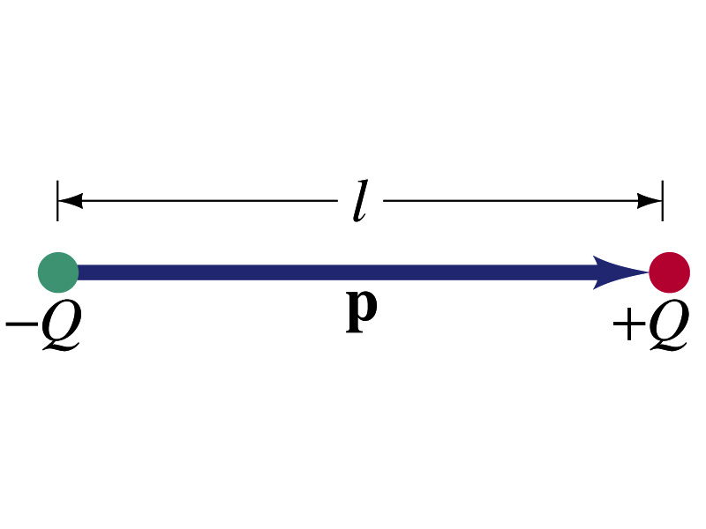
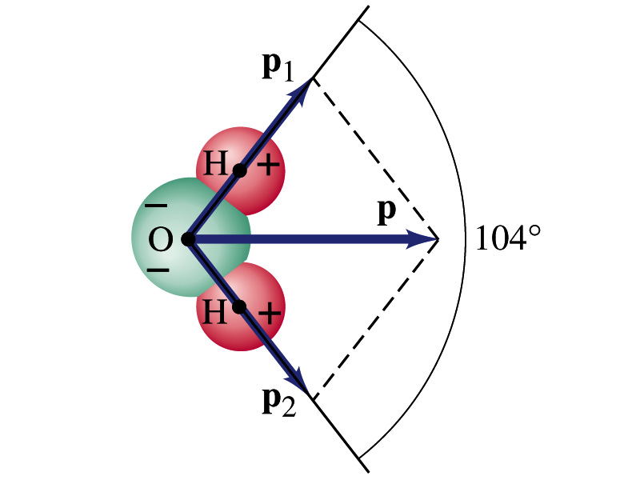
Electric Dipoles
An electric dipole is the combination of two equal charges of opposite signs, +Q and –Q, separated by a distance l, which behaves as one entity.
The quantity Ql is called the electric dipole moment and is represented by the symbol p.
The dipole moment is a vector quantity, p
The magnitude of the dipole moment is Ql. Unit?
Its direction is from the negative to the positive charge.
Many of diatomic molecules like CO have a dipole moment. ➔ These are referred as polar molecules.
Even if the molecule is electrically neutral, their sharing of electron causes separation of charges
Symmetric diatomic molecules, such as O₂, do not have dipole moment.
C-m
The water molecule also has a dipole moment which is the vector sum of two dipole moments between Oxygen and each of Hydrogen atoms.

Slide 5
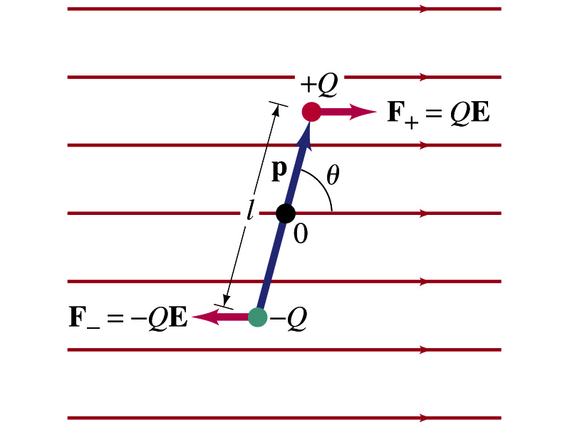
Dipoles in an External Field
Let’s consider a dipole placed in a uniform electric field E.
What do you think will happen to the dipole in the figure?
Forces will be exerted on the charges.
The positive charge will get pushed toward right while the negative charge will get pulled toward left.
What is the net force acting on the dipole?
Zero
So will the dipole not move?
Yes, it will.
Why?
There is torque applied on the dipole.

Slide 6
Dipoles in an External Field, cnt’d
How much is the torque on the dipole?
Do you remember the formula for torque?
The magnitude of the torque exerting on each of the charges with respect to the rotational axis at the center is
Thus, the total torque is
So the torque on a dipole in vector notation is
The effect of the torque is to try to turn the dipole so that the dipole moment is parallel to E. Which direction?

Slide 7
Potential Energy of a Dipole in an External Field
What is the work done on the dipole by the electric field to change the angle from θ₁ to θ₂?
The torque is .
Thus the work done on the dipole by the field is
What happens to the dipole’s potential energy, U, when a positive work is done on it by the field?
It decreases.
We choose U=0 when θ₁=90 degrees, then the potential energy at θ₂=θ becomes
Why negative?
Because τ and θ are opposite directions to each other.

Slide 8
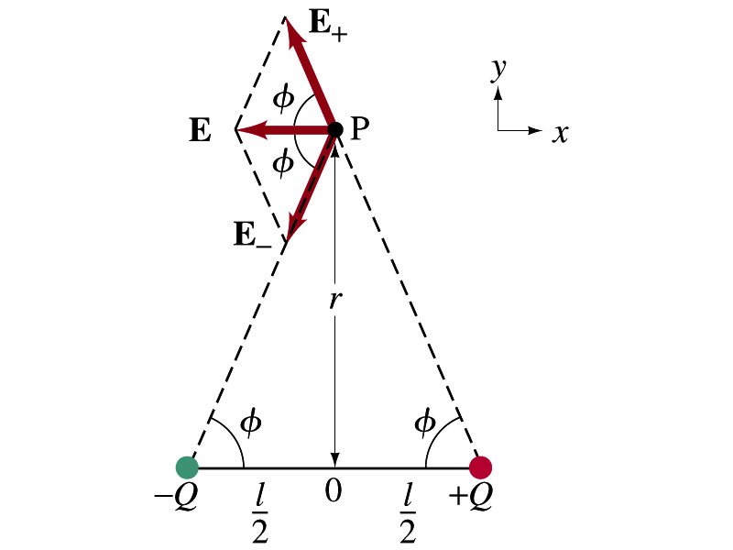
Electric Field by a Dipole
Let’s consider the case in the picture.
There are fields by both the charges. So the total electric field by the dipole is
The magnitudes of the two fields are equal
Now we must work out the x and y components of the total field.
Sum of the two y components is
Zero since they are the same but in opposite direction
So the magnitude of the total field is the same as the sum of the two x-components:

Slide 9
Dipole Electric Field from Afar
What happens when r>>l?.
Why does this make sense?
Since from a far distance, the two charges are very close so that the overall charge gets close to 0!!
This dependence works for the point not on bisector as well

Slide 10
Example 21 – 17
Dipole in a field. The dipole moment of a water molecule is 6.1x10⁻³⁰C-m. A water molecule is placed in a uniform electric field with magnitude 2.0x10⁵N/C. (a) What is the magnitude of the maximum torque that the field can exert on the molecule? (b) What is the potential energy when the torque is at its maximum? (c) In what position will the potential energy take on its greatest value? Why is this different than the position where the torque is maximized?
(a) The torque is maximized when θ=90 degrees. Thus the magnitude of the maximum torque is

Slide 11
Example 21 – 17
(b) What is the potential energy when the torque is at its maximum?
Since the dipole potential energy is
And τ is at its maximum at θ=90 degrees, the potential energy, U, is
Is the potential energy at its minimum at θ=90 degrees?
No
Why not?
Because U will become negative as θ increases.
(c) In what position will the potential energy take on its greatest value?
The potential energy is maximum when cosθ= -1, θ=180 degrees.
Why is this different than the position where the torque is maximized?
The potential energy is maximized when the dipole is oriented so that it has to rotate through the largest angle against the direction of the field, to reach the equilibrium position at θ=0.
Torque is maximized when the field is perpendicular to the dipole, θ=90.

Slide 12
Gauss’ Law
Gauss’ law states the relationship between electric charge and electric field.
More generalized and elegant form of Coulomb’s law.
The electric field by the distribution of charges can be obtained using Coulomb’s law by summing (or integrating) over the charge distributions.
Gauss’ law, however, gives an additional insight into the nature of electrostatic field and a more general relationship between the charge and the field

Slide 13
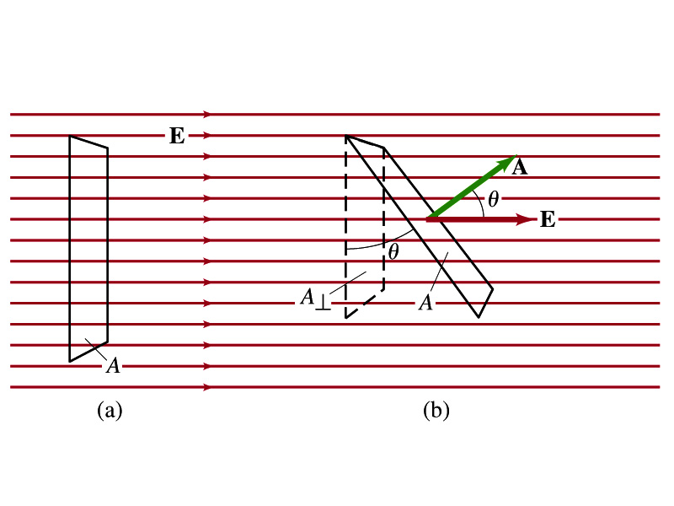
Electric Flux
Let’s imagine a surface of area A through which a uniform electric field E passes
The electric flux Φ_{E} is defined as
Φ_{E}=EA, if the field is perpendicular to the surface
Φ_{E}=EAcosθ, if the field makes an angle θ to the surface
So the electric flux is defined as .
How would you define the electric flux in words?
The total number of field lines passing through the unit area perpendicular to the field.

Slide 14
Example 22 – 1
Electric flux. (a) Calculate the electric flux through the rectangle in the figure (a). The rectangle is 10cm by 20cm and the electric field is uniform with magnitude 200N/C. (b) What is the flux in figure if the angle is 30 degrees?
The electric flux is defined as
So when (a) θ=0, we obtain
And when (b) θ=30 degrees, we obtain

Slide 15
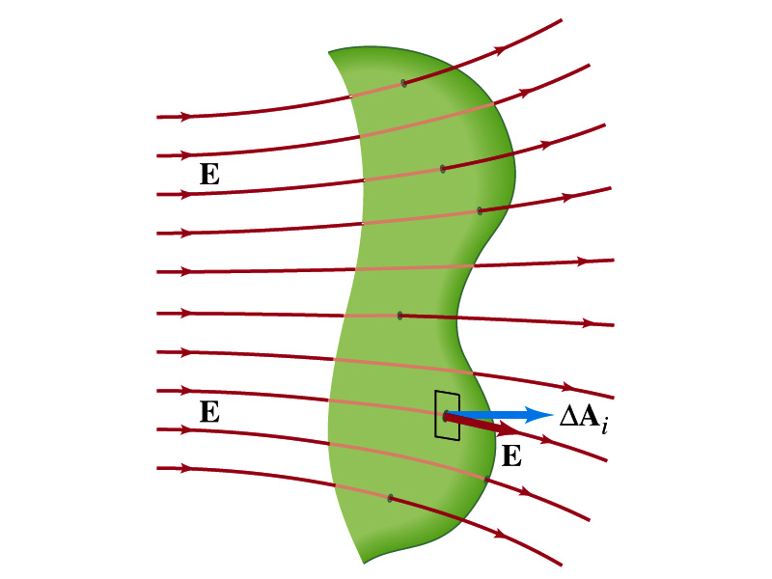
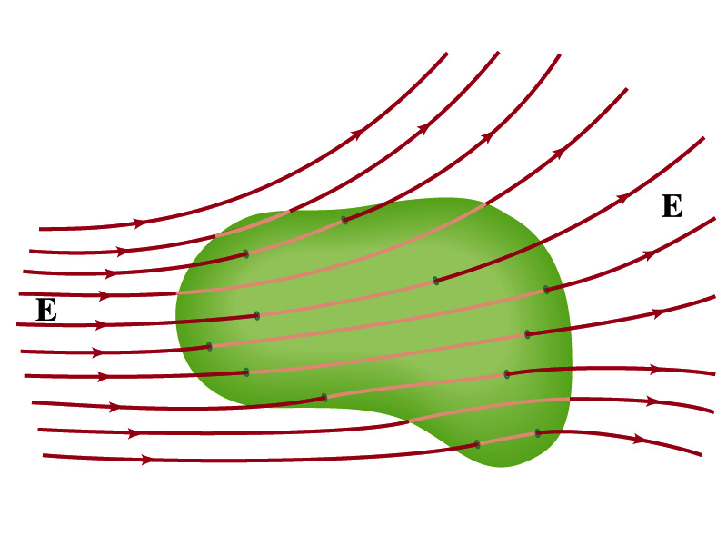
Generalization of the Electric Flux
Let’s consider a surface of area A that is not a square or flat but in some random shape, and that the field is not uniform.
The surface can be divided up into infinitesimally small areas of ΔA_{i} that can be considered flat.
And the electric field through this area can be considered uniform since the area is very small.
Then the electric flux through the entire surface is approximately
In the limit where ΔA_{i} → 0, the discrete summation becomes an integral.
open surface
enclosed surface

Slide 16
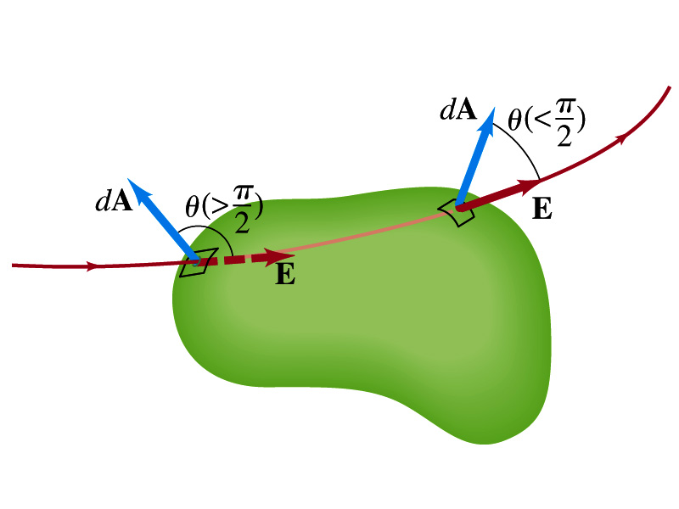
Generalization of the Electric Flux
We arbitrarily define that the area vector points outward from the enclosed volume.
For the line leaving the volume, θ<π/2 and cosθ>0. The flux is positive.
For the line coming into the volume, θ>π/2 and cosθ<0. The flux is negative.
If Φ_{E}>0, there is net flux out of the volume.
If Φ_{E}<0, there is flux into the volume.
In the above figures, each field that enters the volume also leaves the volume, so
The flux is non-zero only if one or more lines start or end inside the surface.

Slide 17
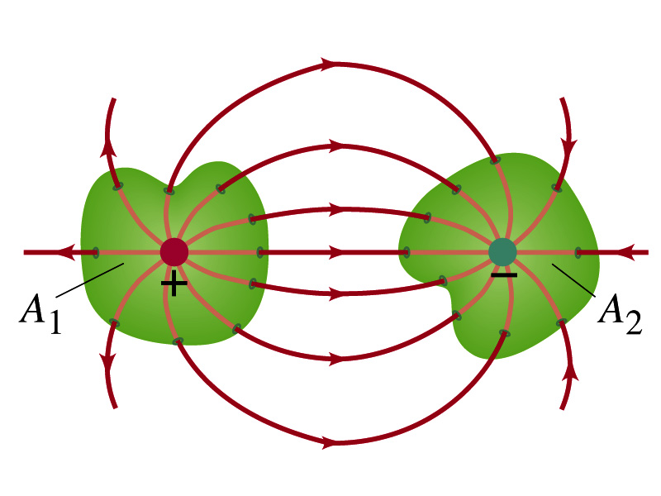
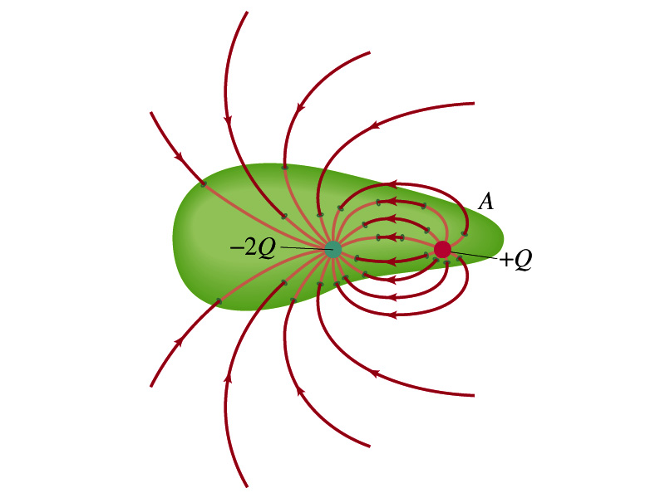
Generalization of the Electric Flux
The field line starts or ends only on a charge.
Sign of the net flux on the surface A₁?
The net outward flux (positive flux)
How about A₂?
Net inward flux (negative flux)
What is the flux in the bottom figure?
There should be a net inward flux (negative flux) since the total charge inside the volume is negative.
The net flux that crosses an enclosed surface is proportional to the total charge inside the surface. ➔ This is the crux of Gauss’ law.

Slide 18
A Brain Teaser of Electric Flux
What would change the electric flux through a circle lying in the xz plane where the electric field is (10N/C)j?
Changing the magnitude of the electric field
Changing the surface area of the circle
Tipping the circle so that it is lying in the xy plane
All of the above
None of the above

