Slide 1
PHYS 1444 – Section 003 Lecture #7
Tuesday, Sept. 13, 2011
Dr. Jaehoon Yu
Chapter 22 Gauss’s Law
Gauss’ Law
Gauss’ Law with many charges
What is Gauss’ Law good for?
Chapter 23 Electric Potential
Electric Potential Energy
Electric Potential
Today’s homework is homework #4, due 10pm, Tuesday, Sept. 20!!

Slide 2
Announcements
Quiz #2
Thursday, Sept. 15
Beginning of the class
Covers: CH21.1 to what we cover today (CH23.1?)
Reading assignments
CH22.4
Colloquium tomorrow
4pm, SH101
UTA Physics Faculty Research Expo

Slide 3
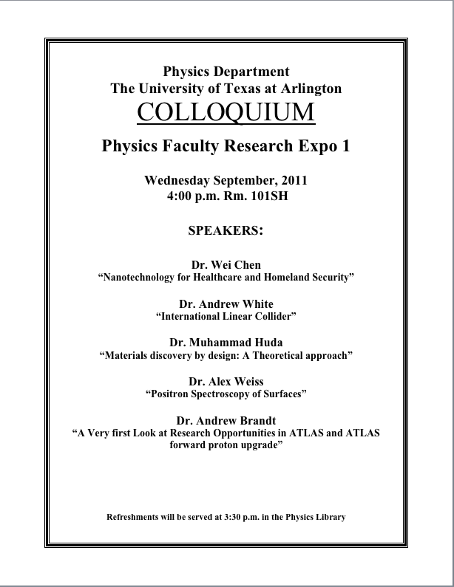

Slide 4
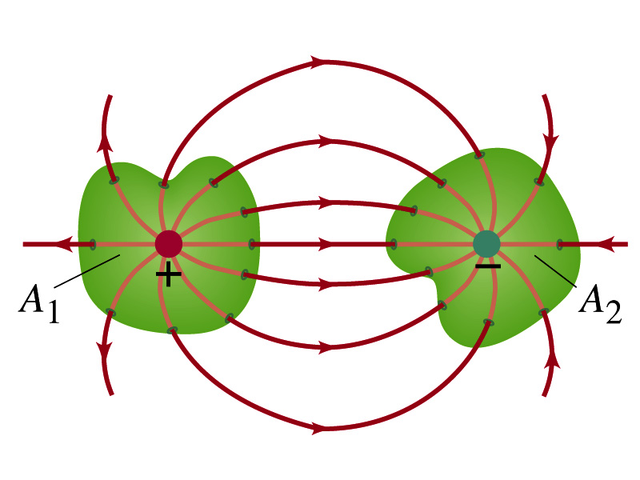
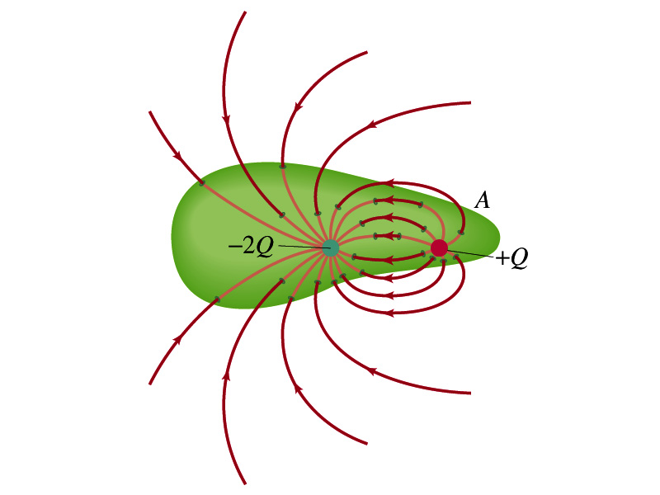
Generalization of the Electric Flux
The field line starts or ends only on a charge.
Sign of the net flux on the surface A₁?
The net outward flux (positive flux)
How about A₂?
Net inward flux (negative flux)
What is the flux in the bottom figure?
There should be a net inward flux (negative flux) since the total charge inside the volume is negative.
The net flux that crosses an enclosed surface is proportional to the total charge inside the surface. ➔ This is the crux of Gauss’ law.

Slide 5
Gauss’ Law
The precise relationship between flux and the enclosed charge is given by Gauss’ Law
ε₀ is the permittivity of free space in the Coulomb’s law
A few important points on Gauss’ Law
Freedom to choose!!
The integral is performed over the value of E on a closed surface of our choice in any given situation.
Test of existence of electrical charge!!
The charge Q_{encl} is the net charge enclosed by the arbitrary closed surface of our choice.
Universality of the law!
It does NOT matter where or how much charge is distributed inside the surface.
The charge outside the surface does not contribute to Q_{encl}. Why?
The charge outside the surface might impact field lines but not the total number of lines entering or leaving the surface

Slide 6
Gauss’ Law
q
q’
Let’s consider the case in the above figure.
What are the results of the closed integral of the Gaussian surfaces A₁ and A₂?
For A₁
For A₂

Slide 7
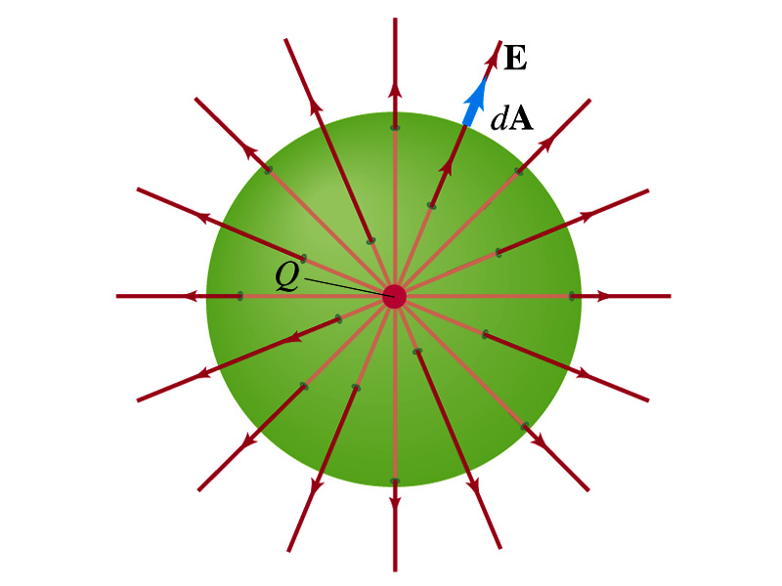
Coulomb’s Law from Gauss’ Law
Let’s consider a charge Q enclosed inside our imaginary gaussian surface of sphere of radius r.
Since we can choose any surface enclosing the charge, we choose the simplest possible one! ☺
The surface is symmetric about the charge.
What does this tell us about the field E?
Must have the same magnitude (uniform) at any point on the surface
Points radially outward / inward parallel to the surface vector dA.
The gaussian integral can be written as
Solve
for E
Electric Field of
Coulomb’s Law

Slide 8
Gauss’ Law from Coulomb’s Law
Let’s consider a single static point charge Q surrounded by an imaginary spherical surface.
Coulomb’s law tells us that the electric field at a spherical surface is
Performing a closed integral over the surface, we obtain
Gauss’ Law

Slide 9
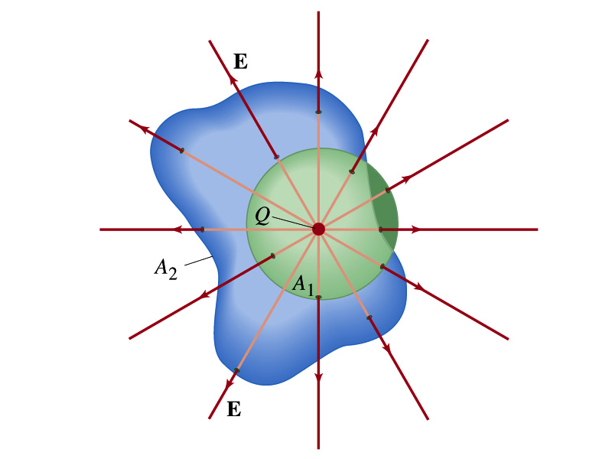
Gauss’ Law from Coulomb’s Law Irregular Surface
Let’s consider the same single static point charge Q surrounded by a symmetric spherical surface A₁ and a randomly shaped surface A₂.
What is the difference in the number of field lines due to the charge Q, passing through the two surfaces?
None. What does this mean?
The total number of field lines passing through the surface is the same no matter what the shape of the enclosed surface is.
So we can write:
What does this mean?
The flux due to the given enclosed charge is the same no matter what the shape of the surface enclosing it is. ➔ Gauss’ law, , is valid for any surface surrounding a single point charge Q.

Slide 10
Gauss’ Law w/ more than one charge
Let’s consider several charges inside a closed surface.
For each charge, Q_{i}, inside the chosen closed surface,
What is ?
The electric field produced by Q_{i} alone!
Since electric fields can be added vectorially, following the superposition principle, the total field E is equal to the sum of the fields due to each charge and any external field. So
The value of the flux depends on the charge enclosed in the surface!! ➔ Gauss’ law.
What is Q_{encl}?
The total enclosed charge!

Slide 11
So what is Gauss’ Law good for?
Derivation of Gauss’ law from Coulomb’s law is only valid for static electric charge.
Electric field can also be produced by changing magnetic fields.
Coulomb’s law cannot describe this field while Gauss’ law is still valid
Gauss’ law is more general than Coulomb’s law.
Can be used to obtain electric field, forces or obtain charges
Gauss’ Law: Any differences between the input and output flux of the electric field over any enclosed surface is due to the charge within that surface!!!

Slide 12
Solving problems with Gauss’ Law
Identify the symmetry of the charge distributions
Draw the appropriate gaussian surface, making sure it passes through the point you want to know the electric field
Use the symmetry of charge distribution to determine the direction of E at the point of gaussian surface
Evaluate the flux
Calculate the enclosed charge by the gaussian surface
Ignore all the charges outside the gaussian surface
Equate the flux to the enclosed charge and solve for E

Slide 13
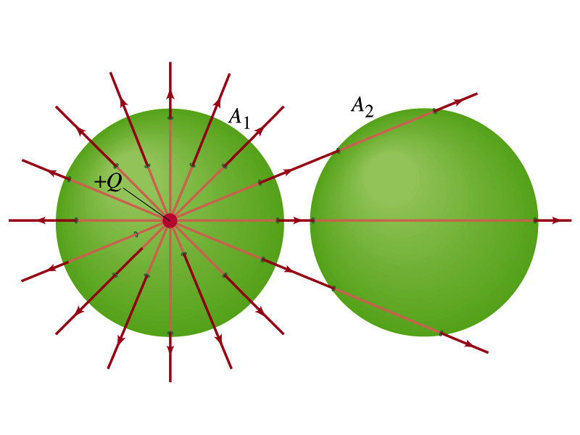
Example 22 – 2
Flux from Gauss’ Law: Consider two gaussian surfaces, A₁ and A₂, shown in the figure. The only charge present is the charge +Q at the center of surface A₁. What is the net flux through each surface A₁ and A₂?
The surface A₁ encloses the charge +Q, so from Gauss’ law we obtain the total net flux
The surface A₂ the charge, +Q, is outside the surface, so the total net flux is 0.

Slide 14
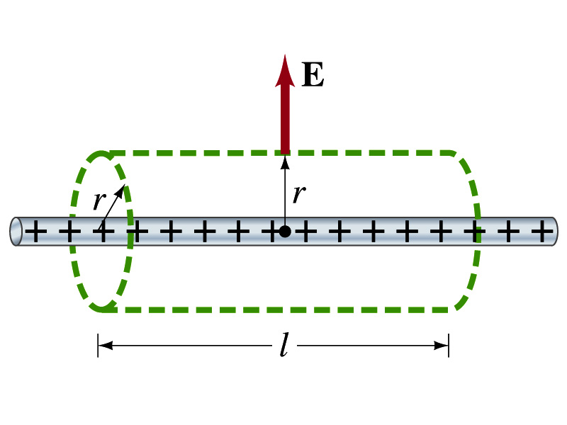
Example 22 – 6
Long uniform line of charge: A very long straight wire possesses a uniform positive charge per unit length, l. Calculate the electric field at points near but outside the wire, far from the ends.
Which direction do you think the field due to the charge on the wire is?
Radially outward from the wire, the direction of radial vector r.
Due to cylindrical symmetry, the field is the same on the gaussian surface of a cylinder surrounding the wire.
The end surfaces do not contribute to the flux at all. Why?
Because the field vector E is perpendicular to the surface vector dA.
From Gauss’ law
Solving for E

Slide 15
Electric Potential Energy
Concept of energy is very useful solving mechanical problems
Conservation of energy makes solving complex problems easier.
When can the potential energy be defined?
Only for a conservative force.
The work done by a conservative force is independent of the path. What does it only depend on??
The difference between the initial and final positions
Can you give me an example of a conservative force?
Gravitational force
Is the electrostatic force between two charges a conservative force?
Yes. Why?
The dependence of the force to the distance is identical to that of the gravitational force.
The only thing matters is the direct linear distance between the object not the path.

Slide 16
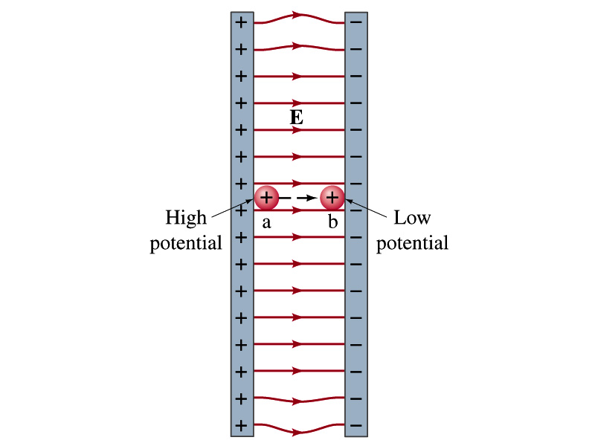
Electric Potential Energy
How would you define the change in electric potential energy U_{b} – U_{a}?
The potential gained by the charge as it moves from point a to point b.
The negative work done on the charge by the electric force to move it from a to b.
Let’s consider an electric field between two parallel plates w/ equal but opposite charges
The field between the plates is uniform since the gap is small and the plates are infinitely long…
What happens when we place a small charge, +q, on a point at the positive plate and let go?
The electric force will accelerate the charge toward negative plate.
What kind of energy does the charged particle gain?
Kinetic energy

Slide 17
Electric Potential Energy
What does this mean in terms of energies?
The electric force is a conservative force.
Thus, the mechanical energy (K+U) is conserved under this force.
The charged object has only the electric potential energy at the positive plate.
The electric potential energy decreases and
Turns into kinetic energy as the electric force works on the charged object, and the charged object gains speed.
Point of greatest potential energy for
Positively charged object
Negatively charged object
PE=
U
0
KE=
0
K
ME=
U
K
U+K

Slide 18
Electric Potential
How is the electric field defined?
Electric force per unit charge: F/q
We can define electric potential (potential) as
The electric potential energy per unit charge
This is like the voltage of a battery…
Electric potential is written with a symbol V
If a positive test charge q has potential energy U_{a} at a point a, the electric potential of the charge at that point is

Slide 19
Electric Potential
Since only the difference in potential energy is meaningful, only the potential difference between two points is measurable
What happens when the electric force does “positive work”?
The charge gains kinetic energy
Electric potential energy of the charge decreases
Thus the difference in potential energy is the same as the negative of the work, W_{ba}, done on the charge by the electric field to move the charge from point a to b.
The potential difference V_{ba} is
Electric potential is independent of the test charge!!

Slide 20
A Few Things about Electric Potential
What does the electric potential depend on?
Other charges that creates the field
What about the test charge?
No, the electric potential is independent of the test charge
Test charge gains potential energy by existing in the potential created by other charges
Which plate is at a higher potential?
Positive plate. Why?
Since positive charge has the greatest potential energy on it.
What happens to the positive charge if it is let go?
It moves from higher potential to lower potential
How about a negative charge?
Its potential energy is higher on the negative plate. Thus, it moves from negative plate to positive. Potential difference is the same.
The unit of the electric potential is Volt (V).
From the definition, 1V = 1J/C.
Zero point of electric potential can be chosen arbitrarily.
Often the ground, a conductor connected to Earth, is zero.

Slide 21
Example 23 – 1
A negative charge: Suppose a negative charge, such as an electron, is placed at point b in the figure. If the electron is free to move, will its electric potential energy increase or decrease? How will the electric potential change?
An electron placed at point b will move toward the positive plate since it was released at its highest potential energy point.
It will gain kinetic energy as it moves toward left, decreasing its potential energy.
The electron, however, moves from the point b at a lower potential to point a at a higher potential. ΔV=V_{a}-V_{b}>0.
This is because the potential is generated by the charges on the plates not by the electron.

