Slide 1
PHYS 1444 – Section 003 Lecture #8
Thursday, Sept. 15, 2011
Dr. Jaehoon Yu
Chapter 23 Electric Potential
Electric Potential and Electric Field
Electric Potential due to Point Charges
Shape of the Electric Potential
V due to Charge Distributions
Equi-potential Lines and Surfaces
Electric Potential Due to Electric Dipole

Slide 2
Announcements
Reading assignments
CH22.4
First Term Exam
Non comprehensive
12:30 – 2:00, Thursday, Sept. 29 in SH103
Covers CH21.1 through what we learn on Tuesday, Sept. 27, plus Appendices A and B on pages A1 – A7

Slide 3
Electric Potential and Potential Energy
What is the definition of the electric potential?
The potential energy difference per unit charge
OK, then, how would you express the potential energy that a charge q would obtain when it is moved between point a and b with the potential difference V_{ba}?
In other words, if an object with charge q moves through a potential difference V_{ba}, its potential energy changes by qV_{ba}.
So based on this, how differently would you describe the electric potential in words?
A measure of how much energy an electric charge can acquire in a given situation
A measure of how much work a given charge can do.

Slide 4
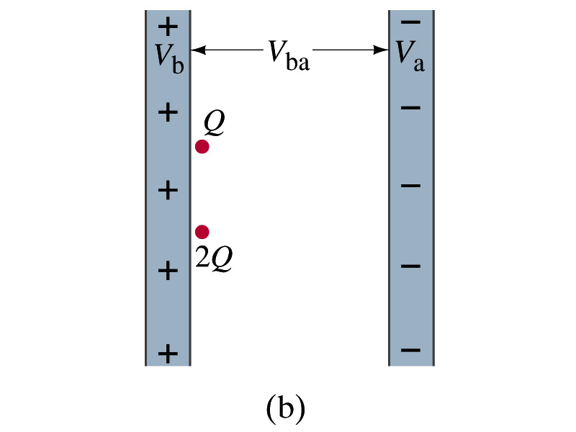
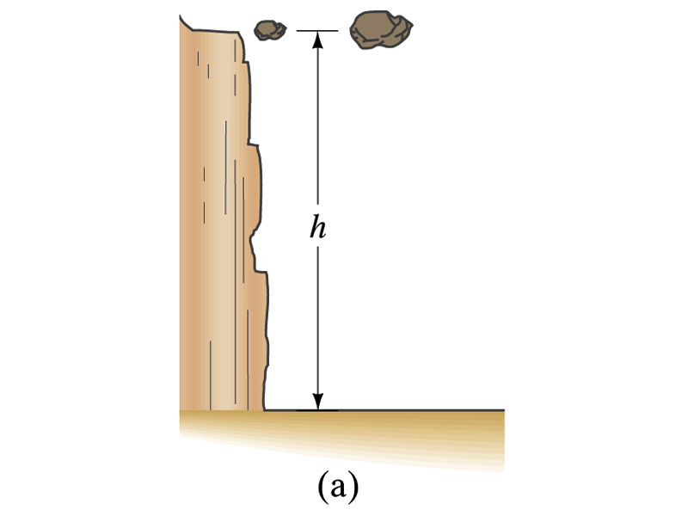
Comparisons of Potential Energies
Let’s compare gravitational and electric potential energies
m
2m
What are the potential energies of the rocks?
mgh and 2mgh
Which rock has a bigger potential energy?
The rock with a larger mass
Why?
It’s got a bigger mass.
What are the potential energies of the charges?
QV_{ba} and 2QV_{ba}
Which object has a bigger potential energy?
The object with a larger charge.
Why?
It’s got a bigger charge.
The potential is the same but the heavier rock or larger charge can do a greater work.

Slide 5
Electric Potential and Potential Energy
The electric potential difference gives potential energy or the possibility to perform work based on the charge of the object.
So what is happening in batteries or generators?
They maintain a potential difference.
The actual amount of energy used or transformed depends on how much charge flows.
How much is the potential difference maintained by a car’s battery?
12Volts
If for a given period, 5C charge flows through the headlight lamp, what is the total energy transformed?
E_{tot}=5C*12V=60 Umm… What is the unit?
If it is left on twice as long? E_{tot}=10C*12V=120J.
Joules

Slide 6
Some Typical Voltages
Sources | Approximate Voltage
Thundercloud to ground | 10⁸ V
High-Voltage Power Lines | 10⁶ V
Power supply for TV tube | 10⁴ V
Automobile ignition | 10⁴ V
Household outlet | 10² V
Automobile battery | 12 V
Flashlight battery | 1.5 V
Resting potential across nerve membrane | 10⁻¹ V
Potential changes on skin (EKG and EEG) | 10⁻⁴ V

Slide 7
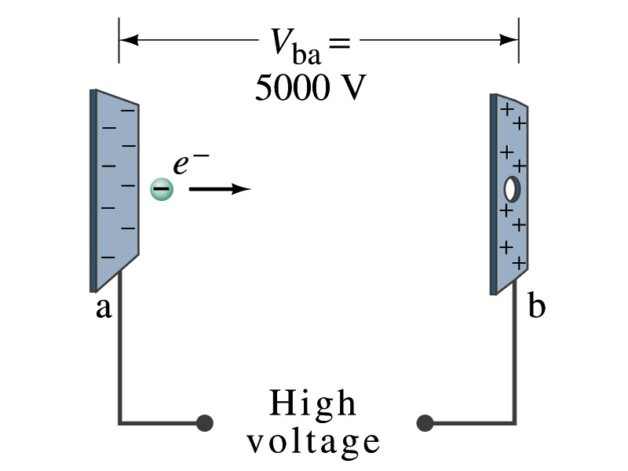
Example 23 – 2
Electrons in TV tube: Suppose an electron in the picture tube of a television set is accelerated from rest through a potential difference V_{ba}=+5000V. (a) What is the change in potential energy of the electron? (b) What is the speed of the electron (m=9.1x10⁻³¹kg) as a result of this acceleration? (c) Repeat for a proton (m=1.67x10⁻²⁷kg) that accelerates through a potential difference of V_{ba}=-5000V.
(a) What is the charge of an electron?
So what is the change of its potential energy?

Slide 8
Example 23 – 2
(b) Speed of the electron?
The entire potential energy of the electron turns to its kinetic energy. Thus the equation is
(C) Speed of a proton?

Slide 9
Electric Potential and Electric Field
The effect of a charge distribution can be described in terms of electric field or electric potential.
What kind of quantities are the electric field and the electric potential?
Electric Field:
Electric Potential:
Since electric potential is a scalar quantity, it is often easier to handle.
Well other than the above, what are the connections between these two quantities?
Vector
Scalar

Slide 10
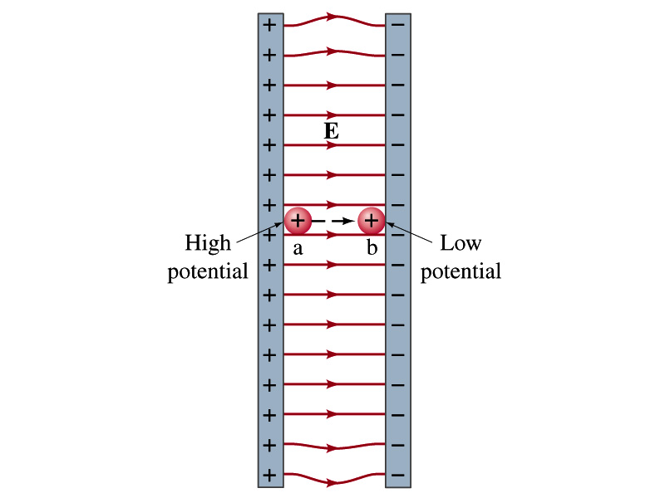
Electric Potential and Electric Field
The potential energy is expressed in terms of a conservative force
For the electrical case, we are more interested in the potential difference:
This formula can be used to determine V_{ba} when the electric field is given.
When the field is uniform and parallel to the path
or
Unit of the electric field in terms of potential?
V/m
Can you derive this from N/C?

Slide 11
Example 23 – 3
Uniform electric field obtained from voltage: Two parallel plates are charged to a voltage of 50V. If the separation between the plates is 5.0cm, calculate the magnitude of the electric field between them, ignoring any fringe effect.
5cm
50V
What is the relationship between electric field and the potential for a uniform field?
Solving for E

