Slide 1
PHYS 1444 – Section 003 Lecture #9
Tuesday, Sept. 20, 2011
Dr. Jaehoon Yu
Chapter 23 Electric Potential
Electric Potential due to Point Charges
Shape of the Electric Potential
V due to Charge Distributions
Equi-potential Lines and Surfaces
Electric Potential Due to Electric Dipole
Today’s homework is homework #5, due 10pm, Tuesday, Sept. 27!!

Slide 2
Announcements
Quiz Results
Class Average: 45.1/70
Equivalent to: 64.4/100
How did you do last time: 45.6/100
Top score: 66/70
Reading assignments
CH23.9
First Term Exam
Non comprehensive
12:30 – 2:00, Thursday, Sept. 29 in SH103
Covers CH21.1 through what we learn on this Thursday, Sept. 22, plus Appendices A and B on pages A1 – A7
There will be a review session Tuesday, Sept. 27, in the class
Bring your own sets of problems to go through in the session
Colloquium this week
Our own Dr. Cuntz

Slide 3
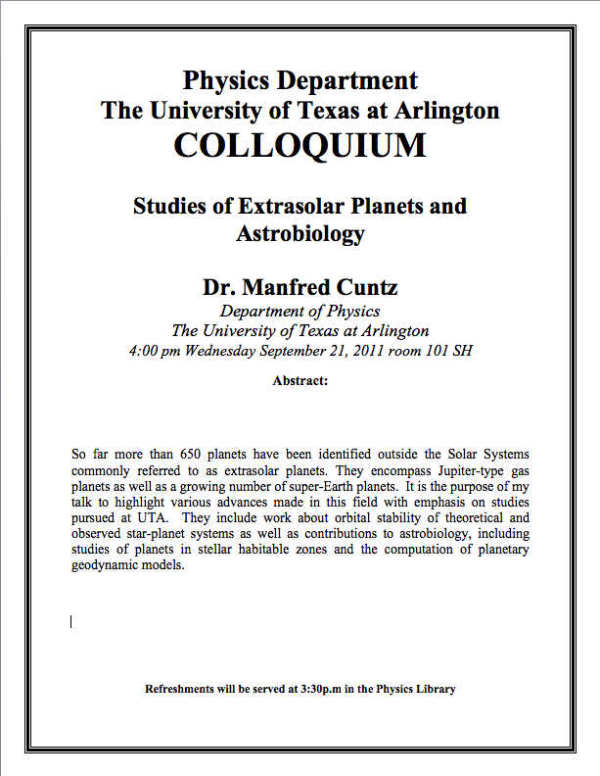

Slide 4
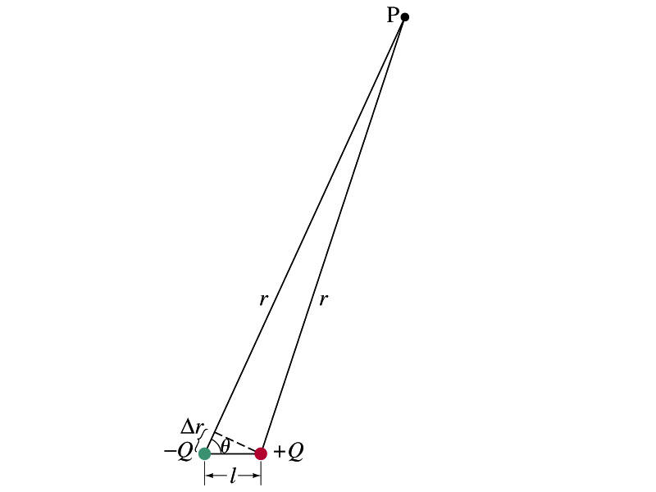
Special Project #3
Derive the formula for the potential due to a dipole whose magnitude of dipole moment is p = Ql at point P which is r away from the +Q of the dipole as shown in the figure on the right. (10 points)
You must show your work in a lot more detail than page 14 of this lecture note to obtain any credit.
Evaluate the moment of a dipole which consists of two charges of 3e and -3e and are 1 nm away from each other. (5 points)
Evaluate the potential due to this dipole at r=1μm away and the angle θ=25 degrees. (5 points)
Be sure to write down proper units.
Due is beginning of the class Tuesday, Oct. 4!.

Slide 5
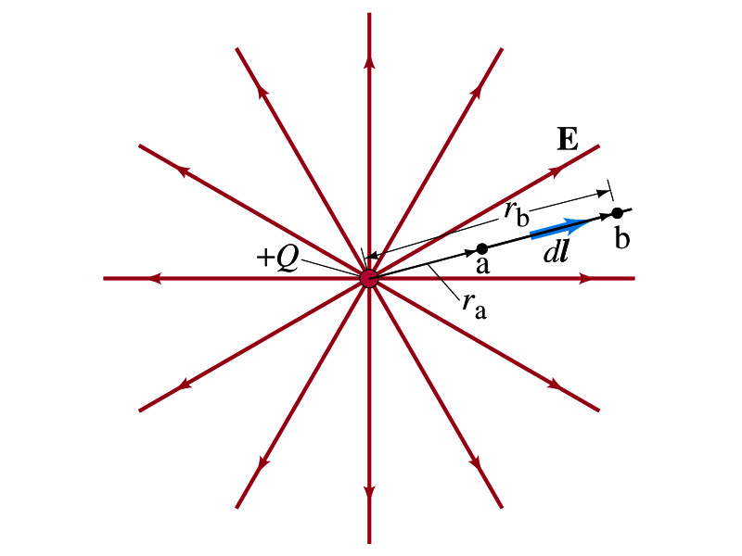
Electric Potential due to Point Charges
What is the electric field by a single point charge Q at a distance r?
Electric potential due to the field E for moving from point r_{a} to r_{b} in radial direction away from the charge Q is

Slide 6
Electric Potential due to Point Charges
Since only the differences in potential have physical meaning, we can choose at .
The electrical potential V at a distance r from a single point charge Q is
So the absolute potential by a single point charge can be thought of the potential difference by a single point charge between r and infinity

Slide 7
Properties of the Electric Potential
What are the differences between the electric potential and the electric field?
Electric potential
Electric potential energy per unit charge
Inversely proportional to the distance
Simply add the potential by each of the charges to obtain the total potential from multiple charges, since potential is a scalar quantity
Electric field
Electric force per unit charge
Inversely proportional to the square of the distance
Need vector sums to obtain the total field from multiple charges
Potential for the positive charge is larger near the charge and decreases towards 0 at large distance.
Potential for the negative charge is large negative near the charge and increases towards 0 at a large distance.

Slide 8
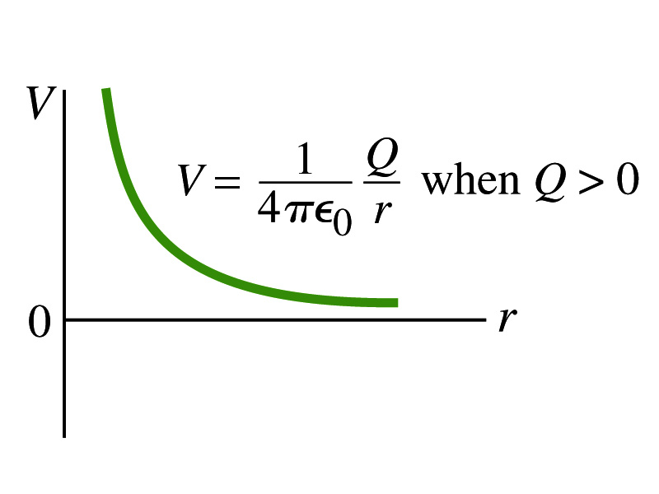
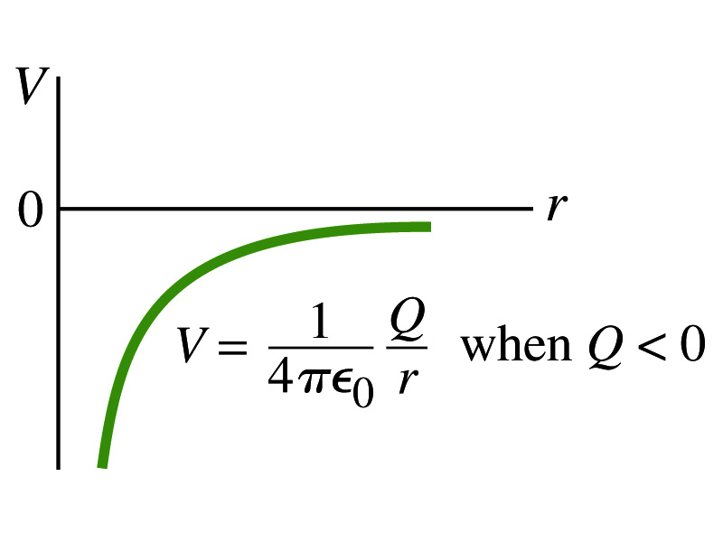
Shape of the Electric Potential
So, how does the electric potential look like as a function of distance?
What is the formula for the potential by a single charge?
Positive Charge
Negative Charge
Uniformly charged sphere would have the potential the same as a single point charge.
What does this mean?
Uniformly charged sphere behaves like all the charge is on the single point in the center.

Slide 9
Example 23 – 6
Work to bring two positive charges close together: What minimum work is required by an external force to bring a charge q=3.00μC from a great distance away (r=∞) to a point 0.500m from a charge Q=20.0 μC?
What is the work done by the electric field in terms of potential energy and potential?
Since we obtain
Electric force does negative work. In other words, the external force must work +1.08J to bring the charge 3.00μC from infinity to 0.500m to the charge 20.0μC.

Slide 10
Electric Potential by Charge Distributions
Let’s consider a case of n individual point charges in a given space and V=0 at r=∞.
Then the potential Via due to the charge Q_{i} at a point a, distance r_{ia} from Q_{i} is
Thus the total potential V_{a} by all n point charges is
For a continuous charge distribution, we obtain

Slide 11
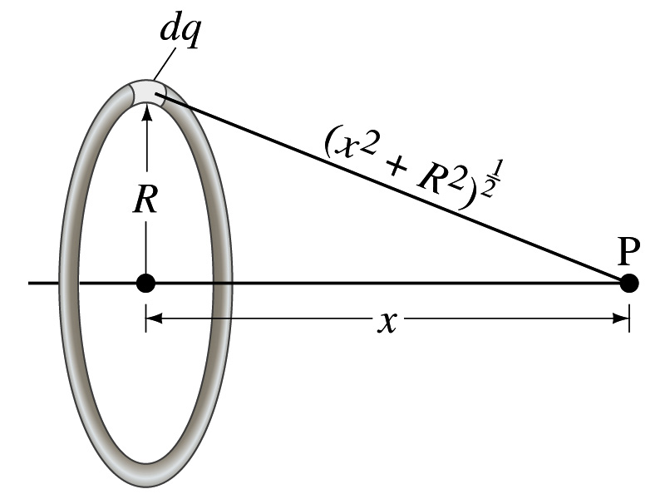
Example 23 – 8
Potential due to a ring of charge: A thin circular ring of radius R carries a uniformly distributed charge Q. Determine the electric potential at a point P on the axis of the ring a distance x from its center.
Each point on the ring is at the same distance from the point P. What is the distance?
So the potential at P is
What’s this?

Slide 12
Equi-potential Surfaces
Electric potential can be graphically shown using the equipotential lines in 2-D or the equipotential surfaces in 3-D
Any two points on the equipotential surfaces (lines) are on the same potential
What does this mean in terms of the potential difference?
The potential difference between two points on an equipotential surface is 0.
How about the potential energy difference?
Also 0.
What does this mean in terms of the work to move a charge along the surface between these two points?
No work is necessary to move a charge between these two points.

Slide 13
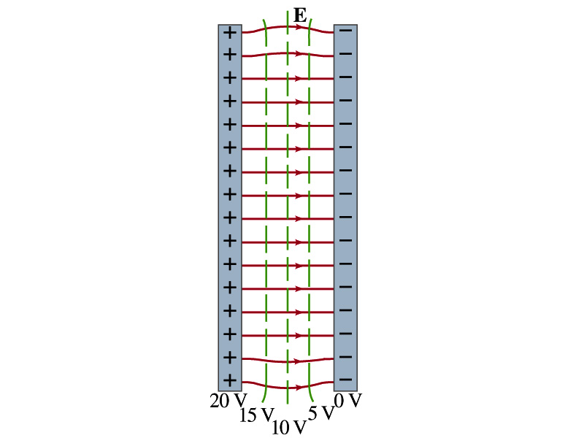
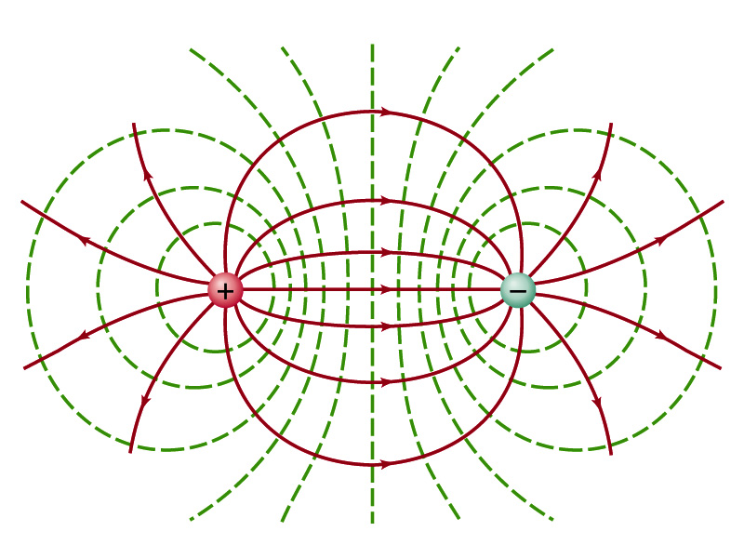
Equi-potential Surfaces
An equipotential surface (line) must be perpendicular to the electric field. Why?
If there are any parallel components to the electric field, it would require work to move a charge along the surface.
Since the equipotential surface (line) is perpendicular to the electric field, we can draw these surfaces or lines easily.
Since there can be no electric field within a conductor in a static case, the entire volume of a conductor must be at the same potential.
So the electric field must be perpendicular to the conductor surface.
Parallel Plate
Point charges
Just like a topological map

Slide 14
Electric Potential due to Electric Dipoles
What is an electric dipole?
Two equal point charge Q of opposite signs separated by a distance l and behaves like one entity: P=Ql
For the electric potential due to a dipole at a point p
We take V=0 at r=∞
The simple sum of the potential at p by the two charges is
Since Δr=lcosθ and if r>>l, r>>Δr, thus r~r+Δr and
V by a dipole at a
distance r from
the dipole

