Slide 1
PHYS 1444 – Section 003
Lecture #15
Tuesday, Oct. 25, 2011
Dr. Jaehoon Yu
Kirchhoff’s Rules
EMFs in Series and Parallel
RC Circuits
  Analysis of RC Circuits
  Discharging of RC Circuits
  Application of RC Circuits
Magnetism and Magnetic Field
Today’s homework is #8, due 10pm, Tuesday, Nov. 1!!

Slide 2
Announcements
Midterm grade discussions will occur from later this week through early next week
  Please do not miss this discussion session
  Will announce Thursday the sequence
Colloquium tomorrow
  4pm, SH101

Slide 3
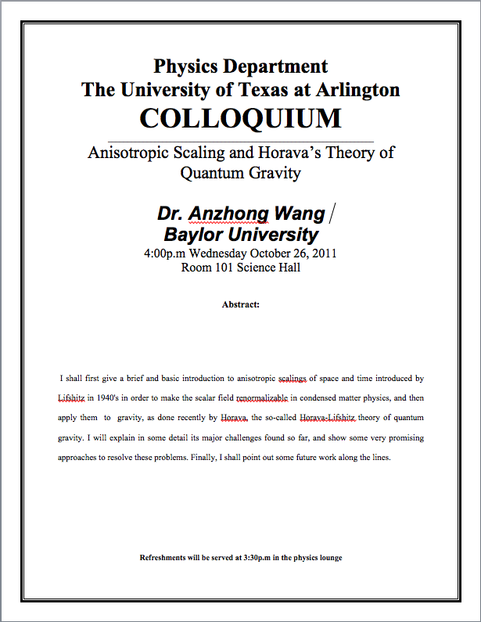

Slide 4
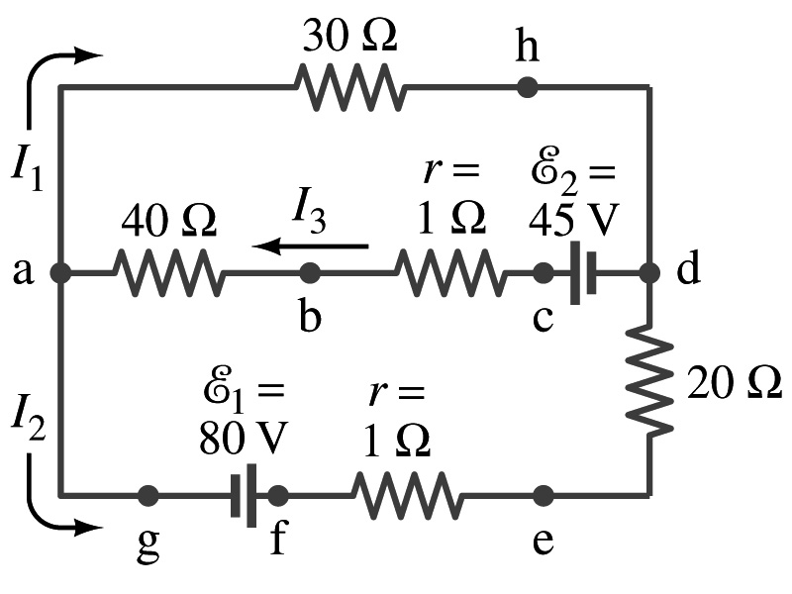
Special Project #5
In the circuit on the right, find out what the currents I₁, I₂ and I₃ are using Kirchhoff’s rules in the following two cases:
  All the directions of the current flows are as shown in the figure. (3points)
  When the directions of the flow of the current I₁ and I₃ are opposite than what is drawn in the figure but the direction of I₂ is the same. (5 points)
  When the directions of the flow of the current I₂ and I₃ are opposite than what is drawn in the figure but the direction of I₁ is the same. (5 points)
Show the details of your OWN work to obtain credit.
Due is at the beginning of the class Thursday, Nov. 3.

Slide 5
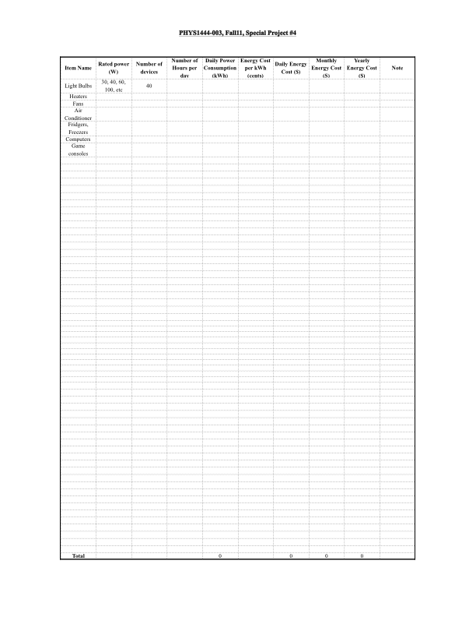
Special Project Spread Sheet

Slide 6
Kirchhoff’s Rules – 1st Rule
Some circuits are very complicated to do the analysis using the simple combinations of resisters
  G. R. Kirchhoff devised two rules to deal with complicated circuits.
Kirchhoff’s rules are based on conservation of charge and energy
  Kirchhoff’s 1st rule: The junction rule, charge conservation.
    At any junction point, the sum of all currents entering the junction must equal to the sum of all currents leaving the junction.
    In other words, what goes in must come out.
    At junction a in the figure, I₃ comes into the junction while I₁ and I₂ leaves: I₃ = I₁+ I₂

Slide 7
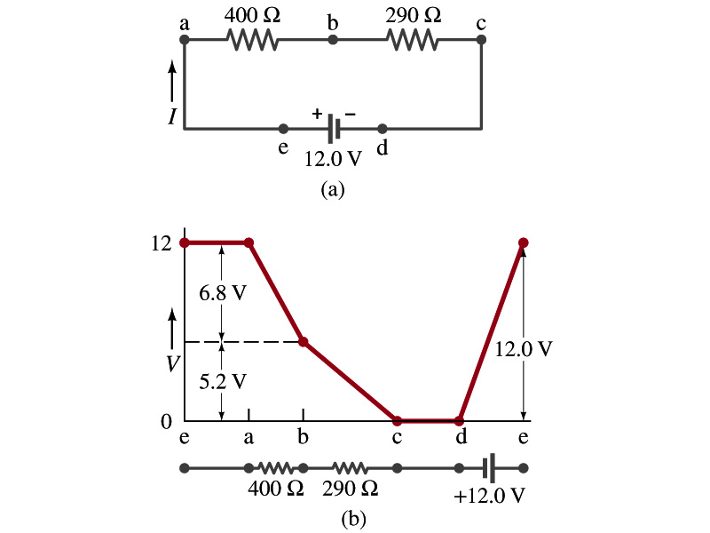
Kirchhoff’s Rules – 2nd Rule
Kirchoff’s 2nd rule: The loop rule, uses conservation of energy.
  The sum of the changes in potential around any closed path of a circuit must be zero.
The current in the circuit in the figure is I=12/690=0.017A.
  Point e is the high potential point while point d is the lowest potential.
  When the test charge starts at e and returns to e, the total potential change is 0.
  Between point e and a, no potential change since there is no source of potential nor any resistance.
  Between a and b, there is a 400Ω resistance, causing IR=0.017*400 =6.8V drop.
  Between b and c, there is a 290Ω resistance, causing IR=0.017*290 =5.2V drop.
  Since these are voltage drops, we use negative sign for these, -6.8V and -5.2V.
  No change between c and d while from d to e there is +12V change.
  Thus the total change of the voltage through the loop is: -6.8V-5.2V+12V=0V.

Slide 8
Using Kirchhoff’s Rules
Determine the flow of currents at the junctions and label each and everyone of the currents.
  It does not matter which direction, you decide.
  If the value of the current after completing the calculations are negative, you just need to flip the direction of the current flow.
Write down the current equation based on Kirchhoff’s 1st rule at various junctions.
  Be sure to see if any of them are the same.
Choose closed loops in the circuit
Write down the potential in each interval of the junctions, keeping the sign properly.
Write down the potential equations for each loop.
Solve the equations for unknowns.

Slide 9
Example 26 – 9
Use Kirchhoff’s rules. Calculate the currents I₁, I₂ and I₃ in each of the branches of the circuit in the figure.
The directions of the current through the circuit is not known a priori but since the current tends to move away from the positive terminal of a battery, we arbitrarily choose the direction of the currents as shown.
We have three unknowns so we need three equations.
Using Kirchhoff’s junction rule at point a, we obtain
This is the same for junction d as well, so no additional information.
Now the second rule on the loop ahdcba.
The total voltage change in the loop ahdcba is.

Slide 10
Example 26 – 9, cnt’d
Now the second rule on the other loop agfedcba.
The total voltage change in loop agfedcba is.
So the three equations become
We can obtain the three current by solving these equations for I₁, I₂ and I₃.
Do this yourselves!!

Slide 11
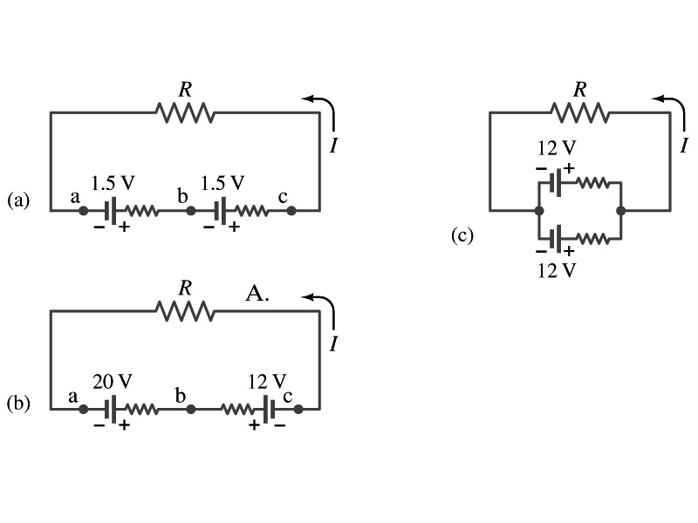
EMFs in Series and Parallel: Charging a Battery
When two or more sources of emfs, such as batteries, are connected in series
  The total voltage is the algebraic sum of their voltages, if their direction is the same
    V_{ab}=1.5 + 1.5=3.0V in figure (a).
  If the batteries are arranged in an opposite direction, the total voltage is the difference between them
Parallel arrangements (c) are used only to increase currents. An example?
    V_{ac}=20 – 12=8.0V in figure (b)
    Connecting batteries in opposite direction is wasteful.
    This, however, is the way a battery charger works.
    Since the 20V battery is at a higher voltage, it forces charges into 12V battery
    Some battery are rechargeable since their chemical reactions are reversible but most the batteries do not reverse their chemical reactions

Slide 12
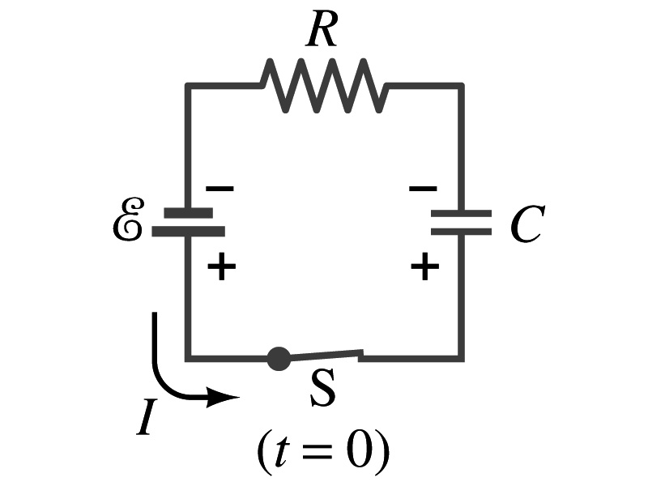
RC Circuits
Circuits containing both resisters and capacitors
  RC circuits are used commonly in everyday life
    Control windshield wiper
    Timing of traffic light from red to green
    Camera flashes and heart pacemakers
How does an RC circuit look?
  There should be a source of emf, capacitors and resisters
What happens when the switch S is closed?
  Current immediately starts flowing through the circuit.
  Electrons flow out of negative terminal of the emf source, through the resister R and accumulates on the upper plate of the capacitor.
  The electrons from the bottom plate of the capacitor will flow into the positive terminal of the battery, leaving only positive charge on the bottom plate.
  As the charge accumulates on the capacitor, the potential difference across it increases
  The current reduces gradually to 0 till the voltage across the capacitor is the same as emf.
  The charge on the capacitor increases till it reaches to its maximum CE.

Slide 13
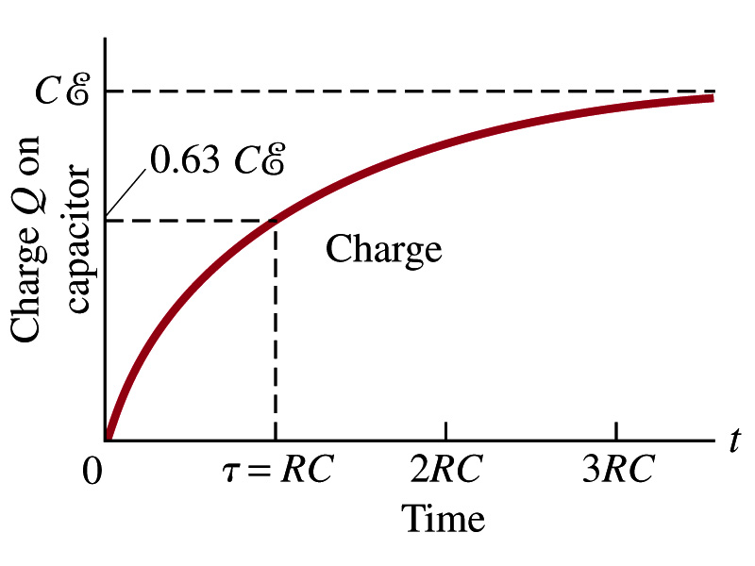
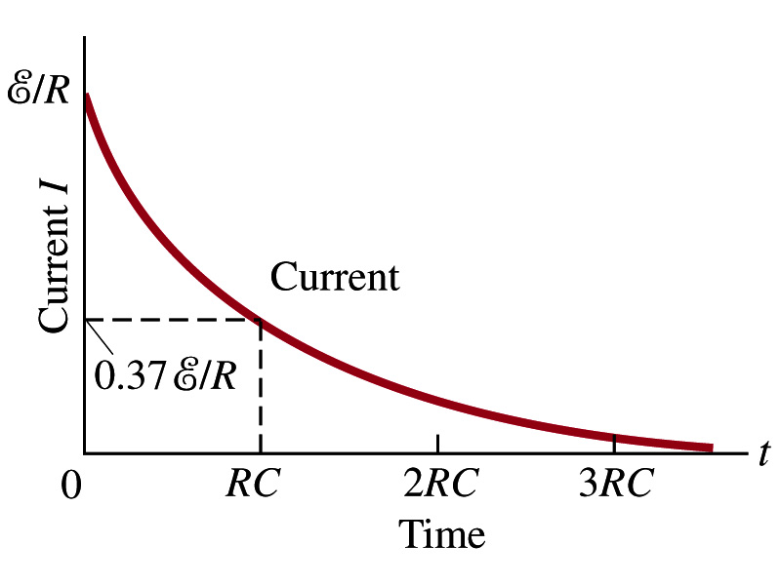
RC Circuits
How does all this look like in graphs?
  The charge and the current on the capacitor as a function of time
  From energy conservation (Kirchhoff’s 2nd rule), the emf E must be equal to the voltage drop across the capacitor and the resister
    E=IR+Q/C
    R includes all resistance in the circuit, including the internal resistance of the battery, I is the current in the circuit at any instance, and Q is the charge of the capacitor at that same instance.

Slide 14
Analysis of RC Circuits
From the energy conservation, we obtain E=IR+Q/C
Which ones are constant in the above equation?
  E, R and C are constant
  Q and I are functions of time
How do we write the rate at which the charge is accumulated on the capacitor?
  We can rewrite the above equation as
  This equation can be solved by rearranging the terms as

Slide 15
Analysis of RC Circuits
Now integrating from t=0 when there was no charge on the capacitor to t when the capacitor is fully charged, we obtain
➔
So, we obtain ➔
Or
The potential difference across the capacitor is V=Q/C, so

Slide 16
Analysis of RC Circuits
Since and
What can we see from the above equations?
  Q and V_{C} increase from 0 at t=0 to maximum value Q_{max}=CE and V_{C}= E.
In how much time?
  The quantity RC is called the time constant of the circuit, τ
    τ=RC, What is the unit?
  What is the physical meaning?
    The time required for the capacitor to reach (1-e⁻¹)=0.63 or 63% of the full charge
The current is
Sec.

Slide 17
Example 26 – 12
RC circuit, with emf. The capacitance in the circuit of the figure is C=0.30μF, the total resistance is 20kΩ, and the battery emf is 12V. Determine (a) the time constant, (b) the maximum charge the capacitor could acquire, (c) the time it takes for the charge to reach 99% of this value, (d) the current I when the charge Q is half its maximum value, (e) the maximum current, and (f) the charge Q when, the current I is 0.20 its maximum value.
(a) Since
We obtain
(b) Maximum charge is
(c) Since
For 99% we obtain
(d) Since
We obtain
The current when Q is 0.5Q_{max}
(e) When is I maximum?
when Q=0:
(f) What is Q when I=120mA?

Slide 18
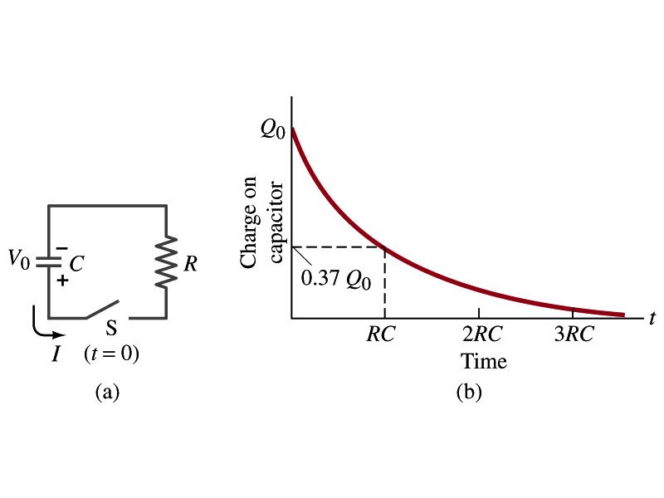
Discharging RC Circuits
When a capacitor is already charged, it is allowed to discharge through a resistance R.
  When the switch S is closed, the voltage across the resistor at any instant equals that across the capacitor. Thus IR=Q/C.
  The rate at which the charge leaves the capacitor equals the negative the current flows through the resistor
    I= - dQ/dt. Why negative?
    Since the current is leaving the capacitor
  Thus the voltage equation becomes a differential equation
Rearrange terms

Slide 19
Discharging RC Circuits
  Now, let’s integrate from t=0 when the charge is Q₀ to t when the charge is Q
  The result is
  Thus, we obtain
  What does this tell you about the charge on the capacitor?
    It decreases exponentially w/ time and w/ the time constant RC
    Just like the case of charging
  The current is:
    The current also decreases exponentially w/ time w/ the constant RC
What is this?

Slide 20
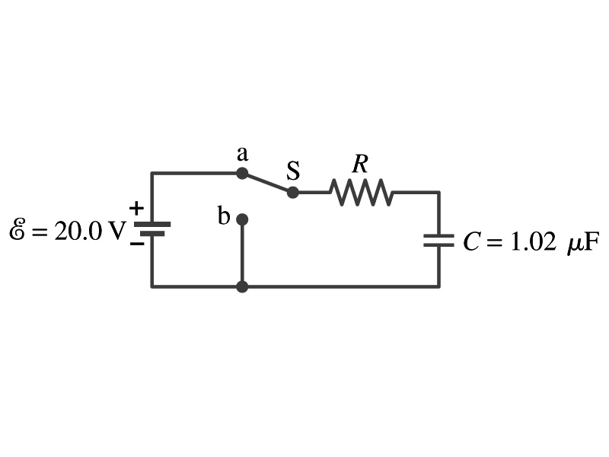
Example 26 – 13
Discharging RC circuit. In the RC circuit shown in the figure the battery has fully charged the capacitor, so Q₀=CE. Then at t=0, the switch is thrown from position a to b. The battery emf is 20.0V, and the capacitance C=1.02μF. The current I is observed to decrease to
0.50 of its initial value in 40μs. (a) what is the value of R? (b) What is the value of Q, the charge on the capacitor, at t=0? (c) What is Q at t=60μs?
(a) Since the current reaches to 0.5 of its initial value in 40μs, we can obtain
For 0.5I₀
Rearrange terms
Solve for R
(b) The value of Q at t=0 is
(c) What do we need to know first for the value of Q at t=60μs?
The RC time
Thus

Slide 21
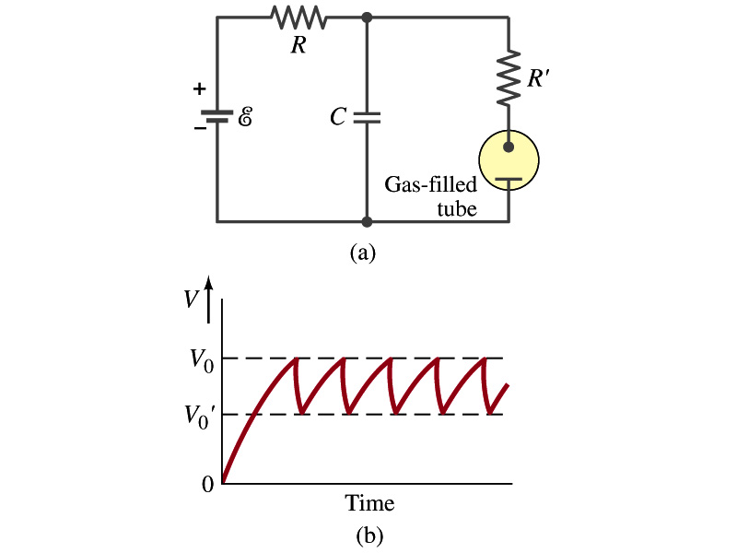
Application of RC Circuits
What do you think the charging and discharging characteristics of RC circuits can be used for?
  To produce voltage pulses at a regular frequency
  How?
    The capacitor charges up to a particular voltage and discharges
    A simple way of doing this is to use breakdown of voltage in a gas filled tube
      The discharge occurs when the voltage breaks down at V₀
      After the completion of discharge, the tube no longer conducts
      Then the voltage is at V₀’ and it starts charging up
      How do you think the voltage as a function of time look?
        A sawtooth shape
    Pace maker, intermittent windshield wiper, etc

