Slide 1
PHYS 1444 – Section 003 Lecture #16
Thursday, Oct. 27, 2011
Dr. Jaehoon Yu
Magnetism and Magnetic Field
Electric Current and Magnetism
Magnetic Forces on Electric Current
About Magnetic Field
Magnetic Forces on a Moving Charge
Charged Particle Path in a Magnetic Field

Slide 2
Announcements
Midterm exam results
Class average: 73/110
Equivalent to 66.4/100
How did you do last time?: 59.5/100
Top score: 99/110
Mid-term grade discussion
Today in the bottom half of the class
Come to my office CPB342
Sequence of discussions
Those with time restrictions: 1 – 1:20pm
A – F: 1 – 2pm
F – O: 1:45 – 3pm
O – Z: 2:45 – 4pm

Slide 3
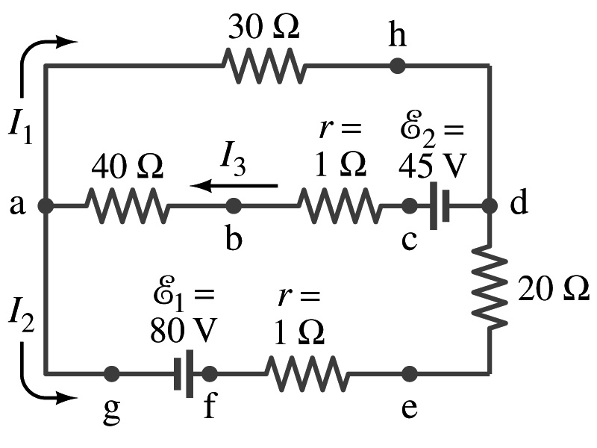
Special Project #5
In the circuit on the right, find out what the currents I₁, I₂ and I₃ are using Kirchhoff’s rules in the following two cases:
All the directions of the current flows are as shown in the figure. (3points)
When the directions of the flow of the current I₁ and I₃ are opposite than what is drawn in the figure but the direction of I₂ is the same. (5 points)
When the directions of the flow of the current I₂ and I₃ are opposite than what is drawn in the figure but the direction of I₁ is the same. (5 points)
Show the details of your OWN work to obtain credit.
Due is at the beginning of the class Thursday, Nov. 3.

Slide 4
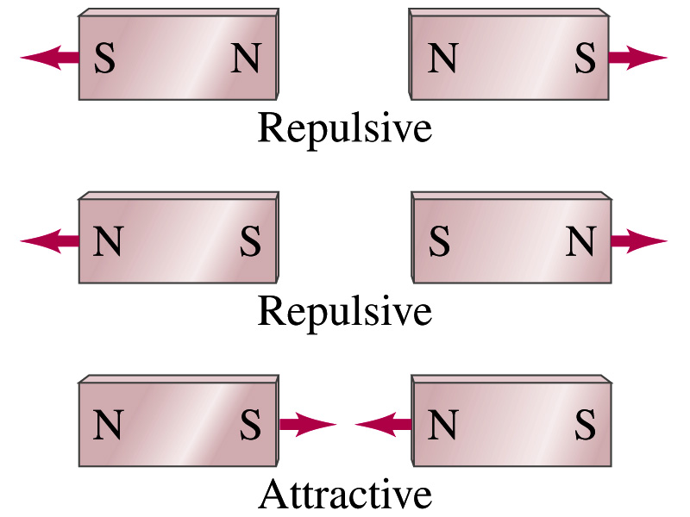
Magnetism
What are magnets?
Objects with two poles, north and south poles
The pole that points to geographical north is the north pole and the other is the south pole
Principle of compass
These are called magnets due to the name of the region, Magnesia, where rocks that attract each other were found
What happens when two magnets are brought to each other?
They exert force onto each other
What kind?
Both repulsive and attractive forces depending on the configurations
Like poles repel each other while the unlike poles attract

Slide 5
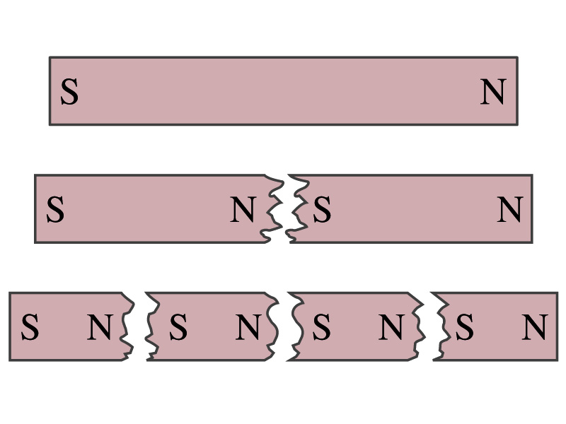
Magnetism
So the magnet poles are the same as the electric charge?
No. Why not?
While the electric charges (positive and negative) can be isolated the magnet poles cannot be isolated.
So what happens when a magnet is cut?
If a magnet is cut, two magnets are made.
The more they get cut, the more magnets are made
Single pole magnets are called the monopole but it has not been seen yet
Ferromagnetic materials: Materials that show strong magnetic effects
Iron, cobalt, nickel, gadolinium and certain alloys
Other materials show very weak magnetic effects

Slide 6
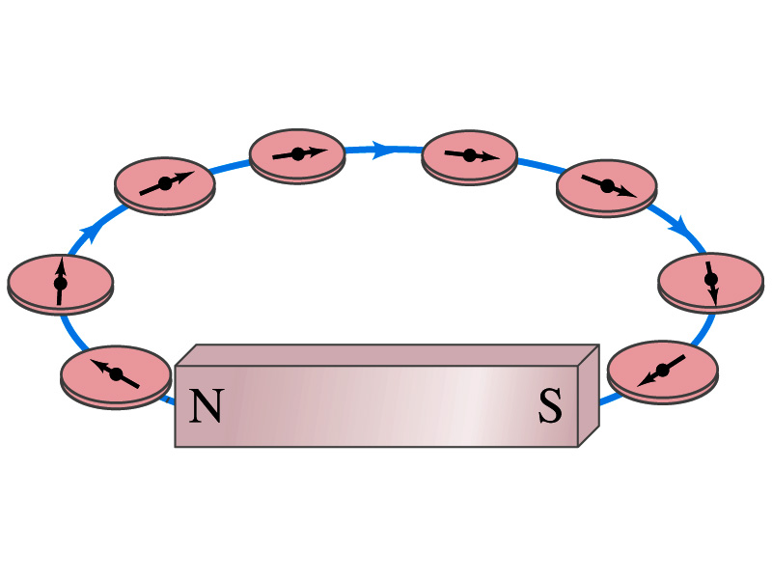
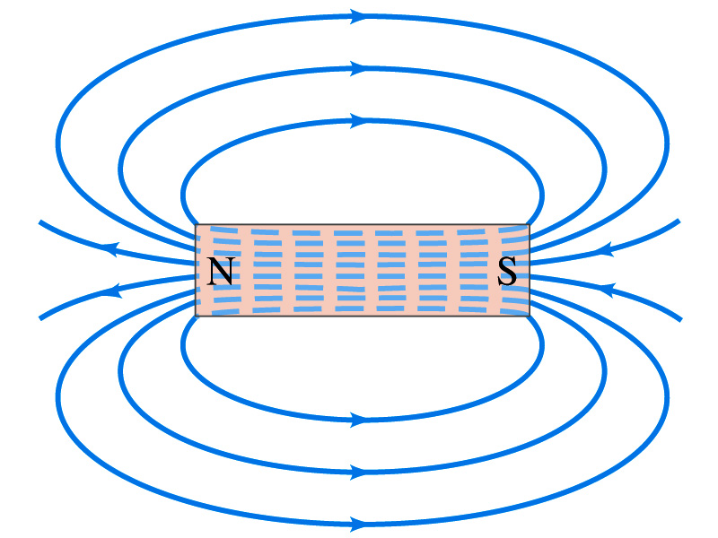
Magnetic Field
Just like the electric field that surrounds electric charge, a magnetic field surrounds a magnet
What does this mean?
Magnetic force is also a field force
The force one magnet exerts onto another can be viewed as the interaction between the magnet and the magnetic field produced by the other magnet
What kind of quantity is the magnetic field? Vector or Scalar?
So one can draw magnetic field lines, too.
Vector
The direction of the magnetic field is tangential to a line at any point
The direction of the field is the direction the north pole of a compass would point to
The number of lines per unit area is proportional to the strength of the magnetic field
Magnetic field lines continue inside the magnet
Since magnets always have both the poles, magnetic field lines form closed loops unlike electric field lines

