Slide 1
PHYS 1444 – Section 003
Lecture #17
Tuesday, Nov. 1, 2011
Dr. Jaehoon Yu
Electric Current and Magnetism
Magnetic Forces on Electric Current
About Magnetic Field
Magnetic Forces on a Moving Charge
Charged Particle Path in a Magnetic Field
Cyclotron Frequency
Today’s homework is #9, due 10pm, Tuesday, Nov. 8!!

Slide 2
Announcements
Those who have not been able to meet me for grade discussions, please come to my office at 10:30am tomorrow, Wednesday
  Please bring your exam end of class or to tomorrow’s meeting
Quiz #3
  Beginning of the class coming Tuesday, Nov. 8
  Covers: CH26.5 through what we finish Thursday!
Colloquium at 4pm tomorrow, Wednesday, SH101
  Department faculty expo part II

Slide 3
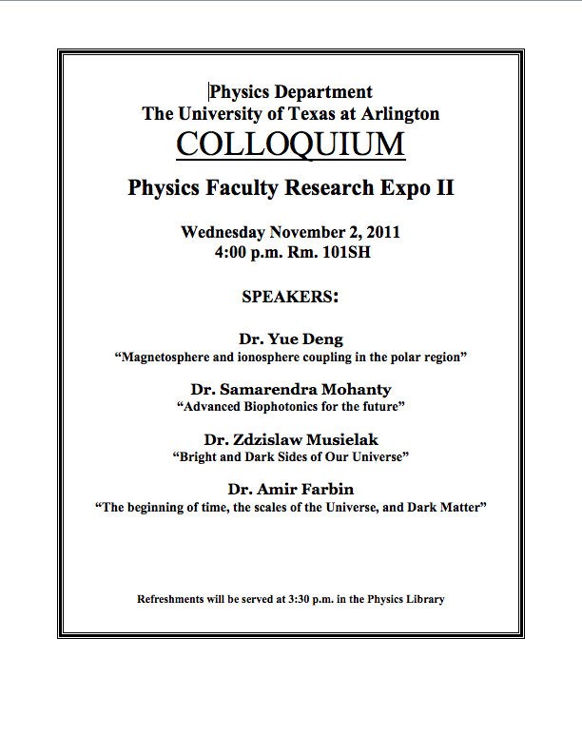

Slide 4
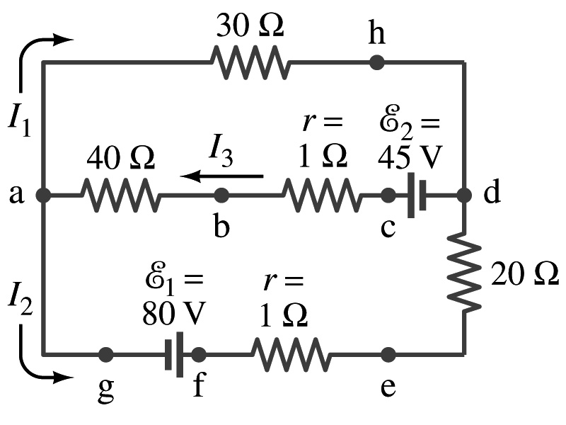
Special Project #5
In the circuit on the right, find out what the currents I₁, I₂ and I₃ are using Kirchhoff’s rules in the following two cases:
  All the directions of the current flows are as shown in the figure. (3points)
  When the directions of the flow of the current I₁ and I₃ are opposite than what is drawn in the figure but the direction of I₂ is the same. (5 points)
  When the directions of the flow of the current I₂ and I₃ are opposite than what is drawn in the figure but the direction of I₁ is the same. (5 points)
Show the details of your OWN work to obtain credit.
Due is at the beginning of the class Thursday, Nov. 3.

Slide 5
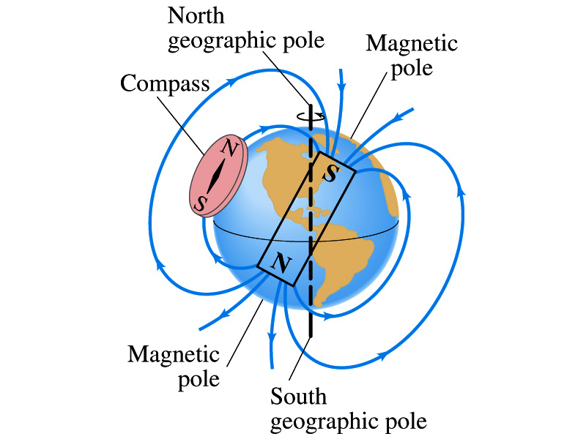
Earth’s Magnetic Field
What magnetic pole does the geographic north pole has to have?
  Magnetic south pole. What? How do you know that?
  Since the magnetic north pole points to the geographic north, the geographic north must have magnetic south pole
    The pole in the north is still called geomagnetic north pole just because it is in the north
  Similarly, south pole has magnetic north pole
The Earth’s magnetic poles do not coincide with the geographic poles ➔ magnetic declination
  Geomagnetic north pole is in northern Canada, some 900km off the true north pole
Earth’s magnetic field line is not tangent to the earth’s surface at all points
  The angle the Earth’s field makes to the horizontal line is called the angle dip

Slide 6
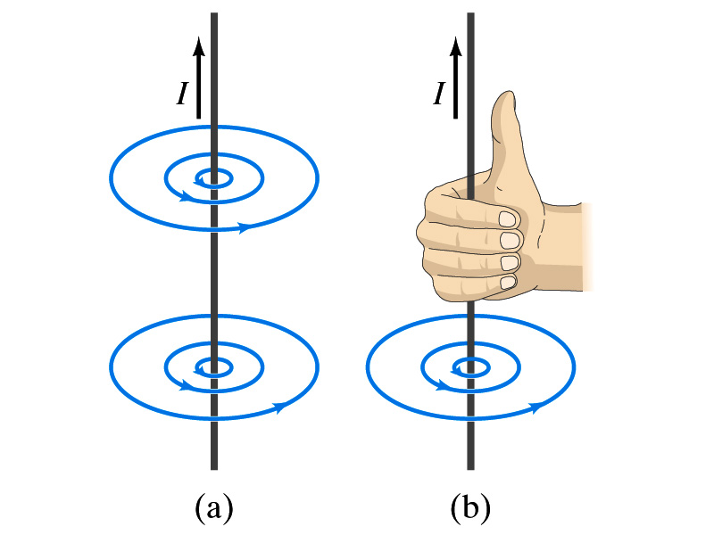
Electric Current and Magnetism
In 1820, Oersted found that when a compass needle is placed near an electric wire, the needle deflects as soon as the wire is connected to a battery and the current flows
  Electric current produces a magnetic field
    The first indication that electricity and magnetism are of the same origin
  What about a stationary electric charge and magnet?
    They don’t affect each other.
The magnetic field lines produced by a current in a straight wire is in the form of circles following the “right-hand” rule
  The field lines follow right-hand fingers wrapped around the wire when the thumb points to the direction of the electric current

Slide 7
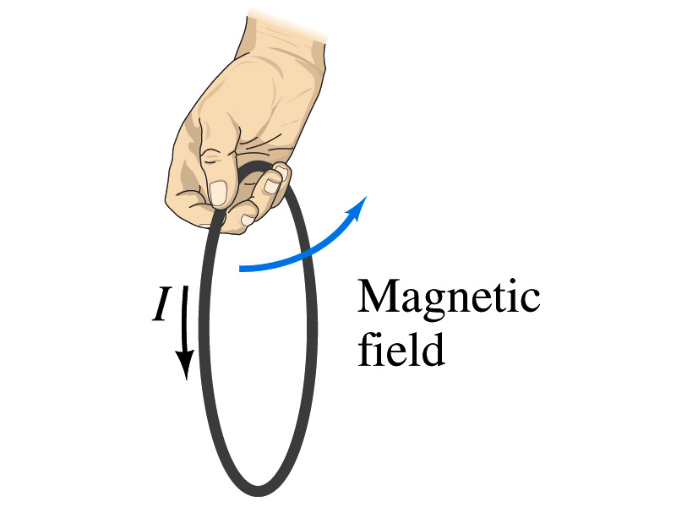
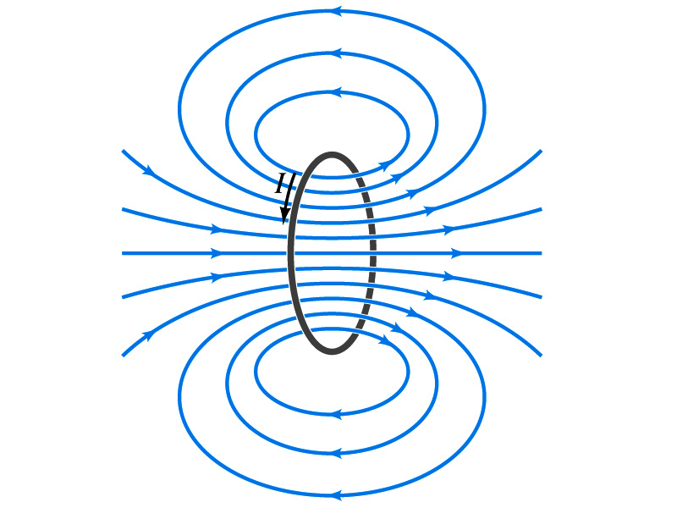
Directions in a Circular Wire?
OK, then what are the directions of the magnetic fields generated by the current flowing through circular loops?

Slide 8
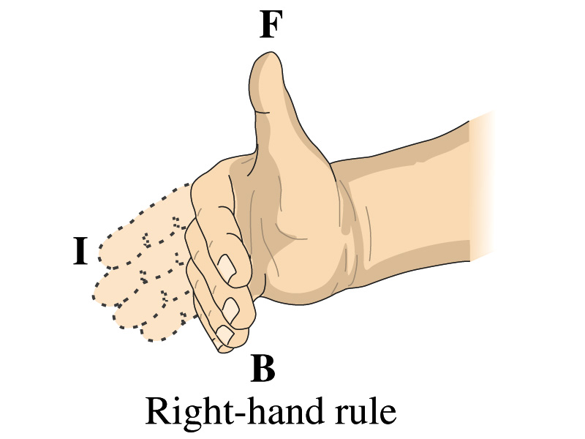
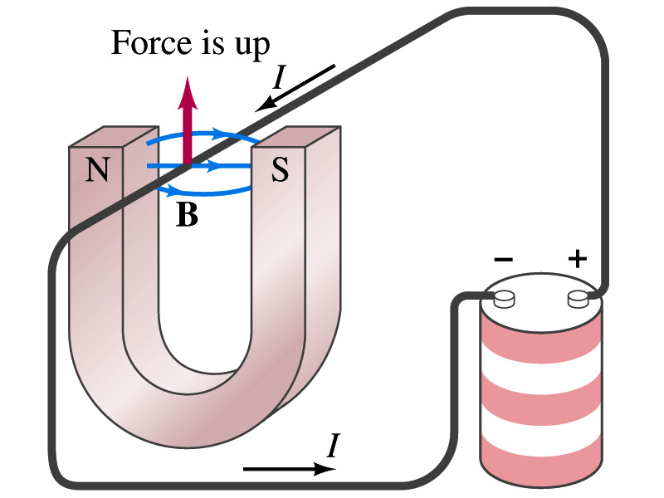
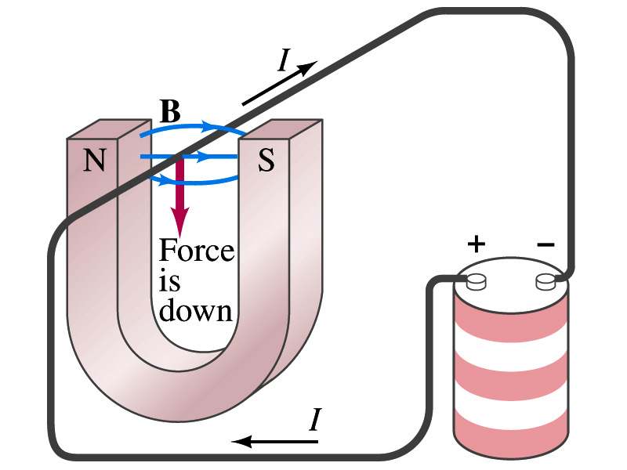
Magnetic Forces on Electric Current
Since the electric current exerts force on a magnet, the magnet should also exert force on the electric current
  Which law justifies this?
    Newton’s 3rd law
  This was also discovered by Oersted
Direction of the force is always
  perpendicular to the direction of the current and also
  perpendicular to the direction of the magnetic field, B
Experimentally the direction of the force is given by another right-hand rule ➔ When the fingers of the right-hand points to the direction of the current and the finger tips bent to the direction of magnetic field B, the direction of thumb points to the direction of the force

Slide 9
Magnetic Forces on Electric Current
OK, we are set for the direction but what about the magnitude?
It is found that the magnitude of the force is directly proportional
  To the current in the wire
  To the length of the wire in the magnetic field (if the field is uniform)
  To the strength of the magnetic field
The force also depends on the angle θ between the directions of the current and the magnetic field
  When the wire is perpendicular to the field, the force is the strongest
  When the wire is parallel to the field, there is no force at all
Thus the force on current I in the wire w/ length l in a uniform field B is

Slide 10
Magnetic Forces on Electric Current
Magnetic field strength B can be defined using the previous proportionality relationship w/ the constant 1:
if θ=90º, and if θ=0º
So the magnitude of the magnetic field B can be defined as
  where F_{max} is the magnitude of the force on a straight length l of the wire carrying the current I when the wire is perpendicular to B
The relationship between F, B and I can be written in a vector formula:
  l is the vector whose magnitude is the length of the wire and its direction is along the wire in the direction of the conventional current
  This formula works if B is uniform.
If B is not uniform or l does not form the same angle with B everywhere, the infinitesimal force acting on a differential length dl is

Slide 11
Fundamentals on the Magnetic Field, B
The magnetic field is a vector quantity
The SI unit for B is tesla (T)
  What is the definition of 1 Tesla in terms of other known units?
  1T=1N/Am
  In older names, tesla is the same as weber per meter-squared
    1Wb/m²=1T
The cgs unit for B is gauss (G)
  How many T is one G?
    1G=10⁻⁴ T
  For computation, one MUST convert G to T at all times
Magnetic field on the Earth’s surface is about 0.5G=0.5x10⁻⁴T
On a diagram, for field coming out and for going in.

Slide 12
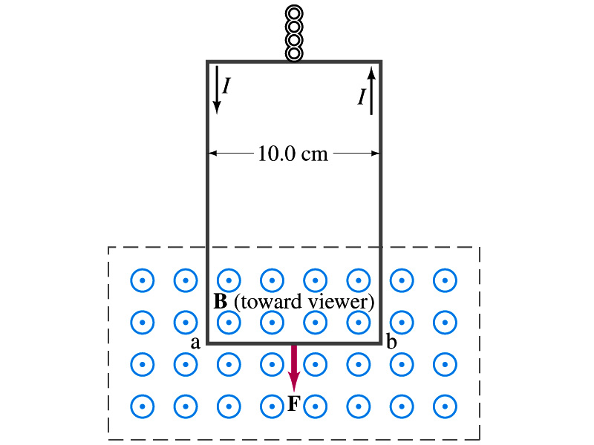
Example 27 – 2
Measuring a magnetic field. A rectangular loop of wire hangs vertically as shown in the figure. A magnetic field B is directed horizontally perpendicular to the wire, and points out of the page. The magnetic field B is very nearly uniform along the horizontal portion of wire ab (length l=10.0cm) which is near the center of a large magnet producing the field. The top portion of the wire loop is free of the field. The loop hangs from a balance which measures a downward force ( in addition to the gravitational force) of F=3.48x10⁻²N when the wire carries a current I=0.245A. What is the magnitude of the magnetic field B at the center of the magnet?
Magnetic force exerted on the wire due to the uniform field is
Since
Magnitude of the force is
Solving for B
Something is not right! What happened to the forces on the loop on the side?
The two forces cancel out since they are in opposite direction with the same magnitude.

Slide 13
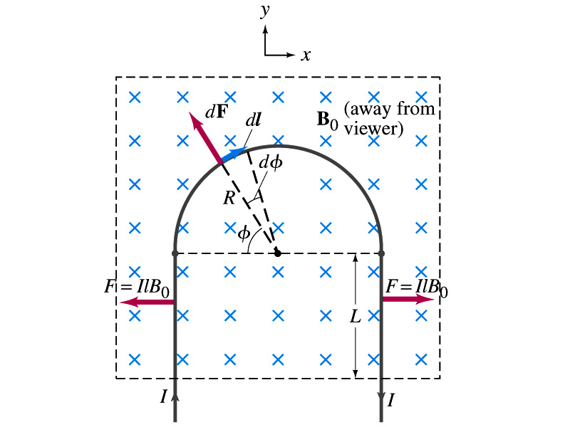
Example 27 – 3
Magnetic force on a semi-circular wire. A rigid wire, carrying the current I, consists of a semicircle of radius R and two straight portions as shown in the figure. The wire lies in a plane perpendicular to the uniform magnetic field B₀. The straight portions each have length l within the field. Determine the net force on the wire due to the magnetic field B₀.
As in the previous example, the forces on the straight sections of the wire is equal and in opposite direction. Thus they cancel.
What do we use to figure out the net force on the semicircle?
We divide the semicircle into infinitesimal straight sections.
What is the net x component of the force exerting on the circular section?
0
Why?
Because the forces on left and the right-hand sides of the semicircle balance.
Since
Y-component of the force dF is
Integrating over ϕ=0 - π
Which direction?
Vertically upward direction. The wire will be pulled deeper into the field.

Slide 14
Magnetic Forces on a Moving Charge
Will moving charge in a magnetic field experience force?
  Yes
  Why?
  Since the wire carrying a current (moving charge) experience force in a magnetic field, a free moving charge must feel the same kind of force…☺
OK, then how much force would it experience?
  Let’s consider N moving particles with charge q each, and they pass by a given point in time interval t.
    What is the current?
  Let t be the time for a charge q to travel a distance L in a magnetic field B
    Then, the length vector l becomes
    Where v is the velocity of the particle
Thus the force on N particles by the field is
The force on one particle with charge q,

Slide 15
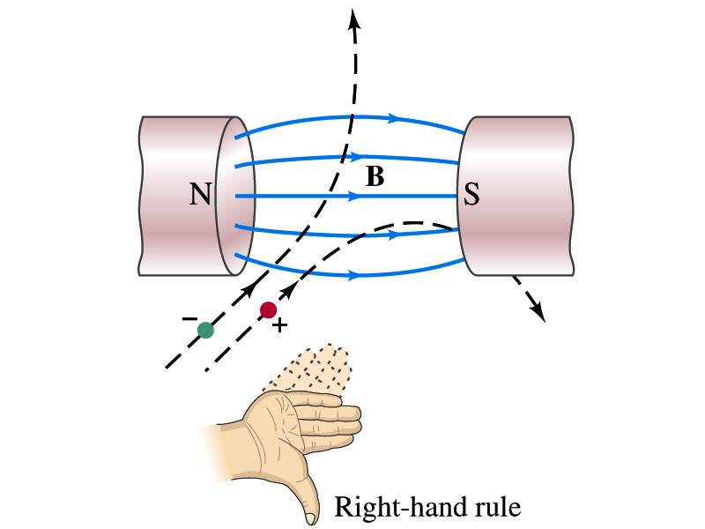
Magnetic Forces on a Moving Charge
This can be an alternative way of defining the magnetic field.
  How?
  The magnitude of the force on a particle with charge q moving with a velocity v in the field is
    What is θ?
      The angle between the magnetic field and the direction of particle’s movement
    When is the force maximum?
      When the angle between the field and the velocity vector is perpendicular.
    ➔
  The direction of the force follows the right-hand-rule and is perpendicular to the direction of the magnetic field

Slide 16
Example 27 – 5
Magnetic force on a proton. A proton having a speed of 5x10⁶m/s in a magnetic field feels a force of F=8.0x10⁻¹⁴N toward West when it moves vertically upward. When moving horizontally in a northerly direction, it feels zero force. What is the magnitude and the direction of the magnetic field in this region?
What is the charge of a proton?
What does the fact that the proton does not feel any force in a northerly direction tell you about the magnetic field?
The field is along the north-south direction.
Why?
Because the particle does not feel any magnetic force when it is moving along the direction of the field.
Since the particle feels force toward West, the field should be pointing to ….
North
Using the formula for the magnitude of the field B, we obtain
We can use magnetic field to measure the momentum of a particle. How?

Slide 17
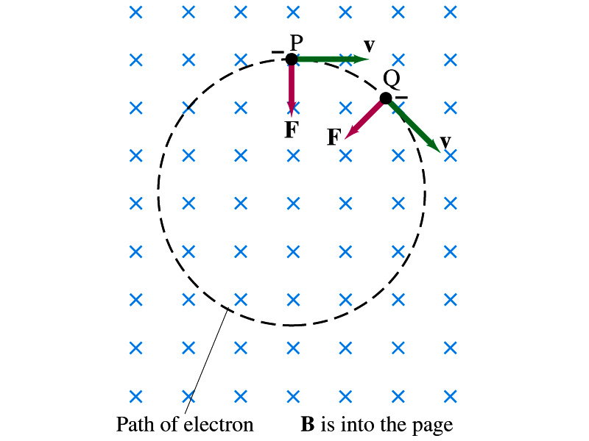
Charged Particle’s Path in Magnetic Field
What shape do you think is the path of a charged particle on a plane perpendicular to a uniform magnetic field?
  Circle!! Why?
  An electron moving to right at the point P in the figure will be pulled downward
  At a later time, the force is still perpendicular to the velocity
  Since the force is always perpendicular to the velocity, the magnitude of the velocity is constant
  The direction of the force follows the right-hand-rule and is perpendicular to the direction of the magnetic field
  Thus, the electron moves on a circular path with a centripetal force F.

Slide 18
Example 27 – 7
Electron’s path in a uniform magnetic field. An electron travels at a speed of 2.0x10⁷m/s in a plane perpendicular to a 0.010-T magnetic field. Describe its path.
What is formula for the centripetal force?
Since the magnetic field is perpendicular to the motion of the electron, the magnitude of the magnetic force is
Since the magnetic force provides the centripetal force, we can establish an equation with the two forces
Solving for r

Slide 19
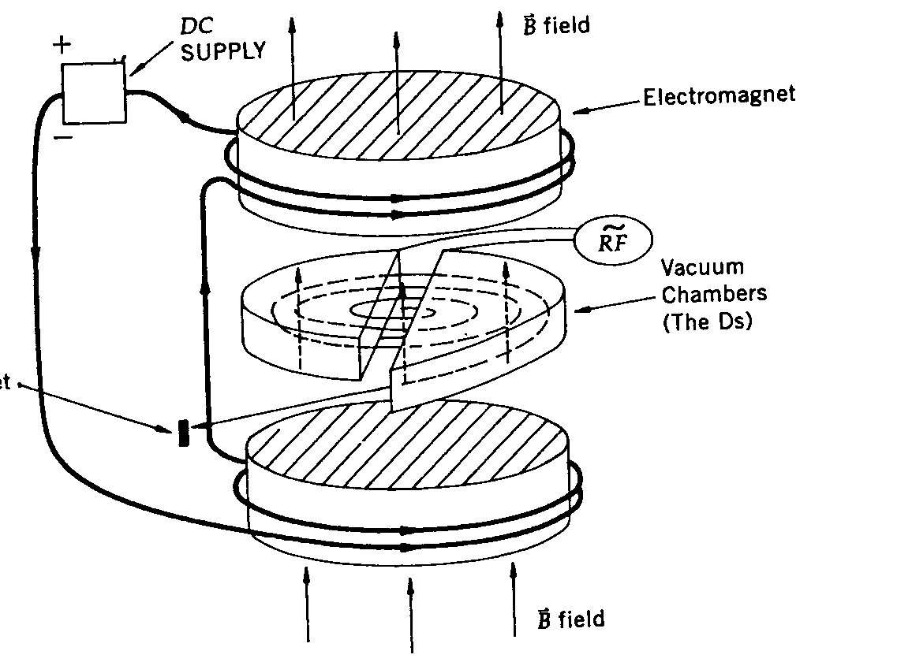
Cyclotron Frequency
The time required for a particle of charge q moving w/ constant speed v to make one circular revolution in a uniform magnetic field, , is
Since T is the period of rotation, the frequency of the rotation is
This is the cyclotron frequency, the frequency of a particle with charge q in a cyclotron accelerator
  While r depends on v, the frequency is independent of v and r.

