Slide 1
PHYS 1444 – Section 003
Lecture #18
Thursday, Nov. 3, 2011
Dr. Jaehoon Yu
Torque on a Current Loop
Magnetic Dipole Moment
Magnetic Dipole Potential Energy
Sources of Magnetic Field
Magnetic Field Due to Straight Wire
Forces Between Two Parallel Wires
Ampére’s Law and Its Verification

Slide 2
Announcements
Quiz #3
  Beginning of the class coming Tuesday, Nov. 8
  Covers: CH26.5 through what we finish Today (CH28.4?)!
Reading Assignments
  CH 27.6 – 27.9
Bring your special project at the end of the class!

Slide 3
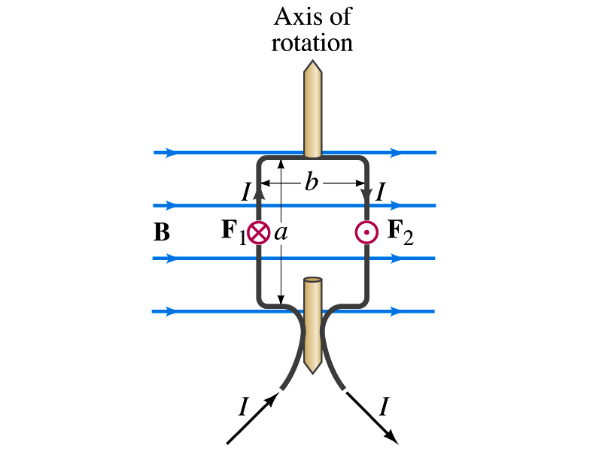
Torque on a Current Loop
What do you think will happen to a closed rectangular loop of wire with electric current as shown in the figure?
  It will rotate! Why?
  The magnetic field exerts a force on both vertical sections of wire.
  Where is this principle used in?
    Ammeters, motors, volt-meters, speedometers, etc
The two forces on the different sections of the wire exerts net torque to the same direction about the rotational axis along the symmetry axis of the wire.
What happens when the wire turns 90 degrees?
  It will not turn unless the direction of the current changes

Slide 4
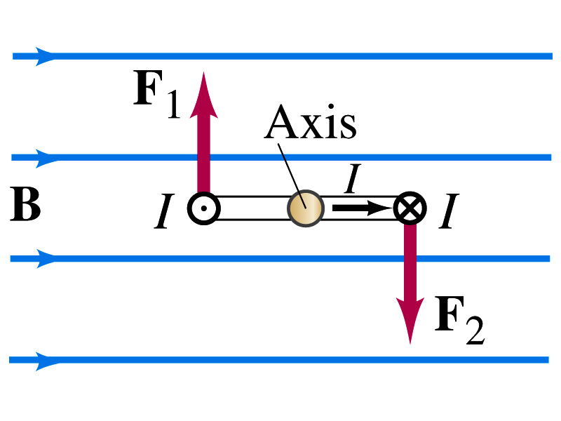
Torque on a Current Loop
So what would be the magnitude of this torque?
  What is the magnitude of the force on the section of the wire with length a?
    F_{a}=IaB
    The moment arm of the coil is b/2
  So the total torque is the sum of the torques by each of the forces
    Where A=ab is the area of the coil loop
  What is the total net torque if the coil consists of N loops of wire?
  If the coil makes an angle θ w/ the field

Slide 5
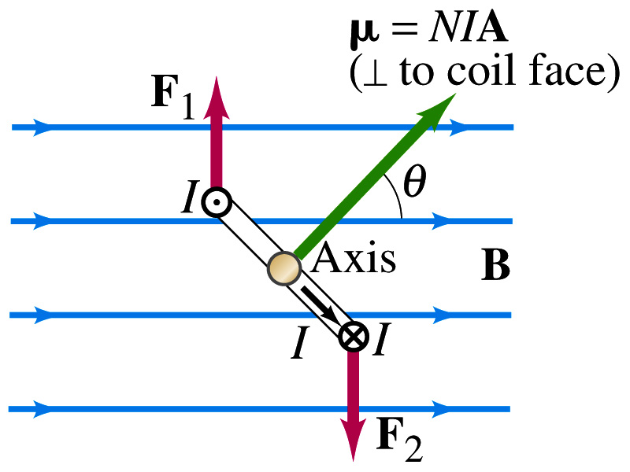
Magnetic Dipole Moment
The formula derived in the previous page for a rectangular coil is valid for any shape of the coil
The quantity NIA is called the magnetic dipole moment of the coil
  It is considered a vector
    Its direction is the same as that of the area vector A and is perpendicular to the plane of the coil consistent with the right-hand rule
      Your thumb points to the direction of the magnetic moment when your finer cups around the loop in the direction of the wire
  Using the definition of magnetic moment, the torque can be written in vector form

Slide 6
Magnetic Dipole Potential Energy
Where else did you see the same form of the torque?
  Remember the torque due to electric field on an electric dipole?
  The potential energy of the electric dipole is
How about the potential energy of a magnetic dipole?
  The work done by the torque is
  If we chose U=0 at θ=π/2, then C=0
  Thus the potential energy is
    Very similar to the electric dipole

Slide 7
Example 27 – 12
Magnetic moment of a hydrogen atom. Determine the magnetic dipole moment of the electron orbiting the proton of a hydrogen atom, assuming (in the Bohr model) it is in its ground state with a circular orbit of radius 0.529x10⁻¹⁰m.
What provides the centripetal force?
The Coulomb force
So we can obtain the speed of the electron from
Solving for v
Since the electric current is the charge that passes through the given point per unit time, we can obtain the current
Since the area of the orbit is A=πr², we obtain the hydrogen magnetic moment

Slide 8
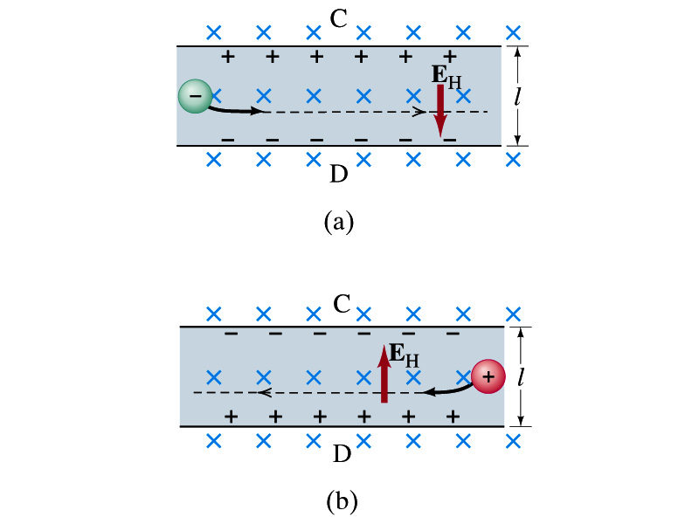
The Hall Effect
What do you think will happen to the electrons flowing through a conductor immersed in a magnetic field?
  Magnetic force will push the electrons toward one side of the conductor. Then what happens?
  A potential difference will be created due to continued accumulation of electrons on one side. Till when? Forever?
  Nope. Till the electric force inside the conductor is equal and opposite to the magnetic force
This is called the Hall Effect
  The potential difference produced is called
    The Hall emf
  The electric field due to the separation of charge is called the Hall field, E_{H}, and it points to the direction opposite to the magnetic force

Slide 9
The Hall Effect
In equilibrium, the force due to Hall field is balanced by the magnetic force ev_{d}B, so we obtain
and
The Hall emf is then
  Where l is the width of the conductor
What do we use the Hall effect for?
  The current of negative charge moving to right is equivalent to the positive charge moving to the left
  The Hall effect can distinguish these since the direction of the Hall field or direction of the Hall emf is opposite
  Since the magnitude of the Hall emf is proportional to the magnetic field strength ➔ can measure the B-field strength
    Hall probe

Slide 10
Sources of Magnetic Field
We have learned so far about the effects of magnetic field on electric currents and moving charge
We will now learn about the dynamics of magnetism
  How do we determine magnetic field strengths in certain situations?
  How do two wires with electric current interact?
  What is the general approach to finding the connection between current and magnetic field?

Slide 11
Magnetic Field due to a Straight Wire
The magnetic field due to the current flowing through a straight wire forms a circular pattern around the wire
  What do you imagine the strength of the field is as a function of the distance from the wire?
    It must be weaker as the distance increases
  How about as a function of current?
    Directly proportional to the current
  Indeed, the above are experimentally verified
    This is valid as long as r << the length of the wire
  The proportionality constant is μ₀/2π, thus the field strength becomes
  μ₀ is the permeability of free space

Slide 12
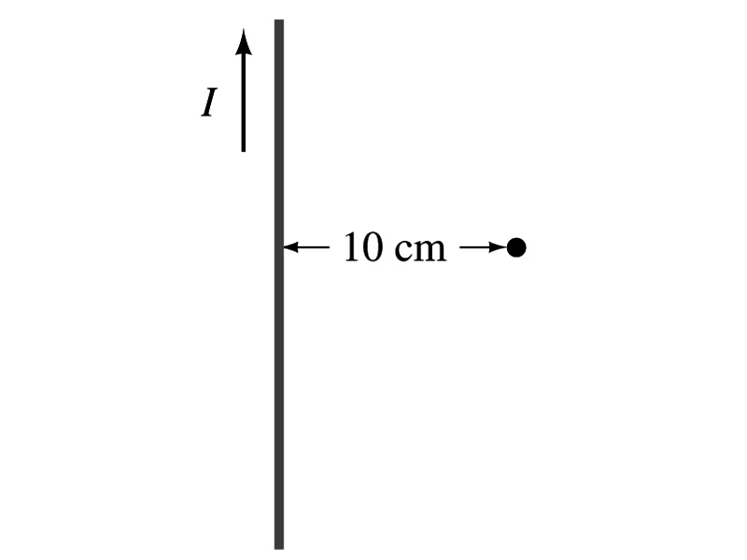
Example 28 – 1
Calculation of B near wire. A vertical electric wire in the wall of a building carries a dc current of 25A upward. What is the magnetic field at a point 10cm due north of this wire?
Using the formula for the magnetic field near a straight wire
So we can obtain the magnetic field at 10cm away as

Slide 13
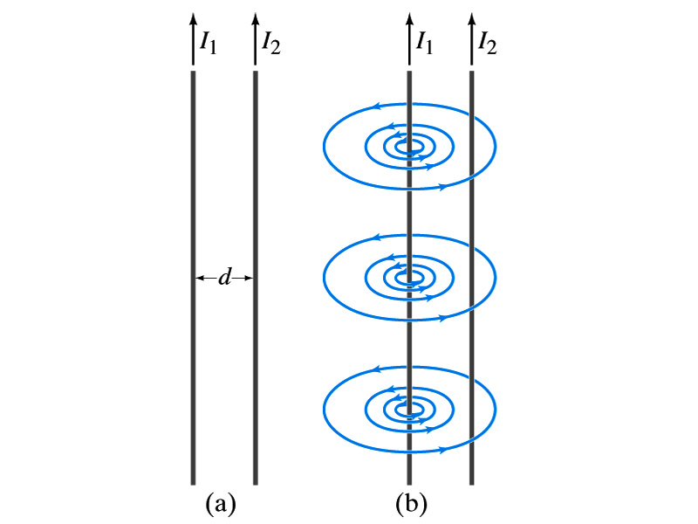
Force Between Two Parallel Wires
We have learned that a wire carrying the electric current produces magnetic field
Now what do you think will happen if we place two current carrying wires next to each other?
  They will exert force onto each other. Repel or attract?
  Depending on the direction of the currents
This was first pointed out by Ampére.
Let’s consider two long parallel conductors separated by a distance d, carrying currents I₁ and I₂.
At the location of the second conductor, the magnitude of the magnetic field produced by I₁ is

Slide 14
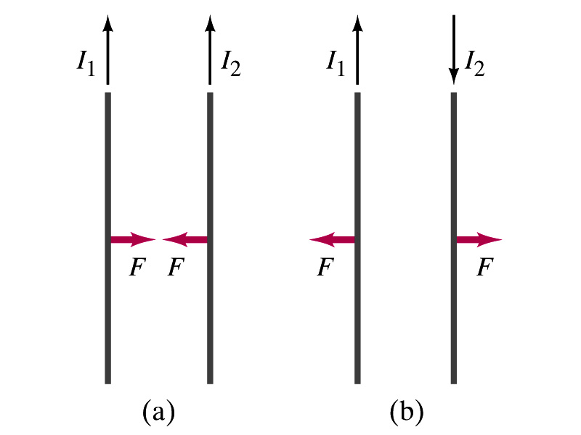
Force Between Two Parallel Wires
The force F by a magnetic field B₁ on a wire of length l, carrying the current I₂ when the field and the current are perpendicular to each other is:
  So the force per unit length is
  This force is only due to the magnetic field generated by the wire carrying the current I₁
    There is the force exerted on the wire carrying the current I₁ by the wire carrying current I₂ of the same magnitude but in opposite direction
So the force per unit length is
How about the direction of the force?
If the currents are in the same direction, the attractive force. If opposite, repulsive.

Slide 15
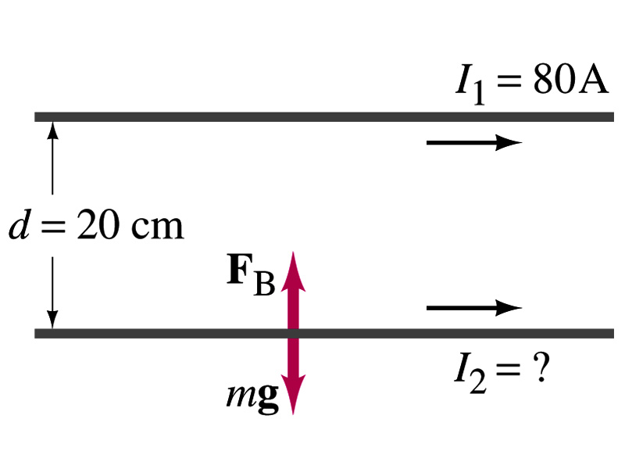
Example 28 – 5
Suspending a wire with current. A horizontal wire carries a current I₁=80A DC. A second parallel wire 20cm below it must carry how much current I₂ so that it doesn’t fall due to the gravity? The lower has a mass of 0.12g per meter of length.
Which direction is the gravitational force?
Down to the center of the Earth
This force must be balanced by the magnetic force exerted on the wire by the first wire.
Solving for I₂

Slide 16
Operational Definition of Ampere and Coulomb
The permeability of free space is defined to be exactly
The unit of current, ampere, is defined using the definition of the force between two wires each carrying 1A of current and separated by 1m
  So 1A is defined as: the current flowing each of two long parallel conductors 1m apart, which results in a force of exactly 2x10⁻⁷N/m.
Coulomb is then defined as exactly 1C=1A s.
We do it this way since the electric current is measured more accurately and controlled more easily than charge.

