Slide 1
PHYS 1444 – Section 003 Lecture #19
Tuesday, Nov. 8, 2011
Dr. Jaehoon Yu
Ampére’s Law and Its Verification
Solenoid and Toroidal Magnetic Field
Biot-Savart Law
Magnetic Materials
B in Magnetic Materials
Hysteresis
Today’s homework is #10, due 10pm, Tuesday, Nov. 15!!

Slide 2
Announcements
Term exam #2
Date and time: 12:30 – 2:00pm, Tuesday, Nov. 22
Location: SH103
Coverage: Ch. 26 – 3 to what we finish Tuesday, Nov. 15
A review session on Thursday, Nov. 17, in SH103
150 problem pack will be prepared and distributed coming Thursday, Nov. 10
Please do NOT miss the exam!!
Colloquium this week
Dr. R. McCroy from U. of Colorado

Slide 3
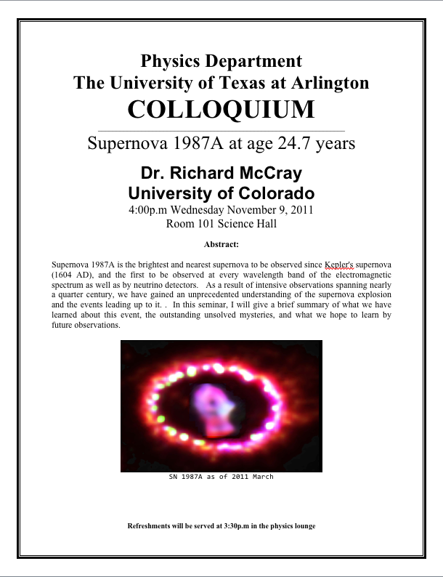

Slide 4
Operational Definition of Ampere and Coulomb
The permeability of free space is defined to be exactly
The unit of current, ampere, is defined using the definition of the force between two wires each carrying 1A of current and separated by 1m
So 1A is defined as: the current flowing each of two long parallel conductors 1m apart, which results in a force of exactly 2x10⁻⁷N/m.
Coulomb is then defined as exactly 1C=1A s.
We do it this way since the electric current is measured more accurately and controlled more easily than the charge.

Slide 5
Ampére’s Law
What is the relationship between the magnetic field strength and the current?
Does this work in all cases?
Nope!
OK, then when?
Only valid for a long straight wire
Then what would be the more generalized relationship between the current and the magnetic field for any shape of the wire?
French scientist André Marie Ampére proposed such a relationship soon after Oersted’s discovery

Slide 6
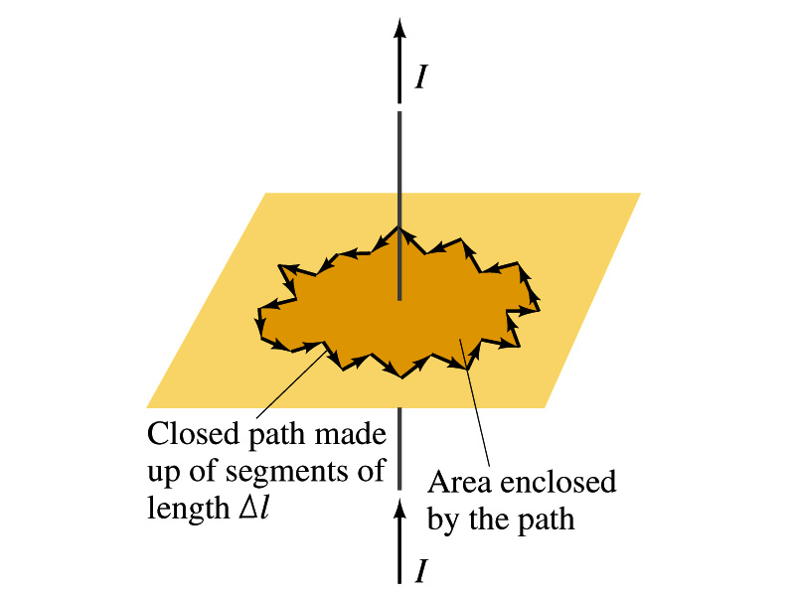
Ampére’s Law
Let’s consider an arbitrary closed path around the current as shown in the figure.
Let’s split this path with small segments each of Δl long.
The sum of all the products of the length of each segment and the component of B parallel to that segment is equal to μ₀ times the net current I_{encl} that passes through the surface enclosed by the path
In the limit Δl →0, this relation becomes
Ampére’s Law
Looks very similar to a law in the electricity. Which law is it?
Gauss’ Law

Slide 7
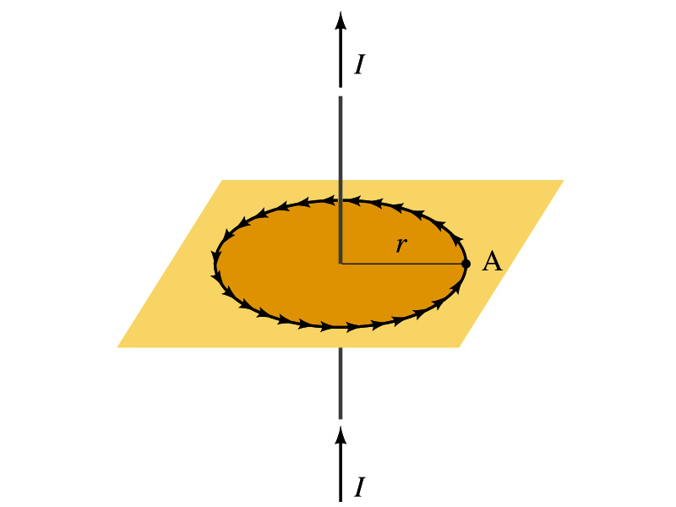
Verification of Ampére’s Law
Let’s find the magnitude of B at a distance r away from a long straight wire w/ current I
This is a verification of Ampere’s Law
We can apply Ampere’s law to a circular path of radius r.
Solving for B
We just verified that Ampere’s law works in a simple case
Experiments verified that it works for other cases too
The importance, however, is that it provides means to relate magnetic field to current

Slide 8
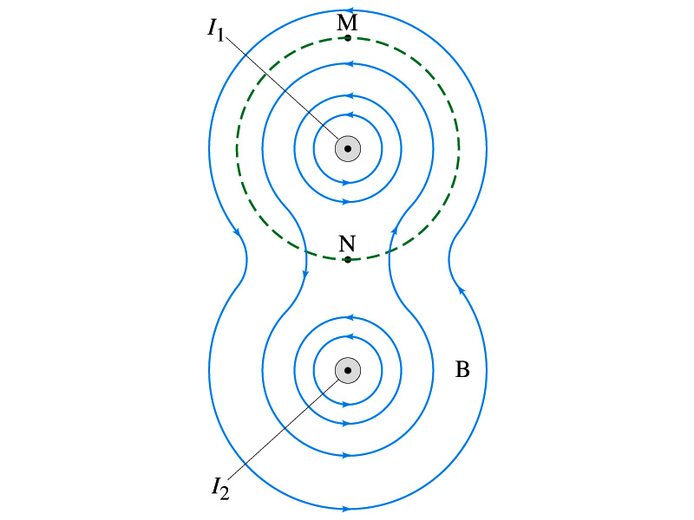
Verification of Ampére’s Law
Since Ampere’s law is valid in general, B in Ampere’s law is not just due to the current I_{encl}.
B is the field at each point in space along the chosen path due to all sources
Including the current I enclosed by the path but also due to any other sources
How do you obtain B in the figure at any point?
Vector sum of the field by the two currents
The result of the closed path integral in Ampere’s law for green dashed path is still μ₀I₁. Why?
While B in each point along the path varies, the integral over the closed path still comes out the same whether there is the second wire or not.

Slide 9
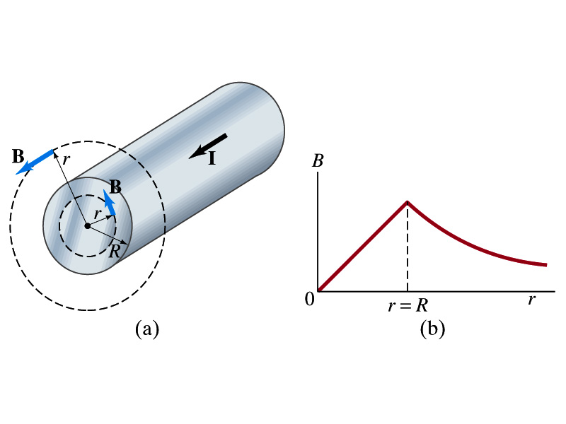
Example 28 – 6
Field inside and outside a wire. A long straight cylindrical wire conductor of radius R carries current I of uniform density in the conductor. Determine the magnetic field at (a) points outside the conductor (r>R) and (b) points inside the conductor (r<R). Assume that r, the radial distance from the axis, is much less than the length of the wire. (c) If R=2.0mm and I=60A, what is B at r=1.0mm, r=2.0mm and r=3.0mm?
Since the wire is long, straight and symmetric, the field should be the same at any point the same distance from the center of the wire.
Since B must be tangential to circles around the wire, let’s choose a circular path of the closed-path integral outside the wire (r>R). What is I_{encl}?
So using Ampere’s law
Solving for B

Slide 10
Example 28 – 6 cont’d
For r<R, the current inside the closed path is less than I. How much is it?
So using Ampere’s law
Solving for B
What does this mean?
The field is 0 at r=0 and increases linearly as a function of the distance from the center of the wire up to r=R then decreases as 1/r beyond the radius of the conductor.

Slide 11
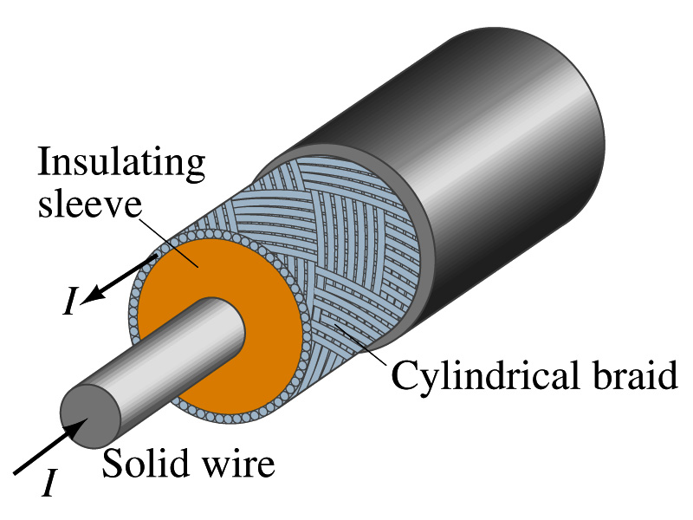
Example 28 – 7
Coaxial cable. A coaxial cable is a single wire surrounded by a cylindrical metallic braid, as shown in the figure. The two conductors are separated by an insulator. The central wire carries current to the other end of the cable, and the outer braid carries the return current and is usually considered ground. Describe the magnetic field (a) in the space between the conductors and (b) outside the cable.
(a) The magnetic field between the conductors is the same as the long, straight wire case since the current in the outer conductor does not impact the enclosed current.
(b) Outside the cable, we can draw a similar circular path, since we expect the field to have a circular symmetry. What is the sum of the total current inside the closed path?
So there is no magnetic field outside a coaxial cable. In other words, the coaxial cable self-shields. The outer conductor also shields against an external electric field. Cleaner signal and less noise.

Slide 12
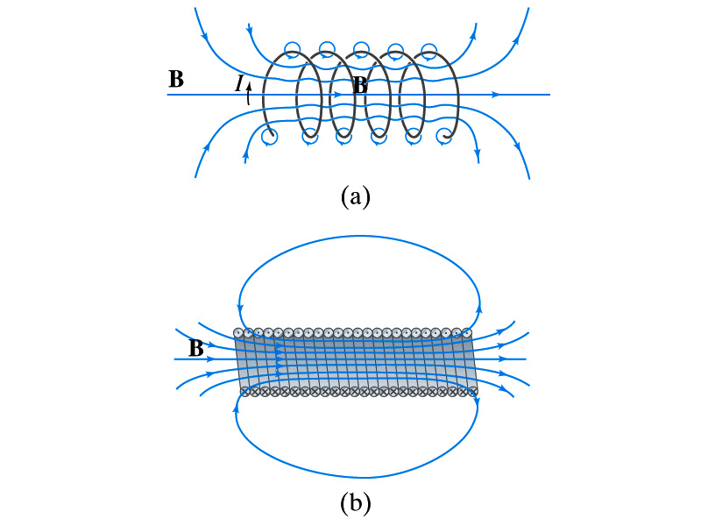
Solenoid and Its Magnetic Field
What is a solenoid?
A long coil of wire consisting of many loops
If the space between loops are wide
The field near the wires are nearly circular
Between any two wires, the fields due to each loop cancel
Toward the center of the solenoid, the fields add up to give a field that can be fairly large and uniform
For a long, densely packed loops
The field is nearly uniform and parallel to the solenoid axes within the entire cross section
The field outside the solenoid is very small compared to the field inside, except the ends
The same number of field lines spread out to an open space
Solenoid Axis

Slide 13
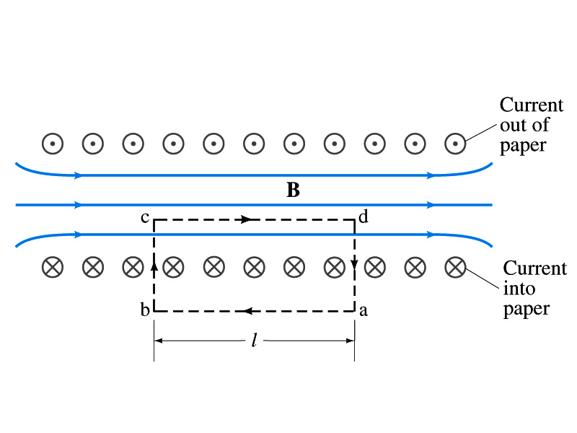
Solenoid Magnetic Field
Now let’s use Ampere’s law to determine the magnetic field inside a very long, densely packed solenoid
Let’s choose the path abcd, far away from the ends
We can consider four segments of the loop for integral
The field outside the solenoid is negligible. So the integral on a→b is 0.
Now the field B is perpendicular to the bc and da segments. So these integrals become 0, also.

Slide 14
Solenoid Magnetic Field
So the sum becomes:
If the current I flows in the wire of the solenoid, the total current enclosed by the closed path is NI
Where N is the number of loops (or turns of the coil) enclosed
Thus Ampere’s law gives us
If we let n=N/l be the number of loops per unit length, the magnitude of the magnetic field within the solenoid becomes
B depends on the number of loops per unit length, n, and the current I
Does not depend on the position within the solenoid but uniform inside it, like a bar magnet

Slide 15
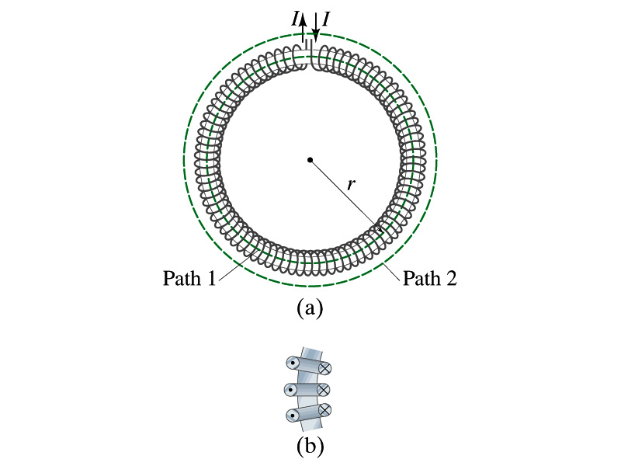
Example 28 – 10
Toroid. Use Ampere’s law to determine the magnetic field (a) inside and (b) outside a toroid, which is like a solenoid bent into the shape of a circle.
(a) How do you think the magnetic field lines inside the toroid look?
Since it is a bent solenoid, it should be a circle concentric with the toroid.
If we choose path of integration one of these field lines of radius r inside the toroid, path 1, to use the symmetry of the situation, making B the same at all points on the path, we obtain from Ampere’s law
Solving for B
So the magnetic field inside a toroid is not uniform. It is larger on the inner edge. However, the field will be uniform if the radius is large and the toroid is thin. The filed in this case is B = μ₀nI.
(b) Outside the solenoid, the field is 0 since the net enclosed current is 0.

