Slide 1
PHYS 1444 – Section 003 Lecture #20
Thursday, Nov. 10, 2011
Dr. Jaehoon Yu
CH28
Biot-Savart Law
Magnetic Materials
B in Magnetic Materials
Hysteresis
CH29
Induced EMF and Electromagnetic Induction
Faraday’s Law of Induction
Magnetic Flux
Lenz’s Law

Slide 2
Announcements
Term exam #2
Date and time: 12:30 – 2:00pm, Tuesday, Nov. 22
Location: SH103
Coverage: Ch. 26 – 3 to what we finish Tuesday, Nov. 15
A review session on Thursday, Nov. 17, in SH103
Please do NOT miss the exam!!
Reading assignments
CH28 – 8, 9 and 10

Slide 3
Special Project #6
B due to current I in a straight wire. For the field near a long straight wire carrying a current I, show that
the Ampere’s law gives the same result as the simple long straight wire, B=μ₀I/2πR. (10 points)
That Biot-Savarat law gives the same result as the simple long straight wire, B=μ₀I/2πR. (10 points)
Must be your OWN work. No credit will be given for for copying straight out of the book or from your friend’s work.
Due is at the beginning of the exam on Tuesday, Nov. 22.

Slide 4
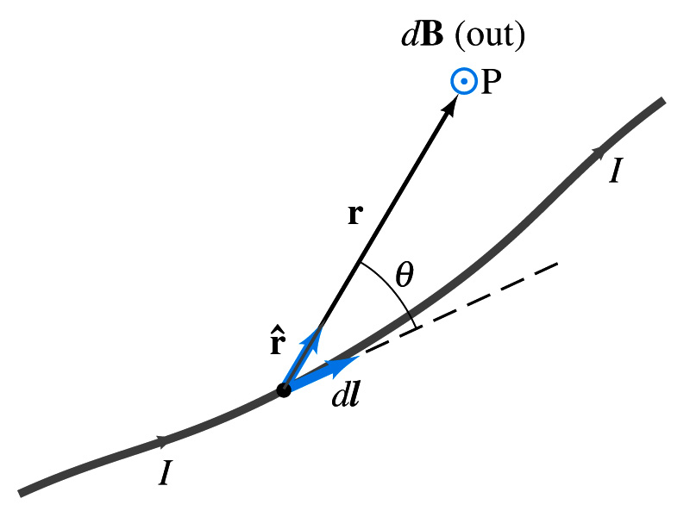
Biot-Savart Law
Ampere’s law is useful in determining magnetic field utilizing symmetry
But sometimes it is useful to have another method of using infinitesimal current segments for B field
Jean Baptiste Biot and Feilx Savart developed a law that a current I flowing in any path can be considered as many infinitesimal current elements
The infinitesimal magnetic field dB caused by the infinitesimal length dl that carries current I is
r is the displacement vector from the element dl to the point P
Biot-Savart law is the magnetic equivalent to Coulomb’s law
Biot-Savart Law
B field in Biot-Savart law is only that by the current, nothing else.

Slide 5
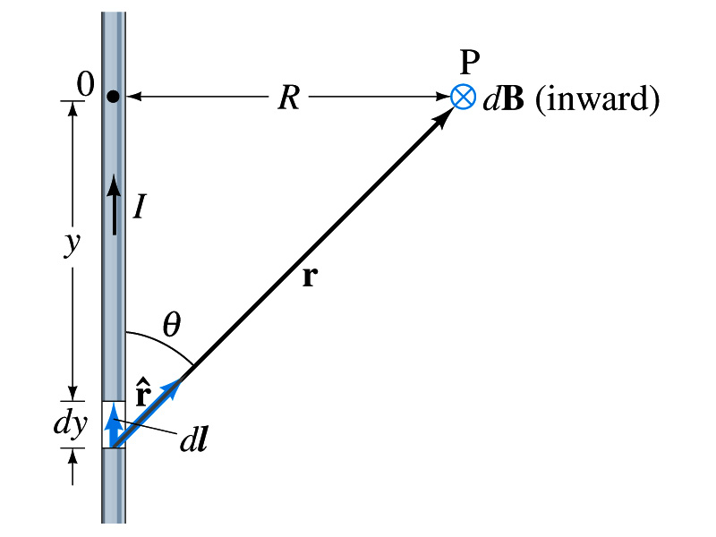
Example 28 – 11
B due to current I in a straight wire. For the field near a long straight wire carrying a current I, show that the Biot-Savarat law gives the same result as the simple long straight wire, B=μ₀I/2πR.
What is the direction of the field B at point P?
Going into the page.
All dB at point P has the same direction based on right-hand rule.
The magnitude of B using Biot-Savart law is
Where dy=dl and r²=R²+y² and since we obtain
Integral becomes
The same as the simple, long straight wire!! It works!!

Slide 6
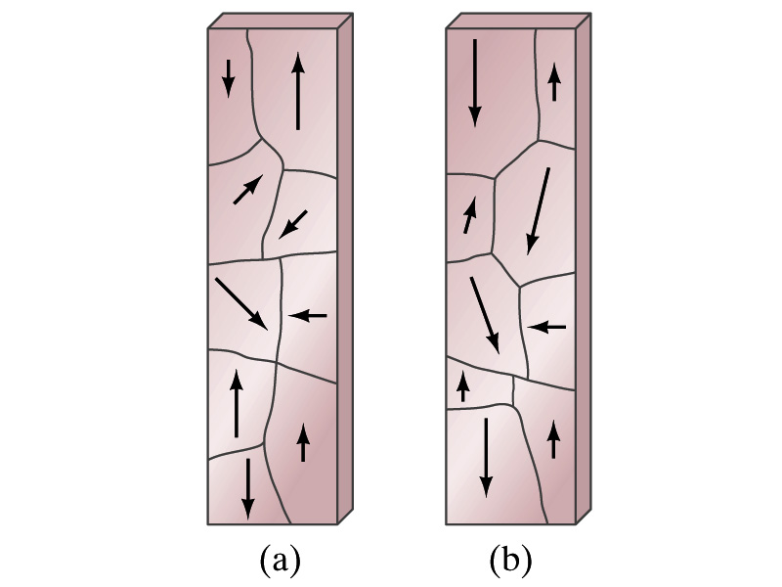
Magnetic Materials - Ferromagnetism
Iron is a material that can turn into a strong magnet
This kind of material is called ferromagnetic material
In microscopic sense, ferromagnetic materials consist of many tiny regions called domains
Domains are like little magnets usually smaller than 1mm in length or width
What do you think the alignment of domains are like when they are not magnetized?
Randomly arranged
What if they are magnetized?
The size of the domains aligned with the external magnetic field direction grows while those of the domains not aligned reduce
This gives magnetization to the material
How do we demagnetize a bar magnet?
Hit the magnet hard or heat it over the Curie temperature

Slide 7
B in Magnetic Materials
What is the magnetic field inside a solenoid?
Magnetic field in a long solenoid is directly proportional to the current.
This is valid only if air is inside the coil
What do you think will happen to B if we have something other than the air inside the solenoid?
It will be increased dramatically, when the current flows
Especially if a ferromagnetic material such as an iron is put inside, the field could increase by several orders of magnitude
Why?
Since the domains in the iron aligns permanently by the external field.
The resulting magnetic field is the sum of that due to current and due to the iron

Slide 8
B in Magnetic Materials
It is sometimes convenient to write the total field as the sum of two terms
B₀ is the field due only to the current in the wire, namely the external field
The field that would be present without a ferromagnetic material
B_{M} is the additional field due to the ferromagnetic material itself; often B_{M}>>B₀
The total field in this case can be written by replacing μ₀ with another proportionality constant μ, the magnetic permeability of the material
μ is a property of a magnetic material
μ is not a constant but varies with the external field

Slide 9
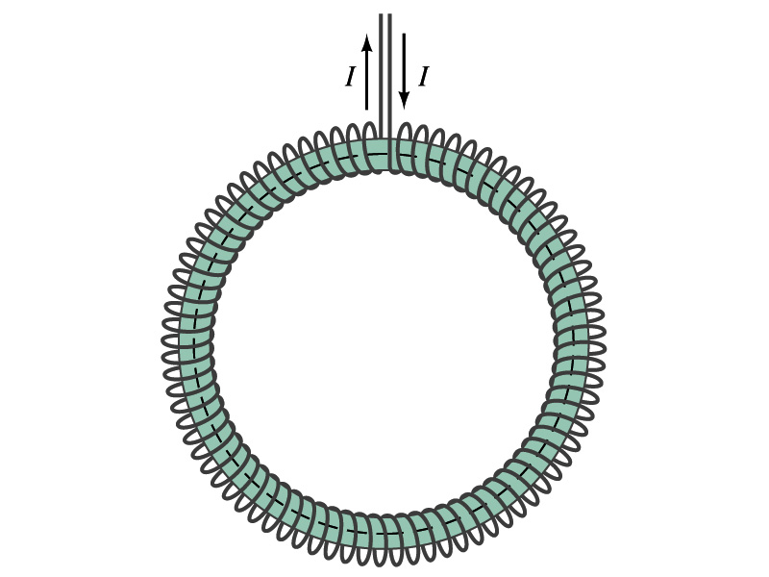
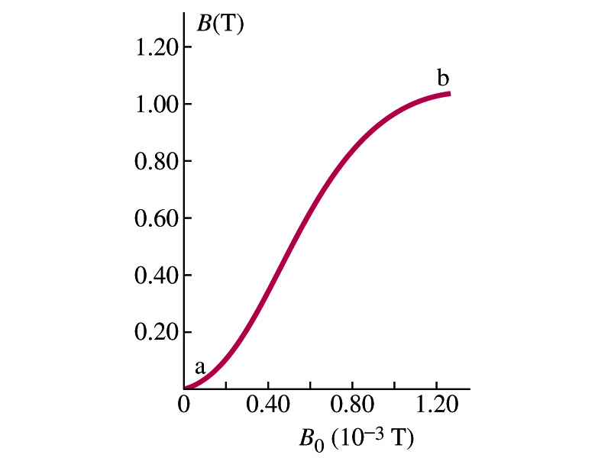
Hysteresis
Iron Core Toroid
What is a toroid?
A solenoid bent into a shape
Toroid can be used for magnetic field measurement
Why?
Since it does not leak magnetic field outside of itself, it fully contains all the magnetic field created within it.
Consider an un-magnetized iron core toroid, without any current flowing in the wire
What do you think will happen if the current slowly increases?
B₀ increases linearly with the current.
And B increases also but follows the curved line shown in the graph
As B₀ increases, the domains become more aligned until nearly all are aligned (point b on the graph)
The iron is said to be approaching saturation
Point b is typically at 70% of the max

Slide 10
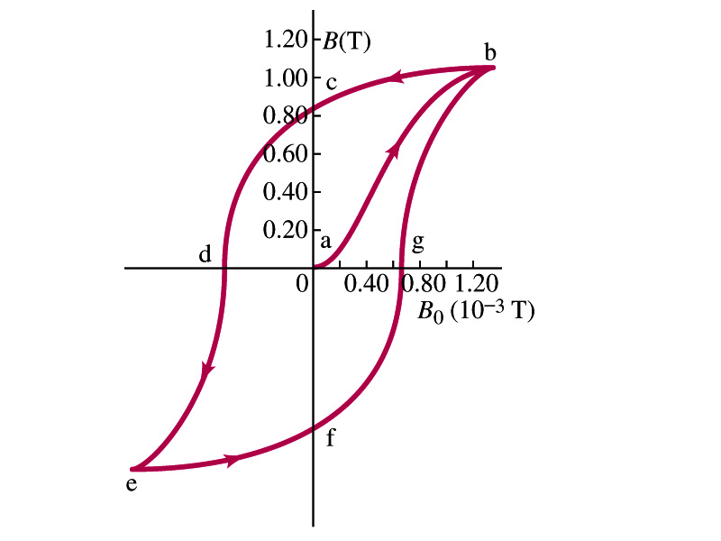
Hysteresis
What do you think will happen to B if the external field B₀ is reduced to 0 by decreasing the current in the coil?
Of course it goes to 0!!
Wrong! Wrong! Wrong! They do not go to 0. Why not?
The domains do not completely return to random alignment state
Now if the current direction is reversed, the external magnetic field direction is reversed, causing the total field B pass 0, and the direction reverses to the opposite side
If the current is reversed again, the total field B will increase but never goes through the origin
This kind of curve whose path does not retrace themselves and does not go through the origin is called the Hysteresis.

Slide 11
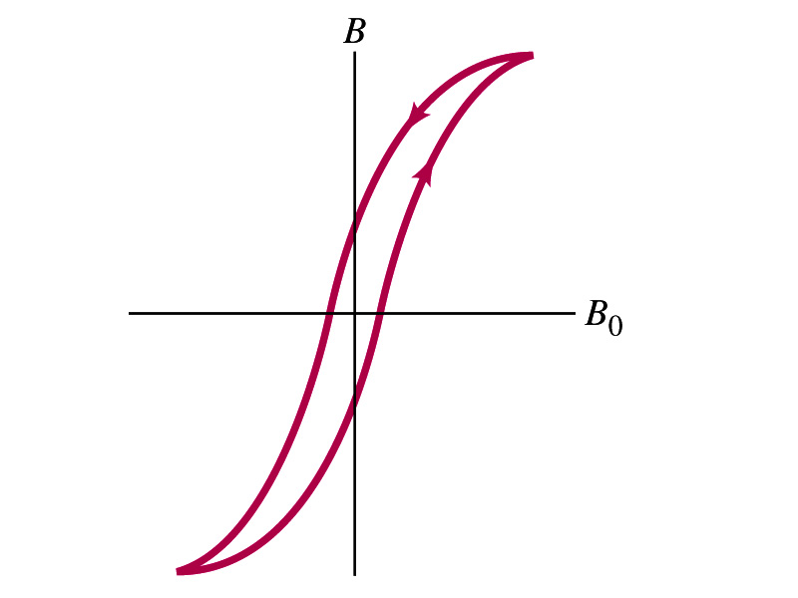
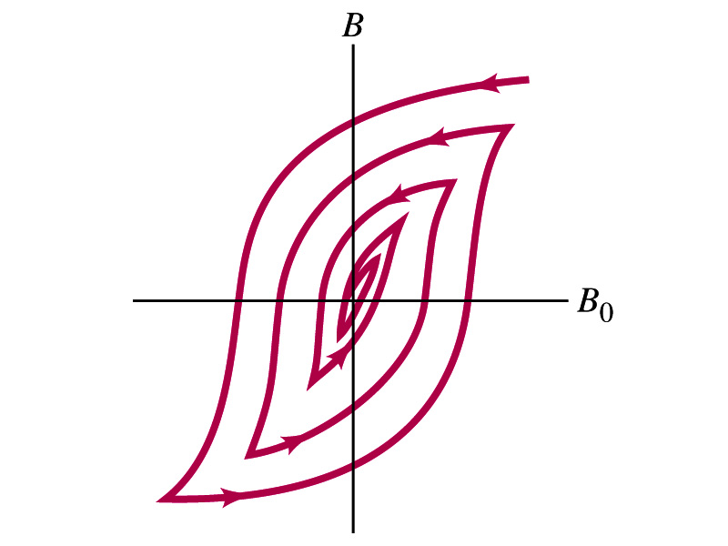
Magnetically Soft Material
In a hysteresis cycle, much energy is transformed to thermal energy. Why?
Due to the microscopic friction between domains as they change directions to align with the external field
The energy dissipated in the hysteresis cycle is proportional to the area of the hysteresis loop
Ferromagnetic material with large hysteresis area is called magnetically hard while the small ones are called soft
Which one do you think are preferred in electromagnets or transformers?
Soft. Why?
Since the energy loss is small and much easier to switch off the field
Then how do we demagnetize a ferromagnetic material?
Keep repeating the Hysteresis loop, reducing the range of B₀.

Slide 12
Induced EMF
It has been discovered by Oersted and company in early 19th century that
Magnetic field can be produced by the electric current
Magnetic field can exert force on the electric charge
So if you were scientists at that time, what would you wonder?
Yes, you are absolutely right! You would wonder if the magnetic field can create the electric current.
An American scientist Joseph Henry and an English scientist Michael Faraday independently found that it was possible
Though, Faraday was given the credit since he published his work before Henry did
He also did a lot of detailed studies on magnetic induction

Slide 13
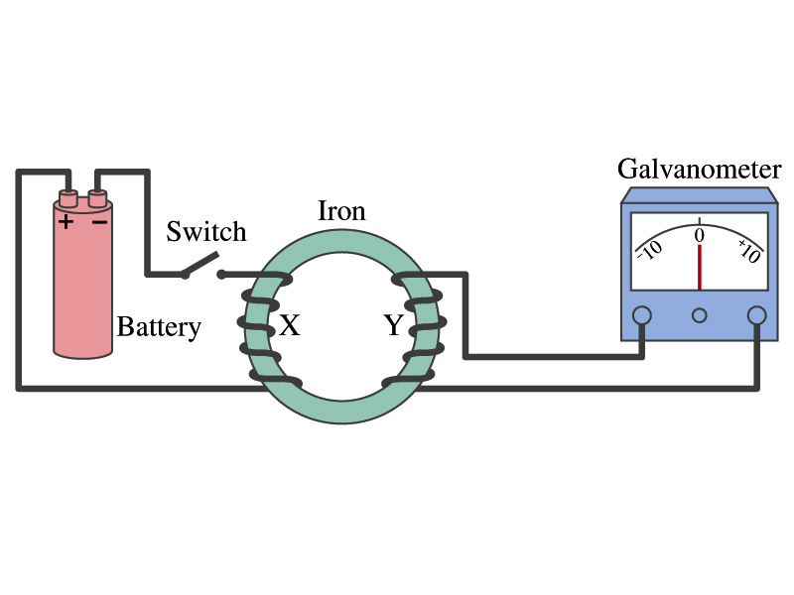
Electromagnetic Induction
Faraday used an apparatus below to show that magnetic field can induce current
Despite his hope he did not see steady current induced on the other side when the switch is thrown
But he did see that the needle on the Galvanometer turns strongly when the switch is initially thrown and is opened
When the magnetic field through coil Y changes, a current flows as if there were a source of emf
Thus he concluded that an induced emf is produced by a changing magnetic field ➔ Electromagnetic Induction

Slide 14
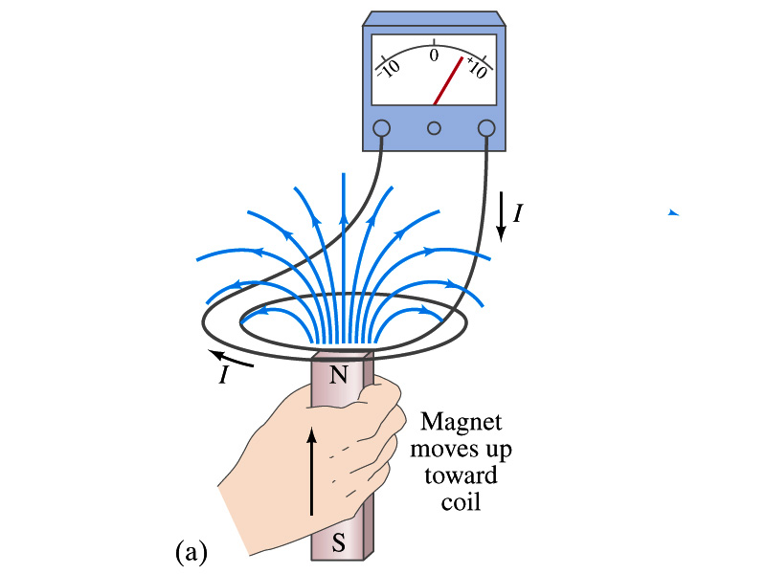
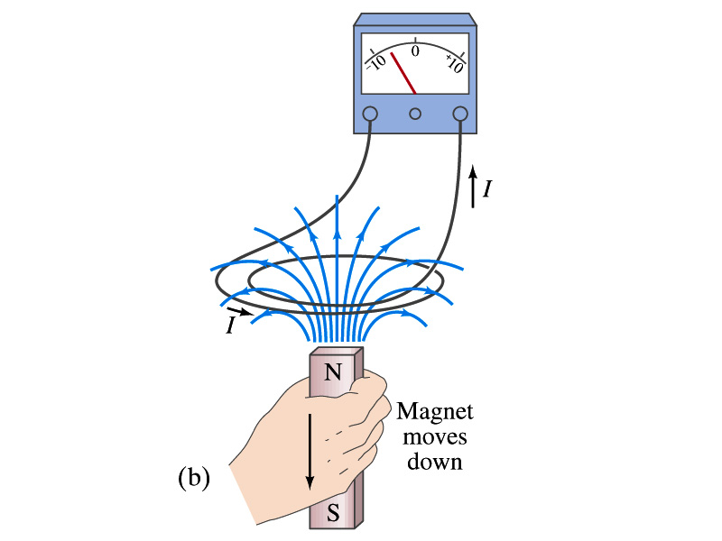
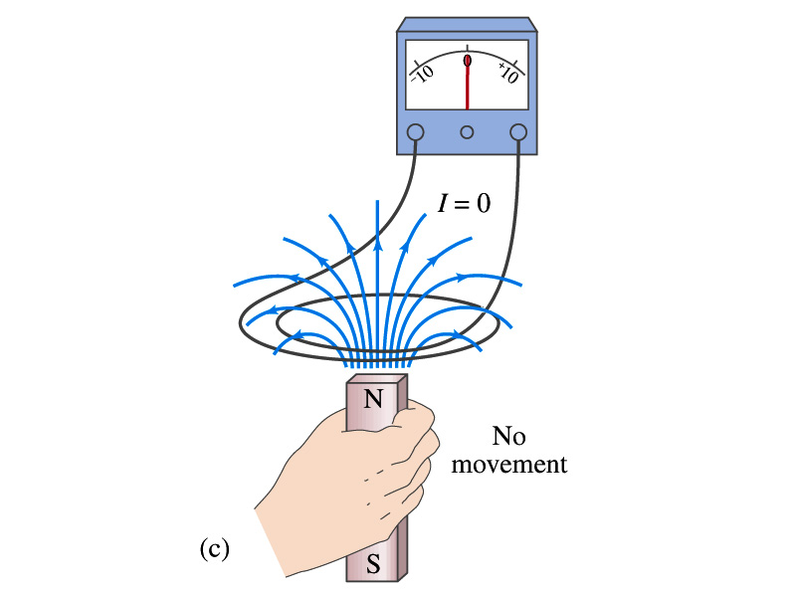
Electromagnetic Induction
Further studies on electromagnetic induction taught
If a magnet is moved quickly into a coil of wire, a current is induced in the wire.
If a magnet is removed from the coil, a current is induced in the wire in the opposite direction
By the same token, the current can also be induced if the magnet stays put but the coil moves toward or away from the magnet
Current is also induced if the coil rotates.
In other words, it does not matter whether the magnet or the coil moves. It is the relative motion that counts.

Slide 15
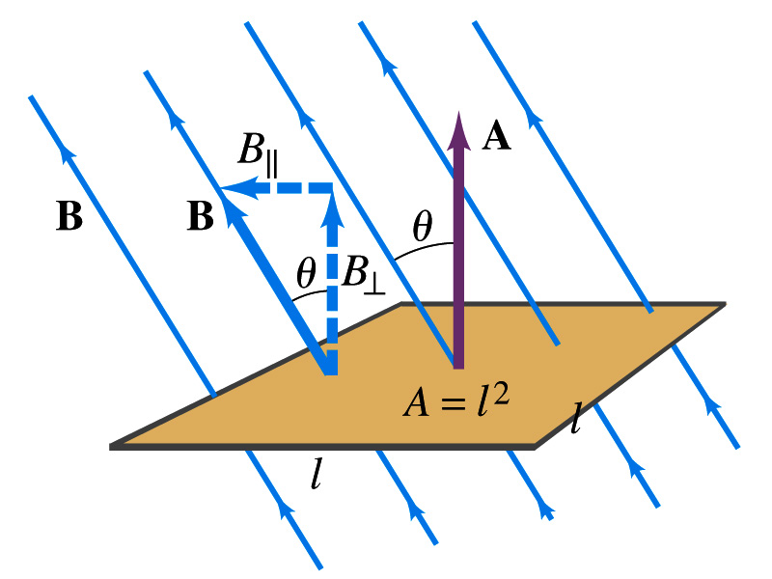
Magnetic Flux
So what do you think is the induced emf proportional to?
The rate of changes of the magnetic field?
the higher the changes the higher the induction
Not really, it rather depends on the rate of change of the magnetic flux, Φ_{B}.
Magnetic flux is defined as (just like the electric flux)
θ is the angle between B and the area vector A whose direction is perpendicular to the face of the loop based on the right-hand rule
What kind of quantity is the magnetic flux?
Scalar. Unit?
or weber
If the area of the loop is not simple or B is not uniform, the magnetic flux can be written as

Slide 16
Faraday’s Law of Induction
In terms of magnetic flux, we can formulate Faraday’s findings
The emf induced in a circuit is equal to the rate of change of magnetic flux through the circuit
If the circuit contains N closely wrapped loops, the total induced emf is the sum of emf induced in each loop
Why negative?
Has got a lot to do with the direction of induced emf…
Faraday’s Law of Induction

Slide 17
Lenz’s Law
It is experimentally found that
An induced emf gives rise to a current whose magnetic field opposes the original change in flux ➔ This is known as Lenz’s Law
In other words, an induced emf is always in a direction that opposes the original change in flux that caused it.
We can use Lenz’s law to explain the following cases in the figures
When the magnet is moving into the coil
Since the external flux increases, the field inside the coil takes the opposite direction to minimize the change and causes the current to flow clockwise
When the magnet is moving out
Since the external flux decreases, the field inside the coil takes the opposite direction to compensate the loss, causing the current to flow counter-clockwise
Which law is Lenz’s law result of?
Energy conservation. Why?

Slide 18
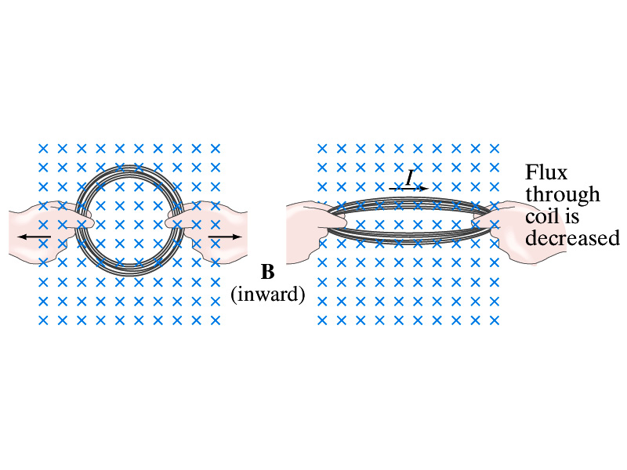
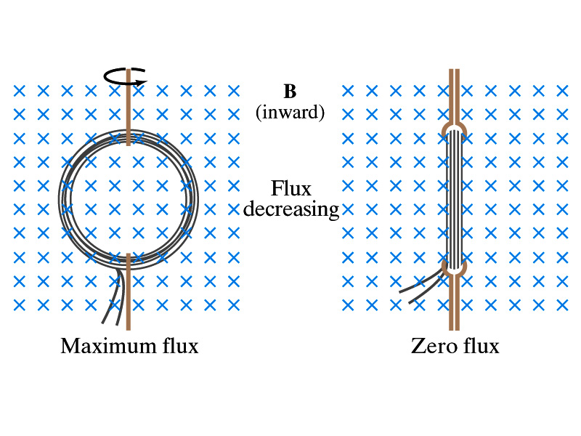
Induction of EMF
How can we induce emf?
Let’s look at the formula for magnetic flux
What do you see? What are the things that can change with time to result in change of magnetic flux?
Magnetic field
The area of the loop
The angle θ between the field and the area vector

Slide 19
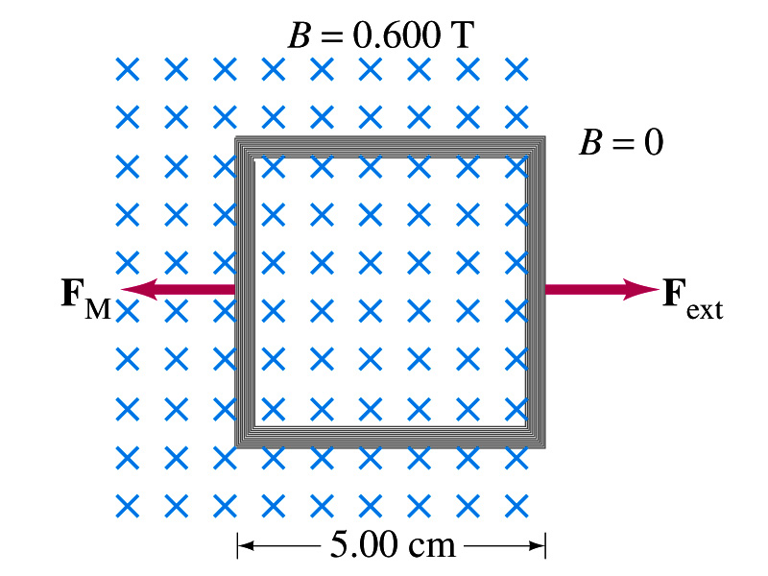
Example 29 – 5
Pulling a coil from a magnetic field. A square coil of wire with side 5.00cm contains 100 loops and is positioned perpendicular to a uniform 0.600-T magnetic field. It is quickly and uniformly pulled from the field (moving perpendicular to B) to a region where B drops abruptly to zero. At t=0, the right edge of the coil is at the edge of the field. It takes 0.100s for the whole coil to reach the field-free
region. Find (a) the rate of change in flux through the coil, (b) the emf and current induced, and (c) how much energy is dissipated in the coil if its resistance is 100Ω. (d) what was the average force required?
What should be computed first?
The initial flux at t=0.
The flux at t=0 is
The change of flux is
Thus the rate of change of the flux is

Slide 20
Example 29 – 5, cnt’d
Thus the total emf induced in this period is
The induced current in this period is
Which direction would the induced current flow?
Clockwise
The total energy dissipated is
Force for each coil is
Force for N coil is

