Slide 1
PHYS 1444 – Section 003
Lecture #21
Tuesday, Nov. 15, 2011
Dr. Jaehoon Yu
Electric Generators
DC Generator
Eddy Currents
Transformer
Generalized Faraday’s Law
Inductance
Today’s homework is #11, due 10pm, Sunday, Nov. 20!!

Slide 2
Announcements
Quiz results
  Class average: 46.5/80
    Equivalent to 58.1/100
    Previous results: 45.6/100 and 65.7/100
  Top score: 80/80
Term exam #2
  Date and time: 12:30 – 2:00pm, Tuesday, Nov. 22
  Location: SH103
  Coverage: CH. 26 – 3 to what we finish today
  A review session on Thursday, Nov. 17, in SH103
  Please do NOT miss the exam!!
Reading assignments
  CH29 – 5 and CH29 – 8
Colloquium this week
  Dr. John Turner

Slide 3
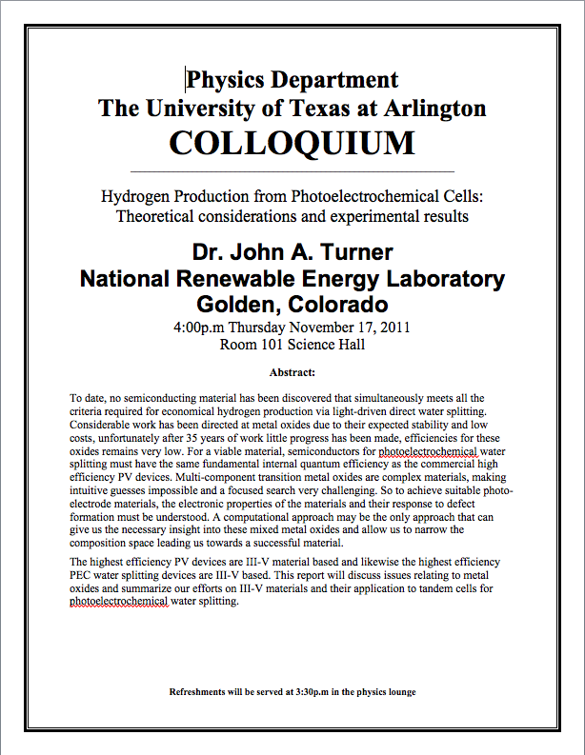

Slide 4
Reminder: Special Project #6
B due to current I in a straight wire. For the field near a long straight wire carrying a current I, show that
the Ampere’s law gives the same result as the simple long straight wire, B=μ₀I/2πR. (10 points)
That Biot-Savarat law gives the same result as the simple long straight wire, B=μ₀I/2πR. (10 points)
Must be your OWN work. No credit will be given for for copying straight out of the book or from your friend’s work.
Due is at the beginning of the exam on Tuesday, Nov. 22.

Slide 5
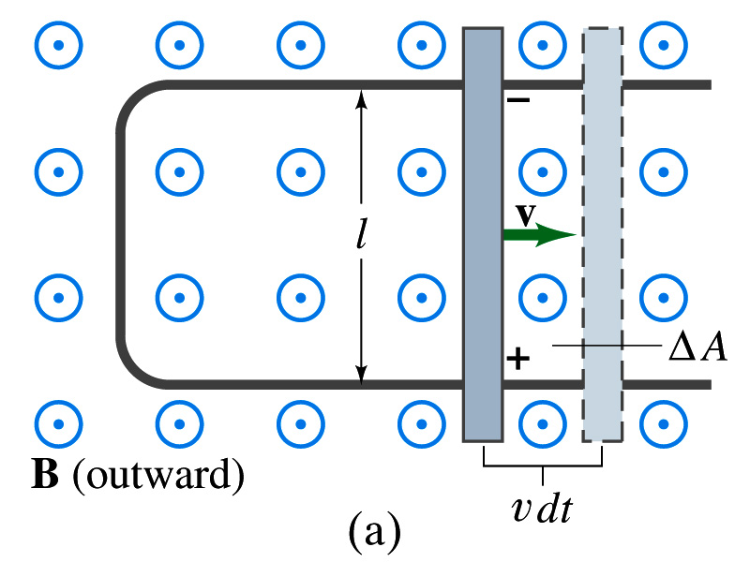
EMF Induced on a Moving Conductor
Another way of inducing emf is using a U shaped conductor with a movable rod resting on it.
As the rod moves at a speed v, it travels vdt in time dt, changing the area of the loop by dA=lvdt.
Using Faraday’s law, the induced emf for this loop is
  This equation is valid as long as B, l and v are perpendicular to each other. What do we do if not?
    Use the scalar product of vector quantities
An emf induced on a conductor moving in a magnetic field is called a motional emf

Slide 6
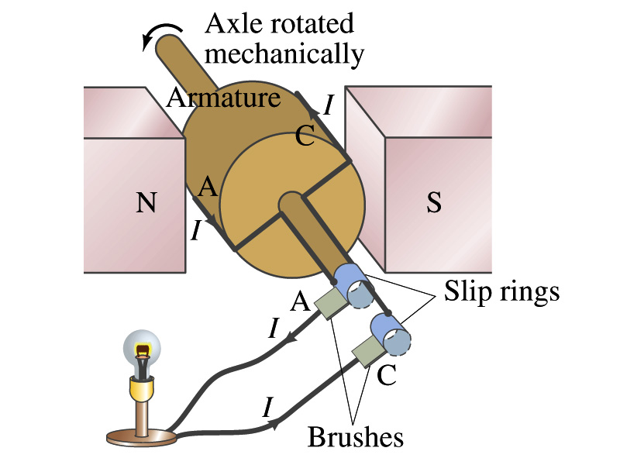
Electric Generators
What does a generator do?
  Transforms mechanical energy into the electrical energy
  What does this look like?
    An inverse of an electric motor which transforms electrical energy to mechanical energy
  An electric generator is also called a dynamo
Whose law does the generator based on?
  Faraday’s law of induction

Slide 7
How does an Electric Generator work?
An electric generator consists of
  Many coils of wires wound on an armature that can rotate by mechanical means in a magnetic field
An emf is induced in the rotating coil
Electric current is the output of a generator
Which direction does the output current flow when the armature rotates counterclockwise?
  The conventional current flows outward on wire A toward the brush
  After half the revolution the wire A will be where the wire C is and the current flow on A is reversed
Thus the current produced is alternating its direction

Slide 8
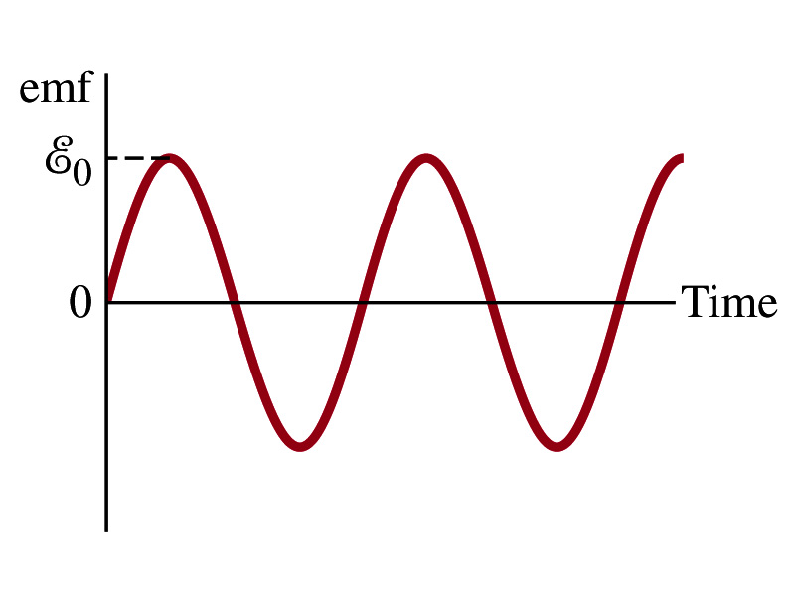
How does an Electric Generator work?
Let’s assume the loop is rotating in a uniform B field w/ a constant angular velocity ω. The induced emf is
What is the variable that changes above?
  The angle θ. What is dθ/dt?
    The angular speed ω.
  So θ=θ₀+ωt
  If we choose θ₀=0, we obtain
  If the coil contains N loops:
  What is the shape of the output?
    Sinusoidal w/ amplitude ε₀=NBAω
US A frequency is 60Hz. Europe is at 50Hz
  Most the U.S. power is generated at steam plants

Slide 9
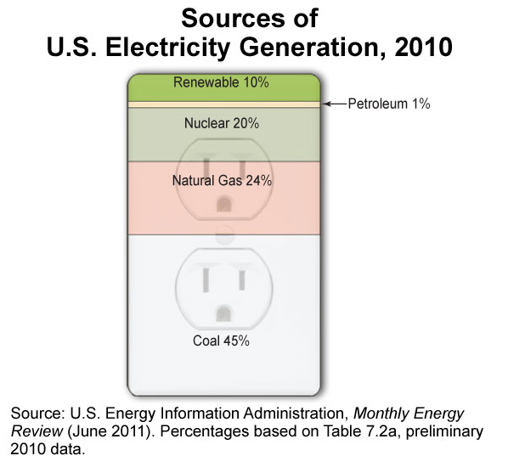
US Electricity Sources

Slide 10
The World Energy Consumption
In 2008, total worldwide energy consumption was 474 EJ (474×10¹⁸ J=132,000 TWh).
  Equivalent to an average energy consumption rate of 15 terawatts (1.504×10¹³ W)
The potential for renewable energy
  solar energy 1600 EJ (444,000 TWh)
  wind power 600 EJ (167,000 TWh)
  geothermal energy 500 EJ (139,000 TWh),
  biomass 250 EJ (70,000 TWh)
  hydropower 50 EJ (14,000 TWh) an
  ocean energy 1 EJ (280 TWh)

Slide 11
Example 29 – 9
An AC generator. The armature of a 60-Hz AC generator rotates in a 0.15-T magnetic field. If the area of the coil is 2.0x10⁻²m², how many loops must the coil contain if the peak output is to be ε₀=170V?
The maximum emf of a generator is
Solving for N
Since
We obtain

Slide 12
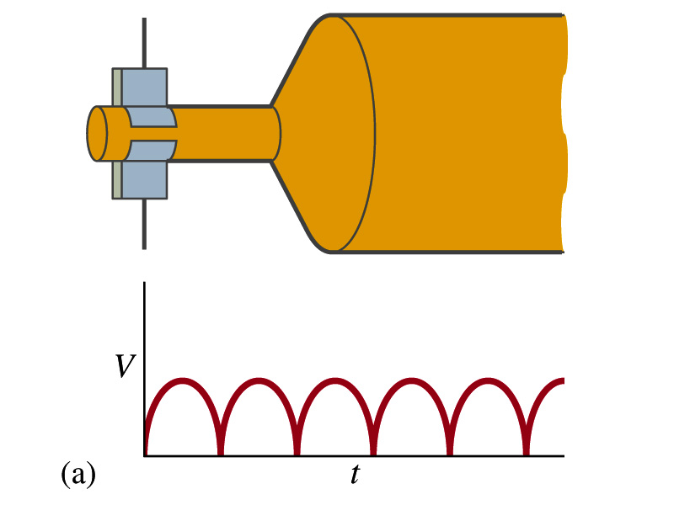
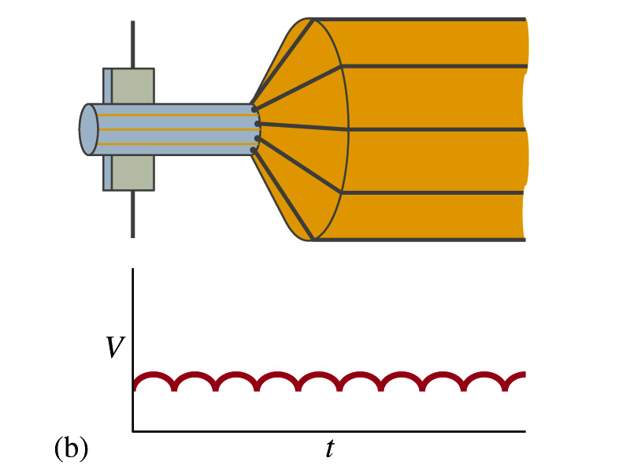
A DC Generator
A DC generator is almost the same as an AC generator except the slip rings are replaced by split-ring commutators
Output can be smoothed out by placing a capacitor on the output
  More commonly done using many armature windings
Smooth output using many windings

Slide 13
Eddy Currents (read more in 29-5)
Induced currents are not always confined to well-defined path
In some cases where a conductor is moving in and out of the magnetic field, the Lenz’s law causes flow of electrons that opposes the change in magnetic flux
  This change is in the direction that impedes the production of emf
  And thus causes energy losses
These currents are called eddy currents
  Just like the eddy currents in the water that pulls the boat in the opposite direction of the movement

Slide 14
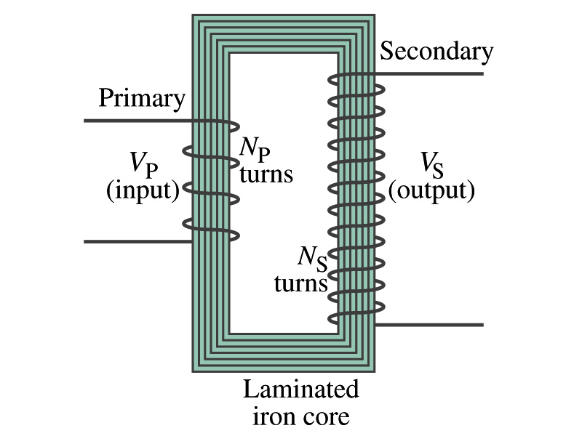
Transformer
What is a transformer?
  A device for increasing or decreasing an AC voltage
  A few examples?
    TV sets to provide High Voltage to picture tubes, portable electronic device converters, transformers on the pole, etc
A transformer consists of two coils of wires known as the primary and the secondary
  The two coils can be interwoven or linked by a laminated soft iron core to reduce eddy current losses
Transformers are designed so that all magnetic flux produced by the primary coil pass through the secondary

Slide 15
How does a transformer work?
When an AC voltage is applied to the primary, the changing B it produces will induce voltage of the same frequency in the secondary wire
So how would we make the voltage different?
  By varying the number of loops in each coil
  From Faraday’s law, the induced emf in the secondary is
  The input primary voltage is
  Since dΦ_{B}/dt is the same, we obtain
Transformer Equation

Slide 16
Transformer Equation
The transformer equation does not work for DC current since there is no change of magnetic flux!!
If N_{S}>N_{P}, the output voltage is greater than the input so it is called a step-up transformer while N_{S}<N_{P} is called step-down transformer
Now, it looks like energy conservation is violated since we can get more emf from smaller ones, right?
  Wrong! Wrong! Wrong! Energy is always conserved!
  A well designed transformer can be more than 99% efficient
  The power output is the same as the input:
The output current for step-up transformer will be lower than the input, while it is larger for step-down x-former than the input.

Slide 17
Example for A Transformer
Portable radio transformer. A transformer for home use of a portable radio reduces 120-V AC to 9.0V AC. The secondary contains 30 turns, and the radio draws 400mA. Calculate (a) the number of turns in the primary (b) the current in the primary and (c) the power transformed.
(a) What kind of a transformer is this?
A step-down x-former
Since
We obtain
We obtain
(b) Also from the transformer equation
(c) Thus the power transformed is
How about the input power?
The same assuming 100% efficiency.

Slide 18
Example 29 – 13: Power Transmission
Transmission lines. An average of 120kW of electric power is sent to a small town from a power plant 10km away. The transmission lines have a total resistance of 0.4Ω. Calculate the power loss if the power is transmitted at (a) 240V and (b) 24,000V.
We cannot use P=V²/R since we do not know the voltage along the transmission line. We, however, can use P=I²R.
(a) If 120kW is sent at 240V, the total current is
Thus the power loss due to transmission line is
(b) If 120kW is sent at 24,000V, the total current is
Thus the power loss due to transmission line is
The higher the transmission voltage, the smaller the current, causing less loss of energy. This is why power is transmitted w/ HV, as high as 170kV.

Slide 19
Electric Field due to Magnetic Flux Change
When electric current flows through a wire, there is an electric field in the wire that moves electrons
We saw, however, that changing magnetic flux induces a current in the wire. What does this mean?
  There must be an electric field induced by the changing magnetic flux.
In other words, a changing magnetic flux produces an electric field
This results apply not just to wires but to any conductor or any region in space

Slide 20
Generalized Form of Faraday’s Law
Recall the relationship between the electric field and the potential difference
Induced emf in a circuit is equal to the work done per unit charge by the electric field
So we obtain
The integral is taken around a path enclosing the area through which the magnetic flux Φ_{Β} is changing.

