Slide 1
PHYS 1444 – Section 003 Lecture #22
Tuesday, Nov. 29, 2011
Dr. Jaehoon Yu
Electric Inductance
Energy Stored in the Magnetic Field
LR circuit
LC Circuit and EM Oscillation
LRC circuit
AC Circuit w/ Resistance only
AC Circuit w/ Inductance only
Today’s homework is #12, due 10pm, Friday, Dec. 9!!

Slide 2
Announcements
Your planetarium extra credit
Please bring your planetarium extra credit sheet by the beginning of the class next Tuesday, Dec. 6
Be sure to tape one edge of the ticket stub with the title of the show on top
Be sure to write your name onto the sheet
Quiz #4
Coming Tuesday, Dec. 6
Covers CH30.1 through what we finish this Thursday
Reading Assignments
CH30.9 – CH30.11
Colloquium this week
Dr. Andy White (just been elected to be an APS fellow!!)

Slide 3
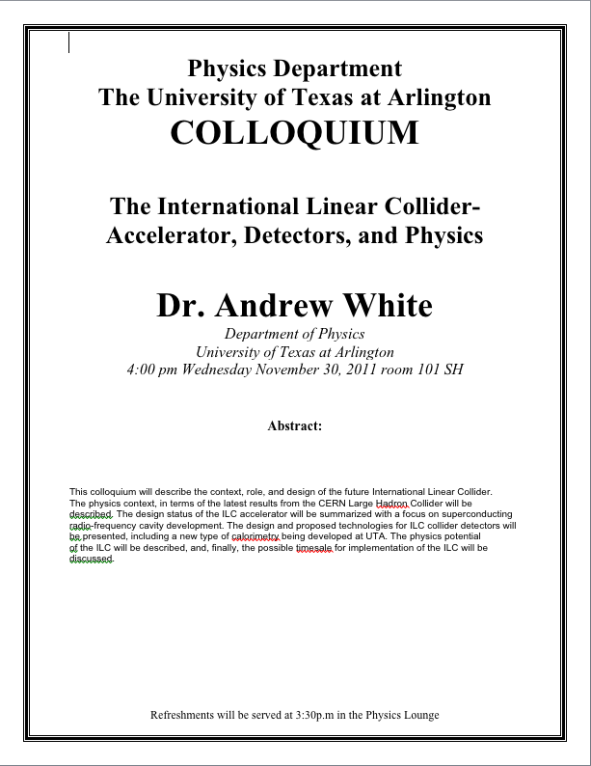

Slide 4
Inductance
Changing magnetic flux through a circuit induce an emf in that circuit
An electric current produces a magnetic field
From these, we can deduce
A changing current in one circuit must induce an emf in a nearby circuit ➔ Mutual inductance
Or induce an emf in itself ➔ Self inductance

Slide 5
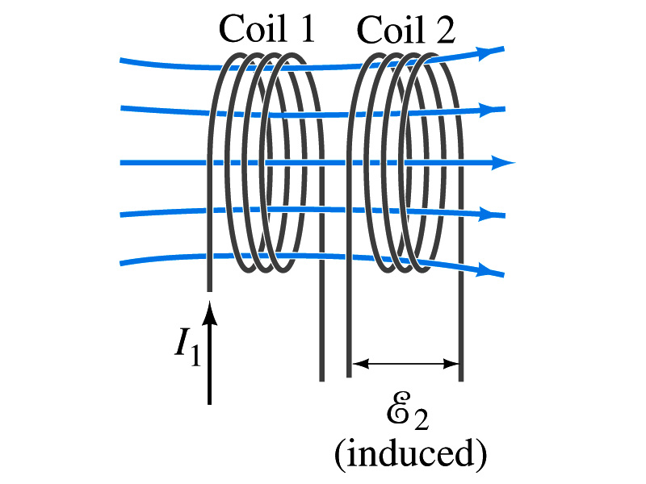
Mutual Inductance
If two coils of wire are placed near each other, a changing current in one will induce an emf in the other.
What is the induced emf, ε₂, in coil2 proportional to?
Rate of the change of the magnetic flux passing through it
This flux is due to current I₁ in coil 1
If Φ₂₁ is the magnetic flux in each loop of coil2 created by coil1 and N₂ is the number of closely packed loops in coil2, then N₂Φ₂₁ is the total flux passing through coil2.
If the two coils are fixed in space, N₂Φ₂₁ is proportional to the current I₁ in coil 1, .
The proportionality constant for this is called the Mutual Inductance and defined by .
The emf induced in coil2 due to the changing current in coil1 is

Slide 6
Mutual Inductance
The mutual induction of coil2 with respect to coil1, M₂₁,
is a constant and does not depend on I₁.
depends only on “geometric” factors such as the size, shape, number of turns and relative position of the two coils, and whether a ferromagnetic material is present
The farther apart the two coils are the less flux can pass through coil, 2, so M₂₁ will be less.
Most cases the mutual inductance is determined experimentally
Conversely, the changing current in coil2 will induce an emf in coil1
M₁₂ is the mutual inductance of coil1 with respect to coil2 and M₁₂ = M₂₁
We can put M=M₁₂=M₂₁ and obtain
SI unit for mutual inductance is henry (H)
What? Does this make sense?

Slide 7
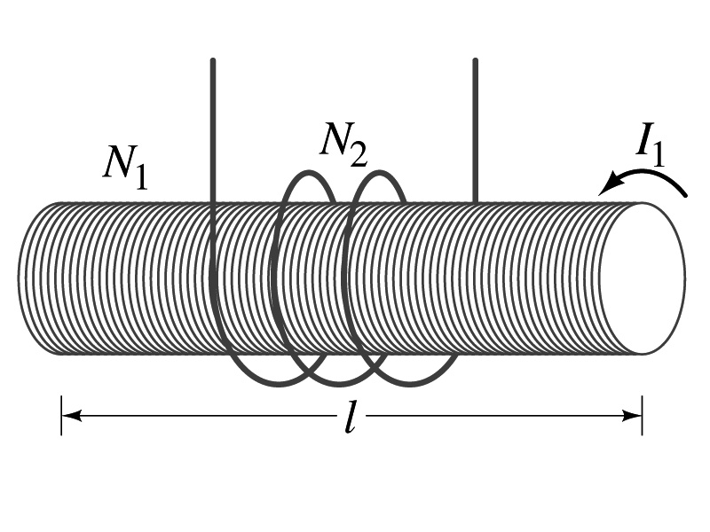
Example 30 – 1
Solenoid and coil. A long thin solenoid of length l and cross-sectional area A contains N₁ closely packed turns of wire. Wrapped around it is an insulated coil of N₂ turns. Assume all the flux from coil 1 (the solenoid) passes through coil 2, and calculate the mutual inductance.
First we need to determine the flux produced by the solenoid.
What is the magnetic field inside the solenoid?
Since the solenoid is closely packed, we can assume that the field lines are perpendicular to the surface area of the coils. Thus the flux through coil 2 is
Thus the mutual inductance of coil 2 is
Note that M₂₁ only depends on geometric factors!

Slide 8
Self Inductance
The concept of inductance applies to a single isolated coil of N turns. How does this happen?
When a changing current passes through a coil
A changing magnetic flux is produced inside the coil
The changing magnetic flux in turn induces an emf in the same coil
This emf opposes the change in flux. Whose law is this?
Lenz’s law
What would this do?
When the current through the coil is increasing?
The increasing magnetic flux induces an emf that opposes the original current
This tends to impedes its increase, trying to maintain the original current
When the current through the coil is decreasing?
The decreasing flux induces an emf in the same direction as the current
This tends to increase the flux, trying to maintain the original current

Slide 9
Self Inductance
Since the magnetic flux Φ_{B} passing through N turn coil is proportional to current I in the coil,
We define self-inductance, L:
The induced emf in a coil of self-inductance L is
What is the unit for self-inductance?
What does magnitude of L depend on?
Geometry and the presence of a ferromagnetic material
Self inductance can be defined for any circuit or part of a circuit
Self Inductance

Slide 10
So what in the world is the Inductance?
It is an impediment onto the electrical current due to the existence of changing flux
So what?
In other words, it behaves like a resistance to the varying current, such as AC, that causes the constant change of flux
But it also provides means to store energy, just like the capacitance

Slide 11
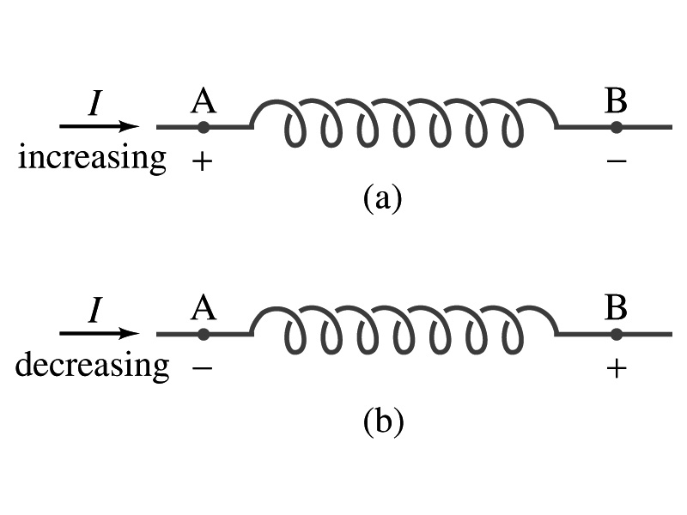
Inductor
An electrical circuit always contains some inductance but is normally negligibly small
If a circuit contains a coil of many turns, it could have large inductance
A coil that has significant inductance, L, is called an inductor and is express with the symbol
Precision resisters are normally wire wound
Would have both resistance and inductance
The inductance can be minimized by winding the wire back on itself in opposite direction to cancel magnetic flux
This is called a “non-inductive winding”
If an inductor has negligible resistance, inductance controls a changing current
For an AC current, the greater the inductance the less the AC current
An inductor thus acts like a resistor to impede the flow of alternating current (not to DC, though. Why?)
The quality of an inductor is indicated by the term reactance or impedance

Slide 12
Example 30 – 3
Solenoid inductance. (a) Determine a formula for the self inductance L of a tightly wrapped solenoid ( a long coil) containing N turns of wire in its length l and whose cross-sectional area is A. (b) Calculate the value of L if N=100, l=5.0cm, A=0.30cm² and the solenoid is air filled. (c) calculate L if the solenoid has an iron core with μ=4000μ₀.
What is the magnetic field inside a solenoid?
The flux is, therefore,
Using the formula for self inductance:
(b) Using the formula above
(c) The magnetic field with an iron core solenoid is

Slide 13
Energy Stored in a Magnetic Field
When an inductor of inductance L is carrying current I which is changing at a rate dI/dt, energy is supplied to the inductor at a rate
What is the work needed to increase the current in an inductor from 0 to I?
The work, dW, done in time dt is
Thus the total work needed to bring the current from 0 to I in an inductor is

Slide 14
Energy Stored in a Magnetic Field
The work done to the system is the same as the energy stored in the inductor when it is carrying current I
This is compared to the energy stored in a capacitor, C, when the potential difference across it is V:
Just like the energy stored in a capacitor is considered to reside in the electric field between its plates
The energy in an inductor can be considered to be stored in its magnetic field
Energy Stored in a magnetic field inside an inductor

Slide 15
Stored Energy in terms of B
So how is the stored energy written in terms of magnetic field B?
Inductance of an ideal solenoid without a fringe effect
The magnetic field in a solenoid is
Thus the energy stored in an inductor is
Thus the energy density is
This formula is valid in any region of space
If a ferromagnetic material is present, μ₀ becomes μ.
E
What is this?
E density
Volume V
What volume does Al represent?
The volume inside a solenoid!!

Slide 16
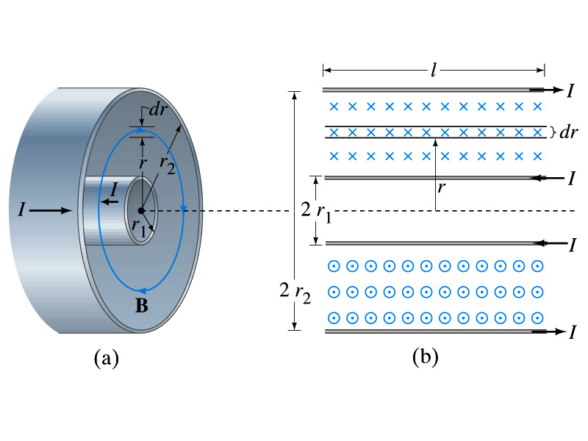
Example 30 – 5
Energy stored in a coaxial cable. (a) How much energy is being stored per unit length in a coaxial cable whose conductors have radii r₁ and r₂ and which carry a current I? (b) Where is the energy density highest?
(a) The total flux through l of the cable is
Thus inductance per unit length for a coaxial cable is
Thus the energy stored per unit length is
(b) Since the magnetic field is
The energy density is highest where B is highest. Since B is highest close to r=r₁, near the surface of the inner conductor.
And the energy density is

