Slide 1
PHYS 1444 – Section 003 Lecture #23
Thursday, Dec. 1, 2011
Dr. Jaehoon Yu
LR circuit
LC Circuit and EM Oscillation
LRC circuit
AC Circuit w/ Resistance only
AC Circuit w/ Inductance only
AC Circuit w/ Capacitance only

Slide 2
Announcements
Term exam results
Class average: 68.5/101
Equivalent to 67.8/100
Previous exams: 59/100 and 66/100
Top score: 95/101
Your planetarium extra credit
Please bring your planetarium extra credit sheet by the beginning of the class next Tuesday, Dec. 6
Be sure to tape one edge of the ticket stub with the title of the show on top
Be sure to write your name onto the sheet
Quiz #4
Coming Tuesday, Dec. 6
Covers CH30.1 through CH30.11
Reading Assignments
CH30.7 – CH30.11
Final comprehensive exam
Date and time: 11am, Thursday, Dec. 15, in SH103
Covers CH1.1 – what we cover coming Tuesday, Dec. 6 + Appendices A and B

Slide 3
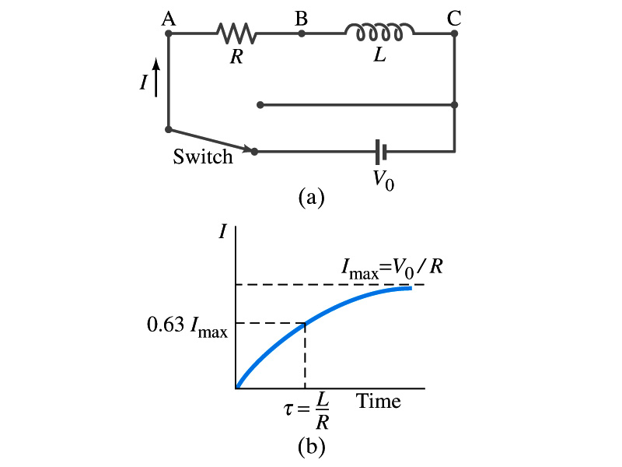
LR Circuits
What happens when an emf is applied to an inductor?
An inductor has some resistance, however negligible
So an inductor can be drawn as a circuit of separate resistance and coil. What is the name this kind of circuit?
What happens at the instance the switch is thrown to apply emf to the circuit?
The current starts to flow, gradually increasing from 0
This change is opposed by the induced emf in the inductor ➔ the emf at point B is higher than point C
However there is a voltage drop at the resistance which reduces the voltage across inductance
Thus the current increases less rapidly
The overall behavior of the current is a gradual increase, reaching to the maximum current I_{max}=V₀/R.
LR Circuit

Slide 4
LR Circuits
This can be shown w/ Kirchhoff rule loop rules
The emfs in the circuit are the battery voltage V₀ and the emf ε=-L(dI/dt) in the inductor opposing the current increase
The sum of the potential changes through the circuit is
Where I is the current at any instance
By rearranging the terms, we obtain a differential eq.
We can integrate just as in RC circuit
So the solution is
Where τ=L/R
This is the time constant τ of the LR circuit and is the time required for the current I to reach 0.63 of the maximum

Slide 5
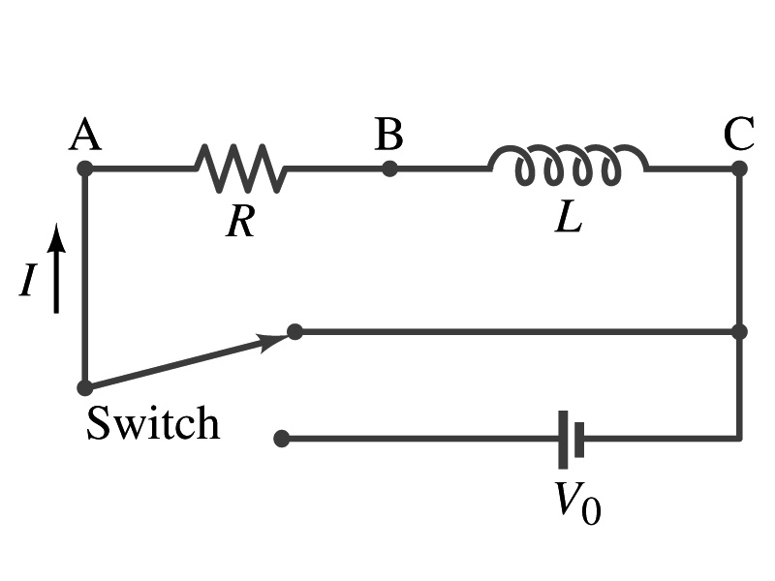
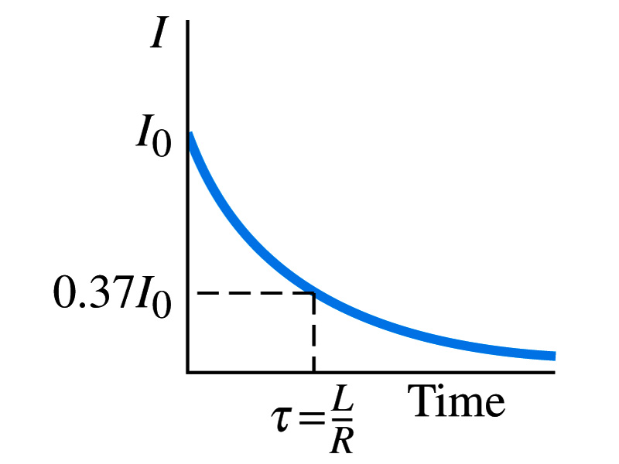
Discharge of LR Circuits
If the switch is flipped away from the battery
The differential equation becomes
So the integration is
Which results in the solution
The current decays exponentially to zero with the time constant τ=L/R
So there always is a reaction time when a system with a coil, such as an electromagnet, is turned on or off.
The current in LR circuit behaves almost the same as that in RC circuit but the time constant is inversely proportional to R in LR circuit unlike the RC circuit

Slide 6
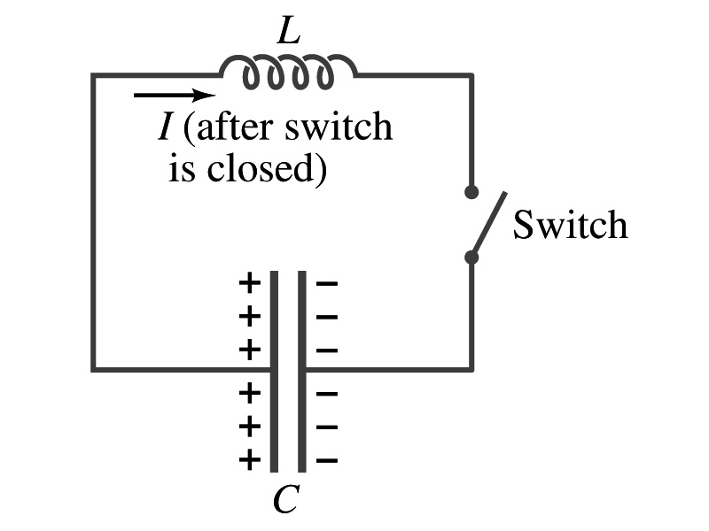
LC Circuit and EM Oscillations
What’s an LC circuit?
A circuit that contains only an inductor and a capacitor
How is this possible? There is no source of emf!!
Well, you can imagine a circuit with a fully charged capacitor
In this circuit, we assume the inductor does not have any resistance
Let’s assume that the capacitor originally has +Q₀ on one plate and –Q₀ on the other
Suppose the switch is closed at t=0
The capacitor starts discharging
The current flowing through the inductor increases
Applying Kirchhoff’s loop rule, we obtain
Since the current flows out of the plate with positive charge, the charge on the plate reduces, so I=-dQ/dt. Thus the differential equation can be rewritten

Slide 7
LC Circuit and EM Oscillations
This equation looks the same as that of the harmonic oscillation
So the solution for this second order differential equation is
Inserting the solution back into the differential equation
Solving this equation for ω, we obtain
The current in the inductor is
So the current also is sinusoidal with the maximum value
The charge on the capacitor oscillates sinusoidally

Slide 8
Energies in LC Circuit & EM Oscillation
The energy stored in the electric field of the capacitor at any time t is
The energy stored in the magnetic field in the inductor at the same instant is
Thus, the total energy in LC circuit at any instant is
So the total EM energy is constant and is conserved.
This LC circuit is an LC oscillator or EM oscillator
The charge Q oscillates back and forth, from one plate of the capacitor to the other
The current also oscillates back and forth as well

Slide 9
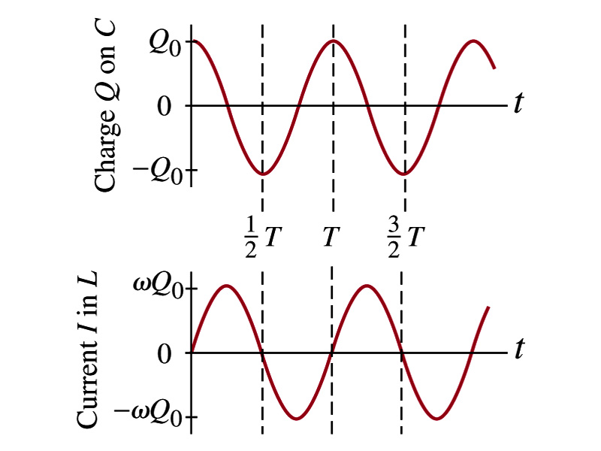
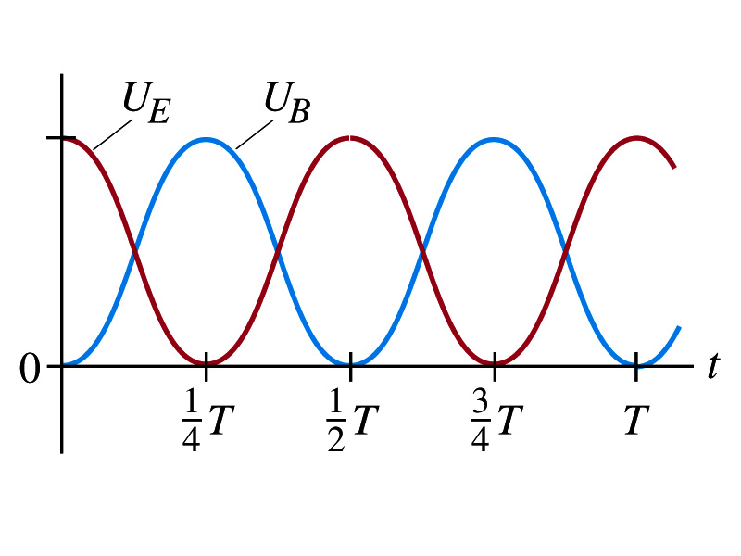
LC Circuit Behaviors

Slide 10
Example 30 – 7
LC Circuit. A 1200-pF capacitor is fully charged by a 500-V dc power supply. It is disconnected from the power supply and is connected, at t=0, to a 75-mH inductor. Determine: (a) The initial charge on the capacitor, (b) the maximum current, (c) the frequency f and period T of oscillation; and (d) the total energy oscillating in the system.
(a) The 500-V power supply, charges the capacitor to
(b) The maximum current is
(c) The frequency is
The period is
(d) The total energy in the system

Slide 11
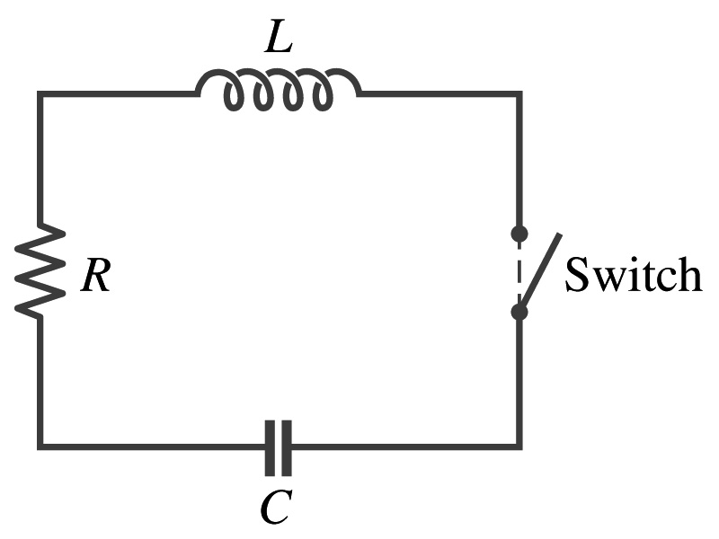
LC Oscillations w/ Resistance (LRC circuit)
There is no such thing as zero resistance coil so all LC circuits have some resistance
So to be more realistic, the effect of the resistance should be taken into account
Suppose the capacitor is charged up to Q₀ initially and the switch is closed in the circuit at t=0
What do you expect to happen to the energy in the circuit?
Well, due to the resistance we expect some energy will be lost through the resister via a thermal conversion
What about the oscillation? Will it look the same as the ideal LC circuit we dealt with?
No? OK then how would it be different?
The oscillation would be damped due to the energy loss.

Slide 12
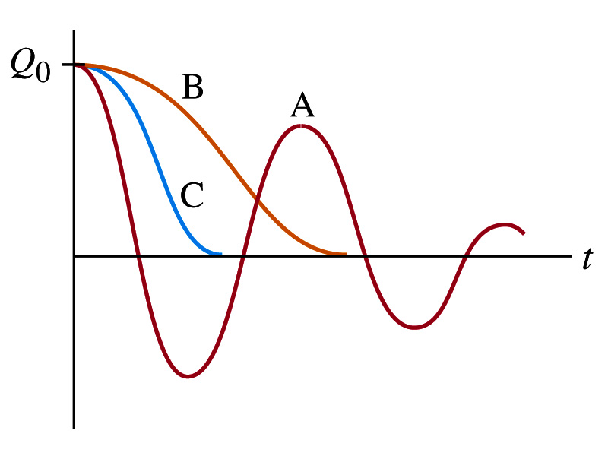
LC Oscillations w/ Resistance (LRC circuit)
Now let’s do some analysis
From Kirchhoff’s loop rule, we obtain
Since I=dQ/dt, the equation becomes
Which is identical to that of a damped oscillator
The solution of the equation is
Where the angular frequency is
R²<4L/C: Underdamped
R²>4L/C: Overdampled

Slide 13
Why do we care about circuits on AC?
The circuits we’ve learned so far contain resistors, capacitors and inductors and have been connected to a DC source or a fully charged capacitor
What? This does not make sense.
The inductor does not work as an impedance unless the current is changing. So an inductor in a circuit with DC source does not make sense.
Well, actually it does. When does it impede?
Immediately after the circuit is connected to the source so the current is still changing. So?
It causes the change of magnetic flux.
Now does it make sense?
Anyhow, learning the responses of resistors, capacitors and inductors in a circuit connected to an AC emf source is important. Why is this?
Since most the generators produce sinusoidal current
Any voltage that varies over time can be expressed in the superposition of sine and cosine functions

Slide 14
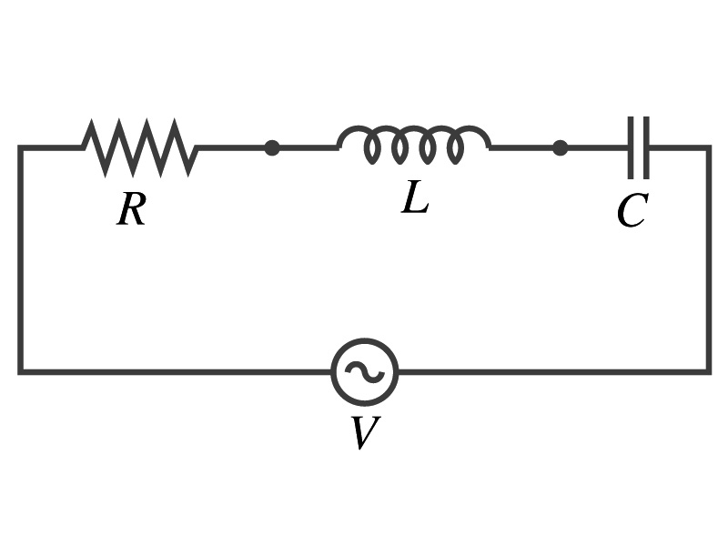
AC Circuits – the preamble
Do you remember how the rms and peak values for current and voltage are related?
The symbol for an AC power source is
We assume that the voltage gives rise to current
where

Slide 15
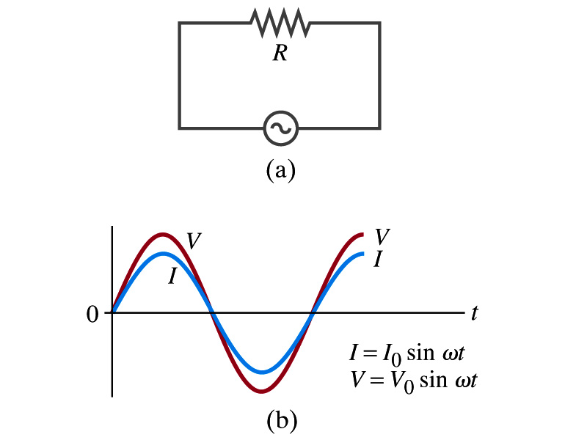
AC Circuit w/ Resistance only
What do you think will happen when an AC source is connected to a resistor?
From Kirchhoff’s loop rule, we obtain
Thus
where
What does this mean?
Current is 0 when voltage is 0 and current is in its peak when voltage is in its peak.
Current and voltage are “in phase”
Energy is lost via the transformation into heat at an average rate

Slide 16
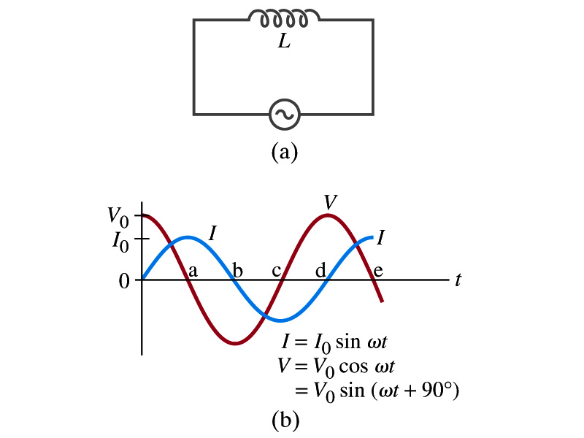
AC Circuit w/ Inductance only
From Kirchhoff’s loop rule, we obtain
Thus
Using the identity
where
What does this mean?
Current and voltage are “out of phase by π/2 or 90º” in other words the current reaches its peak ¼ cycle after the voltage
What happens to the energy?
No energy is dissipated
The average power is 0 at all times
The energy is stored temporarily in the magnetic field
Then released back to the source

Slide 17
AC Circuit w/ Inductance only
How are the resistor and inductor different in terms of energy?
Inductor
Resistor
How are they the same?
They both impede the flow of charge
For a resistance R, the peak voltage and current are related to
Similarly, for an inductor we may write
Where X_{L} is the inductive reactance of the inductor
What do you think is the unit of the reactance?
The relationship is not valid at a particular instance. Why not?
Since V₀ and Ι₀ do not occur at the same time
Stores the energy temporarily in the magnetic field and then releases it back to the emf source
Does not store energy but transforms it to thermal energy, getting it lost to the environment
0 when ω=0.
Ω
is valid!

Slide 18
Example 30 – 9
Reactance of a coil. A coil has a resistance R=1.00Ω and an inductance of 0.300H. Determine the current in the coil if (a) 120 V dc is applied to it; (b) 120 V AC (rms) at 60.0Hz is applied.
Is there a reactance for DC?
Nope. Why not?
Since ω=0,
So for DC power, the current is from Kirchhoff’s rule
For an AC power with f =60Hz, the reactance is
Since the resistance can be ignored compared to the reactance, the rms current is

Slide 19
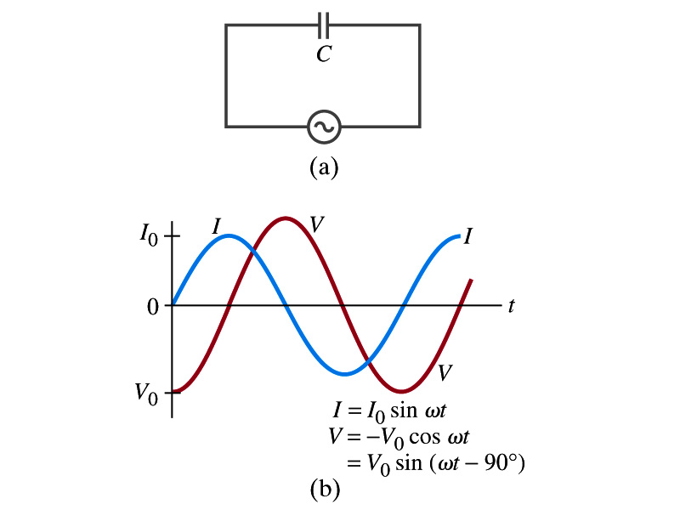
AC Circuit w/ Capacitance only
What happens when a capacitor is connected to a DC power source?
The capacitor quickly charges up.
There is no steady current flow in the circuit
Since a capacitor prevents the flow of a DC current
What do you think will happen if it is connected to an AC power source?
The current flows continuously. Why?
When the AC power turns on, charge begins to flow one direction, charging up the plates
When the direction of the power reverses, the charge flows in the opposite direction

Slide 20
AC Circuit w/ Capacitance only
From Kirchhoff’s loop rule, we obtain
The current at any instance is
The charge Q on the plate at any instance is
Thus the voltage across the capacitor is
Using the identity
Where

Slide 21
AC Circuit w/ Capacitance only
So the voltage is
What does this mean?
Current and voltage are “out of phase by π/2 or 90º” but in this case, the voltage reaches its peak ¼ cycle after the current
What happens to the energy?
No energy is dissipated
The average power is 0 at all times
The energy is stored temporarily in the electric field
Then released back to the source
Applied voltage and the current in the capacitor can be written as
Where the capacitive reactance X_{C} is defined as
Again, this relationship is only valid for rms quantities
Infinite when ω=0.

Slide 22
Example 30 – 10
Capacitor reactance. What are the peak and rms current in the circuit in the figure if C=1.0μF and V_{rms}=120V? Calculate for (a) f=60Hz, and then for (b) f=6.0x10⁵Hz.
The peak voltage is
The capacitance reactance is
Thus the peak current is
The rms current is

Slide 23
AC Circuit w/ LRC
The voltage across each element is
V_{R} is in phase with the current
V_{L} leads the current by 90º
V_{C} lags the current by 90º
From Kirchhoff’s loop rule
V=V_{R}+V_{L}+V_{C}
However since they do not reach the peak voltage at the same time, the peak voltage of the source V₀ will not equal V_{R0}+V_{L0}+V_{C0}
The rms voltage also will not be the simple sum of the three
Let’s try to find the total impedance, peak current Ι₀ and the phase difference between Ι₀ and V₀.

Slide 24
AC Circuit w/ LRC
The current at any instance is the same at all point in the circuit
The currents in each elements are in phase
Why?
Since the elements are in series
How about the voltage?
They are not in phase.
The current at any given time is
The analysis of LRC circuit is done using the “phasor” diagram in which arrows are drawn in an xy plane to represent the amplitude of each voltage, just like vectors
The lengths of the arrows represent the magnitudes of the peak voltages across each element; V_{R0}=I₀R, V_{L0}=I₀X_{L} and V_{C0}=I₀X_{C}
The angle of each arrow represents the phase of each voltage relative to the current, and the arrows rotate at angular frequency ω to take into account the time dependence.
The projection of each arrow on y axis represents voltage across each element at any given time

Slide 25
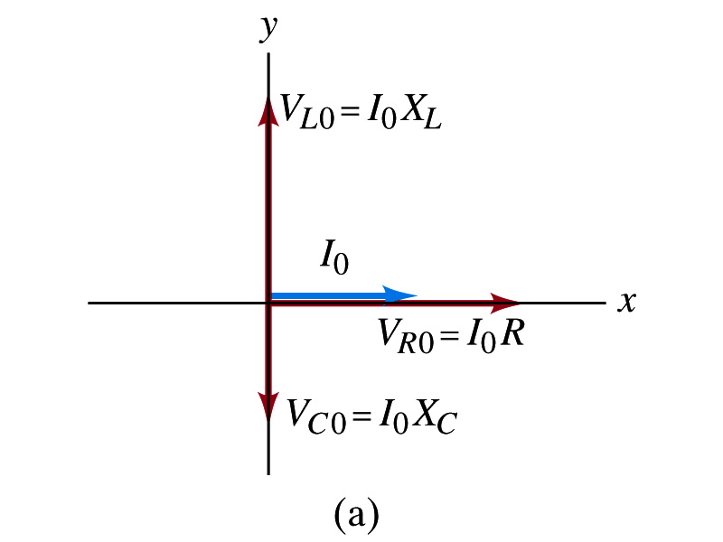
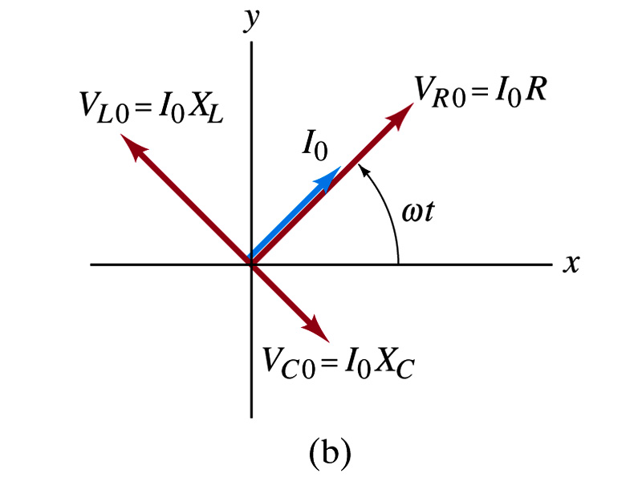
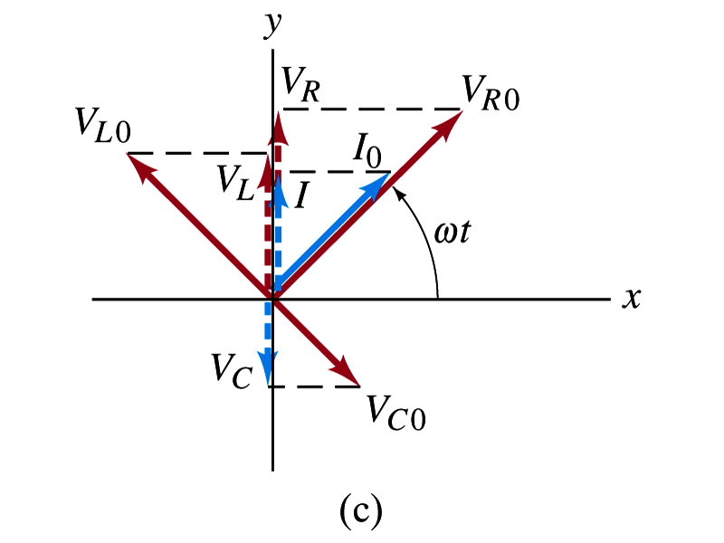
Phasor Diagrams
At t=0, Ι=0.
Thus V_{R0}=0, V_{L0}=Ι₀X_{L}, V_{C0}=Ι₀X_{C}
At t=t,
Thus, the voltages (y-projections) are
+90º
-90º

Slide 26
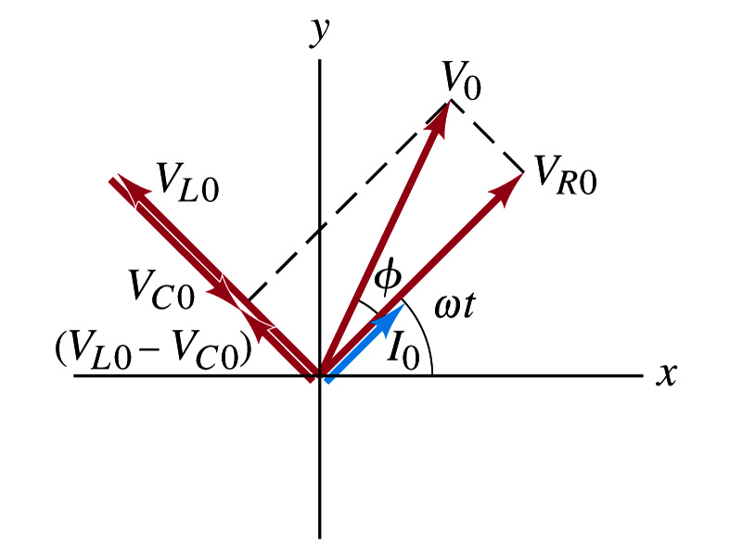
AC Circuit w/ LRC
Since the sum of the projections of the three vectors on the y axis is equal to the projection of their sum.
The sum of the projections represents the instantaneous voltage across the whole circuit which is the source voltage
So we can use the sum of all vectors as the representation of the peak source voltage V₀.
V₀ forms an angle φ to V_{R0} and rotates together with the other vectors as a function of time,
We determine the total impedance Z of the circuit defined by the relationship or
From Pythagorean theorem, we obtain
Thus the total impedance is

Slide 27
AC Circuit w/ LRC
The phase angle φ is
or
What is the power dissipated in the circuit?
Which element dissipates the power?
Only the resistor
The average power is
Since R=Zcosφ
We obtain
The factor cosφ is referred as the power factor of the circuit
For a pure resistor, cosφ=1 and
For a capacitor or inductor alone φ=-90º or +90º, so cosφ=0 and

