Slide 1
PHYS 1444 – Section 003
Lecture #24
Tuesday, Dec. 6, 2011
Dr. Jaehoon Yu
Achievements of Maxwell’s Equations
Extension of Ampere’s Law
Gauss’ Law of Magnetism
Maxwell’s Equations
Production of Electromagnetic Waves
EM Waves from Maxwell’s Equations
Speed of EM Waves
Light as EM Wave

Slide 2
Announcements
Final comprehensive exam
  Date and time: 11am – 12:30pm, Thursday, Dec. 15, SH103
  Covers CH21.1 – what we cover today (CH31.4) + Appendices A and B
  Mixture of multiple choice and free response problems
  Please do not miss the exam
  Review session this 12:30 – 2pm this Thursday, Dec. 8 here in SH103
    Attendance will be taken for extra credit
    Bring your own problems from the packet
Colloquium tomorrow

Slide 3
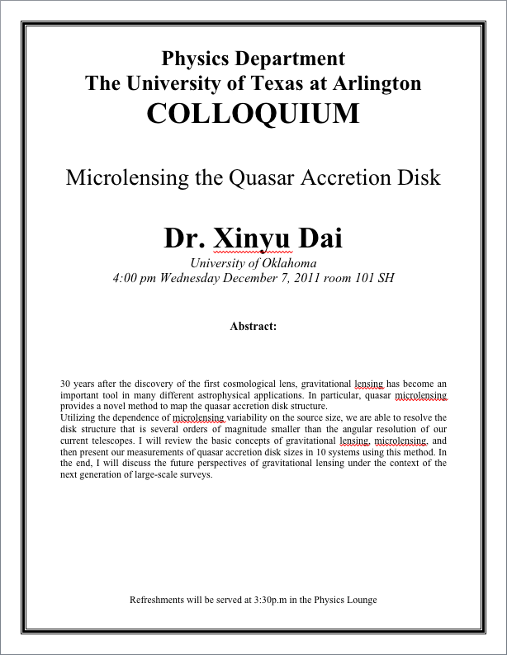

Slide 4
Maxwell’s Equations
The development of EM theory by Oersted, Ampere and others was not done in terms of EM fields
  The idea of fields was introduced somewhat by Faraday
Scottish physicist James C. Maxwell unified all the phenomena of electricity and magnetism in one theory with only four equations (Maxwell’s Equations) using the concept of fields
  This theory provided the prediction of EM waves
  As important as Newton’s law since it provides dynamics of electromagnetism
  This theory is also in agreement with Einstein’s special relativity
The biggest achievement of 19th century electromagnetic theory is the prediction and experimental verifications that the electromagnetic waves can travel through the empty space
  What do you think this accomplishment did?
    Open a new world of communication
    It also yielded the prediction that the light is an EM wave
Since all of Electromagnetism is contained in the four Maxwell’s equations, this is considered as one of the greatest achievements of human intellect

Slide 5
Ampere’s Law
Do you remember the mathematical expression of Oersted discovery of a magnetic field produced by an electric current, given by Ampere?
We’ve learned that a varying magnetic field produces an electric field
Then can the reverse phenomena, that a changing electric field producing a magnetic field, possible?
  If this is the case, it would demonstrate a beautiful symmetry in nature between electricity and magnetism

Slide 6
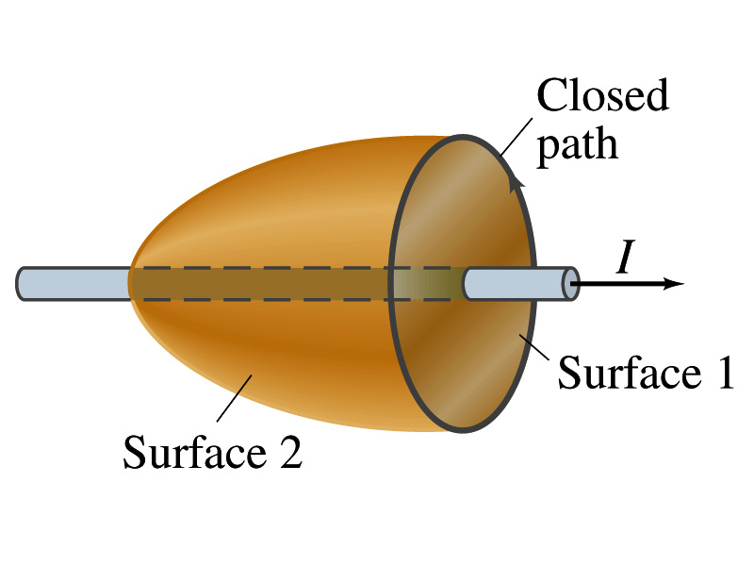
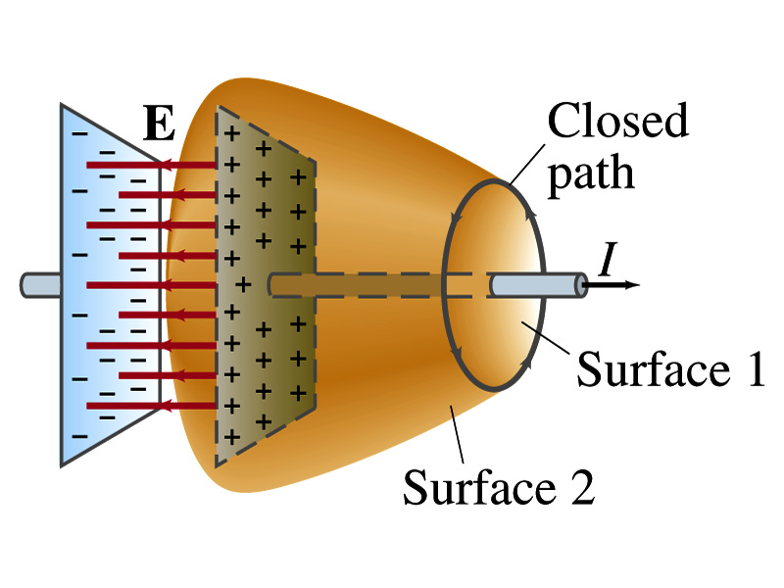
Expanding Ampere’s Law
Let’s consider a wire carrying current Ι
  The current that is enclosed in the loop passes through the surface # 1 in the figure
  We could imagine a different surface # 2 that shares the same enclosed path but cuts through the wire in a different location. What is the current that passes through the surface?
    Still Ι.
  So the Ampere’s law still works
We could then consider a capacitor being charged up or being discharged.
  The current Ι enclosed in the loop passes through the surface #1
  However the surface #2 that shares the same closed loop do not have any current passing through it.
    There is magnetic field present since there is current ➔ In other words there is a changing electric field in between the plates
    Maxwell resolved this by adding an additional term to Ampere’s law involving the changing electric field

Slide 7
Modifying Ampere’s Law
To determine what the extra term should be, we first have to figure out what the electric field between the two plates is
  The charge Q on the capacitor with capacitance C is Q=CV
    Where V is the potential difference between the plates
  Since V=Ed
    Where E is the uniform field between the plates, and d is the separation of the plates
  And for parallel plate capacitor C=ε₀A/d
  We obtain

Slide 8
Modifying Ampere’s Law
  If the charge on the plate changes with time, we can write
  Using the relationship between the current and charge we obtain
    Where Φ_{Ε}=EA is the electric flux through the surface between the plates
  So in order to make Ampere’s law work for the surface 2 in the figure, we must write it in the following form
  This equation represents the general form of Ampere’s law
    This means that a magnetic field can be caused not only by an ordinary electric current but also by a changing electric flux
Extra term by Maxwell

Slide 9
Example 31 – 1
Charging capacitor. A 30-pF air-gap capacitor has circular plates of area A=100cm². It is charged by a 70-V battery through a 2.0-Ω resistor. At the instance the battery is connected, the electric field between the plates is changing most rapidly. At this instance, calculate (a) the current into the plates, and (b) the rate of change of electric field between the plates. (c) Determine the magnetic field induced between the plates. Assume E is uniform between the plates at any instant and is zero at all points beyond the edges of the plates.
Since this is an RC circuit, the charge on the plates is:
For the initial current (t=0), we differentiate the charge with respect to time.
The electric field is
Change of the electric field is

Slide 10
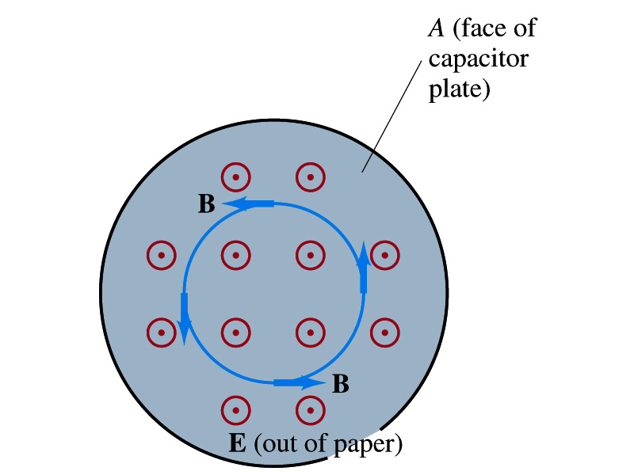
Example 31 – 1
(c) Determine the magnetic field induced between the plates. Assume E is uniform between the plates at any instant and is zero at all points beyond the edges of the plates.
The magnetic field lines generated by changing electric field is perpendicular to E and is circular due to symmetry
Whose law can we use to determine B?
Extended Ampere’s Law w/ Ι_{encl}=0!
We choose a circular path of radius r, centered at the center of the plane, following the B.
For r<r_{plate}, the electric flux is
since E is uniform throughout the plate
So from Ampere’s law, we obtain
Solving for B
For r<r_{plate}
Since we assume E=0 for r>r_{plate}, the electric flux beyond the plate is fully contained inside the surface.
So from Ampere’s law, we obtain
Solving for B
For r>r_{plate}

Slide 11
Displacement Current
Maxwell interpreted the second term in the generalized Ampere’s law equivalent to an electric current
  He called this term as the displacement current, Ι_{D}
  While the other term is called as the conduction current, Ι
Ampere’s law then can be written as
  Where
  While it is in effect equivalent to an electric current, a flow of electric charge, this actually does not have anything to do with the flow itself

Slide 12
Gauss’ Law for Magnetism
If there is a symmetry between electricity and magnetism, there must be an equivalent law in magnetism as the Gauss’ Law in electricity
For a magnetic field B, the magnetic flux Φ_{B} through the surface is defined as
  Where the integration is over the area of either an open or a closed surface
The magnetic flux through a closed surface which completely encloses a volume is
What was the Gauss’ law in the electric case?
  The electric flux through a closed surface is equal to the total net charge Q enclosed by the surface divided by ε₀.
Similarly, we can write Gauss’ law for magnetism as
Why is result of the integral zero?
  There is no isolated magnetic poles, the magnetic equivalent of single electric charges
Gauss’ Law for electricity
Gauss’ Law for magnetism

Slide 13
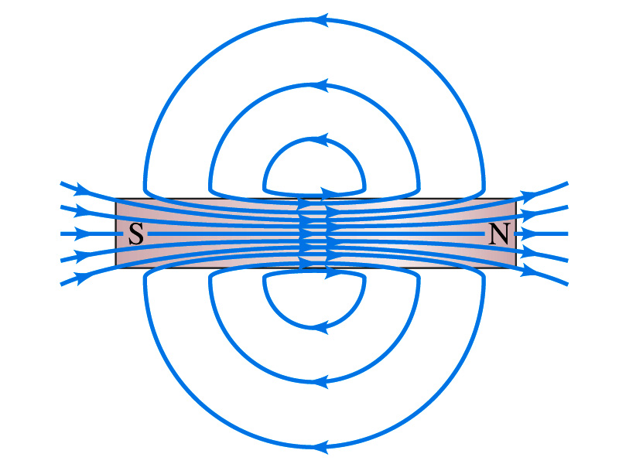
Gauss’ Law for Magnetism
What does the Gauss’ law in magnetism mean physically?
  There are as many magnetic flux lines that enter the enclosed volume as leave it
  If magnetic monopole does not exist, there is no starting or stopping point of the flux lines
    Electricity do have the source and the sink
  Magnetic field lines must be continuous
  Even for bar magnets, the field lines exist both insides and outside of the magnet

Slide 14
Maxwell’s Equations
In the absence of dielectric or magnetic materials, the four equations developed by Maxwell are:
Gauss’ Law for electricity
A generalized form of Coulomb’s law relating electric field to its sources, the electric charge
Gauss’ Law for magnetism
A magnetic equivalent of Coulomb’s law relating magnetic field to its sources. This says there are no magnetic monopoles.
Faraday’s Law
An electric field is produced by a changing magnetic field
Ampére’s Law
A magnetic field is produced by an electric current or by a changing electric field

Slide 15
Maxwell’s Amazing Leap of Faith
According to Maxwell, a magnetic field will be produced even in an empty space if there is a changing electric field
  He then took this concept one step further and concluded that
    If a changing magnetic field produces an electric field, the electric field is also changing in time.
    This changing electric field in turn produces the magnetic field that also changes.
    This changing magnetic field then in turn produces the electric field that changes.
    This process continues.
  With the manipulation of the equations, Maxwell found that the net result of this interacting changing fields is a wave of electric and magnetic fields that can actually propagate (travel) through the space

Slide 16
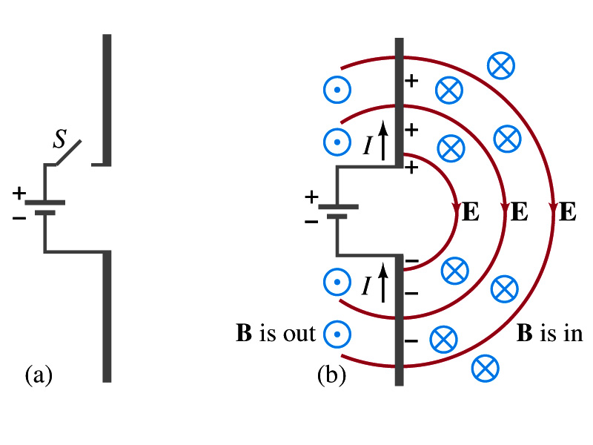
Production of EM Waves
Consider two conducting rods that will serve as an antenna are connected to a DC power source
  What do you think will happen when the switch is closed?
    The rod connected to the positive terminal is charged positive and the other negatively
    Then the electric field will be generated between the two rods
    Since there is current that flows through, the rods generates a magnetic field around them
How far would the electric and magnetic fields extend?
  In static case, the field extends indefinitely
  When the switch is closed, the fields are formed nearby the rods quickly but
  The stored energy in the fields won’t propagate w/ infinite speed

Slide 17
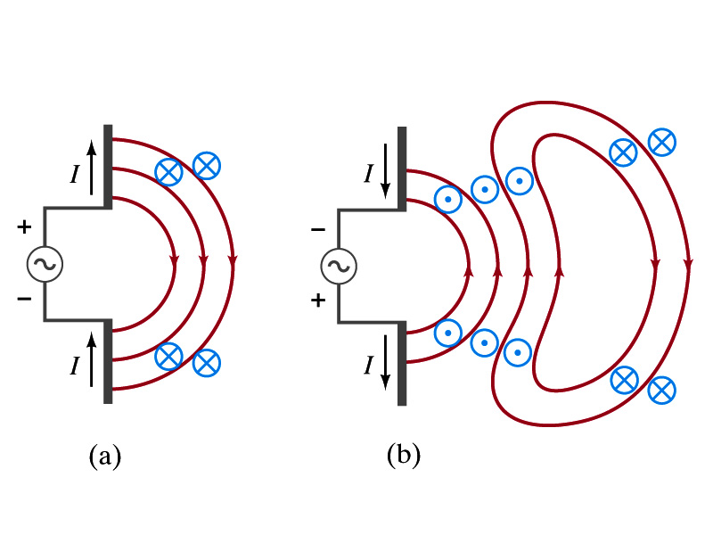
Production of EM Waves
What happens if the antenna is connected to an ac power source?
  When the connection was initially made, the rods are charging up quickly w/ the current flowing in one direction as shown in the figure
    The field lines form as in the dc case
    The field lines propagate away from the antenna
  Then the direction of the voltage reverses
    The new field lines with the opposite direction forms
    While the original field lines still propagates away from the rod reaching out far
      Since the original field propagates through an empty space, the field lines must form a closed loop (no charge exist)
    Since changing electric and magnetic fields produce changing magnetic and electric fields, the fields moving outward is self supporting and do not need antenna with flowing charge
  The fields far from the antenna is called the radiation field
  Both electric and magnetic fields form closed loops perpendicular to each other

