Slide 1
PHYS 3313 – Section 001
Lecture #1
Monday, Aug. 27, 2012
Dr. Jaehoon Yu
Who am I?
How is this class organized?
What do we want from this class?
What is Physics?
Brief history of modern physics

Slide 2
Announcements
Plea to you: Please turn off your cell-phones, pagers and computers in the class
Reading assignment #1: Read and follow through appendices 3, 5, 6 and 7 by Tuesday, Sept. 4
  There will be a quiz next Wednesday, Sept. 5, on this reading assignmentå

Slide 3
Who am I?
Name: Dr. Jaehoon Yu (You can call me Dr. Yu)
Office: Rm 342, Chemistry and Physics Building
Extension: x22814, E-mail: jaehoonyu@uta.edu
My profession: High Energy Particle Physics (HEP)
  Collide particles (protons on anti-protons or electrons on anti-electrons, positrons) at the energies equivalent to 10,000 Trillion degrees
  To understand
    Fundamental constituents of matter
    Forces between the constituents (gravitational, electro-magnetic, weak and strong forces)
    Origin of Mass
    Creation of Universe (Big Bang Theory)
  A pure scientific research activity
    Direct use of the fundamental laws we find may take longer than we want but
    Indirect product of research contribute to every day lives; eg. WWW
  Why do we do with this?
    Make our everyday lives better

Slide 4
High Energy Physics
Definition: A field of physics that pursues understanding the fundamental constituents of matter and basic principles of interactions between them.
Known interactions (forces):
  Gravitational
  Electro-Weak
  Strong
Current theory: The Standard Model of Particle Physics
  Unified Weak and Electromagnetic: SU(2)xU(1)
  Strong Interaction: SU(3)
  Currently:SU(3)xSU(2)xU(1)
  Meaning: 8+4 mediators for forces

Slide 5
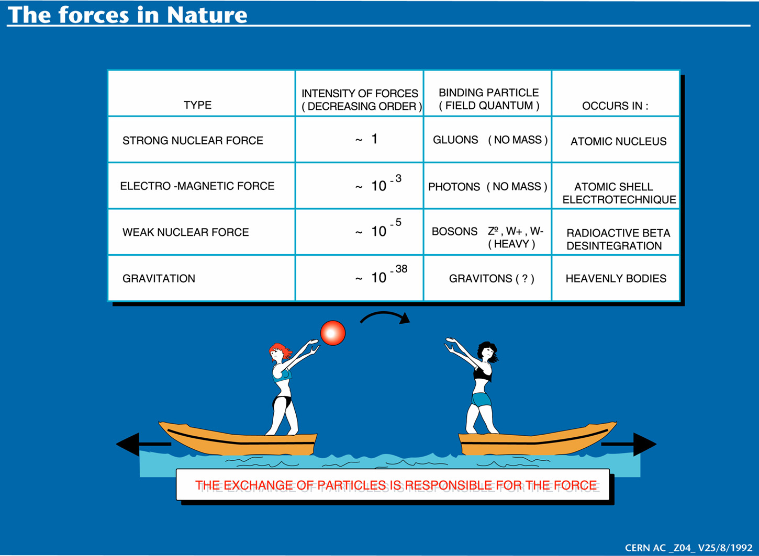

Slide 6
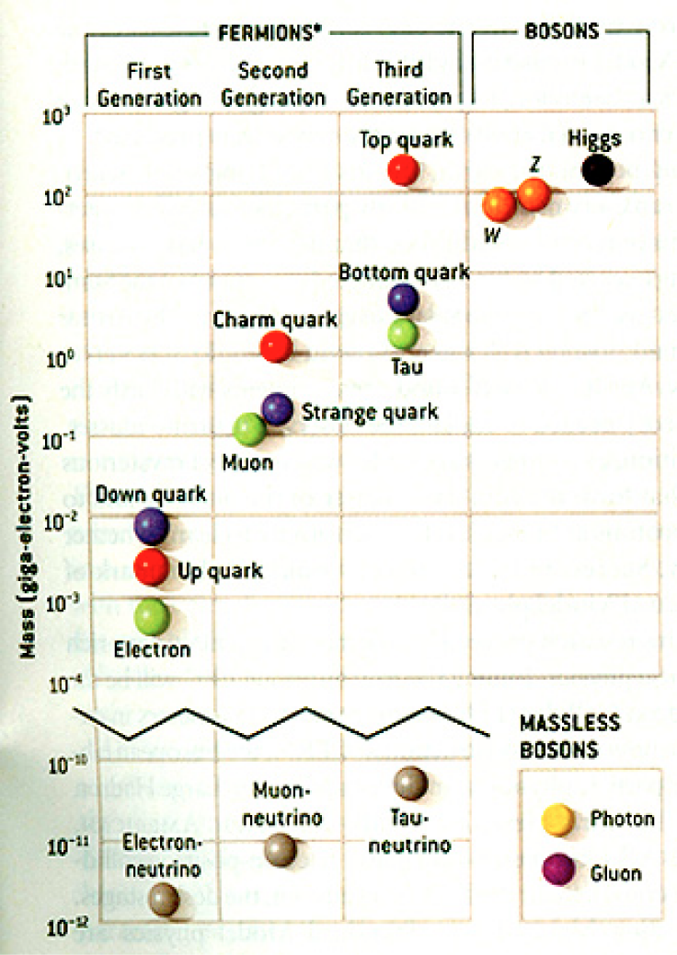
The Standard Model
Discovered in 1995, ~175m_{p}
Make up most ordinary matters ~0.1m_{p}
Total of 16 particles make up the matter in the universe! ➔ Simple and elegant!!!
Tested to a precision of 1 part per million!

Slide 7
Accelerators are Powerful Microscopes.
They make high energy particle beams
that allow us to see small things.
seen by
low energy beam
(poorer resolution)
seen by
high energy beam
(better resolution)

Slide 8
Accelerators are also Time Machines.
They make particles last seen
in the earliest moments of the universe.
Energy
particle beam
energy
anti-particle beam
energy
Particle and anti-particle annihilate.
E = mc²

Slide 9
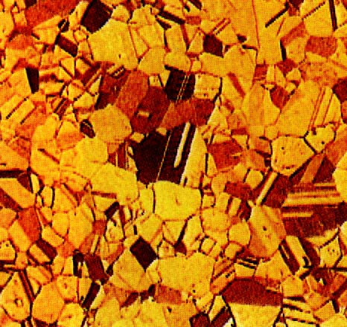
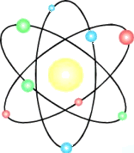


Structure of Matter
Matter
Molecule
Atom
Nucleus
Baryon
Quark
(Hadron)
u
10⁻²m
10⁻⁹m
10⁻¹⁰m
10⁻¹⁴m
10⁻¹⁵m
<10⁻¹⁹m
Condensed matter/Nano-Science/Chemistry
protons, neutrons,
mesons, etc.
π,Ω,Λ...
top, bottom,
charm, strange,
up, down
Atomic Physics
Nuclear
Physics
Electron
(Lepton)
<10⁻¹⁸m
High Energy Physics
Notes:
Give scale and relationship to the domain that high energy physicists work in.
Introduce the fundamental bits of matter loosely so that audience can point back to bulk matter.
Domain.

Slide 10
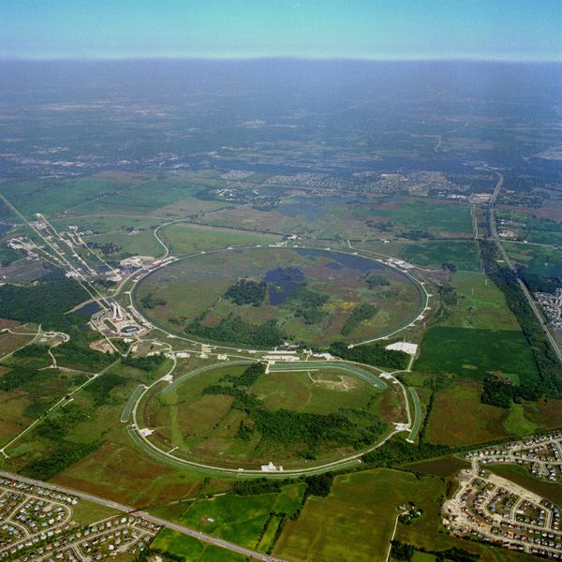
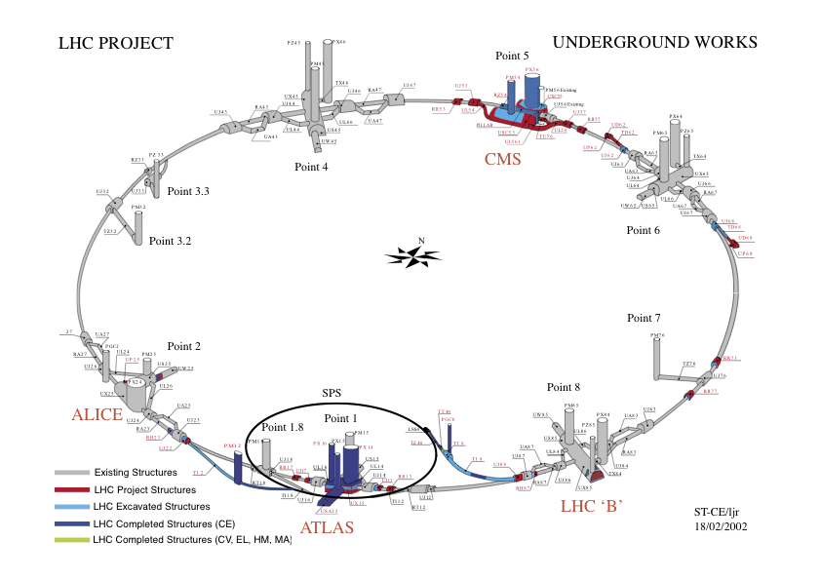
Fermilab Tevatron and LHC at CERN
World’s Highest Energy proton-anti-proton collider
  4km circumference
  E_{cm}=1.96 TeV (=6.3x10⁻⁷J/p➔ 13M Joules on the area smaller than 10⁻⁴m²)
  Equivalent to the kinetic energy of a 20t truck at the speed 81mi/hr➔ 130km/hr
    ~100,000 times the energy density at the ground 0 of the Hiroshima atom bomb
  Was shut down at 2pm CDT, Sept. 30, 2011
  Vibrant other programs running!!
World’s Highest Energy p-p collider
  27km circumference, 100m underground
  Design E_{cm}=14 TeV (=44x10⁻⁷J/p➔ 362M Joules on the area smaller than 10⁻⁴m²)
  Equivalent to the kinetic energy of a B727 (80tons) at the speed 193mi/hr ➔ 312km/hr
    ~3M times the energy density at the ground 0 of the Hiroshima atom bomb
First 7TeV collisions on 3/30/10 ➔ The highest energy humans ever achieved!!
First 8TeV collisions in 2012 on April 5, 2012
Chicago
CDF
p
DØ
Tevatron
p

Slide 11
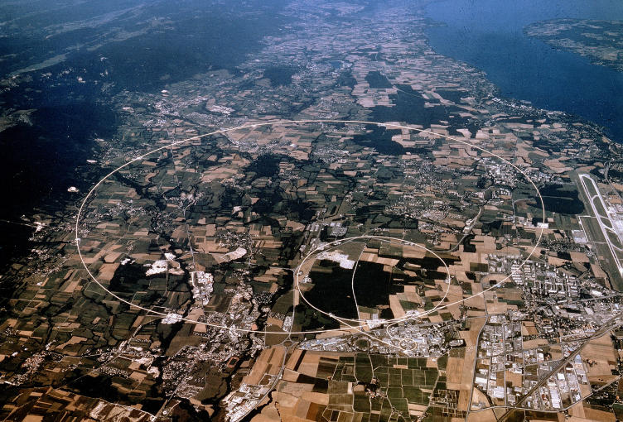


LHC @ CERN Aerial View
CMS
France
Geneva Airport
ATLAS
Swizerland

Slide 12
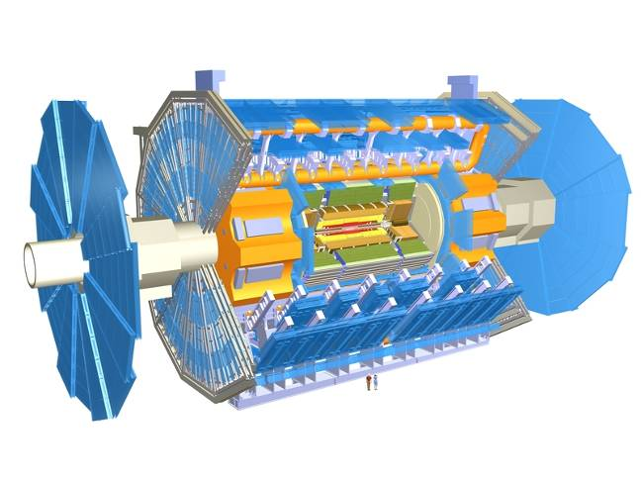
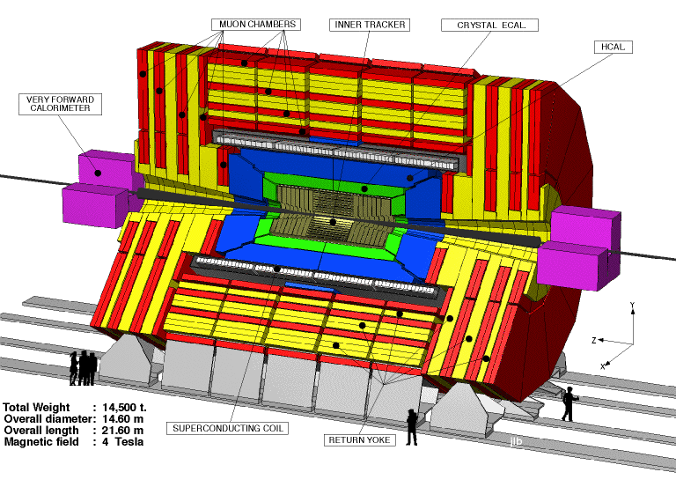
The ATLAS and CMS Detectors
Fully multi-purpose detector with emphasis on lepton ID & precision E & P
Weighs 7000 tons and 10 story tall
Records 200 – 400 collisions/second
Records approximately 350 MB/second
Record over 2 PB per year ➔ 200*Printed material of the US Lib. of Congress

Slide 13
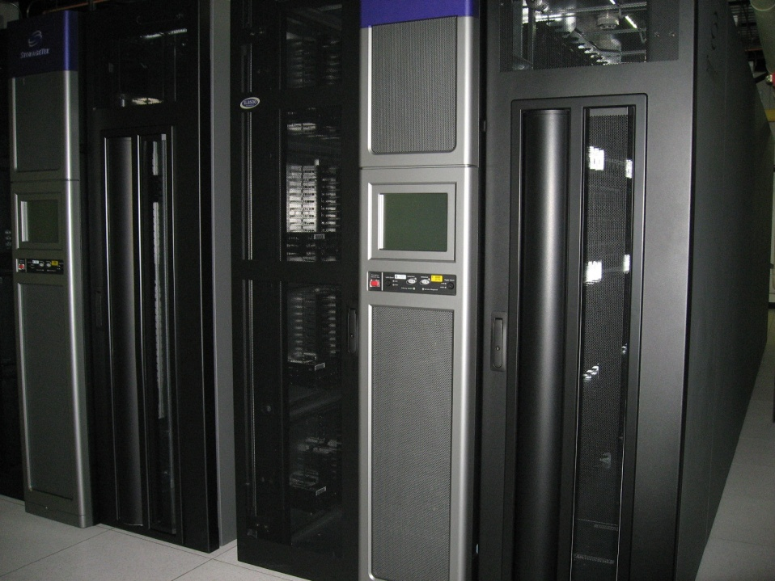
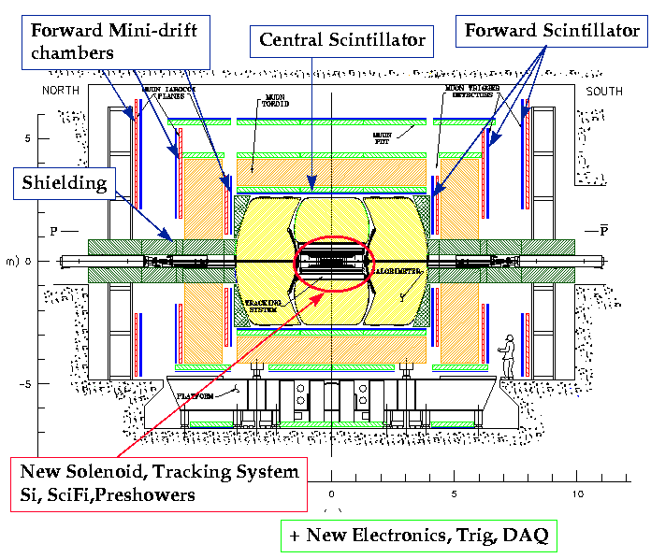
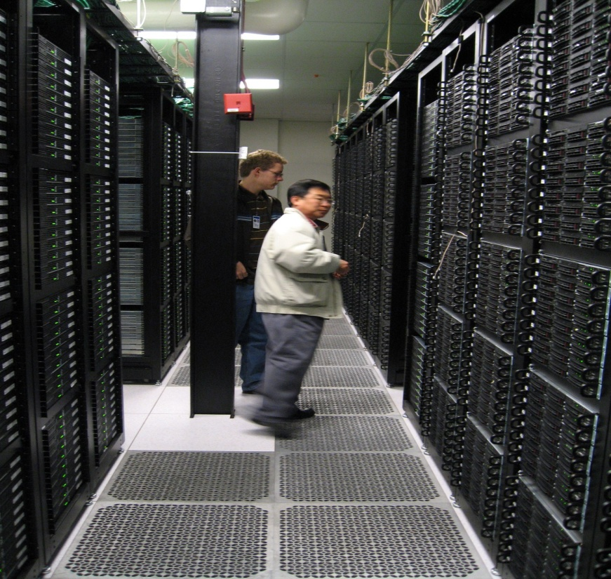
Computers put together a picture
Digital data
p
‾p
Data Reconstruction

Slide 14
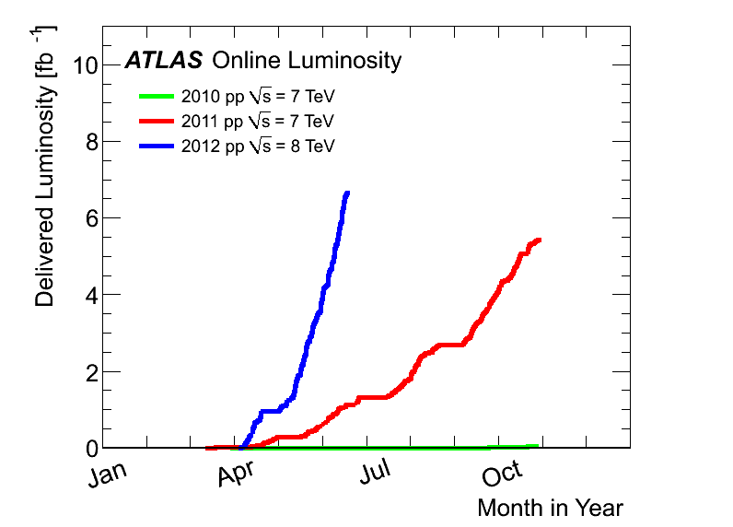
Amount of ATLAS Data
2012:
6.6 fb⁻¹
at 8 TeV
2011
5.6 fb⁻¹
at 7 TeV
2010
0.05 fb⁻¹
at 7 TeV

Slide 15
What is the Higgs and What does it do?
When there is perfect symmetry, one cannot tell directions!
Only when symmetry is broken, can one tell directions
Higgs field works to break the perfect symmetry and give mass
  This field exists right now amongst us so that we have mass
Sometimes, this field spontaneously generates a particle, the Higgs particle
So the Higgs particle is the evidence of the existence of the Higgs field!

Slide 16
How do we look for the Higgs?
Higgs particle is so heavy they decay into some other particles very quickly
When one searches for a new particle, you look for the easiest way to get at them
Of these many signatures of the Higgs, some states are much easier to find, if it were the Standard Model one
  H→ γγ
  H → ZZ* → 4e, 4μ, 2e2μ, 2e2ν and 2μ2ν
  H→ WW*→2e2ν and 2μ2ν
  And many more complicated signatures

Slide 17
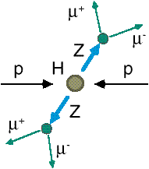
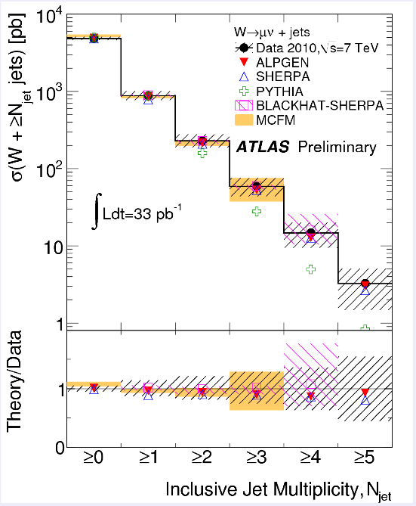
How do we look for the Higgs?
Identify the Higgs candidate events
Understand fakes (backgrounds)
Look for a bump!!
e⁺ (μ⁺)
e⁻ (μ⁻)
e⁺
e⁻

Slide 18
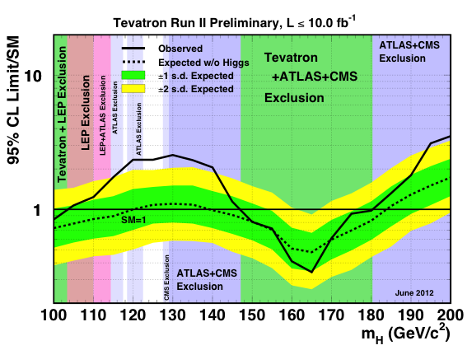
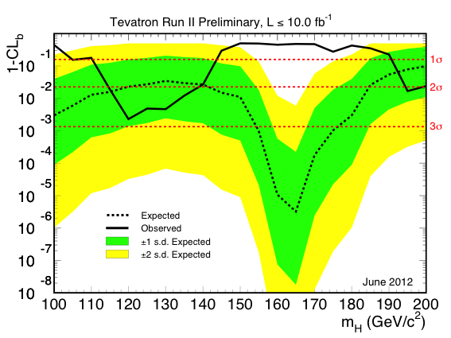
What does Tevatron tell us on Higgs?

Slide 19
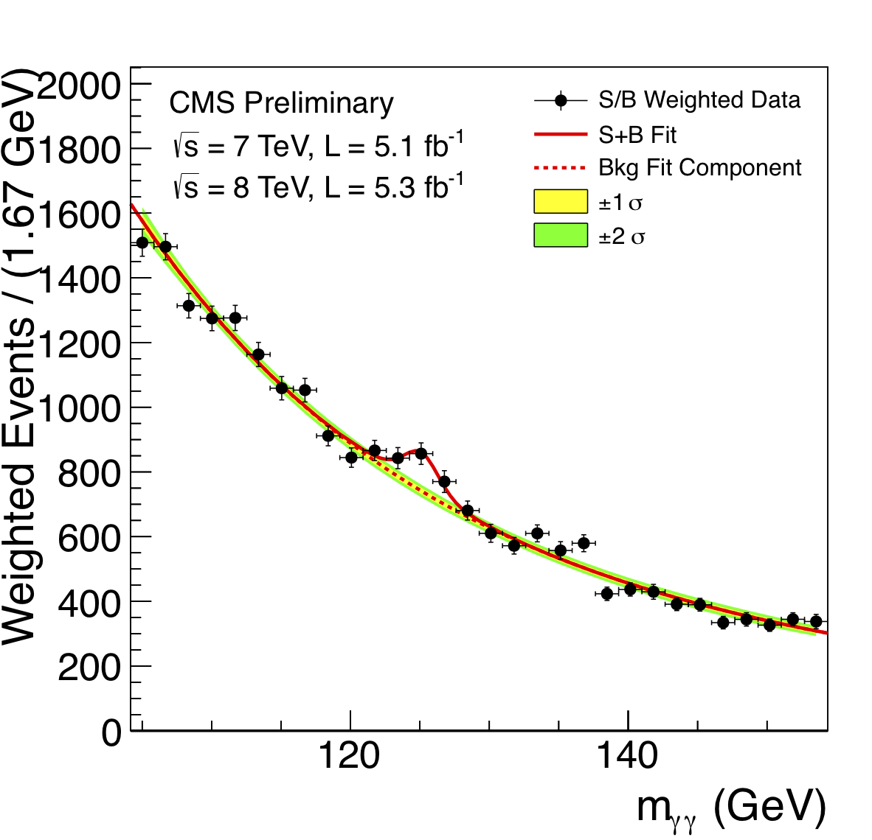
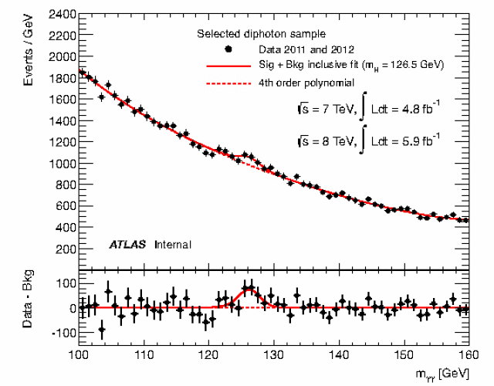
ATLAS and CMS Mass Bump Plots
ATLAS
CMS
LOOK, Ma! Bumps!!

Slide 20
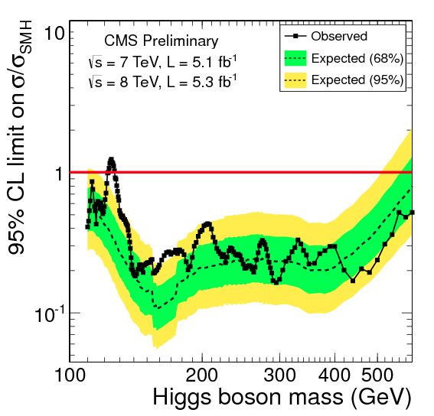
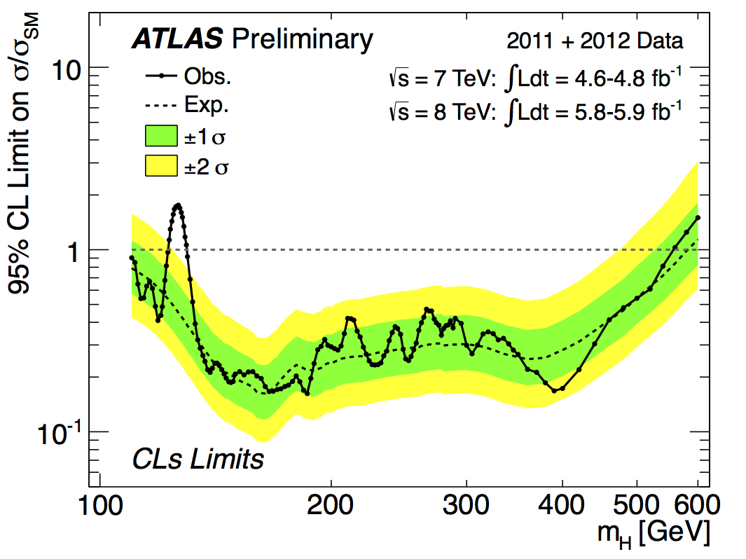
ATLAS Higgs – All M_{H}
ATLAS
CMS

Slide 21
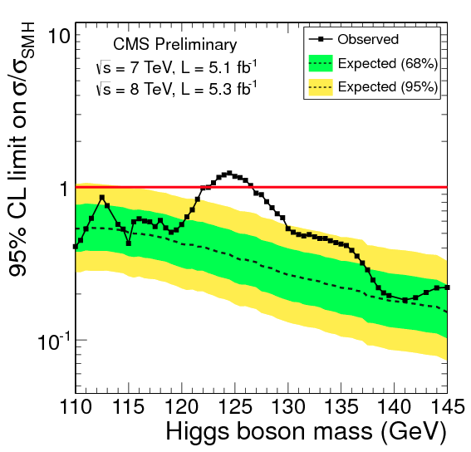
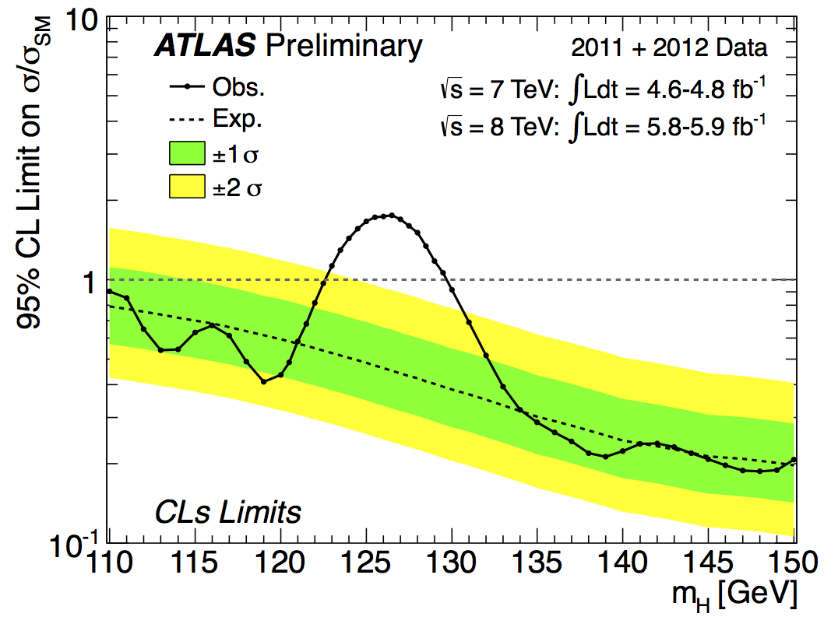
ATLAS and CMS Higgs – low M_{H}
ATLAS
CMS

Slide 22
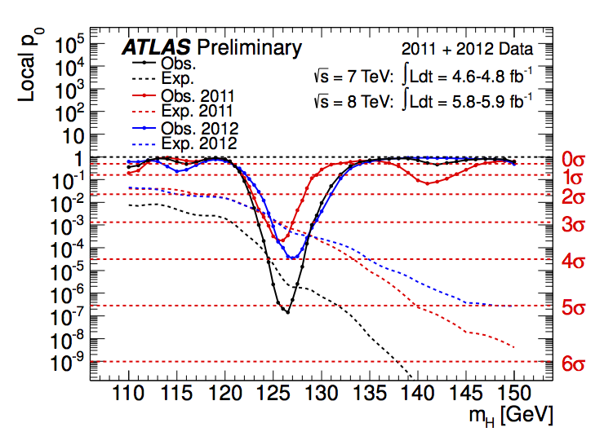
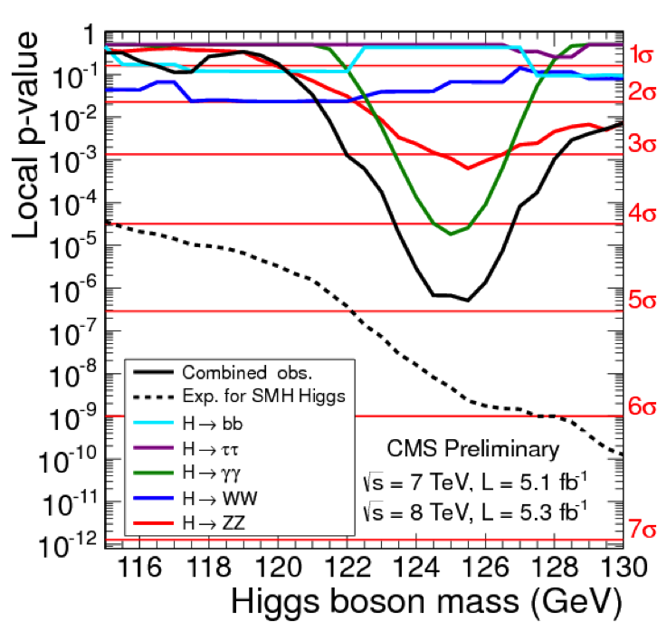
ATLAS and CMS Higgs – Prob.
CMS
ATLAS

Slide 23
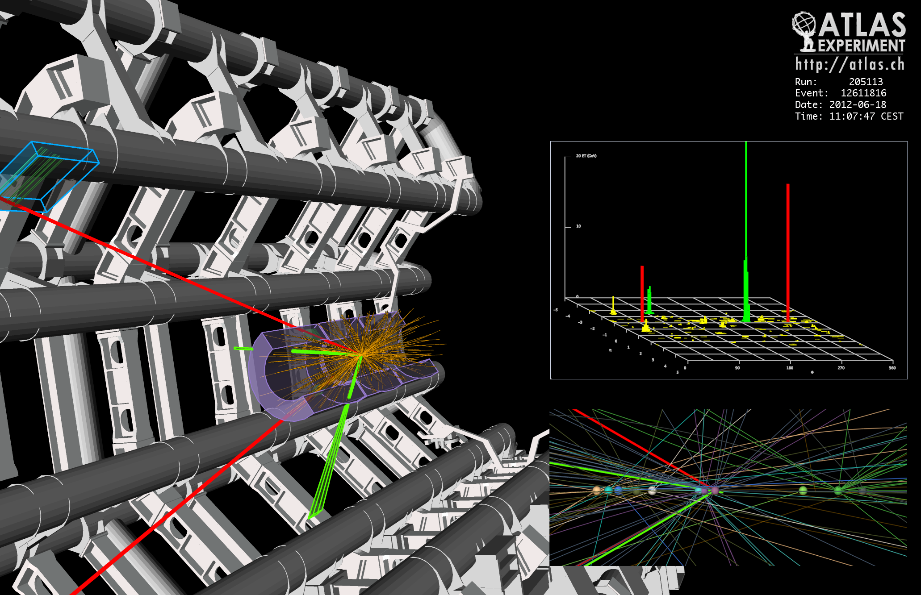
ATLAS Higgs Candidate

Slide 24
So have we seen the Higgs particle?
The statistical significance of the finding is to 5 standard deviations
  Level of significance: 99.99994%
  We can be wrong once if we perform the same experiment 1,740,000 times
So did we find the Higgs particle?
  We have discovered a new particle, the heaviest boson we’ve seen thus far
  It has some properties consistent with the Standard Model Higgs particle
  We, however, do not have enough data to precisely measure all the properties – mass, life time, the rate at which this particle decays to certain other particles, etc – to definitively determine

Slide 25
So why is this discovery important?
This is the giant first in completing the Standard Model
Will help understand the origin of mass and the mechanism at which mass is acquired
Will help understand the origin and the structure of the universe and the inter-relations of the forces
Will help us make our lives better
Generate excitements and interests on science and train the next generation

Slide 26
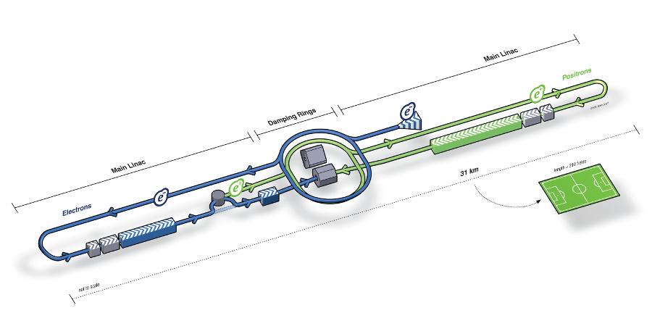
What next? Future Linear Collider
Now that we have found a new boson, precision measurement of the particle’s properties becomes important
An electron-positron collider on a straight line for precision measurements
10~15 years from now (In Dec. 2011, Japanese PM announced that they would bid for a LC in Japan)
Takes 10 years to build the detector
L~31km
Circumference ~6.6km
~300 soccer fields

Slide 27


Slide 28
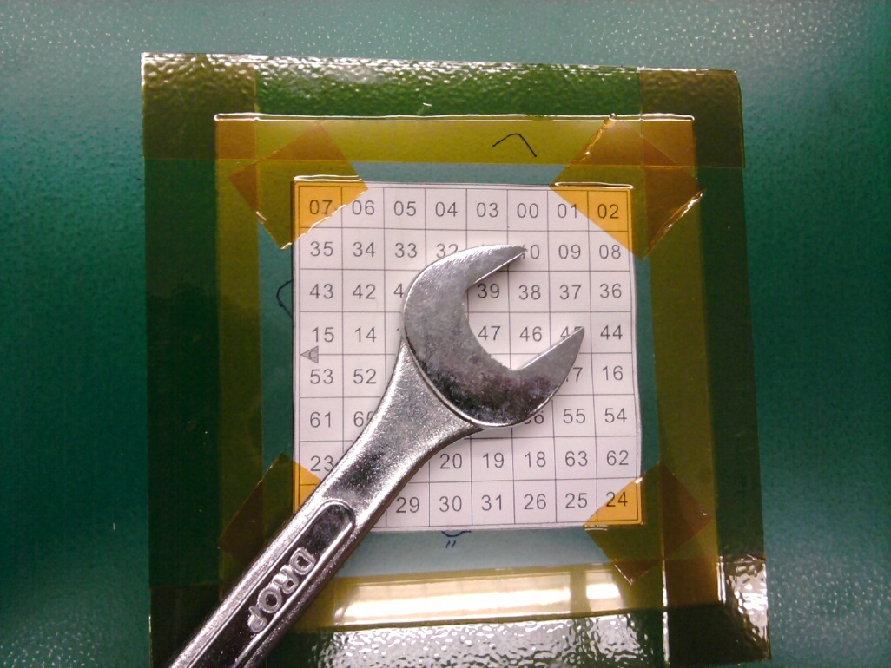
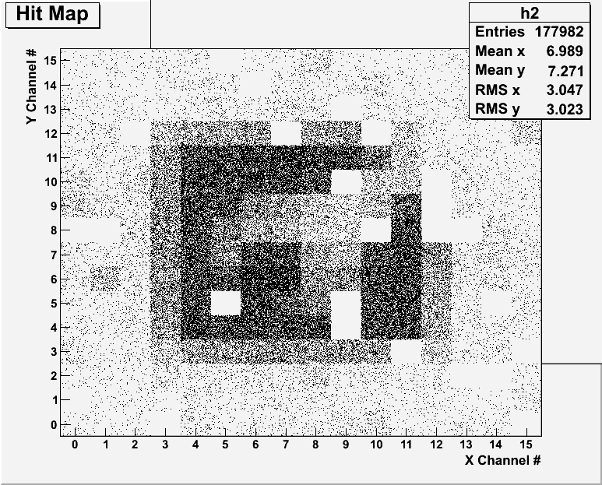
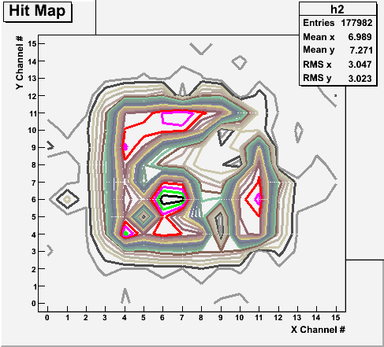
Radioactive Source Run with Internal Trigger
Noisy channels masked out!
Can you see what the object is?

Slide 29
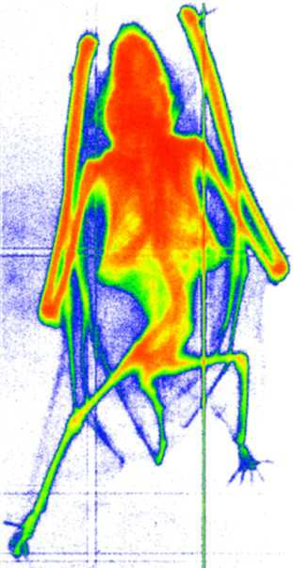
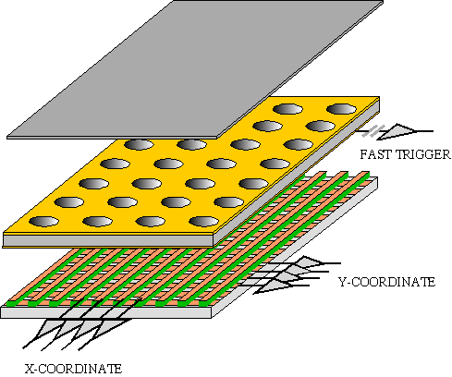
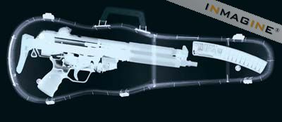
GEM Application Potential
FAST X-RAY IMAGING
Using the lower GEM signal, the readout can be self-triggered with energy discrimination:
9 keV absorption radiography of a small mammal (image size ~ 60 x 30 mm²)
A. Bressan et al,
Nucl. Instr. and Meth. A 425(1999)254
F. Sauli, Nucl. Instr. and Meth.A 461(2001)47

Slide 30
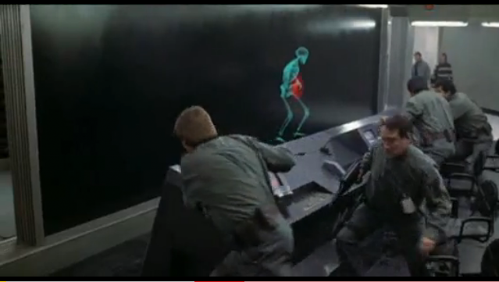
And in not too distant future, we could do …

Slide 31
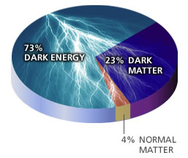
So are we done yet?
Why are there three families of quarks and leptons?
Why is the mass range so large (0.1m_{p} – 175 m_{p})?
How do matters acquire mass?
  Higgs mechanism but where is the Higgs, the God particle?
Why is the matter in the universe made only of particles?
  What happened to anti-particles? Or anti-matters?
Do neutrinos have mass& what are the mixing parameters?
Why are there only three apparent forces?
Is the picture we present the real thing?
  What makes up the 96% of the universe?
  How about extra-dimensions?
How is the universe created?
Are there any other theories that describe the universe better?
Many more questions to be answered!!

Slide 32
Information & Communication Source
Course web page: http://www-hep.uta.edu/%7Eyu/teaching/fall12-3313-001/fall12-3313-001.html
  Contact information & Class Schedule
  Syllabus
  Homework
  Holidays and Exam days
  Evaluation Policy
  Class Style & Communication
  Other information
Primary communication tool is e-mail: Make sure that your e-mail at the time of course registration is the one you most frequently read!!
Office Hours for Dr. Yu: 2:30 – 3:40pm, Mondays and Wednesdays or by appointments

Slide 33
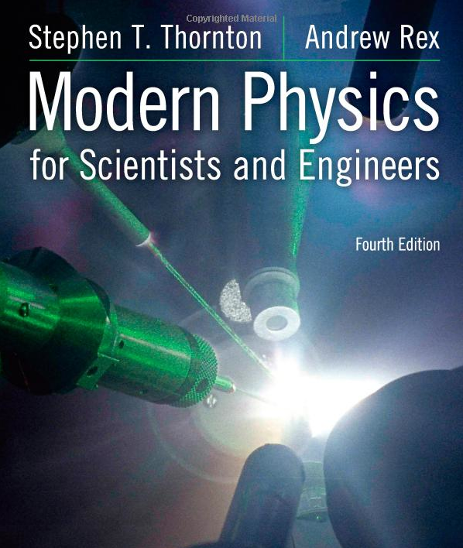
Textbook
Title: Modern Physics for Scientists and Engineers
  4th edition
Authors: S.T. Thornton and A. Rex
ISBN: 978-1-133-10372-1

Slide 34
Evaluation Policy
Homework: 30%
Exams
  Mid-term Exam (Wed., Oct. 10): 20%
  Final Comprehensive Exam (Wed., Dec. 12): 25%
  Missing an exam is not permissible unless pre-approved
    No makeup test
    You will get an F if you miss any of the exams without a prior approval
Group Research Project: 15%
Pop-quizzes: 10%
Extra credits: 10% of the total
Grading will be done on a sliding scale
55% of the grade is in your hand!!
100%

Slide 35
Homework
Solving homework problems is the only way to comprehend class material
Consists of a lot of reading, deriving and writing
Each homework carries the same weight
ALL homework grades will be used for the final grade
Home work will constitute 30% of the total
  A good way of keeping your grades high
Strongly encouraged to collaborate
  Just make sure to submit your own answers written in your OWN way!!

Slide 36
Attendances and Class Style
Attendances:
  Will be taken randomly
  Will be used for extra credits
Class style:
  Lectures will be on electronic media
    The lecture notes will be posted on the web AFTER each class
  Will be mixed with traditional methods
  Active participation through questions and discussions are STRONGLY encouraged ➔ Extra credit….
  Communication between you and me is extremely important
    If you have problems, please do not hesitate talking to me

Slide 37
Extra credit
Up to 10% addition to the total
  Could boost a B to A, C to B or D to C
What constitute for extra credit?
  Random attendances
  Physics Colloquium Participations
  Strong participation in the class discussions
  Special projects
  Watch the valid planetarium shows
  Many other opportunities

Slide 38
Valid Planetarium Shows
Regular running shows
  Experience the Aurora – Fridays at 6:00, Saturdays at 5:30
  Violent Universe – Sundays at 1:30
  Black Holes – Thursdays at 6:00, Saturdays at 2:30
Shows that need special arrangements
  IBEX
  Magnificent Sun
  Nano Cam
  Stars of the Pharaohs
  Time Space
  Two Small Pieces of Glass
  Unseen Universe: The Vision of SOFIA
  Wonders of the Universe
How to submit for extra credit?
  Obtain the ticket stub that is signed and dated by the planetarium star lecturer of the day
  Collect the ticket stubs
  Tape all of them on a sheet of paper with your name and ID written on it
  Submit the sheet at the end of the semester when asked

Slide 39
What can you expect from this class?
All A’s would be perfect for you, wouldn’t it?
  But easy come easy go
  Must put in efforts to make it last and meaningful….
This class is going to be challenging!!
You will earn your grade in this class.
  You will need to put in sufficient time and sincere efforts
  Exams and quizzes will be tough!!
    Sometimes problems might not look exactly like what you learned in the class
    Just putting the right answer in free response problems does not work!
But you have a great control of your grade in your hands, up to 45%!!!
  Homework is 30% of the total grade!!
    Means you will have many homework problems
      Sometimes much more than any other classes
      Sometimes homework problems will be something that you have yet to learn in class
      Exam’s problems will be easier that homework problems but the same principles!!
  Extra credit 10%
I will work with you so that your efforts are properly rewarded

Slide 40
What do we want to learn in this class?
The physics that provided fundamentals to the technical progress for us
Learn concepts of quantum theory for microscopic phenomena and relativity for phenomena with high speed
Learn physical principles that we still exploit
Learn skills to express observations and measurements in mathematical language
Learn skills to research literatures and express your research in systematic manner in writing
Build up confidence in your physics abilities and to take on any challenges laid in front of you!!
Most importantly, let us have a lot of FUN!!

Slide 41
In this course, you will learn…
Concepts and derivation of many of the modern physics
  Special relativity
  Quantum theory
  Atomic physics
  Condensed Matter physics
  Nuclear physics
  Particle Physics
Focus on learning about the concepts with less complicated math
You will be able to understand what fundamental physics provides bases for the current technology

