Slide 1
PHYS 3313 – Section 001 Lecture #2
Wednesday, Aug. 29, 2012
Dr. Jaehoon Yu
Classical Physics
Kinetic Theory of Gas
Concept of Waves and Particles
Conservation Laws and Fundamental Forces
Atomic Theory of Matter
Unsolved Questions of 1895 and New Horizon

Slide 2
Announcements
Reading assignment #1: Read and follow through appendices 3, 5, 6 and 7 by Tuesday, Sept. 4
There will be a quiz next Wednesday, Sept. 5, on this reading assignment
Nobel laureate, Steven Weinberg, will give a public lecture at 7:30pm, Wednesday, Oct. 24
Required attendance!

Slide 3
Special Project #1
Compute the electric force between the two protons separate the farthest in an intact U²³⁸ nucleus. Use the actual size of the U²³⁸ nucleus. (10 points)
Compute the gravitational force between the two protons separate the farthest in an intact U²³⁸ nucleus. (10 points)
Express the electric force in terms of the gravitational force. (5 points)
You must look up the mass of the proton, actual size of the U²³⁸ nucleus, etc, and clearly written on your project.
You MUST have your own, independent answers to the above three questions even if you worked together with others. All those who share the answers will get 0 credit if copied.
Due for the submission is Monday, Sept. 10!

Slide 4
Why do Physics?
Exp.{
To understand nature through experimental observations and measurements (Research)
Establish limited number of fundamental laws, usually with mathematical expressions
Predict the nature’s course
Theory and Experiment work hand-in-hand
Theory works generally under restricted conditions
Discrepancies between experimental measurements and theory are good for improvements
Improves our everyday lives, even though some laws can take a while till we see them amongst us
Theory {
4

Slide 5
Brief History of Physics
AD 18th century:
Newton’s Classical Mechanics: A theory of mechanics based on observations and measurements
AD 19th Century:
Electricity, Magnetism, and Thermodynamics
Late AD 19th and early 20th century (Modern Physics Era, after 1895)
People thought everything was done and nothing new could be discovered
Concept of atoms did not exist
Few problems not well understood late 19th century became the basis for new discoveries in 20th century
That culminates in understanding of phenomena in microscopic scale and extremely high speed approaching the speed of light (3x10⁸m/s)
Einstein’s theory of relativity: Generalized theory of space, time, and energy (mechanics)
Quantum Mechanics: Theory of atomic phenomena
5

Slide 6
MECHANICS
CLASSICAL
PHYSICS
ELECTRICITY
AND
MAGNETISM
THERMODYNAMICS
CONSERVATION LAWS

Slide 7
Triumph of Classical Physics: The Conservation Laws
Conservation of energy: The total sum of energy (in all its forms) is conserved in all interactions.
Conservation of linear momentum: In the absence of external forces, linear momentum is conserved in all interactions.
Conservation of angular momentum: In the absence of external torque, angular momentum is conserved in all interactions.
Conservation of charge: Electric charge is conserved in all interactions.

Slide 8
Mechanics
Galileo (1564-1642)
First great experimentalist
Principle of inertia
Established experimental foundations

Slide 9
Isaac Newton (1642-1727)
Three laws describing the relationship between mass and acceleration.
Newton’s first law (law of inertia): An object in motion with a constant velocity will continue in motion unless acted upon by some net external force.
Newton’s second law: Introduces force (F) as responsible for the the change in linear momentum (p):
Newton’s third law (law of action and reaction): The force exerted by body 1 on body 2 is equal in magnitude and opposite in direction to the force that body 2 exerts on body 1.

Slide 10
Electromagnetism
Contributions made by:
Coulomb (1736-1806)
Oersted (1777-1851)
Young (1773-1829)
Ampère (1775-1836)
Faraday (1791-1867)
Henry (1797-1878)
Maxwell (1831-1879)
Hertz (1857-1894)

Slide 11
Culminates in Maxwell’s Equations
In the absence of dielectric or magnetic materials, the four equations developed by Maxwell are:
Gauss’ Law for electricity
A generalized form of Coulomb’s law relating electric field to its sources, the electric charge
Gauss’ Law for magnetism
A magnetic equivalent of Coulomb’s law relating magnetic field to its sources. This says there are no magnetic monopoles.
Faraday’s Law
An electric field is produced by a changing magnetic field
Generalized Ampére’s Law
A magnetic field is produced by an electric current or by a changing electric field

Slide 12
Thermodynamics
Deals with temperature, heat, work, and the internal energy of systems
Contributions made by:
Benjamin Thompson (1753-1814)
Sadi Carnot (1796-1832)
James Joule (1818-1889)
Rudolf Clausius (1822-1888)
William Thompson (1824-1907)

Slide 13
Primary Results
Introduces thermal equilibrium
The first law establishes heat as energy
Introduces the concept of internal energy
Interprets temperature as a measure of internal energy
Generates limitations of the energy processes that cannot take place

Slide 14
The Laws of Thermodynamics
First law: The change in the internal energy ΔU of a system is equal to the heat Q added to a system plus the work W done by the system ➔ Generalization of conservation of energy including heat
ΔU = Q + W
Second law: It is not possible to convert heat completely into work without some other change taking place.
The “zeroth” law: Two systems in thermal equilibrium with a third system are in thermal equilibrium with each other.
Explicitly stated only in early 20th century
Third law: It is not possible to achieve an absolute zero temperature.

Slide 15
The Kinetic Theory of Gases
Contributions made by:
Robert Boyle (1627-1691) ➔ PV = constant (fixed T)
Jacques Charles (1746-1823) & Joseph Louis Gay-Lussac (1778-1823) ➔ V/T=constant (fixed P)
Culminates in the ideal gas equation for n moles of a “simple” gas:
PV = nRT
(where R is the ideal gas constant, 8.31 J/mol · K)
We know now that gases consist of rapidly moving atoms and molecules, bouncing off each other and the walls!!

Slide 16
Additional Contributions
Amedeo Avogadro (1776-1856) ➔ Hypothesized in 1811 that the equal V of gases at the same T and P contain equal number of molecules (N_{A}=6.023x10²³ molecules/mol)
1 mole of Hydrogen molecule is 2g & 1 mole of carbon is 12g.
John Dalton (1766-1844) opposed due to confusion between his own atomic model and the molecules
Daniel Bernoulli (1700-1782) ➔ Kinetic theory of gases in 1738
By 1895, the kinetic theory of gases are widely accepted
Ludwig Boltzmann (1844-1906), James Clerk Maxwell (1831-1879) & J. Willard Gibbs (1939-1903) made statistical interpretation of thermodynamics bottom half of 19th century

Slide 17
Primary Results of Statistical Interpretation
Average molecular kinetic energy directly related to absolute temperature
Internal energy U directly related to the average molecular kinetic energy
Internal energy equally distributed among the number of degrees of freedom (f ) of the system
(N_{A} = Avogadro’s Number)
And many others

Slide 18
Concept of Waves and Particles
Two ways in which energy is transported:
Point mass interaction: transfers of momentum and kinetic energy: particles
Extended regions wherein energy transfers by way of vibrations and rotations are observed: waves

Slide 19
Particles vs. Waves
Two distinct phenomena describing physical interactions
Both required Newtonian mass
Particles in the form of point masses and waves in the form of perturbation in a mass distribution, i.e., a material medium
The distinctions are observationally quite clear; however, not so for the case of visible light
Thus by the 17th century begins the major disagreement concerning the nature of light

Slide 20
The Nature of Light
Isaac Newton promoted the corpuscular (particle) theory
Published a book “Optiks” in 1704
Particles of light travel in straight lines or rays
Explained sharp shadows
Explained reflection and refraction
Christian Huygens (1629 -1695) promoted the wave theory
Presented theory in 1678
Light propagates as a wave of concentric circles from the point of origin
Explained reflection and refraction
Did not explain sharp shadows
Thomas Young (1773 -1829) & Augustin Fresnel (1788 – 1829) ➔ Showed in 1802 and afterward that light clearly behaves as wave through two slit interference and other experiments
In 1850 Foucault showed that light travel slowly in medium, the final blow to the corpuscular theory in explaining refraction

Slide 21
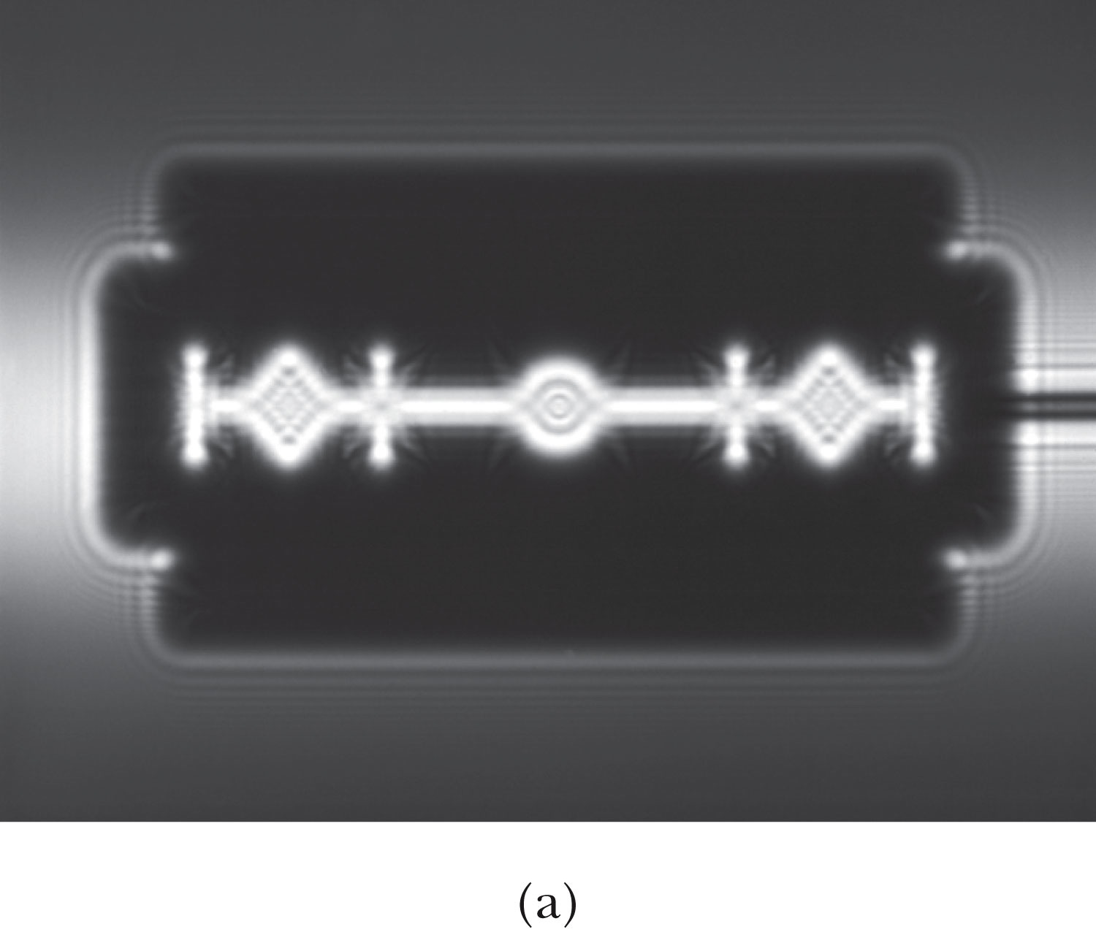
The Wave Theory Advances…
Contributions by Huygens, Young, Fresnel and Maxwell
Double-slit interference patterns
Refraction of light from a vacuum to a medium
Light was an electromagnetic phenomenon
Shadows are not as sharp as once thought with the advancement of experimental precision
Establishes that light propagates as a wave

Slide 22
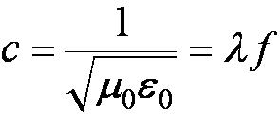
The Electromagnetic Spectrum
Visible light covers only a small range of the total electromagnetic spectrum
All electromagnetic waves travel in a vacuum with a speed c given by:
(where μ₀ and ε₀ are the respective permeability and permittivity of “free” space)

Slide 23
Conservation Laws and Fundamental Forces
Conservations laws are guiding principles of physics
Recall the fundamental conservation laws:
Conservation of energy
Conservation of linear momentum
Conservation of angular momentum
Conservation of electric charge
In addition to the classical conservation laws, two modern results will include:
The conservation of baryons and leptons
The fundamental invariance principles for time reversal, distance, and parity

Slide 24
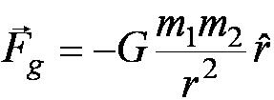
Also in the Modern Context…
The three fundamental forces are introduced
Gravitational:
Responsible for planetary motions, holding things on the ground, etc
Electroweak
Weak: Responsible for nuclear beta decay and effective only over distances of ~10⁻¹⁵ m
Electromagnetic: Responsible for all non-gravitational interactions, such as all chemical reactions, friction, tension….
(Coulomb force)
Strong: Responsible for “holding” the nucleus together and effective less than ~10⁻¹⁵ m

Slide 25
Relative Strength of Fundamental Forces

Slide 26
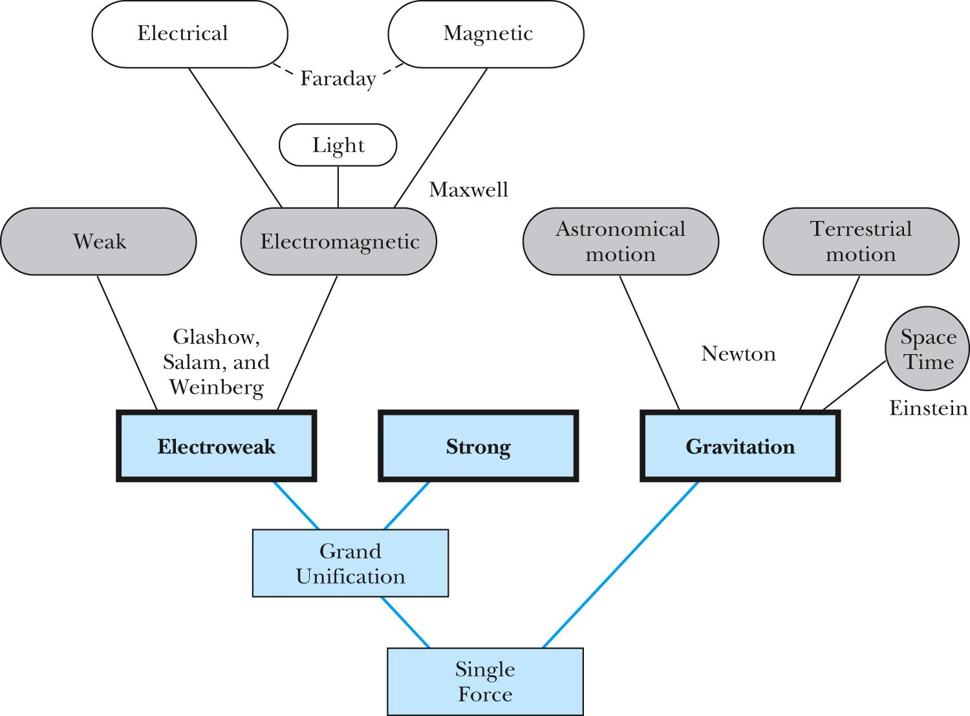
Unification of Forces
GUT, String theory
Not yet experimentally verified: p decays, magnetic monopole
Note: Weinberg is coming for a public lecture at 7:30pm, Wednesday, Oct. 24; “The Standard Model, Higgs Boson, Who Cares?”

Slide 27
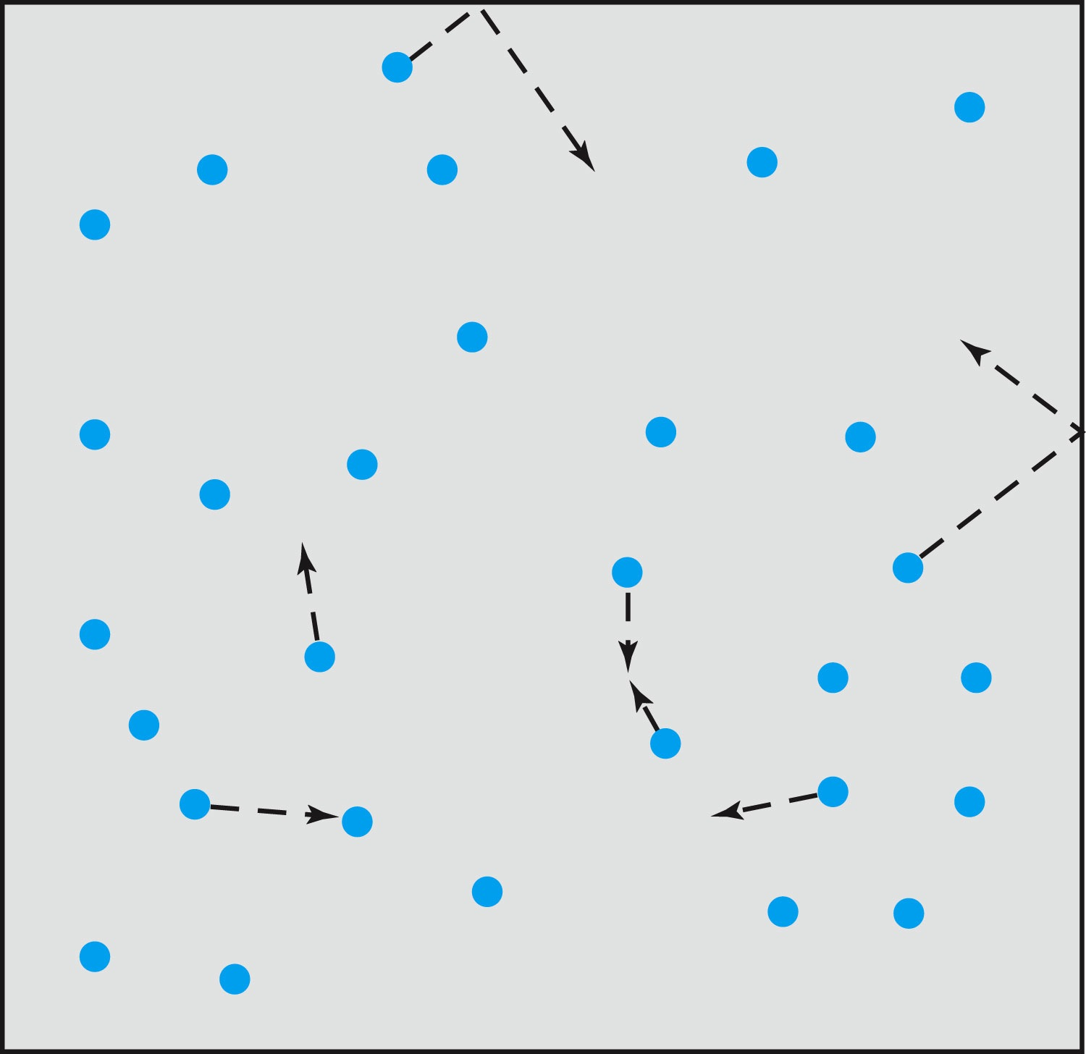
Relevance of Gas Concept to Atoms
The idea of gas (17th century) as a collection of small particles bouncing around with kinetic energy enabled concept of small, unseen objects
This concept formed the bases of existence something small that make up matter

Slide 28
The Atomic Theory of Matter
Concept initiated by Democritus and Leucippus (~450 B.C.)
(first to us the Greek atomos, meaning “indivisible”)
In addition to fundamental contributions by Boyle, Charles, and Gay-Lussac, Proust (1754 – 1826) proposes the law of definite proportions
Dalton advances the atomic theory of matter to explain the law of definite proportions
Avogadro proposes that all gases at the same temperature, pressure, and volume contain the same number of molecules (atoms); viz. 6.02 × 10²³ atoms
Cannizzaro (1826 – 1910) makes the distinction between atoms and molecules advancing the ideas of Avogadro.

Slide 29
Further Advances in Atomic Theory
Maxwell derives the speed distribution of atoms in a gas
Robert Brown (1753 – 1858) observes microscopic “random” motion of suspended grains of pollen in water
Einstein in the 20th century explains this random motion using atomic theory

Slide 30
Opposition to the Atomic Theory
Ernst Mach (1838 – 1916) opposes the theory on the basis of logical positivism, i.e., atoms being “unseen” place into question their reality
Wilhelm Ostwald (1853 – 1932) supports this premise but on experimental results of radioactivity, discrete spectral lines, and the formation of molecular structures

Slide 31
Overwhelming Evidence for Existence of Atoms
Max Planck (1858 – 1947) advances the concept to explain blackbody radiation by use of submicroscopic “quanta”
Boltzmann requires existence of atoms for his advances in statistical mechanics
Albert Einstein (1879 – 1955) uses molecules to explain Brownian motion and determines the approximate value of their size and mass
Jean Perrin (1870 – 1942) experimentally verifies Einstein’s predictions

Slide 32
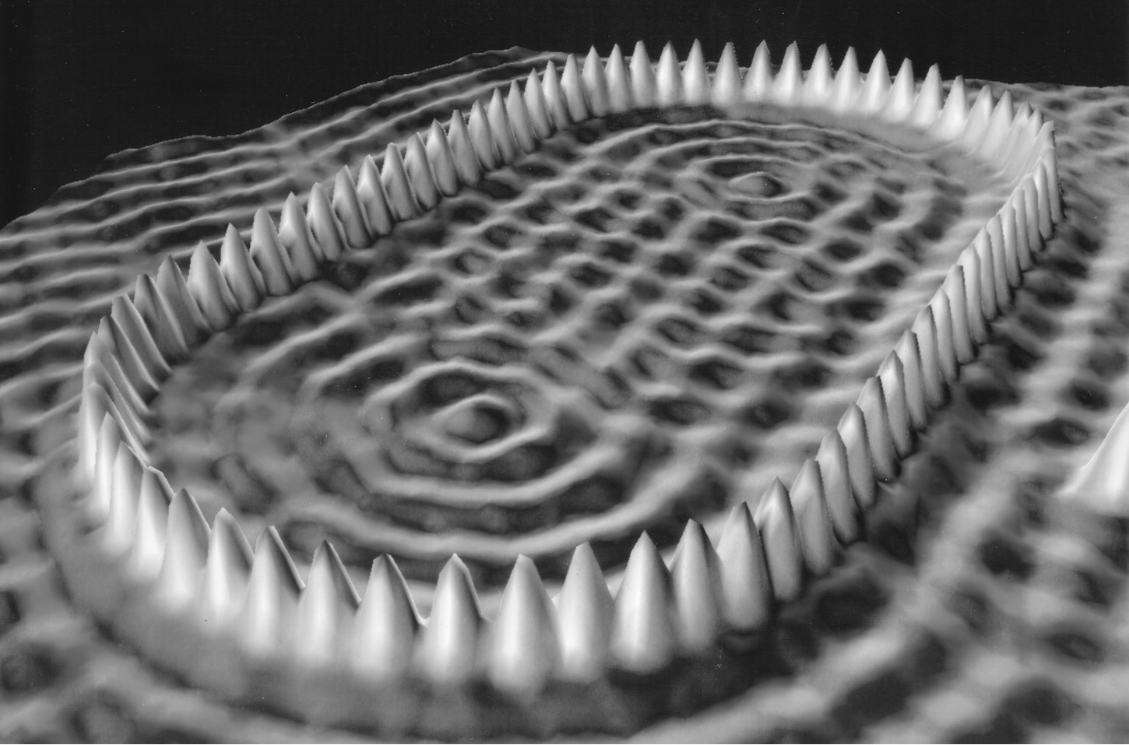
Unresolved Questions and New Horizons
The atomic theory controversy raises fundamental questions
It was not universally accepted
The constitutes (if any) of atoms became a significant question
The structure of matter remained unknown with certainty
Experimental precisions were insufficient to discern this level of small scale

Slide 33
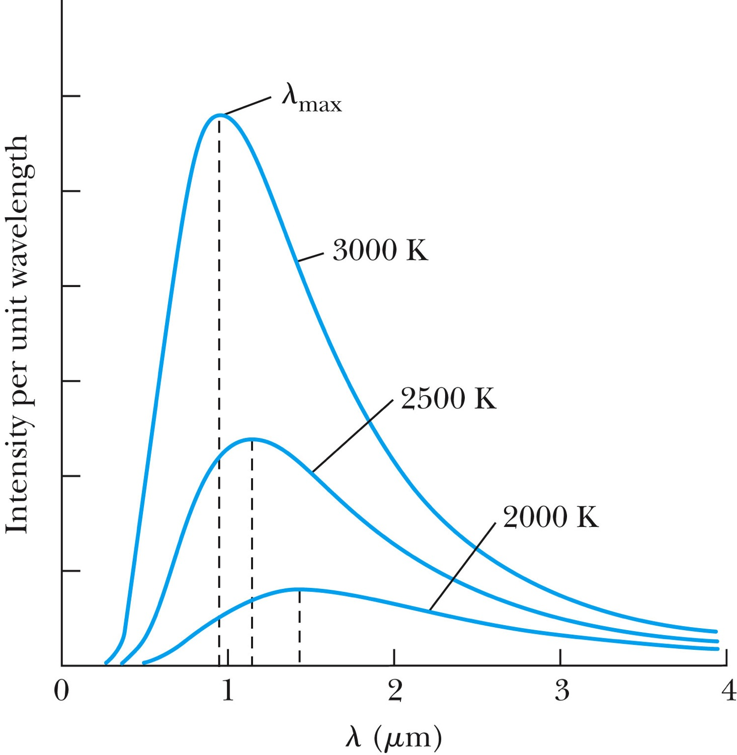
Further Complications
Three fundamental problems:
The (non) existence of an EM medium that transmits light from the sun
The observed differences in the electric and magnetic field between stationary and moving reference systems
The failure of classical physics to explain blackbody radiation in which characteristic spectra of radiation that cover the entire EM wavelengths were observed depending on temperature not on the body itself

Slide 34
Additional Discoveries Contribute to the Complications
Discovery of x-rays (1895, Rontgen)
Discovery of radioactivity (1896, Becquerel)
Discovery of the electron (1897, Thompson)
Discovery of the Zeeman effect (1896, Zeeman) dependence of spectral frequency on magnetic field

Slide 35
The Beginnings of Modern Physics
These new discoveries and the many resulting complications required a revision of the fundamental physical assumptions culminated in the successes of the classical foundations
To this end the introduction of the modern theory of relativity and quantum mechanics becomes the starting point of this most fascinating revision

Slide 36
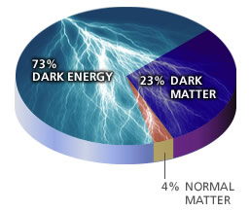
Unsolved Problems Today!
Why are there three families of quarks and leptons?
Why is the mass range so large (0.1m_{p} – 175 m_{p})?
How do matters acquire mass?
Higgs mechanism but where is the Higgs, the God particle?
Why is the matter in the universe made only of particles?
What happened to anti-particles? Or anti-matters?
Do neutrinos have mass& what are the mixing parameters?
Why are there only three apparent forces?
Is the picture we present the real thing?
What makes up the 96% of the universe?
How about extra-dimensions?
How is the universe created?
Are there any other theories that describe the universe better?
Many more questions to be answered!!

