Slide 1
PHYS 3313 – Section 001 Lecture #4
Monday, Sept. 10, 2012
Dr. Jaehoon Yu
Lorentz Transformation
Time Dilation & Length Contraction
Relativistic Velocity Addition
Twin Paradox
Spacetime Diagram

Slide 2
Announcements
Reading assignments: CH 2.7 and 2.8
Reminder for homework #1
chapter 2 end of the chapter problems
17, 21, 23, 24, 32, 59, 61, 66, 68, 81 and 96
Due is by the beginning of the class, coming Wednesday, Sept. 12
Given the fact that this is not an online submission, the deadline is deferred to Beginning of the class Monday, Sept. 17
Work in study groups together with other students but PLEASE do write your answer in your own way!
Colloquium this week: Physics faculty research expo
Please be sure to sign in with my class clearly marked!
And write your name as clearly as you can!

Slide 3
Special Project #2
Derive the three Lorentz velocity transformation equations. (10 points)
Derive the three reverse Lorentz velocity transformation equations. (10 points)
You must derive each one separately starting from the Lorentz spatial coordinate transformation equations to obtain any credit.
Just switching the signs and primes will not cut!
Must take the simplest form of the equations, using β and γ.
You MUST have your own, independent answers to the above three questions even if you worked together with others. All those who share the answers will get 0 credit if copied.
Due for the submission is Wednesday, Sept. 19!

Slide 4
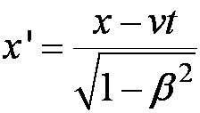
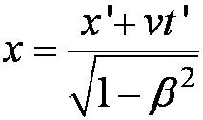
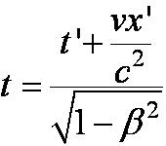
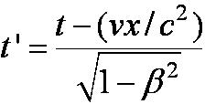
The complete Lorentz Transformations
Some things to note
What happens when β~0 (or v~0)?
The Lorentz x-formation becomes Galilean x-formation
Space-time are not separated
For non-imaginary x-formations, the frame speed cannot exceed c!

Slide 5
Time Dilation and Length Contraction
Direct consequences of the Lorentz Transformation:
Time Dilation:
Clocks in a moving inertial reference frame K’ run slower with respect to stationary clocks in K.
Length Contraction:
Lengths measured in a moving inertial reference frame K’ are shorter with respect to the same lengths stationary in K.

Slide 6
Time Dilation
To understand time dilation the idea of proper time must be understood:
proper time,T₀, is the time difference between two events occurring at the same position in a system as measured by a clock at that position.
Same location (spark “on” then off”)

Slide 7
Time Dilation
Is this a Proper Time?
spark “on” then spark “off”
Beginning and ending of the event occur at different positions

Slide 8
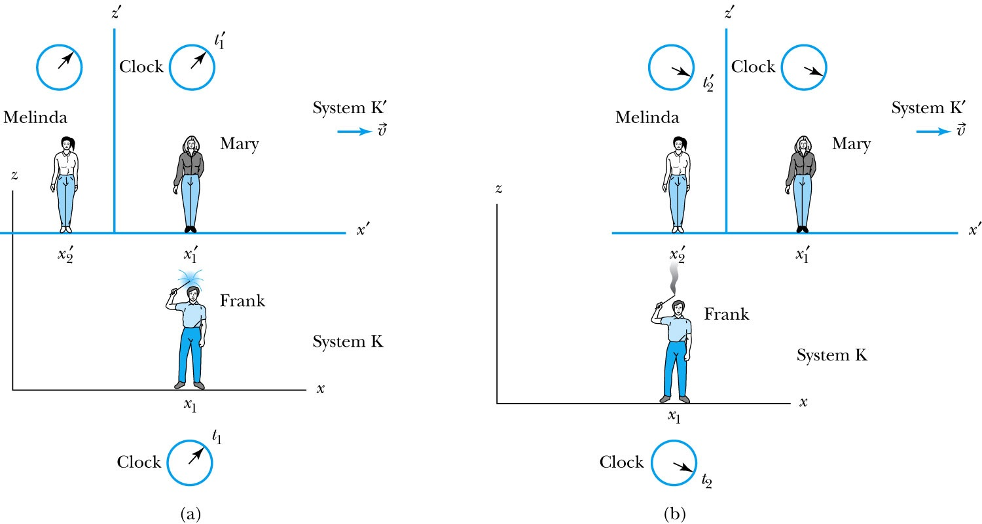
Time Dilation with Mary, Frank, and Melinda
Frank’s clock is at the same position in system K when the sparkler is lit in (a) (t=t₁) and when it goes out in (b) (t=t₂). ➔ The proper time T₀=t₂-t₁
Mary, in the moving system K’, is beside the sparkler when it was lit (t=t₁’)
Melinda then moves into the position where and when the sparkler extinguishes (t=t₂’)
Thus, Melinda, at the new position, measures the time in system K’ when the sparkler goes out in (b).

Slide 9
According to Mary and Melinda…
Mary and Melinda measure the two times for the sparkler to be lit and to go out in system K’ as times t₁’and t₂’ so that by the Lorentz transformation:
Note here that Frank records x₂ – x₁ = 0 in K with a proper time: T₀ = t₂ – t₁ or
with T’= t₂’ – t₁’

Slide 10
Time Dilation: Moving Clocks Run Slow
1) T ‘> T₀ or the time measured between two events at different positions is greater than the time between the same events at one position: time dilation.
The proper time is always the shortest time!!
2) The events do not occur at the same space and time coordinates in the two system
3) System K requires 1 clock and K’ requires 2 clocks.

Slide 11
Time Dilation Example: muon lifetime
Muons are essentially heavy electrons (~200 times heavier)
Muons are typically generated in collisions of cosmic rays in upper atmosphere and, unlike electrons, decay ( μsec)
For a muon incident on Earth with v=0.998c, an observer on Earth would see what lifetime of the muon?
2.2 μsec?
t=35 μsec
Moving clocks run slow so when an outside observer measures, they see a longer time than the muon itself sees.

Slide 12
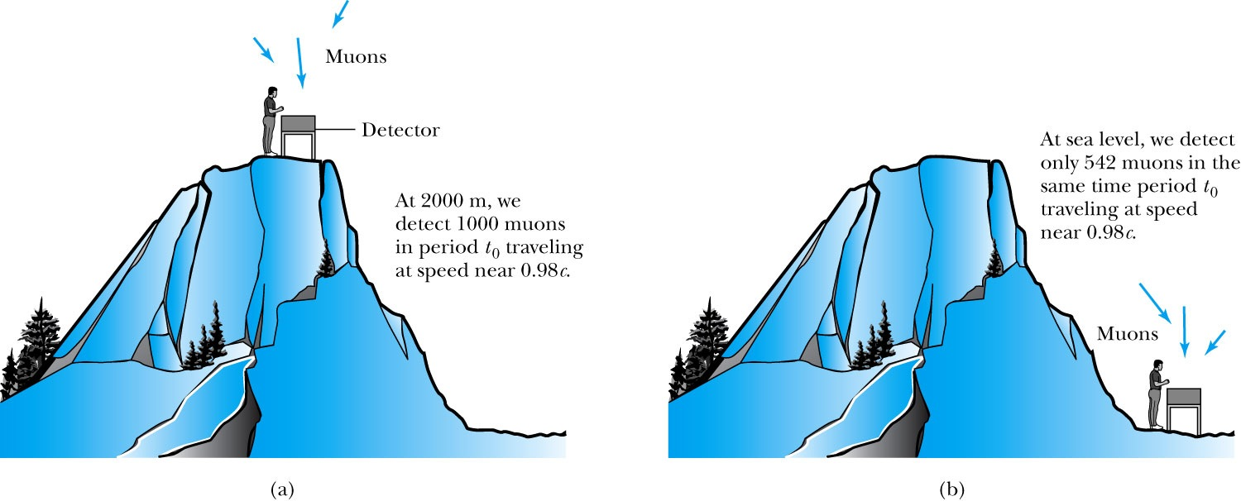
Experimental Verification of Time Dilation
Arrival of Muons on the Earth’s Surface
The number of muons detected with speeds near 0.98c is much different (a) on top of a mountain than
(b) at sea level, because of the muon’s decay. The experimental result agrees with our time dilation equation.

Slide 13
Length Contraction
To understand length contraction the idea of proper length must be understood:
Let an observer in each system K and K’ have a meter stick at rest in their own system such that each measures the same length at rest.
The length as measured at rest at the same time is called the proper length.
Notes:
Added “their own system”; changed measure to measures

Slide 14
Length Contraction cont’d
Each observer lays the stick down along his or her respective x axis, putting the left end at x_{ℓ} (or x’_{ℓ}) and the right end at x_{r} (or x’_{r}).
Thus, in the rest frame K, Frank measures his stick to be:
L₀ = x_{r} - x_{ℓ}
Similarly, in the moving frame K’, Mary measures her stick at rest to be:
L’₀ = x’_{r} – x’_{ℓ}
Frank in his rest frame measures the moving length in Mary’s frame moving with velocity.
Thus using the Lorentz transformations Frank measures the length of the stick in K’ as:
Where both ends of the stick must be measured simultaneously, i.e, t_{r} = t_{ℓ}
Here Mary’s proper length is L’₀ = x’_{r} – x’_{ℓ}
and Frank’s measured length is L = x_{r} – x_{ℓ}

Slide 15
Measurement in Rest Frame
The observer in the rest frame measures the moving length as L given by
but since both Mary and Frank in their respective frames measure L’₀ = L₀
and L₀ > L, i.e. the moving stick shrinks

Slide 16
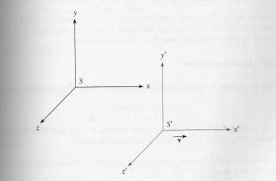
Length Contraction Summary
Proper length (length of object in its own frame:
Length of object in observer’s frame:
γ>1 so the length is shorter in the direction of motion
(length contraction!)

Slide 17
More about Muons
Rate: 1/cm²/minute at Earth’s surface (so for a person with 600 cm² that would be 600/60=10 muons/sec passing through!)
They are typically produced in atmosphere about 6 km above surface of Earth and often have velocities that are a substantial fraction of speed of light, v=.998 c for example and life time 2.2 μsec
How do they reach the Earth if they only go 660 m and not 6000 m?
The time dilation stretches life time to t=35 μsec not 2.2 μsec, thus they can travel 16 times further, or about 10 km, implying they easily reach the ground
But riding on a muon, the trip takes only 2.2 μsec, so how do they reach the ground???
Muon-rider sees the ground moving towards him, so the length he has to travel contracts and is only
At 1000 km/sec, it would take 5 seconds to cross U.S. , pretty fast, but does it give length contraction? {not much contraction}
(for v=0.9c, the length is reduced by 44%)

Slide 18
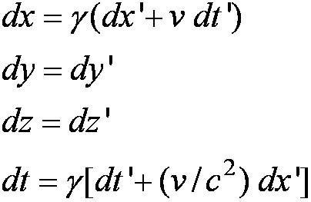
Addition of Velocities
How do we add velocities in a relativistic case?
Taking differentials of the Lorentz transformation, relative velocities may be calculated:

Slide 19
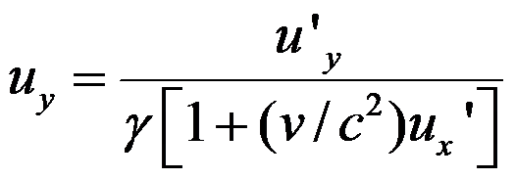
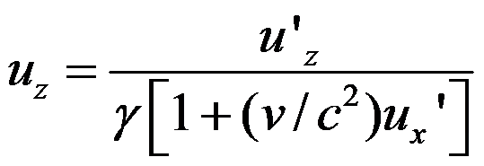
So that…
defining velocities as: u_{x} = dx/dt, u_{y} = dy/dt, u’_{x} = dx’/dt’, etc. it can be shown that:
With similar relations for u_{y} and u_{z:}

Slide 20
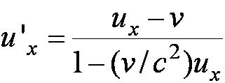
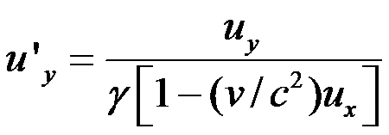
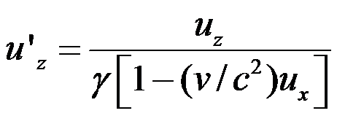
The Lorentz Velocity Transformations
In addition to the previous relations, the Lorentz velocity transformations for u’_{x}, u’_{y} , and u’_{z} can be obtained by switching primed and unprimed and changing v to –v:

Slide 21
Velocity Addition Summary
Galilean Velocity addition where and
From inverse Lorentz transform and
So
Thus
What would be the measured speed of light in S frame?
Since we get
Observer in S frame measures c too! Strange but true!

Slide 22
Velocity Addition Example
Lance is riding his bike at 0.8c relative to observer. He throws a ball at 0.7c in the direction of his motion. What speed does the observer see?
What if he threw it just a bit harder?
Doesn’t help—asymptotically approach c, can’t exceed (it’s not just a postulate it’s the law)

Slide 23
Twin Paradox
The Set-up: Twins Mary and Frank at age 30 decide on two career paths: Mary (the Moving twin) decides to become an astronaut and to leave on a trip 8 lightyears (ly) from the Earth at a great speed and to return; Frank (the Fixed twin) decides to reside on the Earth.
The Problem: Upon Mary’s return, Frank reasons that her clocks measuring her age must run slow. As such, she will return younger. However, Mary claims that it is Frank who is moving and consequently his clocks must run slow.
The Paradox: Who is younger upon Mary’s return?

Slide 24
The Resolution
Frank’s clock is in an inertial system during the entire trip; however, Mary’s clock is not. As long as Mary is traveling at constant speed away from Frank, both of them can argue that the other twin is aging less rapidly.
When Mary slows down to turn around, she leaves her original inertial system and eventually returns in a completely different inertial system.
Mary’s claim is no longer valid, because she does not remain in the same inertial system. There is also no doubt as to who is in the inertial system. Frank feels no acceleration during Mary’s entire trip, but Mary does.

