Slide 1
PHYS 3313 – Section 001
Lecture #5
Wednesday, Sept. 12, 2012
Dr. Jaehoon Yu
Spacetime Diagram& Invariants
The Doppler Effect
Relativistic Momentum and Energy
Relationship between relativistic quantities
Binding energy

Slide 2
Announcements
Reading assignments: CH 2.10 (special topic), 2.13 and 2.14
  Please go through eq. 2.45 through eq. 2.49 and example 2.9
Reminder for homework #1
  chapter 2 end of the chapter problems
  17, 21, 23, 24, 32, 59, 61, 66, 68, 81 and 96
  Due is by the beginning of the class, Monday, Sept. 17
  Work in study groups together with other students but PLEASE do write your answer in your own way!
Colloquium today: Physics faculty research expo
  Drs. Brandt, Deng, Farbin, Liu, Veervatina and Zhang

Slide 3
Special Project #2
Derive the three Lorentz velocity transformation equations. (10 points)
Derive the three reverse Lorentz velocity transformation equations. (10 points)
Prove that the spacetime invariant quantity s²=x²-(ct)² is indeed invariant, i.e. s²=s’², in Lorentz Transformation. (5 points)
You must derive each one separately starting from the Lorentz spatial coordinate transformation equations to obtain any credit.
  Just switching the signs and primes will not cut!
  Must take the simplest form of the equations, using β and γ.
You MUST have your own, independent answers to the above three questions even if you worked together with others. All those who share the answers will get 0 credit if copied.
Due for the submission is Wednesday, Sept. 19!

Slide 4
Spacetime
When describing events in relativity, it is convenient to represent events on a spacetime diagram.
In this diagram one spatial coordinate x specifies position and instead of time t, ct is used as the other coordinate so that both coordinates will have dimensions of length.
Spacetime diagrams were first used by H. Minkowski in 1908 and are often called Minkowski diagrams. Paths in Minkowski spacetime are called worldlines.

Slide 5
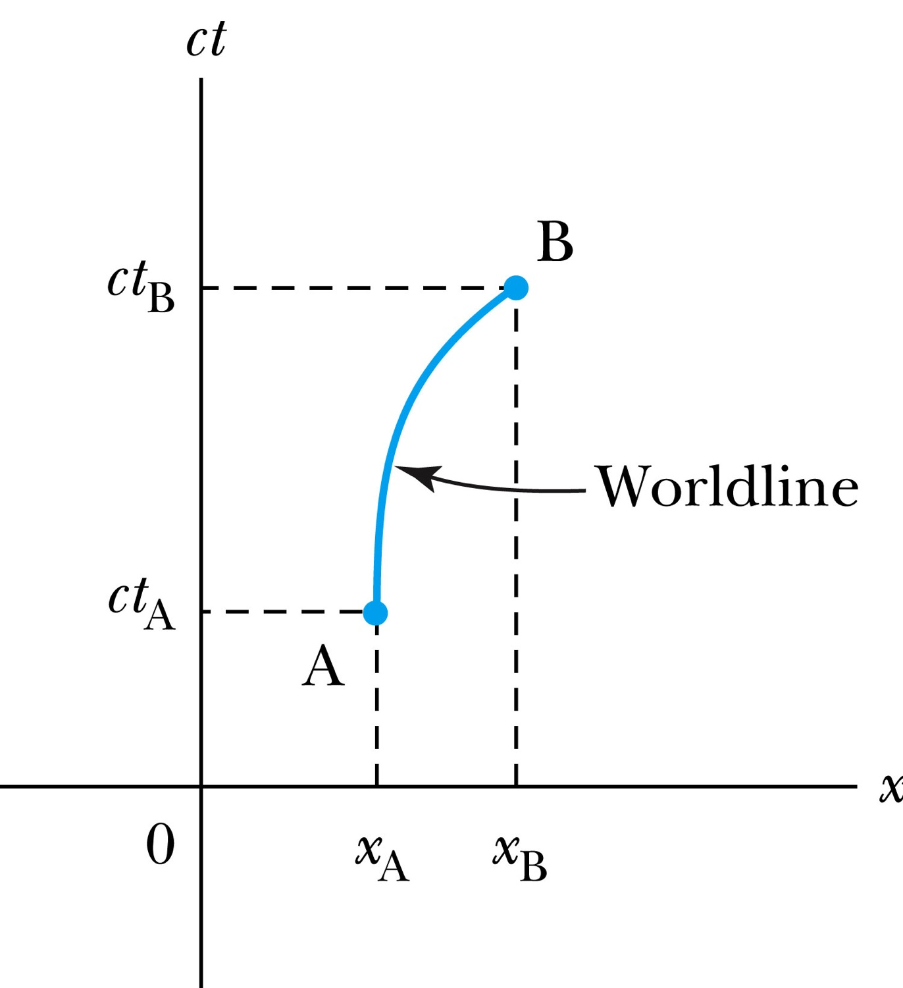
Spacetime Diagram
Notes:
Add the paragraph for Figure 2.21

Slide 6
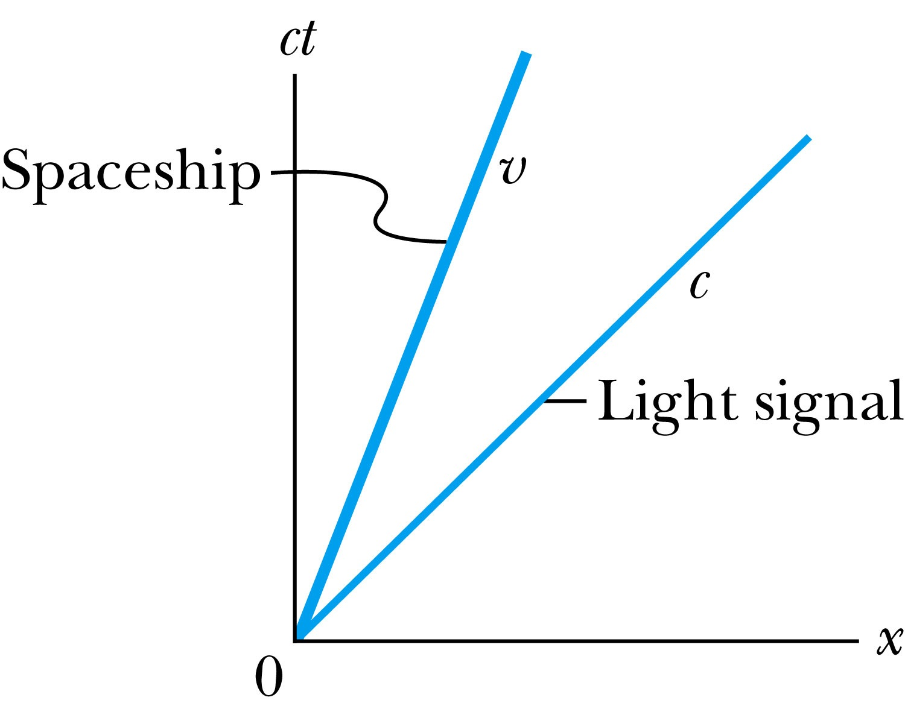
Particular Worldlines
How does the worldline for a spaceship running at the velocity v(<c) look?
How does the worldline for light signal look?
Notes:
Add the paragraph from Fig. 2.22

Slide 7
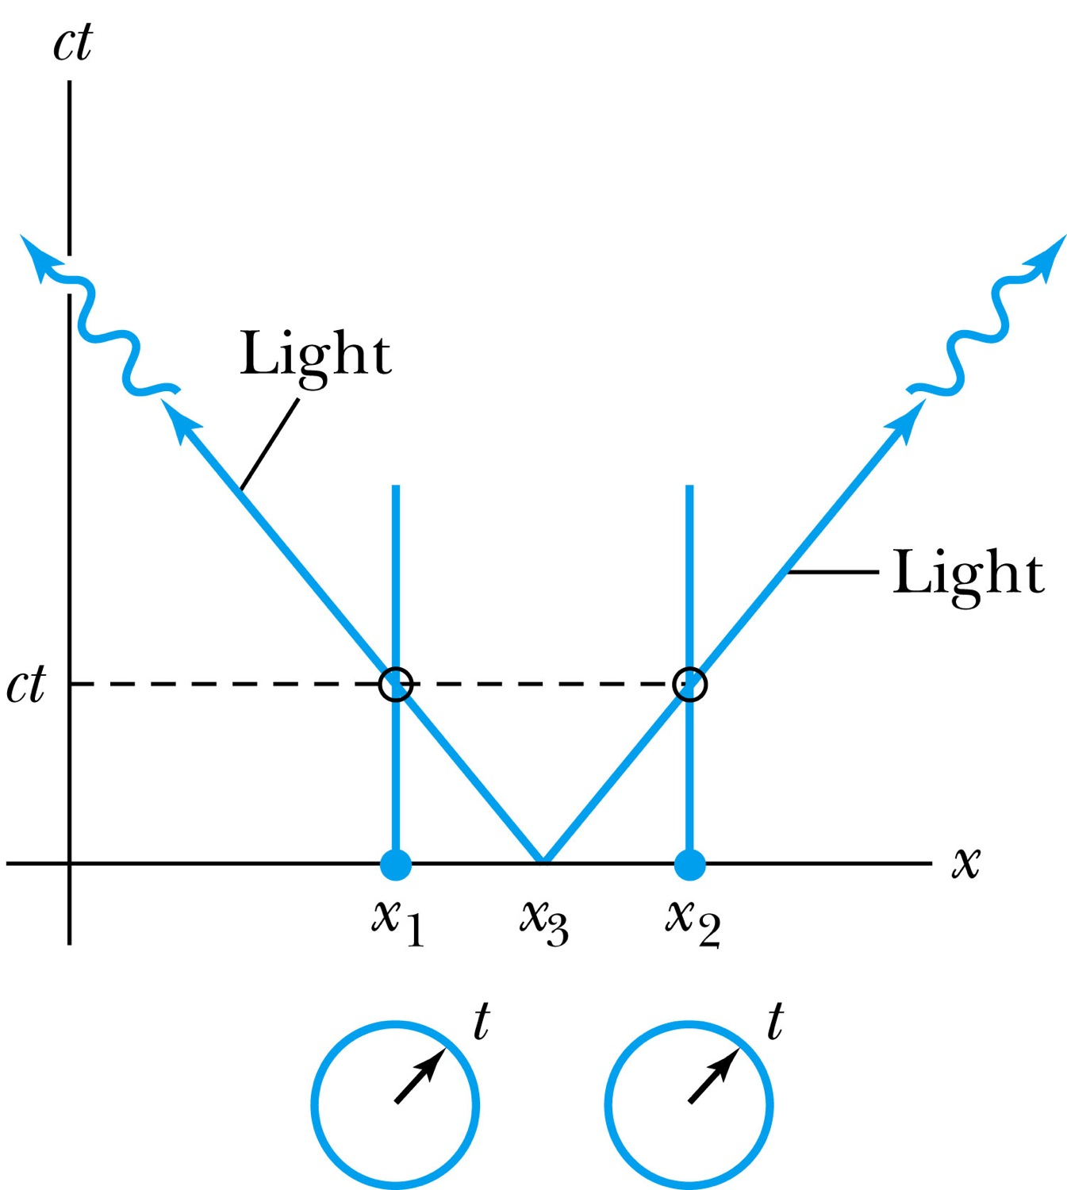
How about time measured by two stationary clocks?
Notes:
Add paragraph from figure 2.23

Slide 8
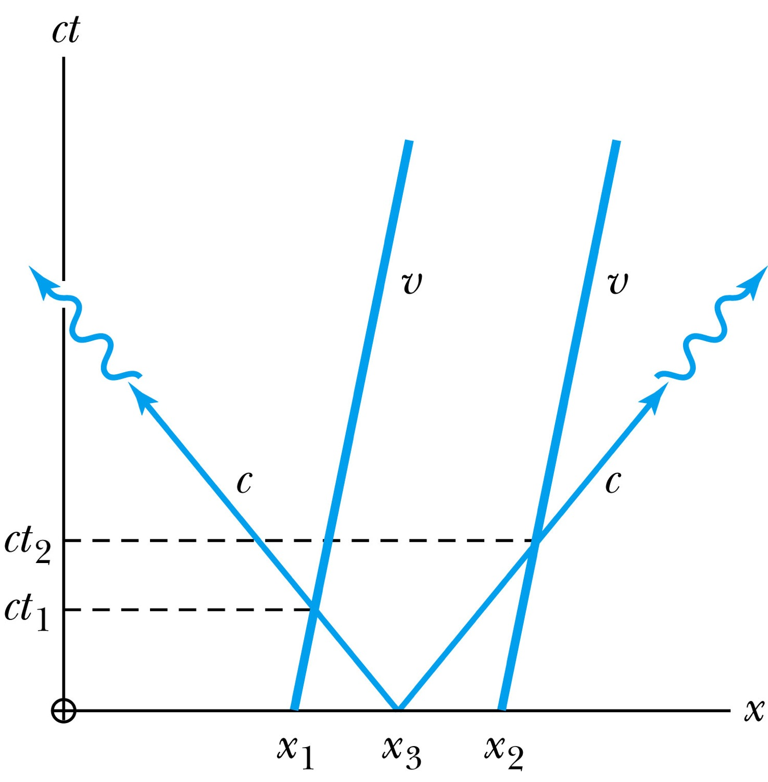
How about time measured by moving clocks?
Notes:
Add paragraph from figure 2.24

Slide 9
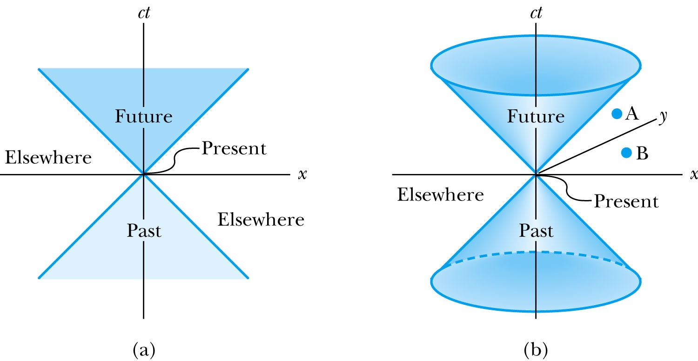
The Light Cone
Notes:
Add paragraph from Figure 2.25

Slide 10
Invariant Quantities: The Spacetime Interval
Since all observers “see” the same speed of light, then all observers, regardless of their velocities, must see spherical wave fronts. Thus the quantity:
s² = x² – c²t² = (x’)² – c² (t’)² = (s’)²
is invariant.
For any two events, the spacetime interval Δs²=Δx²-Δ(ct)² between the two events is invariant in any inertial frame.

Slide 11
Spacetime Invariants
There are three possibilities for the invariant quantity Δs²:
Δs²=Δx²-Δ(ct)²
Δs² = 0: Δx² = c² Δt²: lightlike separation
  Two events can be connected only by a light signal.
Δs² > 0: Δx² > c² Δt²: spacelike separation
  No signal can travel fast enough to connect the two events. The events are not causally connected!!
Δs² < 0: Δx² < c² Δt²: timelike separation
  Two events can be causally connected.
  These two events cannot occur simultaneously!

Slide 12
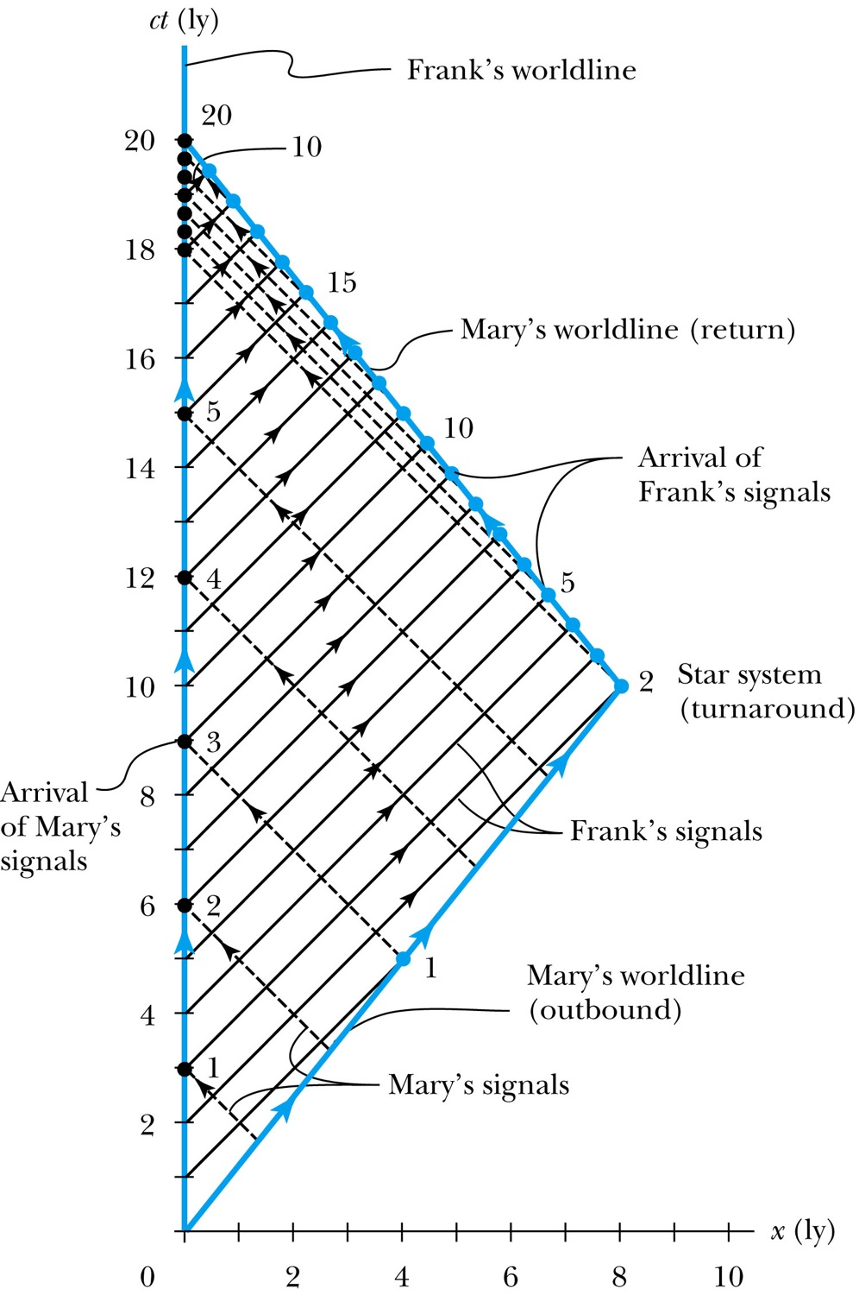
The Twin Paradox in Space-Time
Notes:
Figure 2.26 The spacetime diagram for Mary’s trip to the star system and back. Notice that Frank’s worldline is a vertical line at x = 0, and Mary’s two worldlines have the correct slope given by the magnitude c/v. The black dashed lines represent light signals sent at annual intervals from Mary to Frank. Frank’s annual signals to Mary are solid black. The solid dots denote the time when the light signals arrive.

Slide 13
The Doppler Effect
The Doppler effect of sound
  increased frequency of sound as a source approaches a receiver
  decreased frequency as the source recedes.
Also, the same change in sound frequency occurs when the source is fixed and the receiver is moving.
  The change in frequency of the sound wave depends on whether the source or receiver is moving.
Does this violate the principle of relativity?
  No
  Why not?
  Sounds wave is in a special frame of media such as air, water, or a steel plate in order to propagate;
Light does not need a medium to propagate!

Slide 14
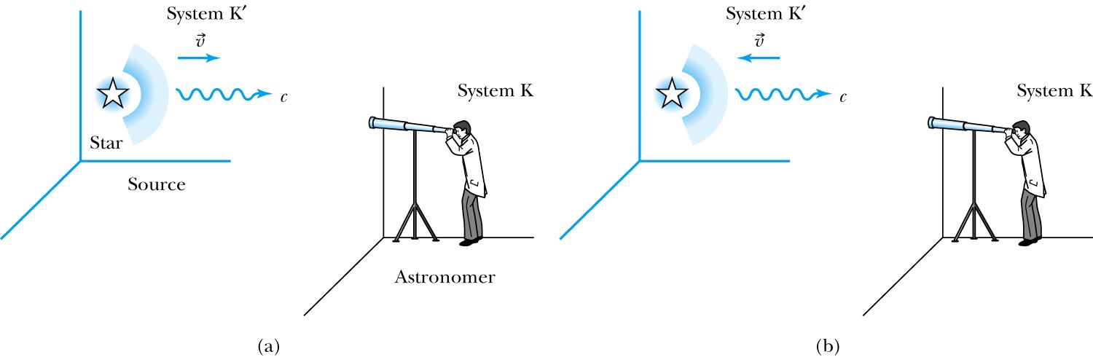
Recall the Doppler Effect
Notes:
Add paragraph from figure 2.27

Slide 15
The Relativistic Doppler Effect
Consider a source of light (a star) and a receiver (an astronomer) approaching one another with a relative velocity v.
Consider the receiver in system K and the light source in system K’ moving toward the receiver with velocity v.
The source emits n waves during the time interval T.
Because the speed of light is always c and the source is moving with velocity v, the total distance between the front and rear of the wave transmitted during the time interval T is:
Length of wave train = cT − vT

Slide 16
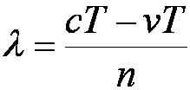
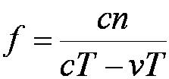
The Relativistic Doppler Effect (con’t)
Because there are n waves emitted by the source in time period T, the wavelength measured by the stationary receiver is
And the resulting frequency measured by the receiver is
The number of waves emitted in the moving frame of the source is n=f₀T ‘₀ with the proper time T’₀=T/γ we obtain the measured frequency by the receiver as

Slide 17
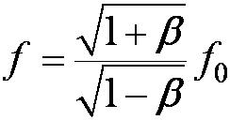
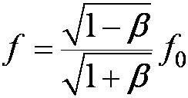
Results of Relativistic Doppler Effect
When source/receiver is approaching with β = v/c the resulting frequency is
Higher than the actual source’s frequency, blue shift!!
When source/receiver is receding with β = v/c the resulting frequency is
Lower than the actual source’s frequency, red shift!!
If we use +β for approaching source/receiver and -β for receding source/receiver, relativistic Doppler Effect can be expressed
What can we use this for?

Slide 18
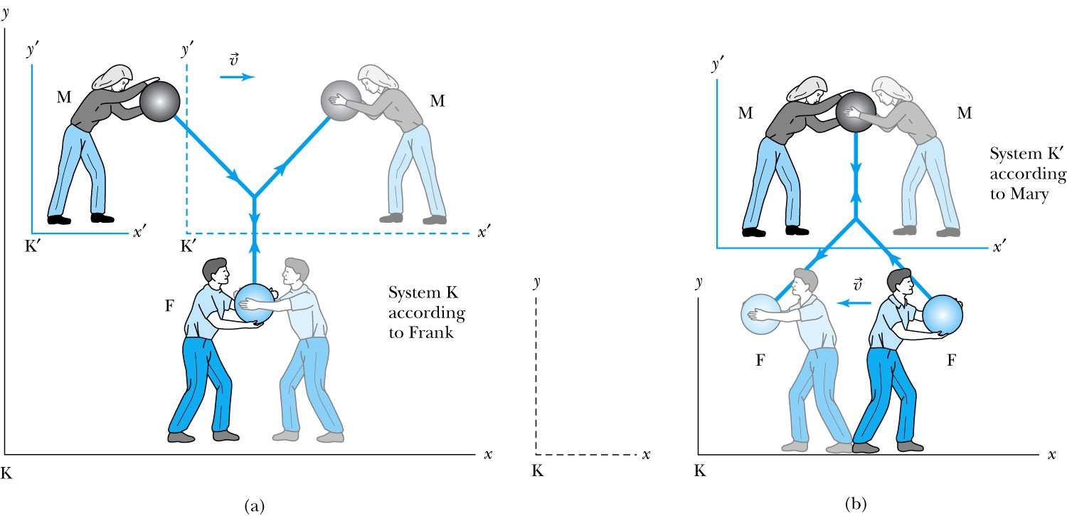
Relativistic Momentum
Most fundamental principle used here is the momentum conservation!
Frank is at rest in system K holding a ball of mass m.
Mary holds a similar ball in system K’ that is moving in the x direction with velocity v with respect to system K.
Notes:
Add paragraph from figure 2.29

Slide 19


Relativistic Momentum
If we use the definition of momentum, the momentum of the ball thrown by Frank is entirely in the y direction
p_{Fy} = mu₀
The change of momentum as observed by Frank is
Δp_{F} = Δp_{Fy} = −2mu₀
Mary measures the initial velocity of her own ball to be
u’_{Mx} = 0 and u’_{My} = −u₀.
In order to determine the velocity of Mary’s ball as measured by Frank we use the velocity transformation equations:

Slide 20


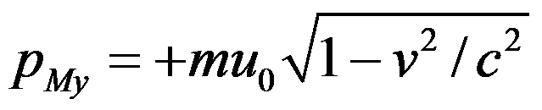
Relativistic Momentum
Before the collision, the momentum of Mary’s ball as measured by Frank (the Fixed frame) with the Lorentz velocity X-formation becomes
For a perfectly elastic collision, the momentum after the collision is
Thus the change in momentum of Mary’s ball according to Frank is
OMG! The linear momentum is not conserved even w/o external force!!
What do we do?
Redefine the momentum in a fashion
Something else has changed. Mass is now, mγ!! The relativistic mass!!
Mass as the fundamental property of matter is called the “rest mass”, m₀!
Notes:
Spaced a bit more evenly

Slide 21
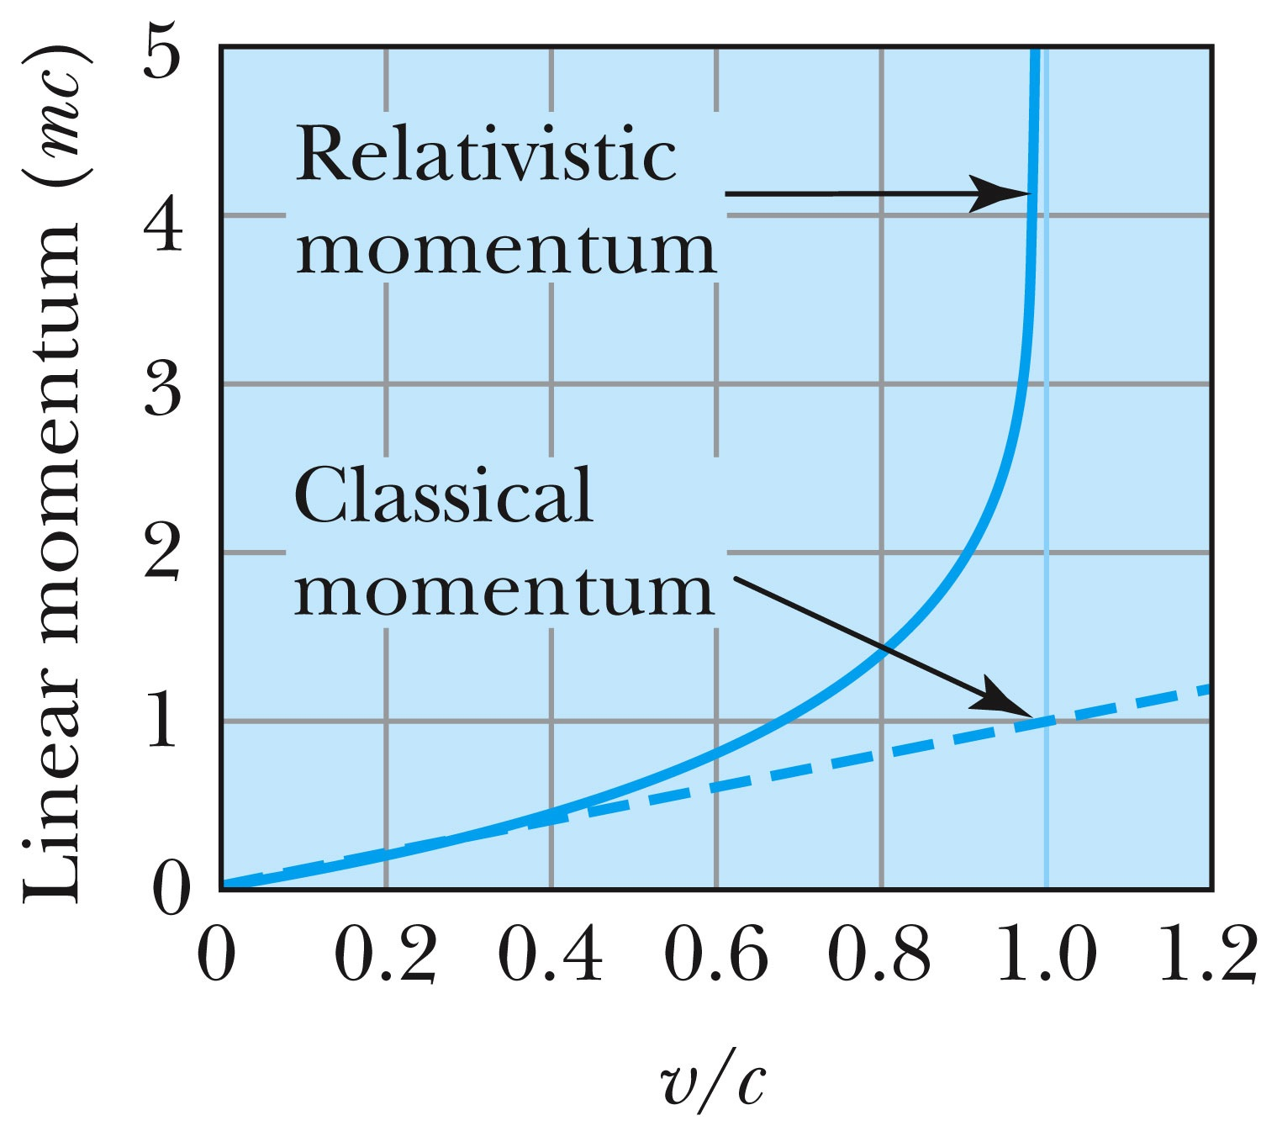
Relativistic and Classical Linear Momentum
Notes:
Add arrow head to the line from “Relativistic” to the graph
Possibly make the line from the “Classical” straight (as in figure 2.310
rather than curved, also add arrow head to this line pointing to the curve.

Slide 22
How do we keep momentum conserved in a relativistic case?
Redefine the classical momentum in the form:
This Γ(u) is different than the γ factor since it uses the particle’s speed u
➔ What? How does this make sense?
➔ Well the particle itself is moving with relativistic speed, thus that must impact the measurements by the observer in rest frame!!
Now, the agreed value of the momentum in all frames is:
Resulting in the new relativistic definition of the momentum:
Notes:
Spaced a bit more evenly

Slide 23
Relativistic Energy
Due to the new idea of relativistic mass, we must now redefine the concepts of work and energy.
  Modify Newton’s second law to include our new definition of linear momentum, and force becomes:
The work W done by a force F to move a particle from rest to a certain kinetic energy is
Resulting relativistic kinetic energy becomes
Why doesn’t this look anything like the classical KE?

Slide 24
Big note on Relativistic KE
Only is right!
and are wrong!

Slide 25
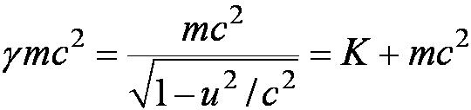

Total Energy and Rest Energy
Rewriting the relativistic kinetic energy:
The term mc² is called the rest energy and is denoted by E₀.
The sum of the kinetic energy and rest energy is interpreted as the total energy of the particle.

Slide 26
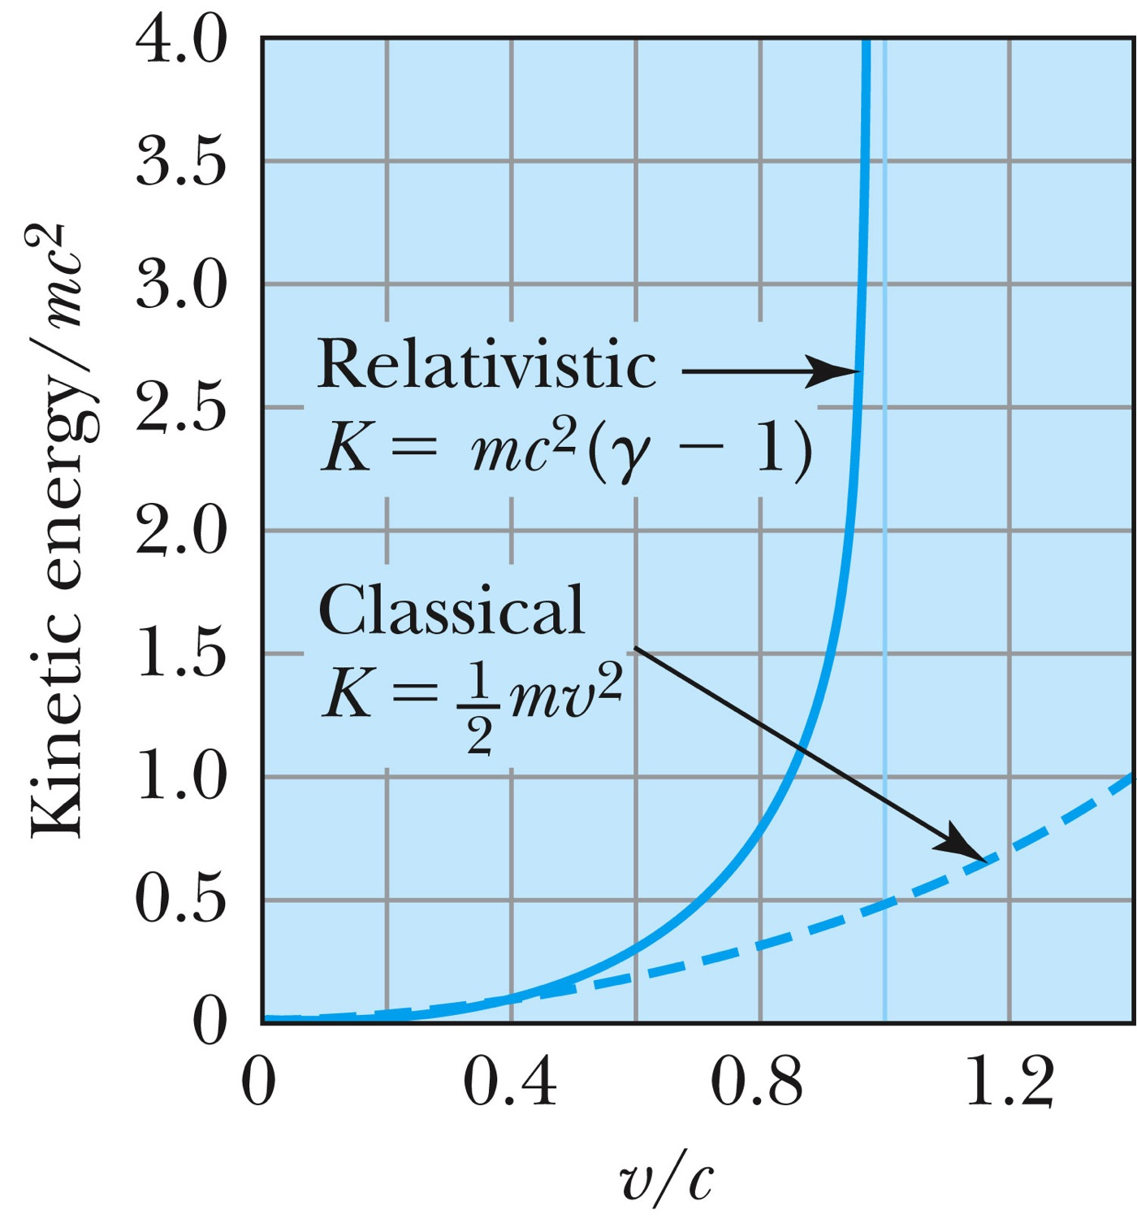
Relativistic and Classical Kinetic Energies
Notes:
Add arrow head to the line from “Relativistic” to the graph
Possibly make the line from the “Classical” straight (as in figure 2.310
rather than curved, also add arrow head to this line pointing to the curve.

Slide 27
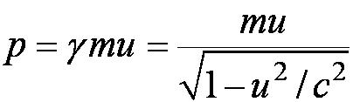
Relationship of Energy and Momentum
We square this result, multiply by c², and rearrange the result.
Rewrite
Rewrite
Notes:
Title rewritten

Slide 28
Massless Particles have a speed equal to the speed of light c
Recall that a photon has “zero” rest mass and the equation from the last slide reduces to: E = pc and we may conclude that:
Thus the velocity, u, of a massless particle must be c since, as 0, and it follows that: u = c.
Notes:
Add this slide

Slide 29
Units of Work, Energy and Mass
The work done in accelerating a charge through a potential difference is W = qV.
  For a proton, with the charge e = 1.602 × 10⁻¹⁹ C being accelerated across a potential difference of 1 V, the work done is
  1 eV = 1.602 × 10⁻¹⁹ J
  W = (1.602 × 10⁻¹⁹)(1 V) = 1.602 × 10⁻¹⁹ J
eV is also used as a unit of energy.

Slide 30
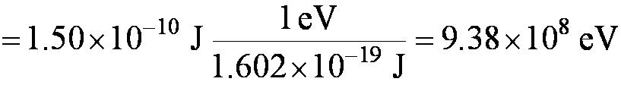
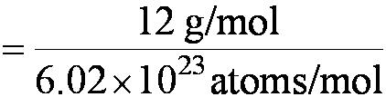


Other Units
Rest energy of a particle:
Example: Rest energy, E₀, of proton
Atomic mass unit (amu): Example: carbon-12
Mass (¹²C atom)
Mass (¹²C atom)

Slide 31


Binding Energy
The potential energy associated with the force keeping the system together ➔ E_{B}.
The difference between the rest energy of the individual particles and the rest energy of the combined bound system.

