Slide 1
PHYS 3313 – Section 001 Lecture #6
Monday, Sept. 17, 2012
Dr. Jaehoon Yu
Discovery of the X-ray and the Electron
Determination of Electron Charge
Line Spectra
Quantization
Blackbody Radiation
Photoelectric Effect
Compton Effect
Pair production/Pair annihilation

Slide 2
Announcements
Reading assignments: CH 3.3 (special topic – the discovery of Helium) and CH3.7
Quiz results
Class average: 17.7/65
Equivalent to: 27.2/100
Top score: 53/65
Conference volunteer application
LCWS12 international conference : Oct. 21 – 26, 2012
Send e-mail to Dr. Jackson (cbjackson@uta.edu)
Subject must have: LCWS12 Volunteer Application
Colloquium this week: Physics Faculty Expo - II

Slide 3
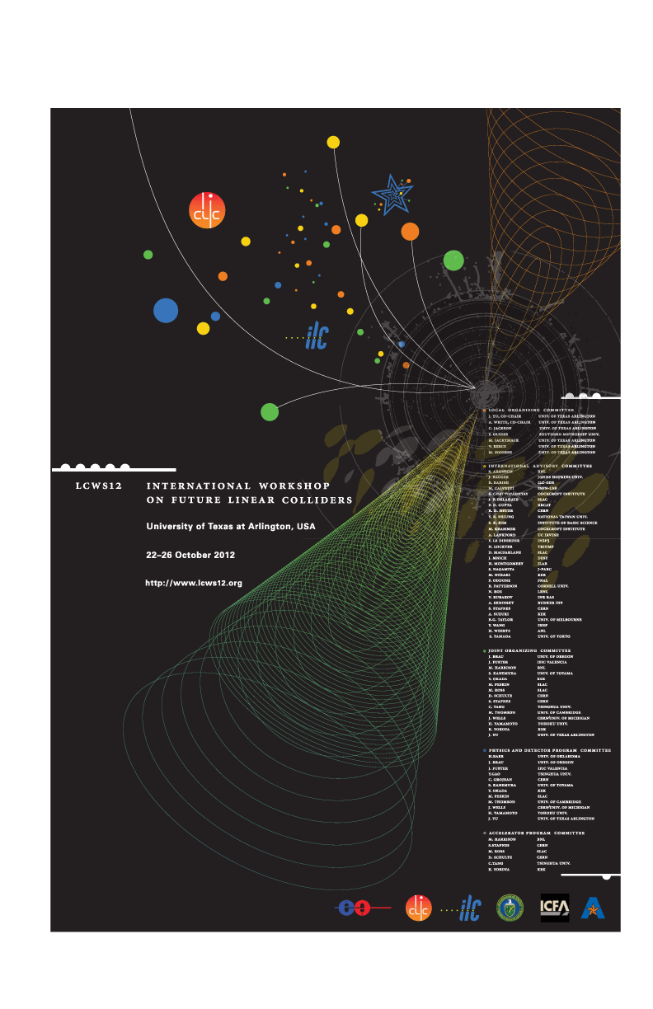

Slide 4
Special Project #2
Derive the three Lorentz velocity transformation equations. (10 points)
Derive the three reverse Lorentz velocity transformation equations. (10 points)
Prove that the spacetime invariant quantity s²=x²-(ct)² is indeed invariant, i.e. s²=s’², in Lorentz Transformation. (5 points)
You must derive each one separately starting from the Lorentz spatial coordinate transformation equations to obtain any credit.
Just switching the signs and primes will not cut!
Must take the simplest form of the equations, using β and γ.
You MUST have your own, independent answers to the above three questions even if you worked together with others. All those who share the answers will get 0 credit if copied.
Due for the submission is this Wednesday, Sept. 19!

Slide 5
What does the word “Quantize” mean?
Dictionary: To restrict to discrete values
To consist of indivisible discrete quantities instead of continuous quantities
Integer is a quantized set with respect to real numbers
Some examples of quantization?
Digital photos
Lego blocks
Electric charge
Photon (a quanta of light) energy
Angular momentum
Etc…

Slide 6
Discovery of the X Ray and the Electron
X rays were discovered by Wilhelm Röntgen in 1895.
Observed x rays emitted by cathode rays bombarding glass
Electrons were discovered by J. J. Thomson.
Observed that cathode rays were charged particles

Slide 7
Cathode Ray Experiments
In the 1890s scientists and engineers were familiar with cathode rays, generated from one of the metal plates in an evacuated tube across a large electric potential
People thought cathode rays had something to do with atoms.
It was known that cathode rays could penetrate matter and their properties were under intense investigation during the 1890s.

Slide 8
Observation of X Rays
Wilhelm Röntgen studied the effects of cathode rays passing through various materials.
He noticed that a phosphorescent screen near the tube glowed during some of these experiments.
These rays were unaffected by magnetic fields and penetrated materials more than cathode rays.
He called them x rays and deduced that they were produced by the cathode rays bombarding the glass walls of his vacuum tube

Slide 9
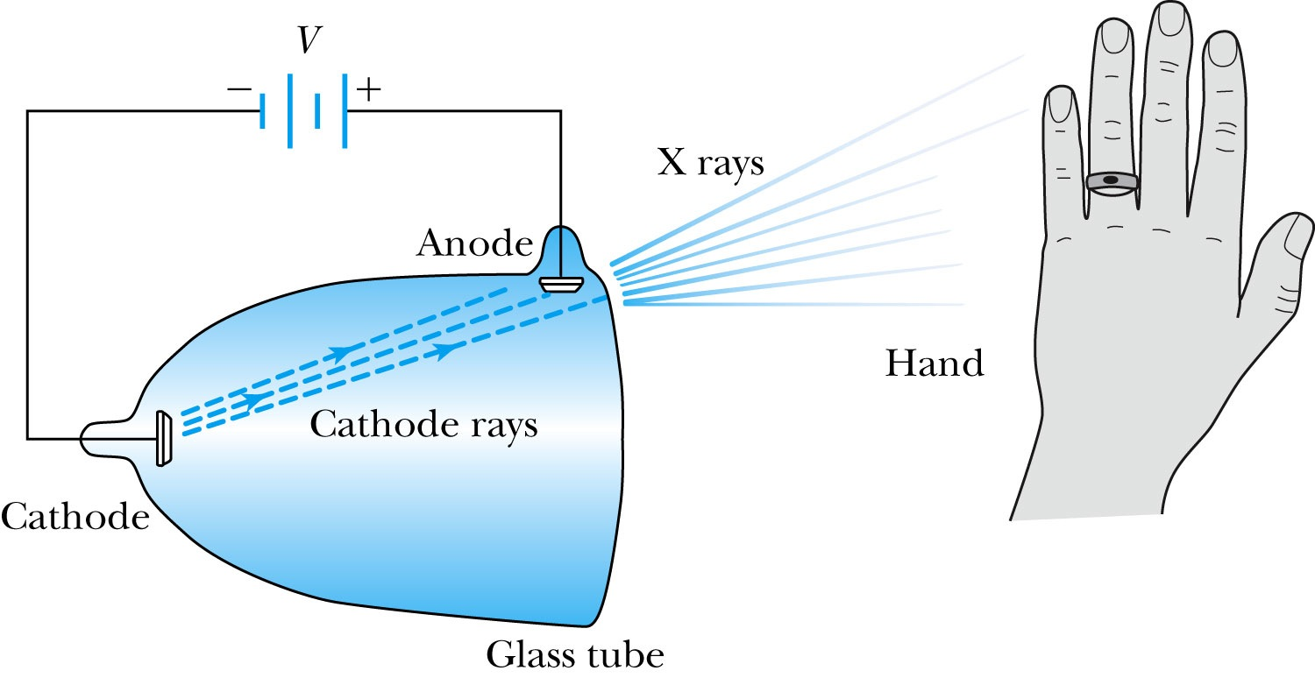
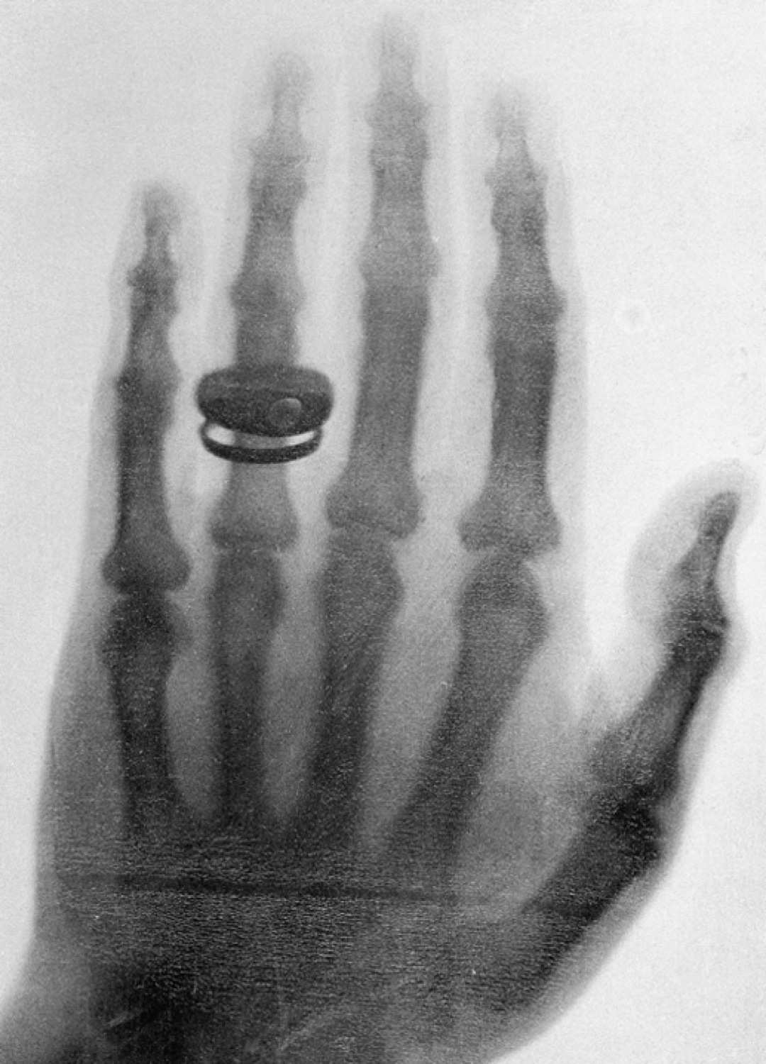
Röntgen’s X Ray Tube
Röntgen produced x-ray by allowing cathode rays to impact the glass wall of the tube.
Took image the bones of a hand on a phosphorescent screen.

Slide 10
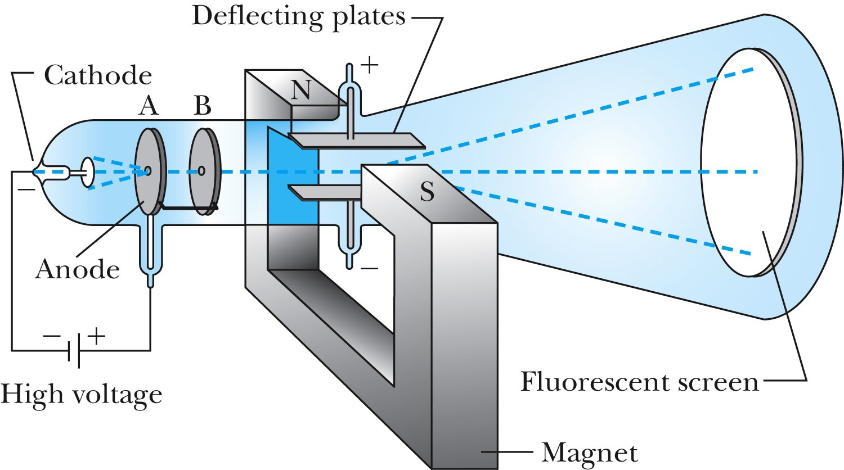
J.J. Thomson’s Cathode-Ray Experiment
Thomson showed that the cathode rays were negatively charged particles (electrons)! How?
By deflecting them in electric and magnetic fields.

Slide 11
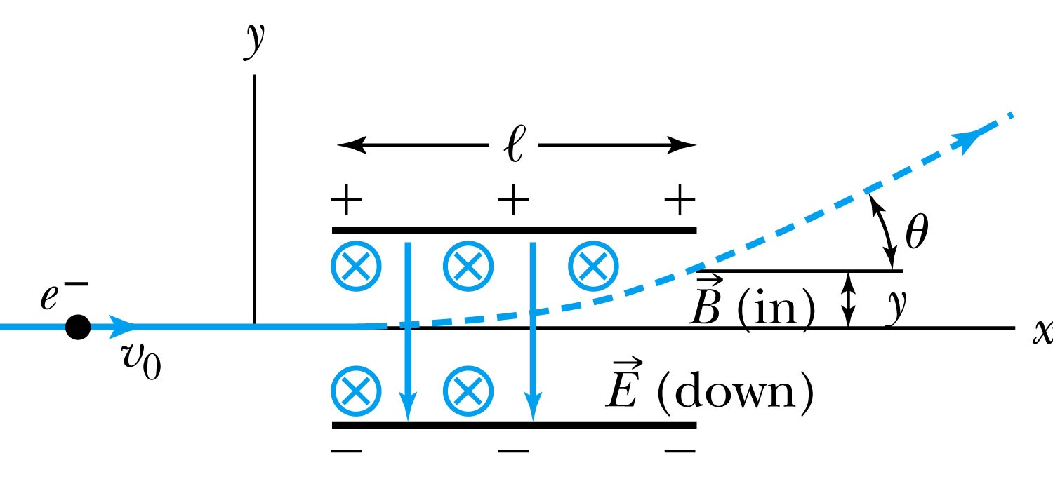
Thomson’s Experiment
Thomson measured the ratio of the electron’s charge to mass by sending electrons through a region containing a magnetic field perpendicular to an electric field.
Measure the deflection angle with only E!
Turn on and adjust B field till no deflection!
What do we know?
l, B, E and θ
What do we not know?
v₀, q and m

Slide 12
Calculation of q/m
An electron moving through the electric field w/o magnetic field is accelerated by a force:
Electron angle of deflection:
Adjust the perpendicular magnetic field till it balances E and keeps electrons from deflecting in y-direction
Charge to mass ratio:

Slide 13
Ex 3.1: Thomson’s experiment
In an experiment similar to Thomson’s, we use deflecting plates 5.0cm in length with an electric field of 1.2x10⁴V/m. Without the magnetic field, we find an angular deflection of 30º, and with a magnetic field of 8.8x10⁻⁴T we find no deflection. What is the initial velocity of the electron and its q/m?
First v₀ using E and B, we obtain:
q/m is then
What is the actual value of q/m using the known quantities?

Slide 14
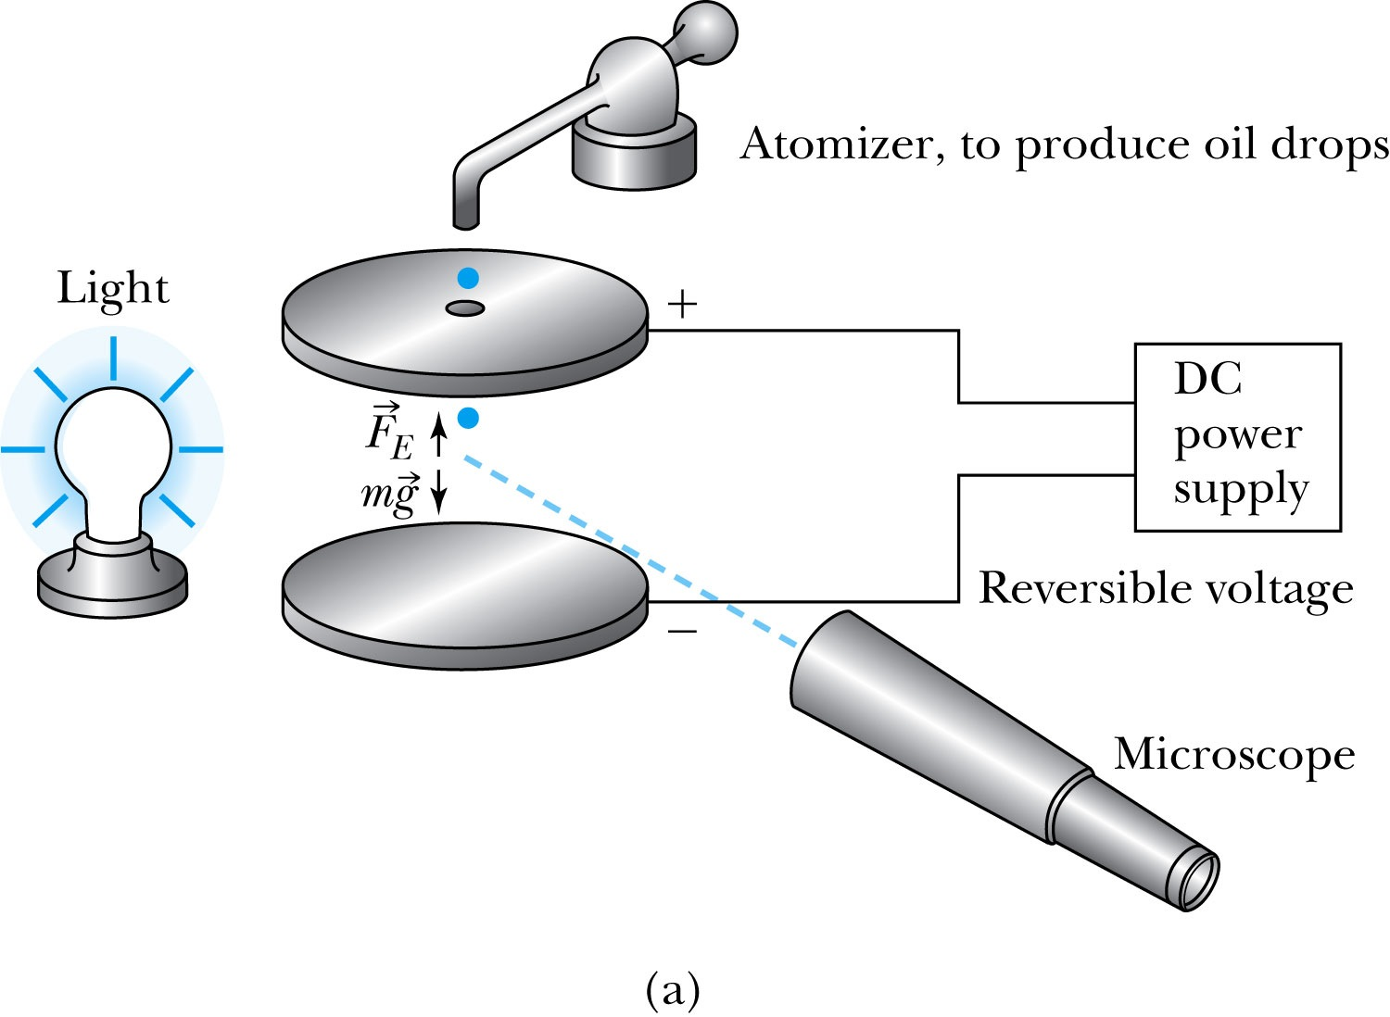
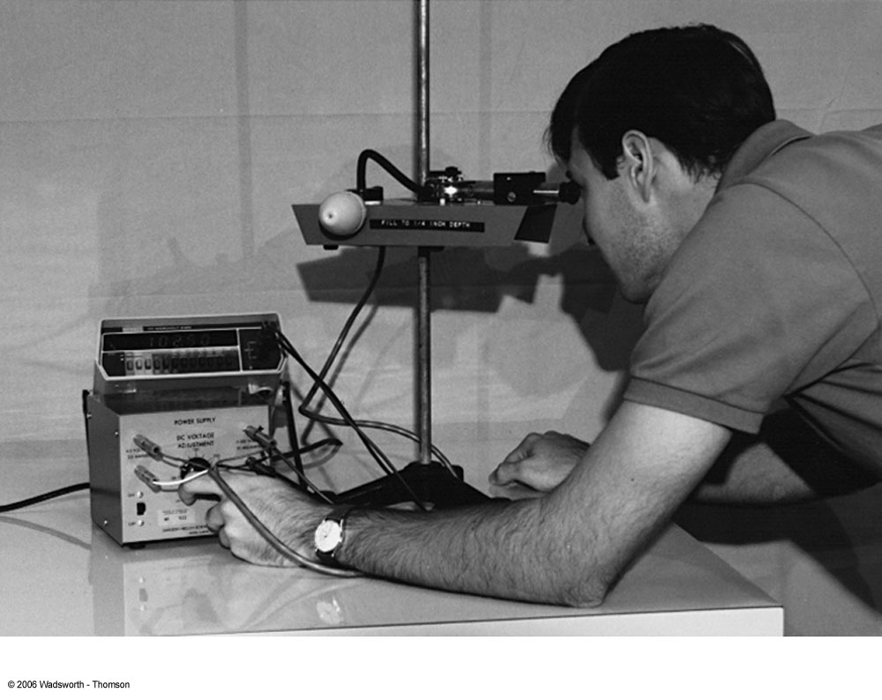
Determination of Electron Charge
Millikan (and Fletcher) in 1909 measured charge of electron, showed that free electric charge is in multiples of the basic charge of an electron

Slide 15
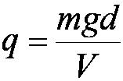
Calculation of the oil drop charge
Used an electric field and gravity to suspend a charged oil drop
So the magnitude of the charge on the oil drop
Mass is determined from Stokes’ relationship of the terminal velocity to the radius and density
Thousands of experiments showed that there is a basic quantized electron charge
C

Slide 16
Line Spectra
Chemical elements produce unique wavelengths of light when burned or excited in an electrical discharge.
Collimated light is passed through a diffraction grating with thousands of ruling lines per centimeter.
The diffracted light is separated at an angle θ according to its wavelength λ by the equation:
where d is the distance between rulings and n is an integer called the order number

Slide 17
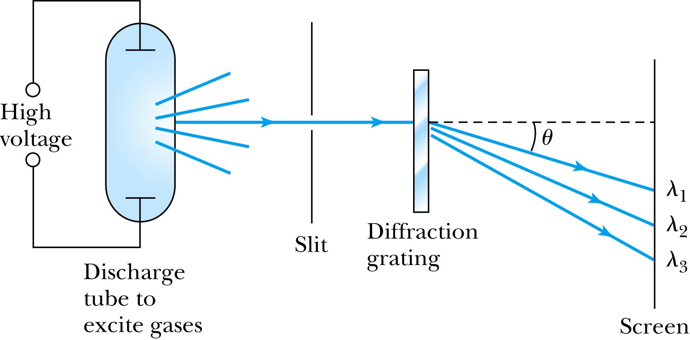
Optical Spectrometer
Diffraction creates a line spectrum pattern of light bands and dark areas on the screen.
Chemical elements and the composition of materials can be identified through the wavelengths of these line spectra

Slide 18
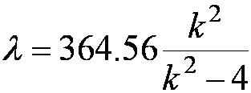
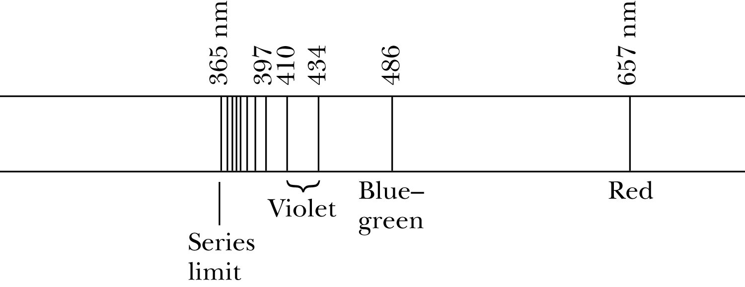
Balmer Series
In 1885, Johann Balmer found an empirical formula for wavelength of the visible hydrogen line spectra in nm:
nm (where k = 3,4,5… and k > 2)

Slide 19
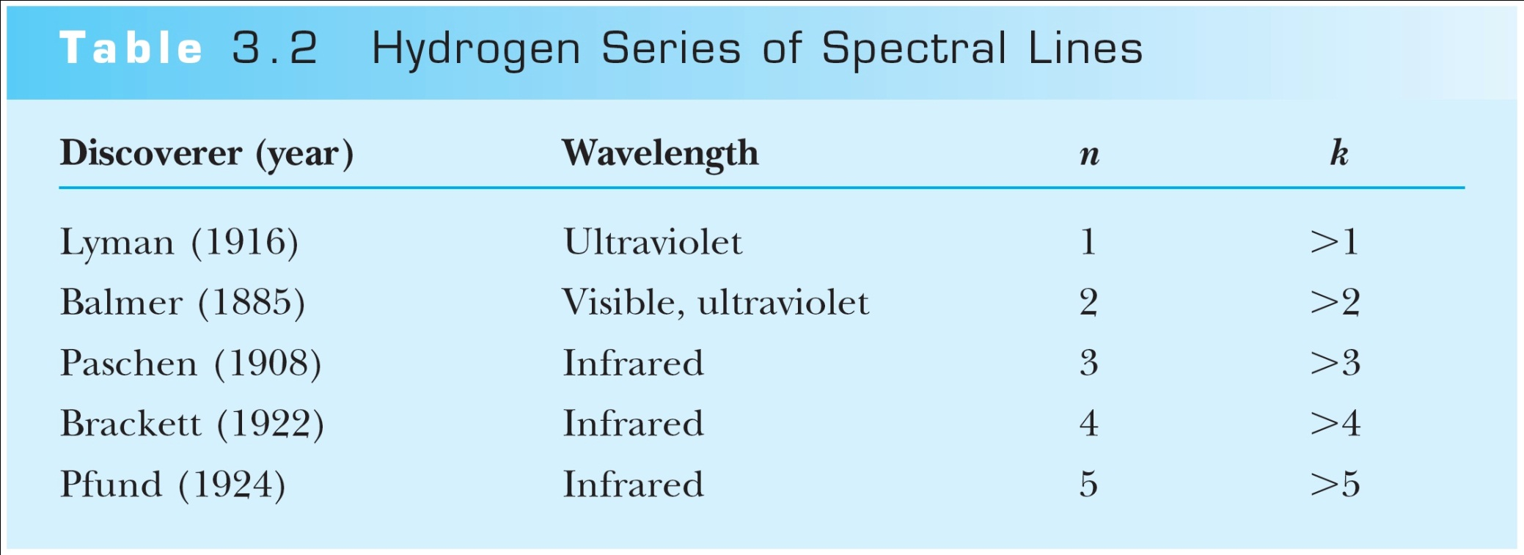
Rydberg Equation
Several more series of emission lines at infrared and ultraviolet wavelengths were discoverd, the Balmer series equation was extended to the Rydberg equation:
(n = 2)

Slide 20
Quantization
Current theories predict that charges are quantized in units (quarks) of ±e/3 and ±2e/3, but quarks are not directly observed experimentally.
The charges of particles that have been directly observed are always quantized in units of ±e.
The measured atomic weights are not continuous—they have only discrete values, which are close to integral multiples of a unit mass.

Slide 21
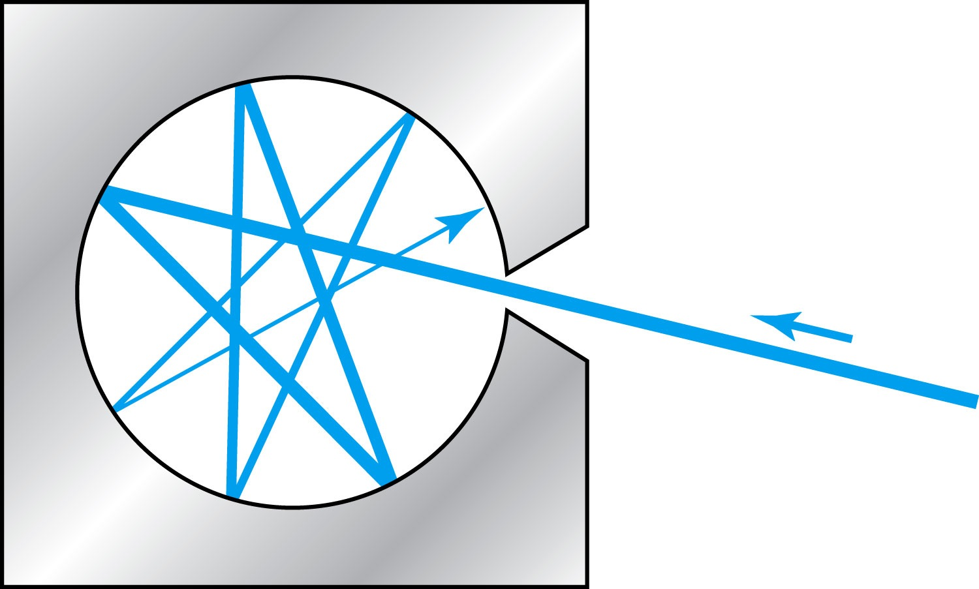
Blackbody Radiation
When matter is heated, it emits radiation.
A blackbody is an ideal object that has 100% absorption and 100% emission without a loss of energy
A cavity in a material that only emits thermal radiation can be considered as a black-body. Incoming radiation is fully absorbed in the cavity.
Blackbody radiation is theoretically interesting because
Radiation properties are independent of the particular material.
Properties of intensity versus wavelength at fixed temperatures can be studied

Slide 22
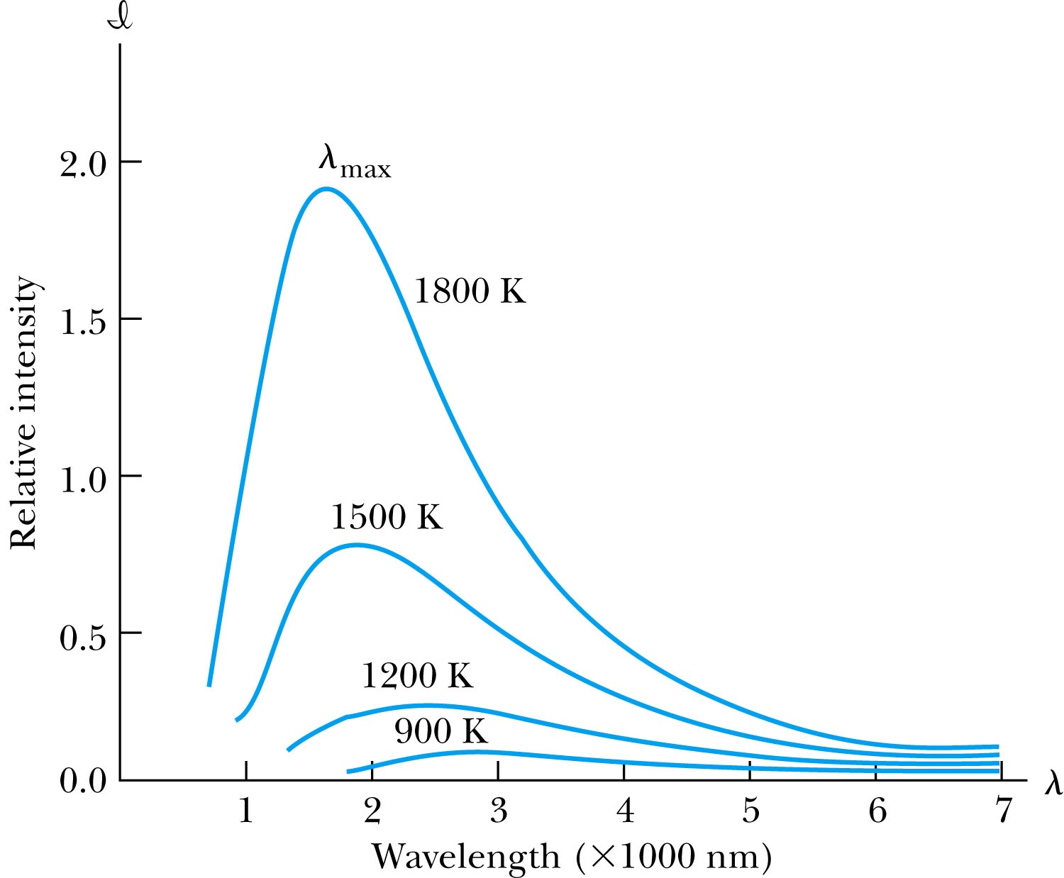
Wien’s Displacement Law
The intensity (λ, T) is the total power radiated per unit area per unit wavelength at a given temperature.
Wien’s displacement law: The maximum of the distribution shifts to smaller wavelengths as the temperature increases.
(where λ_{max} = wavelength of the peak)

Slide 23
Stefan-Boltzmann Law
The total power radiated increases with the temperature:
This is known as the Stefan-Boltzmann law, with the constant σ experimentally measured to be 5.6705×10⁻⁸ W / (m² · K⁴).
The emissivity ε (ε = 1 for an idealized blackbody) is the ratio of the emissive power of an object to that of an ideal blackbody and is always less than 1.

Slide 24
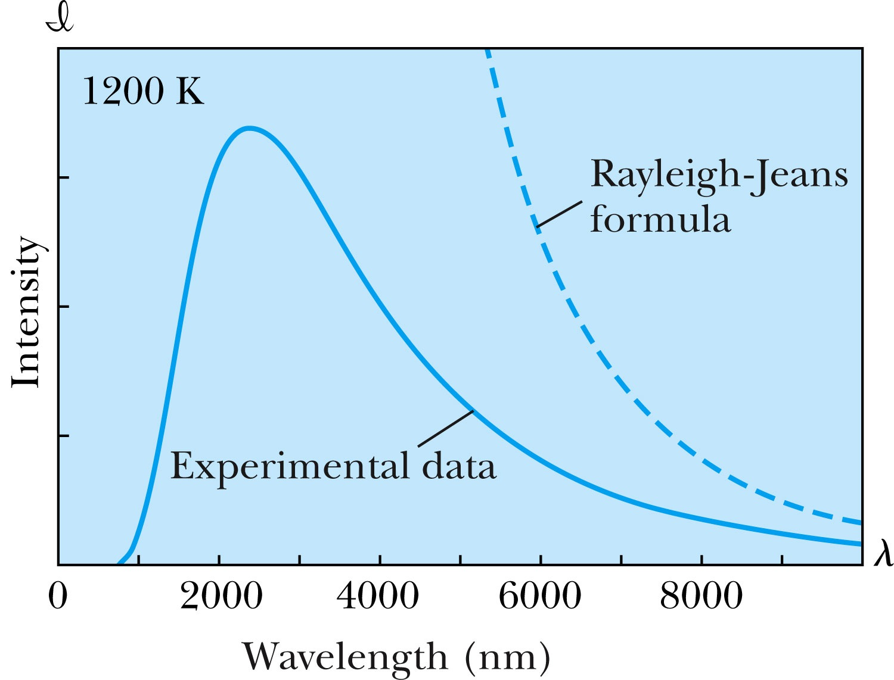
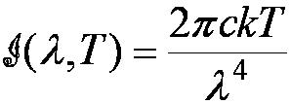
Rayleigh-Jeans Formula
Lord Rayleigh used the classical theories of electromagnetism and thermodynamics to show that the blackbody spectral distribution should be
Worked reasonably at longer wavelengths
it deviates badly at short wavelengths.
➔ “the ultraviolet catastrophe” a serious issue that couldn’t be explained

Slide 25
Planck’s Radiation Law
Planck assumed that the radiation in the cavity was emitted (and absorbed) by some sort of “oscillators” that were contained in the walls. He used Boltzman’s statistical methods to arrive at the following formula that fit the blackbody radiation data.
Planck made two modifications to the classical theory:
The oscillators (of electromagnetic origin) can only have certain discrete energies determined by E_{n} = nhf, where n is an integer, f is the frequency, and h is called Planck’s constant. h = 6.6261 × 10⁻³⁴ J·s.
The oscillators can absorb or emit energy ONLY in discrete multiples of the fundamental quantum of energy given by
Planck’s radiation law

Slide 26
Photoelectric Effect
Methods of electron emission:
Thermionic emission: Application of heat allows electrons to gain enough energy to escape.
Secondary emission: The electron gains enough energy by transfer from another high-speed particle that strikes the material from outside.
Field emission: A strong external electric field pulls the electron out of the material.
Photoelectric effect: Incident light (electromagnetic radiation) shining on the material transfers energy to the electrons, allowing them to escape.
Electromagnetic radiation interacts with electrons within metals and gives the electrons increased kinetic energy. Light can give electrons enough extra kinetic energy to allow them to escape. We call the ejected electrons photoelectrons.

Slide 27
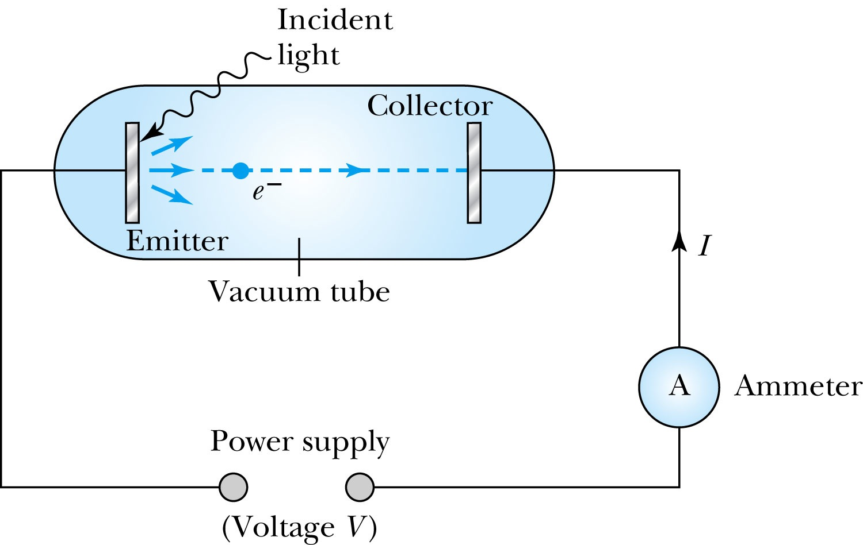
Photoelectric Effect Experimental Setup

Slide 28
Experimental Results
Light intensity does not affect the KE of the photoelectrons
The max KE of the photoelectrons, for a given emitting material, depends only on the frequency of the light
The smaller the work function φ of the emitter material, the smaller is the threshold frequency of the light that can eject photoelectrons.
When the photoelectrons are produced, their number is proportional to the intensity of light.
The photoelectrons are emitted almost instantly following illumination of the photocathode, independent of the intensity of the light. ➔ Totally unexplained by classical physics

