Slide 1
PHYS 3313 – Section 001
Lecture #7
Wednesday, Sept. 19, 2012
Dr. Jaehoon Yu
Photoelectric Effect
Compton Effect
Pair production/Pair annihilation

Slide 2
Announcements
Reading assignments: CH3.9
Homework #2
  CH3 end of the chapter problems: 2, 19, 27, 36, 41, 47 and 57
  Due Wednesday, Sept. 26
Quiz #2 Wednesday, Sept. 26
  Beginning of the class
  Covers CH1.1 – what we finish Monday, Sept. 24
Conference volunteer application
  LCWS12 international conference : Oct. 21 – 26, 2012
  Send e-mail to Dr. Jackson (cbjackson@uta.edu)
    Subject must have: LCWS12 Volunteer Application
Colloquium this week: Physics Faculty Expo – II
  Drs. Chen (bio-phys), Park (Astro), White (HEP), Mohanty(bio-phy), Fazleev (material) and Ngai (optics)

Slide 3
Photoelectric Effect
Definition: Incident electromagnetic radiation shining on the material transfers energy to the electrons, allowing them to escape the surface of the metal. Ejected electrons are called photoelectrons
Other methods of electron emission:
Thermionic emission: Application of heat allows electrons to gain enough energy to escape.
Secondary emission: The electron gains enough energy by transfer from another high-speed particle that strikes the material from outside.
Field emission: A strong external electric field pulls the electron out of the material.

Slide 4
Classical Interpretation of Photoelectric Effect
Classical theory allows EM radiation to eject photoelectrons from matter
Classical theory predicts the energy of the photoelectrons increase proportion to the radiation intensity
Thus, KE of the photoelectrons must be proportional to the intensity of light not the current
Time for an experiment!

Slide 5
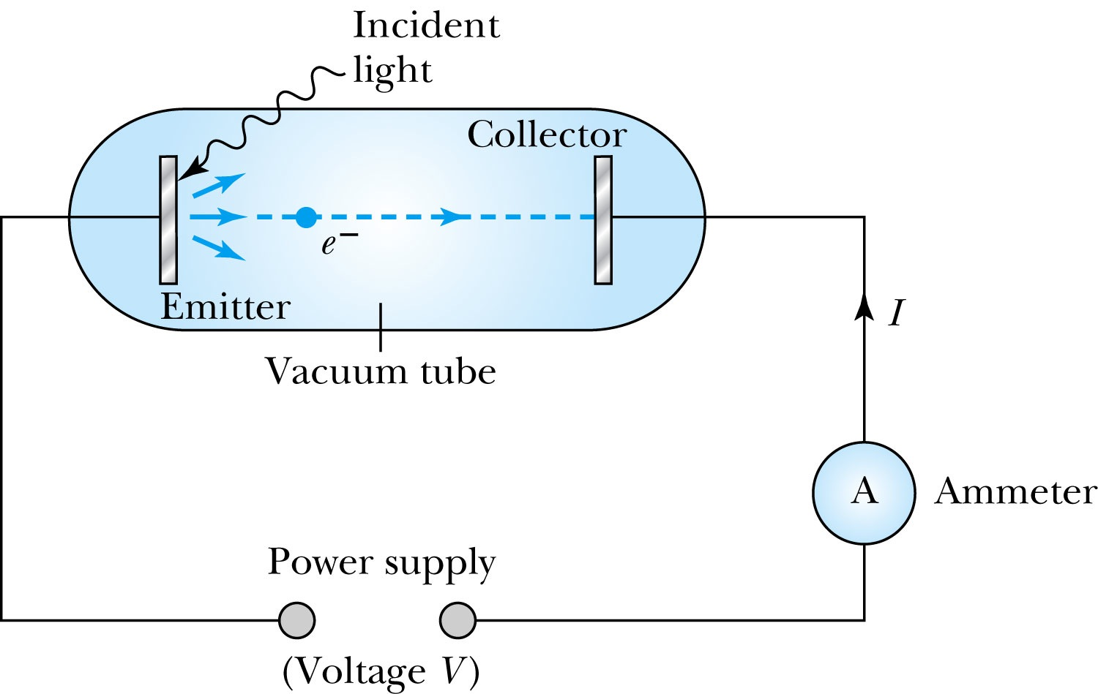
Photoelectric Effect Experimental Setup
Hmm.. Something does not make sense!!
Anode
Photocathode
V increased reverse direction to stop I

Slide 6
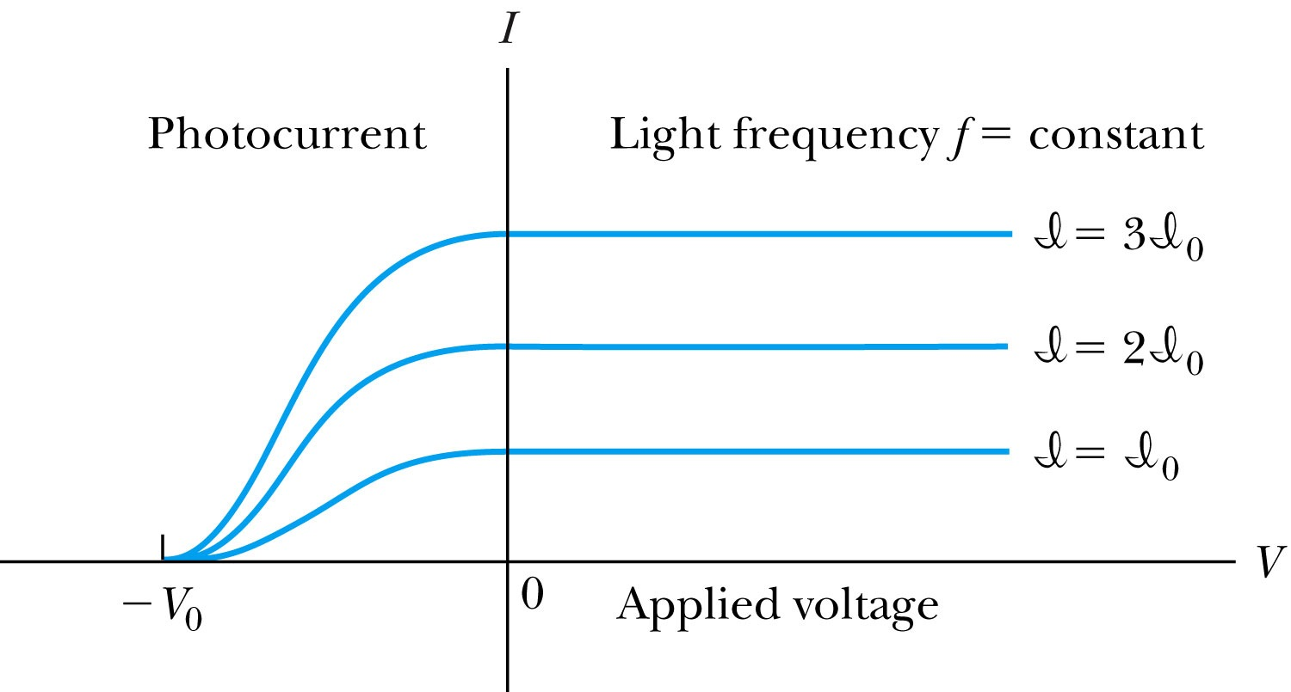
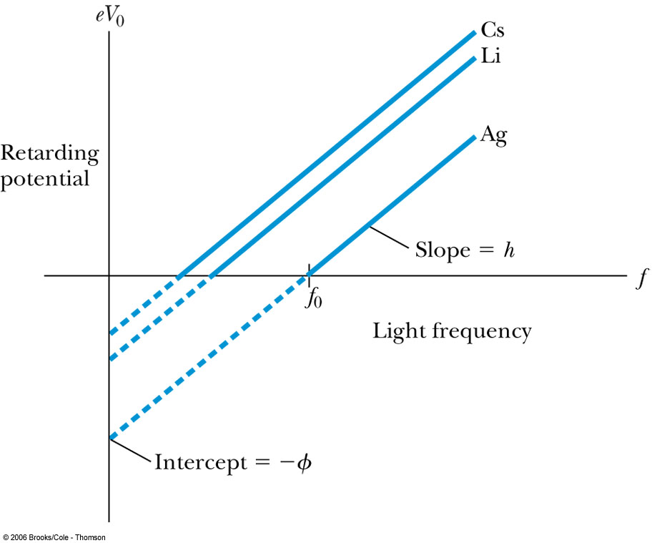
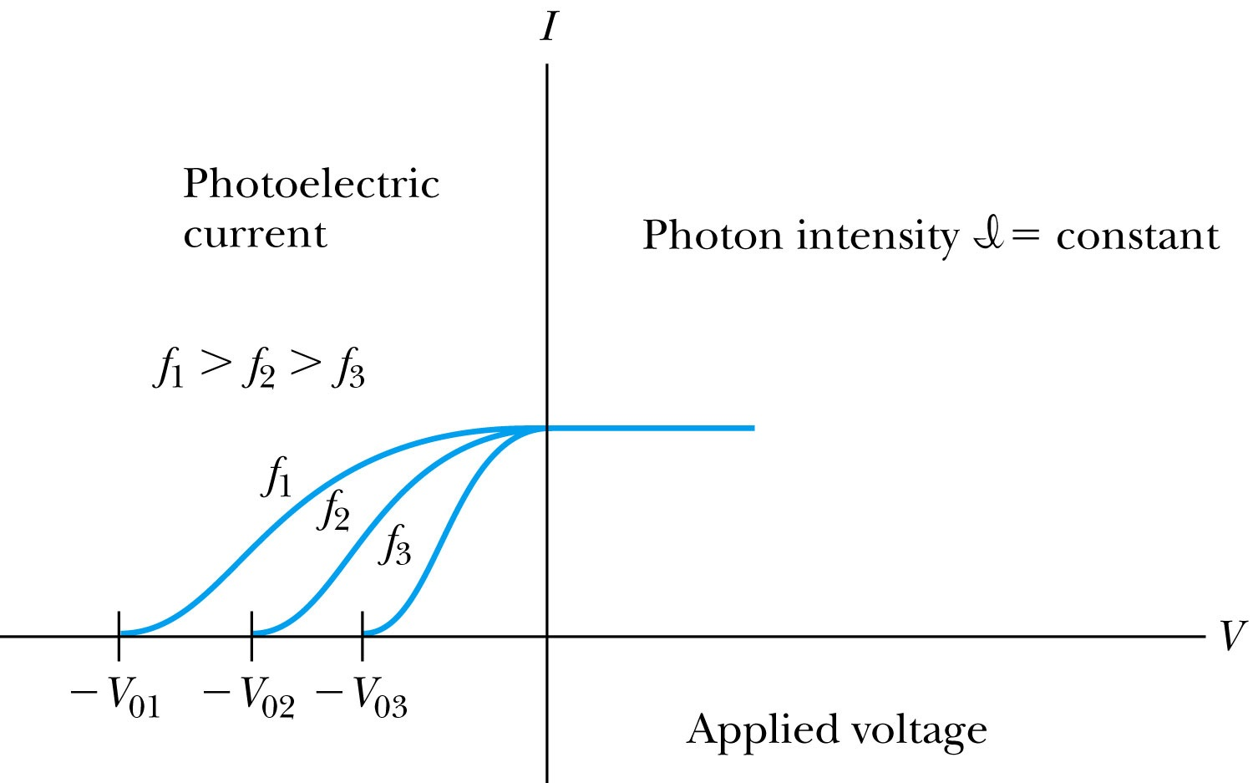
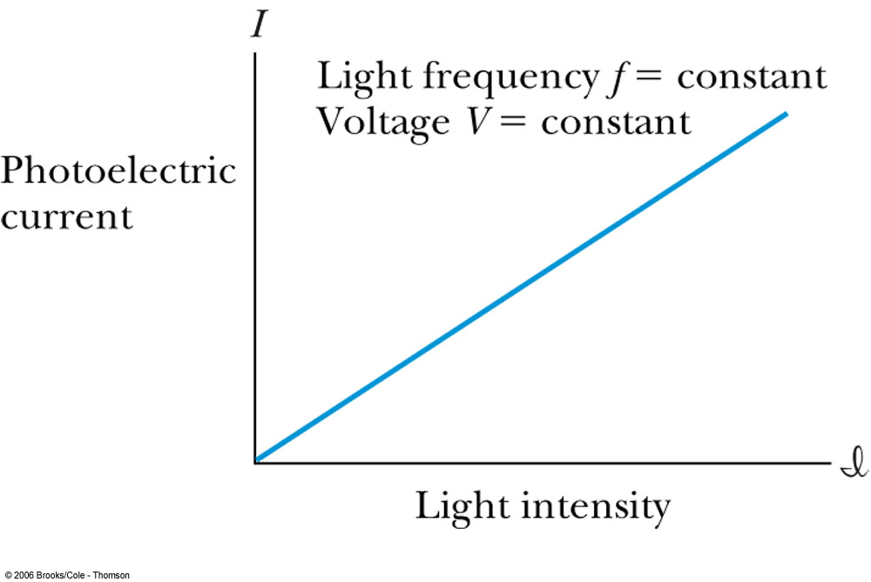
Experimental Observations
KE proportional to frequency!!
The same V₀,but higher current
The same current!!
Number of photoelectrons proportional to light intensity!!

Slide 7
Summary of Experimental Observations
Light intensity does not affect the KE of the photoelectrons
The max KE of the photoelectrons, for a given emitting material, depends only on the frequency of the light
The smaller the work function φ of the emitter material, the smaller is the threshold frequency of the light that can eject photoelectrons.
When the photoelectrons are produced, their number is proportional to the intensity of light.
The photoelectrons are emitted almost instantly following illumination of the photocathode, independent of the intensity of the light. ➔ Totally unexplained by classical physics

Slide 8
Einstein’s Theory of Photoelectric Effect
Einstein suggested that the electromagnetic radiation field is quantized into particles called photons. Each photon has the energy quantum:
where f is the frequency of the light and h is Planck’s constant.
The photon travels at the speed of light in a vacuum, and its wavelength is given by

Slide 9
Einstein’s Theory
Conservation of energy yields:
where φ is the work function of the metal
The energy can then be written
The retarding potentials measured the KE of the most energetic photoelectrons.

Slide 10
Quantum Interpretation
KE of the electron depend only on the light frequency and the work function φ of the material not the light intensity at all
Einstein in 1905 predicted that the stopping potential was linearly proportional to the light frequency, with a slope h, the same constant found by Planck.
From this, Einstein concluded that light is a particle with energy:
Was he already thinking about particle/wave duality?

Slide 11
Ex 3.11: Photoelectric Effect
Light of wavelength 400nm is incident upon lithium (=2.93eV). Calculate (a) the photon energy and (b) the stopping potential V₀.
Since the wavelength is known, we use plank’s formula:
The stopping potential can be obtained using Einstein’s formula for photoelectron energy

Slide 12

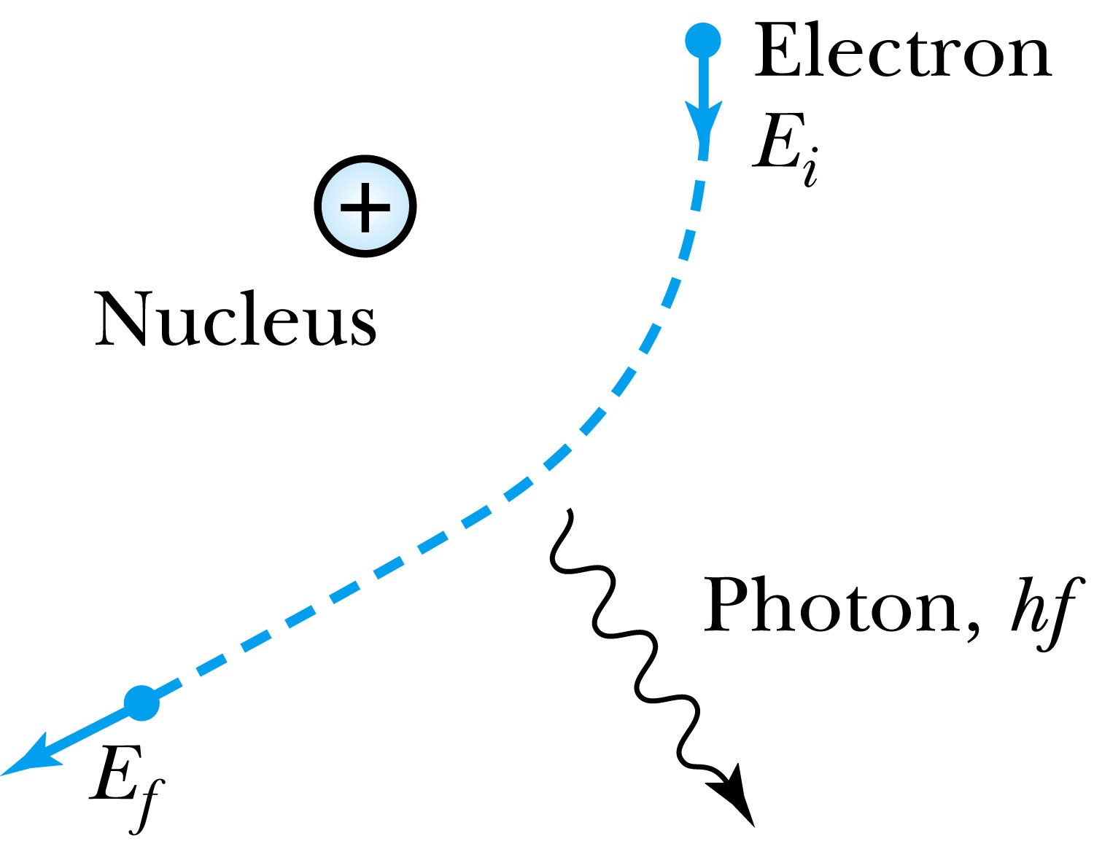
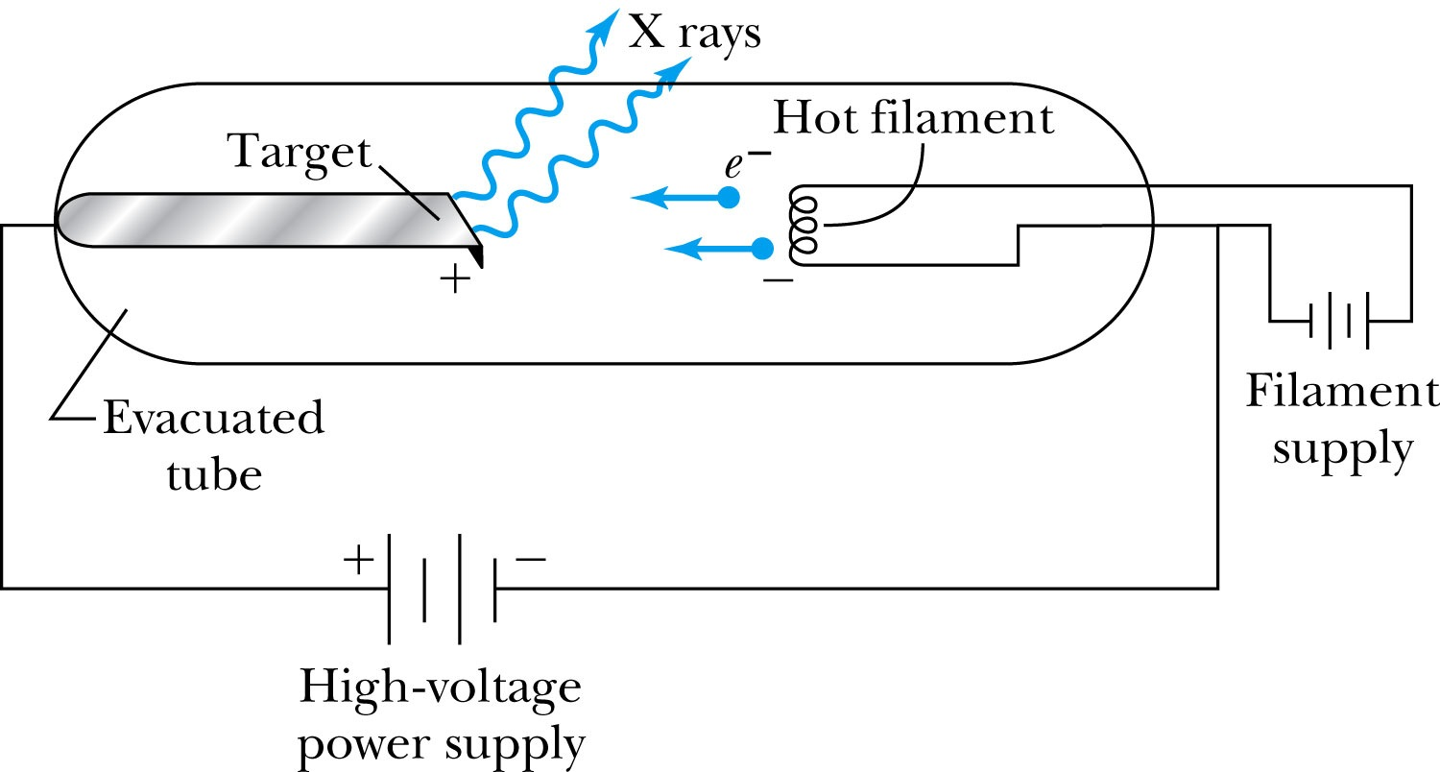
X-Ray Production
Bremsstrahlung (German word for braking radiation): Radiation of a photon from an energetic electron passing through matter due to an acceleration
Since linear momentum must be conserved, the nucleus absorbs very little energy, and it is ignored. The final energy of the electron is determined from the conservation of energy to be
An electron that loses a large amount of energy will produce an X-ray photon.
  Current passing through a filament produces copious numbers of electrons by thermionic emission.
  These electrons are focused by the cathode structure into a beam and are accelerated by potential differences of thousands of volts until they impinge on a metal anode surface, producing x rays by bremsstrahlung as they stop in the anode material

Slide 13
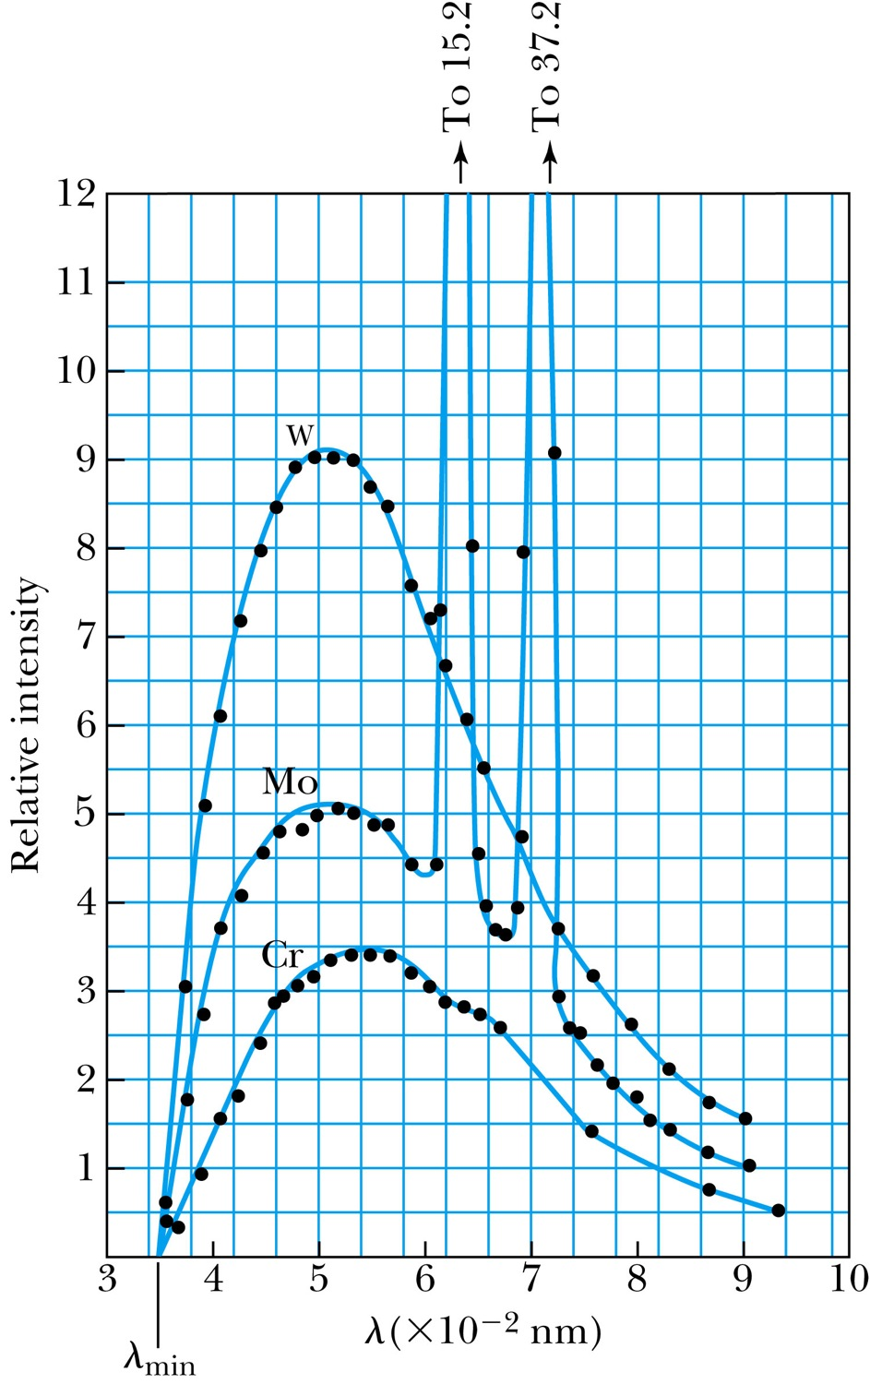
Inverse Photoelectric Effect.
Conservation of energy requires that the electron KE equal the maximum photon energy
  Work function neglected since it’s small compared to the potential energy of the electron.
This is the Duane-Hunt limit
  The photon wavelength depends only on the accelerating voltage
  The same for all targets.

Slide 14
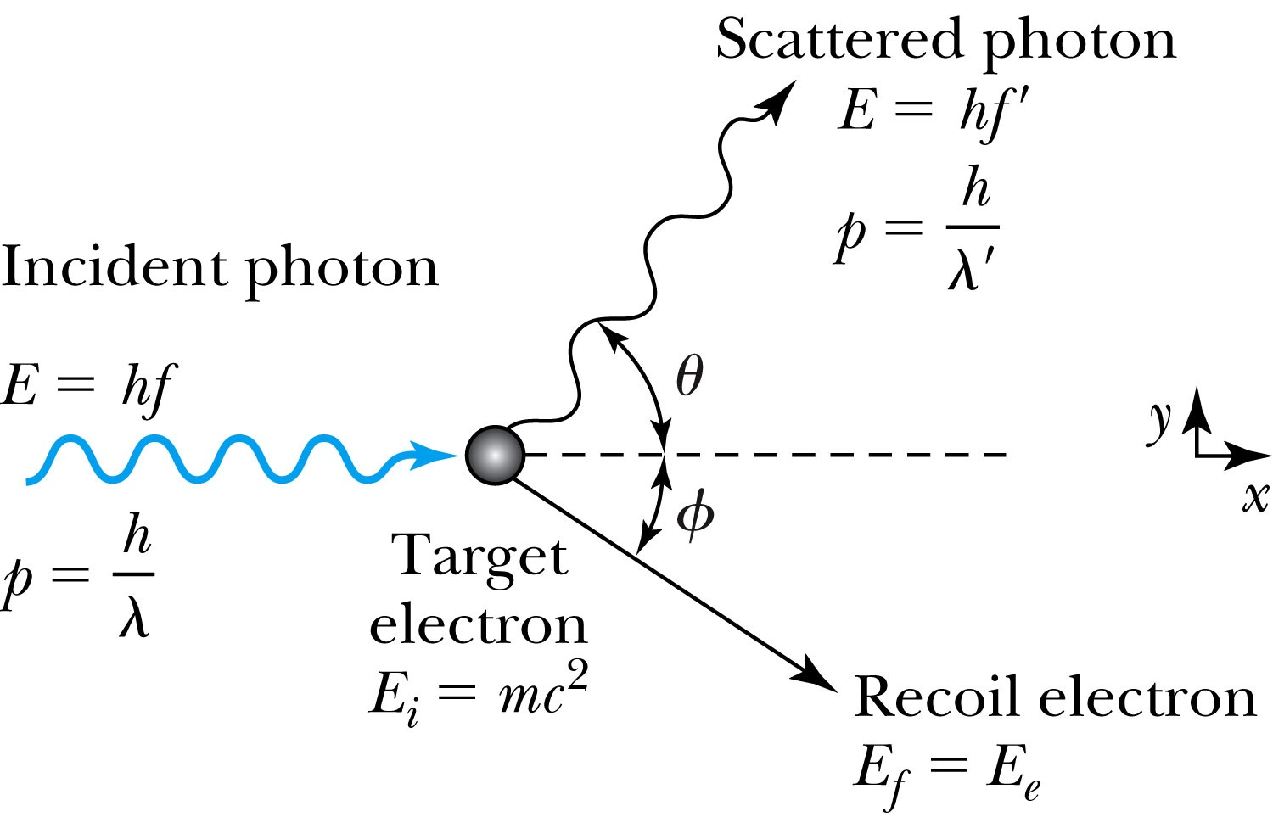
Compton Effect
When a photon enters matter, it is likely to interact with one of the atomic electrons.
The photon is scattered from only one electron
The laws of conservation of energy and momentum apply as in any elastic collision between two particles. The momentum of a particle moving at the speed of light is
The electron energy can be written as
Change of the scattered photon wavelength is known as the Compton effect:

Slide 15
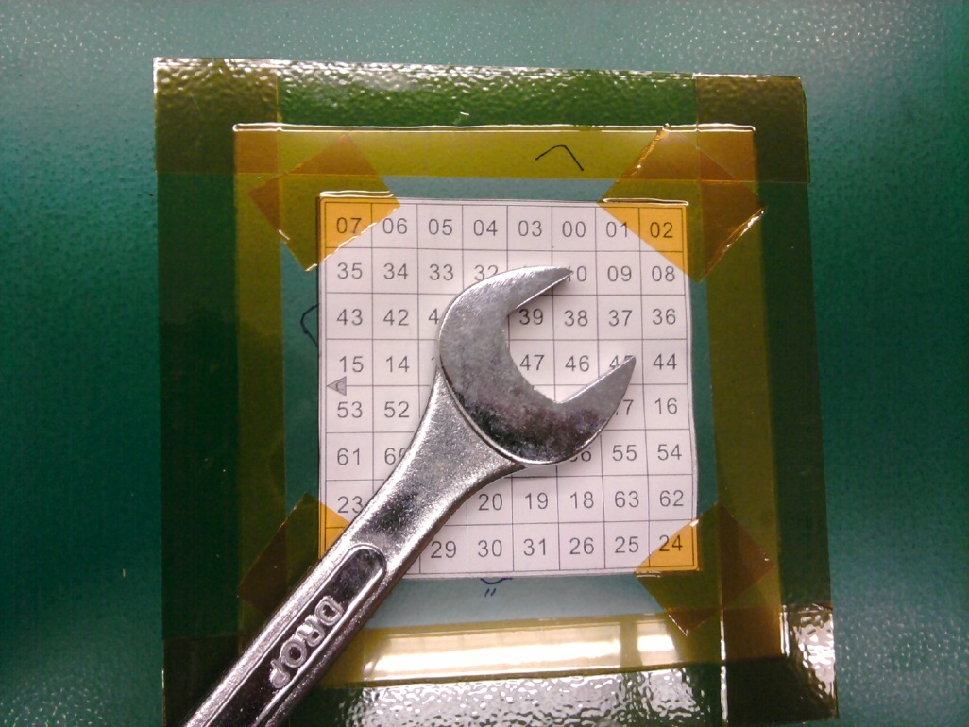
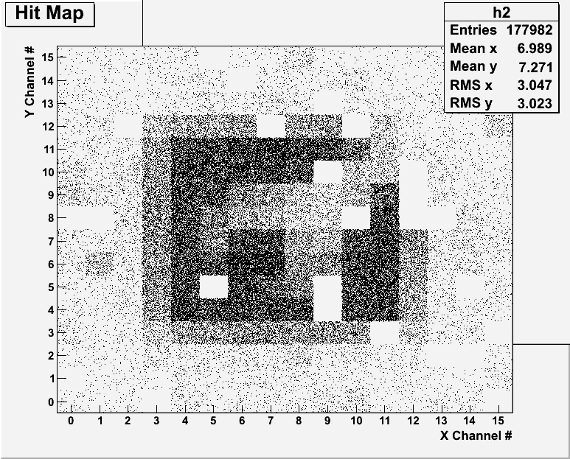
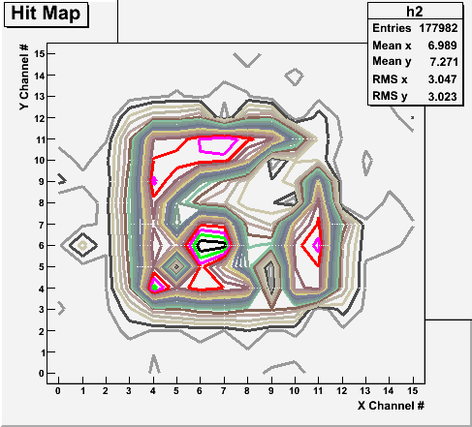
Radioactive Source Run with Internal Trigger
Noisy channels masked out!
Can you see what the object is?

Slide 16
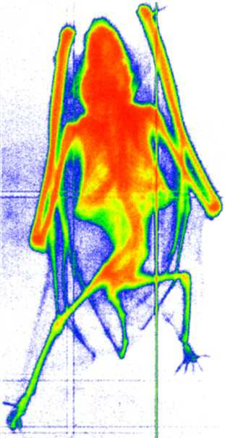
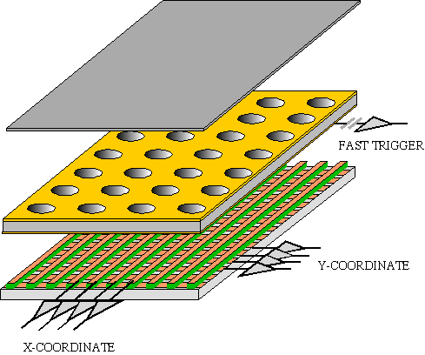

GEM Application Potential
FAST X-RAY IMAGING
Using the lower GEM signal, the readout can be self-triggered with energy discrimination:
9 keV absorption radiography of a small mammal (image size ~ 60 x 30 mm²)
A. Bressan et al,
Nucl. Instr. and Meth. A 425(1999)254
F. Sauli, Nucl. Instr. and Meth.A 461(2001)47

Slide 17
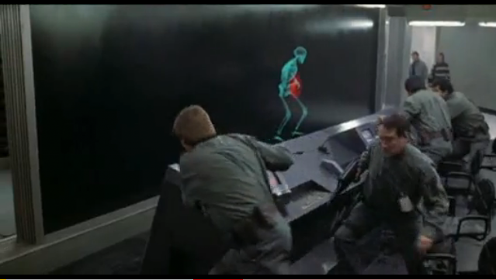
And in not too distant future, we could do …

Slide 18

Pair Production and Annihilation
If a photon can create an electron, it must also create a positive charge to balance charge conservation.
In 1932, C. D. Anderson observed a positively charged electron (e⁺) in cosmic radiation. This particle, called a positron, had been predicted to exist several years earlier by P. A. M. Dirac.
A photon’s energy can be converted entirely into an electron and a positron in a process called pair production.
  Can only happen inside a material
  How much energy do you think is needed?

Slide 19




Pair Production in Empty Space?
Energy conservation for pair production in empty space
Momentum conservation yields
Thus max energy exchange
Recall that the total energy for a particle can be written as
However this yields a contradiction:
and hence the conversion of energy in empty space is impossible and thus pair production cannot happen in empty space

Slide 20
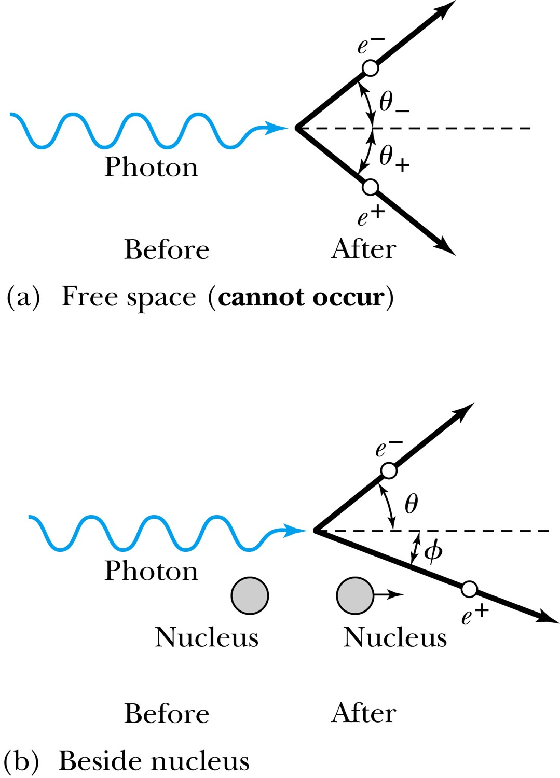

Pair Production in Matter
Since the relations and contradict each other, a photon can not produce an electron and a positron in empty space.
In the presence of matter, the nucleus absorbs some energy and momentum.
The photon energy required for pair production in the presence of matter is

Slide 21
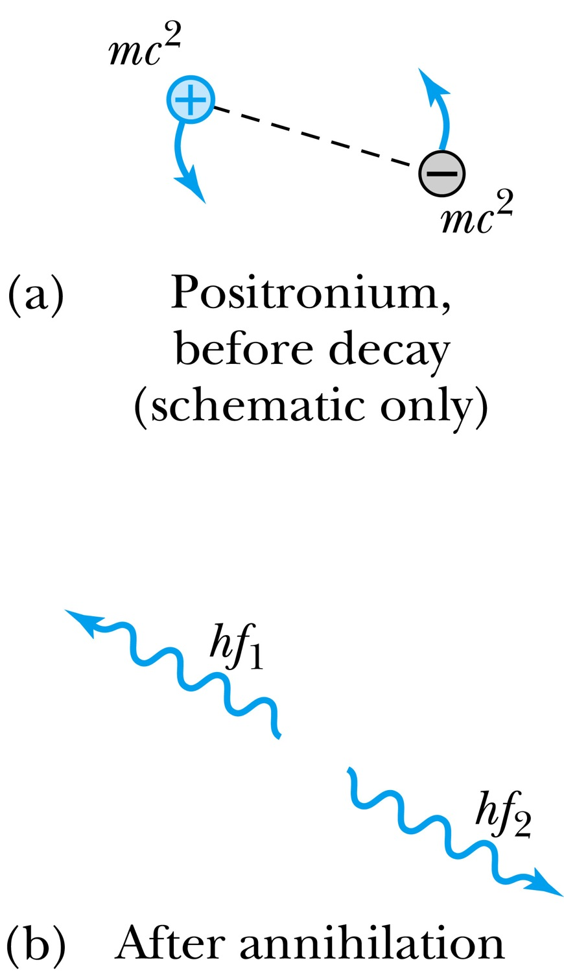

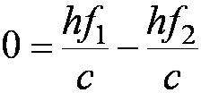


Pair Annihilation
A positron going through matter will likely annihilate with an electron.
A positron is drawn to an electron and form an atom-like configuration called positronium.
Pair annihilation in empty space will produce two photons to conserve momentum. Annihilation near a nucleus can result in a single photon.
Conservation of energy:
Conservation of momentum:
The two photons will be almost identical, so that
The two photons from positronium annihilation will move in opposite directions with an energy:

