Slide 1
PHYS 3313 – Section 001 Lecture #8
Monday, Sept. 24, 2012
Dr. Jaehoon Yu
Atomic Model of Thomson
Rutherford Scattering Experiment and Rutherford Atomic Model
The Classic Atomic Model
The Bohr Model of the Hydrogen Atom
Bohr Radius

Slide 2
Announcements
Reminder: Homework #2
CH3 end of the chapter problems: 2, 19, 27, 36, 41, 47 and 57
Due this Wednesday, Sept. 26
Quiz #2 this Wednesday, Sept. 26
Beginning of the class
Covers CH1.1 – CH4.3 (Rutherford scattering)
Conference volunteers, please send e-mail to Dr. Jackson (cbjackson@uta.edu) ASAP!
Not sure if there is a colloquium this week. I will keep you informed in class Wednesday!

Slide 3
Special Project #3
A total of N_{i} incident projectile particle of atomic number Z₁ kinetic energy KE scatter on a target of thickness t and atomic number Z₂ and has n atoms per volume. What is the total number of scattered projectile particles at an angle θ? (20 points)
Please be sure to define all the variables used in your derivation! Points will be deducted for missing variable definitions.
This derivation must be done on your own. Please do not copy the book or your friends’.
Due is Monday, Oct. 8.

Slide 4
The Atomic Models of Thomson and Rutherford
Pieces of evidence that scientists had in 1900 to indicate that the atom was not a fundamental unit
There are simply too many kinds of atoms (~70 known at that time), belonging to a distinct chemical element
Too many to be fundamental!!
Atoms and electromagnetic phenomena seem to be intimately related
The issue valence ➔ Why certain elements combine with some elements but not with others
Is there a characteristic internal atomic structure?
The discoveries of radioactivity, x rays, and the electron

Slide 5
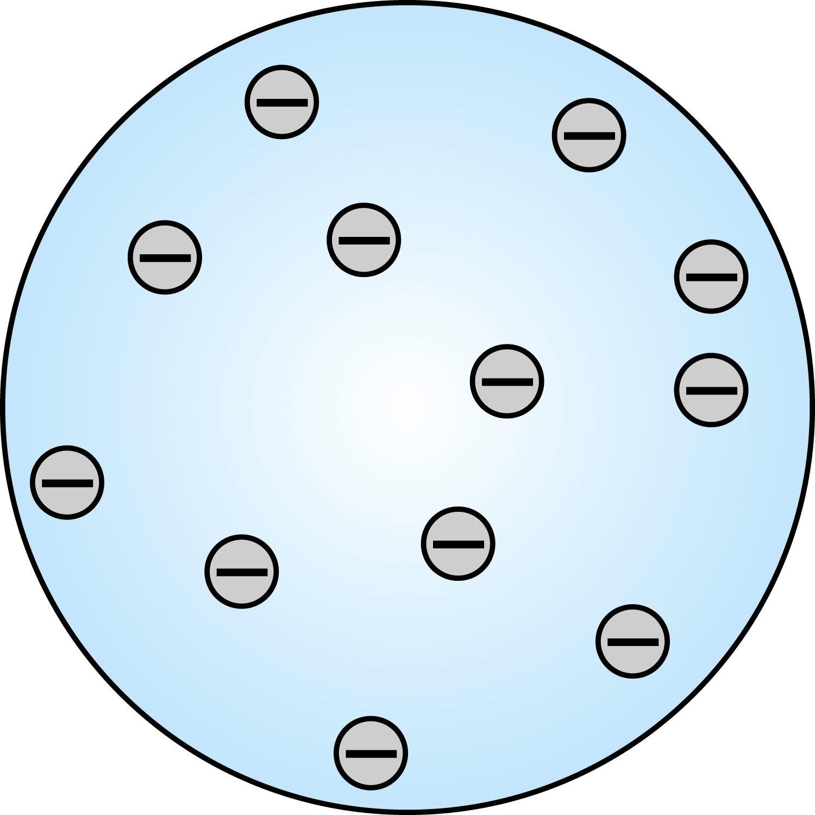
Thomson’s Atomic Model
Thomson’s “plum-pudding” model
Atoms are electrically neutral and have electrons in them
Atoms must have equal amount of positive charges in it to balance electron negative charges
So how about positive charges spread uniformly throughout a sphere the size of the atom with, the newly discovered “negative” electrons embedded in the uniform background.
Thomson’s thought when the atom was heated the electrons could vibrate about their equilibrium positions, thus producing electromagnetic radiation.

Slide 6
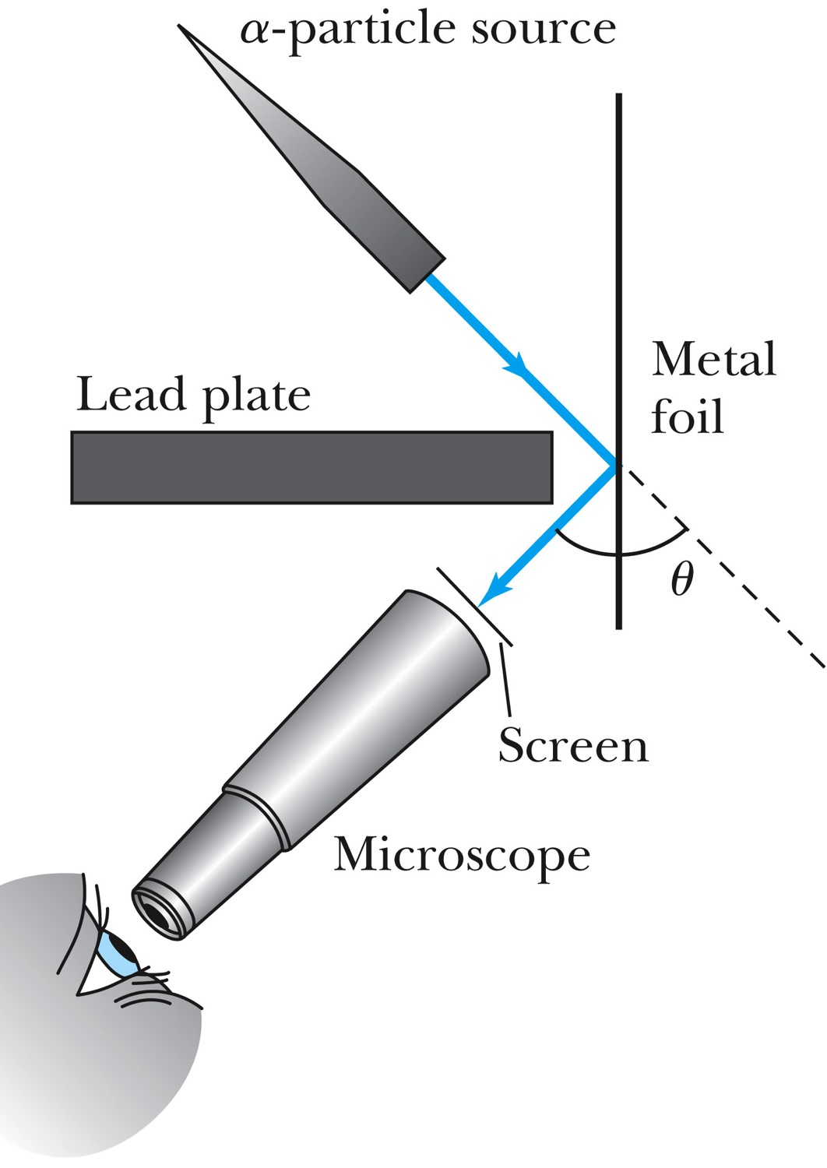
Experiments of Geiger and Marsden
Rutherford, Geiger, and Marsden conceived a new technique for investigating the structure of matter by scattering a particles from atoms.
Geiger showed that many a particles were scattered from thin gold-leaf targets at backward angles greater than 90°.

Slide 7
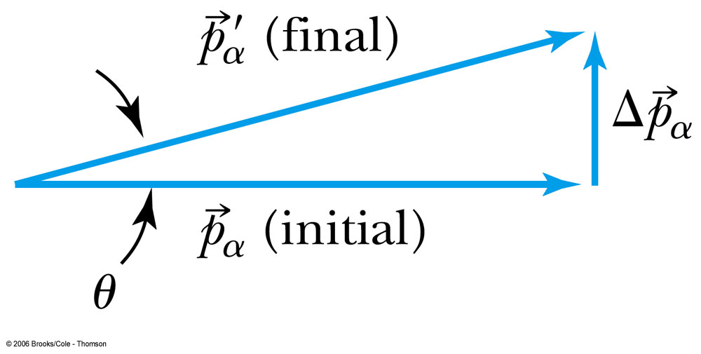
Ex 4.1: Maximum Scattering Angle
Geiger and Marsden (1909) observed backward-scattered (θ>=90º) α particles when a beam of energetic α particles was directed at a piece of gold foil as thin as 6.0x10⁻⁷m. Assuming an α particle scatters from an electron in the foil, what is the maximum scattering angle?
The maximum scattering angle corresponding to the maximum momentum change
Using the momentum conservation and the KE conservation for an elastic collision, the maximum momentum change of the α particle is
Determine θ by letting Δp_{max} be perpendicular to the direction of motion.

Slide 8
Multiple Scattering from Electrons
If an α particle were scattered by many electrons and N electrons results in <θ>_{total} ~ √Nθ
The number of atoms across the thin gold layer of 6 × 10⁻⁷ m:
Assume the distance between atoms is
and there are
That gives

Slide 9
Rutherford’s Atomic Model
<θ>_{total}~0.8º even if the α particle scattered from all 79 electrons in each atom of gold
The experimental results were inconsistent with Thomson’s atomic model.
Rutherford proposed that an atom has a positively charged core (nucleus) surrounded by the negative electrons.

Slide 10
Assumptions of Rutherford Scattering
The scatterer is so massive that it does not recoil significantly; therefore the initial and final KE of the α particle are practically equal.
The target is so thin that only a single scattering occurs.
The bombarding particle and target scatterer are so small that they may be treated as point masses and charges.
Only the Coulomb force is effective.

Slide 11
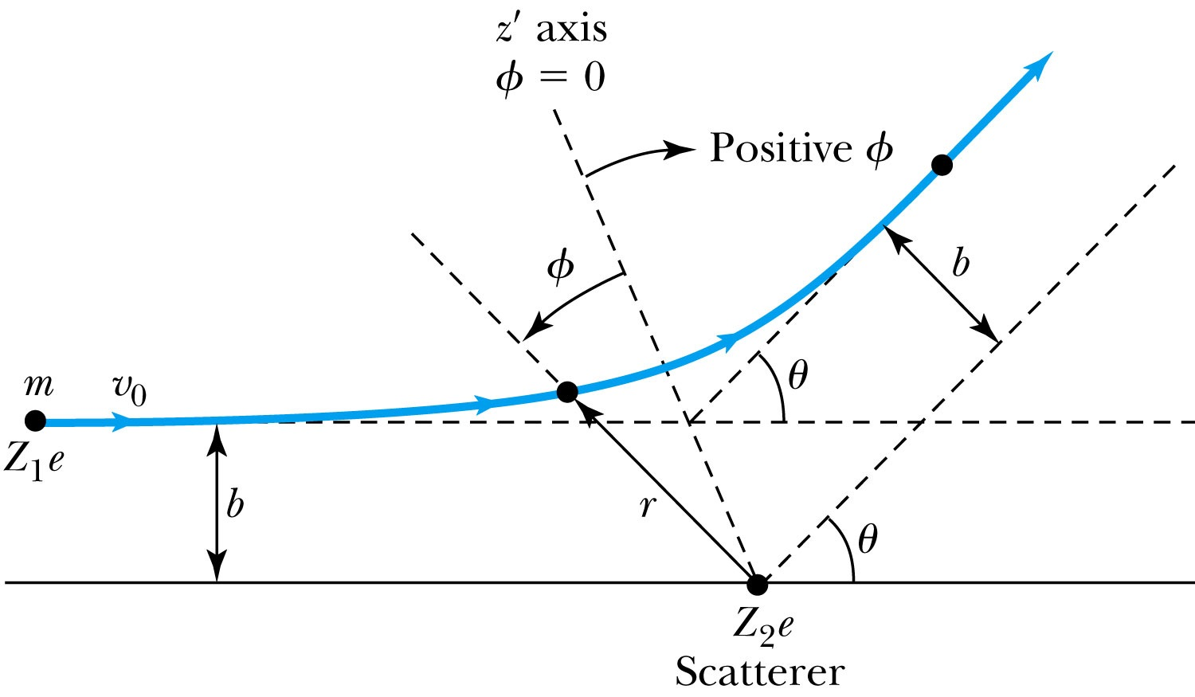
Rutherford Scattering
Scattering experiments help us study matter too small to be observed directly by measuring the angular distributions of the scattered particles
What is the force acting in this scattering?
There is a relationship between the impact parameter b and the scattering angle θ.
When b is small,
r gets small.
Coulomb force gets large.
θ can be large and the particle can be repelled backward.

Slide 12
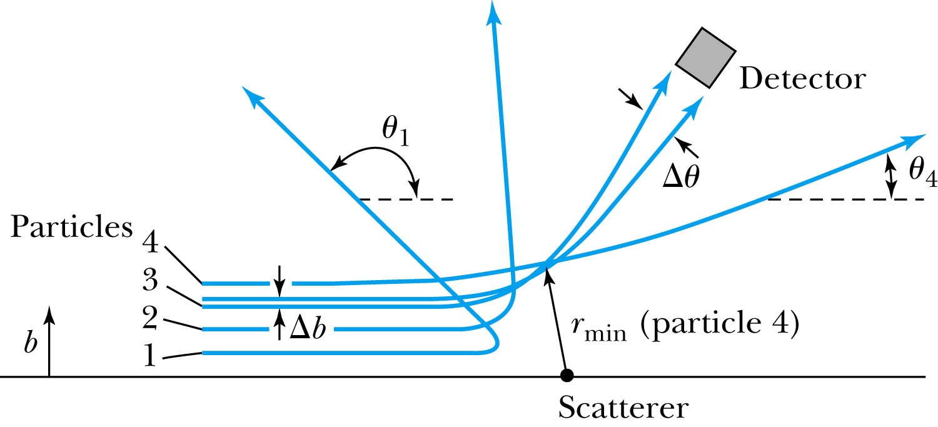
The Relationship Between the Impact Parameter b and the Scattering Angle
The relationship between the impact parameter b and scattering angle Δθ. Particles with small impact parameters approach the nucleus most closely (r_{min}) and scatter to the largest angles. Particles within the range of impact parameters b will be scattered within Δθ.

Slide 13
Rutherford Scattering
What are the quantities that can affect the scattering?
What was the force again?
The Coulomb force
The charge of the incoming particle (Z₁e)
The charge of the target particle (Z₂e)
The minimum distance the projectile approaches the target (r)
Using the fact that this is a totally elastic scattering under a central force, we know
Linear momentum is conserved
KE is conserved
Angular momentum is conserved
From this, impact parameter

Slide 14
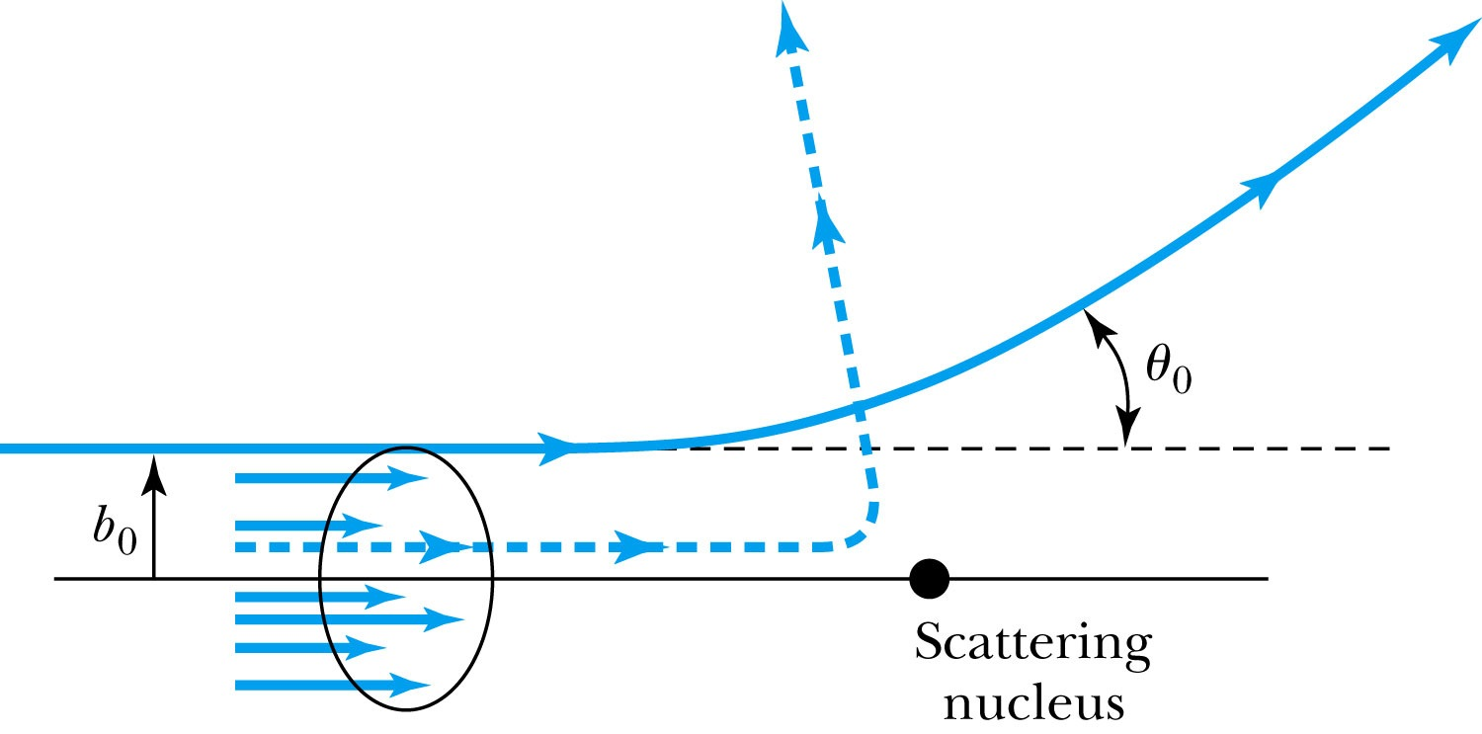
Rutherford Scattering - probability
Any particle inside the circle of area πb₀² will be similarly scattered.
The cross section σ = πb² is related to the probability for a particle being scattered by a nucleus.
The fraction of incident particles scattered is
The number of scattering nuclei per unit area .
t: target thickness
n: atomic number density

Slide 15
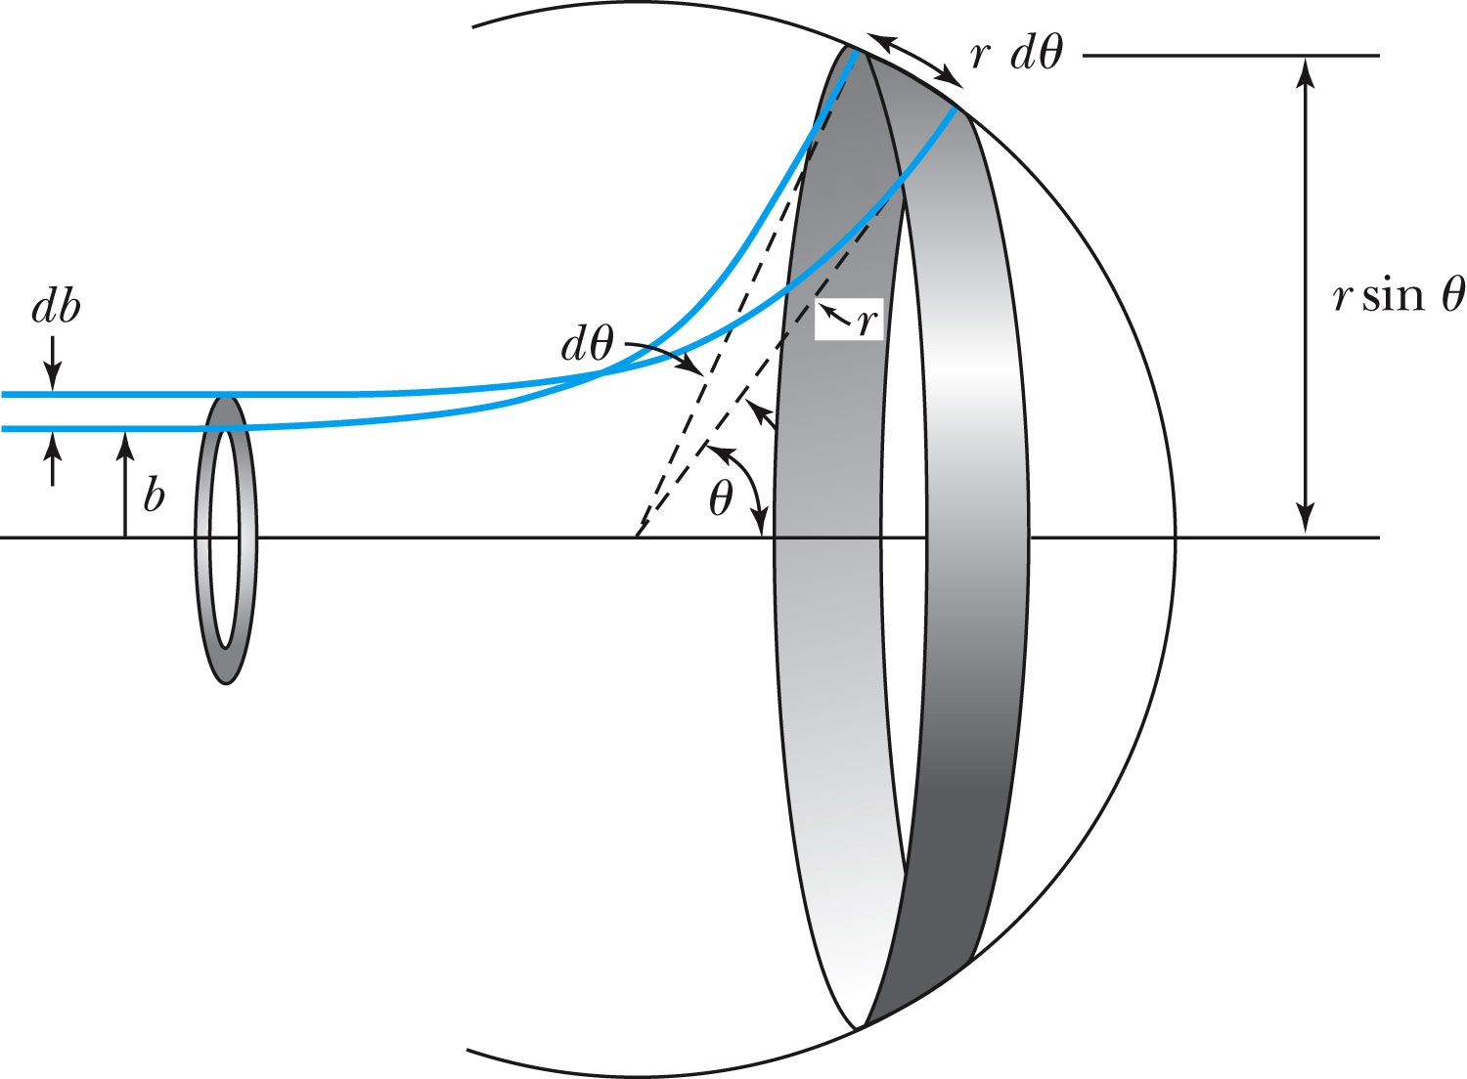
Rutherford Scattering Equation
In actual experiment a detector is positioned from θ to θ + dθ that corresponds to incident particles between b and b + db.
The number of particles scattered into the the angular coverage per unit area is

Slide 16
The Important Points
The scattering is proportional to the square of the atomic number of both the incident particle (Z₁) and the target scatterer (Z₂).
The number of scattered particles is inversely proportional to the square of the kinetic energy of the incident particle.
For the scattering angle θ, the scattering is proportional to 4th power of sin(θ/2).
The Scattering is proportional to the target thickness for thin targets.

Slide 17
The Classical Atomic Model
As suggested by the Rutherford Model the atom consisted of a small, massive, positively charged nucleus surrounded by moving electrons. This then suggested consideration of a planetary model of the atom.
Let’s consider atoms as a planetary model.
The force of attraction on the electron by the nucleus and Newton’s 2nd law give
where v is the tangential velocity of the electron.
The total energy is

Slide 18
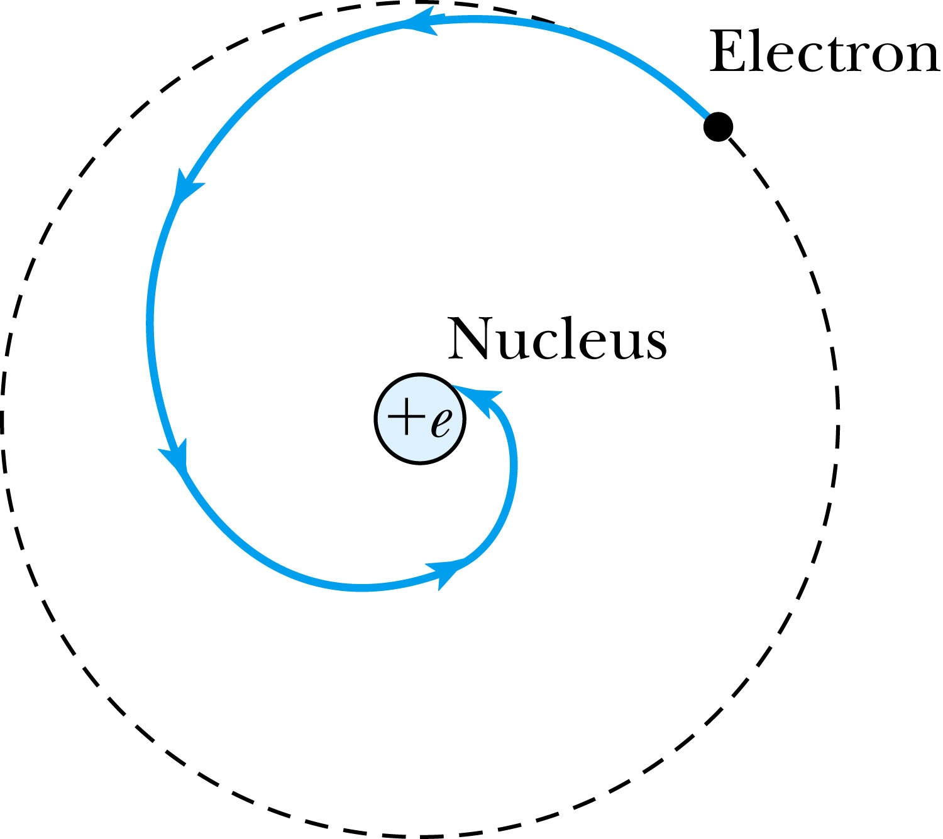
The Planetary Model is Doomed
From classical E&M theory, an accelerated electric charge radiates energy (electromagnetic radiation) which means total energy must decrease. Radius r must decrease!!
Electron crashes into the nucleus!?
Physics had reached a turning point in 1900 with Planck’s hypothesis of the quantum behavior of radiation.

Slide 19
The Bohr Model of the Hydrogen Atom – The assumptions
“Stationary” states or orbits must exist in atoms, i.e., orbiting electrons do not radiate energy in these orbits. These orbits or stationary states are of a fixed definite energy E.
The emission or absorption of electromagnetic radiation can occur only in conjunction with a transition between two stationary states. The frequency, f, of this radiation is proportional to the difference in energy of the two stationary states:
E = E₁ − E₂ = hf
where h is Planck’s Constant
Classical laws of physics do not apply to transitions between stationary states.
The mean kinetic energy of the electron-nucleus system is quantized as K = nhf_{orb}/2, where f_{orb} is the frequency of rotation. This is equivalent to the angular momentum of a stationary state to be an integral multiple of h/2

