Slide 1
PHYS 3313 – Section 001 Lecture #9
Wednesday, Sept. 26, 2012
Dr. Jaehoon Yu
The Bohr Model of the Hydrogen Atom
Bohr Radius
Fine Structure Constant
The Correspondence Principle
Characteristic X-ray Spectra
Atomic Excitation by Electrons

Slide 2
Announcements
Reading assignments: CH4.6 and CH4.7
Mid-term exam
In class on Wednesday, Oct. 10, in PKH107
Covers: CH1.1 to what we finish Wednesday Oct. 3
Style: Mixture of multiple choices and free response problems which are more heavily weighted
Mid-term exam constitutes 20% of the total
Conference volunteers, please send e-mail to Dr. Jackson (cbjackson@uta.edu) ASAP!
Extra credit of 3 points per each hour served, as good as attending the class!!
Colloquium today
4pm, SH101
Dr. Kaushik De on latest LHC results

Slide 3
Special Project #3
A total of N_{i} incident projectile particles of atomic number Z₁ kinetic energy KE scatter on a target of thickness t, atomic number Z₂ and with n atoms per volume. What is the total number of scattered projectile particles at an angle θ? (20 points)
Please be sure to define all the variables used in your derivation! Points will be deducted for missing variable definitions.
This derivation must be done on your own. Please do not copy the book or your friends’.
Due is Monday, Oct. 8.

Slide 4
The Bohr Model of the Hydrogen Atom – The assumptions
“Stationary” states or orbits must exist in atoms, i.e., orbiting electrons do not radiate energy in these orbits. These orbits or stationary states are of a fixed definite energy E.
The emission or absorption of electromagnetic radiation can occur only in conjunction with a transition between two stationary states. The frequency, f, of this radiation is proportional to the difference in energy of the two stationary states:
E = E₁ − E₂ = hf
where h is Planck’s Constant
Bohr thought this has to do with fundamental length of order ~10⁻¹⁰m
Classical laws of physics do not apply to transitions between stationary states.
The mean kinetic energy of the electron-nucleus system is quantized as K = nhf_{orb}/2, where f_{orb} is the frequency of rotation. This is equivalent to the angular momentum of a stationary state to be an integral multiple of h/2π

Slide 5
How did Bohr Arrived at the angular momentum quantization?
The mean kinetic energy of the electron-nucleus system is quantized as K = nhf_{orb}/2, where f_{orb} is the frequency of rotation. This is equivalent to the angular momentum of a stationary state to be an integral multiple of h/2π.
Kinetic energy can be written
Angular momentum is defined as
The relationship between linear and angular quantifies
Thus, we can rewrite

Slide 6
Bohr’s Quantized Radius of Hydrogen
The angular momentum is
So the speed of an orbiting e can be written
From the Newton’s law for a circular motion
So from above two equations, we can get

Slide 7
Bohr Radius
The radius of the hydrogen atom for stationary states is
Where the Bohr radius for a given stationary state is:
The smallest diameter of the hydrogen atom is
OMG!! The fundamental length!!
n = 1 gives its lowest energy state (called the “ground” state)

Slide 8
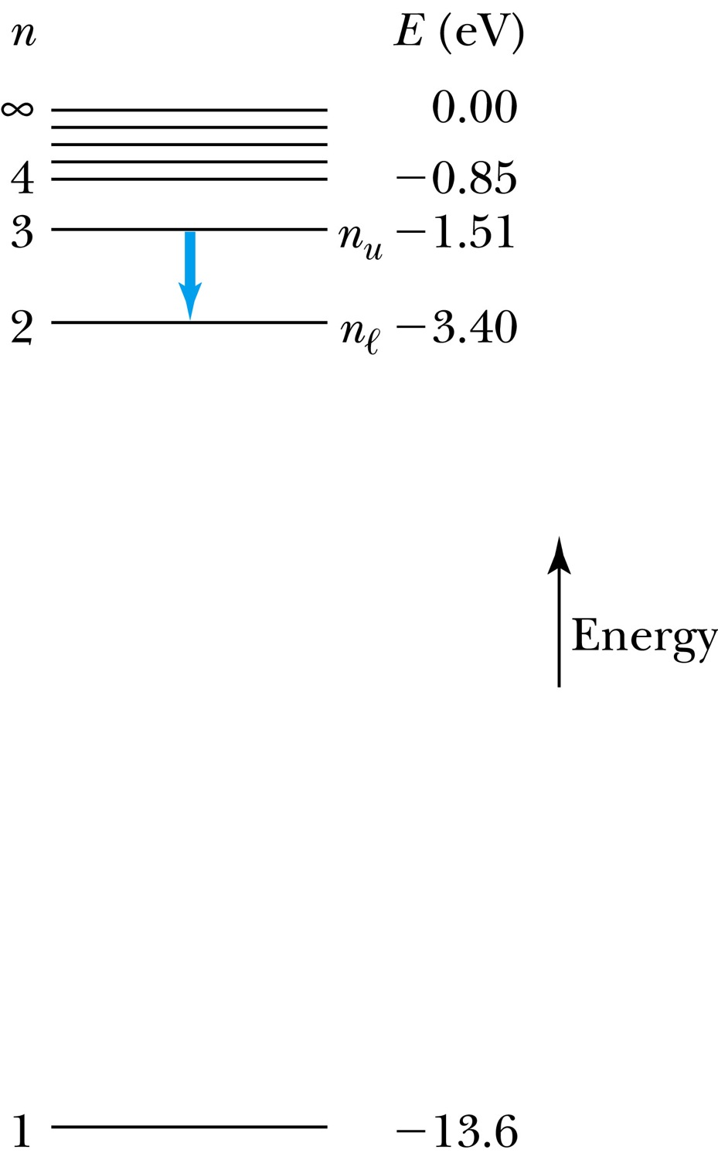
The Hydrogen Atom
The energies of the stationary states
where E₀ is the ground state energy
Emission of light occurs when the atom is in an excited state and decays to a lower energy state (n_{u} → n_{ℓ}).
where f is the frequency of a photon.
R∞ is the Rydberg constant.

Slide 9
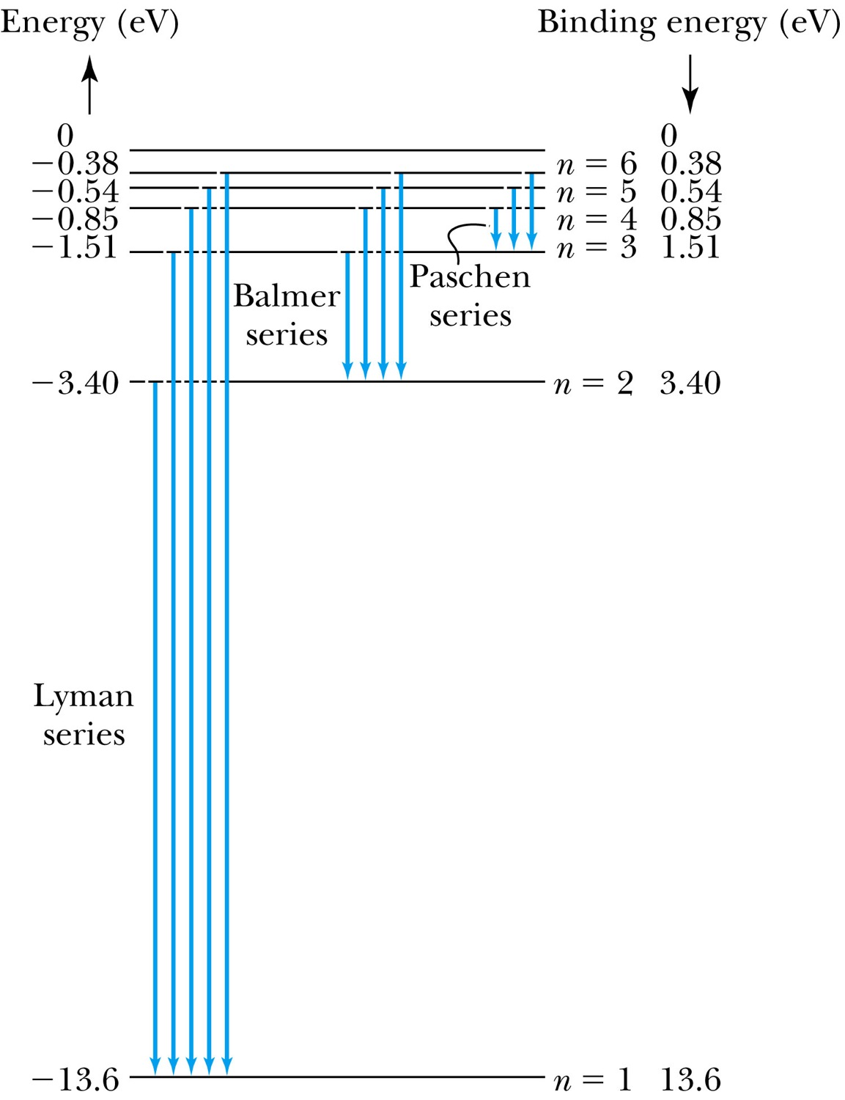
Transitions in the Hydrogen Atom
Lyman series: The atom will remain in the excited state for a short time before emitting a photon and returning to a lower stationary state. All hydrogen atoms exist in n = 1 (invisible).
Balmer series: When sunlight passes through the atmosphere, hydrogen atoms in water vapor absorb the wavelengths (visible).

Slide 10
Fine Structure Constant
The electron’s speed on an orbit in the Bohr model:
On the ground state, v₁ = 2.2 × 10⁶ m/s ~ less than 1% of the speed of light
The ratio of v₁ to c is the fine structure constant, α.

Slide 11
The Correspondence Principle
Classical electrodynamics
Bohr’s atomic model
+
Determine the properties
of radiation
Need a principle to relate the new modern results with classical ones.
Bohr’s correspondence
principle
In the limits where classical and quantum theories should agree, the quantum theory must produce the classical results.

Slide 12
The Correspondence Principle
The frequency of the radiation emitted f_{classical} is equal to the orbital frequency f_{orb} of the electron around the nucleus.
The frequency of the transition from n + 1 to n is
For large n the classical limit,
Substitute E₀:
So the frequency of the radiated E between classical theory and Bohr model agrees in large n case!!

Slide 13
Importance of Bohr’s Model
Demonstrated the need for Plank’s constant in understanding atomic structure
Assumption of quantized angular momentum which led to quantization of other quantities, r, v and E as follows
Orbital Radius:
Orbital Speed:
Energy levels:

Slide 14
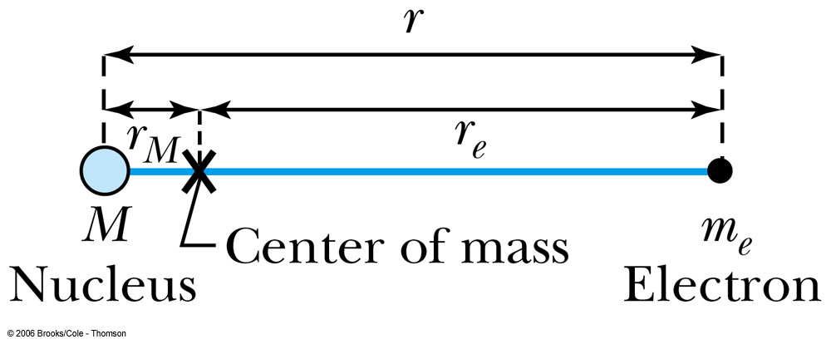
Successes and Failures of the Bohr Model
The electron and hydrogen nucleus actually revolved about their mutual center of mass ➔ reduced mass correction!!
All we need is to replace m_{e} with atom’s reduced mass.
The Rydberg constant for infinite nuclear mass, R∞ is replaced by R.

Slide 15
Limitations of the Bohr Model
The Bohr model was a great step of the new quantum theory, but it had its limitations.
Works only to single-electron atoms
Even for ions ➔ What would change?
The charge of the nucleus
Could not account for the intensities or the fine structure of the spectral lines
Fine structure is caused by the electron spin
Could not explain the binding of atoms into molecules

Slide 16
Characteristic X-Ray Spectra and Atomic Number
Shells have letter names:
K shell for n = 1
L shell for n = 2
The atom is most stable in its ground state.
When a transition occurs in a heavy atom, the radiation emitted is an x ray.
It has the energy E (x ray) = E_{u} − E_{ℓ}.
An electron from higher shells will fill the inner-shell vacancy at lower energy.

Slide 17
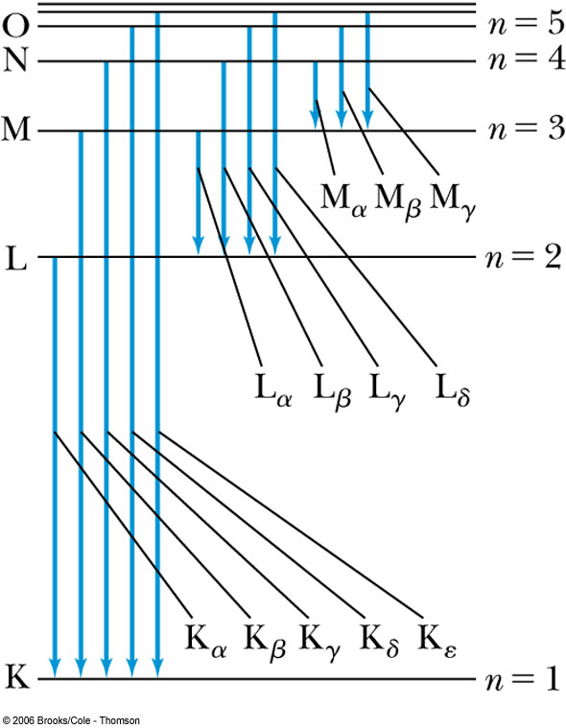
Atomic Number
L shell to K shell K_{α} x ray
M shell to K shell K_{β} x ray
Atomic number Z = number of protons in the nucleus
Moseley found a relationship between the frequencies of the characteristic x ray and Z.
This holds for the K_{α} x ray

Slide 18
Moseley’s Empirical Results
The x ray is produced from n = 2 to n = 1 transition.
In general, the K series of x ray wavelengths are
Moseley’s research clarified the importance of the electron shells for all the elements, not just for hydrogen.

Slide 19
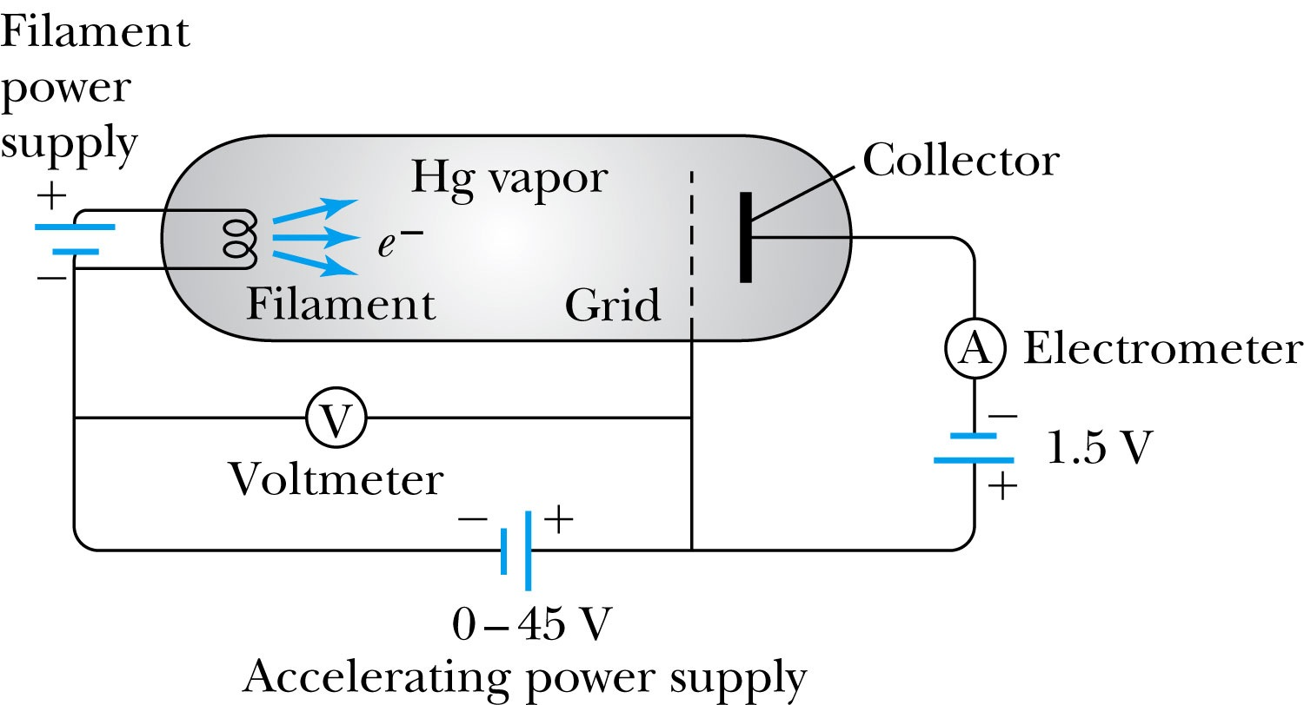
Atomic Excitation by Electrons
Franck and Hertz studied the phenomenon of ionization.
Accelerating voltage is below 5 V
electrons did not lose energy
Accelerating voltage is above 5 V
sudden drop in the current

Slide 20
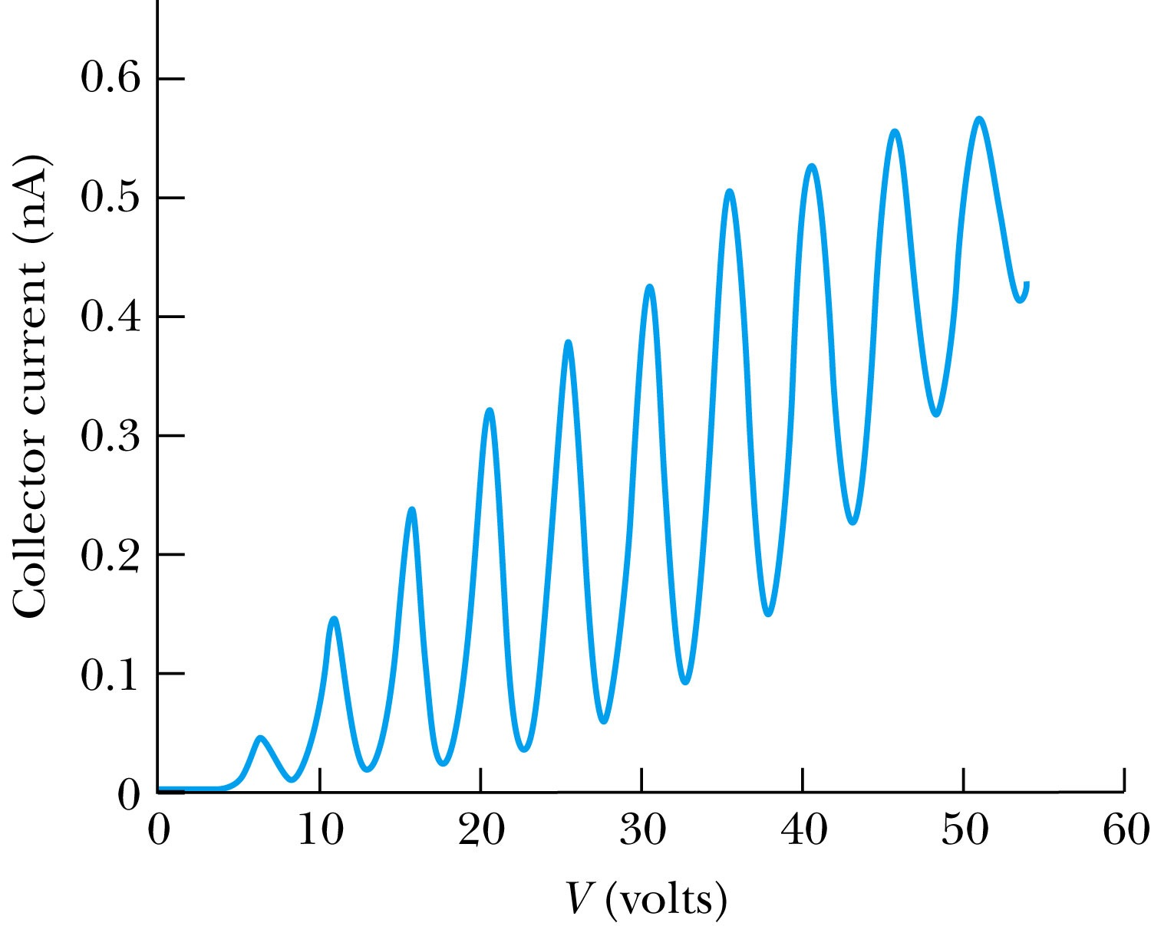
Atomic Excitation by Electrons
Ground state has E₀ to be zero.
First excited state has E₁.
The energy difference E₁ − 0 = E₁ is the excitation energy.
Hg has an excitation energy of 4.88 eV in the first excited state
No energy can be transferred to Hg below 4.88 eV because not enough energy is available to excite an electron to the next energy level
Above 4.88 eV, the current drops because scattered electrons no longer reach the collector until the accelerating voltage reaches 9.8 eV and so on.

