Slide 1
PHYS 3313 – Section 001 Lecture #10
Monday, Oct. 1, 2012
Dr. Jaehoon Yu
Importance of Bohr’s Model
X-ray Scattering
Bragg’s Law
De Broglie Waves
Bohr’s Quantization
Electron Scattering
Wave Properties

Slide 2
Announcements
Reading assignments: CH4.6 and CH4.7
Mid-term exam
In class on Wednesday, Oct. 10, in PKH107
Covers: CH1.1 to what we finish this Wednesday, Oct. 3
Style: Mixture of multiple choices and free response problems which are more heavily weighted
Mid-term exam constitutes 20% of the total
Homework #3
End of chapter problems on CH4: 5, 14, 17, 21, 23 and 45
Due: Monday, Oct. 8
Colloquium this week
4pm, Wednesday, Oct. 3, SH101
Dr. Hongxing Jiang of Texas Tech

Slide 3
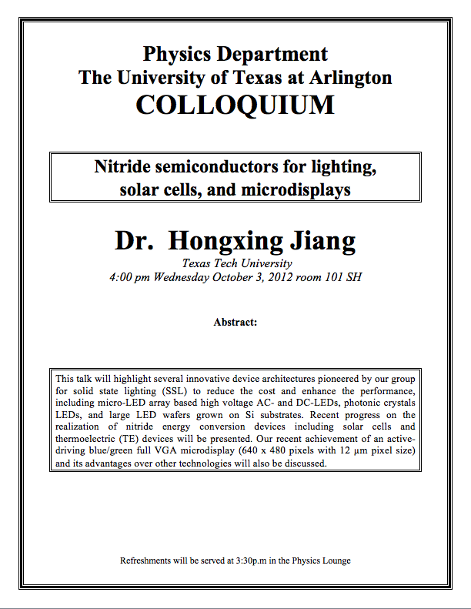

Slide 4
Special Project #3
A total of N_{i} incident projectile particles of atomic number Z₁ kinetic energy KE scatter on a target of thickness t, atomic number Z₂ and with n atoms per volume. What is the total number of scattered projectile particles at an angle θ? (20 points)
Please be sure to define all the variables used in your derivation! Points will be deducted for missing variable definitions.
This derivation must be done on your own. Please do not copy the book or your friends’.
Due is Monday, Oct. 8.

Slide 5
Importance of Bohr’s Model
Demonstrated the need for Plank’s constant in understanding atomic structure
Assumption of quantized angular momentum which led to quantization of other quantities, r, v and E as follows
Orbital Radius:
Orbital Speed:
Energy levels:

Slide 6
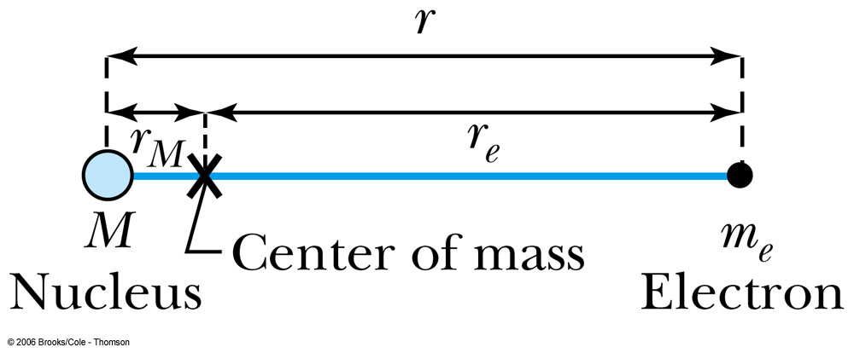
Successes and Failures of the Bohr Model
The electron and hydrogen nucleus actually revolved about their mutual center of mass ➔ reduced mass correction!!
All we need is to replace m_{e} with atom’s reduced mass.
The Rydberg constant for infinite nuclear mass, R∞ is replaced by R.

Slide 7
Limitations of the Bohr Model
The Bohr model was a great step of the new quantum theory, but it had its limitations.
Works only to single-electron atoms
Even for ions ➔ What would change?
The charge of the nucleus
Could not account for the intensities or the fine structure of the spectral lines
Fine structure is caused by the electron spin
When a magnetic field is applied, spectral lines split
Could not explain the binding of atoms into molecules

Slide 8
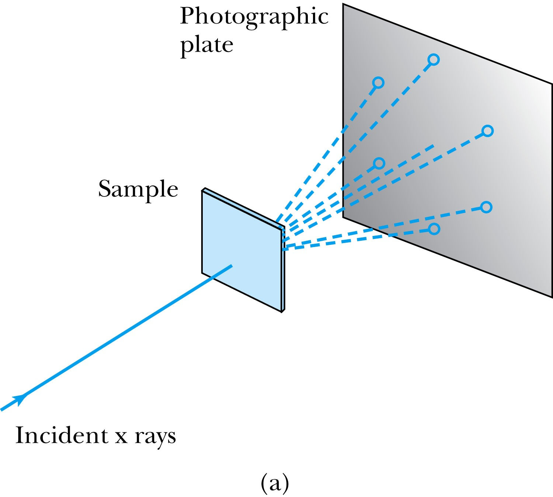
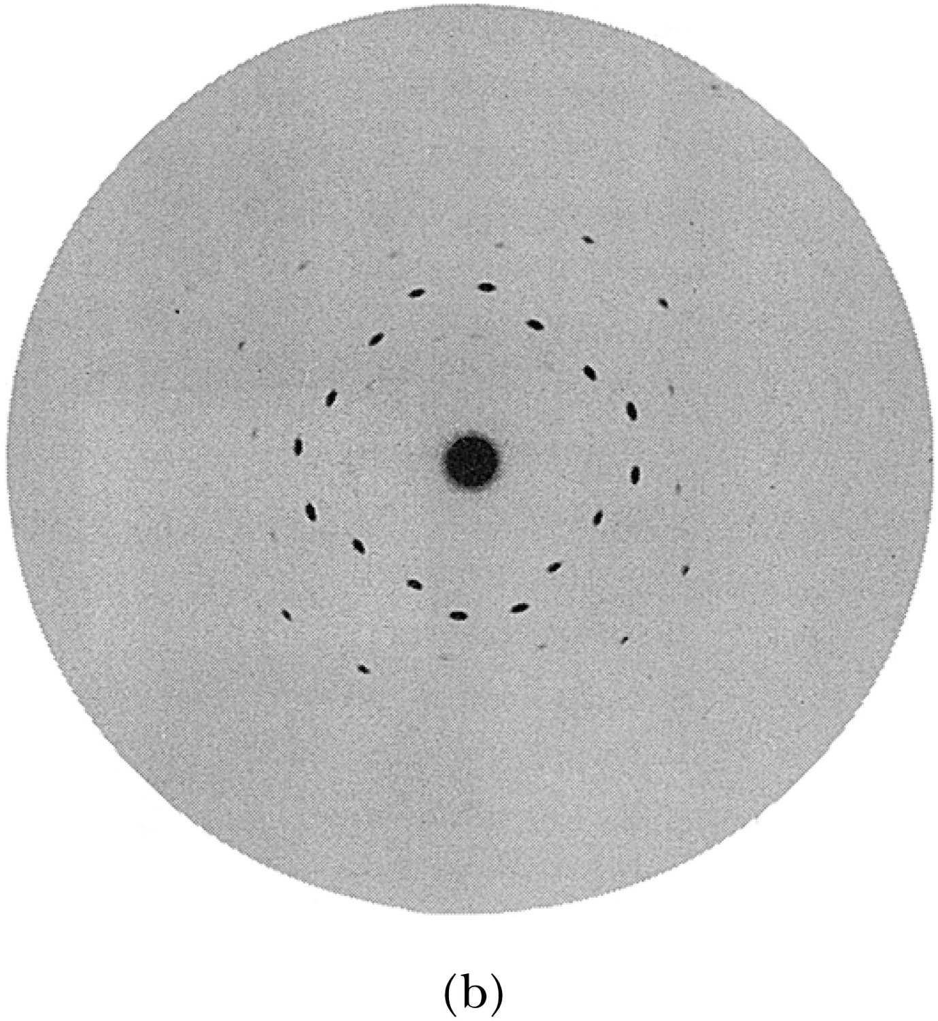
X-Ray Scattering
Max von Laue suggested that if x rays were a form of electromagnetic radiation, interference effects should be observed. (Wave property!!)
Crystals act as three-dimensional gratings, scattering the waves and producing observable interference effects.

Slide 9
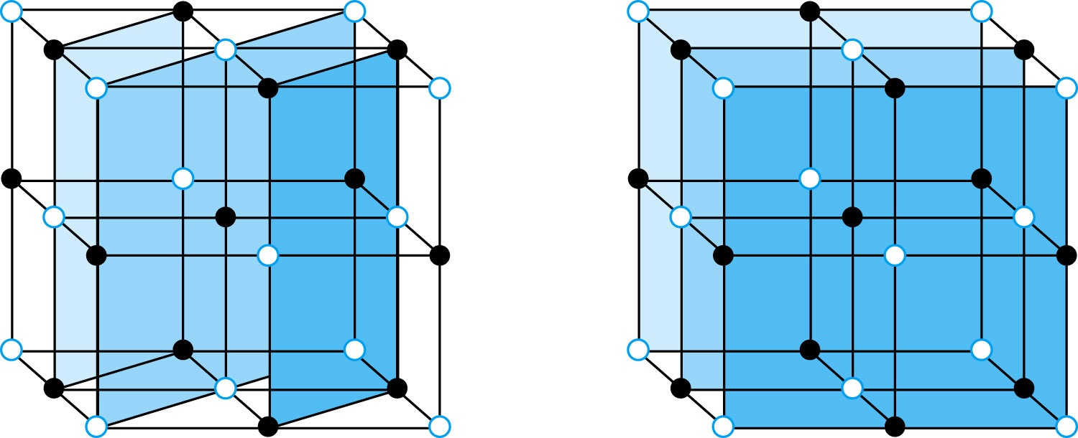
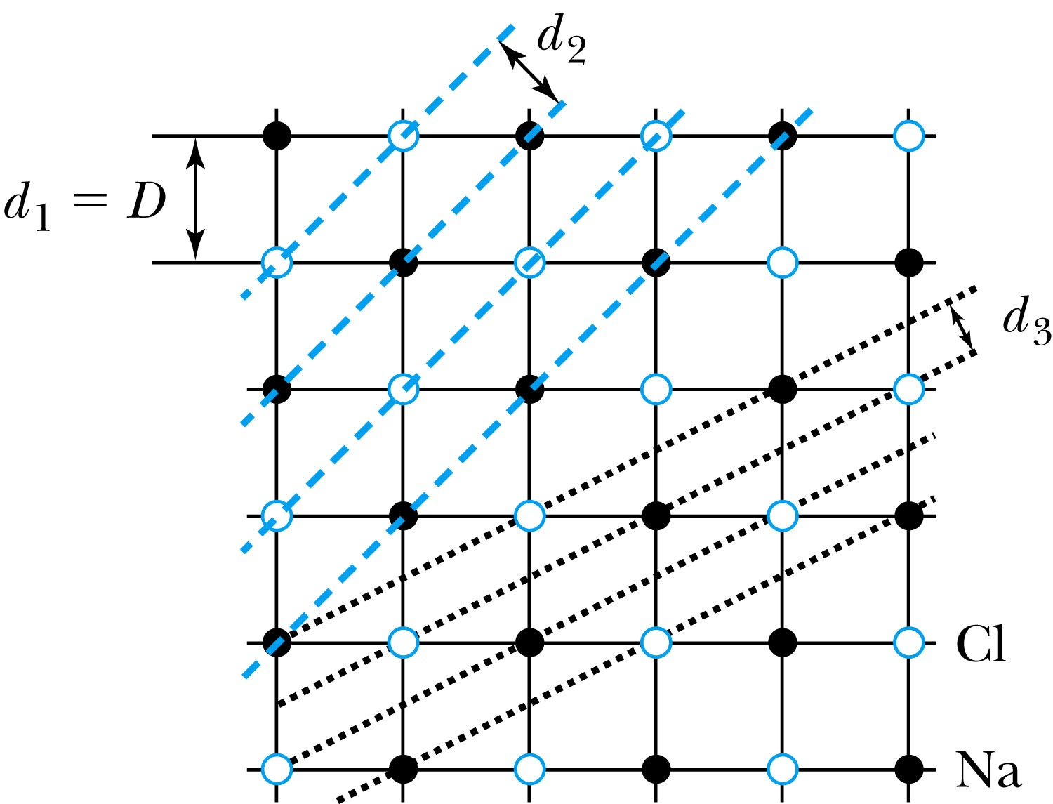
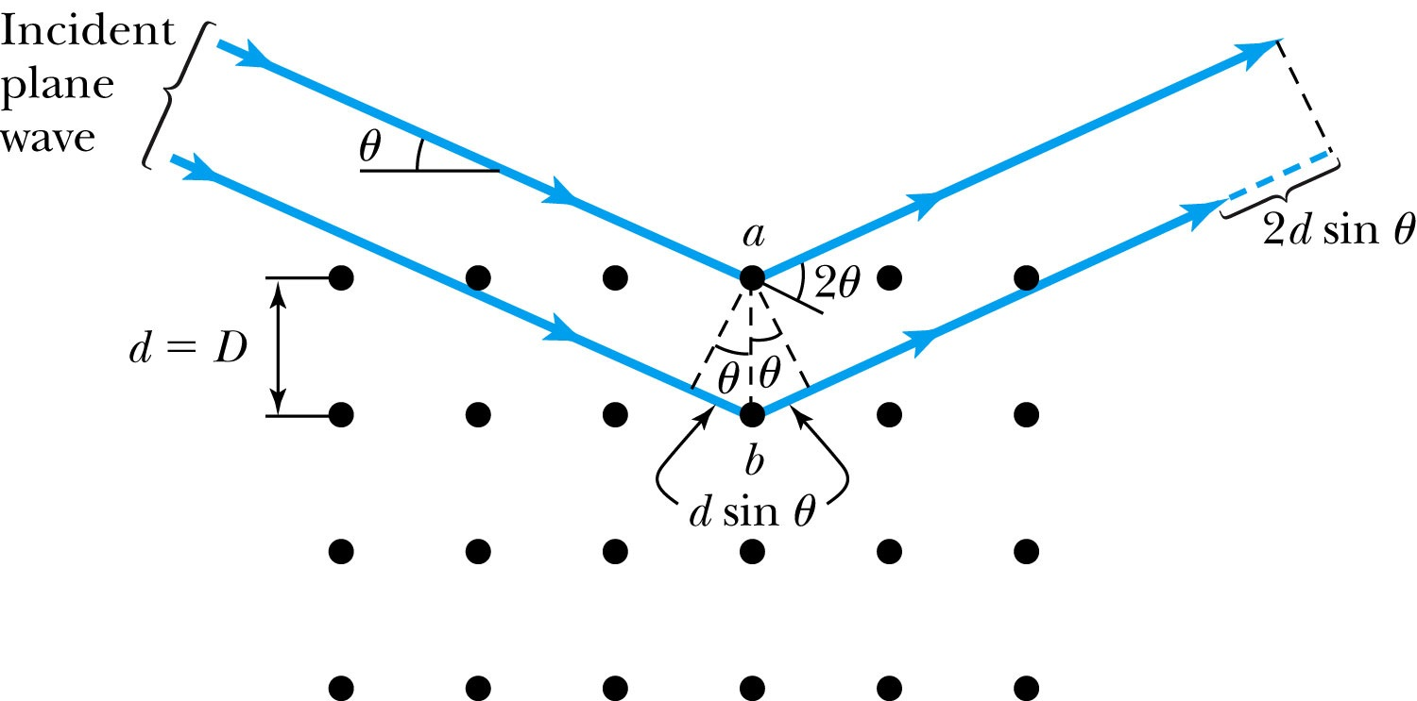
Bragg’s Law
William Lawrence Bragg interpreted the x-ray scattering as the reflection of the incident x-ray beam from a unique set of planes of atoms within the crystal.
There are two conditions for constructive interference of the scattered x rays:
The angle of incidence must equal the angle of reflection of the outgoing wave. (total reflection)
The difference in path lengths between two rays must be an integral number of wavelengths.
Bragg’s Law:
nλ = 2d sin θ
(n = integer)

Slide 10
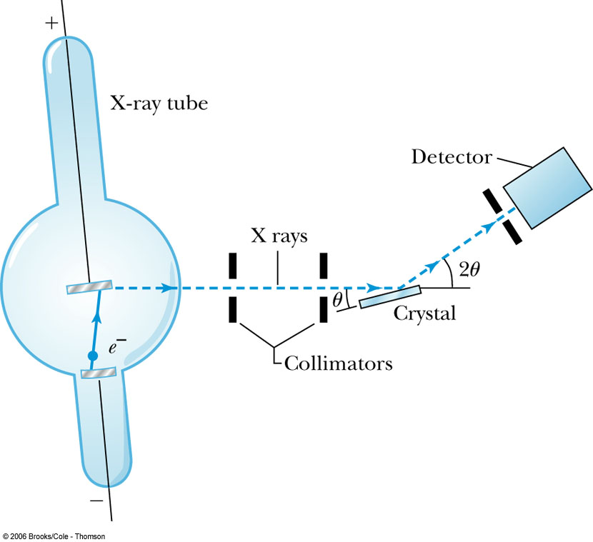
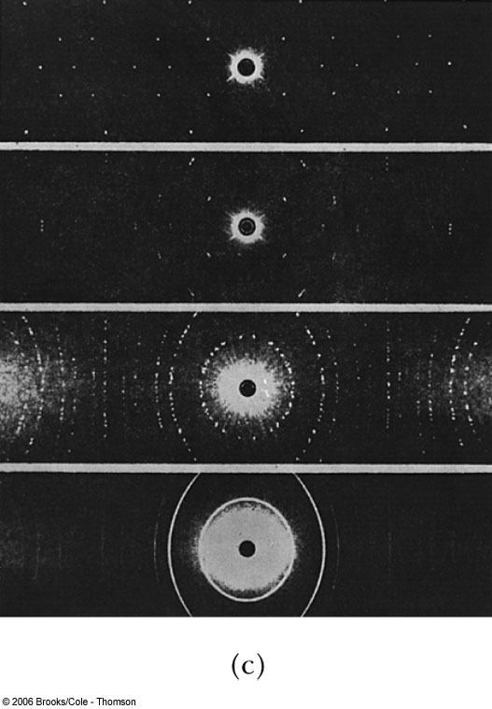
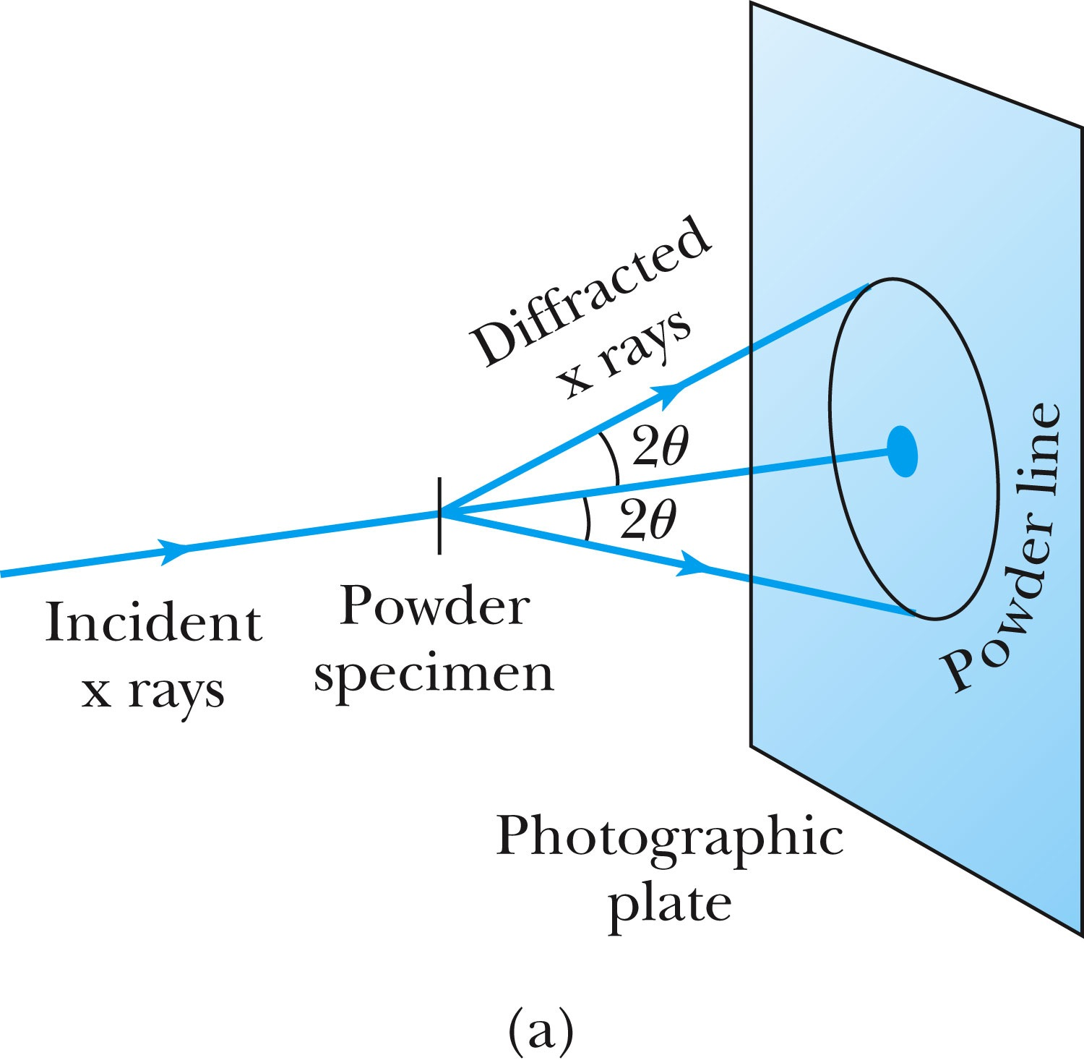
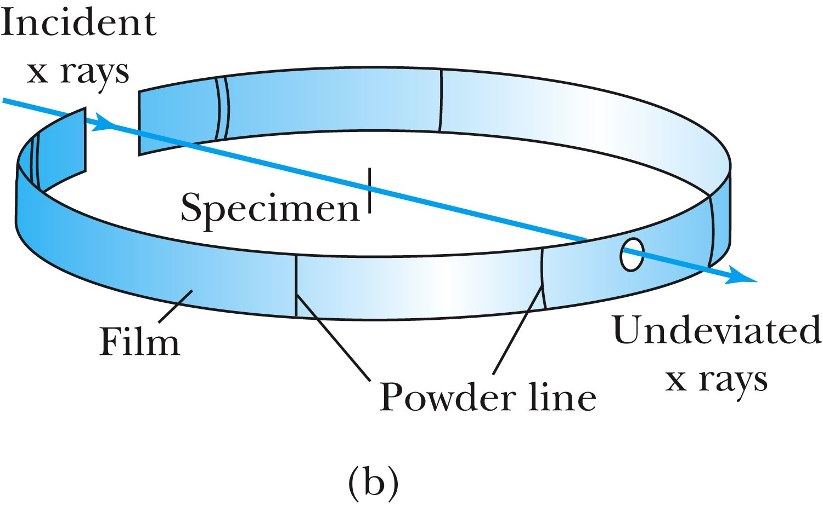
The Bragg Spectrometer
A Bragg spectrometer scatters x rays from several crystals. The intensity of the diffracted beam is determined as a function of scattering angle by rotating the crystal and the detector.
When a beam of x rays passes through the powdered crystal, the dots become a series of rings due to random arrangement.

Slide 11
Ex 5.1: Bragg’s Law
X rays scattered from rock salt (NaCl) are observed to have an intense maximum at an angle of 20º from the incident direction. Assuming n=1 (from the intensity), what must be the wavelength of the incident radiation?
Bragg’s law: nλ = 2d sin θ
What do we need to know to use this? The lattice spacing d!
We know n=1 and 2θ=20º.
We use the density of NaCl to find out what d is.

Slide 12
De Broglie Waves
Prince Louis V. de Broglie suggested that mass particles should have wave properties similar to electromagnetic radiation ➔ many experiments supported this!
Thus the wavelength of a matter wave is called the de Broglie wavelength:
Since for a photon, E = pc and E = hf, the energy can be written as

Slide 13
Bohr’s Quantization Condition
One of Bohr’s assumptions concerning his hydrogen atom model was that the angular momentum of the electron-nucleus system in a stationary state is an integral multiple of h/2π.
The electron is a standing wave in an orbit around the proton. This standing wave will have nodes and be an integral number of wavelengths.
The angular momentum becomes:

Slide 14
Ex 5.2: De Broglie Wavelength
Calculate the De Broglie wavelength of (a) a tennis ball of mass 57g traveling 25m/s (about 56mph) and (b) an electron with kinetic energy 50eV.
What is the formula for De Broglie Wavelength?
(a) for a tennis ball, m=0.057kg.
(b) for electron with 50eV KE, since KE is small, we can use non-relativistic expression of electron momentum!
What are the wavelengths of you running at the speed of 2m/s? What about your car of 2 metric tons at 100mph? How about the proton with 14TeV kinetic energy?
What is the momentum of the photon from a green laser?

Slide 15
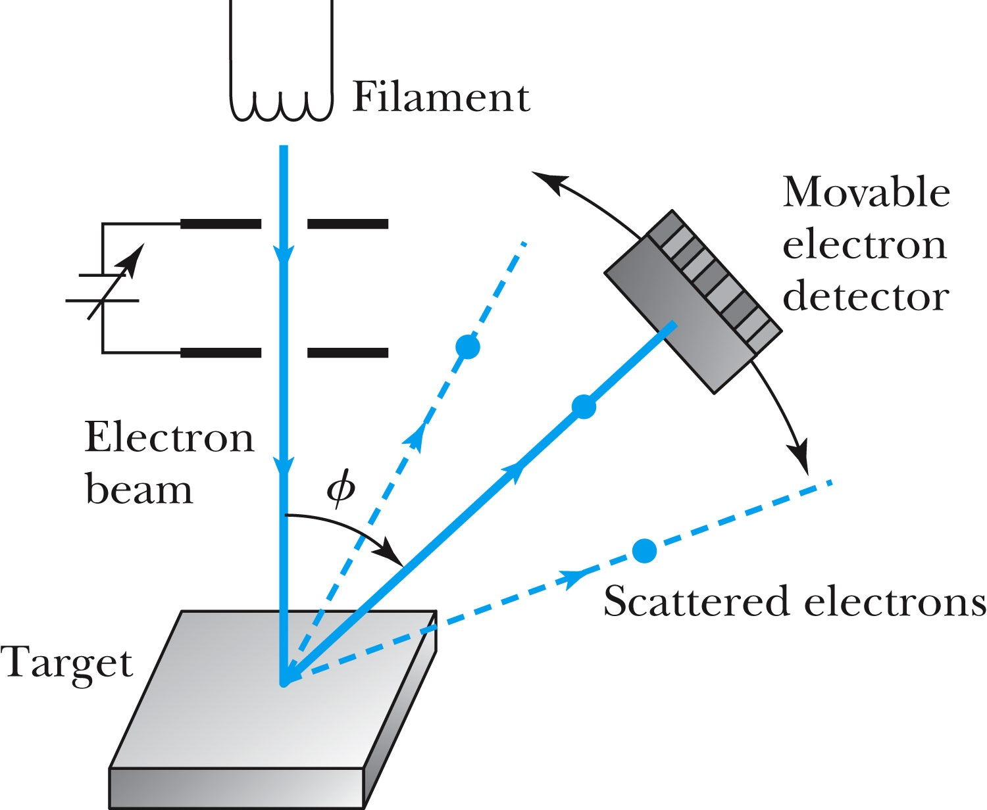
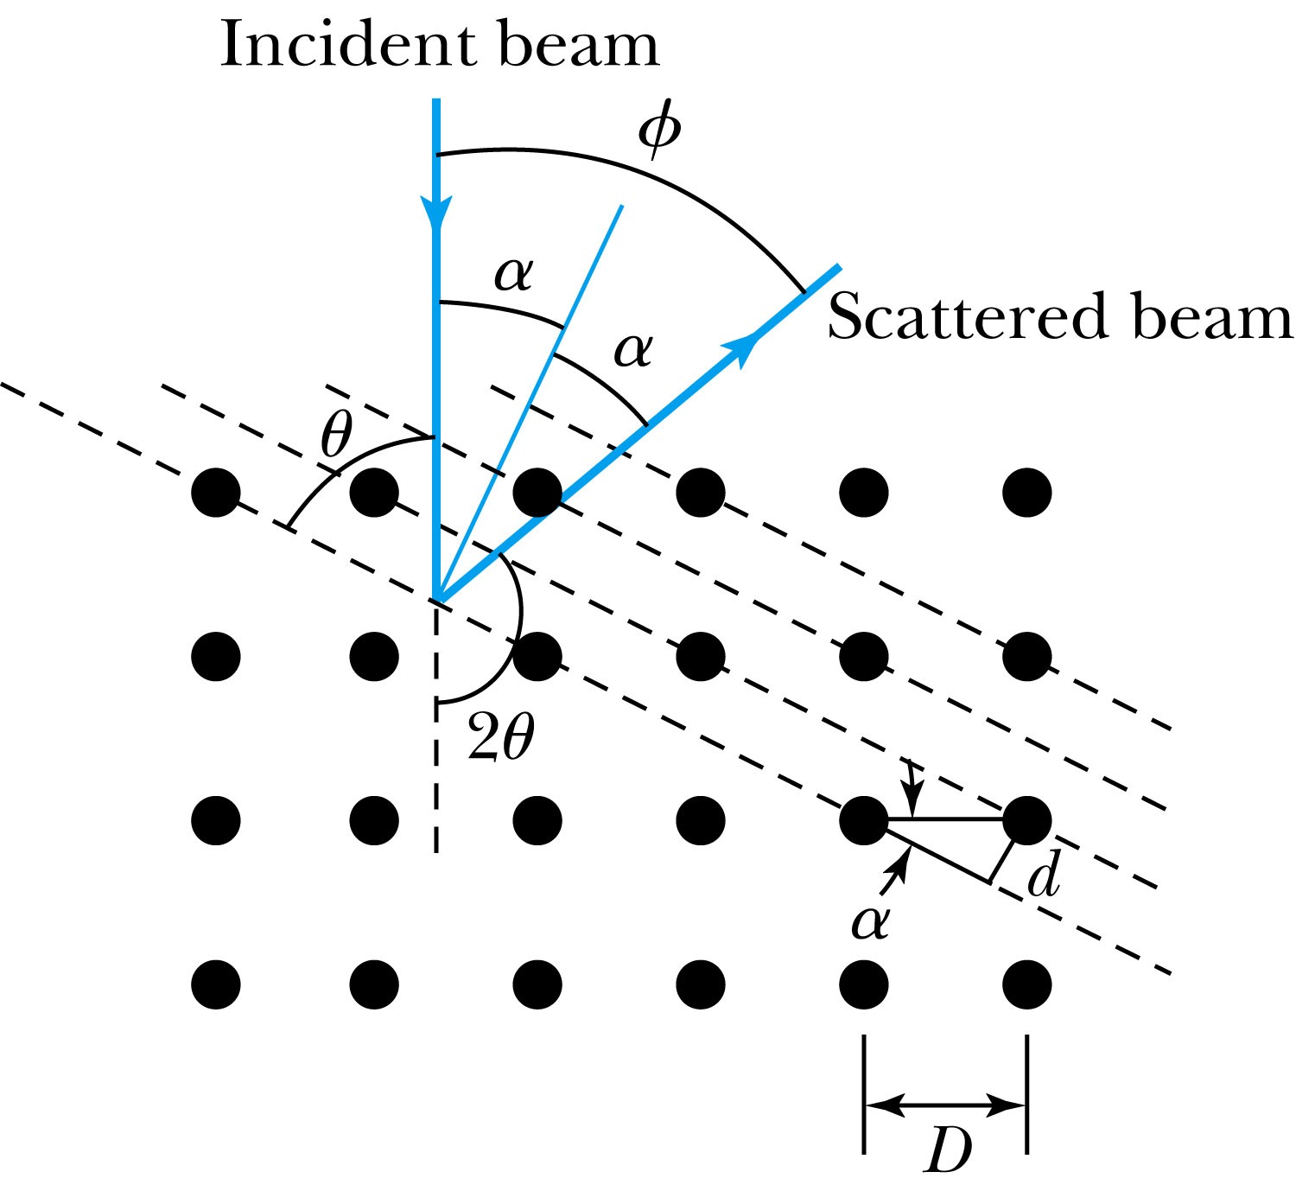
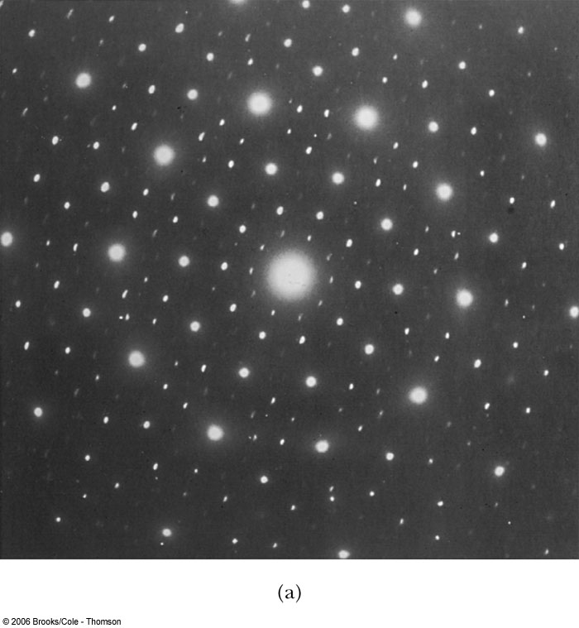
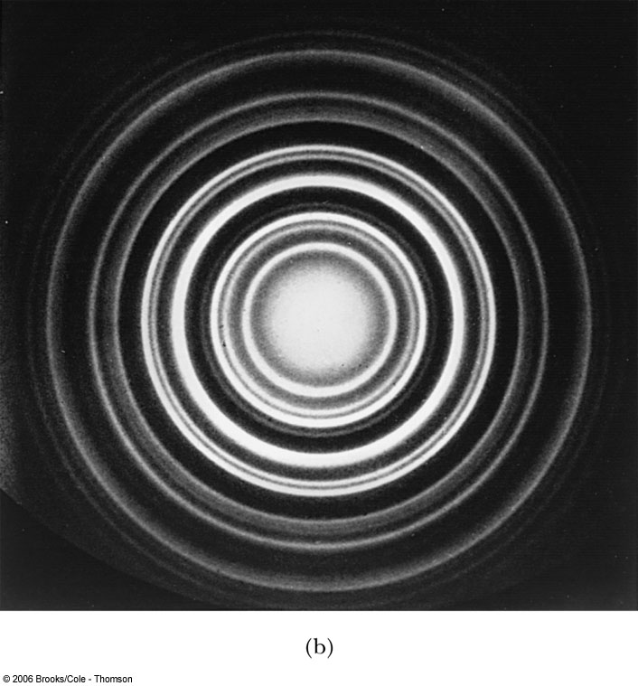
Electron Scattering
Davisson and Germer experimentally observed that electrons were diffracted much like x rays in nickel crystals. ➔ direct proof of De Broglie wave!
George P. Thomson (1892–1975), son of J. J. Thomson, reported seeing the effects of electron diffraction in transmission experiments. The first target was celluloid, and soon after that gold, aluminum, and platinum were used. The randomly oriented polycrystalline sample of SnO₂ produces rings as shown in the figure at right.

