Slide 1
PHYS 3313 – Section 001
Lecture #11
Wednesday, Oct. 3, 2012
Dr. Amir Farbin (disguised as Dr. Yu)
Wave Motion & Properties
Superposition Principle
Wave Packets
Gaussian Wave Packets
Dispersion
Wave–Particle Duality
Uncertainty Principle
Schrodinger Equation

Slide 2
Announcements
Mid-term exam
  In class on Wednesday, Oct. 10, in PKH107
  Covers: CH1.1 to what we finish this Wednesday, Oct. 3
  Style: Mixture of multiple choices and free response problems which are more heavily weighted
  Mid-term exam constitutes 20% of the total
  Please do NOT miss the exam! You will get an F if you miss it.
Homework #3
  End of chapter problems on CH4: 5, 14, 17, 21, 23 and 45
  Due: Monday, Oct. 8
Colloquium this week
  4pm, Wednesday, Oct. 3, SH101
  Dr. Hongxing Jiang of Texas Tech

Slide 3
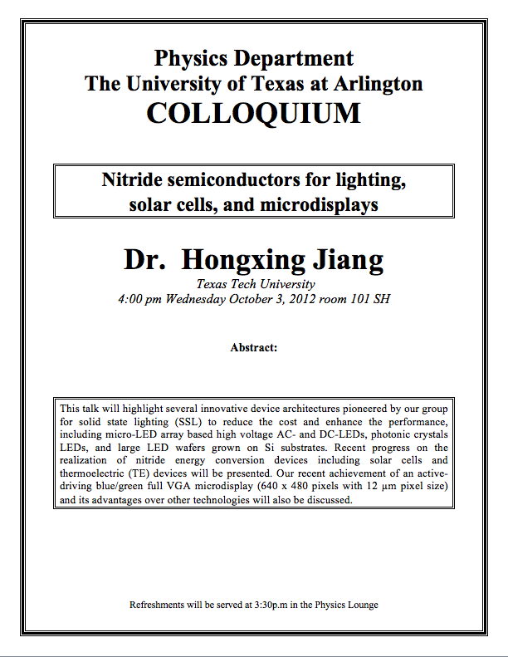

Slide 4
Reminder: Special Project #3
A total of N_{i} incident projectile particles of atomic number Z₁ kinetic energy KE scatter on a target of thickness t, atomic number Z₂ and with n atoms per volume. What is the total number of scattered projectile particles at an angle θ? (20 points)
Please be sure to define all the variables used in your derivation! Points will be deducted for missing variable definitions.
This derivation must be done on your own. Please do not copy the book or your friends’.
Due is Monday, Oct. 8.

Slide 5
Photons, which we thought were waves, act particle like (eg Photoelectric effect or Compton Scattering)
Electrons, which we thought were particles, act particle like (eg electron scattering)
De Broglie: All matter has intrinsic wavelength.
  Wave length inversely proportional to momentum
  The more massive… the smaller the wavelength… the harder to observe the wavelike properties
  So while photons appear mostly wavelike, electrons (next lightest particle!) appear mostly particle like.
How can we reconcile the wave/particle views?

Slide 6
Wave Motion
De Broglie matter waves suggest a further description. The displacement of a wave is
This is a solution to the wave equation
Define the wave number k and the angular frequency ω as:
The wave function is now:

Slide 7
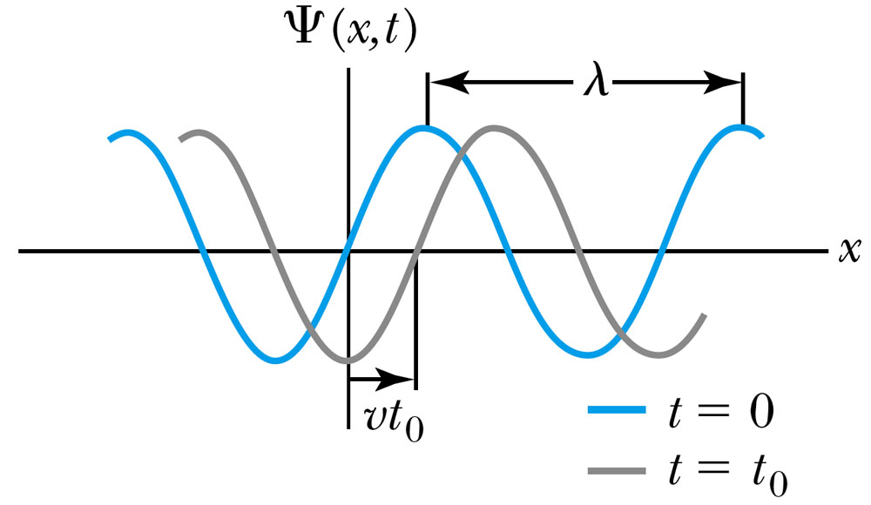
Wave Properties
The phase velocity is the velocity of a point on the wave that has a given phase (for example, the crest) and is given by
A phase constant Φ shifts the wave:
.
(When φ=π/2)

Slide 8
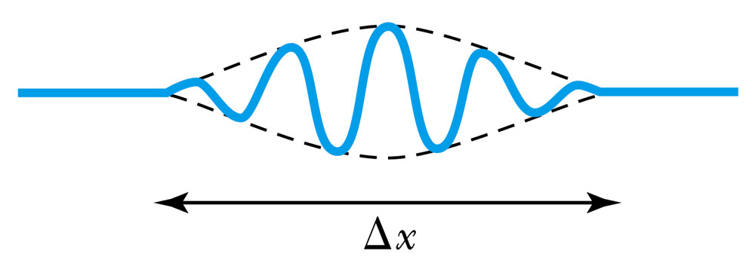
Principle of Superposition
When two or more waves traverse the same region, they act independently of each other.
Combining two waves yields:
The combined wave oscillates within an envelope that denotes the maximum displacement of the combined waves.
When combining many waves with different amplitudes and frequencies, a pulse, or wave packet, can be formed, which can move at a group velocity:

Slide 9
Fourier Series
Adding 2 waves isn’t localized in space… but adding lots of waves can be.
The sum of many waves that form a wave packet is called a Fourier series:
Summing an infinite number of waves yields the Fourier integral:

Slide 10
Wave Packet Envelope
The superposition of two waves yields a wave number and angular frequency of the wave packet envelope.
The range of wave numbers and angular frequencies that produce the wave packet have the following relations:
A Gaussian wave packet has similar relations:
The localization of the wave packet over a small region to describe a particle requires a large range of wave numbers. Conversely, a small range of wave numbers cannot produce a wave packet localized within a small distance.

Slide 11
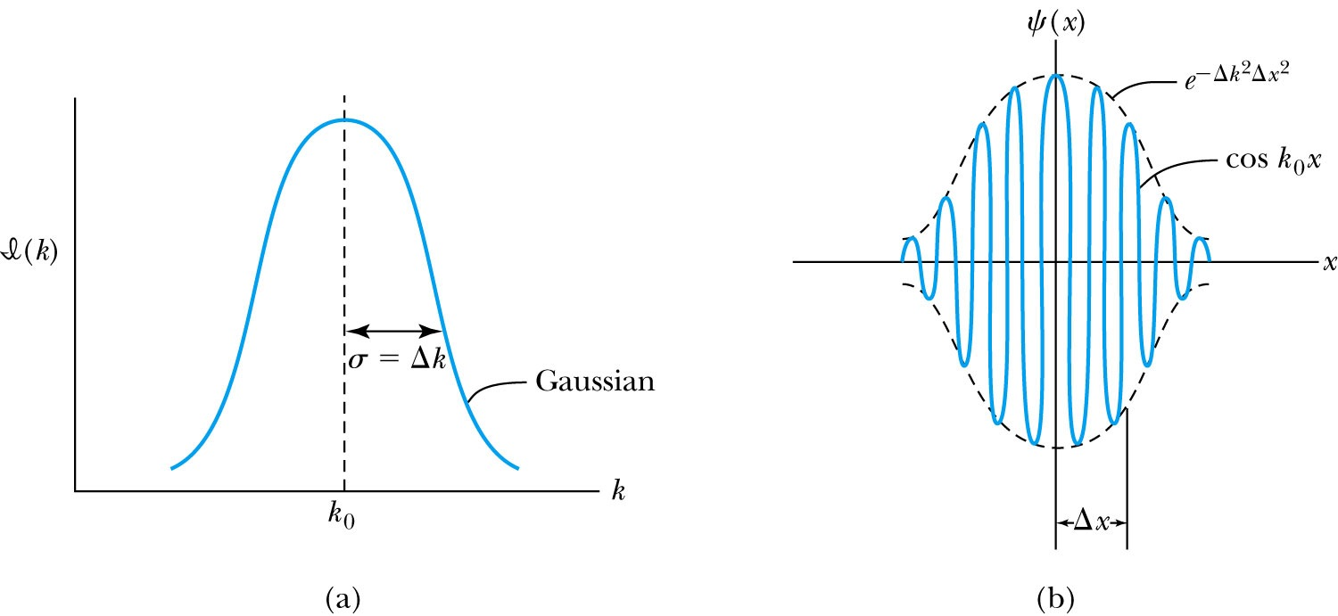
Gaussian Function
A Gaussian wave packet describes the envelope of a pulse wave.
The group velocity is

Slide 12
Dispersion
Considering the group velocity of a de Broglie wave packet yields:
The relationship between the phase velocity and the group velocity is
Hence the group velocity may be greater or less than the phase velocity. A medium is called nondispersive when the phase velocity is the same for all frequencies and equal to the group velocity.

Slide 13
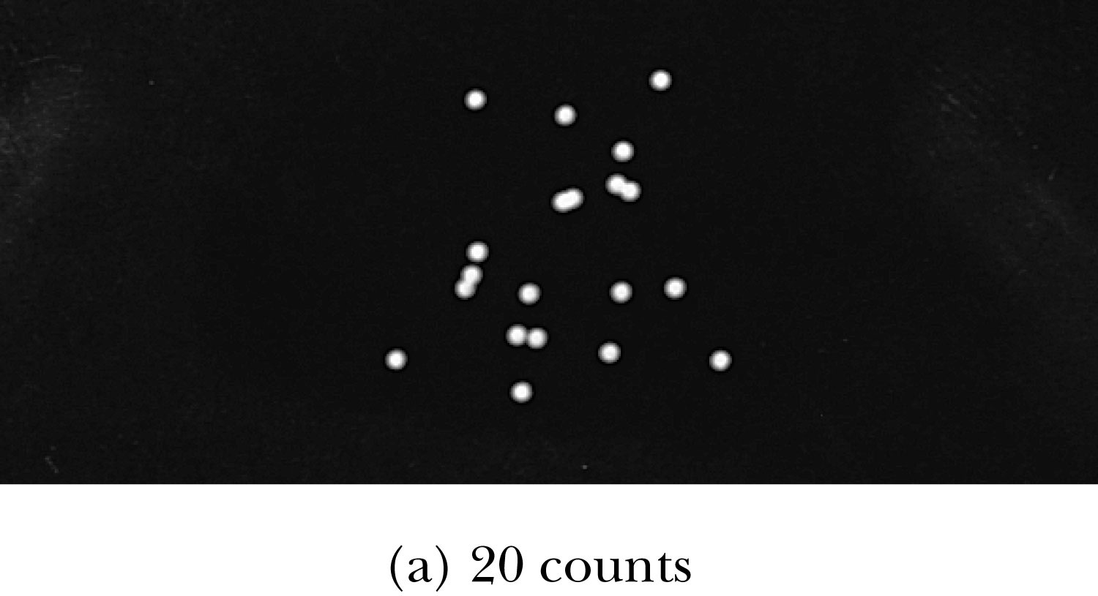
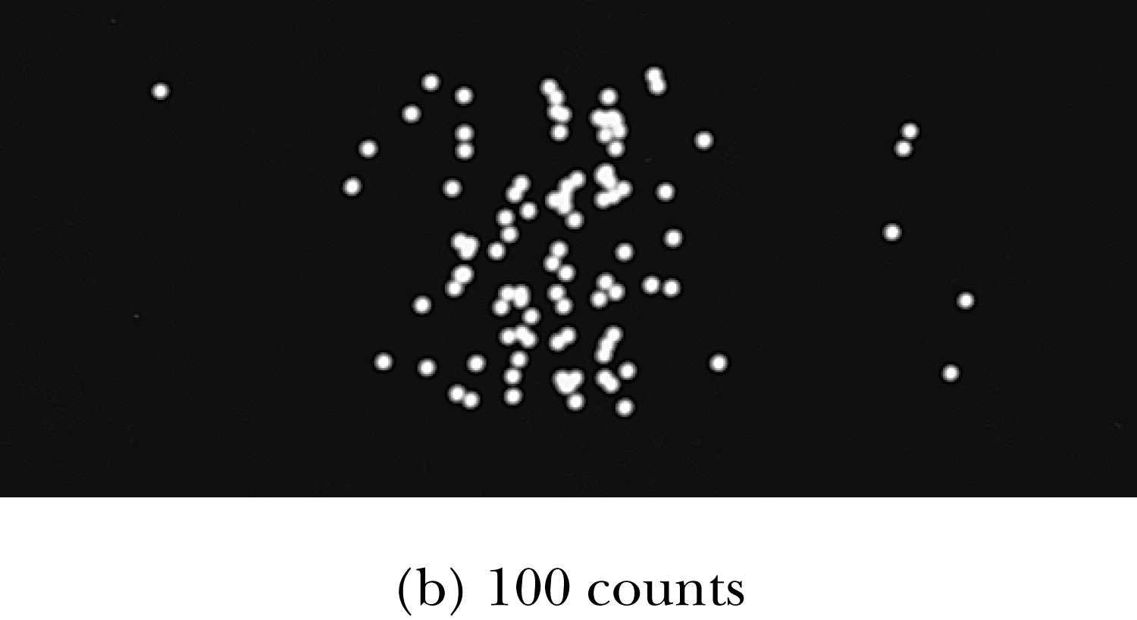
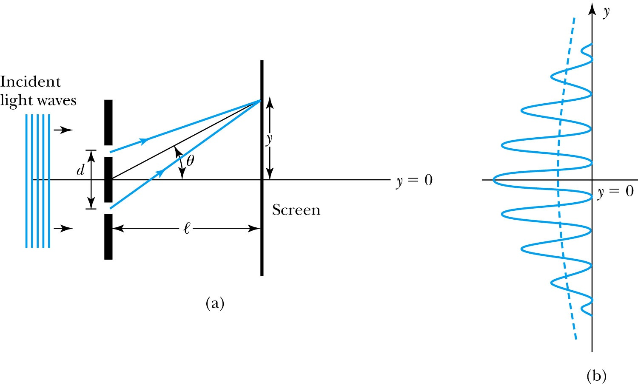
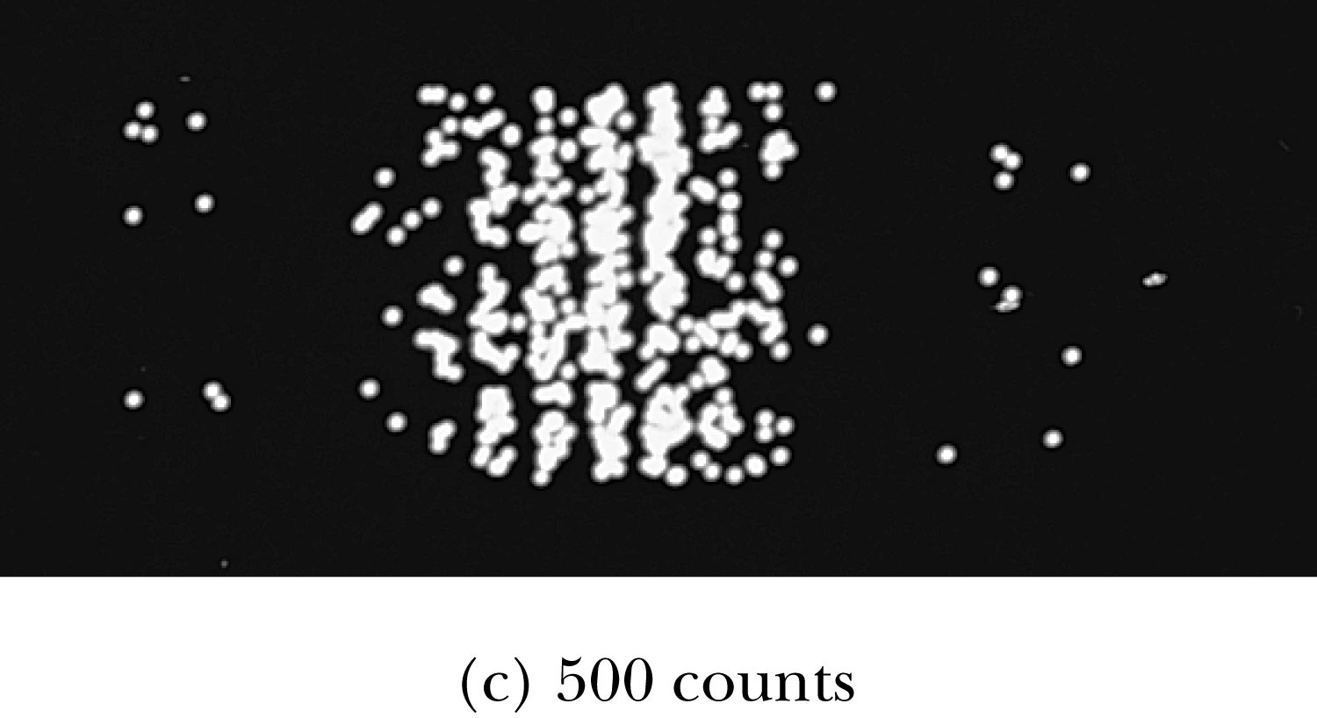
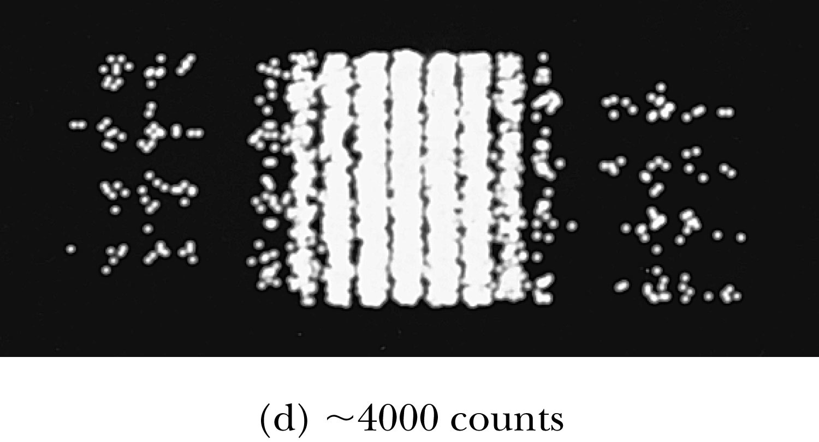
Waves or Particles?
Young’s double-slit diffraction experiment demonstrates the wave property of light.
However, dimming the light results in single flashes on the screen representative of particles.

Slide 14
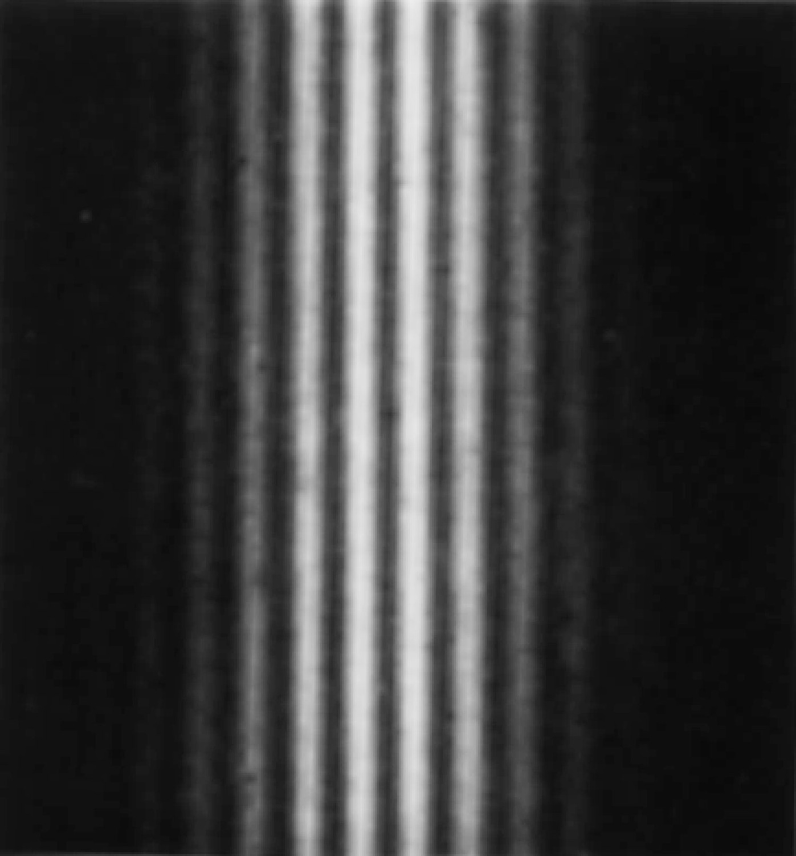
Electron Double-Slit Experiment
C. Jönsson of Tübingen, Germany, succeeded in 1961 in showing double-slit interference effects for electrons by constructing very narrow slits and using relatively large distances between the slits and the observation screen.
This experiment demonstrated that precisely the same behavior occurs for both light (waves) and electrons (particles).

Slide 15
Which slit?
To determine which slit the electron went through: We set up a light shining on the double slit and use a powerful microscope to look at the region. After the electron passes through one of the slits, light bounces off the electron; we observe the reflected light, so we know which slit the electron came through.
Use a subscript “ph” to denote variables for light (photon). Therefore the momentum of the photon is
The momentum of the electrons will be on the order of .
The difficulty is that the momentum of the photons used to determine which slit the electron went through is sufficiently great to strongly modify the momentum of the electron itself, thus changing the direction of the electron! The attempt to identify which slit the electron is passing through will in itself change the interference pattern.

Slide 16
Wave particle duality solution
The solution to the wave particle duality of an event is given by the following principle.
Bohr’s principle of complementarity: It is not possible to describe physical observables simultaneously in terms of both particles and waves.
Physical observables are the quantities such as position, velocity, momentum, and energy that can be experimentally measured. In any given instance we must use either the particle description or the wave description.

Slide 17
Uncertainty Principle
It is impossible to measure simultaneously, with no uncertainty, the precise values of k and x for the same particle. The wave number k may be rewritten as
For the case of a Gaussian wave packet we have
Thus for a single particle we have Heisenberg’s uncertainty principle:

Slide 18
Energy Uncertainty
If we are uncertain as to the exact position of a particle, for example an electron somewhere inside an atom, the particle can’t have zero kinetic energy.
The energy uncertainty of a Gaussian wave packet is
combined with the angular frequency relation
Energy-Time Uncertainty Principle: .

Slide 19
Probability, Wave Functions, and the Copenhagen Interpretation
The wave function determines the likelihood (or probability) of finding a particle at a particular position in space at a given time.
The total probability of finding the electron is 1. Forcing this condition on the wave function is called normalization.

Slide 20
The Copenhagen Interpretation
Bohr’s interpretation of the wave function consisted of 3 principles:
    The uncertainty principle of Heisenberg
    The complementarity principle of Bohr
    The statistical interpretation of Born, based on probabilities determined by the wave function
Together these three concepts form a logical interpretation of the physical meaning of quantum theory. According to the Copenhagen interpretation, physics depends on the outcomes of measurement.

Slide 21
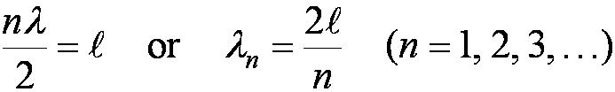
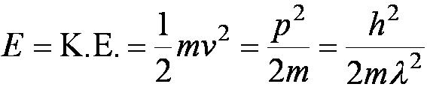
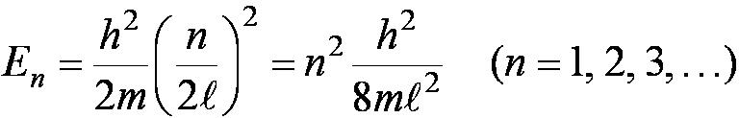
Particle in a Box
A particle of mass m is trapped in a one-dimensional box of width l.
The particle is treated as a wave.
The box puts boundary conditions on the wave. The wave function must be zero at the walls of the box and on the outside.
In order for the probability to vanish at the walls, we must have an integral number of half wavelengths in the box.
The energy of the particle is .
The possible wavelengths are quantized which yields the energy:
The possible energies of the particle are quantized.

Slide 22
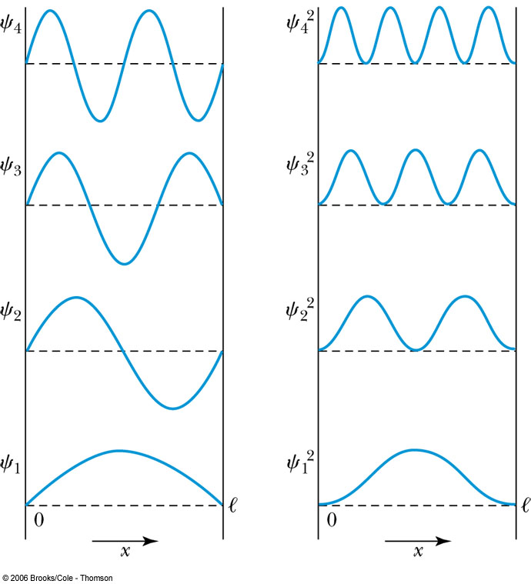

Probability of the Particle
The probability of observing the particle between x and x + dx in each state is
Note that E₀ = 0 is not a possible energy level.
The concept of energy levels, as first discussed in the Bohr model, has surfaced in a natural way by using waves.

