Slide 1
PHYS 3313 – Section 001
Lecture #11
Monday, Oct. 8, 2012
Dr. Jaehoon Yu
Midterm Exam Review

Slide 2
Announcements
Quiz results
  Class average: 40.4/60
    Equivalent to: 67.3/100
  How did you do last time?: 27.4/100
  Top score: 60/60
Mid-term exam
  In class on Wednesday, Oct. 10, in PKH107
  Covers: CH1.1 to CH5.8
  Style: Mixture of multiple choices and free response problems which are more heavily weighted
  Mid-term exam constitutes 20% of the total
  Please do NOT miss the exam! You will get an F if you miss it.
Homework #4
  End of chapter problems on CH5: 8, 10, 16, 24, 26, 36 and 47
  Due: Wednesday, Oct. 17
Colloquium this week
  4pm, Wednesday, Oct. 10, SH101
  Dr. Marco Nadeli of UNT

Slide 3
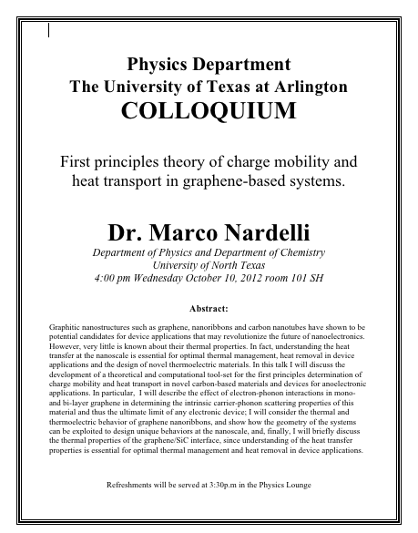

Slide 4
Triumph of Classical Physics:
The Conservation Laws
Conservation of energy: The total sum of energy (in all its forms) is conserved in all interactions.
Conservation of linear momentum: In the absence of external forces, linear momentum is conserved in all interactions.
Conservation of angular momentum: In the absence of external torque, angular momentum is conserved in all interactions.
Conservation of charge: Electric charge is conserved in all interactions.

Slide 5
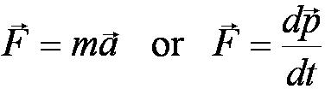

Isaac Newton (1642-1727)
Three laws describing the relationship between mass and acceleration.
Newton’s first law (law of inertia): An object in motion with a constant velocity will continue in motion unless acted upon by some net external force.
Newton’s second law: Introduces force (F) as responsible for the the change in linear momentum (p):
Newton’s third law (law of action and reaction): The force exerted by body 1 on body 2 is equal in magnitude and opposite in direction to the force that body 2 exerts on body 1.

Slide 6
Maxwell’s Equations for EM Radiation
In the absence of dielectric or magnetic materials, the four equations developed by Maxwell are:
Gauss’ Law for electricity
A generalized form of Coulomb’s law relating electric field to its sources, the electric charge
Gauss’ Law for magnetism
A magnetic equivalent of Coulomb’s law relating magnetic field to its sources. This says there are no magnetic monopoles.
Faraday’s Law
An electric field is produced by a changing magnetic field
Generalized Ampére’s Law
A magnetic field is produced by an electric current or by a changing electric field

Slide 7
The Laws of Thermodynamics
First law: The change in the internal energy ΔU of a system is equal to the heat Q added to a system plus the work W done by the system ➔ Generalization of conservation of energy including heat
ΔU = Q + W
Second law: It is not possible to convert heat completely into work without some other change taking place.
The “zeroth” law: Two systems in thermal equilibrium with a third system are in thermal equilibrium with each other.
  Explicitly stated only in early 20th century
Third law: It is not possible to achieve an absolute zero temperature.

Slide 8
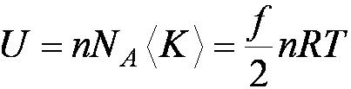
Primary Results of Statistical Interpretation
Culminates in the ideal gas equation for n moles of a “simple” gas:
PV = nRT
(where R is the ideal gas constant, 8.31 J/mol · K)
Average molecular kinetic energy directly related to absolute temperature
Internal energy U directly related to the average molecular kinetic energy
Internal energy equally distributed among the number of degrees of freedom (f ) of the system
(N_{A} = Avogadro’s Number)
And many others

Slide 9
Particles vs. Waves
Two distinct phenomena describing physical interactions
  Both required Newtonian mass
  Particles in the form of point masses and waves in the form of perturbation in a mass distribution, i.e., a material medium
  The distinctions are observationally quite clear; however, not so for the case of visible light
  Thus by the 17th century begins the major disagreement concerning the nature of light

Slide 10
The Nature of Light
Isaac Newton promoted the corpuscular (particle) theory
  Published a book “Optiks” in 1704
  Particles of light travel in straight lines or rays
  Explained sharp shadows
  Explained reflection and refraction
Christian Huygens (1629 -1695) promoted the wave theory
  Presented theory in 1678
  Light propagates as a wave of concentric circles from the point of origin
  Explained reflection and refraction
  Did not explain sharp shadows
Thomas Young (1773 -1829) & Augustin Fresnel (1788 – 1829) ➔ Showed in 1802 and afterward that light clearly behaves as wave through two slit interference and other experiments
In 1850 Foucault showed that light travel slowly in medium, the final blow to the corpuscular theory in explaining refraction

Slide 11
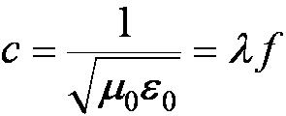
The Electromagnetic Spectrum
Visible light covers only a small range of the total electromagnetic spectrum
All electromagnetic waves travel in vacuum with a speed c given by:
(where μ₀ and ε₀ are the respective permeability and permittivity of “free” space)

Slide 12
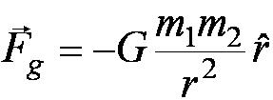

Also in the Modern Context…
The three fundamental forces are introduced
  Gravitational:
    Responsible for planetary motions, holding things on the ground, etc
  Electroweak
    Weak: Responsible for nuclear beta decay and effective only over distances of ~10⁻¹⁵ m
    Electromagnetic: Responsible for all non-gravitational interactions, such as all chemical reactions, friction, tension….
    (Coulomb force)
  Strong: Responsible for “holding” the nucleus together and effective less than ~10⁻¹⁵ m

Slide 13
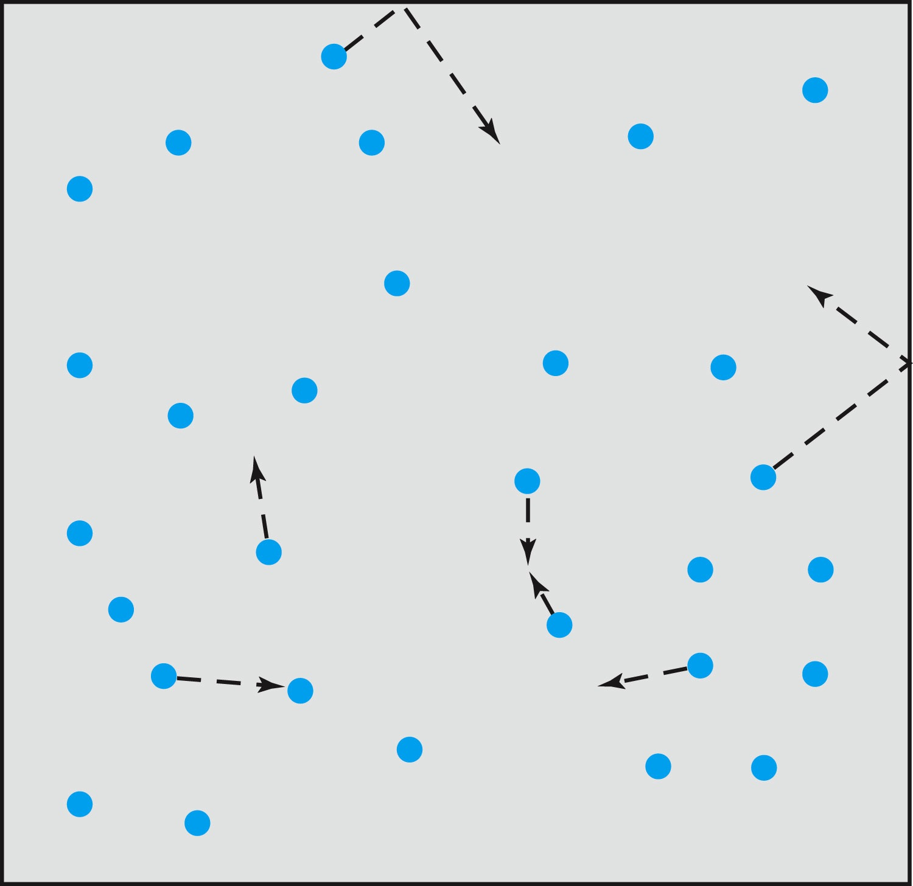
Relevance of Gas Concept to Atoms
The idea of gas (17th century) as a collection of small particles bouncing around with kinetic energy enabled concept of small, unseen objects
This concept formed the bases of existence something small that make up matter

Slide 14
The Atomic Theory of Matter
Concept initiated by Democritus and Leucippus (~450 B.C.)
(first to us the Greek atomos, meaning “indivisible”)
In addition to fundamental contributions by Boyle, Charles, and Gay-Lussac, Proust (1754 – 1826) proposes the law of definite proportions
Dalton advances the atomic theory of matter to explain the law of definite proportions
Avogadro proposes that all gases at the same temperature, pressure, and volume contain the same number of molecules (atoms); viz. 6.02 × 10²³ atoms
Cannizzaro (1826 – 1910) makes the distinction between atoms and molecules advancing the ideas of Avogadro.
Maxwell derives the speed distribution of atoms in a gas
Robert Brown (1753 – 1858) observes microscopic “random” motion of suspended grains of pollen in water
Einstein in the 20th century explains this random motion using atomic theory

Slide 15
Overwhelming Evidence for Existence of Atoms
Max Planck (1858 – 1947) advances the concept to explain blackbody radiation by use of submicroscopic “quanta”
Boltzmann requires existence of atoms for his advances in statistical mechanics
Albert Einstein (1879 – 1955) uses molecules to explain Brownian motion and determines the approximate value of their size and mass
Jean Perrin (1870 – 1942) experimentally verifies Einstein’s predictions

Slide 16
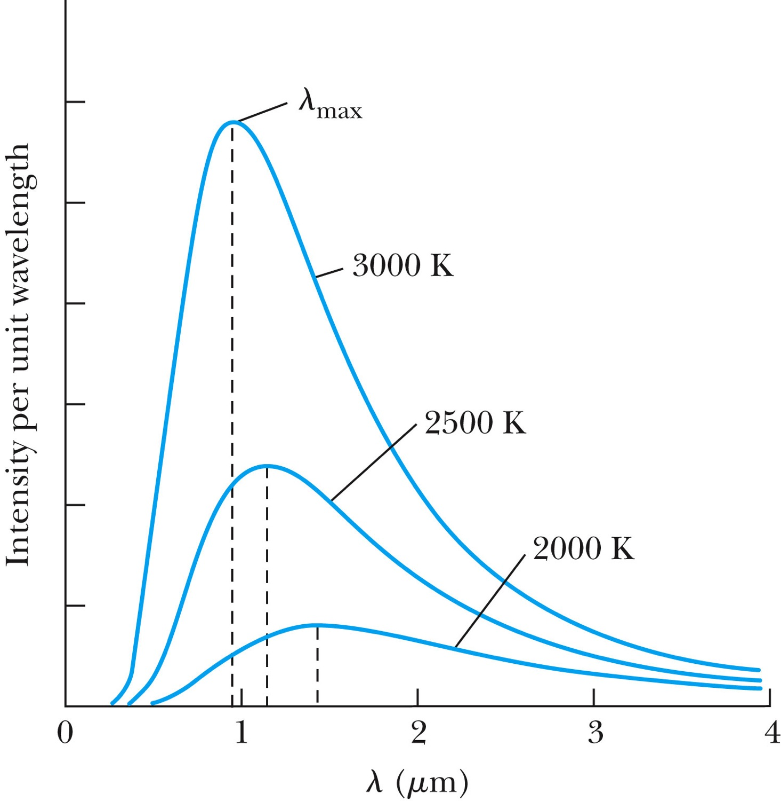
Further Complications
Three fundamental problems:
The (non) existence of an EM medium that transmits light from the sun
The observed differences in the electric and magnetic field between stationary and moving reference systems
The failure of classical physics to explain blackbody radiation in which characteristic spectra of radiation that cover the entire EM wavelengths were observed depending on temperature not on the body itself

Slide 17
Additional Discoveries Contribute to the Complications
Discovery of x-rays (1895, Rontgen)
Discovery of radioactivity (1896, Becquerel)
Discovery of the electron (1897, Thompson)
Discovery of the Zeeman effect (1896, Zeeman) dependence of spectral frequency on magnetic field

Slide 18
Newtonian (Classical) Relativity
It is assumed that Newton’s laws of motion must be measured with respect to (relative to) some reference frame.
A reference frame is called an inertial frame if Newton laws are valid in that frame.
Such a frame is established when a body, not subjected to net external forces, is observed to move in rectilinear motion at constant velocity
➔ Newtonian Principle of Relativity (Galilean Invariance): If Newton’s laws are valid in one reference frame, then they are also valid in another reference frame moving at a uniform velocity relative to the first system.

Slide 19
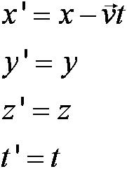
Conditions of the Galilean Transformation
Parallel axes between the two inertial reference frames
K’ has a constant relative velocity in the x-direction with respect to K
Time (t) for all observers is a Fundamental invariant, i.e., the same for all inertial observers
  Space and time are separate!!

Slide 20

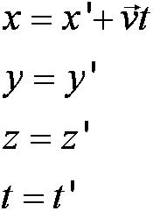
The Inverse Relations
Step 1. Replace with
Step 2. Replace “primed” quantities with
“unprimed” and “unprimed” with “primed”

Slide 21

Ether as the Absolute Reference System
In Maxwell’s theory, the speed of light is given by
  The velocity of light between moving systems must be a constant.
  Needed a system of medium that keeps this constant!
Ether proposed as the absolute reference system in which the speed of light is constant and from which other measurements could be made.
The Michelson-Morley experiment was an attempt to show the existence of ether.

Slide 22
Conclusions of Michelson Experiment
Michelson noted that he should be able to detect a phase shift of light due to the time difference between path lengths but found none.
He thus concluded that the hypothesis of the stationary ether must be incorrect.
After several repeats and refinements with assistance from Edward Morley (1893-1923), again a null result.
Thus, ether does not seem to exist!
Many explanations ensued afterward but none worked out!
This experiment shattered the popular belief of light being waves

Slide 23
Einstein’s Postulates
Fundamental assumption: Maxwell’s equations must be valid in all inertial frames
The principle of relativity: The laws of physics are the same in all inertial systems. There is no way to detect absolute motion, and no preferred inertial system exists
  Published a paper in 1905 at the age 26
  Believed to be fundamental
The constancy of the speed of light: Observers in all inertial systems measure the same value for the speed of light in a vacuum.

Slide 24
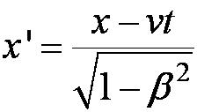
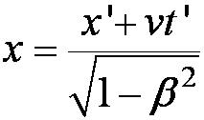




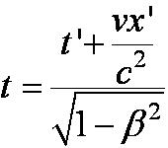
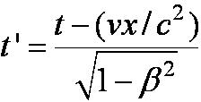
The complete Lorentz Transformations
Where and
Some things to note
  What happens when β~0 (or v~0)?
    The Lorentz x-formation becomes Galilean x-formation
  Space–time are not separated
  For non-imaginary x-formations, the frame speed cannot exceed c!

Slide 25
Time Dilation and Length Contraction
Direct consequences of the Lorentz Transformation:
Time Dilation:
Clocks in a moving inertial reference frame K’ run slower with respect to stationary clocks in K.
Length Contraction:
Lengths measured in a moving inertial reference frame K’ are shorter with respect to the same lengths stationary in K.

Slide 26
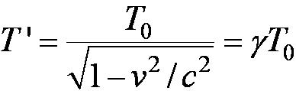
Time Dilation: Moving Clocks Run Slow
1) T ‘> T₀ or the time measured between two events at different positions is greater than the time between the same events at one position: time dilation.
The proper time is always the shortest time!!
2) The events do not occur at the same space and time coordinates in the two system
3) System K requires 1 clock and K’ requires 2 clocks.

Slide 27
Time Dilation Example: muon lifetime
Muons are essentially heavy electrons (~200 times heavier)
Muons are typically generated in collisions of cosmic rays in upper atmosphere and, unlike electrons, decay ( μsec)
For a muon incident on Earth with v=0.998c, an observer on Earth would see what lifetime of the muon?
2.2 μsec?
t=35 μsec
Moving clocks run slow so when an outside observer measures, they see a longer time than the muon itself sees.

Slide 28
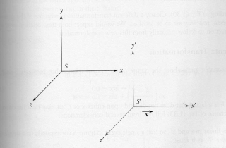
Length Contraction
Proper length (length of an object in its own frame:
Length of an object in observer’s frame:
γ>1 so the length is shorter in the direction of motion
(length contraction!)

Slide 29
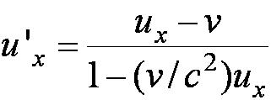
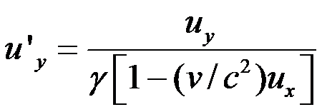
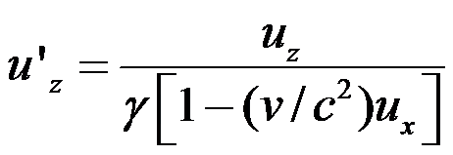
The Lorentz Velocity Transformations
In addition to the previous relations, the Lorentz velocity transformations for u’_{x}, u’_{y} , and u’_{z} can be obtained by switching primed and unprimed and changing v to –v:

Slide 30
Velocity Addition Summary
Galilean Velocity addition where and
From inverse Lorentz transform and
So
Thus
What would be the measured speed of light in S frame?
  Since we get
Observer in S frame measures c too! Strange but true!

Slide 31
Velocity Addition Example
Lance is riding his bike at 0.8c relative to observer. He throws a ball at 0.7c in the direction of his motion. What speed does the observer see?
What if he threw it just a bit harder?
Doesn’t help—asymptotically approach c, can’t exceed (it’s not just a postulate it’s the law)

Slide 32
Spacetime
When describing events in relativity, it is convenient to represent events on a spacetime diagram.
In this diagram one spatial coordinate x specifies position and instead of time t, ct is used as the other coordinate so that both coordinates will have dimensions of length.
Spacetime diagrams were first used by H. Minkowski in 1908 and are often called Minkowski diagrams. Paths in Minkowski spacetime are called worldlines.

Slide 33
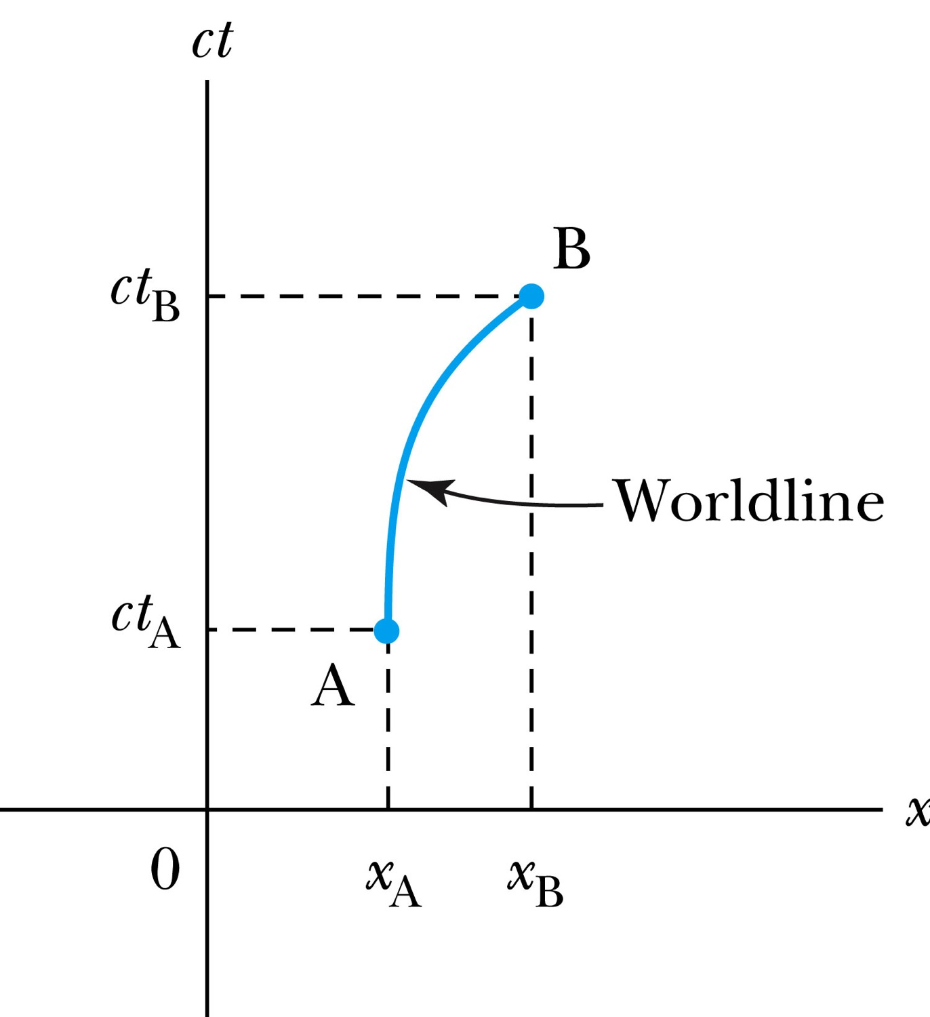
Spacetime Diagram
Notes:
Add the paragraph for Figure 2.21

Slide 34
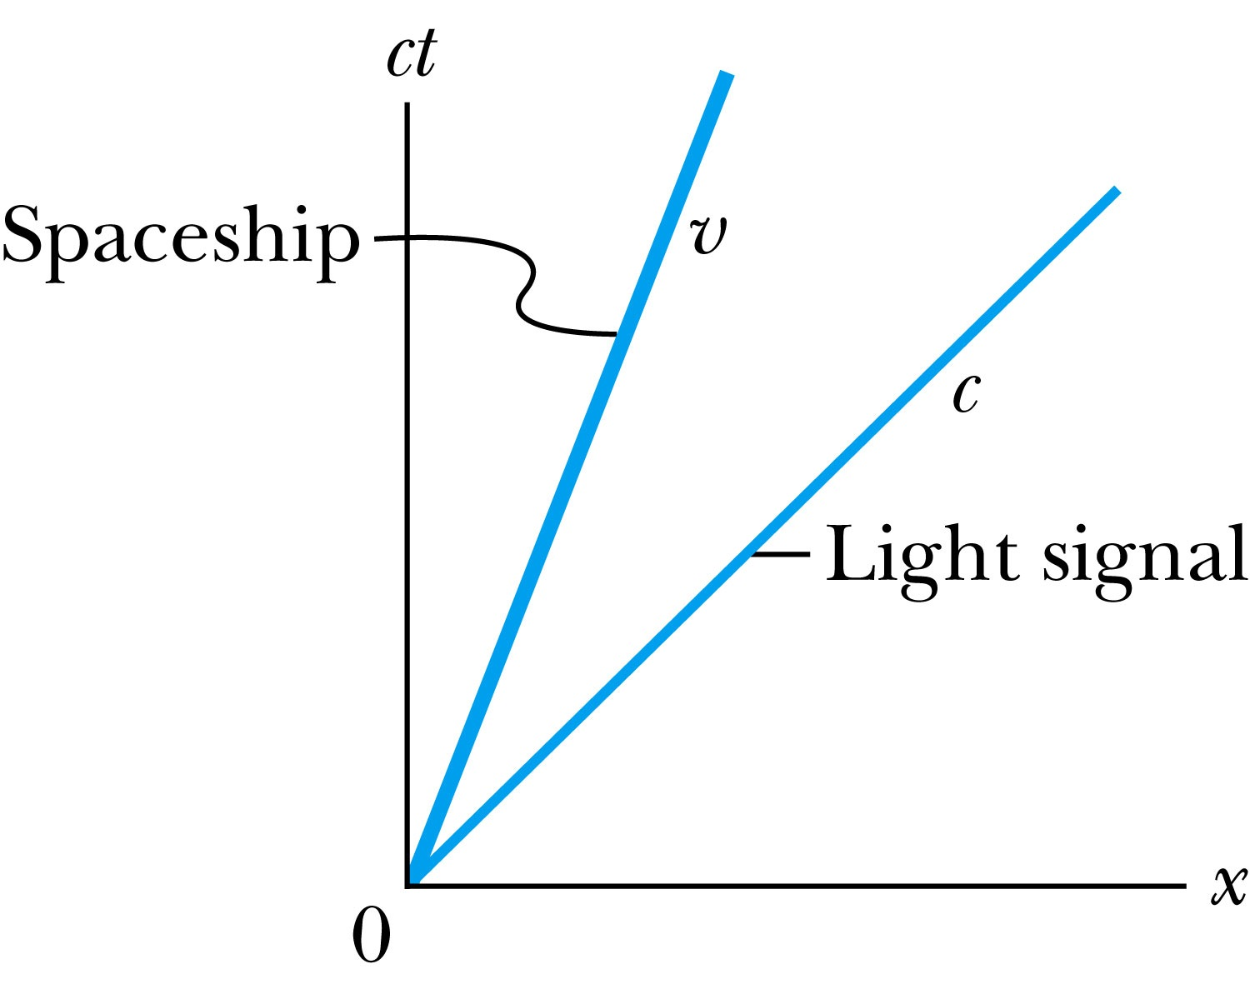
Particular Worldlines
How does the worldline for a spaceship running at the velocity v(<c) look?
How does the worldline for light signal look?
Notes:
Add the paragraph from Fig. 2.22

Slide 35
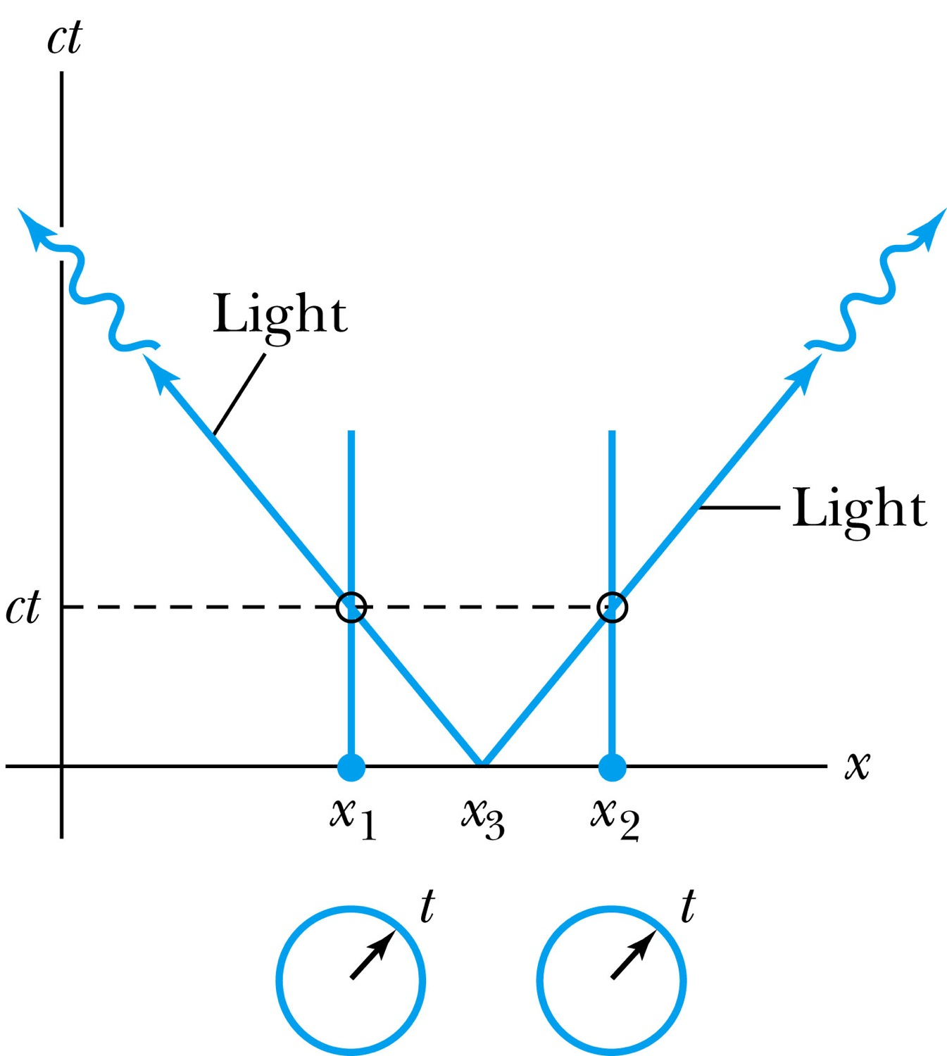
How about time measured by two stationary clocks?
Notes:
Add paragraph from figure 2.23

Slide 36
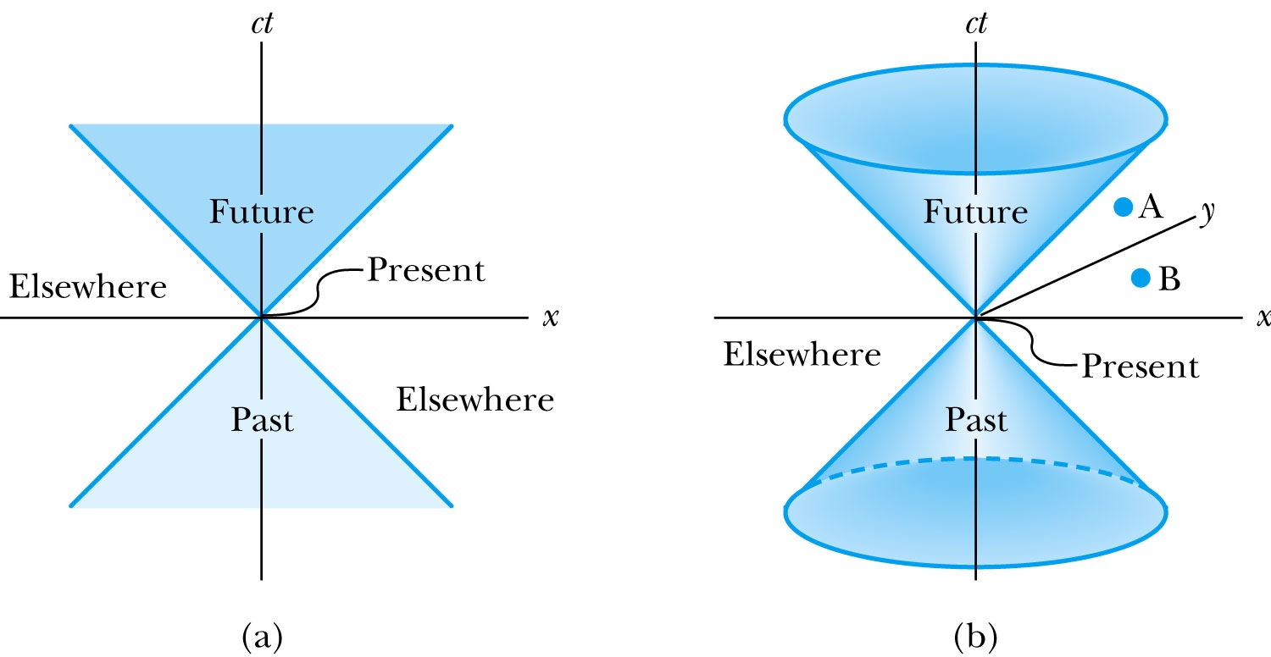
The Light Cone
Notes:
Add paragraph from Figure 2.25

Slide 37
Spacetime Invariants
There are three possibilities for the invariant quantity Δs²:
Δs²=Δx²-Δ(ct)²
Δs² = 0: Δx² = c² Δt²: lightlike separation
  Two events can be connected only by a light signal.
Δs² > 0: Δx² > c² Δt²: spacelike separation
  No signal can travel fast enough to connect the two events. The events are not causally connected!!
Δs² < 0: Δx² < c² Δt²: timelike separation
  Two events can be causally connected.
  These two events cannot occur simultaneously!

Slide 38
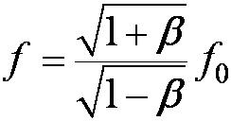
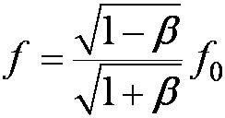
Relativistic Doppler Effect
When source/receiver is approaching with β = v/c the resulting frequency is
Higher than the actual source’s frequency, blue shift!!
When source/receiver is receding with β = v/c the resulting frequency is
Lower than the actual source’s frequency, red shift!!
If we use +β for approaching source/receiver and -β for receding source/receiver, relativistic Doppler Effect can be expressed
What can we use this for?

Slide 39
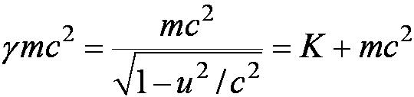

Relativistic Momentum, total Energy and Rest Energy
relativistic definition of the momentum:
Rewriting the relativistic kinetic energy:
The term mc² is called the rest energy and is denoted by E₀.
The sum of the kinetic energy and rest energy is interpreted as the total energy of the particle.

Slide 40
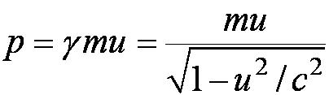
Relationship of Energy and Momentum
We square this result, multiply by c², and rearrange the result.
Rewrite
Rewrite
Notes:
Title rewritten

Slide 41
Units of Work, Energy and Mass
The work done in accelerating a charge through a potential difference is W = qV.
  For a proton, with the charge e = 1.602 × 10⁻¹⁹ C being accelerated across a potential difference of 1 V, the work done is
  1 eV = 1.602 × 10⁻¹⁹ J
  W = (1.602 × 10⁻¹⁹)(1 V) = 1.602 × 10⁻¹⁹ J
eV is also used as a unit of energy.

Slide 42
What does the word “Quantize” mean?
Dictionary: To restrict to discrete values
To consist of indivisible discrete quantities instead of continuous quantities
  Integer is a quantized set with respect to real numbers
Some examples of quantization?
  Digital photos
  Lego blocks
  Electric charge
  Photon (a quanta of light) energy
  Angular momentum
  Etc…

Slide 43
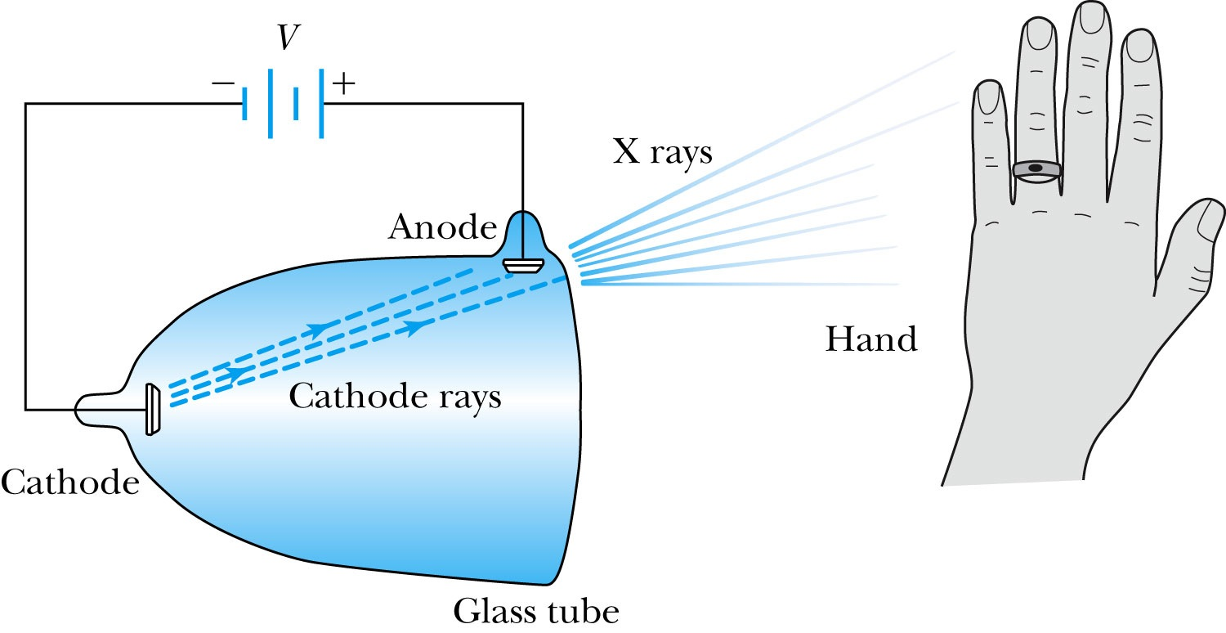
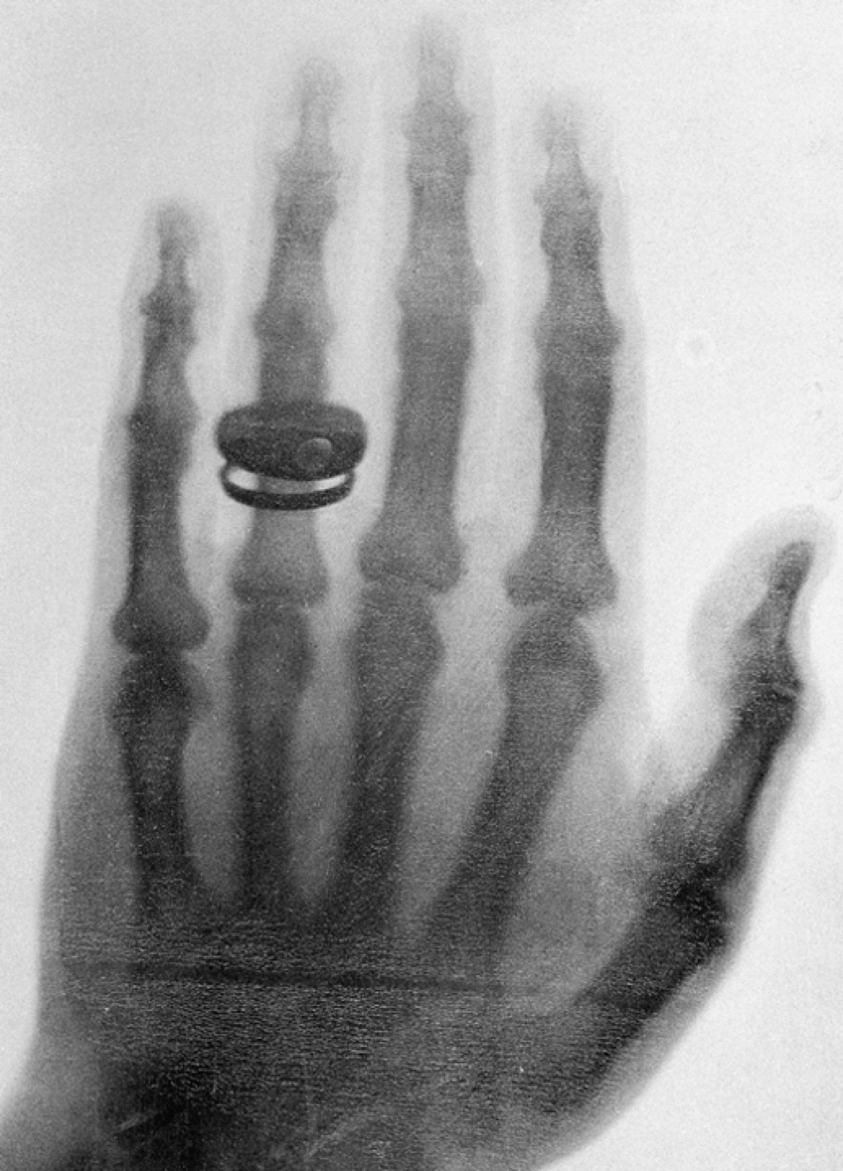
Röntgen’s X Ray Tube
Röntgen produced x-ray by allowing cathode rays to impact the glass wall of the tube.
Took image the bones of a hand on a phosphorescent screen.

Slide 44
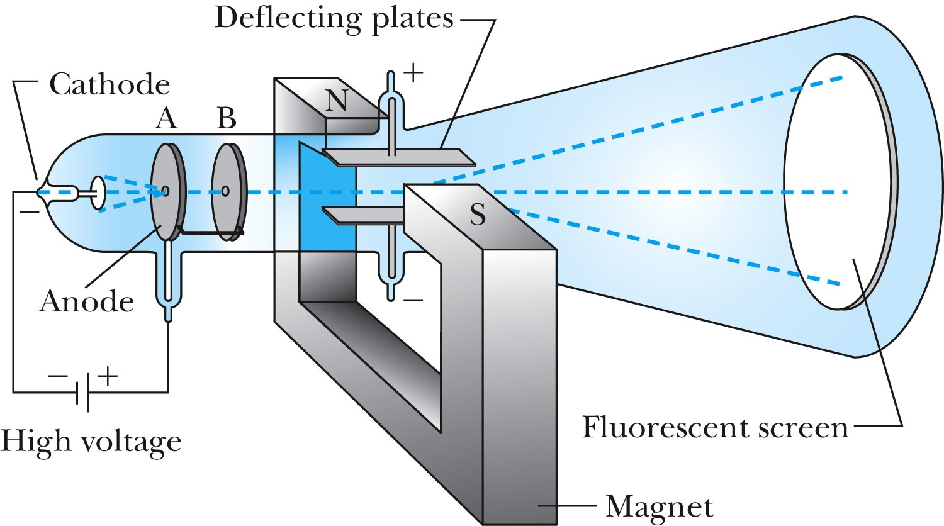
J.J. Thomson’s Cathode-Ray Experiment
Thomson showed that the cathode rays were negatively charged particles (electrons)! How?
  By deflecting them in electric and magnetic fields.

Slide 45
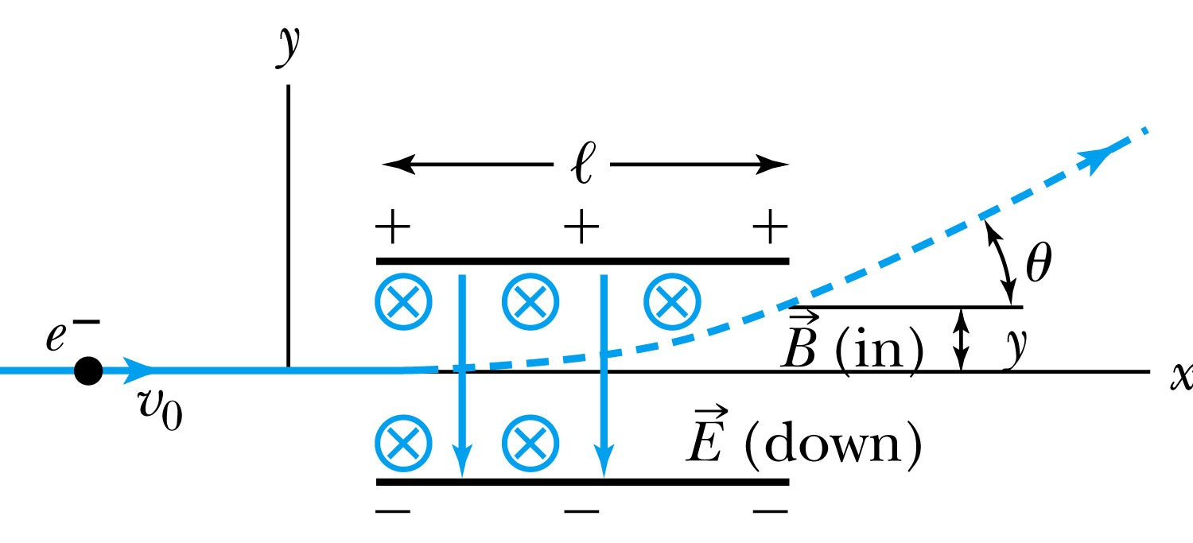
Thomson’s Experiment
Thomson measured the ratio of the electron’s charge to mass by sending electrons through a region containing a magnetic field perpendicular to an electric field.
Measure the deflection angle with only E!
Turn on and adjust B field till no deflection!
What do we know?
  l, B, E and θ
What do we not know?
  v₀, q and m

Slide 46
Ex 3.1: Thomson’s experiment
In an experiment similar to Thomson’s, we use deflecting plates 5.0cm in length with an electric field of 1.2x10⁴V/m. Without the magnetic field, we find an angular deflection of 30º, and with a magnetic field of 8.8x10⁻⁴T we find no deflection. What is the initial velocity of the electron and its q/m?
First v₀ using E and B, we obtain:
q/m is then
What is the actual value of q/m using the known quantities?

Slide 47
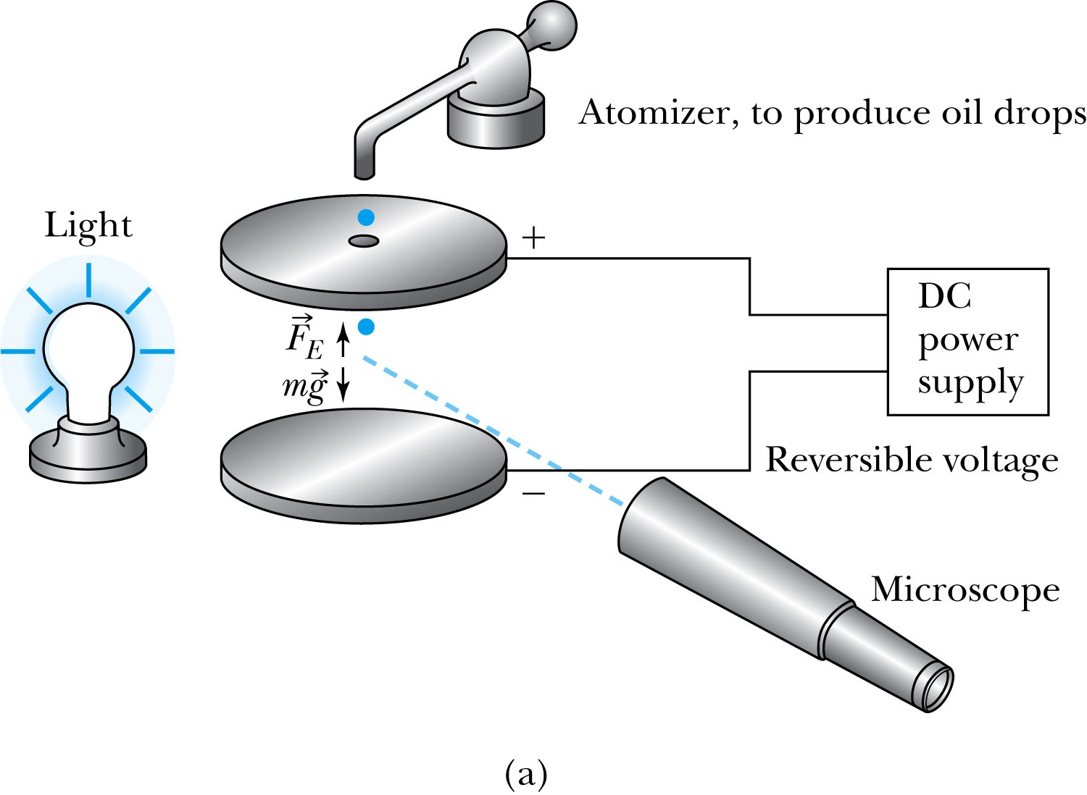
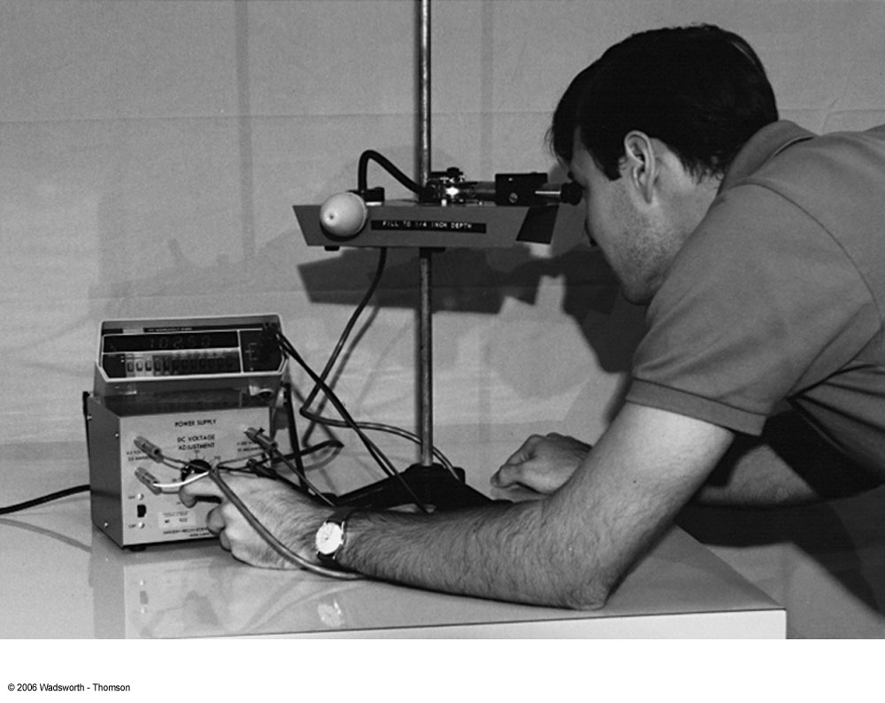
Determination of Electron Charge
Millikan (and Fletcher) in 1909 measured charge of electron, showed that free electric charge is in multiples of the basic charge of an electron

Slide 48

Line Spectra
Chemical elements produce unique wavelengths of light when burned or excited in an electrical discharge.
Collimated light is passed through a diffraction grating with thousands of ruling lines per centimeter.
  The diffracted light is separated at an angle θ according to its wavelength λ by the equation:
where d is the distance between rulings and n is an integer called the order number

Slide 49
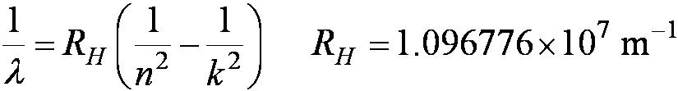
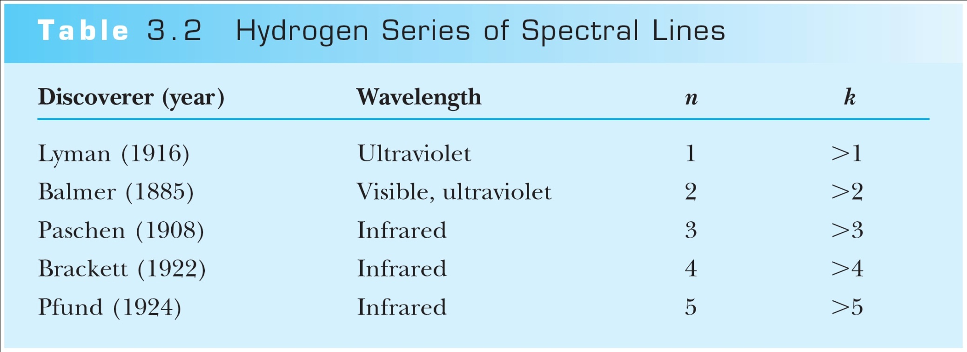
Rydberg Equation
Several more series of emission lines at infrared and ultraviolet wavelengths were discoverd, the Balmer series equation was extended to the Rydberg equation:
(n = 2)

Slide 50
Quantization
Current theories predict that charges are quantized in units (quarks) of ±e/3 and ±2e/3, but quarks are not directly observed experimentally.
The charges of particles that have been directly observed are always quantized in units of ±e.
The measured atomic weights are not continuous—they have only discrete values, which are close to integral multiples of a unit mass.

Slide 51
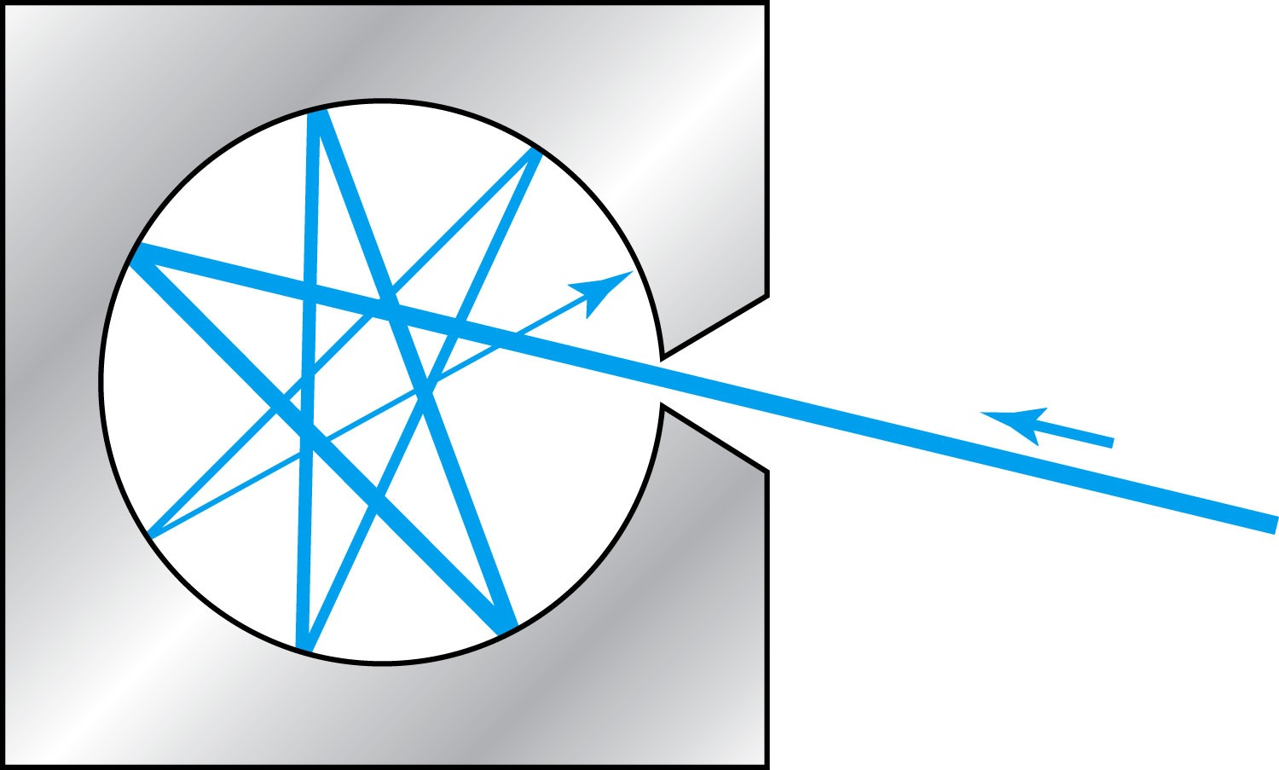
Blackbody Radiation
When matter is heated, it emits radiation.
A blackbody is an ideal object that has 100% absorption and 100% emission without a loss of energy
A cavity in a material that only emits thermal radiation can be considered as a black-body. Incoming radiation is fully absorbed in the cavity.
Blackbody radiation is theoretically interesting because
  Radiation properties are independent of the particular material.
  Properties of intensity versus wavelength at fixed temperatures can be studied

Slide 52

Stefan-Boltzmann Law
The total power radiated increases with the temperature:
This is known as the Stefan-Boltzmann law, with the constant σ experimentally measured to be 5.6705×10⁻⁸ W / (m² · K⁴).
The emissivity ε (ε = 1 for an idealized blackbody) is the ratio of the emissive power of an object to that of an ideal blackbody and is always less than 1.

Slide 53
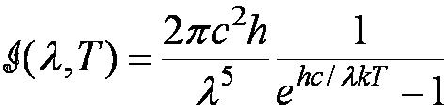
Planck’s Radiation Law
Planck assumed that the radiation in the cavity was emitted (and absorbed) by some sort of “oscillators” that were contained in the walls. He used Boltzman’s statistical methods to arrive at the following formula that fit the blackbody radiation data.
Planck made two modifications to the classical theory:
    The oscillators (of electromagnetic origin) can only have certain discrete energies determined by E_{n} = nhf, where n is an integer, f is the frequency, and h is called Planck’s constant. h = 6.6261 × 10⁻³⁴ J·s.
    The oscillators can absorb or emit energy ONLY in discrete multiples of the fundamental quantum of energy given by
Planck’s radiation law

Slide 54
Photoelectric Effect
Definition: Incident electromagnetic radiation shining on the material transfers energy to the electrons, allowing them to escape the surface of the metal. Ejected electrons are called photoelectrons
Other methods of electron emission:
Thermionic emission: Application of heat allows electrons to gain enough energy to escape.
Secondary emission: The electron gains enough energy by transfer from another high-speed particle that strikes the material from outside.
Field emission: A strong external electric field pulls the electron out of the material.

Slide 55
Summary of Experimental Observations
Light intensity does not affect the KE of the photoelectrons
The max KE of the photoelectrons, for a given emitting material, depends only on the frequency of the light
The smaller the work function φ of the emitter material, the smaller is the threshold frequency of the light that can eject photoelectrons.
When the photoelectrons are produced, their number is proportional to the intensity of light.
The photoelectrons are emitted almost instantly following illumination of the photocathode, independent of the intensity of the light. ➔ Totally unexplained by classical physics

Slide 56
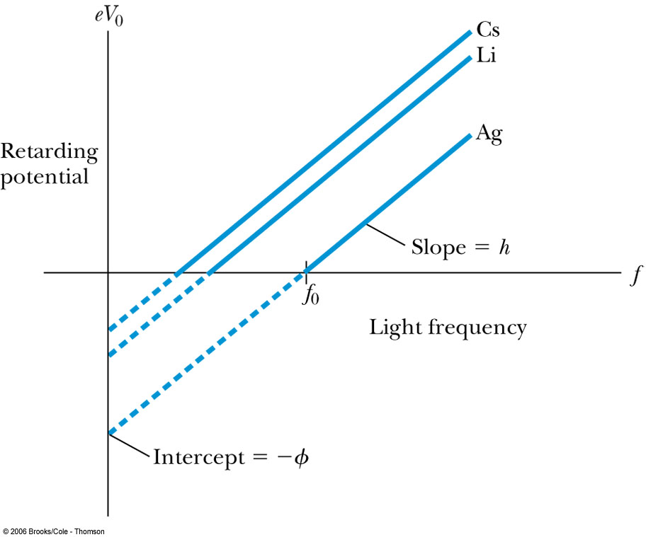
Quantum Interpretation – Photoelectric Effect
KE of the electron depend only on the light frequency and the work function φ of the material not the light intensity at all
Einstein in 1905 predicted that the stopping potential was linearly proportional to the light frequency, with a slope h, the same constant found by Planck.
From this, Einstein concluded that light is a particle with energy:
Was he already thinking about particle/wave duality?

Slide 57
Ex 3.11: Photoelectric Effect
Light of wavelength 400nm is incident upon lithium (=2.93eV). Calculate (a) the photon energy and (b) the stopping potential V₀.
Since the wavelength is known, we use plank’s formula:
The stopping potential can be obtained using Einstein’s formula for photoelectron energy

Slide 58

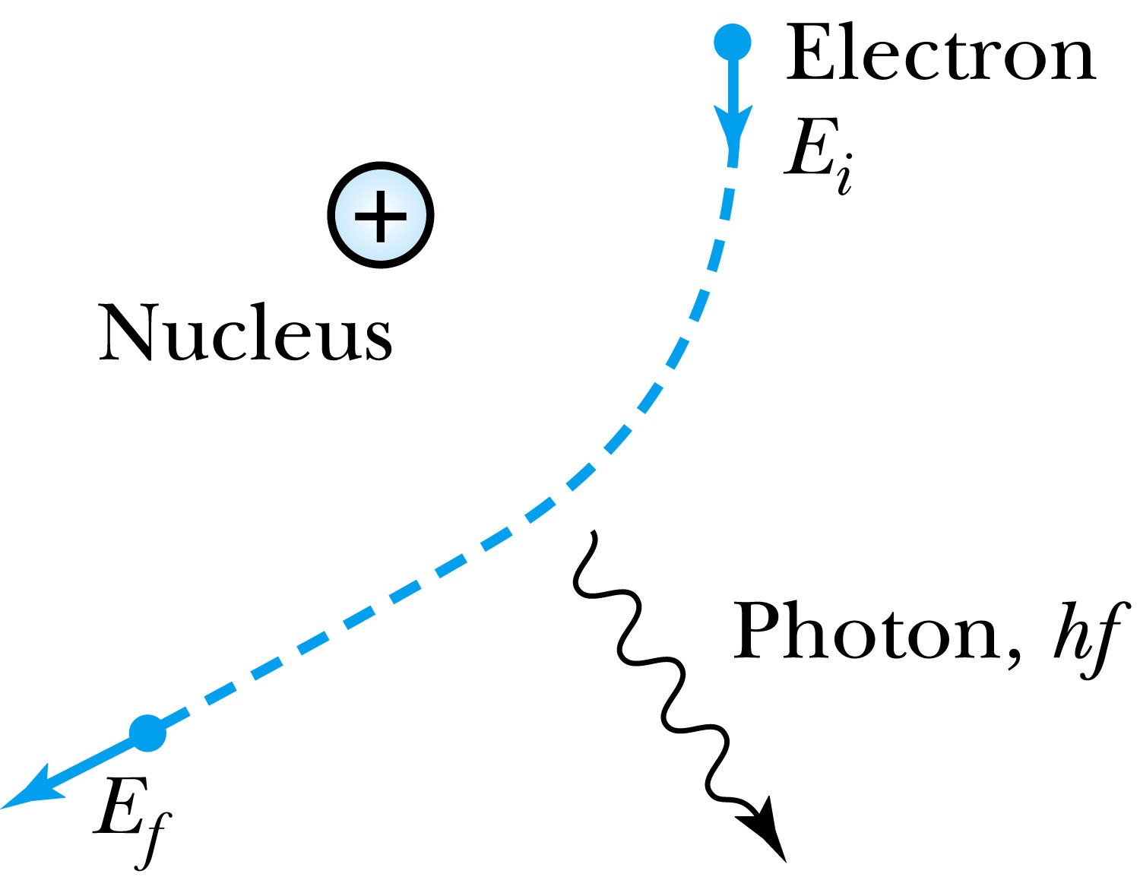
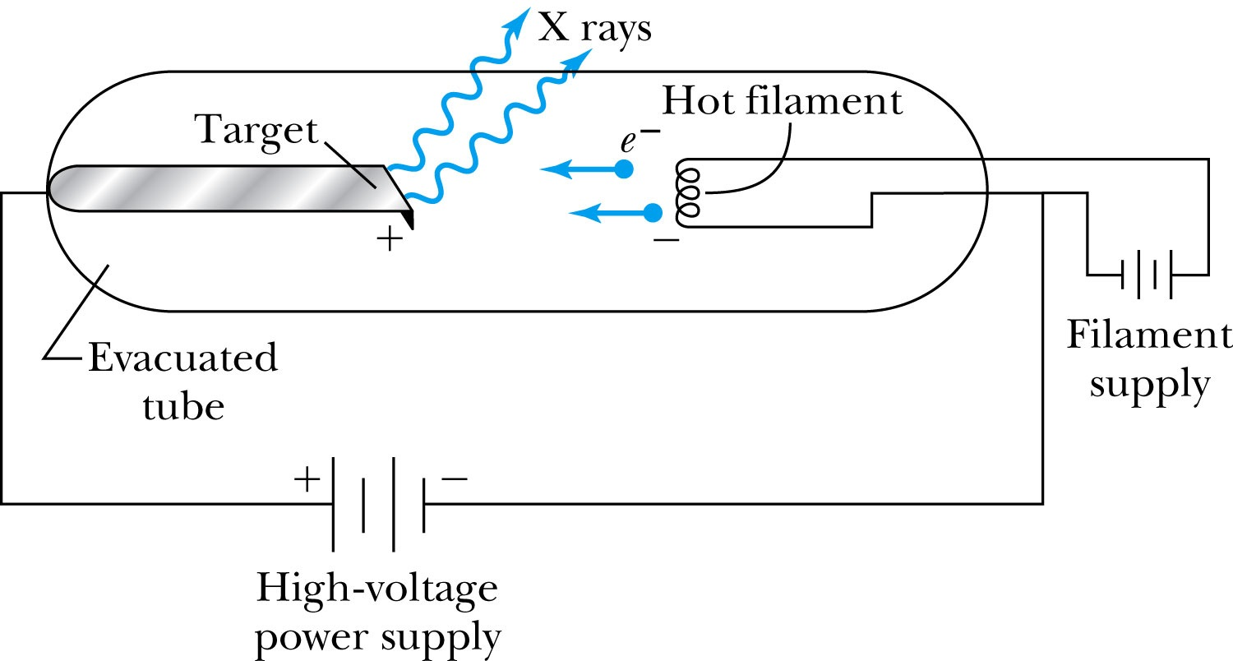
X-Ray Production
Bremsstrahlung (German word for braking radiation): Radiation of a photon from an energetic electron passing through matter due to an acceleration
Since linear momentum must be conserved, the nucleus absorbs very little energy, and it is ignored. The final energy of the electron is determined from the conservation of energy to be
An electron that loses a large amount of energy will produce an X-ray photon.
  Current passing through a filament produces copious numbers of electrons by thermionic emission.
  These electrons are focused by the cathode structure into a beam and are accelerated by potential differences of thousands of volts until they impinge on a metal anode surface, producing x rays by bremsstrahlung as they stop in the anode material

Slide 59
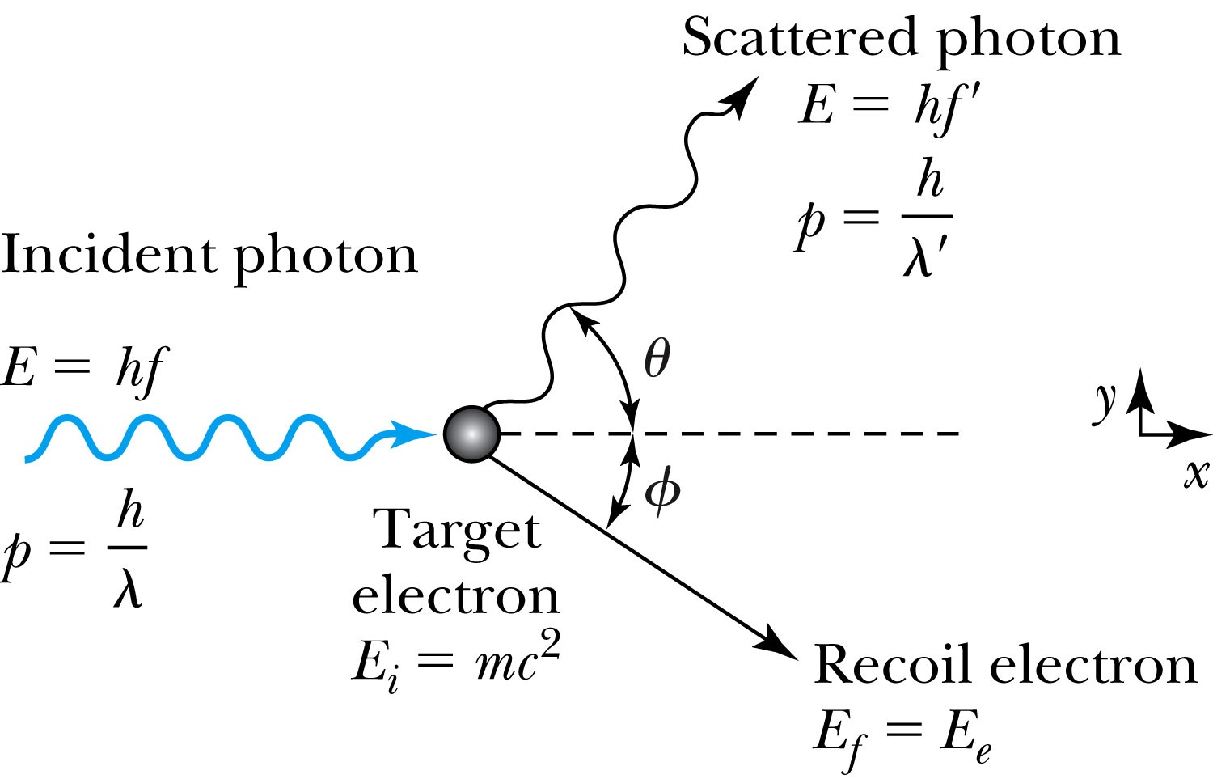
Compton Effect
When a photon enters matter, it is likely to interact with one of the atomic electrons.
The photon is scattered from only one electron
The laws of conservation of energy and momentum apply as in any elastic collision between two particles. The momentum of a particle moving at the speed of light is
The electron energy can be written as
Change of the scattered photon wavelength is known as the Compton effect:

Slide 60

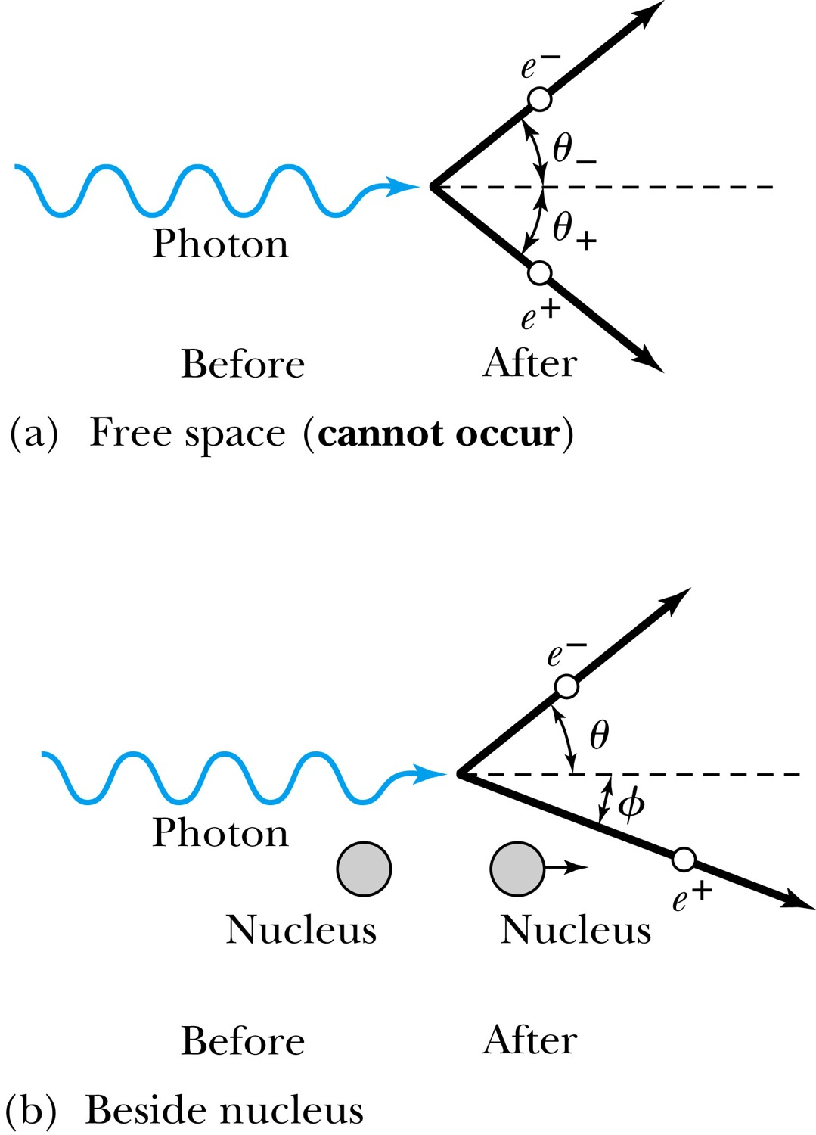


Pair Production in Matter
Since the relations and contradict each other, a photon can not produce an electron and a positron in empty space.
In the presence of matter, the nucleus absorbs some energy and momentum.
The photon energy required for pair production in the presence of matter is

Slide 61
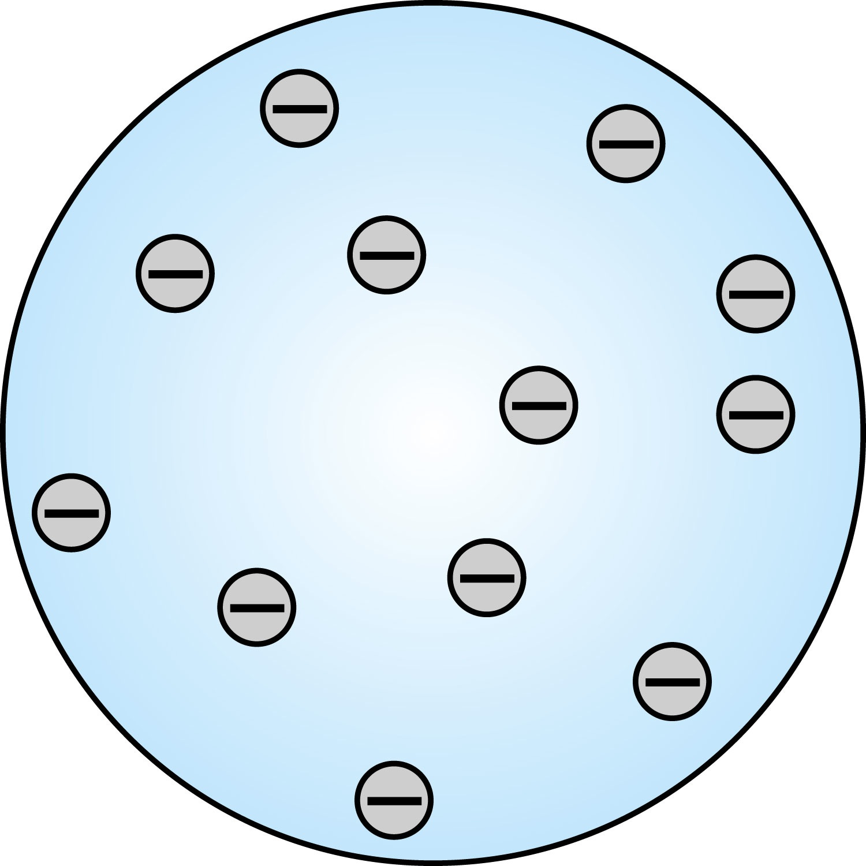
Thomson’s Atomic Model
Thomson’s “plum-pudding” model
  Atoms are electrically neutral and have electrons in them
  Atoms must have equal amount of positive charges in it to balance electron negative charges
  So how about positive charges spread uniformly throughout a sphere the size of the atom with, the newly discovered “negative” electrons embedded in the uniform background.
Thomson’s thought when the atom was heated the electrons could vibrate about their equilibrium positions, thus producing electromagnetic radiation.

Slide 62
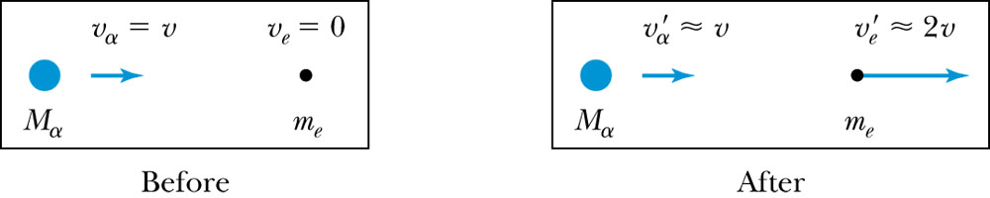
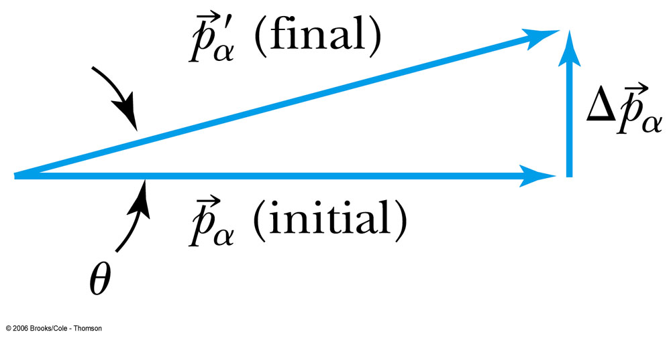
Ex 4.1: Maximum Scattering Angle
Geiger and Marsden (1909) observed backward-scattered (θ>=90º) α particles when a beam of energetic α particles was directed at a piece of gold foil as thin as 6.0x10⁻⁷m. Assuming an α particle scatters from an electron in the foil, what is the maximum scattering angle?
The maximum scattering angle corresponding to the maximum momentum change
Using the momentum conservation and the KE conservation for an elastic collision, the maximum momentum change of the α particle is
Determine θ by letting Δp_{max} be perpendicular to the direction of motion.

Slide 63

Rutherford’s Atomic Model
<θ>_{total}~0.8º even if the α particle scattered from all 79 electrons in each atom of gold
The experimental results were inconsistent with Thomson’s atomic model.
Rutherford proposed that an atom has a positively charged core (nucleus) surrounded by the negative electrons.

Slide 64
Assumptions of Rutherford Scattering
The scatterer is so massive that it does not recoil significantly; therefore the initial and final KE of the α particle are practically equal.
The target is so thin that only a single scattering occurs.
The bombarding particle and target scatterer are so small that they may be treated as point masses and charges.
Only the Coulomb force is effective.

Slide 65
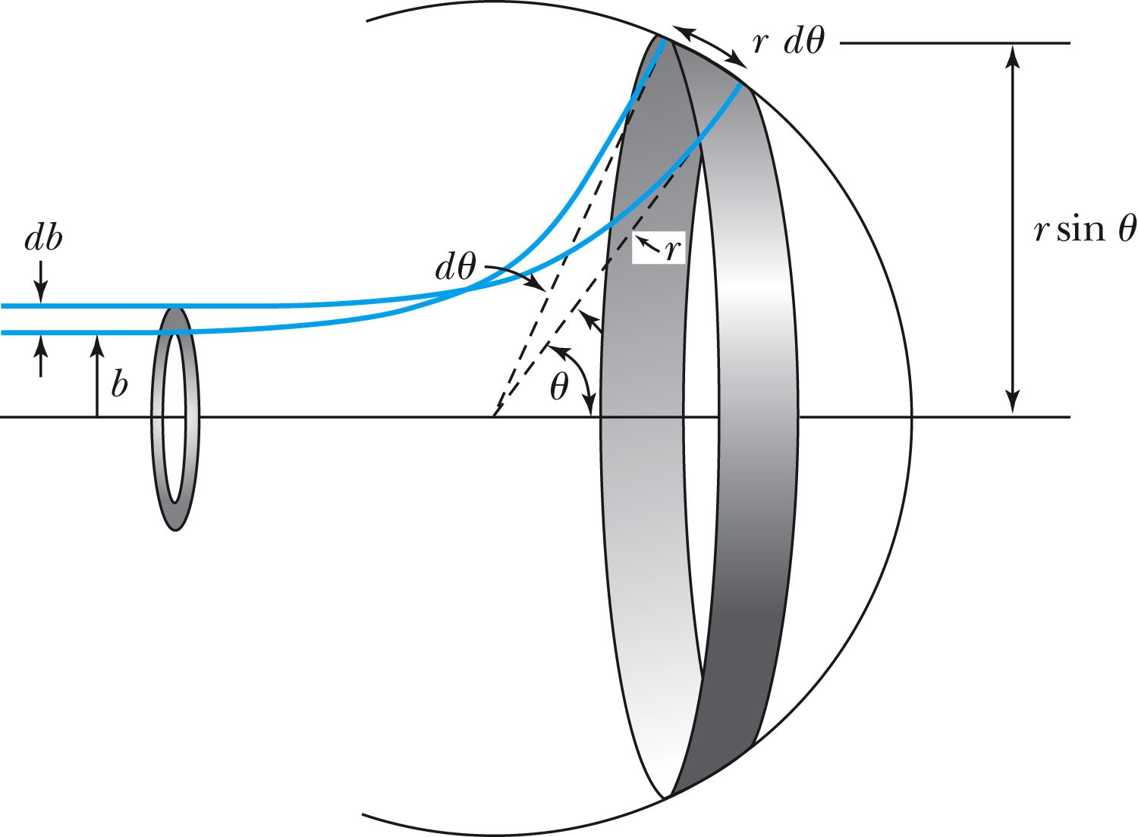
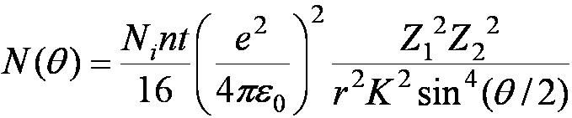
Rutherford Scattering Equation
In actual experiment a detector is positioned from θ to θ + dθ that corresponds to incident particles between b and b + db.
The number of particles scattered into the the angular coverage per unit area is

Slide 66
The Important Points
The scattering is proportional to the square of the atomic number of both the incident particle (Z₁) and the target scatterer (Z₂).
The number of scattered particles is inversely proportional to the square of the kinetic energy of the incident particle.
For the scattering angle θ, the scattering is proportional to 4th power of sin(θ/2).
The Scattering is proportional to the target thickness for thin targets.

Slide 67
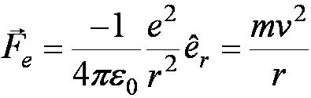
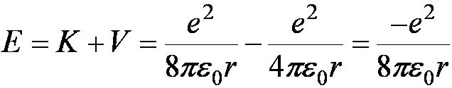
The Classical Atomic Model
As suggested by the Rutherford Model the atom consisted of a small, massive, positively charged nucleus surrounded by moving electrons. This then suggested consideration of a planetary model of the atom.
Let’s consider atoms as a planetary model.
The force of attraction on the electron by the nucleus and Newton’s 2nd law give
where v is the tangential velocity of the electron.
The total energy is

Slide 68
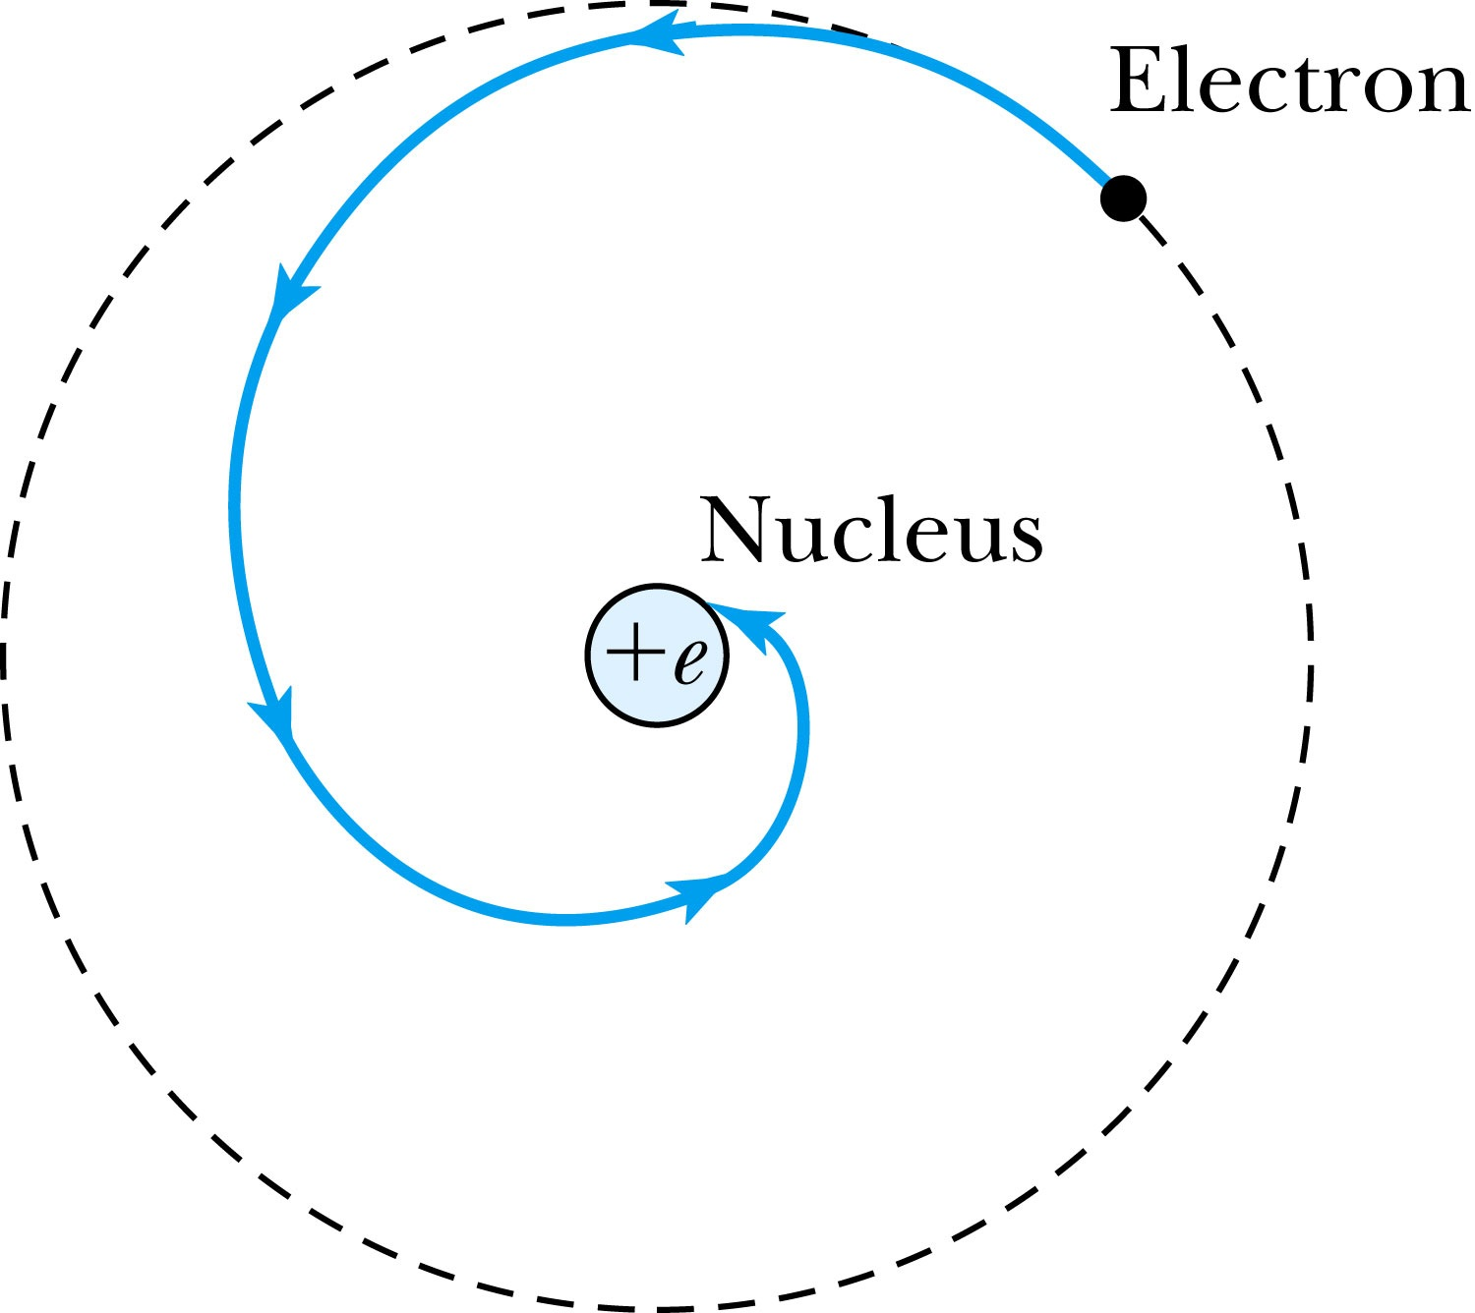
The Planetary Model is Doomed
From classical E&M theory, an accelerated electric charge radiates energy (electromagnetic radiation) which means total energy must decrease. Radius r must decrease!!
Electron crashes into the nucleus!?
Physics had reached a turning point in 1900 with Planck’s hypothesis of the quantum behavior of radiation.

Slide 69
The Bohr Model of the Hydrogen Atom – The assumptions
“Stationary” states or orbits must exist in atoms, i.e., orbiting electrons do not radiate energy in these orbits. These orbits or stationary states are of a fixed definite energy E.
The emission or absorption of electromagnetic radiation can occur only in conjunction with a transition between two stationary states. The frequency, f, of this radiation is proportional to the difference in energy of the two stationary states:
E = E₁ − E₂ = hf
where h is Planck’s Constant
  Bohr thought this has to do with fundamental length of order ~10⁻¹⁰m
Classical laws of physics do not apply to transitions between stationary states.
The mean kinetic energy of the electron-nucleus system is quantized as
K = nhf_{orb}/2, where f_{orb} is the frequency of rotation. This is equivalent to the angular momentum of a stationary state to be an integral multiple of h/2π

Slide 70
Importance of Bohr’s Model
Demonstrated the need for Plank’s constant in understanding atomic structure
Assumption of quantized angular momentum which led to quantization of other quantities, r, v and E as follows
Orbital Radius:
Orbital Speed:
Energy levels:

Slide 71
Fine Structure Constant
The electron’s speed on an orbit in the Bohr model:
On the ground state, v₁ = 2.2 × 10⁶ m/s ~ less than 1% of the speed of light
The ratio of v₁ to c is the fine structure constant, α.

Slide 72
Limitations of the Bohr Model
The Bohr model was a great step of the new quantum theory, but it had its limitations.
Works only to single-electron atoms
  Even for ions ➔ What would change?
  The charge of the nucleus
Could not account for the intensities or the fine structure of the spectral lines
  Fine structure is caused by the electron spin
  When a magnetic field is applied, spectral lines split
Could not explain the binding of atoms into molecules

Slide 73
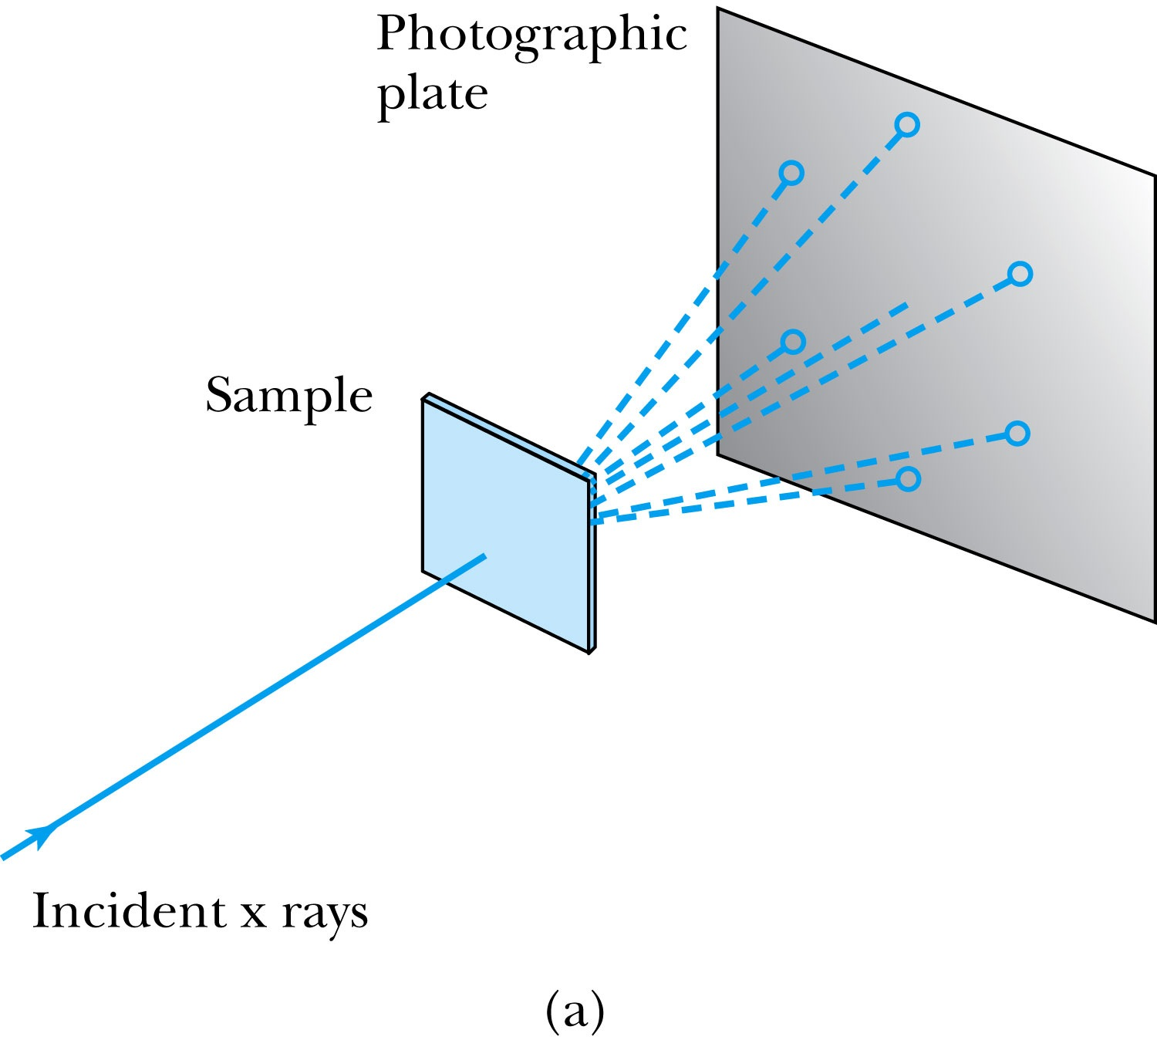

X-Ray Scattering
Max von Laue suggested that if x rays were a form of electromagnetic radiation, interference effects should be observed. (Wave property!!)
Crystals act as three-dimensional gratings, scattering the waves and producing observable interference effects.

Slide 74



Bragg’s Law
William Lawrence Bragg interpreted the x-ray scattering as the reflection of the incident x-ray beam from a unique set of planes of atoms within the crystal.
There are two conditions for constructive interference of the scattered x rays:
The angle of incidence must equal the angle of reflection of the outgoing wave. (total reflection)
The difference in path lengths between two rays must be an integral number of wavelengths.
Bragg’s Law:
nλ = 2d sin θ
(n = integer)

Slide 75
Ex 5.1: Bragg’s Law
X rays scattered from rock salt (NaCl) are observed to have an intense maximum at an angle of 20º from the incident direction. Assuming n=1 (from the intensity), what must be the wavelength of the incident radiation?
Bragg’s law: nλ = 2d sin θ
What do we need to know to use this? The lattice spacing d!
We know n=1 and 2θ=20º.
We use the density of NaCl to find out what d is.

Slide 76
De Broglie Waves
Prince Louis V. de Broglie suggested that mass particles should have wave properties similar to electromagnetic radiation ➔ many experiments supported this!
Thus the wavelength of a matter wave is called the de Broglie wavelength:
Since for a photon, E = pc and E = hf, the energy can be written as

Slide 77

Bohr’s Quantization Condition
One of Bohr’s assumptions concerning his hydrogen atom model was that the angular momentum of the electron-nucleus system in a stationary state is an integral multiple of h/2π.
The electron is a standing wave in an orbit around the proton. This standing wave will have nodes and be an integral number of wavelengths.
The angular momentum becomes:

Slide 78
Ex 5.2: De Broglie Wavelength
Calculate the De Broglie wavelength of (a) a tennis ball of mass 57g traveling 25m/s (about 56mph) and (b) an electron with kinetic energy 50eV.
What is the formula for De Broglie Wavelength?
(a) for a tennis ball, m=0.057kg.
(b) for electron with 50eV KE, since KE is small, we can use non-relativistic expression of electron momentum!
What are the wavelengths of you running at the speed of 2m/s? What about your car of 2 metric tons at 100mph? How about the proton with 14TeV kinetic energy?
What is the momentum of the photon from a green laser?

Slide 79




Electron Scattering
Davisson and Germer experimentally observed that electrons were diffracted much like x rays in nickel crystals. ➔ direct proof of De Broglie wave!
George P. Thomson (1892–1975), son of J. J. Thomson, reported seeing the effects of electron diffraction in transmission experiments. The first target was celluloid, and soon after that gold, aluminum, and platinum were used. The randomly oriented polycrystalline sample of SnO₂ produces rings as shown in the figure at right.

Slide 80
Photons, which we thought were waves, act particle like (eg Photoelectric effect or Compton Scattering)
Electrons, which we thought were particles, act particle like (eg electron scattering)
De Broglie: All matter has intrinsic wavelength.
  Wave length inversely proportional to momentum
  The more massive… the smaller the wavelength… the harder to observe the wavelike properties
  So while photons appear mostly wavelike, electrons (next lightest particle!) appear mostly particle like.
How can we reconcile the wave/particle views?

Slide 81
Wave Motion
De Broglie matter waves suggest a further description. The displacement of a wave is
This is a solution to the wave equation
Define the wave number k and the angular frequency ω as:
The wave function is now:

Slide 82

Wave Properties
The phase velocity is the velocity of a point on the wave that has a given phase (for example, the crest) and is given by
A phase constant Φ shifts the wave:
.
(When φ=π/2)

Slide 83

Principle of Superposition
When two or more waves traverse the same region, they act independently of each other.
Combining two waves yields:
The combined wave oscillates within an envelope that denotes the maximum displacement of the combined waves.
When combining many waves with different amplitudes and frequencies, a pulse, or wave packet, can be formed, which can move at a group velocity:

Slide 84
Wave Packet Envelope
The superposition of two waves yields a wave number and angular frequency of the wave packet envelope.
The range of wave numbers and angular frequencies that produce the wave packet have the following relations:
A Gaussian wave packet has similar relations:
The localization of the wave packet over a small region to describe a particle requires a large range of wave numbers. Conversely, a small range of wave numbers cannot produce a wave packet localized within a small distance.

Slide 85

Gaussian Function
A Gaussian wave packet describes the envelope of a pulse wave.
The group velocity is

Slide 86
Wave particle duality solution
The solution to the wave particle duality of an event is given by the following principle.
Bohr’s principle of complementarity: It is not possible to describe physical observables simultaneously in terms of both particles and waves.
Physical observables are the quantities such as position, velocity, momentum, and energy that can be experimentally measured. In any given instance we must use either the particle description or the wave description.

Slide 87
Heisenberg’s Uncertainty Principle
Due to the wave-particle duality of matter, there are limiting factors in precise measurements of closely related physical quantities.
Momentum – position uncertainty
Energy – time uncertainty

Slide 88
Probability, Wave Functions, and the Copenhagen Interpretation
The wave function determines the likelihood (or probability) of finding a particle at a particular position in space at a given time.
The total probability of finding the electron is 1. Forcing this condition on the wave function is called normalization.

Slide 89
The Copenhagen Interpretation
Bohr’s interpretation of the wave function consisted of 3 principles:
    The uncertainty principle of Heisenberg
    The complementarity principle of Bohr
    The statistical interpretation of Born, based on probabilities determined by the wave function
Together these three concepts form a logical interpretation of the physical meaning of quantum theory. According to the Copenhagen interpretation, physics depends on the outcomes of measurement.

Slide 90


Probability of the Particle
The probability of observing the particle between x and x + dx in each state is
Note that E₀ = 0 is not a possible energy level.
The concept of energy levels, as first discussed in the Bohr model, has surfaced in a natural way by using waves.

