Slide 1
PHYS 3313 – Section 001 Lecture #12
Monday, Oct. 15, 2012
Dr. Jaehoon Yu
The Schrödinger Wave Equation
Time-Independent Schrödinger Wave Equation
Probability Density
Wave Function Normalization
Expectation Values
Operators – Position, Momentum and Energy

Slide 2
Announcements
Reminder Homework #4
End of chapter problems on CH5: 8, 10, 16, 24, 26, 36 and 47
Due: This Wednesday, Oct. 17
Reading assignments
CH6.1 – 6.7 + the special topic
Colloquium this week
4pm, Wednesday, Oct. 17, SH101
Drs. Musielak and Fry of UTA

Slide 3
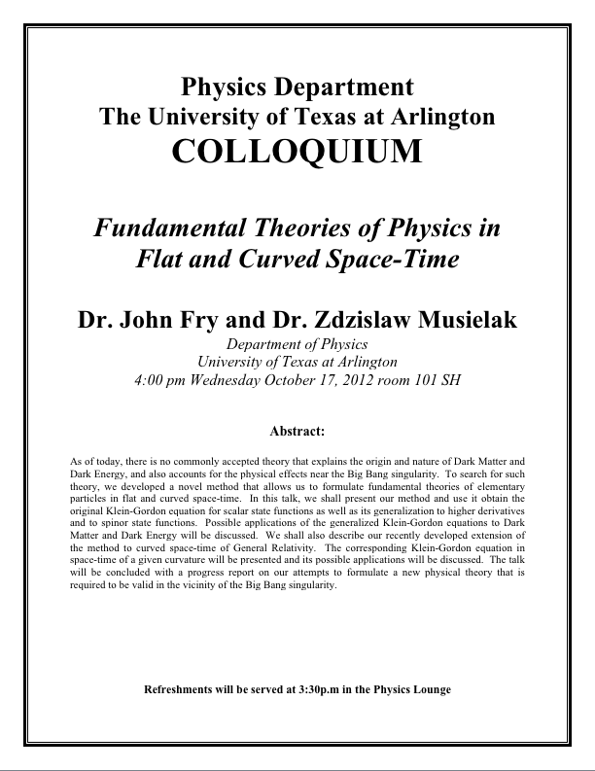

Slide 4
Special project #5
Prove that the wave function Ψ=A[sin(kx-ωt)+icos(kx-ωt)] is a good solution for the time-dependent Schrödinger wave equation. Do NOT use the exponential expression of the wave function. (10 points)
Determine whether or not the wave function Ψ=Ae^{-α|x|} satisfy the time-dependent Schrödinger wave equation. (10 points)
Due for this special project is Monday, Oct. 22.
You MUST have your own answers!

Slide 5
The Schrödinger Wave Equation
The Schrödinger wave equation in its time-dependent form for a particle of energy E moving in a potential V in one dimension is
The extension into three dimensions is
where is an imaginary number

Slide 6
Ex 6.1: Wave equation and Superposition
The wave equation must be linear so that we can use the superposition principle to. Prove that the wave function in Schrodinger equation is linear by showing that it is satisfied for the wave equation Ψ (ξ,τ)=αΨ₁ (ξ,τ)+βΨ₂ (ξ,τ) where a and b are constants and Ψ₁ (ξ,τ) and Ψ₂ (ξ,τ) describe two waves each satisfying the Schrodinger Eq.
Rearrange terms

Slide 7
General Solution of the Schrödinger Wave Equation
The general form of the solution of the Schrödinger wave equation is given by:
which also describes a wave propergating in the x direction. In general the amplitude may also be complex. This is called the wave function of the particle.
The wave function is also not restricted to being real. Only the physically measurable quantities (or observables) must be real. These include the probability, momentum and energy.

Slide 8
Ex 6.2: Solution for wave equation
Show that Ae^{i(kx-ωt)} satisfies the time-dependent Schrodinger wave Eq.
So Ae^{i(kx-ωt)} is a good solution and satisfies Schrodinger Eq.

Slide 9
Ex 6.3: Bad solution for wave equation
Determine Ψ (ξ,τ)=Asin(kx-ωt) is an acceptable solution for the time-dependent Schrodinger wave Eq.
This is not true in all x and t. So Ψ (x,t)=Asin(kx-ωt) is not an acceptable solution for Schrodinger Eq.

Slide 10
Normalization and Probability
The probability P(x) dx of a particle being between x and X + dx was given in the equation
Here Ψ* denotes the complex conjugate of Ψ
The probability of the particle being between x₁ and x₂ is given by
The wave function must also be normalized so that the probability of the particle being somewhere on the x axis is 1.

Slide 11
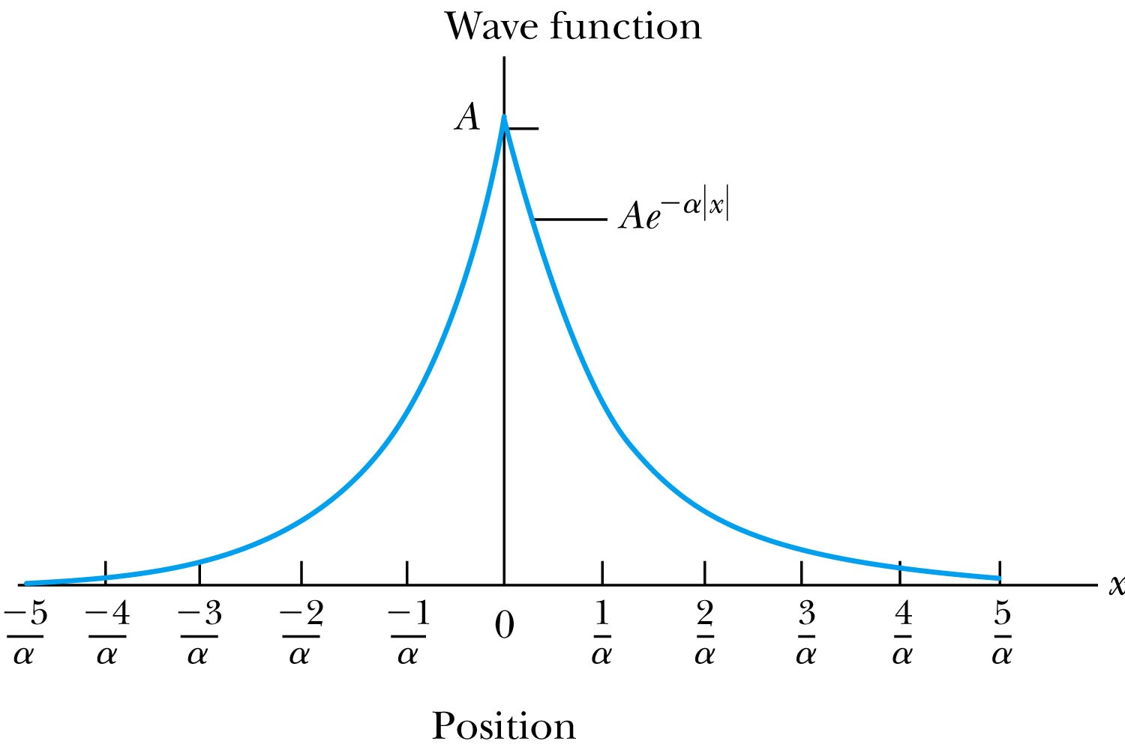
Ex 6.4: Normalization
Consider a wave packet formed by using the wave function that Ae^{-α|ξ|}, where A is a constant to be determined by normalization. Normalize this wave function and find the probabilities of the particle being between 0 and 1/α, and between 1/α and 2/α.
Probability density
Normalized Wave Function

Slide 12
Ex 6.4: Normalization, cont’d
Using the wave function, we can compute the probability for a particle to be with 0 to 1/α and 1/α to 2/α.
For 0 to 1/α:
For 1/α to 2/α:
How about 2/α:to ∞?

