Slide 1
PHYS 3313 – Section 001 Lecture #13
Wednesday, Oct. 17, 2012
Dr. Jaehoon Yu
Properties of valid wave functions
Time independent Schrodinger Equation
Expectation Values
Operators – Position, Momentum and Energy
Infinite Potential Well
Finite Potential Well

Slide 2
Announcements
Reading assignments
CH6.1 – 6.7 + the special topic
Colloquium this week
4pm, today, Oct. 17, SH101
Drs. Musielak and Fry of UTA
Please mark your calendar for the Weinberg lecture at 7:30pm, coming Wednesday, Oct. 24!!
Let all of your family and friends know of this.

Slide 3
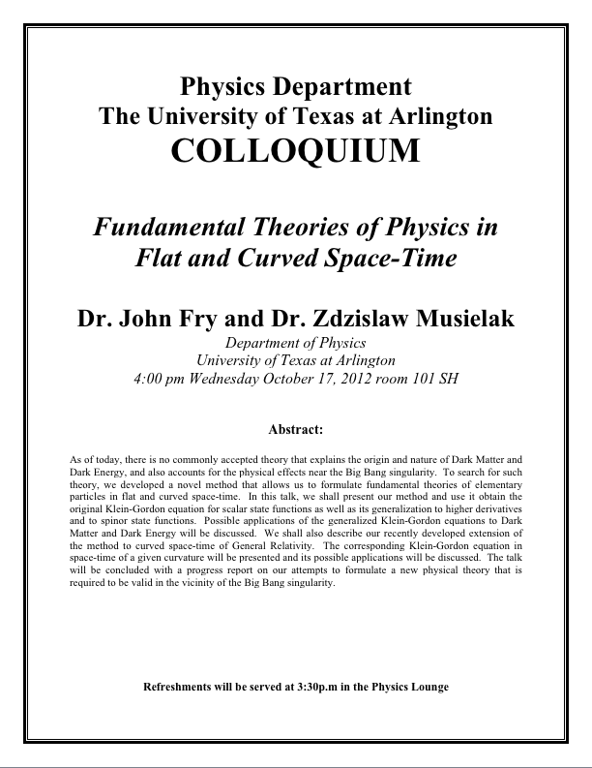

Slide 4
Special project #4
Show that the wave function Ψ=A[sin(kx-ωt)+icos(kx-ωt)] is a good solution for the time-dependent Schrödinger wave equation. Do NOT use the exponential expression of the wave function. (10 points)
Determine whether or not the wave function Ψ=Ae^{-α|x|} satisfies the time-dependent Schrödinger wave equation. (10 points)
Due for this special project is Monday, Oct. 22.
You MUST have your own answers!

Slide 5
Special project #5
Show that the Schrodinger equation becomes Newton’s second law. (15 points)
Deadline Monday, Oct. 29, 2012
You MUST have your own answers!

Slide 6
Properties of Valid Wave Functions
Boundary conditions
To avoid infinite probabilities, the wave function must be finite everywhere.
To avoid multiple values of the probability, the wave function must be single valued.
For finite potentials, the wave function and its derivative must be continuous. This is required because the second-order derivative term in the wave equation must be single valued. (There are exceptions to this rule when V is infinite.)
In order to normalize the wave functions, they must approach zero as x approaches infinity.
Solutions that do not satisfy these properties do not generally correspond to physically realizable circumstances.

Slide 7
Time-Independent Schrödinger Wave Equation
The potential in many cases will not depend explicitly on time.
The dependence on time and position can then be separated in the Schrödinger wave equation. Let,
which yields:
Now divide by the wave function:
The left side of this last equation depends only on time, and the right side depends only on spatial coordinates. Hence each side must be equal to a constant. The time dependent side is

Slide 8
Time-Independent Schrödinger Wave Equation(con’t)
We integrate both sides and find:
where C is an integration constant that we may choose to be 0. Therefore
This determines f to be by comparing it to the wave function of a free particle
This is known as the time-independent Schrödinger wave equation, and it is a fundamental equation in quantum mechanics.

Slide 9
Stationary State
Recalling the separation of variables:
and with f(t) = the wave function can be written as:
The probability density becomes:
The probability distributions are constant in time. This is a standing wave phenomena that is called the stationary state.

Slide 10
Comparison of Classical and Quantum Mechanics
Newton’s second law and Schrödinger’s wave equation are both differential equations.
Newton’s second law can be derived from the Schrödinger wave equation, so the latter is the more fundamental.
Classical mechanics only appears to be more precise because it deals with macroscopic phenomena. The underlying uncertainties in macroscopic measurements are just too small to be significant due to the small size of the Planck’s constant

Slide 11
Expectation Values
In quantum mechanics, measurements can only be expressed in terms of average behaviors since precision measurement of each event is impossible
The expectation value is the expected result of the average of many measurements of a given quantity. The expectation value of x is denoted by <x>.
Any measurable quantity for which we can calculate the expectation value is called a physical observable. The expectation values of physical observables (for example, position, linear momentum, angular momentum, and energy) must be real, because the experimental results of measurements are real.
The average value of x is

Slide 12
Continuous Expectation Values
We can change from discrete to continuous variables by using the probability P(x,t) of observing the particle at a particular x.
Using the wave function, the expectation value is:
The expectation value of any function g(x) for a normalized wave function:

Slide 13
Momentum Operator
To find the expectation value of p, we first need to represent p in terms of x and t. Consider the derivative of the wave function of a free particle with respect to x:
With k = p / ħ we have
This yields
This suggests we define the momentum operator as .
The expectation value of the momentum is

Slide 14
Position and Energy Operators
The position x is its own operator as seen above.
The time derivative of the free-particle wave function is
Substituting ω = E / ħ yields
The energy operator is
The expectation value of the energy is

Slide 15
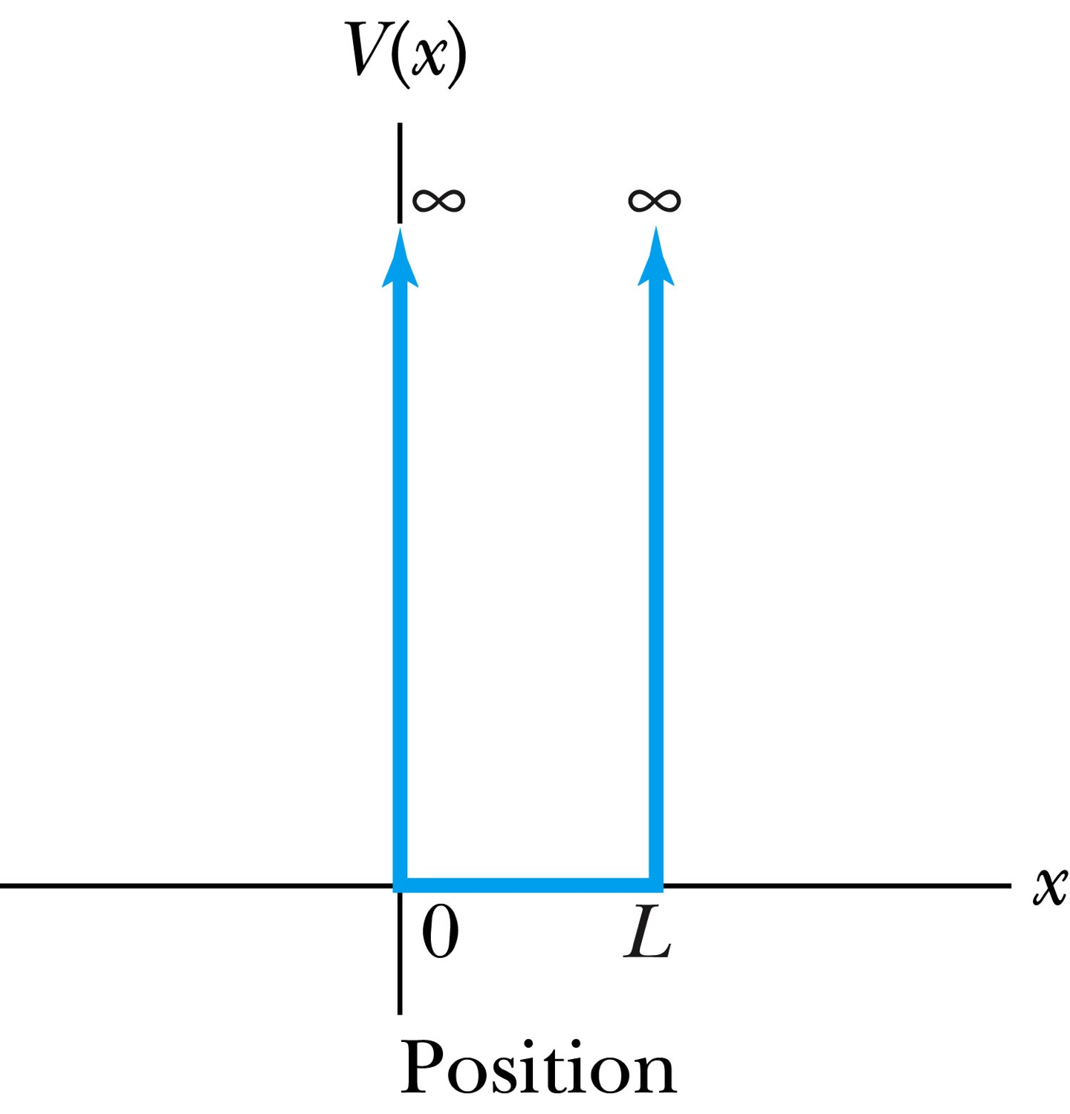
Infinite Square-Well Potential
The simplest such system is that of a particle trapped in a box with infinitely hard walls that the particle cannot penetrate. This potential is called an infinite square well and is given by
The wave function must be zero where the potential is infinite.
Where the potential is zero inside the box, the Schrödinger wave equation becomes where .
The general solution is .

Slide 16
Quantization
Since the wave function must be continuous, the boundary conditions of the potential dictate that the wave function must be zero at x = 0 and x = L. This yields valid solutions for B=0 and for integer values of n such that kL = nπ ➔ k=nπ/L
The wave function is now
We normalize the wave function
The normalized wave function becomes
These functions are identical to those obtained for a vibrating string with fixed ends.

