Slide 1
PHYS 3313 – Section 001 Lecture #14
Monday, Oct. 22, 2012
Dr. Jaehoon Yu
Infinite Potential Well
Finite Potential Well
Penetration Depth
Degeneracy
Simple Harmonic Oscillator
Parabolic Potential
Barriers and Tunneling

Slide 2
Announcements
Mid-term results
Class average:59.9/96
Equivalent to 62.4/100
Stop score: 94/96
Homework #5
CH6 end of chapter problems: 3, 5, 11, 14, 22, and 26
Due on Monday, Oct. 29, in class
Mid-term grade discussions during the class time Wednesday in my office, CPB342
Last names A – G: 1:00pm – 1:40pm
Last names H – Z: 1:40pm – 2:20pm
LCWS12
You are welcome to sit in the talks
Colloquium this week
At 4pm in SH101
Dr. Tadashi Ogitsu from Lorentz Livermore National Lab.
Don’t forget the Weinberg lecture at 7:30pm, this Wednesday, Oct. 24!

Slide 3
Special project #5
Show that the Schrodinger equation becomes Newton’s second law. (15 points)
Deadline Monday, Oct. 29, 2012
You MUST have your own answers!

Slide 4
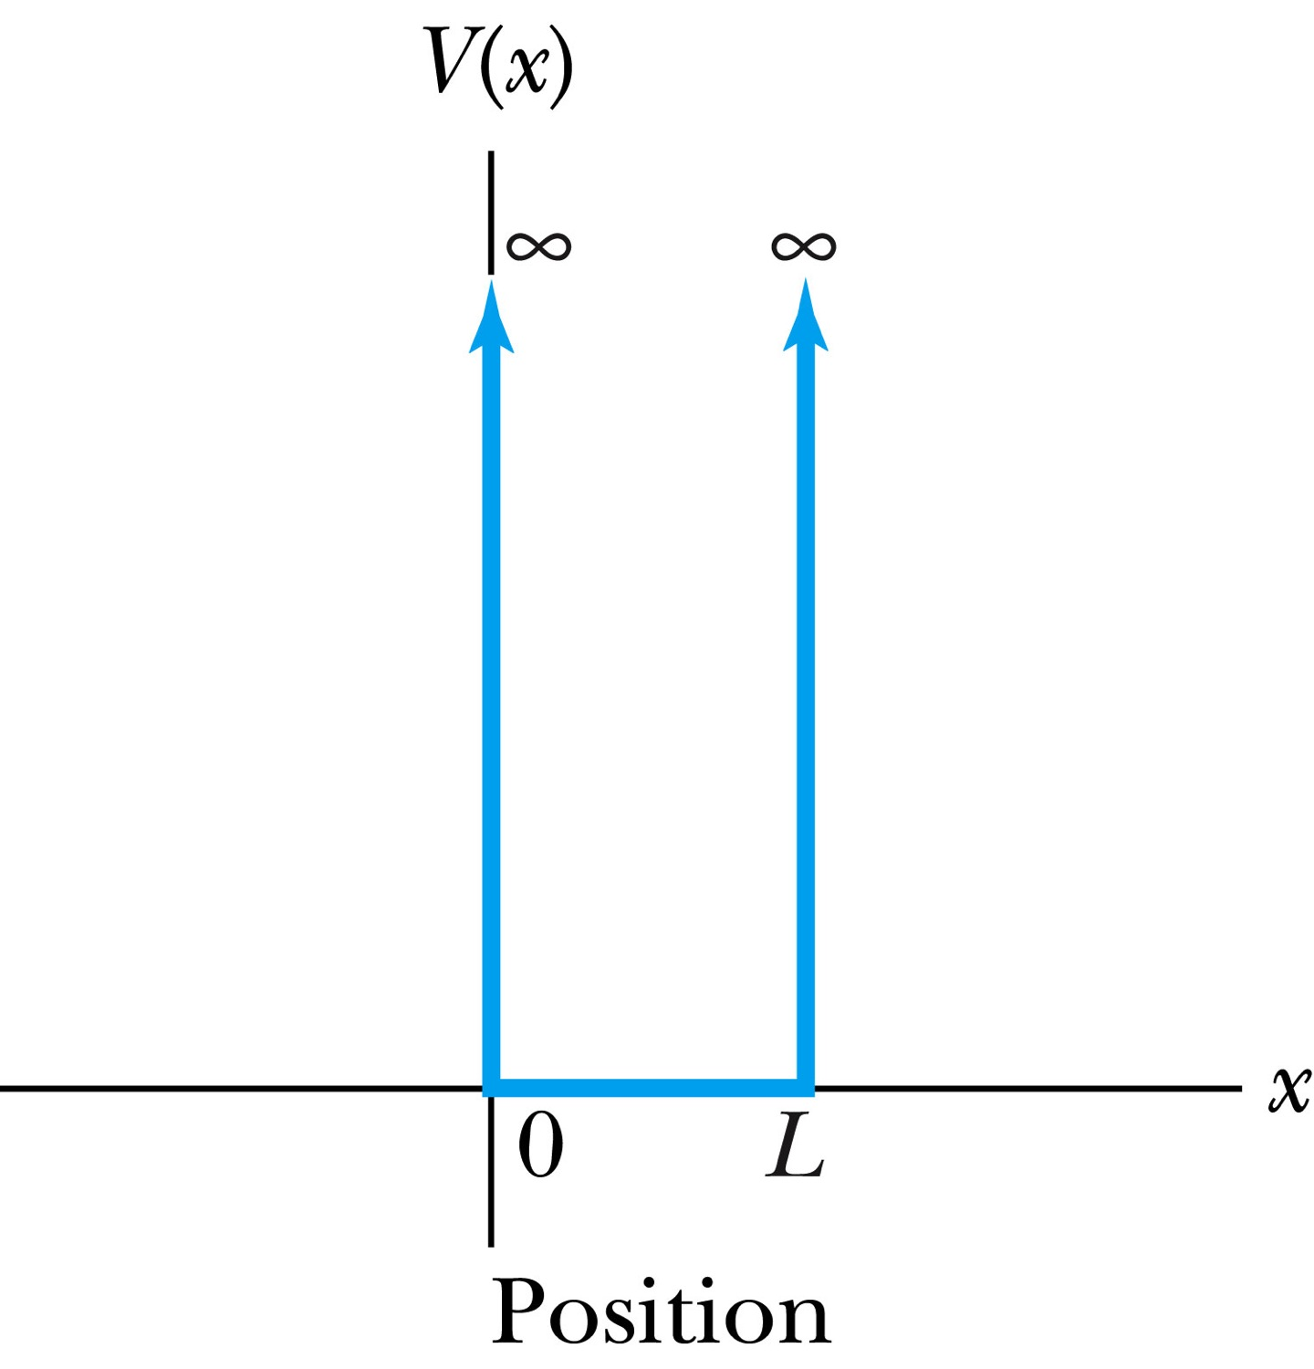
Infinite Square-Well Potential
The simplest such system is that of a particle trapped in a box with infinitely hard walls that the particle cannot penetrate. This potential is called an infinite square well and is given by
The wave function must be zero where the potential is infinite.
Where the potential is zero inside the box, the Schrödinger wave equation becomes where .
The general solution is .

Slide 5
Quantization
Since the wave function must be continuous, the boundary conditions of the potential dictate that the wave function must be zero at x = 0 and x = L. This yields valid solutions for B=0 and for integer values of n such that kL = nπ ➔ k=nπ/L
The wave function is now
We normalize the wave function
The normalized wave function becomes
These functions are identical to those obtained for a vibrating string with fixed ends.

Slide 6
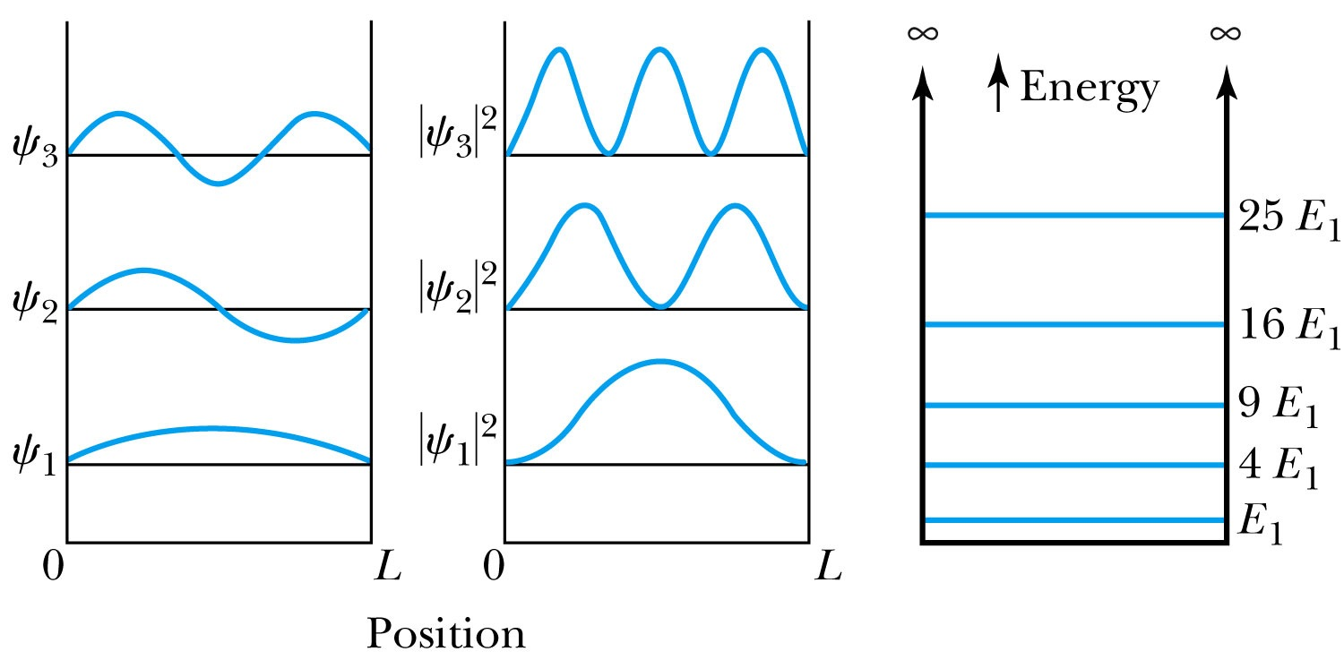
Quantized Energy
The quantized wave number now becomes
Solving for the energy yields
Note that the energy depends on the integer values of n. Hence the energy is quantized and nonzero.
The special case of n = 1 is called the ground state energy.

Slide 7
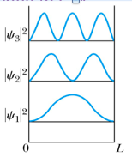
How does this correspond to Classical Mech.?
What is the probability of finding a particle in a box of length L?
Bohr’s correspondence principle says that QM and CM must correspond to each other! When?
When n becomes large, the QM approaches to CM
So when n→∞, the probability of finding a particle in a box of length L is
Which is identical to the CM probability!!
One can also see this from the plot of P!

Slide 8
Ex 6.8: Expectation values inside a box
Determine the expectation values for x, x², p and p² of a particle in an infinite square well for the first excited state.
What is the wave function of the first excited state?
n=?
2

Slide 9
Ex 6.9: Proton Transition Energy
A typical diameter of a nucleus is about 10⁻¹⁴m. Use the infinite square-well potential to calculate the transition energy from the first excited state to the ground state for a proton confined to the nucleus.
The energy of the state n is
What is n for the ground state?
n=1
What is n for the 1st excited state?
n=2
So the proton transition energy is

