Slide 1
PHYS 3313 – Section 001
Lecture #16
Wednesday, Oct. 31, 2012
Dr. Amir Farbin
Reflection and Transmission
Tunneling
Alpha Particle Decay
Use of Schrodinger Equation on Hydrogen Atom

Slide 2
Announcements
Reminder: homework #7
  CH6 end of chapter problems: 34, 39, 46, 62 and 65
  Due on Monday, Nov. 12, in class
Quiz #3
  Beginning of the class Monday, Nov. 12
  Covers CH5 through what we finish this Wednesday
Colloquium this week
  At 4pm, today, Wednesday, Oct. 31, in SH101

Slide 3
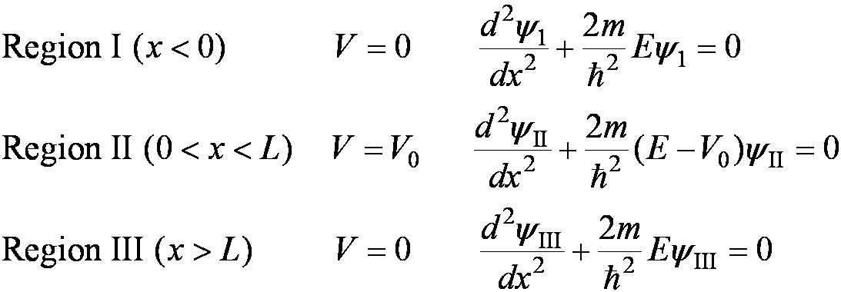
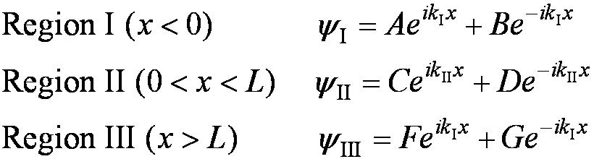
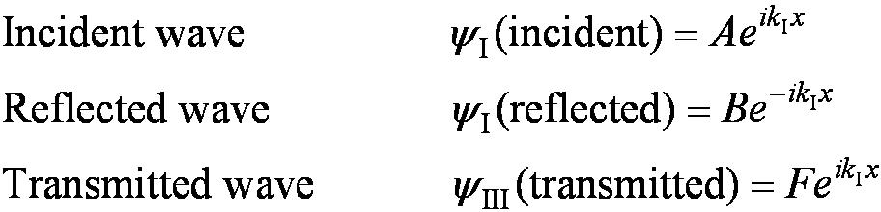
Reflection and Transmission
The wave function will consist of an incident wave, a reflected wave, and a transmitted wave.
The potentials and the Schrödinger wave equation for the three regions are as follows:
The corresponding solutions are:
As the wave moves from left to right, we can simplify the wave functions to:

Slide 4
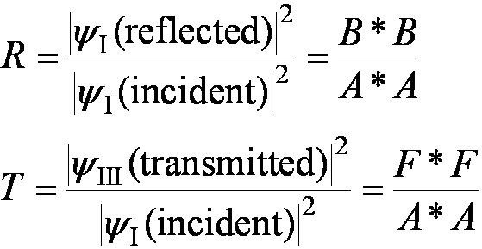
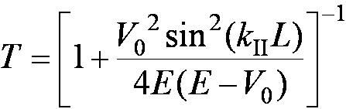
Probability of Reflection and Transmission
The probability of the particles being reflected R or transmitted T is:
The maximum kinetic energy of the photoelectrons depends on the value of the light frequency f and not on the intensity.
Because the particles must be either reflected or transmitted we have: R + T = 1
By applying the boundary conditions x → ±∞, x = 0, and x = L, we arrive at the transmission probability:
Notice that there is a situation in which the transmission probability is 1.

Slide 5
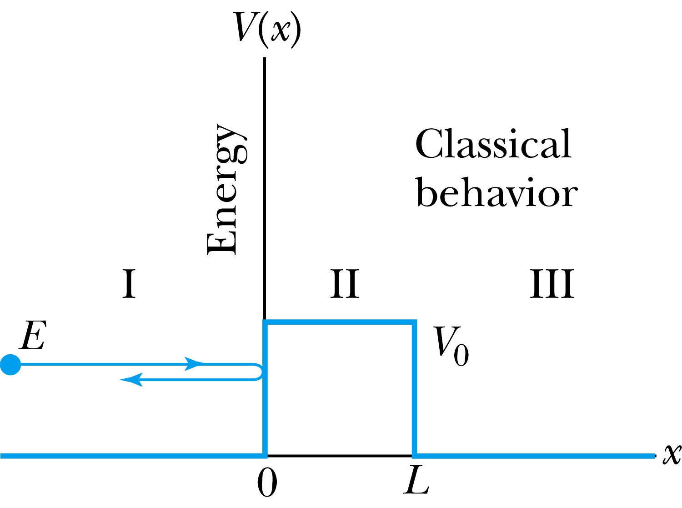
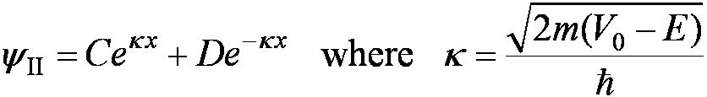
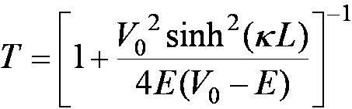
Tunneling
Now we consider the situation where classically the particle does not have enough energy to surmount the potential barrier, E < V₀.
The quantum mechanical result, however, is one of the most remarkable features of modern physics, and there is ample experimental proof of its existence. There is a small, but finite, probability that the particle can penetrate the barrier and even emerge on the other side.
The wave function in region II becomes
The transmission probability that
describes the phenomenon of tunneling is

Slide 6
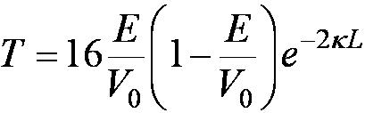
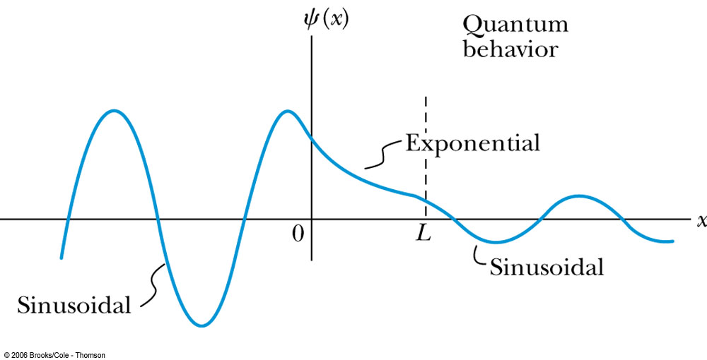
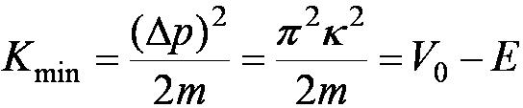
Uncertainty Explanation
Consider when κL >> 1 then the transmission probability becomes:
This violation allowed by the uncertainty principle is equal to the negative kinetic energy required! The particle is allowed by quantum mechanics and the uncertainty principle to penetrate into a classically forbidden region. The minimum such kinetic energy is:

Slide 7
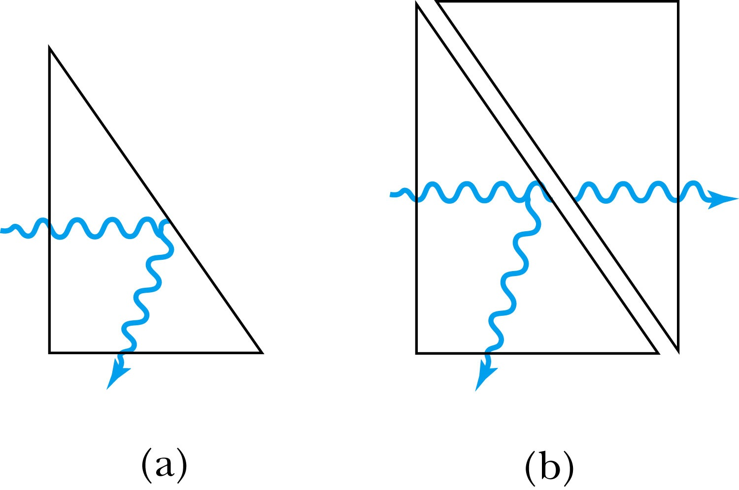
Analogy with Wave Optics
If light passing through a glass prism reflects from an internal surface with an angle greater than the critical angle, total internal reflection occurs. However, the electromagnetic field is not exactly zero just outside the prism. If we bring another prism very close to the first one, experiments show that the electromagnetic wave (light) appears in the second prism.
The situation is analogous to the tunneling described here. This effect was observed by Newton and can be demonstrated with two prisms and a laser. The intensity of the second light beam decreases exponentially as the distance between the two prisms increases.

Slide 8
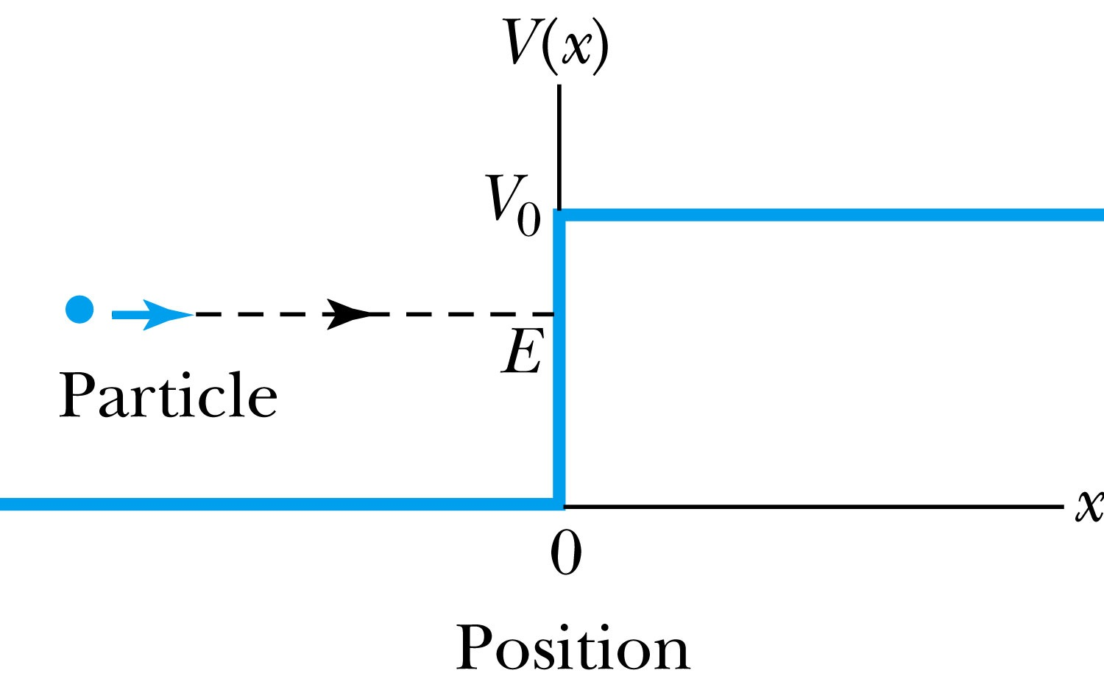
Potential Well
Consider a particle passing through a potential well region rather than through a potential barrier.
Classically, the particle would speed up passing the well region, because K = mv² / 2 = E + V₀.
According to quantum mechanics, reflection and transmission may occur, but the wavelength inside the potential well is smaller than outside. When the width of the potential well is precisely equal to half-integral or integral units of the wavelength, the reflected waves may be out of phase or in phase with the original wave, and cancellations or resonances may occur. The reflection/cancellation effects can lead to almost pure transmission or pure reflection for certain wavelengths. For example, at the second boundary (x = L) for a wave passing to the right, the wave may reflect and be out of phase with the incident wave. The effect would be a cancellation inside the well.

