Slide 1
PHYS 3313 – Section 001 Lecture #17
Monday, Nov. 1, 2012
Dr. Jaehoon Yu
Alpha Particle Decay
Use of Schrodinger Equation on Hydrogen Atom
Solutions for Schrodinger Equation for Hydrogen Atom
Quantum Numbers
Principal Quantum Number

Slide 2
Announcements
Thank you for those of you volunteered for LCWS12
Reminder: homework #6
CH6 end of chapter problems: 34, 39, 46, 62 and 65
Due on Monday, Nov. 12, in class
Quiz #3
Beginning of the class Wednesday, Nov. 7.
Covers CH5 through what we finish today
Colloquium this week
At 4pm, Wednesday, Nov. 7, in SH101
Dr. Nick White of Goddard Space Center, NASA

Slide 3
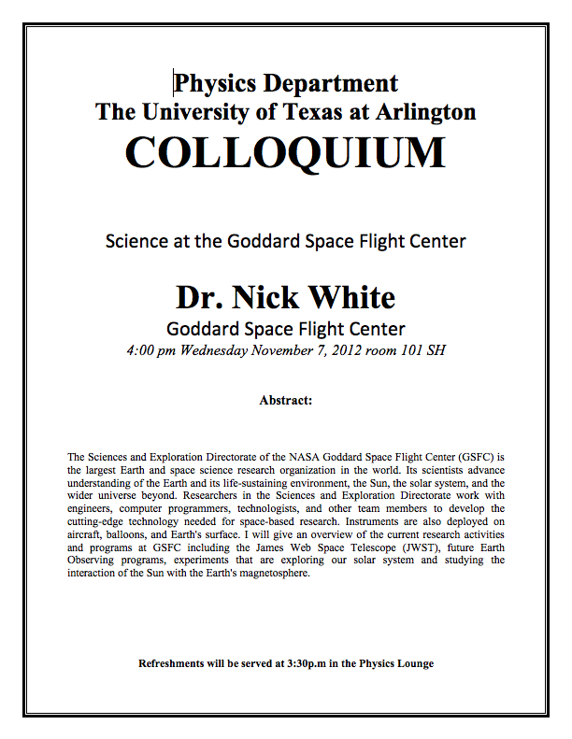

Slide 4
Research Projects
Each of the 10 research groups picks one research topic
Study the topic as a group, looking up references
Original theory or Original observation
Experimental proofs or Theoretical prediction + subsequent experimental proofs
Importance and the impact of the theory/experiment
Conclusions
Each member of the group writes a 10 (max) page report, including figures (must not copy!!)
10% of the total grade
Can share the theme and facts but you must write your own!
Due Mon., Nov. 26, 2012
Each group presents a 10min power point talk
5% of the total grade
Date and time will be announced close to the end of the semester

Slide 5
Research Topics
Black body radiation
Michelson–Morley experiment
The Photoelectric effect
Special Relativity
The property of molecules, Browning Motion
Compton Effect
Radioactive
Rutherford Scattering
Super-conductivity
The Unification of Electromagnetic and Weak forces

Slide 6
Research Presentations
Each of the 10 research groups makes a 10min presentation
8min presentation + 2min Q&A
All presentations must be in power point
I must receive all final presentation files by 8pm, Sunday, Dec. 2
No changes are allowed afterward
The representative of the group makes the presentation with all group members participate in the Q&A session
Date and time: Determined by drawing
In class Monday, Dec. 3 or in class Wednesday, Dec. 5
Important metrics
Contents of the presentation: 60%
Inclusion of all important points as mentioned in the report
The quality of the research and making the right points
Quality of the presentation itself: 15%
Presentation manner: 10%
Q&A handling: 10%
Staying in the allotted presentation time: 5%
Judging participation and sincerity: 5%

Slide 7
Group – Research Topic Association
Research Group | Research Topic | Presentation Date
1 | 6 | 12/5-4
2 | 5 | 12/5-5
3 | 7 | 12/5-1
4 | 2 | 12/3-2
5 | 1 | 12/3-3
6 | 9 | 12/3-5
7 | 10 | 12/3-1
8 | 4 | 12/5-3
9 | 3 | 12/5-2
10 | 8 | 12/3-4

Slide 8
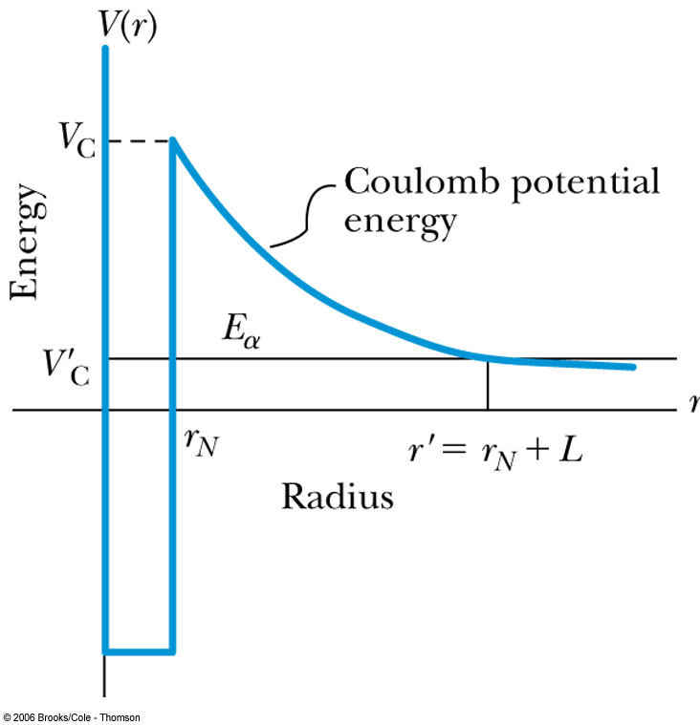
Alpha-Particle Decay
May nuclei heavier than Pb emits alpha particles (nucleus of He)! The phenomenon of tunneling explains the alpha-particle decay of heavy, radioactive nuclei.
Inside the nucleus, an alpha particle feels the strong, short-range attractive nuclear force as well as the repulsive Coulomb force.
The nuclear force dominates inside the nuclear radius where the potential is approximately a square well.
The Coulomb force dominates outside the nuclear radius.
The potential barrier at the nuclear radius is several times greater than the energy of an alpha particle (~5MeV).
According to quantum mechanics, however, the alpha particle can “tunnel” through the barrier. Hence this is observed as radioactive decay.

Slide 9
Application of the Schrödinger Equation to the Hydrogen Atom
The approximation of the potential energy of the electron-proton system is the Coulomb potential:
To solve this problem, we use the three-dimensional time-independent Schrödinger Equation.
For Hydrogen-like atoms with one electron (He⁺ or Li⁺⁺)
Replace e² with Ze² (Z is the atomic number)
Use appropriate reduced mass μ

Slide 10
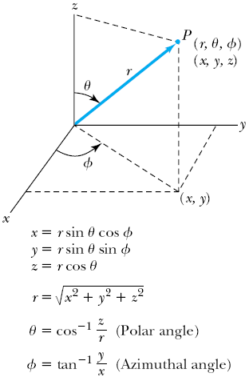
Application of the Schrödinger Equation
The potential (central force) V(r) depends on the distance r between the proton and electron.
Transform to spherical polar coordinates to exploit the radial symmetry.
Insert the Coulomb potential into the transformed Schrödinger equation.

Slide 11
Application of the Schrödinger Equation
The wave function ψ is a function of r, θ and φ .
The equation is separable into three equations of independent variables
The solution may be a product of three functions.
We can separate the Schrodinger equation in polar coordinate into three separate differential equations, each depending only on one coordinate: r, θ, or φ .

Slide 12
Solution of the Schrödinger Equation for Hydrogen
Substitute ψ into the polar Schrodinger equation and separate the resulting equation into three equations: R(r), f(θ), and g(φ).
Separation of Variables
The derivatives in Schrodinger eq. can be written as
Substituting them into the polar coord. Schrodinger Eq.
Multiply both sides by r² sin² θ / Rfg
Reorganize

Slide 13
Solution of the Schrödinger Equation
Only r and θ appear on the left-hand side and only φ appears on the right-hand side of the equation
The left-hand side of the equation cannot change as φ changes.
The right-hand side cannot change with either r or θ.
Each side needs to be equal to a constant for the equation to be true in all cases. Set the constant −m_{ℓ}² equal to the right-hand side of the reorganized equation
It is convenient to choose a solution to be .
-------- azimuthal equation

