Slide 1
PHYS 3313 – Section 001 Lecture #17
Wednesday, Nov. 7, 2012
Dr. Jaehoon Yu
Solutions for Schrodinger Equation for Hydrogen Atom
Quantum Numbers
Principal Quantum Number
Orbital Angular Momentum Quantum Number
Magnetic Quantum Number

Slide 2
Announcements
Research team member list have been updated on the web!
Remember the deadline for your research paper is Monday, Nov. 26!!
Reminder: homework #6
CH6 end of chapter problems: 34, 39, 46, 62 and 65
Due on Monday, Nov. 12, in class
Reading assignments
CH7.6 and the entire CH8
Colloquium today
At 4pm, Wednesday, Nov. 7, in SH101
Dr. Nick White of Goddard Space Center, NASA

Slide 3
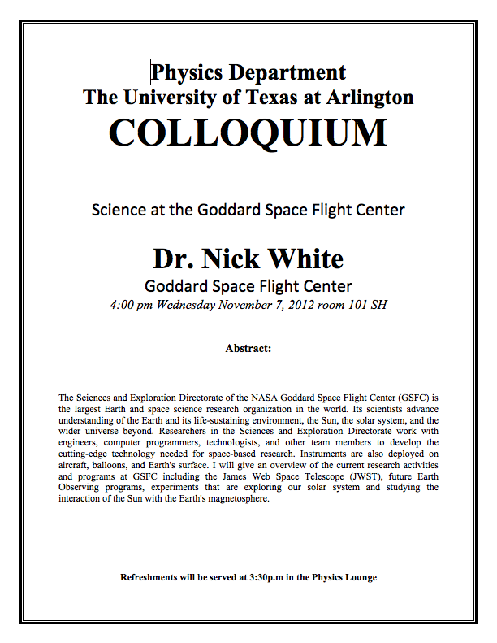

Slide 4
Group – Research Topic Association
Research Group | Research Topic | Presentation Date
1 | 6 | 12/5-4
2 | 5 | 12/5-5
3 | 7 | 12/5-1
4 | 2 | 12/3-2
5 | 1 | 12/3-3
6 | 9 | 12/3-5
7 | 10 | 12/3-1
8 | 4 | 12/5-3
9 | 3 | 12/5-2
10 | 8 | 12/3-4

Slide 5
Solution of the Schrödinger Equation for Hydrogen
Substitute ψ into the polar Schrodinger equation and separate the resulting equation into three equations: R(r), f(θ), and g(φ).
Separation of Variables
The derivatives in Schrodinger eq. can be written as
Substituting them into the polar coord. Schrodinger Eq.
Multiply both sides by r² sin² θ / Rfg
Reorganize

Slide 6
Solution of the Schrödinger Equation
Only r and θ appear on the left-hand side and only φ appears on the right-hand side of the equation
The left-hand side of the equation cannot change as φ changes.
The right-hand side cannot change with either r or θ.
Each side needs to be equal to a constant for the equation to be true in all cases. Set the constant −m_{ℓ}² equal to the right-hand side of the reorganized equation
It is convenient to choose a solution to be .
-------- azimuthal equation

Slide 7
Solution of the Schrödinger Equation
satisfies the previous equation for any value of m_{ℓ}.
The solution be single valued in order to have a valid solution for any φ, which requires
m_{ℓ} must be zero or an integer (positive or negative) for this to work
If the sign were positive, the solution would not be normalized.
Now, set the remaining equation equal to −m_{ℓ}² and divide either side with sin²θ and rearrange it.
Everything depends on r on the left side and θ on the right side of the equation.

Slide 8
Solution of the Schrödinger Equation
Set each side of the equation equal to constant ℓ(ℓ + 1).
Radial Equation
Angular Equation
Schrödinger equation has been separated into three ordinary second-order differential equations, each containing only one variable.

Slide 9
Solution of the Radial Equation
The radial equation is called the associated Laguerre equation, and the solutions R that satisfy the appropriate boundary conditions are called associated Laguerre functions.
Assume the ground state has ℓ = 0, and this requires m_{ℓ} = 0.
We obtain
The derivative of yields two terms, we obtain

Slide 10
Solution of the Radial Equation
Let’s try a solution where A is a normalization constant,a₀ is a constant with the dimension of length.
Take derivatives of R, we obtain.
To satisfy this equation for any r, each of the two expressions in parentheses must be zero.
Set the second parentheses equal to zero and solve for a₀.
Set the first parentheses equal to zero and solve for E.
Both equal to the Bohr’s results
Bohr’s radius
Ground state energy of the hydrogen atom

