Slide 1
PHYS 3313 – Section 001 Lecture #18
Monday, Nov. 12, 2012
Dr. Jaehoon Yu
Quantum Numbers
Principal Quantum Number
Orbital Angular Momentum Quantum Number
Magnetic Quantum Number
The Zeeman Effect
Intrinsic Spin

Slide 2
Announcements
Quiz #3 results
Class average: 17.7/50
Equivalent to 35.4/100
Previous averages: 27.4/100 and 67.3/100
Homework #7
CH7 end of chapter problems: 7, 8, 9, 12, 17 and 29
Due on Monday, Nov. 19, in class
Reading assignments
CH7.6 and the entire CH8
Colloquium Wednesday
At 4pm, Wednesday, Nov. 14, in SH101
Dr. Masaya Takahashi of UT South Western Medical

Slide 3
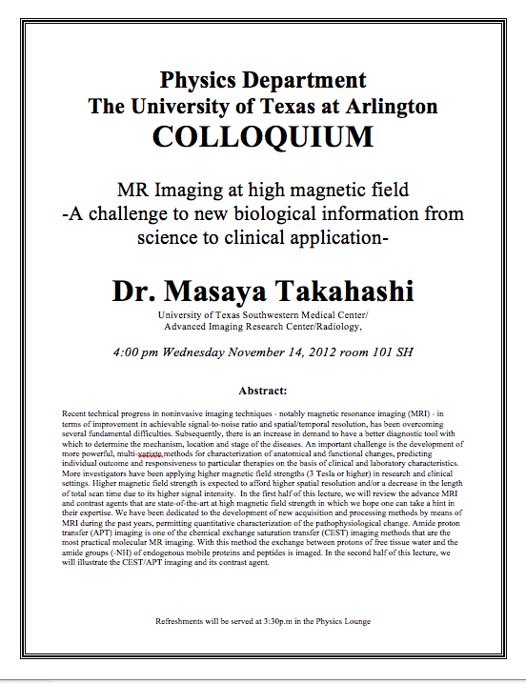

Slide 4
Principal Quantum Number n
It results from the solution of R(r) in the separate Schrodinger Eq. because R(r) includes the potential energy V(r).
The result for this quantized energy is
The negative means the energy E indicates that the electron and proton are bound together.

Slide 5
Quantum Numbers
The full solution of the radial equation requires an introduction of a quantum number, n, which is a non-zero positive integer.
The three quantum numbers:
n Principal quantum number
ℓ Orbital angular momentum quantum number
m_{ℓ} Magnetic quantum number
The boundary conditions put restrictions on these
n = 1, 2, 3, 4, . . . (n>0) Integer
ℓ = 0, 1, 2, 3, . . . , n − 1 (ℓ < n) Integer
m_{ℓ} = −ℓ, −ℓ + 1, . . . , 0, 1, . . . , ℓ − 1, ℓ (|m_{ℓ}| ≤ ℓ) Integer
The predicted energy level is

Slide 6
Ex 7.3: Quantum Numbers & Degeneracy
What are the possible quantum numbers for the state n=4 in atomic hydrogen? How many degenerate states are there?
n ℓ m_{ℓ}
4 0 0
4 1 -1, 0, +1
4 2 -2, -1, 0, +1, +2
4 3 -3, -2, -1, 0, +1, +2, +3
The energy of a atomic hydrogen state is determined only by the primary quantum number, thus, all these quantum states, 1+3+5+7 = 16, are in the same energy state.
Thus, there are 16 degenerate states for the state n=4.

Slide 7
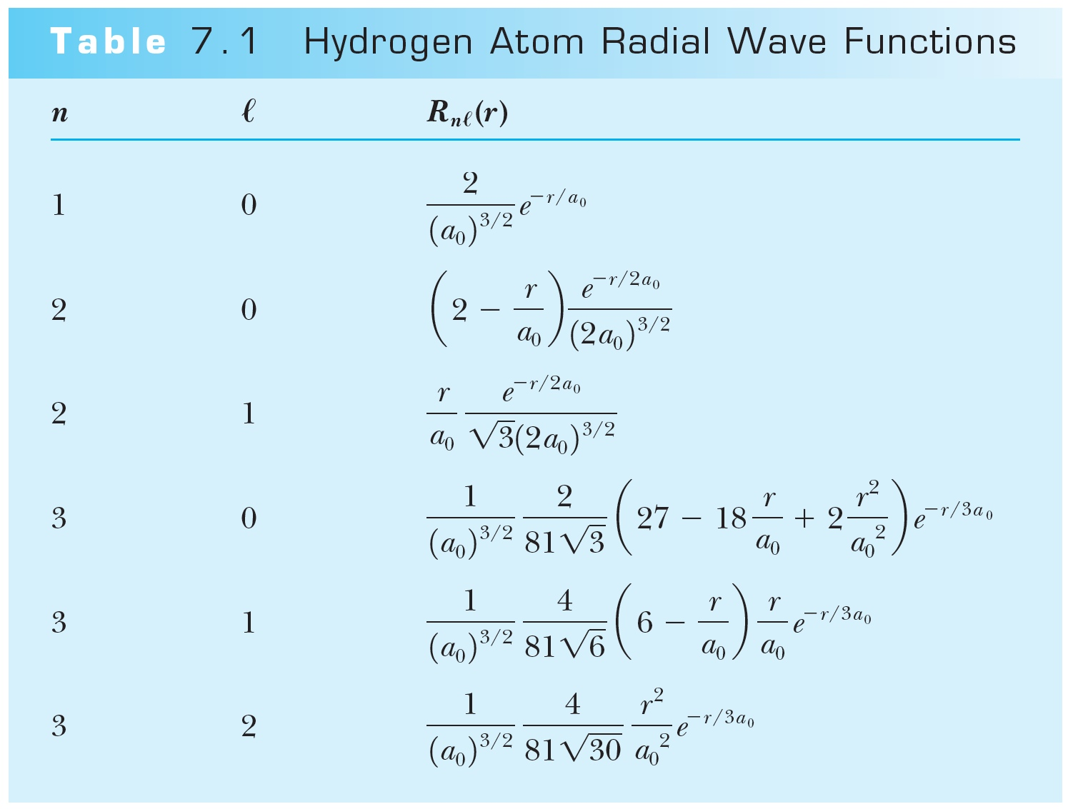
Hydrogen Atom Radial Wave Functions
The radial solution is specified by the values of n and ℓ
First few radial wave functions R_{nℓ}

Slide 8
Solution of the Angular and Azimuthal Equations
The solutions for azimuthal eq. are or
Solutions to the angular and azimuthal equations are linked because both have m_{ℓ}
Group these solutions together into functions
---- spherical harmonics

Slide 9
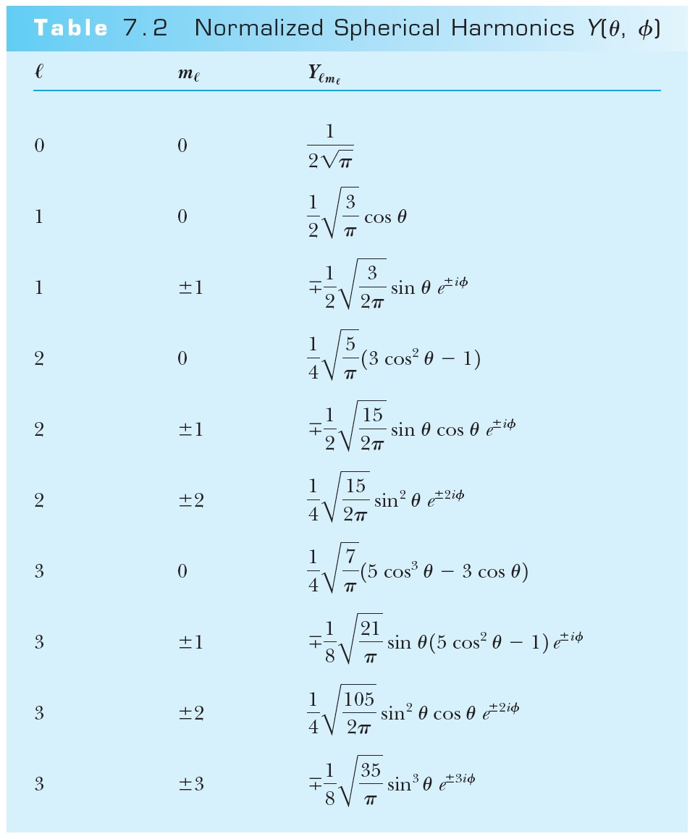
Normalized Spherical Harmonics

Slide 10
Ex 7.1: Spherical Harmonic Function
Show that the spherical harmonic function Y11(θ,φ) satisfies the angular Schrodinger equation.

Slide 11
Solution of the Angular and Azimuthal Equations
The radial wave function R and the spherical harmonics Y determine the probability density for the various quantum states.
Thus the total wave function ψ(r,θ,φ) depends on n, ℓ, and m_{ℓ}. The wave function can be written as

Slide 12
Orbital Angular Momentum Quantum Number ℓ
It is associated with the R(r) and f(θ) parts of the wave function.
Classically, the orbital angular momentum with L = mv_{orbital}r.
ℓ is related to L by .
In an ℓ = 0 state, .
It disagrees with Bohr’s semi-classical “planetary” model of electrons orbiting a nucleus L = nħ.

Slide 13
Orbital Angular Momentum Quantum Number ℓ
A certain energy level is degenerate with respect to ℓ when the energy is independent of ℓ.
Use letter names for the various ℓ values
ℓ = 0 1 2 3 4 5 . . .
Letter = s p d f g h . . .
Atomic states are referred to by their n and ℓ
A state with n = 2 and ℓ = 1 is called a 2p state
The boundary conditions require n > ℓ

Slide 14
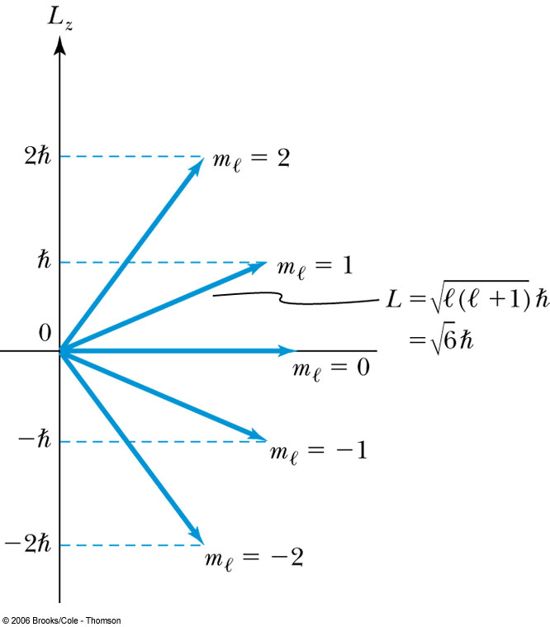
Magnetic Quantum Number m_{ℓ}
The angle φ is a measure of the rotation about the z axis.
The solution for g(φ) specifies that m_{ℓ} is an integer and related to the z component of L.
The relationship of L, L_{z}, ℓ, and m_{ℓ} for ℓ = 2.
is fixed.
Because L_{z} is quantized, only certain orientations of are possible and this is called space quantization.

Slide 15
Magnetic Quantum Number m_{ℓ}
Quantum mechanics allows to be quantized along only one direction in space. Because of the relation L² = L_{x}² + L_{y}² + L_{z}², once a second component is known, the third component will also be known.
Now, since we know there is no preferred direction,
We expect the average of the angular momentum components squared to be .

Slide 16
Magnetic Effects on Atomic Spectra—The Normal Zeeman Effect
The Dutch physicist Pieter Zeeman showed the spectral lines emitted by atoms in a magnetic field split into multiple energy levels. It is called the Zeeman effect.
Normal Zeeman effect:
A spectral line of an atom is split into three lines.
Consider the atom to behave like a small magnet.
The current loop has a magnetic moment μ = IA and the period T = 2πr / v. If an electron can be considered as orbiting a circular current loop of I = dq / dt around the nucleus, we obtain
where L = mvr is the magnitude of the orbital
angular momentum

Slide 17
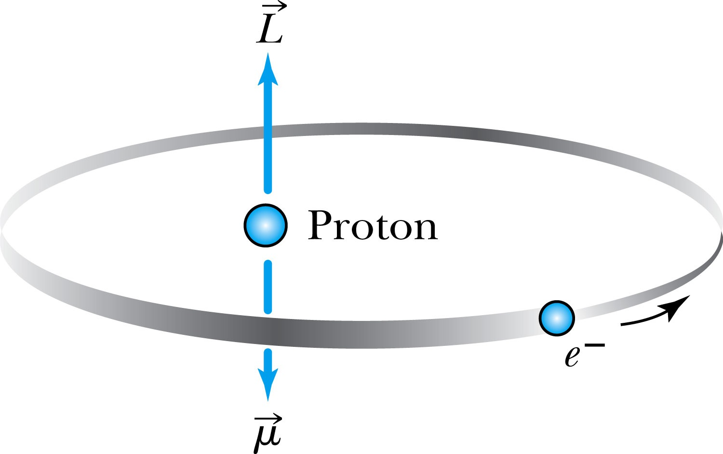
The Normal Zeeman Effect
Since there is no magnetic field to align them, points in random directions.
The dipole has a potential energy
The angular momentum is aligned with the magnetic moment, and the torque between and causes a precession of .
Where μ_{B} = eħ / 2m is called the Bohr magneton.
cannot align exactly in the z direction and has only certain allowed quantized orientations.

Slide 18
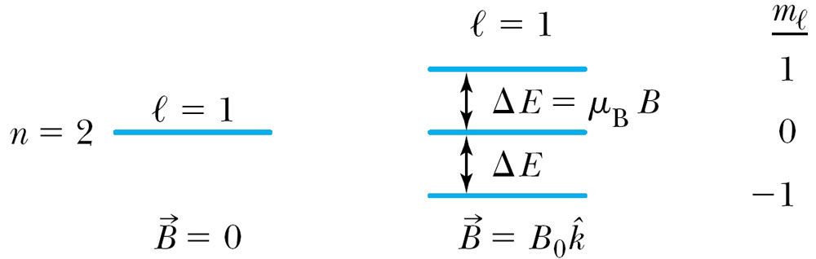
The Normal Zeeman Effect
The potential energy is quantized due to the magnetic quantum number m_{ℓ}.
When a magnetic field is applied, the 2p level of atomic hydrogen is split into three different energy states with the electron energy difference of ΔE = μ_{B}B Δm_{ℓ}.
So split is into a total of 2ℓ+1 energy states
m_{ℓ} | Energy
1 | E₀ + μ_{B}B
0 | E₀
−1 | E₀ − μ_{B}B

Slide 19
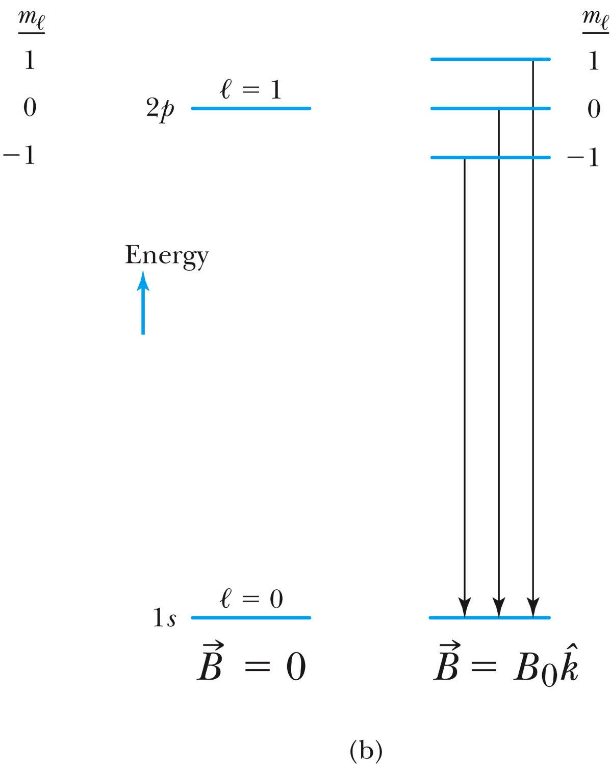
The Normal Zeeman Effect
A transition from 2p to 1s

Slide 20
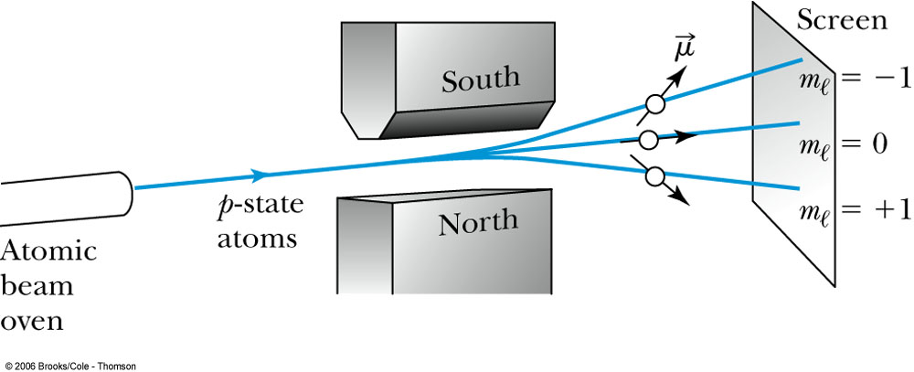
The Normal Zeeman Effect
An atomic beam of particles in the ℓ = 1 state pass through a magnetic field along the z direction. (Stern-Gerlach experiment)
The m_{ℓ} = +1 state will be deflected down, the m_{ℓ} = −1 state up, and the m_{ℓ} = 0 state will be undeflected.
If the space quantization were due to the magnetic quantum number m_{ℓ}, m_{ℓ} states is always odd (2ℓ + 1) and should have produced an odd number of lines.

Slide 21
Intrinsic Spin
In 1920, to explain spectral line splitting of Stern-Gerlach experiment, Wolfgang Pauli proposed the forth quantum number assigned to electrons
In 1925, Samuel Goudsmit and George Uhlenbeck in Holland proposed that the electron must have an intrinsic angular momentum and therefore a magnetic moment.
Paul Ehrenfest showed that the surface of the spinning electron should be moving faster than the speed of light to obtain the needed angular momentum!!
In order to explain experimental data, Goudsmit and Uhlenbeck proposed that the electron must have an intrinsic spin quantum number s = ½.

Slide 22
Intrinsic Spin
The spinning electron reacts similarly to the orbiting electron in a magnetic field. (Dirac showed that this is ecessary due to special relativity..)
We should try to find L, L_{z}, ℓ, and m_{ℓ}.
The magnetic spin quantum number m_{s} has only two values, m_{s} = ±½.
The electron’s spin will be either “up” or “down” and can never be spinning with its magnetic moment μ_{s} exactly along the z axis.
For each state of the other quantum numbers, there are two spins values
The intrinsic spin angular momentum vector .

Slide 23
Intrinsic Spin
The magnetic moment is or .
The coefficient of is −2μ_{B} as with is a consequence of theory of relativity.
The gyro-magnetic ratio (ℓ or s).
g_{ℓ} = 1 and g_{s} = 2, then
The z component of is .
In ℓ = 0 state
Apply m_{ℓ} and the potential energy becomes
and
no splitting due to .
there is space quantization due to the intrinsic spin .

Slide 24
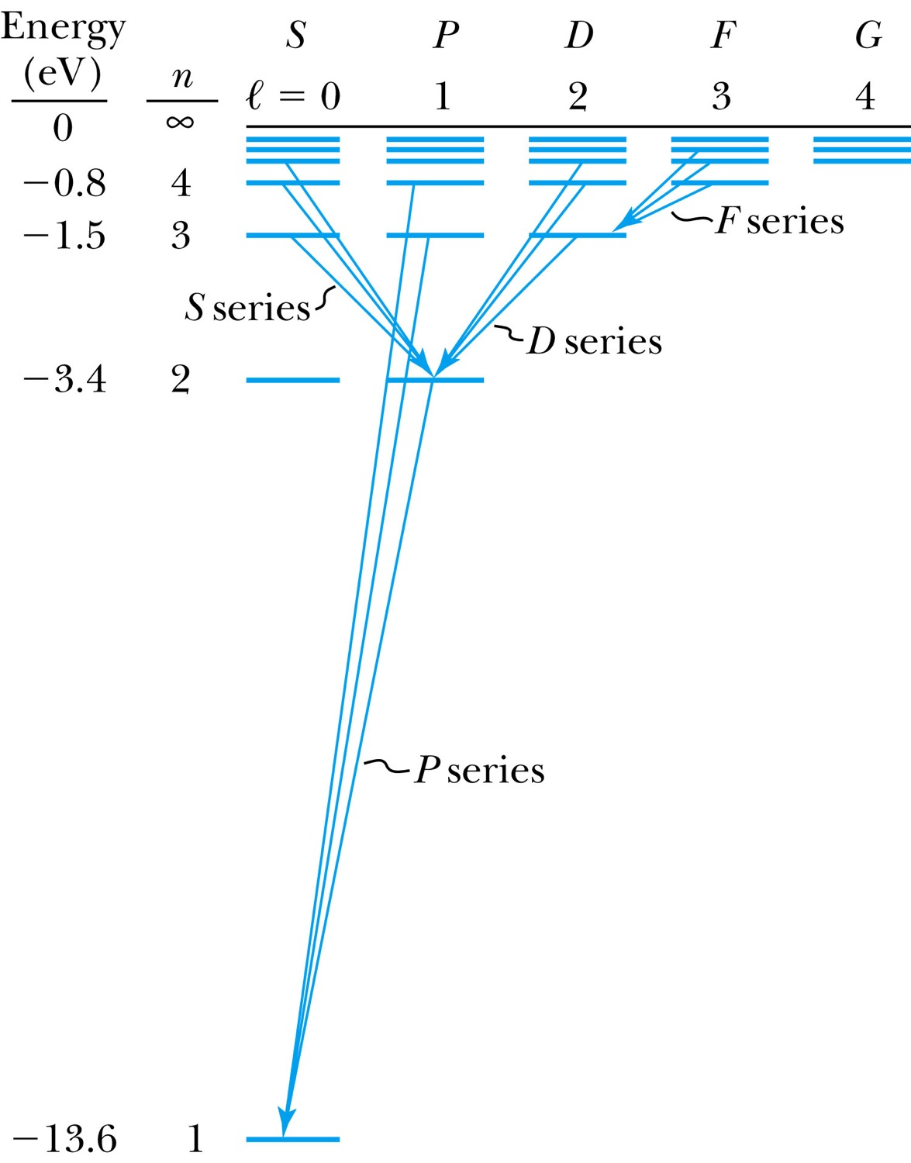
Energy Levels and Electron Probabilities
For hydrogen, the energy level depends on the principle quantum number n.
In ground state an atom cannot emit radiation. It can absorb electromagnetic radiation, or gain energy through inelastic bombardment by particles.

Slide 25
Selection Rules
We can use the wave functions to calculate transition probabilities for the electron to change from one state to another.
Allowed transitions: Electrons absorbing or emitting photons to change states when Δℓ = ±1.
Forbidden transitions:Other transitions possible but occur with much smaller probabilities when Δℓ ≠ ±1.
Δn=anything
Δℓ = ±1
Δm_{ℓ} 0, ±1

Slide 26
Probability Distribution Functions
We must use wave functions to calculate the probability distributions of the electrons.
The “position” of the electron is spread over space and is not well defined.
We may use the radial wave function R(r) to calculate radial probability distributions of the electron.
The probability of finding the electron in a differential volume element dτ is

Slide 27
Probability Distribution Functions
The differential volume element in spherical polar coordinates is
Therefore,
We are only interested in the radial dependence.
The radial probability density is P(r) = r²|R(r)|² and it depends only on n and l.

Slide 28
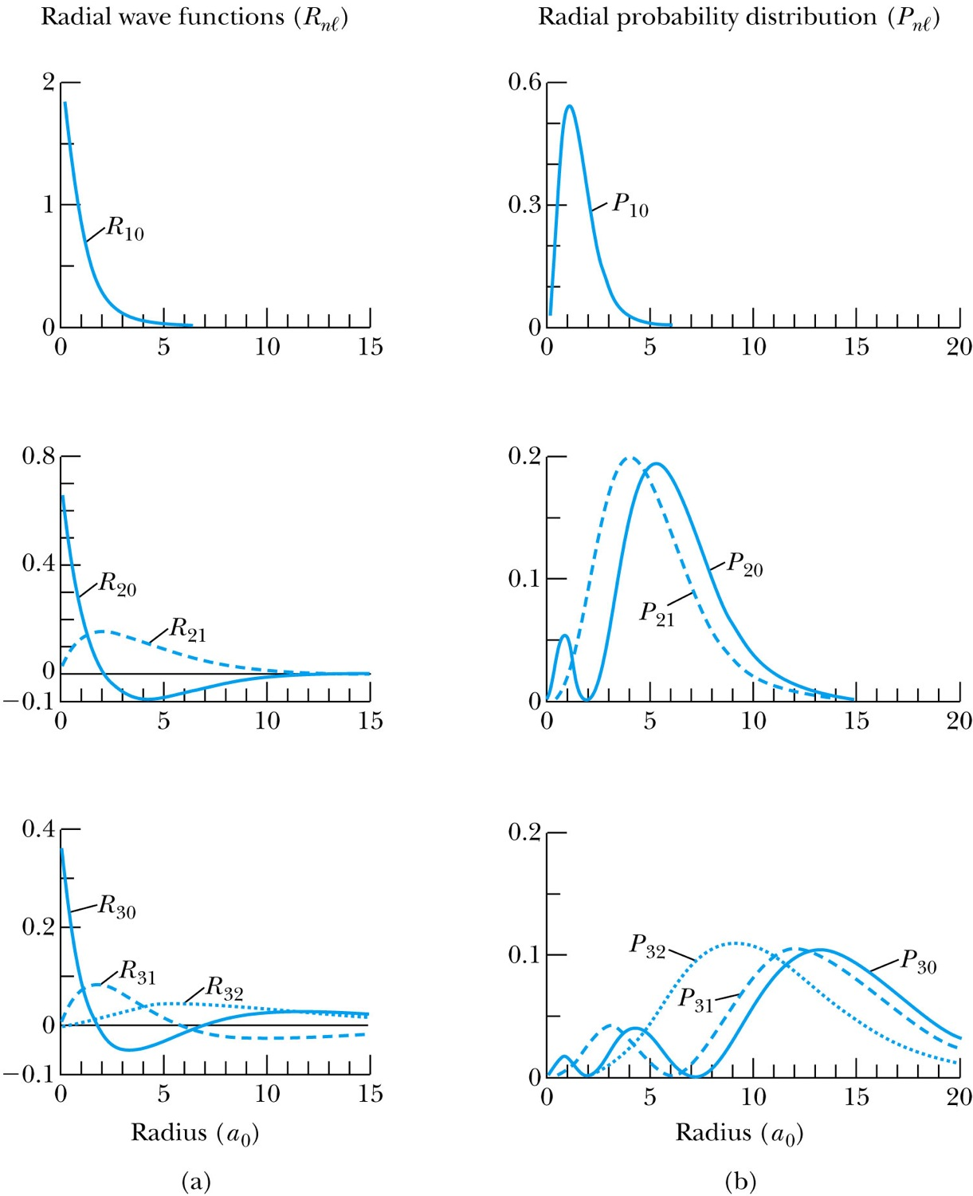
Probability Distribution Functions
R(r) and P(r) for the lowest-lying states of the hydrogen atom

Slide 29
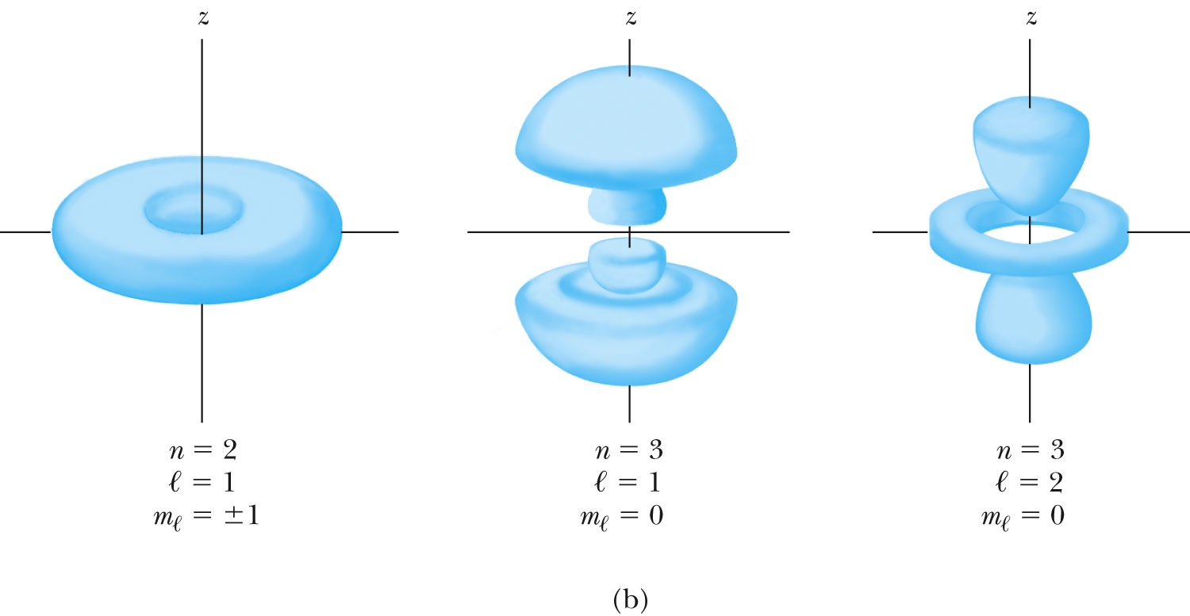
Probability Distribution Functions
The probability density for the hydrogen atom for three different electron states

