Slide 1
PHYS 3313 – Section 001
Lecture #19
Wednesday, Nov. 14, 2012
Dr. Jaehoon Yu
Historical Overview
Maxwell Velocity Distribution
Equipartition Theorem
Classical and Quantum Statistics
Fermi-Dirac Statistics
Quantum Theory of Conductivity
Bose-Einstein Statistics
Liquid Helium

Slide 2
Announcements
Reminder Homework #7
  CH7 end of chapter problems: 7, 8, 9, 12, 17 and 29
  Due on Monday, Nov. 19, in class
Reading assignments
  Entire CH8 (in particular CH8.1), CH9.4 and CH9.7
Class is cancelled Wednesday, Nov. 21
Please be sure to do class evaluations!Colloquium Wednesday
  At 4pm, Wednesday, Nov. 14, in SH101
  Dr. Masaya Takahashi of UT South Western Medical

Slide 3
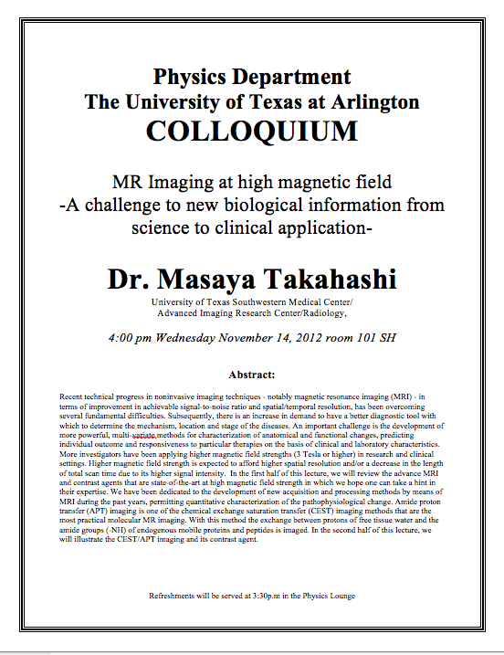

Slide 4
Why is statistical physics necessary?
Does physics perceive inherent uncertainty and indeterminism since everything is probabilistic?
Statistical physics is necessary since
  As simple problems as computing probability of coin toss is complex, so it is useful to reduce it to statistical terms
  When the number of particles gets large, it is rather impractical to describe the motion of individual particle than describing the motion of a group of particles
  Uncertainties are inherent as Heisenberg’s uncertainty principle showed and are of relatively large scale in atomic and subatomic level
Statistical physics necessary for atomic physics and the description of solid states which consists of many atoms

Slide 5
Historical Overview
Statistics and probability: New mathematical methods developed to understand the Newtonian physics through the eighteenth and nineteenth centuries.
Lagrange around 1790 and Hamilton around 1840: They added significantly to the computational power of Newtonian mechanics.
Pierre-Simon de Laplace (1749-1827)
  Had a view that it is possible to have a perfect knowledge of the universe
  Can predict the future and the past to the beginning of the universe
  He told Napoleon that the hypothesis of God is not necessary
  But he made major contributions to the theory of probability
Benjamin Thompson (Count Rumford): Put forward the idea of heat as merely the motion of individual particles in a substance but not well accepted
James Prescott Joule: Demonstrated experimentally the mechanical equivalence of heat and energy

Slide 6
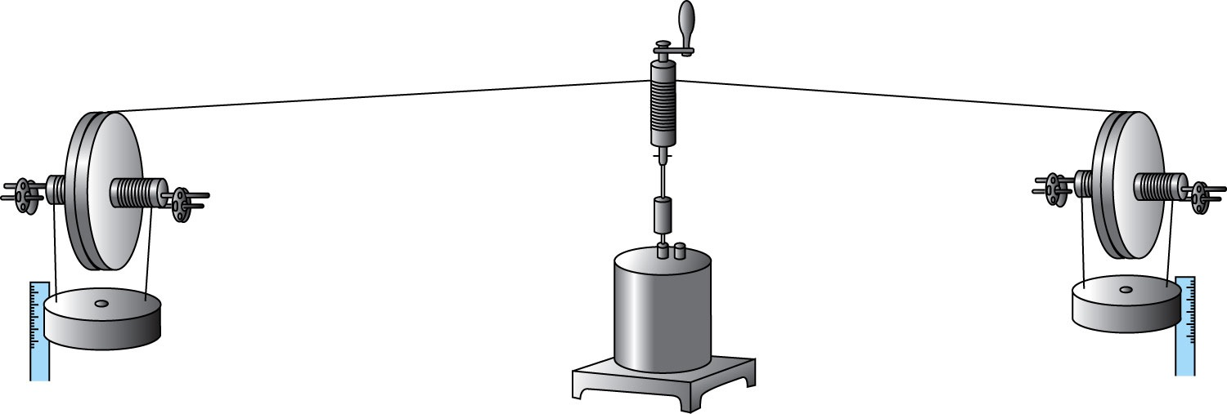
Joule’s experiment
Showed deterministically the equivalence of heat and energy
Dropping weight into the water and measuring the change of temperature of the water

Slide 7
Historical Overview
James Clark Maxwell
  Brought the mathematical theories of probability and statistics to bear on the physical thermodynamics problems
  Showed that distributions of an ideal gas can be used to derive the observed macroscopic phenomena
  His electromagnetic theory succeeded to the statistical view of thermodynamics
Einstein: Published a theory of Brownian motion, a theory that supported the view that atoms are real
Bohr: Developed atomic and quantum theory

Slide 8
Maxwell Velocity Distribution
Laplace claimed that it is possible to know everything about an ideal gas by knowing the position and velocity precisely
There are six parameters—the position (x, y, z) and the velocity (v_{x}, v_{y}, v_{z})—per molecule to know the position and instantaneous velocity of an ideal gas.
These parameters make up 6D phase space
The velocity components of the molecules are more important than positions, because the energy of a gas should depend only on the velocities.
Define a velocity distribution function = the probability of finding a particle with velocity between where

Slide 9
Maxwell Velocity Distribution
Maxwell proved that the probability distribution function is proportional to
Therefore .
where C is a proportionality constant and β ≡ (kT)⁻¹.
Because v² = v_{x}² + v_{y}² + v_{z}²,
Rewrite this as the product of three factors (i.e. probability density).

Slide 10
The solution
Since the probability is 1 when integrated over entire space, we obtain
Thus
The average velocity in x direction is
The average of the square of the velocity in x direction is
Where T is the absolute temperature (temp in C+273), m is the molecular mass and k is the Boltzman constant
Solve for C’

Slide 11
Maxwell Velocity Distribution
The results for the x, y, and z velocity components are identical.
The mean translational kinetic energy of a molecule:
Purely statistical considerations is good evidence of the validity of this statistical approach to thermodynamics.
Note no dependence of the formula to the mass!!

Slide 12
Ex 9.1: Molecule Kinetic Energy
Compute the mean translational KE of (a) a single ideal gas molecule in eV and (b) a mol of ideal gas in J at room temperature 20ºC.
What is the mean translational KE of 1kg of steam at 1atm at 100ºC, assuming an ideal gas?
Water molecule is 18g/mol.

Slide 13
Equipartition Theorem
The formula for average kinetic energy 3kT/2 works for monoatomic molecule what is it for diatomic molecule?
Consider oxygen molecule as two oxygen atoms connected by a massless rod ➔ This will have both translational and rotational energy
How much rotational energy is there and how is it related to temperature?
Equipartition Theorem:
  In equilibrium a mean energy of ½ kT per molecule is associated with each independent quadratic term in the molecule’s energy.
  Each independent phase space coordinate: degree of freedom
  Essentially the mean energy of a molecule is ½ kT *NDoF

Slide 14
Equipartition Theorem
In a monatomic ideal gas, each molecule has
There are three degrees of freedom.
Mean kinetic energy is
In a gas of N helium molecules, the total internal energy is
The heat capacity at constant volume is
For the heat capacity for 1 mole,
using the ideal gas constant R = 8.31 J/K.

Slide 15
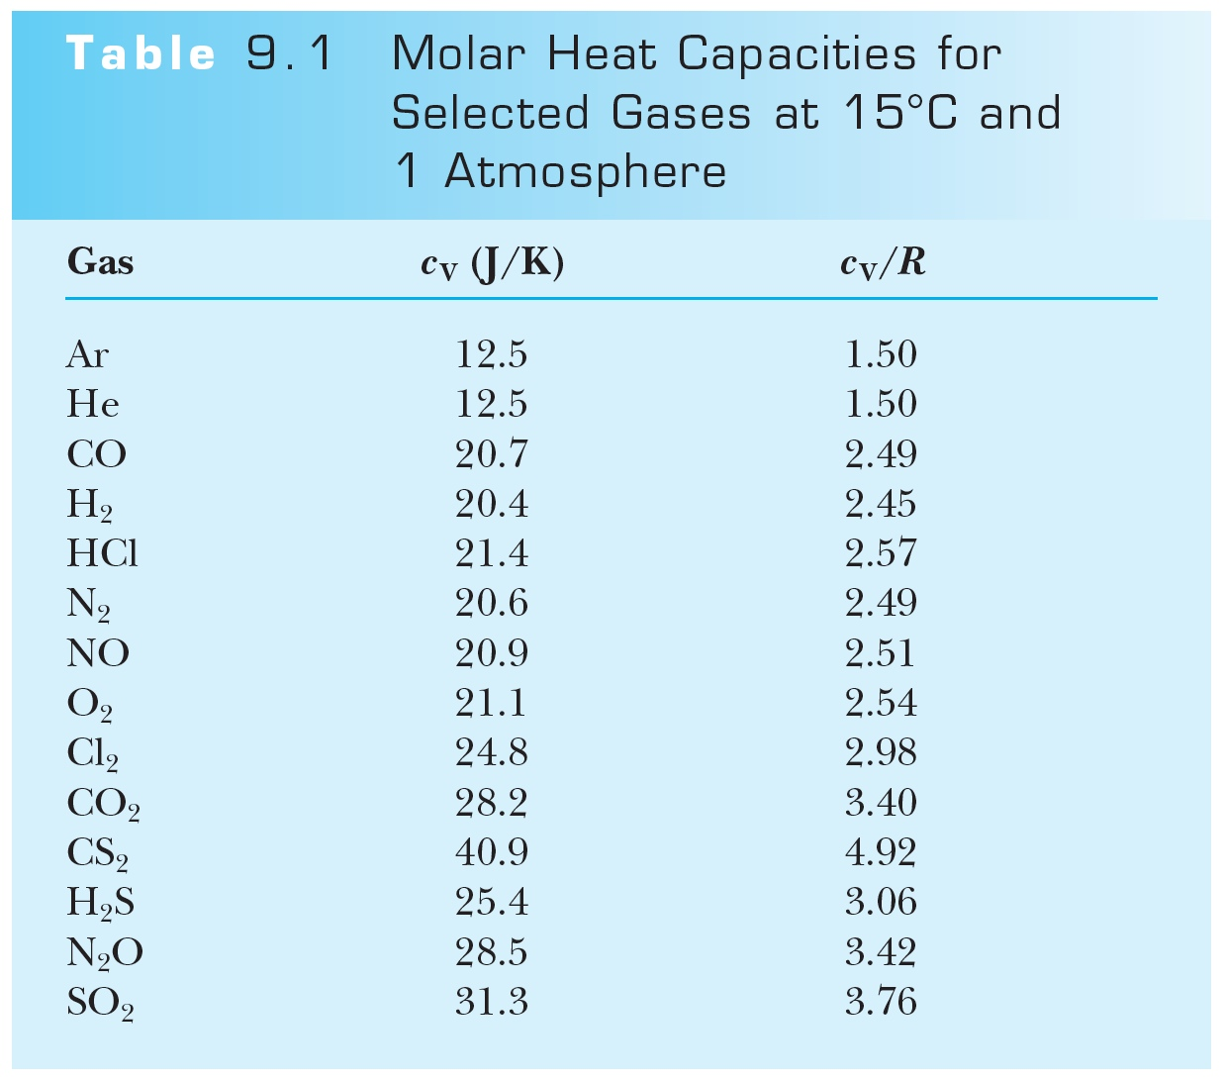
Table of Measured Gas Heat Capacities

Slide 16
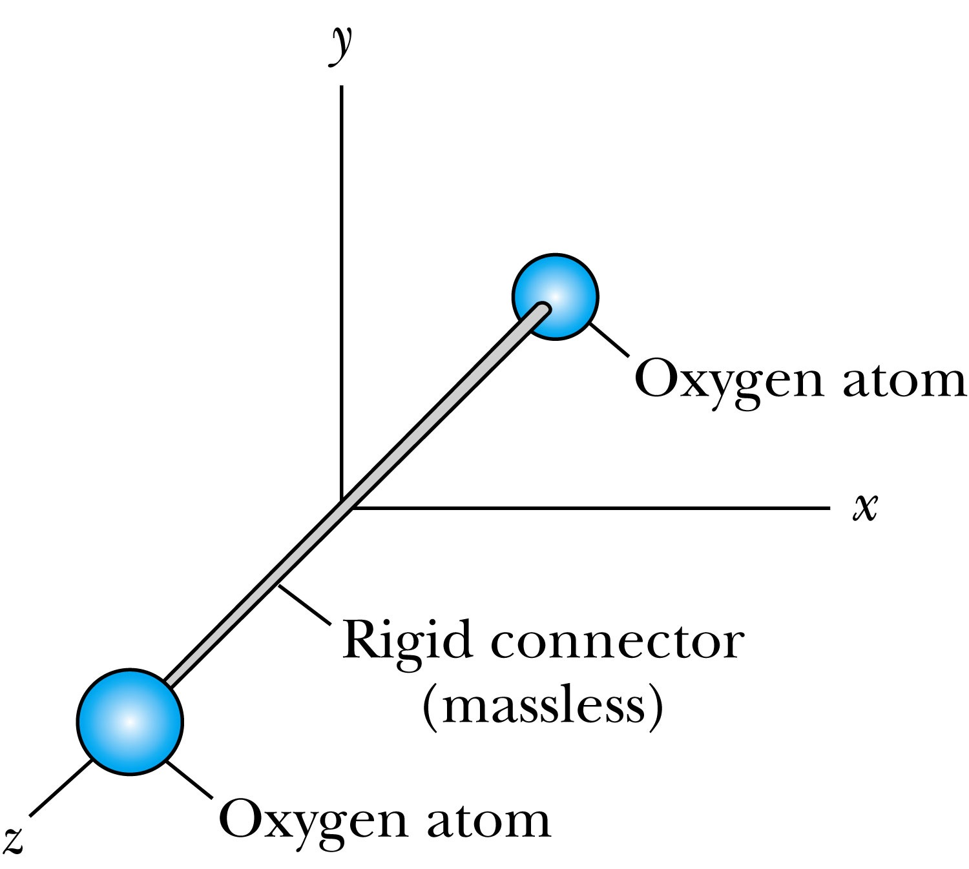
The Rigid Rotator Model
For diatomic gases, consider the rigid rotator model.
The molecule rotates about either the x or y axis.
The corresponding rotational energies are
There are five degrees of freedom (three translational and two rotational)➔ resulting in mean energy of 5kT/2 per molecule according to equi-partition principle (C_{V}=5R/2)

Slide 17
Equipartition Theorem
From previous chapter, the mass of an atom is confined to a nucleus that magnitude is smaller than the whole atom.
  I_{z} is smaller than I_{x} and I_{y}.
  Only rotations about x and y are allowed.
In some circumstances it is better to think of atoms connected to each other by a massless spring.
The vibrational kinetic energy is
There are seven degrees of freedom (three translational, two rotational, and two vibrational). ➔ 7kT/2 per molecule
While it works pretty well, the simple assumptions made for equi-partition principle, such as massless connecting rod, is not quite sufficient for detailed molecular behaviors

Slide 18
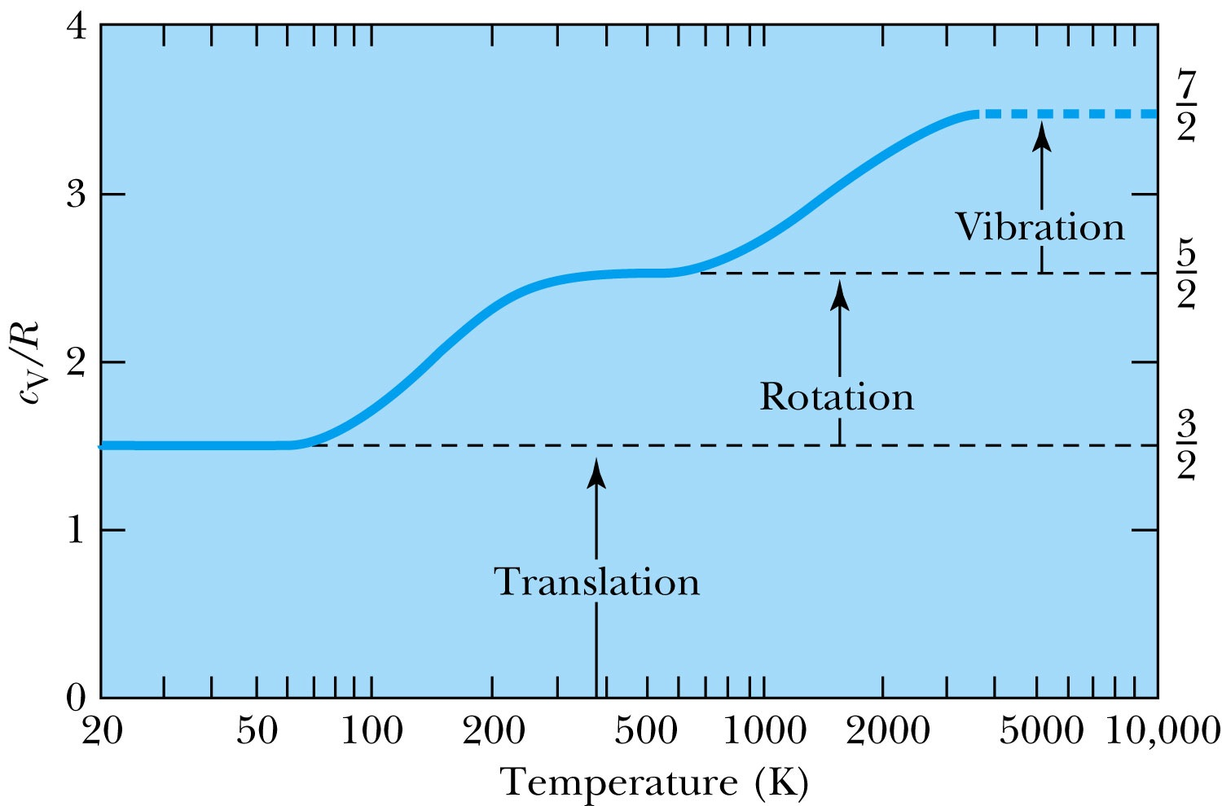
Molar Heat Capacity
The heat capacities of diatomic gases are temperature dependent, indicating that the different degrees of freedom are “turned on” at different temperatures.
Example of H₂

Slide 19
Classical and Quantum Statistics
In gas, particles are so far apart, they do not interact substantially ➔ even if they collide, they can be considered as elastic and do not affect the mean values
If molecules, atoms, or subatomic particles are in the liquid or solid state, the Pauli exclusion principle* prevents two particles with identical quantum states from sharing the same space ➔ limits available energy states in quantum systems
  Recall there is no restriction on particle energies in classical physics.
This affects the overall distribution of energies
*Pauli Exclusion Principle: No two electrons in an atom may have the same set of quantum numbers

Slide 20
Classical Distributions
Rewrite Maxwell speed distribution in terms of energy.
  Probability for finding a particle between speed v and v+dv
For a monatomic gas the energy is all translational kinetic energy.
where

Slide 21
Classical Distributions
Boltzmann showed that the statistical factor exp(−βE) is a characteristic of any classical system.
  regardless of how quantities other than molecular speeds may affect the energy of a given state
Maxwell-Boltzmann factor for classical system:
The energy distribution for classical system:
n(E) dE: the number of particles with energies between E and E + dE
g(E): the density of states, is the number of states available per unit energy range
F_{MB}: the relative probability that an energy state is occupied at a given temperature

Slide 22
Quantum Distributions
  Identical particles cannot be distinguished if their wave functions overlap significantly
  Characteristic of indistinguishability that makes quantum statistics different from classical statistics.
Consider two distinguishable particles in two different energy state with the same probability (0.5 each)
The possible configurations are
Since the four states are equally likely, the probability of each state is one-fourth (0.25).
E1 | E2
A, B
A | B
B | A
 | A, B

Slide 23
Quantum Distributions
If the two particles are indistinguishable:
There are only three possible configurations
Thus the probability of each is one-third (~0.33).
Because some particles do not obey the Pauli exclusion principle, two kinds of quantum distributions are needed.
Fermions: Particles with half-spins (1/2) that obey the Pauli principle.
  Examples?
Bosons: Particles with zero or integer spins that do NOT obey the Pauli principle.
  Examples?
State 1 | State 2
XX
X | X
 | XX
Electron, proton, neutron, any atoms or molecules with odd number of fermions
Photon, force mediators, pions, any atoms or molecules with even number of fermions

Slide 24
Quantum Distributions
Fermi-Dirac distribution:
where
Bose-Einstein distribution:
where
B_{i} (i = FD or BE) is a normalization factor.
Both distributions reduce to the classical Maxwell-Boltzmann distribution when B_{i} exp(βE) is much greater than 1.
  the Maxwell-Boltzmann factor A exp(−βE) is much less than 1.
  In other words, the probability that a particular energy state will be occupied is much less than 1!

Slide 25
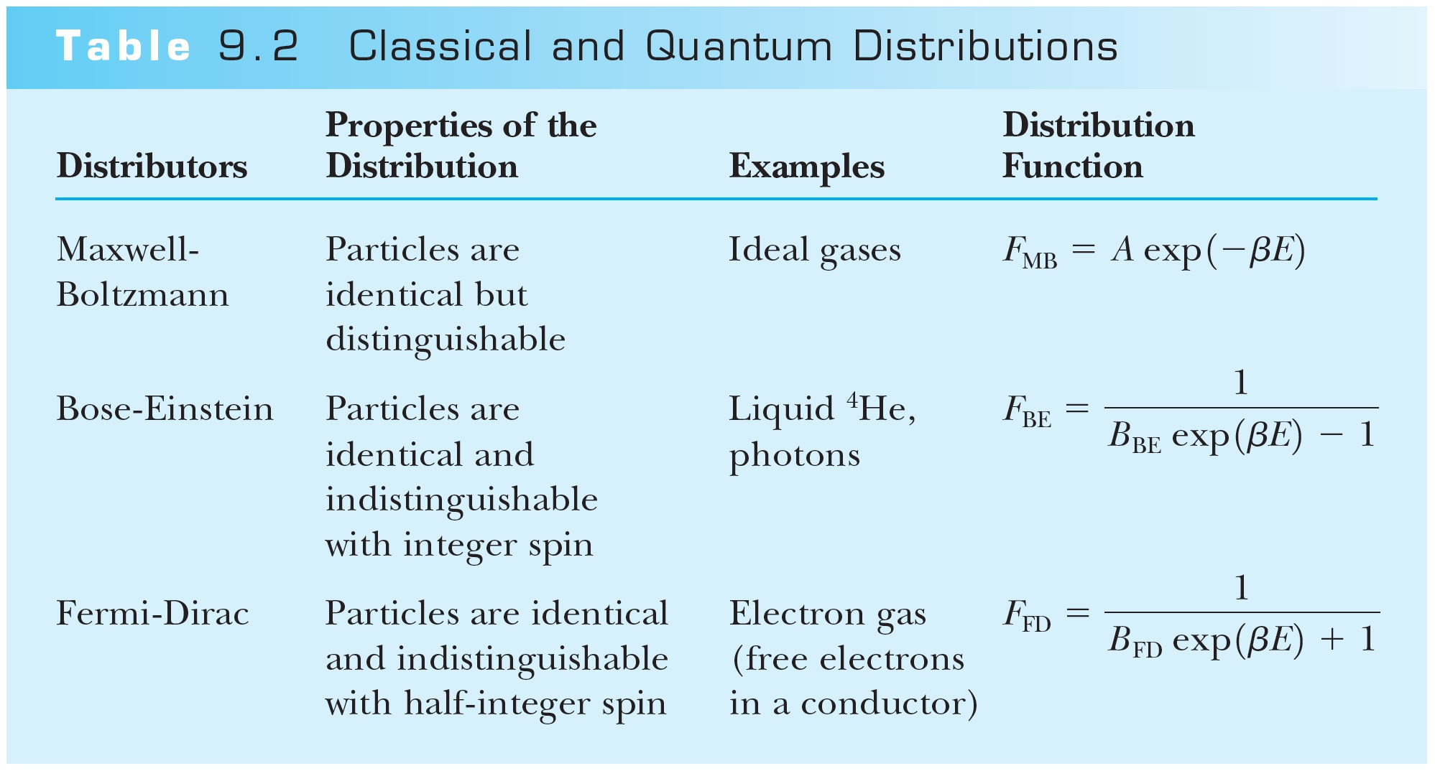
Summary of Classical and Quantum Distributions

Slide 26
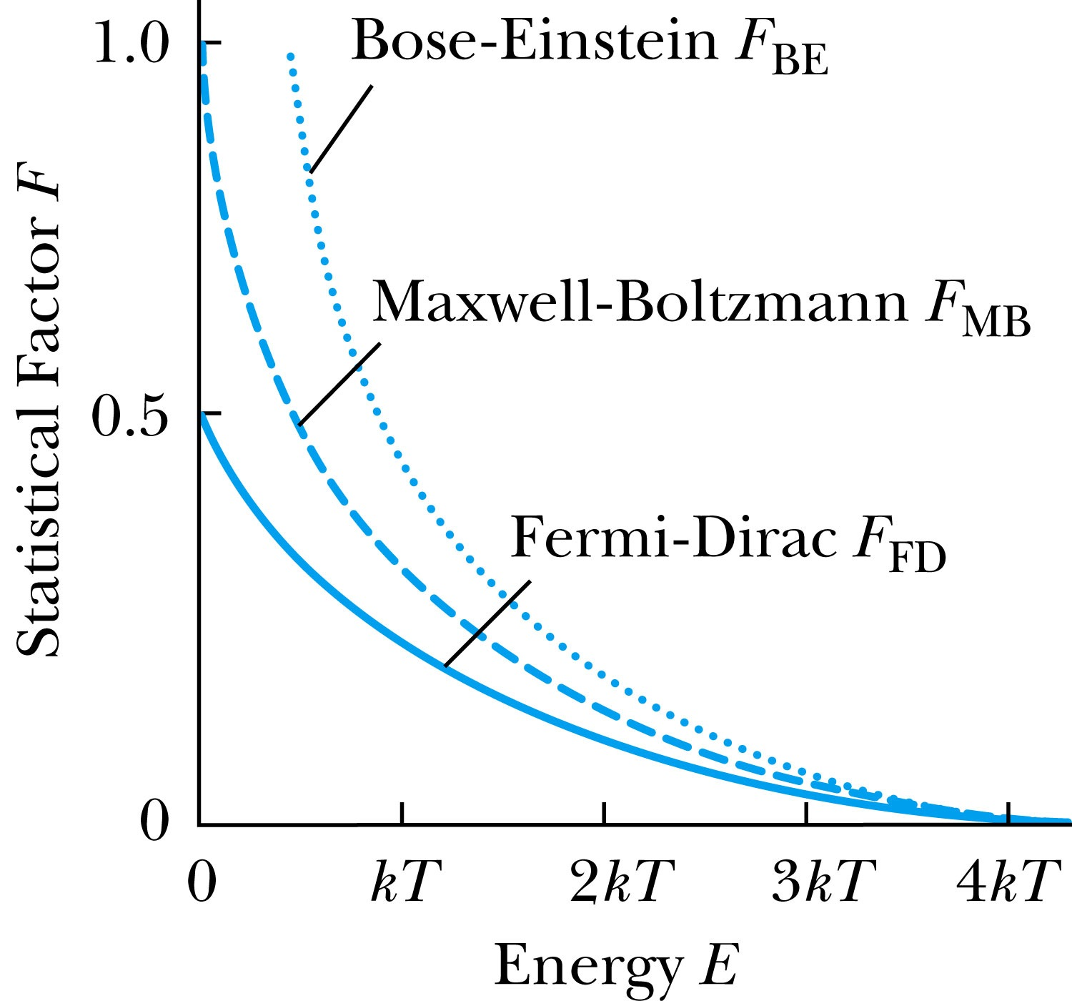
Quantum Distributions
The normalization constants for the distributions depend on the physical system being considered.
Because bosons do not obey the Pauli exclusion principle, more bosons can fill lower energy states.
Three graphs coincide at high energies – the classical limit.
Maxwell-Boltzmann statistics may be used in the classical limit.

Slide 27
Fermi-Dirac Statistics
This is most useful for electrical conduction
The normalization factor B_{FD}
  Where E_{F} is called the Fermi energy.
The Fermi-Dirac Factor becomes
When E = E_{F}, the exponential term is 1. ➔F_{FD} =1/2
In the limit as T → 0,
At T = 0, fermions occupy the lowest energy levels available to them
  Since they cannot all fill the same energy due to Pauli Exclusion principle, they will fill the energy states up to Fermi Energy
Near T = 0, there is little chance that thermal agitation will kick a fermion to an energy greater than E_{F}.

Slide 28
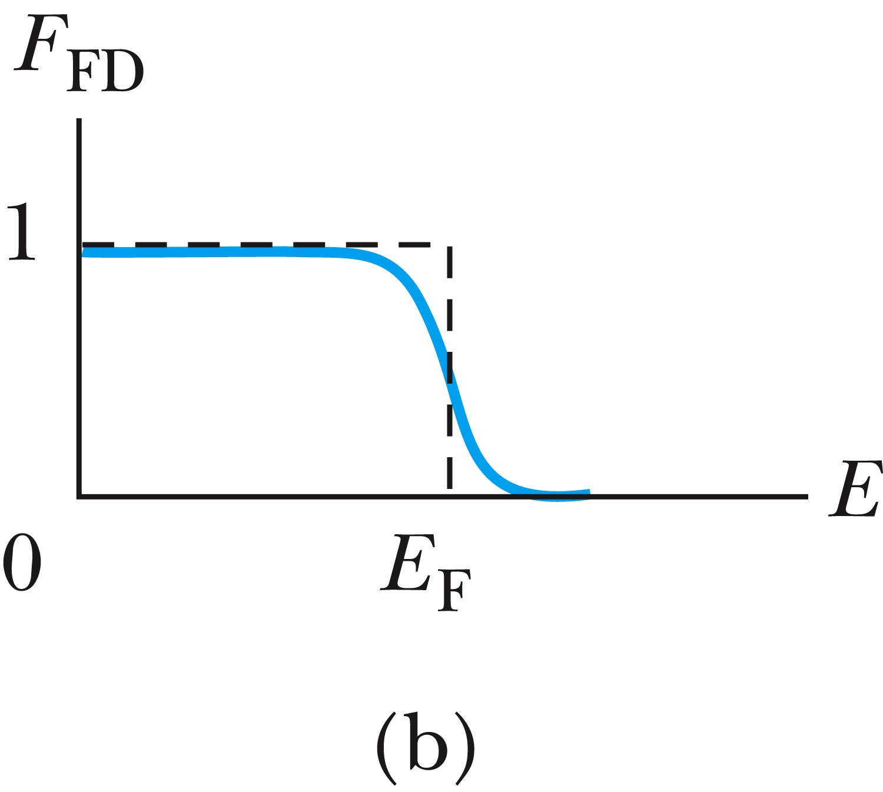
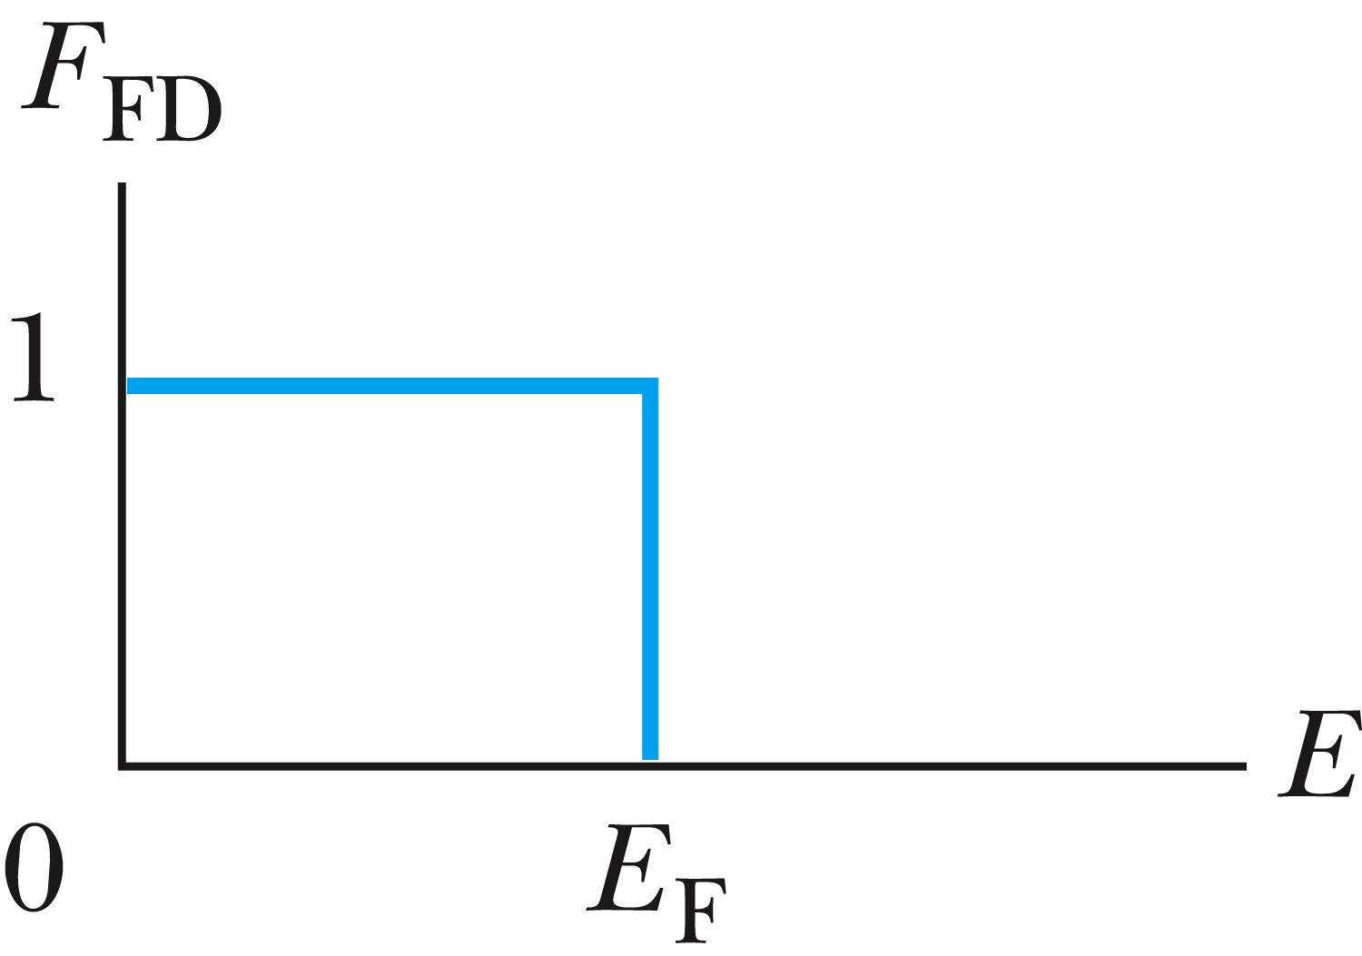
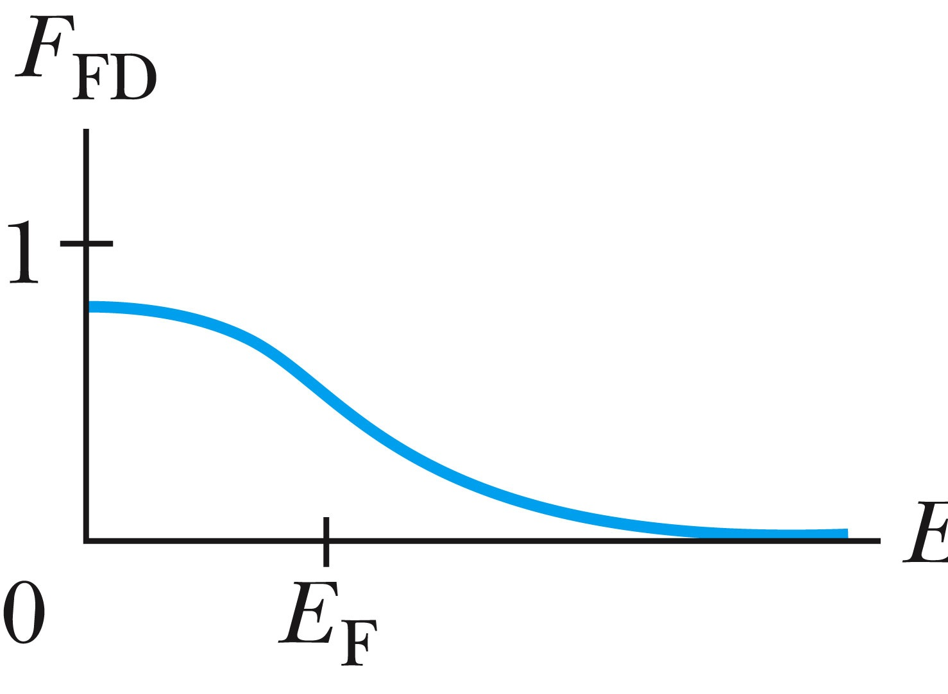
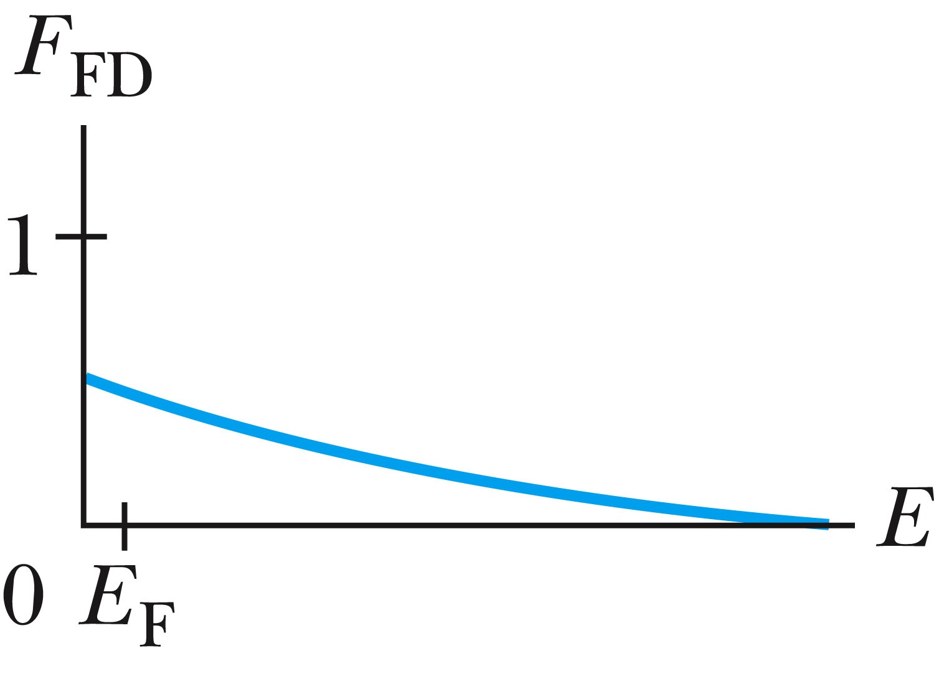
Fermi-Dirac Statistics
T > 0
T = 0
As the temperature increases from T = 0, the Fermi-Dirac factor “smears out”, and more fermions jump to higher energy level above Fermi energy
We can define Fermi temperature, defined as T_{F} ≡ E_{F} / k
T = T_{F}
T >> T_{F}
When T >> T_{F}, F_{FD} approaches a simple decaying exponential

Slide 29
Classical Theory of Electrical Conduction
Paul Drude (1900) showed that the current in a conductor should be linearly proportional to the applied electric field that is consistent with Ohm’s law.
Prediction of the electrical conductivity
Mean free path is
True electrical conductivity:
According to the Drude model, the conductivity should be proportional to T^{−1/2}.
But for most conductors is very nearly proportional to T⁻¹
The heat capacity of the electron gas is R.
This is not consistent with experimental results.

Slide 30
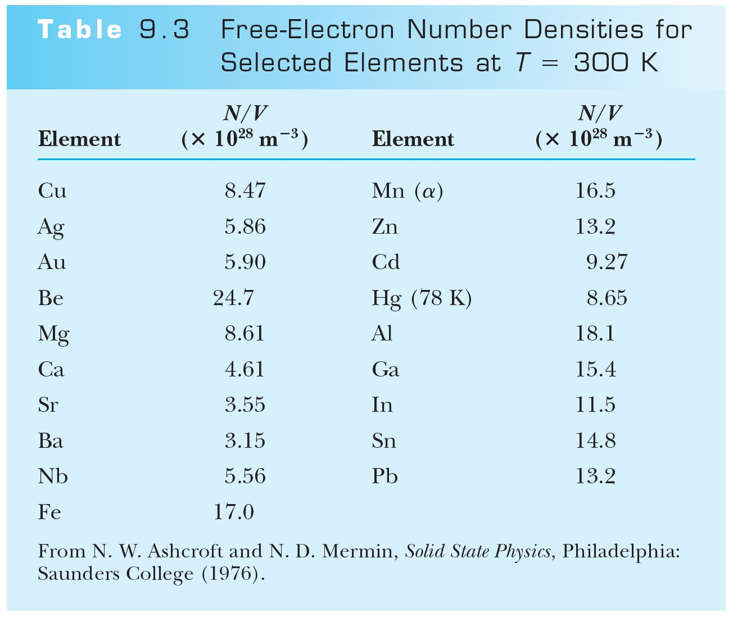
Free Electron Number Density
Table 9-3 p319

Slide 31

Quantum Theory of Electrical Conduction
Arnold Sommerfield used correct distribution n(E) at room temperature and found a value for α of π² / 4.
With the value T_{F} = 80,000 K for copper, we obtain c_{V} ≈ 0.02R, which is consistent with the experimental value! Quantum theory has proved to be a success.
Replace mean speed in the previous page by Fermi speed u_{F} defined from .
Conducting electrons are loosely bound to their atoms
  these electrons must be at the high energy level
  at room temperature the highest energy level is close to the Fermi energy
We should use

Slide 32
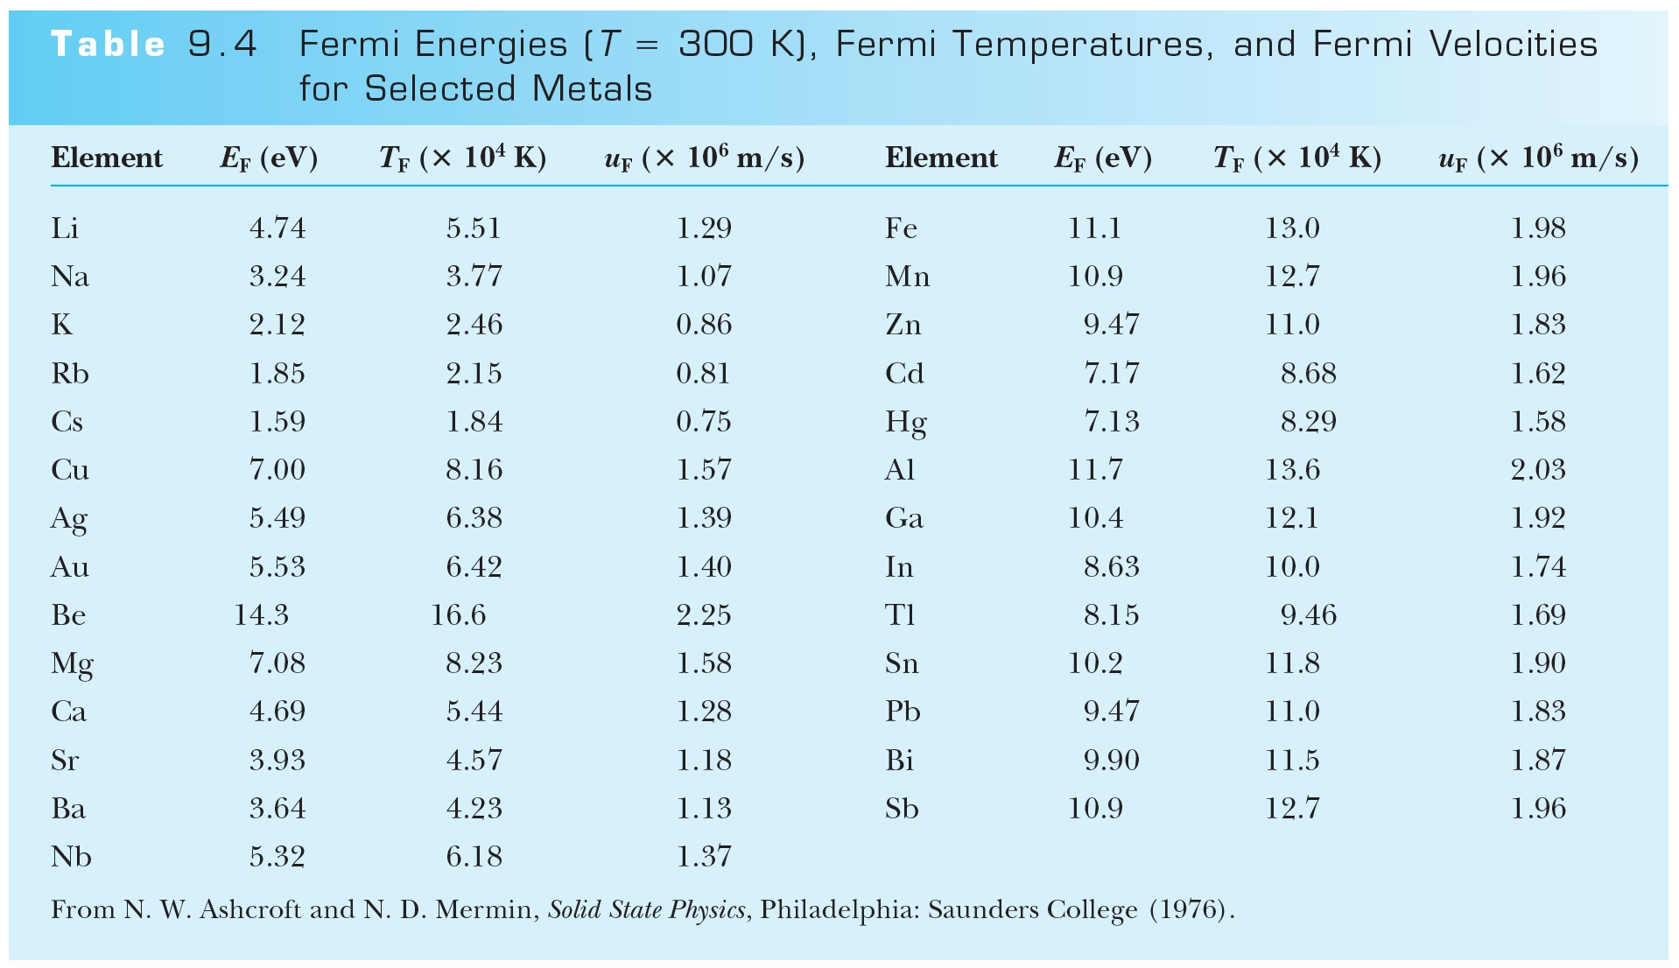
Fermi energies, temperatures and velocities
Table 9-4 p319

Slide 33
Quantum Theory of Electrical Conduction
Drude thought that the mean free path could be no more than several tenths of a nanometer, but it was longer than his estimation.
Einstein calculated the value of ℓ to be on the order of 40 nm in copper at room temperature.
The conductivity is
Sequence of proportions

Slide 34
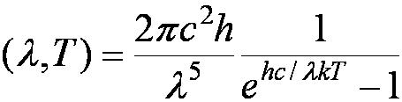

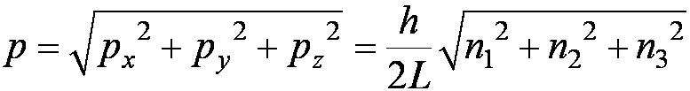
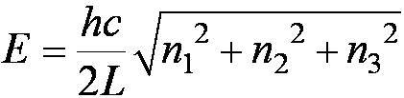
Bose-Einstein Statistics
Blackbody Radiation
Intensity of the emitted radiation is
Use the Bose-Einstein distribution because photons are bosons with spin 1.
For a free particle in terms of momentum:
The energy of a photon is pc, so

Slide 35
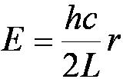
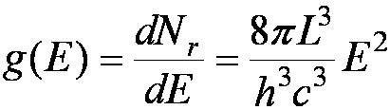
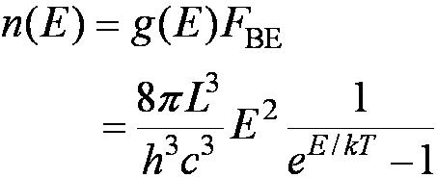
Bose-Einstein Statistics
The number of allowed energy states within “radius” r is
Where 1/8 comes from the restriction to positive values of n_{i} and 2 comes from the fact that there are two possible photon polarizations.
Energy is proportional to r,
The density of states g(E) is
The Bose-Einstein factor:

Slide 36
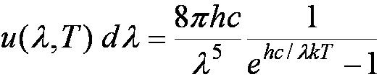
Bose-Einstein Statistics
Convert from a number distribution to an energy density distribution u(E).
  Multiply by a factor E/L³
  For all photons in the range E to E + dE
Using E = hc/λ and |dE| = (hc/λ²) dλ
In the SI system, multiplying by c/4 is required.

Slide 37
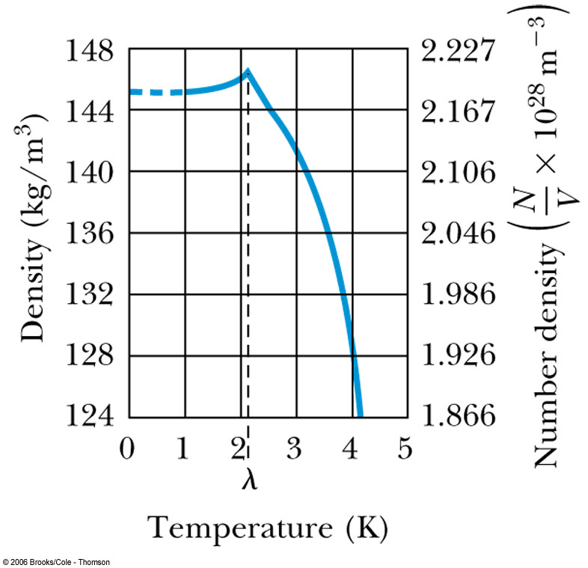
Liquid Helium
Has the lowest boiling point of any element (4.2 K at 1 atmosphere pressure) and has no solid phase at normal pressure
The density of liquid helium as a function of temperature:

Slide 38
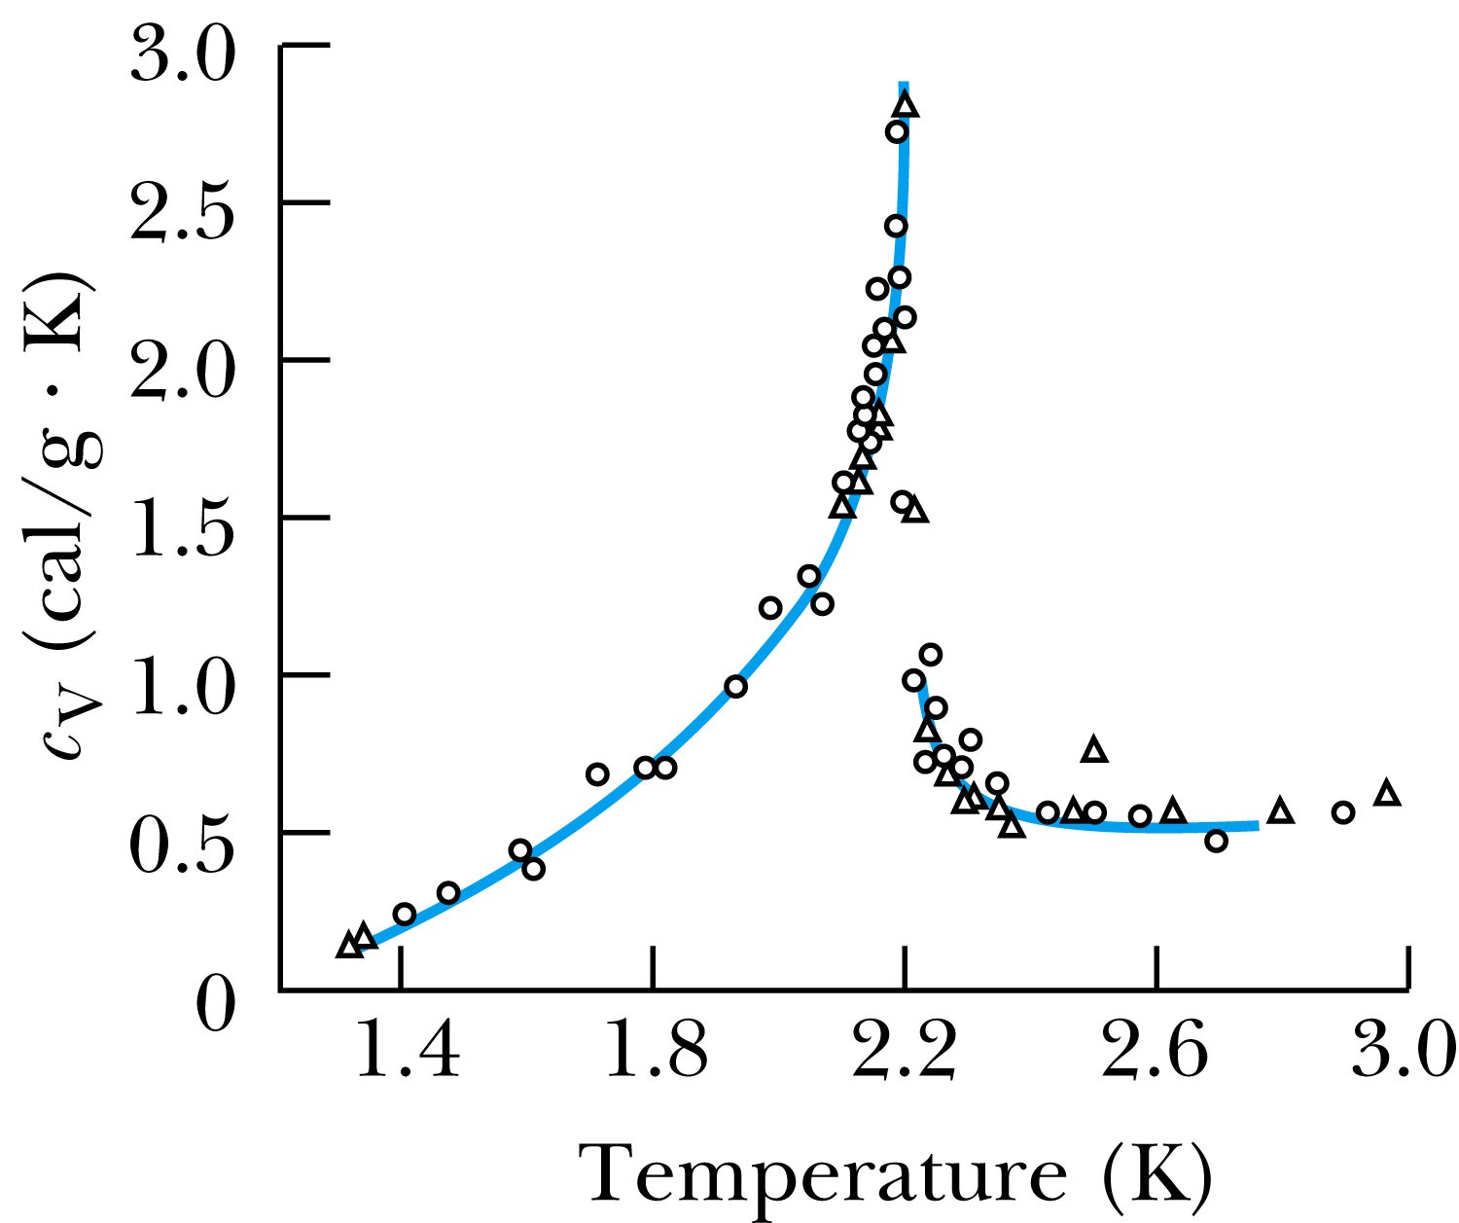
Liquid Helium
The specific heat of liquid helium as a function of temperature:
The temperature at about 2.17 K is referred to as the critical temperature (T_{c}), transition temperature, or lambda point.
As the temperature is reduced from 4.2 K toward the lambda point, the liquid boils vigorously. At 2.17 K the boiling suddenly stops.
What happens at 2.17 K is a transition from the normal phase to the superfluid phase.

Slide 39
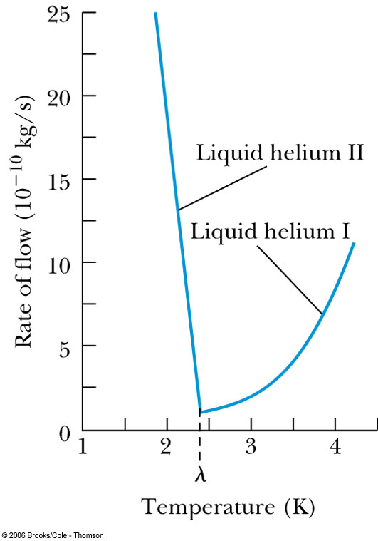
Liquid Helium
The rate of flow increases dramatically as the temperature is reduced because the superfluid has a low viscosity.
Creeping film – formed when the viscosity is very low

Slide 40
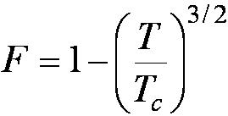
Liquid Helium
Fritz London claimed (1938) that liquid helium below the lambda point is part superfluid and part normal.
  As the temperature approaches absolute zero, the superfluid approaches 100% superfluid.
The fraction of helium atoms in the superfluid state:
Superfluid liquid helium is referred to as a Bose-Einstein condensation.
  not subject to the Pauli exclusion principle
  all particles are in the same quantum state

Slide 41
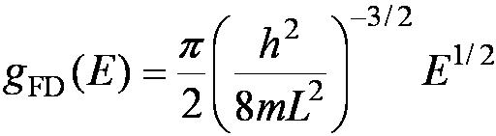
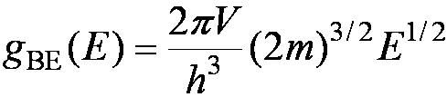
Liquid Helium
Such a condensation process is not possible with fermions because fermions must “stack up” into their energy states, no more than two per energy state.
⁴He isotope is a fermion and superfluid mechanism is radically different than the Bose-Einstein condensation.
Use the fermions’ density of states function and substituting for the constant E_{F} yields
Bosons do not obey the Pauli principle, therefore the density of states should be less by a factor of 2.

Slide 42
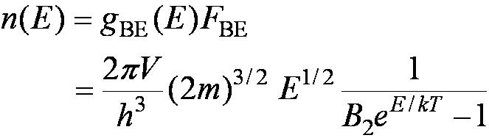
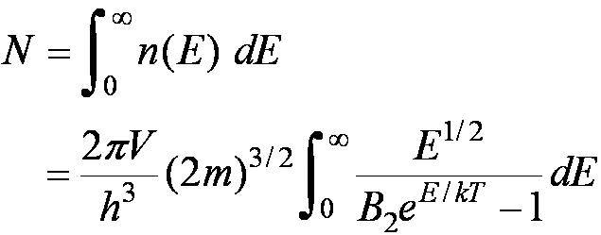
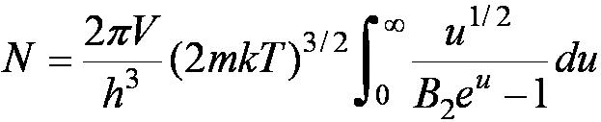
Liquid Helium
m is the mass of a helium atom.
The number distribution n(E) is now
In a collection of N helium atoms the normalization condition is
Substituting u = E / kT,

Slide 43
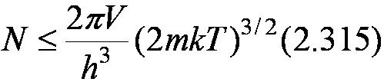
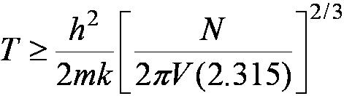
Liquid Helium
Use minimum value of B_{BE} = 1; this result corresponds to the maximum value of N.
Rearrange this,
The result is T ≥ 3.06 K.
The value 3.06 K is an estimate of T_{c}.

Slide 44
Bose-Einstein Condensation in Gases
By the strong Coulomb interactions among gas particles it was difficult to obtain the low temperatures and high densities needed to produce the condensate. Finally success was achieved in 1995.
First, they used laser cooling to cool their gas of ⁸⁷Rb atoms to about 1 mK. Then they used a magnetic trap to cool the gas to about 20 nK. In their magnetic trap they drove away atoms with higher speeds and further from the center. What remained was an extremely cold, dense cloud at about 170 nK.

