Slide 1
PHYS 3313 – Section 001
Lecture #20
Monday, Nov. 19, 2012
Dr. Jaehoon Yu
Liquid Helium
Bose-Einstein Condensation
Laser and Holography
Superconductivity

Slide 2
Announcements
Remember the deadline for your research paper, Monday, Nov. 26!!
Your presentations are in classes on Dec. 3 and Dec. 5
  All presentation ppt files must be sent to me by 8pm Sunday, Dec. 2
Final exam is 11am – 1:30pm, Monday, Dec. 10
Reading assignments
  CH10.1, 10.3 and 10.4
No regular colloquium this week
Quiz Monday, Nov. 26
No class this Wednesday! Happy Thanksgiving!
Class feedback today!!

Slide 3
Research Project Report
Must contain the following at the minimum
  Original theory or Original observation
  Experimental proofs or Theoretical prediction + subsequent experimental proofs
  Importance and the impact of the theory/experiment
  Conclusions
Each member of the group writes a 10 (max) page report, including figures
  10% of the total grade
  Can share the theme and facts but you must write your own!
  Text of the report must NOT be a copy
  Due Mon., Nov. 26, 2012

Slide 4
Research Presentations
Each of the 10 research groups makes a 10min presentation
  8min presentation + 2min Q&A
  All presentations must be in power point
  I must receive all final presentation files by 8pm, Sunday, Dec. 2
    No changes are allowed afterward
  The representative of the group makes the presentation followed by all group members’ participation in the Q&A session
Date and time:
  In class Monday, Dec. 3 or in class Wednesday, Dec. 5
Important metrics
  Contents of the presentation: 60%
    Inclusion of all important points as mentioned in the report
    The quality of the research and making the right points
  Quality of the presentation itself: 15%
  Presentation manner: 10%
  Q&A handling: 10%
  Staying in the allotted presentation time: 5%
  Judging participation and sincerity: 5%

Slide 5
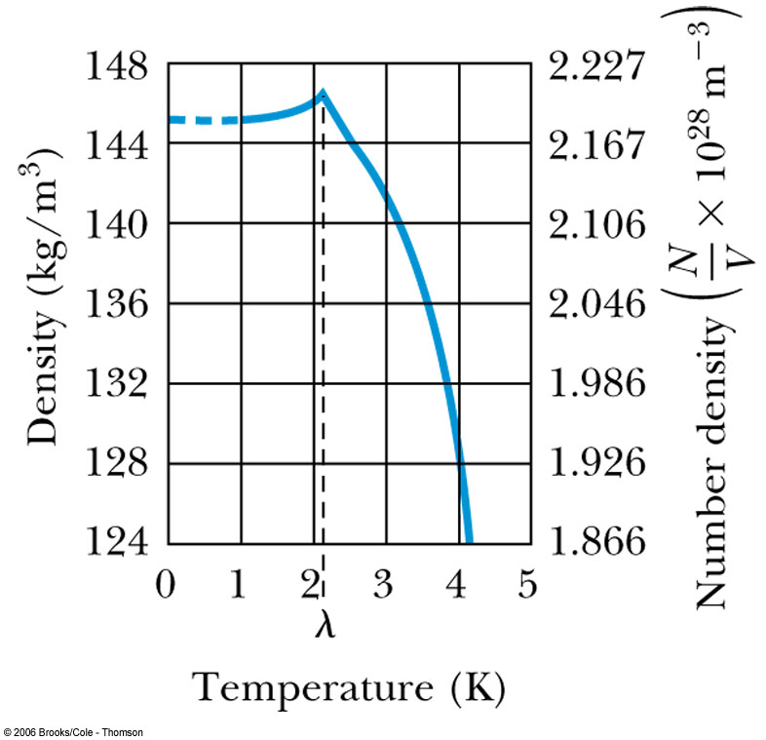
Liquid Helium
Has the lowest boiling point of any element (4.2 K at 1 atmosphere pressure) and has no solid phase at normal pressure
Helium is so light and has high speed and so escapes out side of the Earth atmosphere ➔ Must be captured from underground

Slide 6
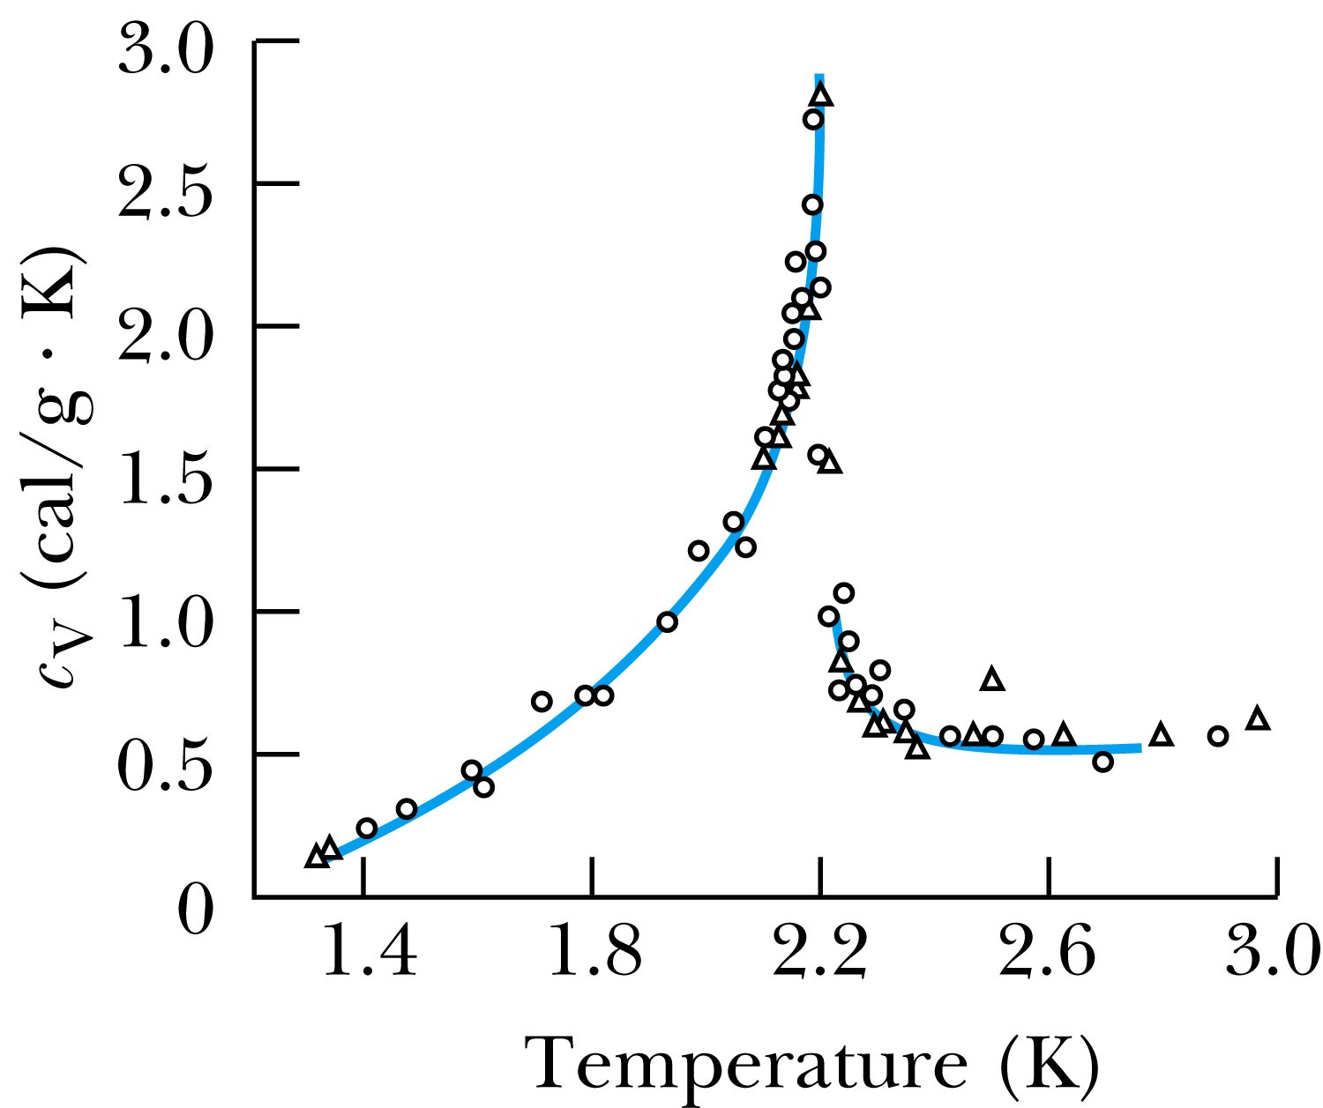
Liquid Helium
The specific heat of liquid helium as a function of temperature
The temperature at about 2.17 K is referred to as the critical temperature (T_{c}), transition temperature, or lambda point.
As the temperature is reduced from 4.2 K toward the lambda point, the liquid boils vigorously. At 2.17 K the boiling suddenly stops.
What happens at 2.17 K is a transition from the normal phase to the superfluid phase.

Slide 7
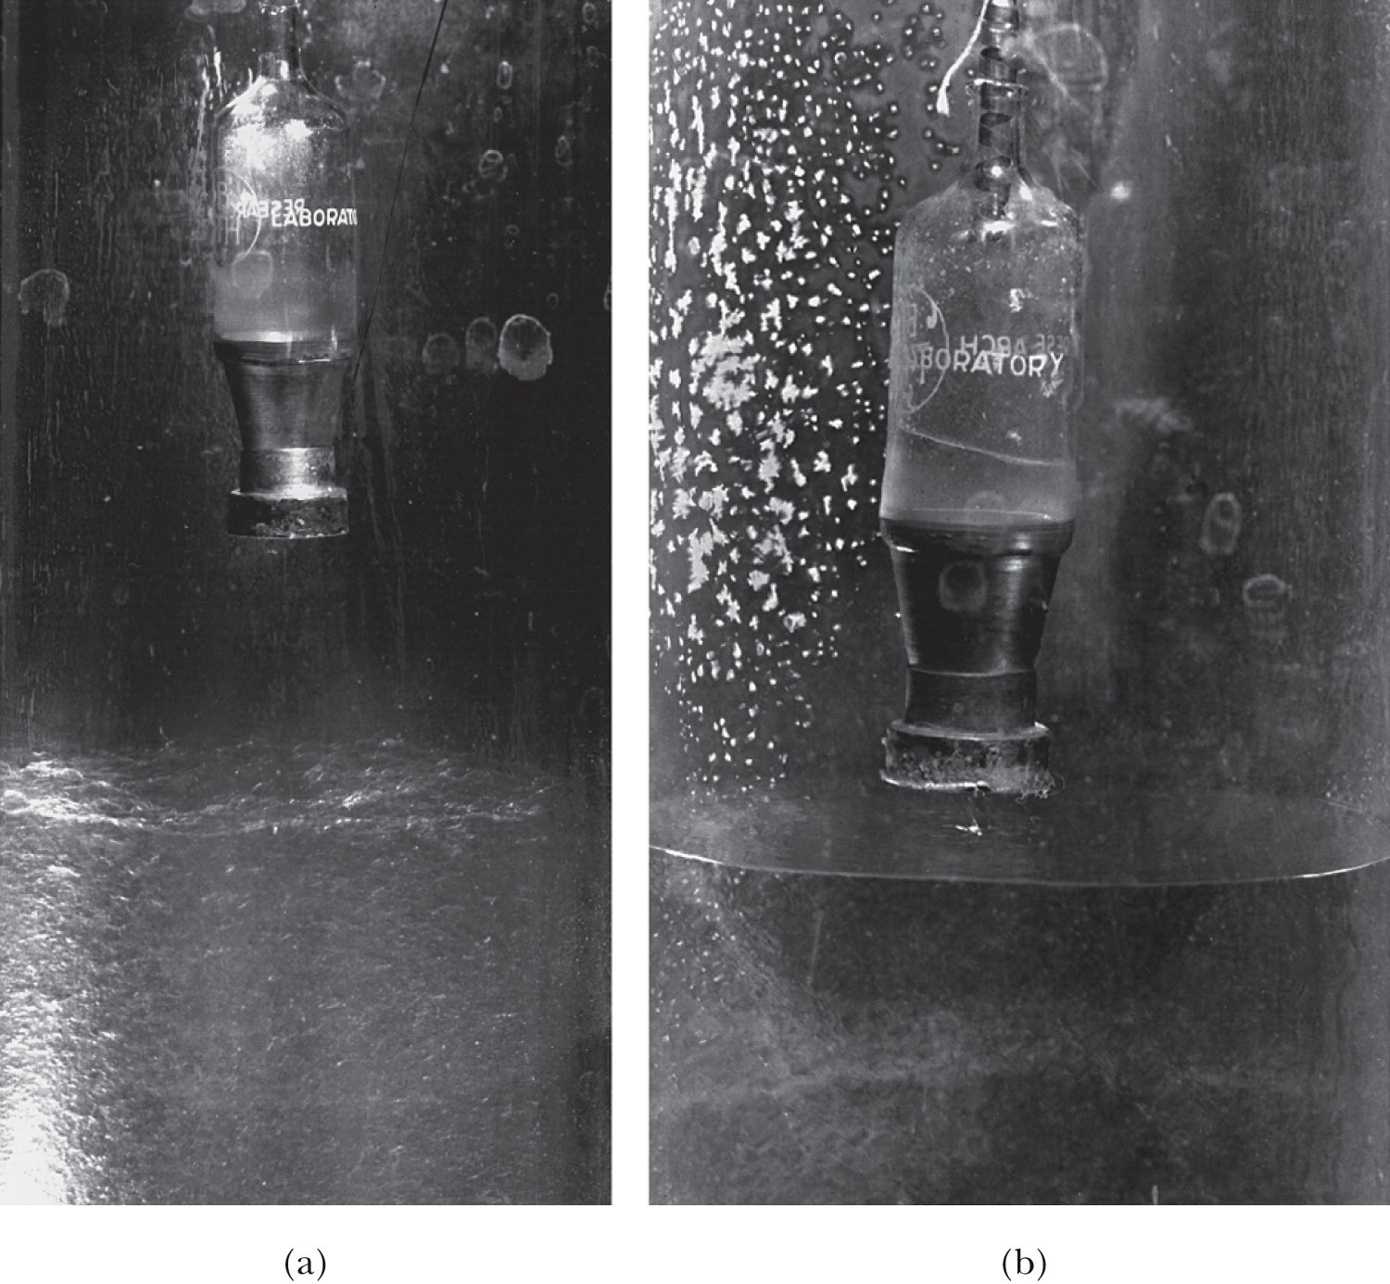
He Transition to Superfluid State
T>T_{c}
T<T_{c}
Vessel with very fine holes that do not allow passage of normal liquid
See the liquid here
Boiling surface
Calm surface below 2.17K

Slide 8
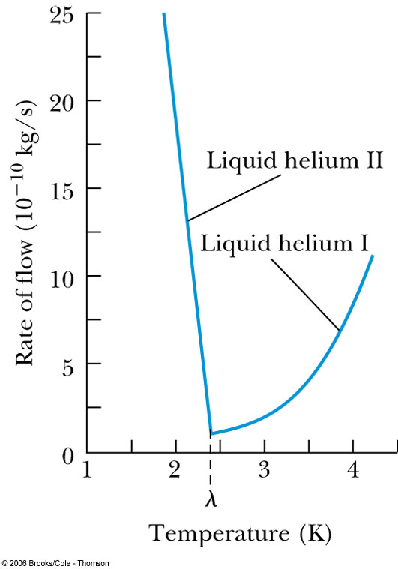
Liquid Helium
The rate of flow increases dramatically as the temperature is reduced because the superfluid has a low viscosity.
Creeping film – formed when the viscosity is very low
But when the viscosity is measured through the drag on a metal surface, He behaves like a normal fluid ➔ Contradiction!!

Slide 9
Liquid Helium
Fritz London claimed (1938) that liquid helium below the lambda point is a mixture of superfluid and normal fluid.
  As the temperature approaches absolute zero, the superfluid approaches 100% superfluid.
The fraction of helium atoms in the superfluid state:
Superfluid liquid helium (⁴He) is referred to as a Bose-Einstein condensation.
  ⁴He is a boson thus it is not subject to the Pauli exclusion principle
  all particles are in the same quantum state

Slide 10
Liquid Helium Critical Temp.
Such a BE condensation process is not possible with fermions because fermions must “stack up” into their energy states, no more than two per energy state.
³He, an isotope of ⁴He, is a fermion and superfluid mechanism is radically different than the Bose-Einstein condensation.
Use the fermions’ density of states function and substituting for the constant E_{F} yields
Bosons do not obey the Pauli principle, therefore the density of states should be less by a factor of 2.

Slide 11
Liquid Helium Critical Temp.
m is the mass of a helium atom and V is the volume in consideration
The number distribution n(E) is now
In a collection of N helium atoms the normalization condition is
Substituting u = E / kT,

Slide 12
Liquid Helium Critical Temp.
Use minimum value of B_{BE} = 1; this result corresponds to the maximum value of N.
Rearrange this,
Using the normal liquid He number density (N/V), the result is T ≥ 3.06 K.
The value 3.06 K is an estimate of T_{c}.

Slide 13
Bose-Einstein Condensation in Gases
BE condensation in liquid has been accomplished but gas condensation state hadn’t been till 1995
The strong Coulomb interactions among gas particles made it difficult to obtain the low temperatures and high densities needed to produce the BE condensate.
Finally success was achieved by E. Cornell and C. Weiman in Boulder, CO, with Rb (at 20nK) and W. Kettle at MIT on Sodium (at 20μK) ➔ Awarded of Nobel prize in 2001
The procedure
  Laser cool their gas of ⁸⁷Rb atoms to about 1 mK.
  Used a magnetic trap to cool the gas to about 20 nK, driving away atoms with higher speeds and keeping only the low speed ones
  At about 170 nK, Rb gas went through a transition, resulting in very cold and dense state of gas
Possible application of BEC is an atom laser but it will take long time..

Slide 14
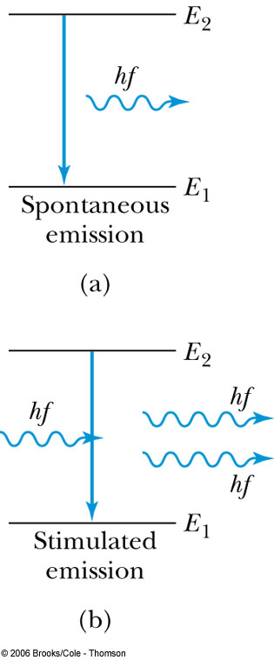
Stimulated Emission and Lasers
Spontaneous emission: A molecule in an excited state will decay to a lower energy state and emit a photon, without any stimulus from the outside.
Due to the uncertainty principle, the best we can do is to calculate the probability that a spontaneous transition will occur.
  And the phases of the photons emitted from this process are random
If a spectral line has a width ΔE, then a lower-bound estimate of the lifetime is Δt = ħ / (2 ΔE).

Slide 15
Stimulated Emission and Lasers
Stimulated emission: A photon incident upon a molecule in an excited state causes the unstable system to decay to a lower state.
The photon emitted tends to have the same phase and direction as the stimulated radiation.
If the incoming photon has the same energy as the emitted photon:
The result is two photons of the same
wavelength and phase traveling in the
same direction.
Because the incoming photon just
triggers emission of the second
photon.
These two photons are said to be coherent!
Einstein explained this stimulated emission in his 1917 paper “On the Quantum Theory of Radiation

Slide 16
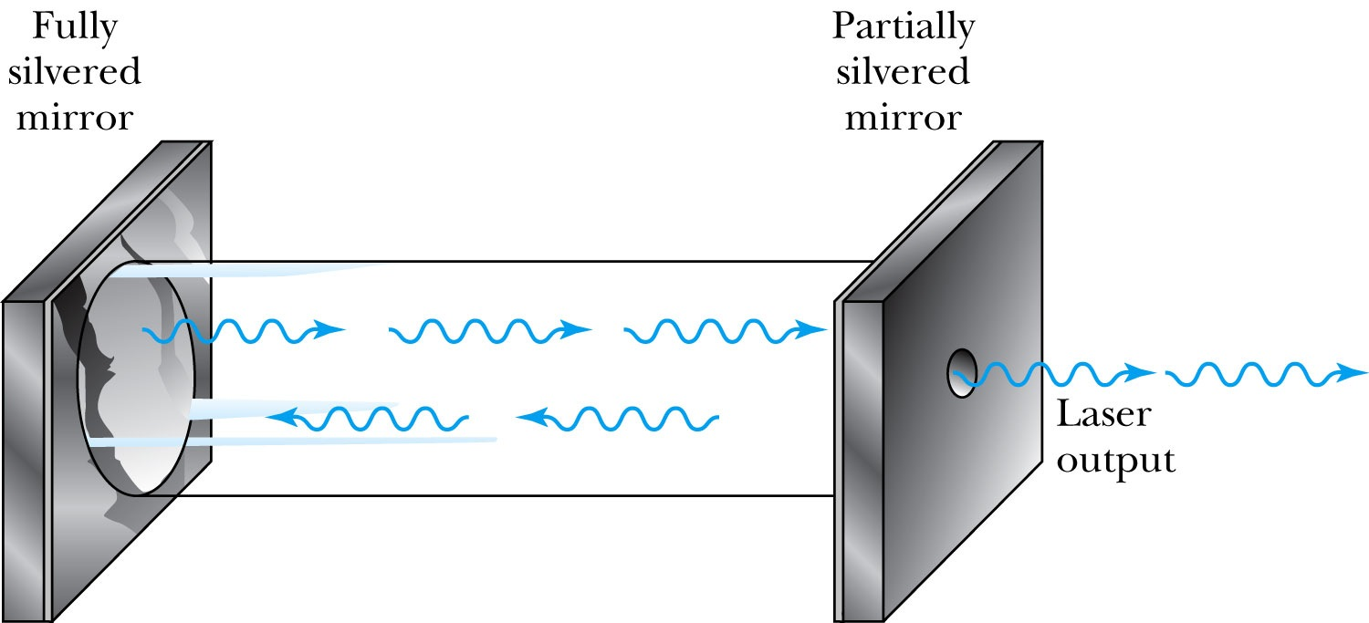
Stimulated Emission and Lasers
Laser stands for “light amplification by the stimulated emission of radiation”
  The first working laser was by Theodore H. Maiman in 1960
Masers: Microwaves are used instead of visible light.
  The first working maser was by C.H. Townse in 1954
helium-neon laser

Slide 17
Stimulated Emission and Lasers
The body of the laser is a closed tube, filled with about a 9/1 ratio of helium and neon.
Photons bouncing back and forth between two mirrors are used to stimulate the transitions in neon.
Photons produced by stimulated emission will be coherent, and the photons that escape through the silvered mirror will be a coherent beam.
How are atoms put into the excited state?
We cannot rely on the photons in the tube; if we did:
Any photon produced by stimulated emission would have to be “used up” to excite another atom.
There may be nothing to prevent spontaneous emission from atoms in the excited state. ➔ The beam would not be coherent.

Slide 18
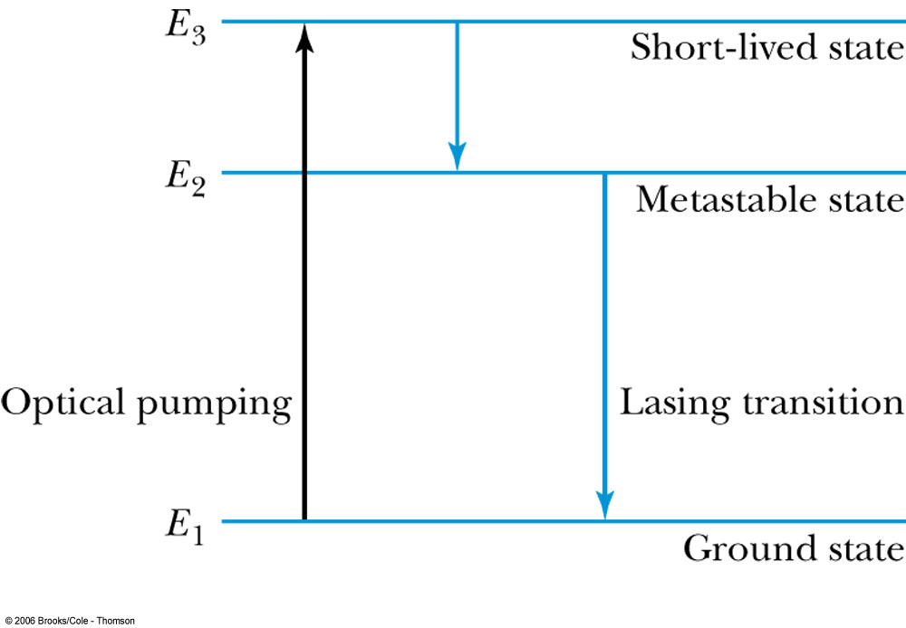
Stimulated Emission and Lasers
Use a multilevel atomic system to see those problems.
Three-level system
Atoms in the ground state are pumped to a higher state by some external energy source (power supply)
The atom decays quickly from E₃ to E₂.
The spontaneous transition from E₂ to E₁ is forbidden by a Δℓ = ±1 selection rule. ➔ E₂ is said to be metastable.
Population inversion: more atoms are in the metastable than in the ground state

Slide 19
Stimulated Emission and Lasers
After an atom has been returned to the ground state from E₂, we want the external power supply to return it immediately to E₃, but it may take some time for this to happen.
A photon with energy E₂ − E₁ can be absorbed by the atom ➔ resulting a much weaker beam
This is undesirable because the absorbed photon is unavailable for stimulating another transition.
A four level system can help avoiding this system

Slide 20
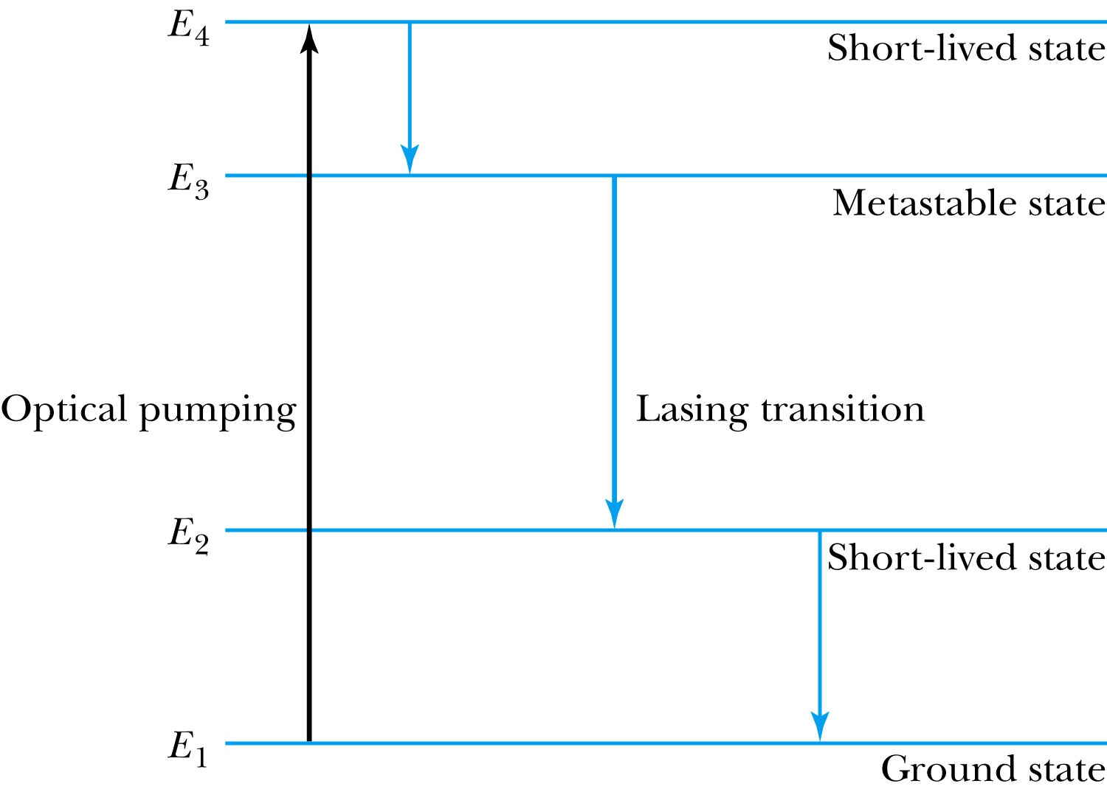
Stimulated Emission and Lasers
Four-level system
Atoms are pumped from the ground state to E₄.
They decay quickly to the metastable state E₃.
The stimulated emission takes atoms from E₃ to E₂.
The spontaneous transition from E₂ to E₁ is not forbidden, so E₂ will not exist long enough for a photon to be kicked from E₂ to E₃.
→ Lasing process can proceed efficiently.

Slide 21
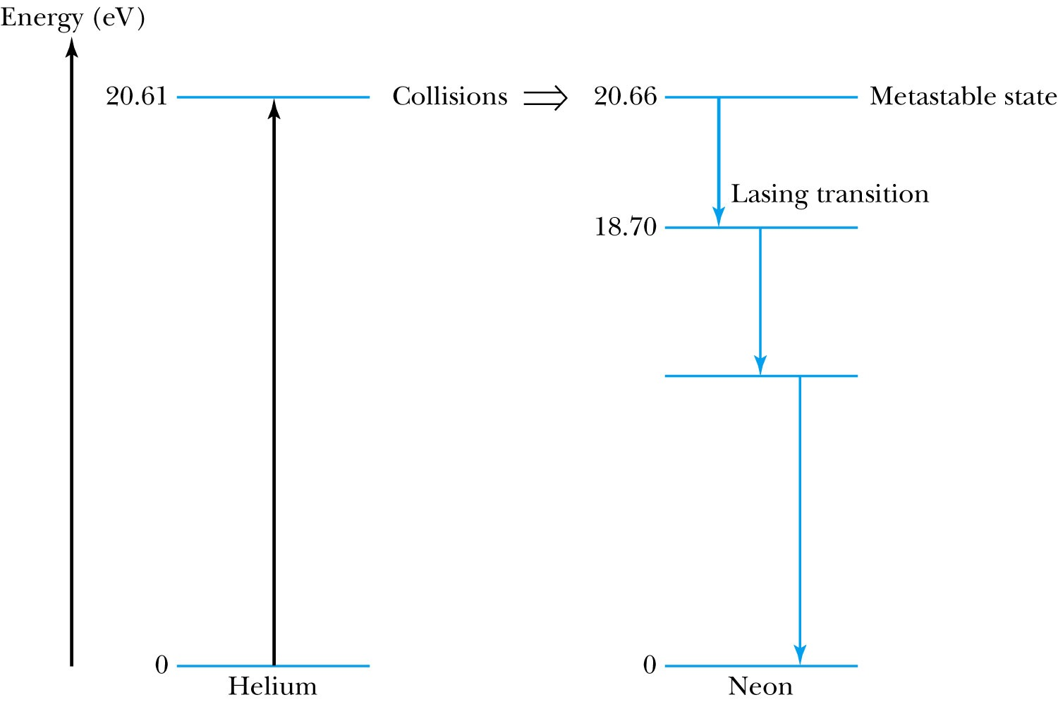
Stimulated Emission and Lasers
The red helium-neon laser uses transitions between energy levels in both helium and neon via their collisions

Slide 22
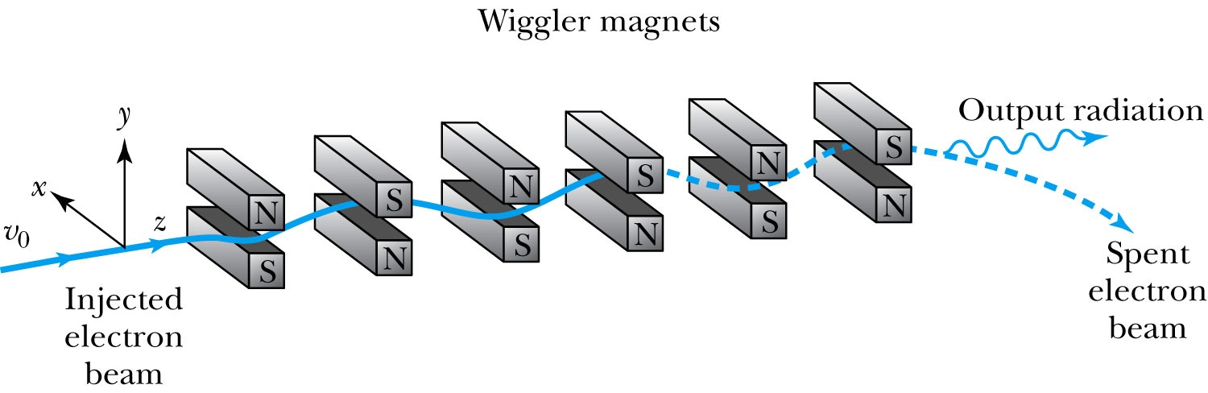
Tunable & Free Electron Lasers
Tunable laser:
The emitted radiation wavelength can be adjusted as wide as 200 nm adjusting the mixture of organic dyes
Semi conductor lasers are replacing dye lasers.
Free-electron laser:
Notes:
Place the “Free-electron laser” and diagram on the next slide.

Slide 23
Free Electron Lasers
This laser relies on charged particles.
A series of magnets called wigglers is used to accelerate a beam of electrons.
Free electrons are not tied to atoms; they aren’t dependent upon atomic energy levels and can be tuned to wavelengths well into the UV part of the spectrum.
Went down to 0.15nm wavelength at SLAC light source in 2009
Notes:
Add previous slides diagram on this slide.

Slide 24
Scientific Applications of Lasers
An extremely coherent and nondivergent beam is used in making precise determination of large and small distances.
  Precise determination of the speed of light resulted from precision laser measurement ➔ redefinition of 1m
  Precise (to 10cm) determination of the distance between the Earth and the moon
Pulsed lasers are used in thin-film deposition to study the electronic properties of different materials.
The use of lasers in fusion research for containing enough nuclei in a confined space for fusion to occur
  Inertial confinement: A pellet of deuterium and tritium would be induced into fusion by an intense burst of laser light coming simultaneously from many directions.

Slide 25
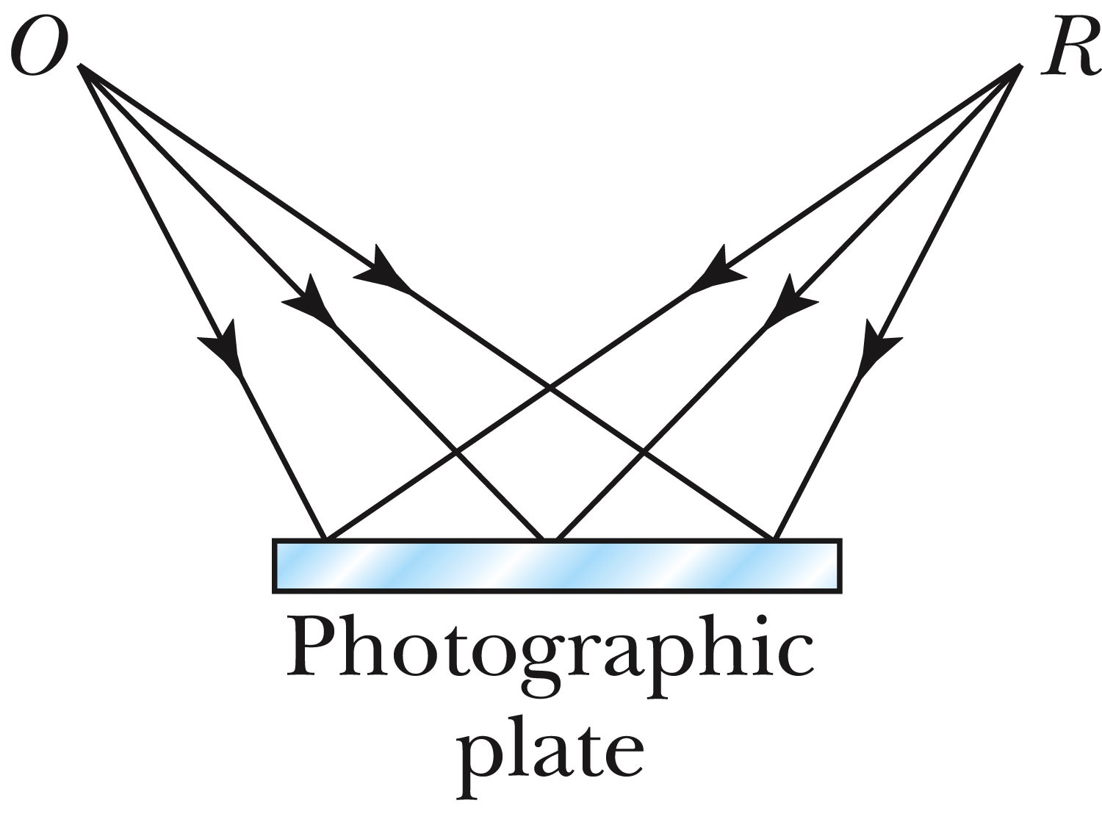
Holography
Consider laser light emitted by a reference source R.
The light through a combination of mirrors and lenses can be made to strike both a photographic plate and an object O.
The laser light is coherent; the image on the film will be an interference pattern.

Slide 26
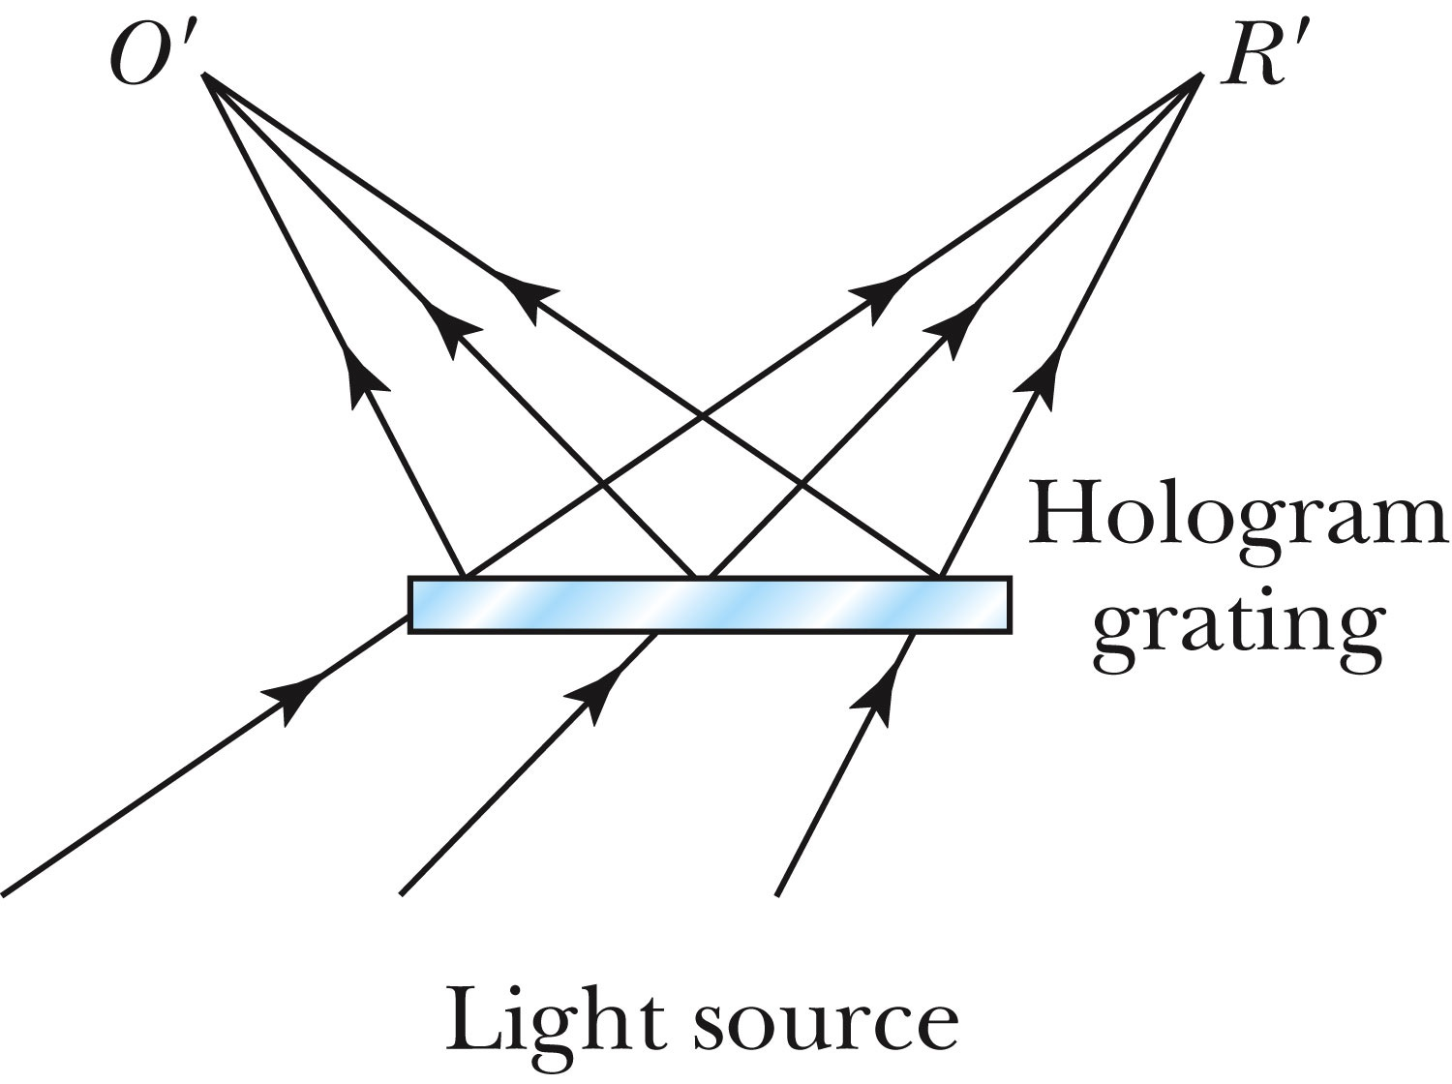
Holography
After exposure this interference pattern is a hologram, and when the hologram is illuminated from the other side, a real image of O is formed.
If the lenses and mirrors are properly situated, light from virtually every part of the object will strike every part of the film.
➔ Each portion of the film contains enough information to reproduce the whole object in 3D

Slide 27
Holography
Transmission hologram: The reference beam is on the same side of the film as the object and the illuminating beam is on the opposite side.
Reflection hologram: Reverse the positions of the reference and illuminating beam. The result will be a white light hologram in which the different colors contained in white light provide the colors seen in the image.
Interferometry: Two holograms of the same object produced at different times can be used to detect motion, growth or imperfections that could not otherwise be seen.

Slide 28
Other Laser Applications
Used in surgery to make precise incisions
  Ex: eye operations
We see in everyday life such as the scanning devices used by supermarkets and other retailers
  Ex. Bar code of packaged product
CD and DVD players
Laser light is directed toward disk tracks that contain encoded information.
The reflected light is then sampled and turned into electronic signals that produce a digital output.

Slide 29
Superconductivity
Superconductivity is characterized by the absence of electrical resistance and the expulsion of magnetic flux from the superconductor and was discovered 100 yrs ago
It is characterized by two macroscopic features:
Zero resistivity
  First discovered in 1911 by Onnes who achieved temperatures approaching 1 K with liquid helium.
  In a superconductor the resistivity drops abruptly to zero at critical (or transition) temperature T_{c}.
  Superconducting behavior tends to be similar within a given column of the periodic table.
  In 1956 – 1958, British physicists led by S.C. Collins established a current in a superconducting ring without power source

Slide 30
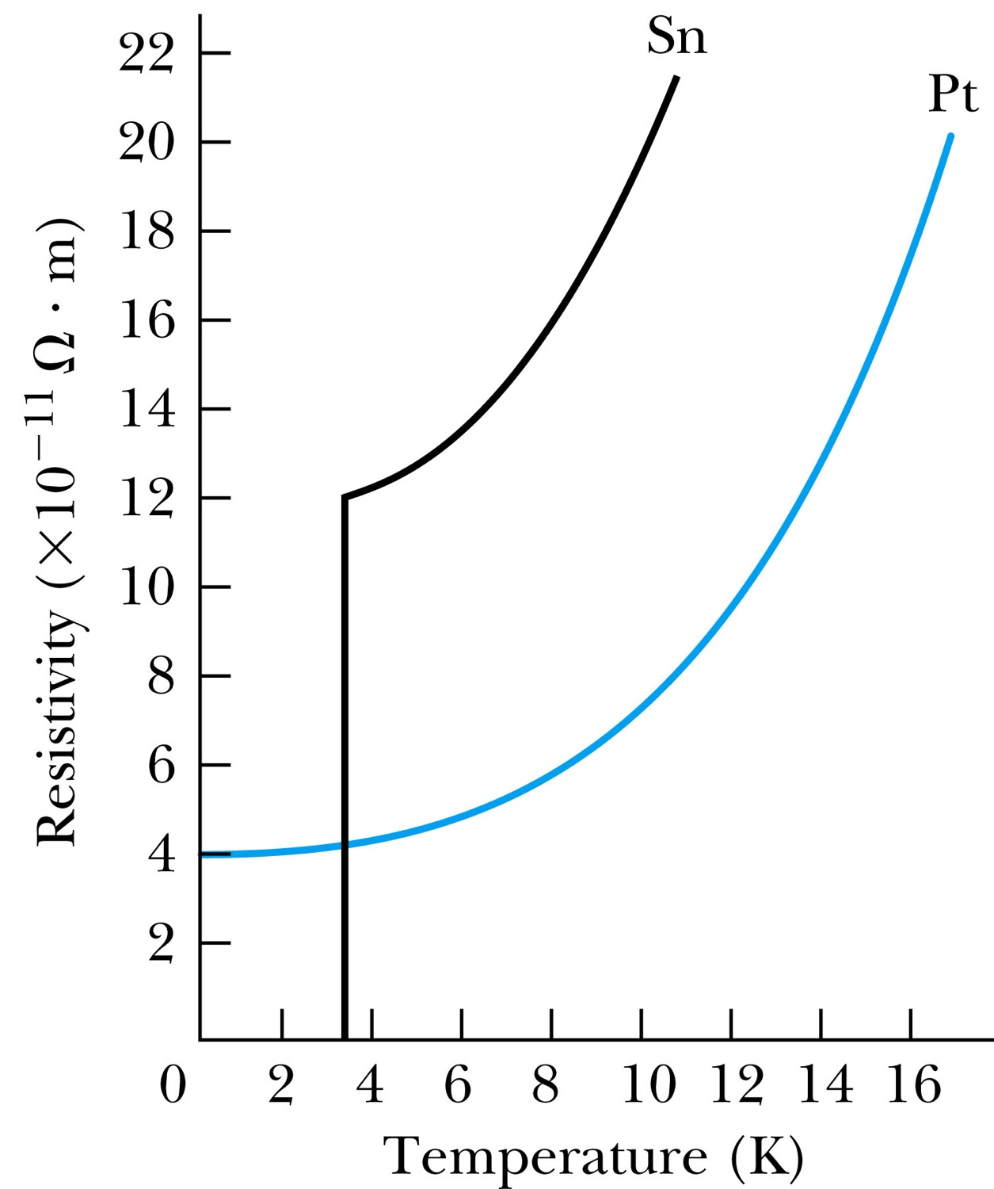
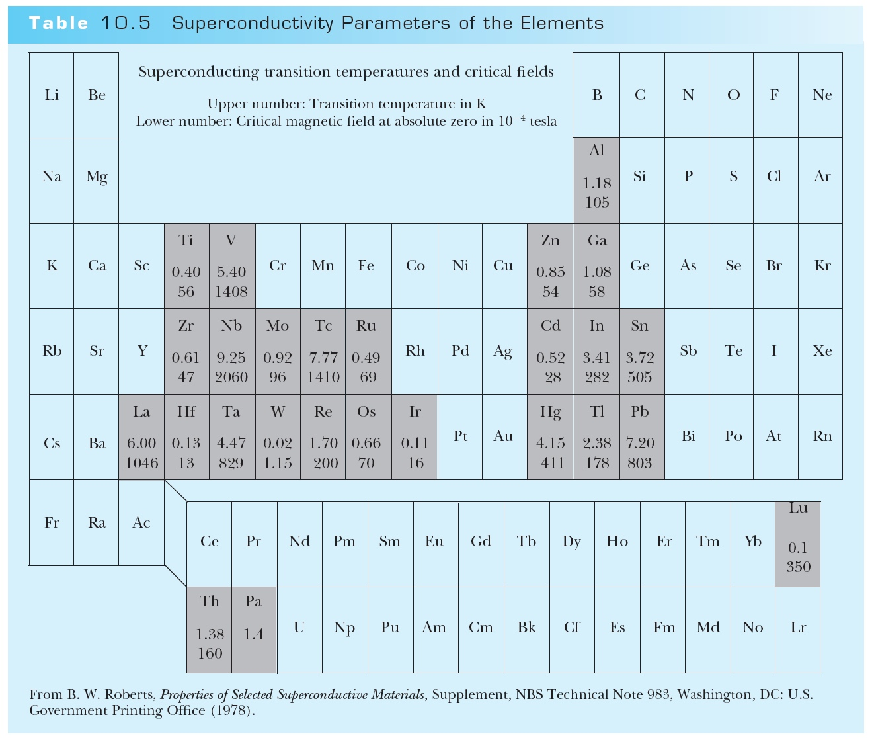
Superconductivity – Zero Resistivity
T_{c}

Slide 31
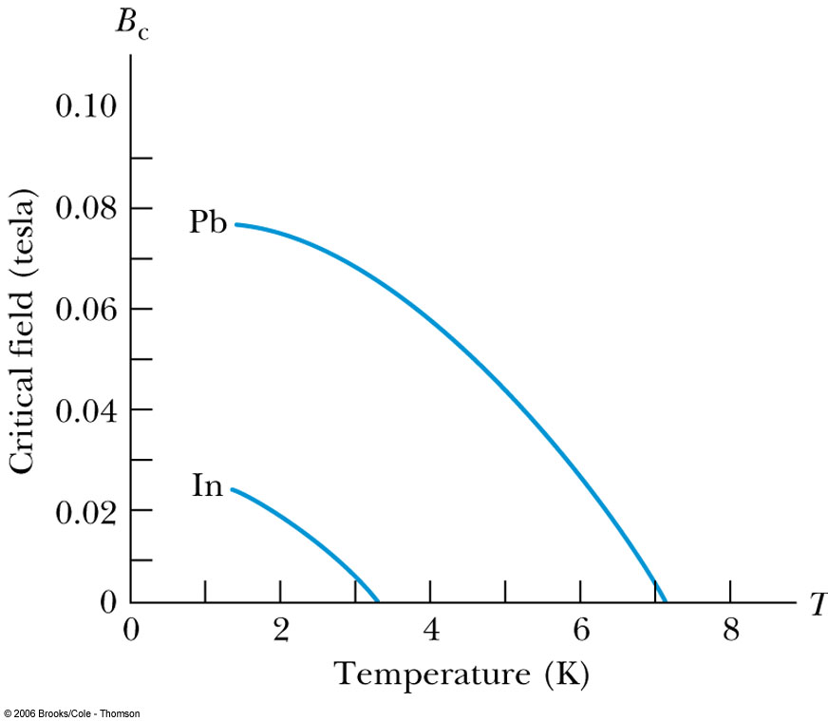
Superconductivity –Meissner Effect
The complete expulsion of magnetic flux from within a superconductor by generating a screening current discovered in 1933 by W. Meissner and R. Oschenfeld
The Meissner effect works only to the point where the critical field B_{c} is exceeded, and the superconductivity is lost until the magnetic field is reduced to below B_{c}.
The critical field varies with temperature.
To use a superconducting wire to carry current without resistance, there will be a limit (critical current) to the current that can be used.

Slide 32
Type I and Type II Superconductors
There is a lower critical field, B_{c1} and an upper critical field, B_{c2.}
Type II: Below B_{c1} and above B_{c2}.
Behave in the same manner
Type I: Below and above B_{c}

Slide 33
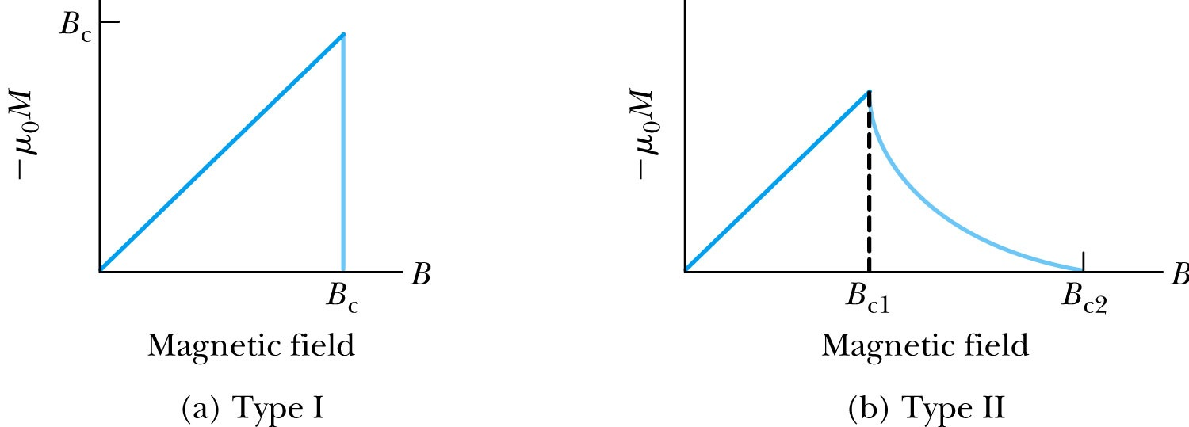
Type I and Type II Superconductors
Between B_{c1} and B_{c2} (vortex state), there is a partial penetration of magnetic flux although the zero resistivity is not lost.
Lenz’s law:
A phenomenon from classical physics
A changing magnetic flux generates a current in a conductor in such way that the current produced will oppose the change in the original magnetic flux.

