Slide 1
PHYS 3313 – Section 001
Lecture #21
Monday, Nov. 26, 2012
Dr. Jaehoon Yu
Superconductivity Theory, The Cooper Pair
Application of Superconductivity
Semi-Conductor
Nano-technology
Graphene

Slide 2
Announcements
Your presentations are in classes on Dec. 3 and Dec. 5
  All presentation ppt files must be sent to me by 8pm this Sunday, Dec. 2
Final exam is 11am – 1:30pm, Monday, Dec. 10
  You can prepare a one 8.5x11.5 sheet (front and back) of handwritten formulae and values of constants for the exam
  No formulae or values of constants will be provided!
Reading assignments
  CH10.1, 10.3 and 10.4
Please be sure to fill out the feedback survey. Only about 10 of you have done it as of yesterday.
Colloquium this Wednesday, week, at 4pm in SH101

Slide 3
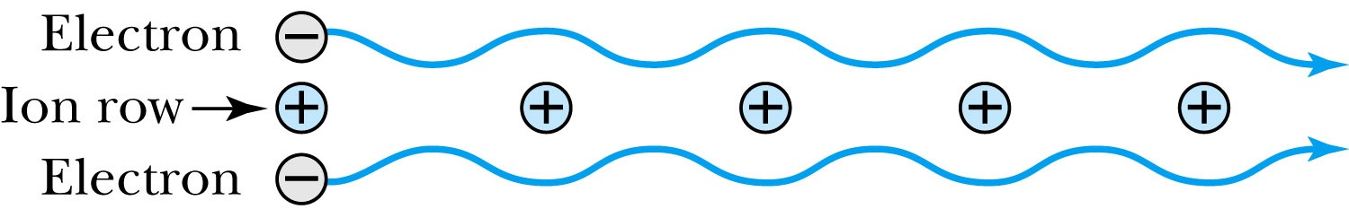
Superconductivity
Bardeen-Cooper-Schrieffer theory (electron-phonon interaction):
Electrons form Cooper pairs which propagate throughout the lattice.
Propagation is without resistance because the electrons move in resonance with the lattice vibrations (phonons).
How is it possible for two electrons to form a coherent pair?
Each of the two electrons experiences a net attraction toward the nearest positive ion.
Relatively stable electron pairs can be formed. The two fermions combine to form a boson. Then the collection of these bosons condense to form the superconducting state.

Slide 4
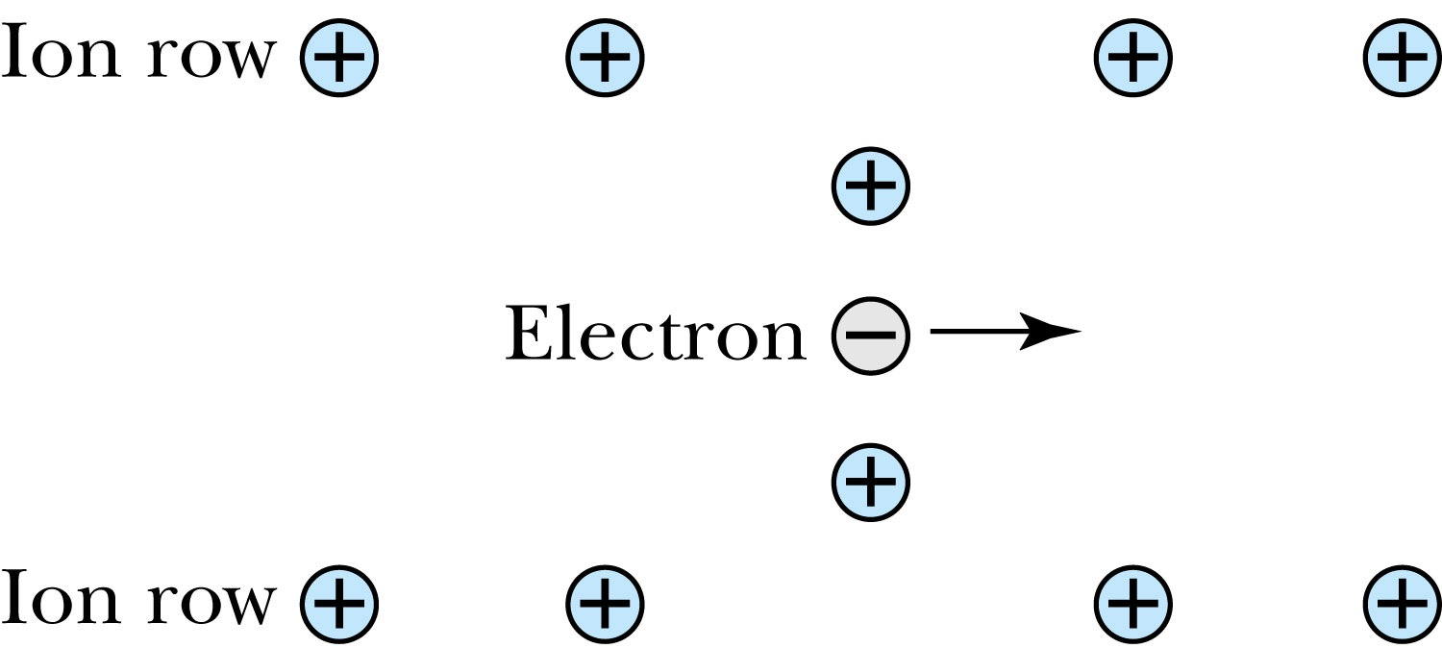
Superconductivity
Considering just one of the two electrons, the propagation wave that is created by lattice deformation due to the Coulomb attraction between the electron and ions is associated with phonon transmission, and the electron-phonon resonance allows the electron to move without resistance.
The complete BCS theory predicts other observed phenomena.
  An isotope effect with an exponent very close to 0.5.
  It gives a critical field.
  Predicts that metals with higher resistivity in room temperature are better superconductors

Slide 5
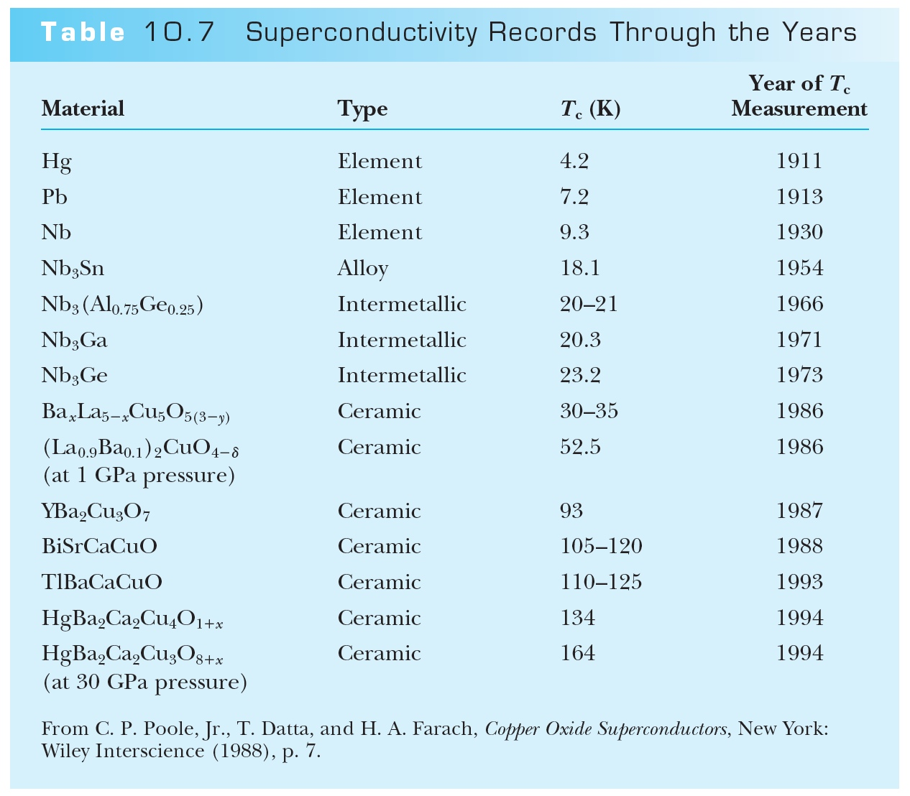
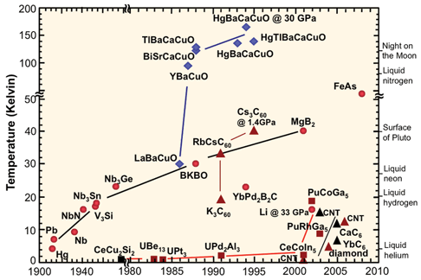
The Search for a Higher T_{c}
Keeping materials at extremely low temperatures is very expensive and requires cumbersome insulation techniques.
Making liquid He is very hard

Slide 6
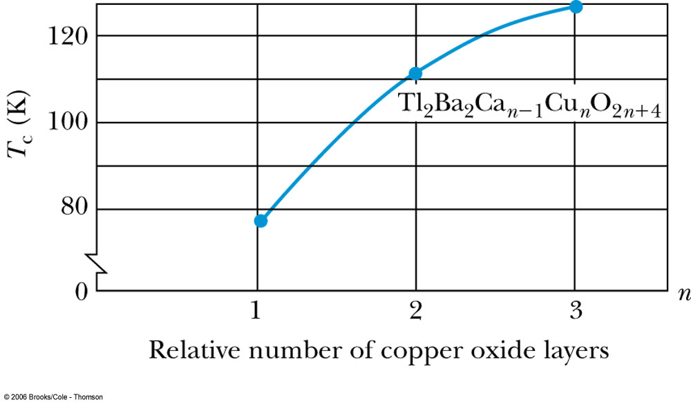
The Search for a Higher T_{c}
The copper oxide superconductors fall into a category of ceramics.
Most ceramic materials are not easy to mold into convenient shapes.
There is a regular variation of T_{c} with n.
T_{c} of thallium-copper oxide with n = 3

Slide 7
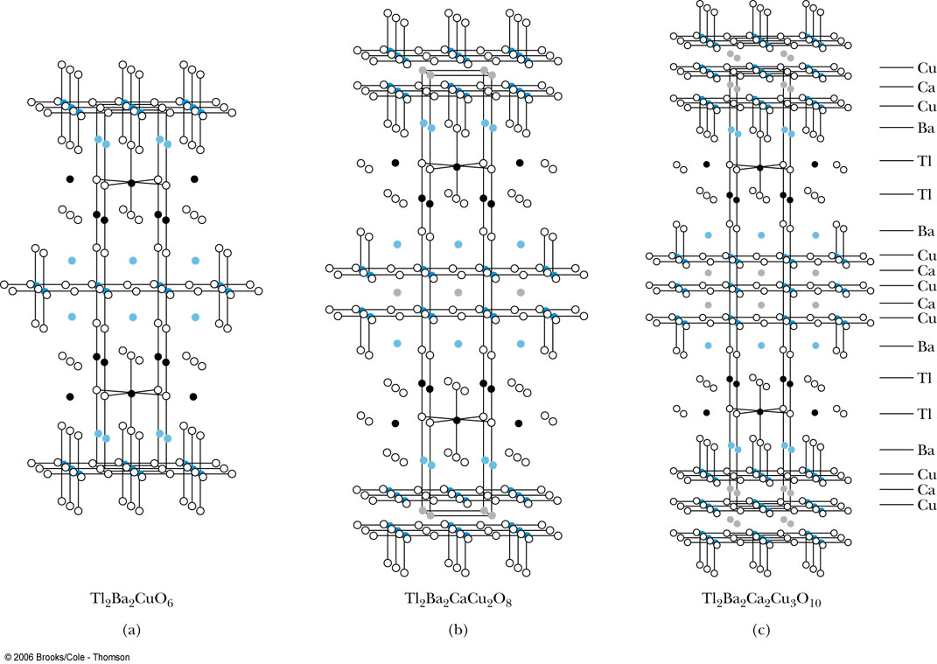
The Search for a Higher T_{c}
Higher values of n correspond to more stacked layers of copper and oxygen.
thallium-based superconductor

Slide 8
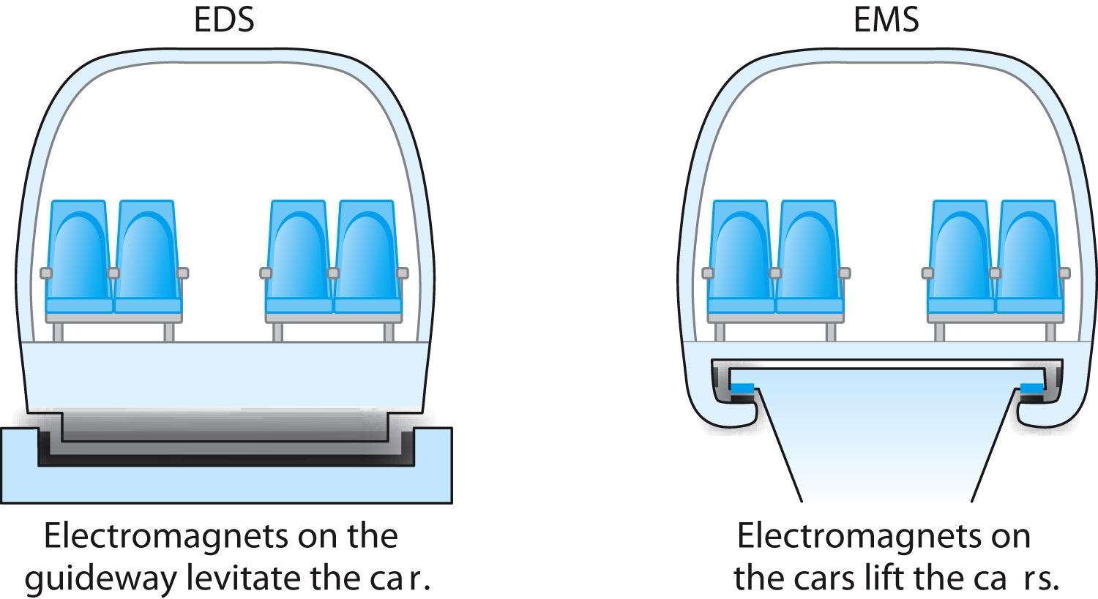
Applications of Superconductivity
Maglev: Magnetic levitation of trains
In an electrodynamic (EDS) system, magnets on the guideway repel the car to lift it.
In an electromagnetic (EMS) system, magnets attached to the bottom of the car lie below the guideway and are attracted upward toward the guideway to lift the car.

Slide 9
Generation and Transmission of Electricity
Significant energy savings if the heavy iron cores used today could be replaced by lighter superconducting magnets.
Expensive transformers would no longer have to be used to step up voltage for transmission and down again for use.
Energy loss rate for transformers is
MRI obtains clear pictures of the body’s soft tissues, allowing them to detect tumors and other disorders of the brain, muscles, organs, and connective tissues.

Slide 10
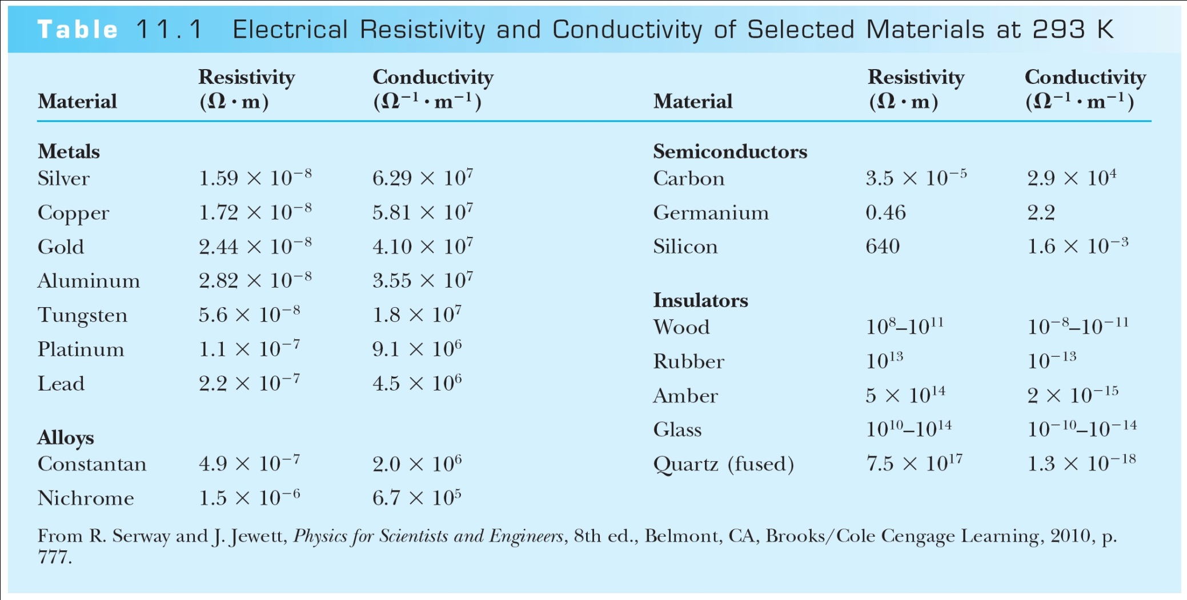
Categories of Solids
There are three categories of solids, based on their conducting properties:
  conductors
  semiconductors
  insulators
The electrical conductivity at room temperature is quite different for each of these three kinds of solids
  Metals and alloys have the highest conductivities
  followed by semiconductors
  and then by insulators

Slide 11
Band Theory and Conductivity
Band theory helps us understand what makes a conductor, insulator, or semiconductor.
  Good conductors like copper can be understood using the free electron.
  It is also possible to make a conductor using a material with its highest band filled, in which case no electron in that band can be considered free.
  If this filled band overlaps with the next higher band, however (so that effectively there is no gap between these two bands) then an applied electric field can make an electron from the filled band jump to the higher level.
This allows conduction to take place, although typically with slightly higher resistance than in normal metals. Such materials are known as semimetals.

Slide 12
Valence and Conduction Bands
The band structures of insulators and semiconductors resemble each other qualitatively. Normally there exists in both insulators and semiconductors a filled energy band (referred to as the valence band) separated from the next higher band (referred to as the conduction band) by an energy gap.
If this gap is at least several electron volts, the material is an insulator. It is too difficult for an applied field to overcome that large an energy gap, and thermal excitations lack the energy to promote sufficient numbers of electrons to the conduction band.
For energy gaps smaller than about 1 electron volt, it is possible for enough electrons to be excited thermally into the conduction band, so that an applied electric field can produce a modest current.
The result is a semiconductor.

Slide 13
Holes and Intrinsic Semiconductors
When electrons move into the conduction band, they leave behind vacancies in the valence band. These vacancies are called holes. Because holes represent the absence of negative charges, it is useful to think of them as positive charges.
Whereas the electrons move in a direction opposite to the applied electric field, the holes move in the direction of the electric field.
A semiconductor in which there is a balance between the number of electrons in the conduction band and the number of holes in the valence band is called an intrinsic semiconductor.
Examples of intrinsic semiconductors include pure carbon and germanium.

Slide 14
Impurity Semiconductor
It is possible to fine-tune a semiconductor’s properties by adding a small amount of another material, called a dopant, to the semiconductor creating what is a called an impurity semiconductor.
As an example, silicon has four electrons in its outermost shell (this corresponds to the valence band) and arsenic has five.
Thus while four of arsenic’s outer-shell electrons participate in covalent bonding with its nearest neighbors (just as another silicon atom would), the fifth electron is very weakly bound.
It takes only about 0.05 eV to move this extra electron into the conduction band.
The effect is that adding only a small amount of arsenic to silicon greatly increases the electrical conductivity.

Slide 15
n-type and p-type Semiconductors
The addition of arsenic to silicon creates what is known as an n-type semiconductor (n for negative), because it is the electrons close to the conduction band that will eventually carry electrical current.
The new arsenic energy levels just below the conduction band are called donor levels because an electron there is easily donated to the conduction band.
It is always easier to think in terms of the flow of positive charges (holes) in the direction of the applied field, so we call this a p-type semiconductor (p for positive).
In addition to intrinsic and impurity semiconductors, there are many compound semiconductors, which consist of equal numbers of two kinds of atoms.

Slide 16
Integrated Circuits
The most important use of all these semiconductor devices today is not in discrete components, but rather in integrated circuits commonly called chips.
Some integrated circuits contain a million or more components such as resistors, capacitors, transistors, and logic switches.
Two benefits: miniaturization and processing speed

Slide 17
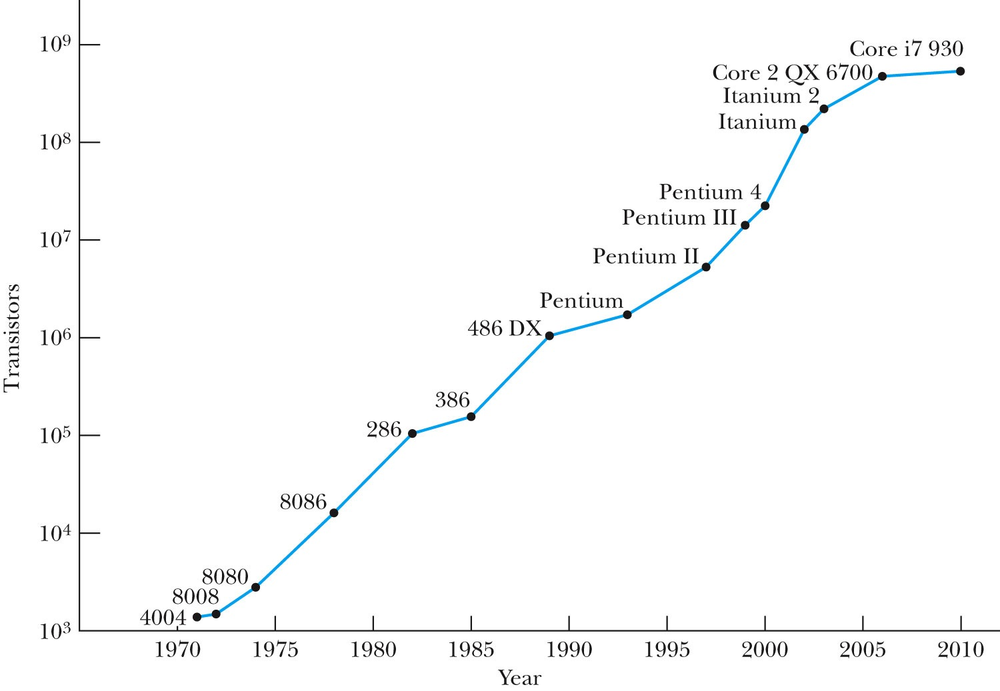
Moore’s Law and Computing Power
Figure 11.29: Moore’s law, showing the progress in computing power over a 30-year span, illustrated here with Intel chip names. The Pentium 4 contains over 50 million transistors. Courtesy of Intel Corporation. Graph from http://www.intel.com/research/silicon/mooreslaw.htm.

Slide 18
Nanotechnology & Carbon Nanotubes
Nanotechnology is generally defined as the scientific study and manufacture of materials on a submicron scale.
These scales range from single atoms on the order of 0.1 nm up to 1 micron (1000 nm).
This technology has applications in engineering, chemistry, and the life sciences and, as such, is interdisciplinary.
In 1991, following the discovery of C₆₀ buckminsterfullerenes, or “buckyballs,” Japanese physicist Sumio Iijima discovered a new geometric arrangement of pure carbon into large molecules.
In this arrangement, known as a carbon nanotube, hexagonal arrays of carbon atoms lie along a cylindrical tube instead of a spherical ball.

Slide 19
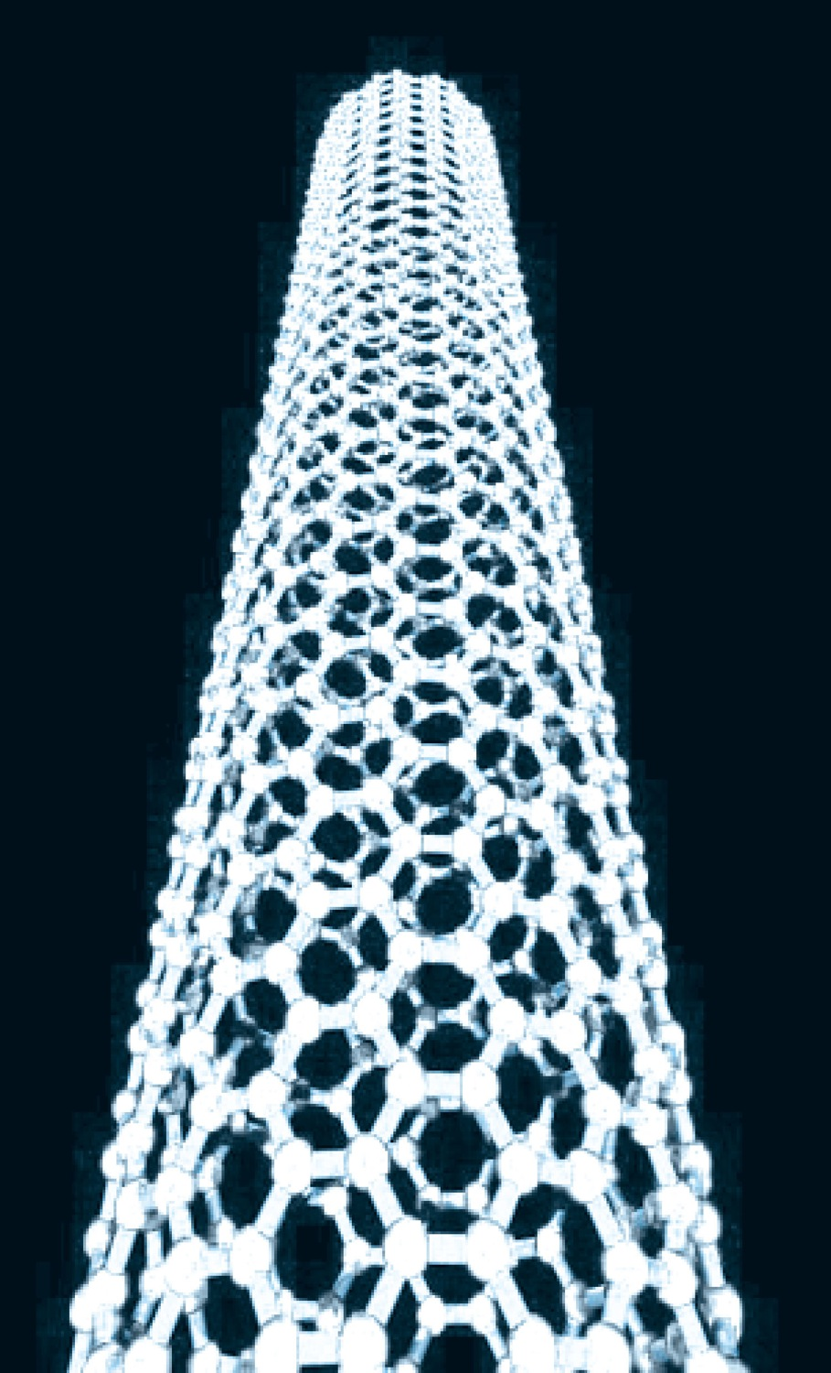
Structure of a Carbon Nanotube
There is virtually no limit to the length of the tube. From Chris Ewels/www.ewels.info
leads to two types of nanotubes. A single-walled nanotube has just the single shell of hexagons as shown.
In a multi-walled nanotube, multiple layers are nested like the rings in a tree trunk.
Single-walled nanotubes tend to have fewer defects, and they are therefore stronger structurally but they are also more expensive and difficult to make.

Slide 20
Applications of Nanotubes
Because of their strength they are used as structural reinforcements in the manufacture of composite materials
  (batteries in cell-phones use nanotubes in this way)
Nanotubes have very high electrical and thermal conductivities, and as such lead to high current densities in high-temperature superconductors.
One problem in the development of truly small-scale electronic devices is that the connecting wires in any circuit need to be as small as possible, so that they do not overwhelm the nanoscale components they connect.
In addition to the nanotubes already described, semiconductor wires (for example indium phosphide) have been fabricated with diameters as small as 5 nm.
These nanowires have been shown useful in connecting nanoscale transistors and memory circuits. These are referred to as nanotransistors

Slide 21
Graphene
A new material called graphene was ﬁrst isolated in 2004. Graphene is a single layer of hexagonal carbon, essentially the way a single plane of atoms appears in common graphite.
A. Geim and K. Novoselov received the 2010 Nobel Prize in Physics for “ground-breaking experiments.” Pure graphene conducts electrons much faster than other materials at room temperature.
Graphene transistors may one day result in faster computing.

Slide 22
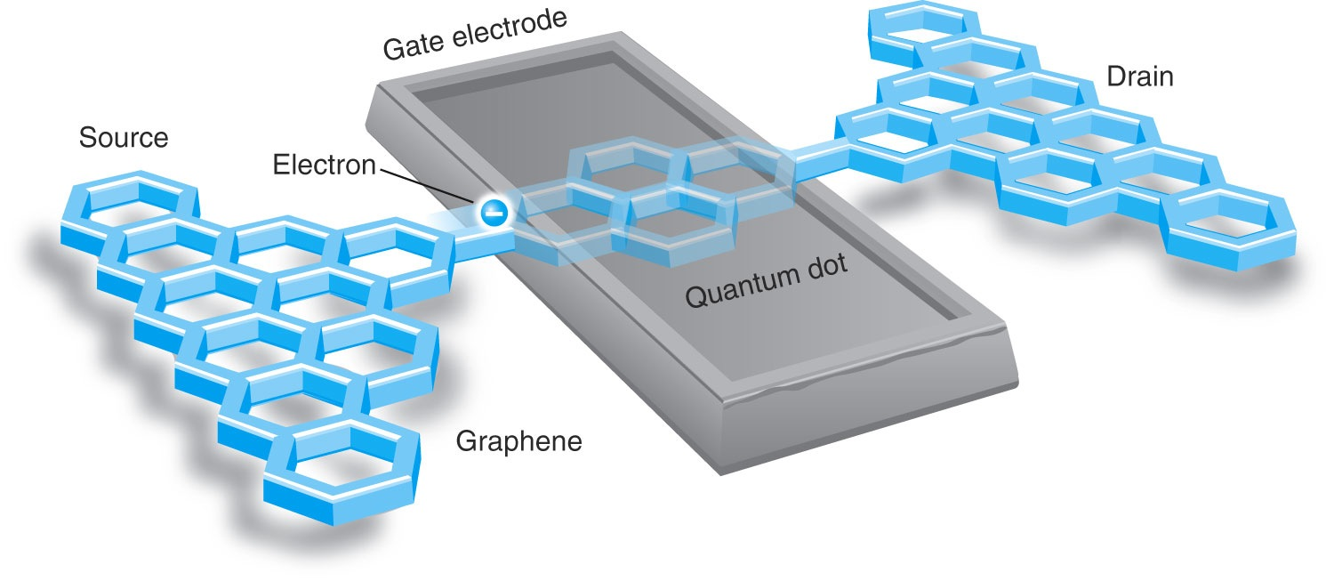
Graphene
Figure 11.33 Schematic diagram of graphene-based transistor developed at the University of Manchester. The passage of a single electron from source to drain registers 1 bit of information—a 0 or 1 in binary code.

Slide 23
Quantum Dots
Quantum dots are nanostructures made of semiconductor materials.
  They are typically only a few nm across, containing up to 1000 atoms.
  Each contains an electron-hole pair ]confined within the dot’s boundaries, (somewhat analogous to a particle conﬁned to a potential well discussed in Chapter 6.
Properties result from the fact that the band gap varies over a wide range and can be controlled precisely by manipulating the quantum dot’s size and shape.
  They can be made with band gaps that are nearly continuous throughout the visible light range (1.8 to 3.1 eV) and beyond.

Slide 24
Nanotechnology and the Life Sciences
The complex molecules needed for the variety of life on Earth are themselves examples of nanoscale design.
Examples of unusual materials designed for specific purposes include the molecules that make up claws, feathers, and even tooth enamel.

Slide 25
Information Science
It’s possible that current photolithographic techniques for making computer chips could be extended into the hard-UV or soft x-ray range, with wavelengths on the order of 1 nm, to fabricate silicon-based chips on that scale
In the 1990s physicists learned that it is possible to take advantage of quantum effects to store and process information more efficiently than a traditional computer. To date, such quantum computers have been built in prototype but not mass-produced.

