Slide 1
PHYS 3313 – Section 001
Lecture #22
Wednesday, Nov. 28, 2012
Dr. Jaehoon Yu
Introduction to Particle Physics
Particle Accelerators
Particle Physics Detectors
Hot topics in Particle Physics
What’s coming in the future?

Slide 2
Announcements
Your presentations are in classes on Dec. 3 and Dec. 5
  All presentation ppt files must be sent to me by 8pm this Sunday, Dec. 2
Final exam is 11am – 1:30pm, Monday, Dec. 10
  You can prepare a one 8.5x11.5 sheet (front and back) of handwritten formulae and values of constants for the exam
  No formulae or values of constants will be provided!
Planetarium extra credit
  Tape one side of your ticket stubs on a sheet of paper with your name on it
  Submit the sheet on Wednesday, Dec. 5
Please be sure to fill out the feedback survey.
Colloquium today at 4pm in SH101

Slide 3
Introduction
What are elementary particles?
  Particles that make up all matters in the universe
What are the requirements for elementary particles?
  Cannot be broken into smaller pieces
  Cannot have sizes
The notion of “elementary particles” have changed from early 1900’s through present
  In the past, people thought protons, neutrons, pions, kaons, ρ-mesons, etc, as elementary particles
Why?
  Due to the increasing energies of accelerators that allowed us to probe smaller distance scales
What is the energy needed to probe 0.1–fm?
  From de Broglie Wavelength, we obtain

Slide 4
Interaction Time
The ranges of forces also affect interaction time
  Typical time for Strong interaction ~10⁻²⁴sec
    What is this time scale?
    A time that takes light to traverse the size of a proton (~1 fm)
  Typical time for EM force ~10⁻²⁰ – 10⁻¹⁶ sec
  Typical time for Weak force ~10⁻¹³ – 10⁻⁶ sec
In GeV ranges, the four forces (now three since EM and Weak forces are unified!) are different
These are used to classify elementary particles

Slide 5
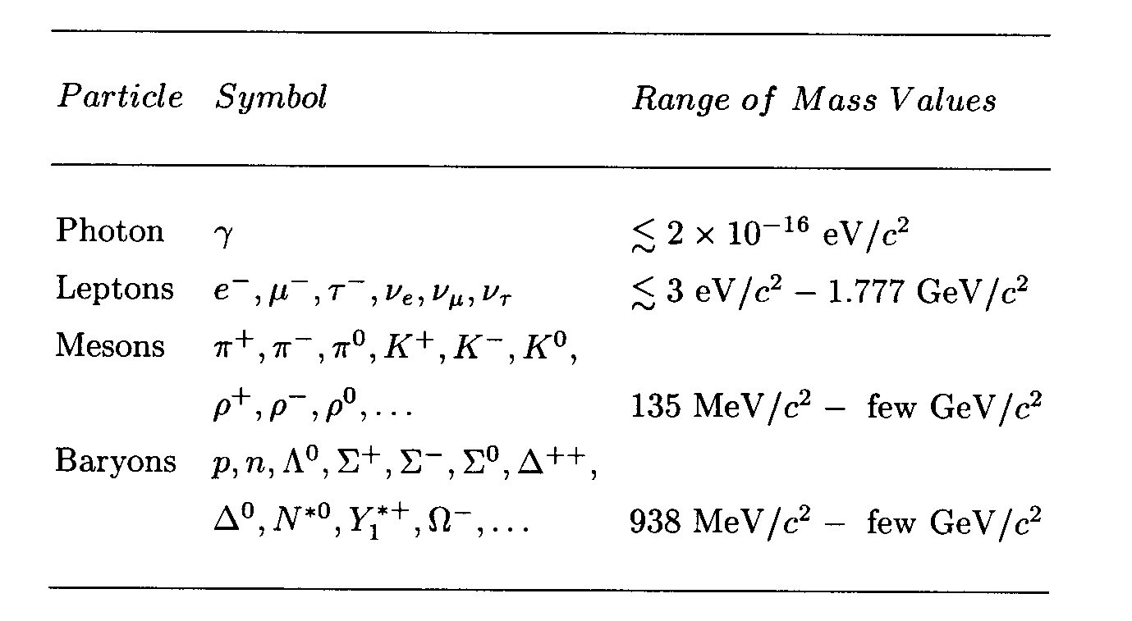
Elementary Particles
Before the quark concept in 70’s, all known elementary particles were grouped in four depending on the nature of their interactions

Slide 6
Elementary Particle Interactions
How do these particles interact??
  All particles, including photons and neutrinos, participate in gravitational interactions
  Photons can interact electromagnetically with any particles with electric charge
  All charged leptons participate in both EM and weak interactions
  Neutral leptons do not have EM couplings
  All hadrons (Mesons and baryons) respond to the strong force and appears to participate in all the interactions

Slide 7
Bosons, Fermions, Particles and Antiparticles
Bosons
  All have integer spin angular momentum, follow BE statistics
  All mesons (consists of two quarks) are bosons
Fermions
  All have half integer spin angular momentum follow FD statistics
  All leptons and baryons (consist of three quarks) are fermions
All particles have anti-particles
  What are anti-particles?
    Particles that has same mass as particles but with opposite quantum numbers
  What is the anti-particle of
    A π⁰?
    A neutron?
    A K⁰?
    A Neutrino?

Slide 8
Allowed Interactions
When can an interaction occur?
  If it is kinematically allowed
  If it does not violate any recognized conservation laws
    Eg. A reaction that violates charge conservation will not occur
  In order to deduce conservation laws, a full theoretical understanding of forces are necessary
Since we do not have full theory for all the forces
  Many of general conservation rules for particles are based on experiments
One of the clearest conservation is the lepton number conservation
  While photon and meson numbers are not conserved

Slide 9
Prohibited Proton Decay
Can the decay occur?
  Kinematically??
    Yes, proton mass is a lot larger than the sum of the two masses
  Electrical charge?
    Yes, it is conserved
But this decay does not occur (<10⁻⁴⁰/sec)
  Why?
    Must be a conservation law that prohibits this decay
  What could it be?
    An additive and conserved quantum number, Baryon number (B)
    All baryons have B=1
    Anti-baryons? (B=-1)
    Photons, leptons and mesons have B=0
Since proton is the lightest baryon, it does not decay.

Slide 10
The Standard Model of Particle Physics
In late 60’s, Jerome Friedman, Henry Kendall and Rich Taylor designed an experiment with electron beam scattering off of hadrons and deuterium at SLAC (Stanford Linear Accelerator Center)
  Data could be easily understood if protons and neutrons are composed of point-like objects with charges -1/3e and +2/3e.
  A point-like electrons scattering off of point-like quark partons inside the nucleons and hadrons
    Corresponds to modern day Rutherford scattering
    Higher energies of the incident electrons could break apart the target particles, revealing the internal structure

Slide 11
The Standard Model of Particle Physics
By early 70’s, it was clear that hadrons (baryons and mesons) are not fundamental point-like objects
But leptons did not show any evidence of internal structure
  Even at high energies they still do not show any structure
  Can be regarded as elementary particles
The phenomenological understanding along with observation from electron scattering (Deep Inelastic Scattering, DIS) and the quark model
Resulted in the Standard Model that can describe three of the four known forces along with quarks, leptons and gauge bosons as the fundamental particles

Slide 12
Quarks and Leptons
In SM, there are three families of leptons
  ➔ Increasing order of lepton masses
  Convention used in strong isospin symmetry, higher member of multiplet carries higher electrical charge
And three families of quark constituents
All these fundamental particles are fermions w/ spin
Q
0
-1
Q
+2/3
-1/3

Slide 13
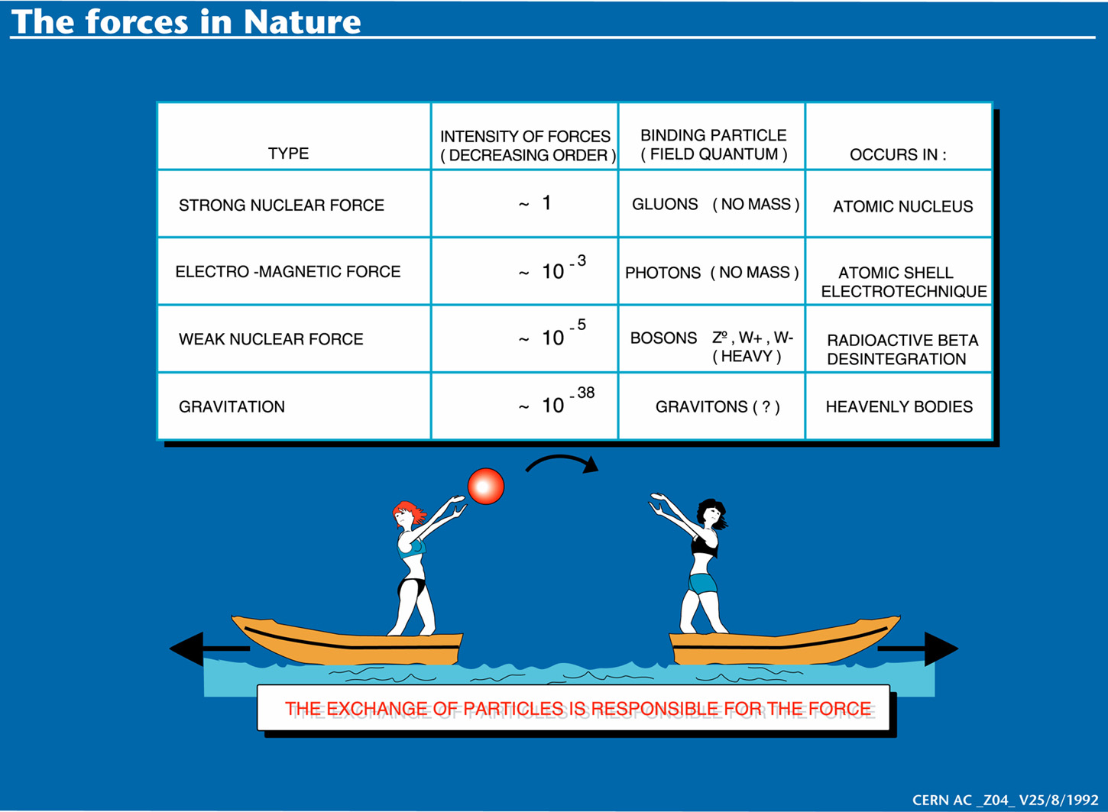

Slide 14
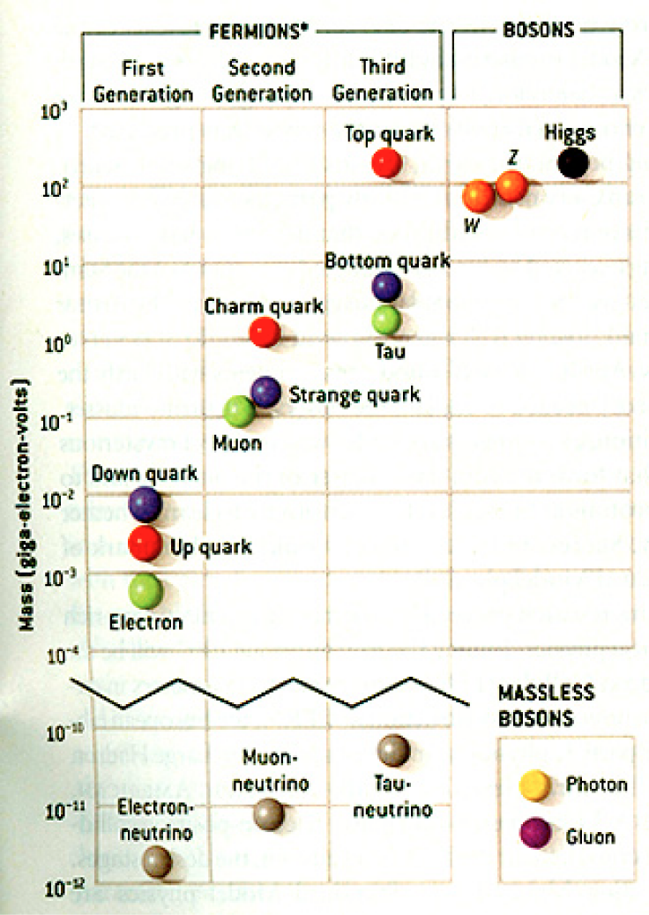
The Standard Model
Discovered in 1995, ~175m_{p}
Make up most ordinary matters ~0.1m_{p}
Total of 16 particles make up the matter in the universe! ➔ Simple and elegant!!!
Tested to a precision of 1 part per million!

Slide 15
Particle Accelerators
How can one obtain high energy particles?
  Cosmic ray ➔ Sometimes we observe 1000TeV cosmic rays
    Low flux and cannot control energies too well
Need to look into small distances to probe the fundamental constituents with full control of particle energies and fluxes
  Particle accelerators
Accelerators need not only to accelerate particles but also to
  Track them
  Maneuver them
  Constrain their motions to the order of 1μm or better
Why?
  Must correct particle paths and momenta to increase fluxes and control momenta

Slide 16
Particle Accelerators
Depending on what the main goals of physics are, one needs different kinds of accelerator experiments
Fixed target experiments: Probe the nature of the nucleons ➔ Structure functions
  Results also can be used for producing secondary particles for further accelerations ➔ Tevatron anti-proton production
Colliders: Probes the interactions between fundamental constituents
  Hadron colliders: Wide kinematic ranges and high discovery potential
    Proton-anti-proton: TeVatron at Fermilab, at CERN
    Proton-Proton: Large Hadron Collider at CERN (turned on early 2010)
  Lepton colliders: Very narrow kinematic reach, so it is used for precision measurements
    Electron-positron: LEP at CERN, Petra at DESY, PEP at SLAC, Tristan at KEK, ILC in the med-range future
    Muon-anti-muon: Conceptual accelerator in the far future
  Lepton-hadron colliders: HERA at DESY

Slide 17
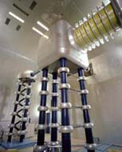
Electrostatic Accelerators: Cockcroft-Walton
Cockcroft-Walton Accelerator
  Pass ions through sets of aligned DC electrodes at successively increasing fixed potentials
  Consists of ion source (hydrogen gas) and a target with the electrodes arranged in between
  Acceleration Procedure
    Electrons are either added or striped off of an atom
    Ions of charge q then get accelerated through series of electrodes, gaining kinetic energy of T=qV through every set of electrodes
Limited to about 1MeV acceleration due to voltage breakdown and discharge beyond voltage of 1MV.
Available commercially and also used as the first step high current injector (to ~1mA).

Slide 18
Electrostatic Accelerators: Van de Graaff
Energies of particles through DC accelerators are proportional to the applied voltage
Robert Van de Graaff developed a clever mechanism to increase HV
  The charge on any conductor resides on its outermost surface
  If a conductor carrying additional charge touches another conductor that surrounds it, all of its charges will transfer to the outer conductor increasing the charge on the outer conductor, thereby increasing voltage higher

Slide 19
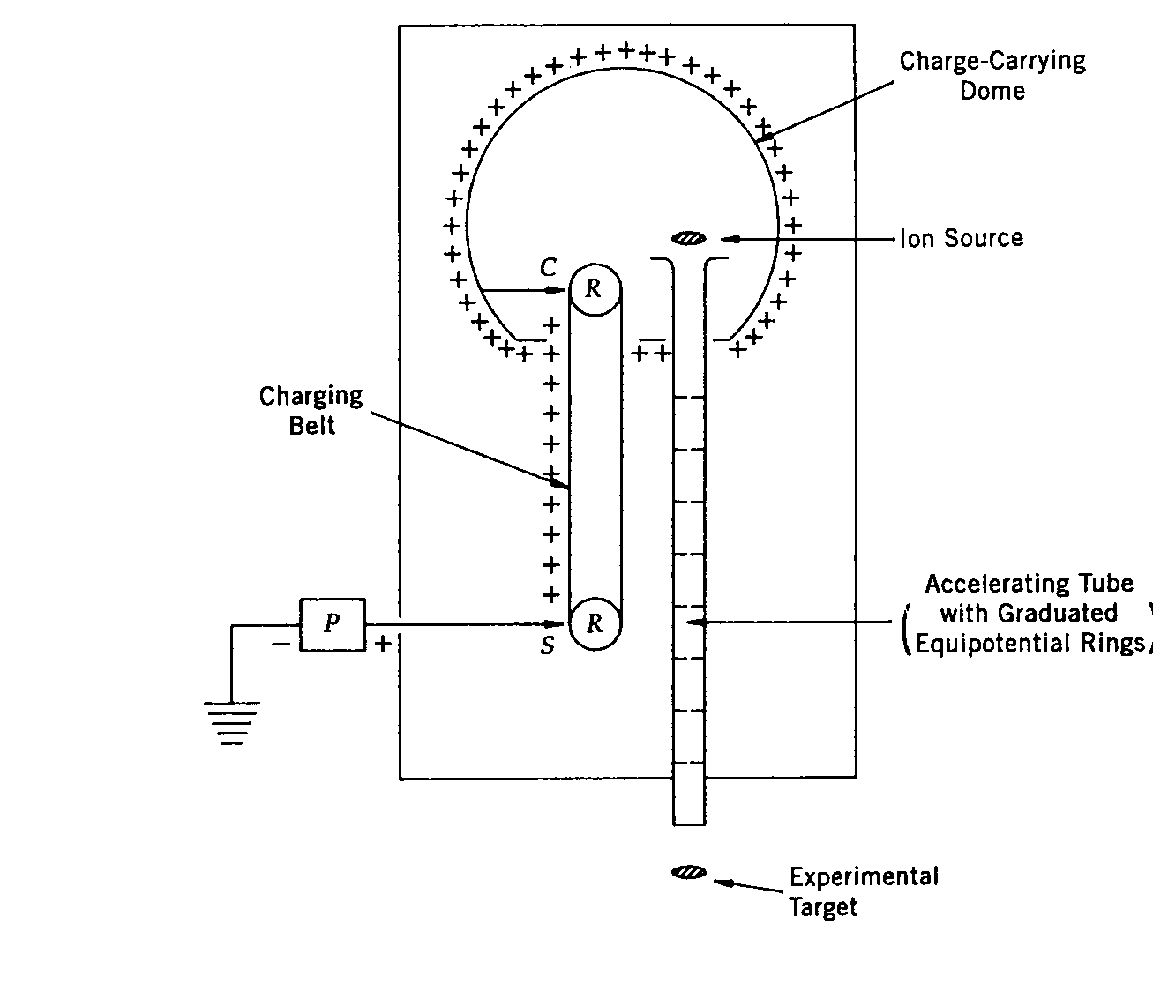
Electrostatic Accelerators: Van de Graaff
Sprayer adds positive charge to the conveyor belt at corona points
Charge is carried on an insulating conveyor belt
The charges get transferred to the dome via the collector
The ions in the source then gets accelerated to about 12MeV
Tandem Van de Graff can accelerate particles up to 25 MeV
This acceleration normally occurs in high pressure gas that has very high breakdown voltage

Slide 20
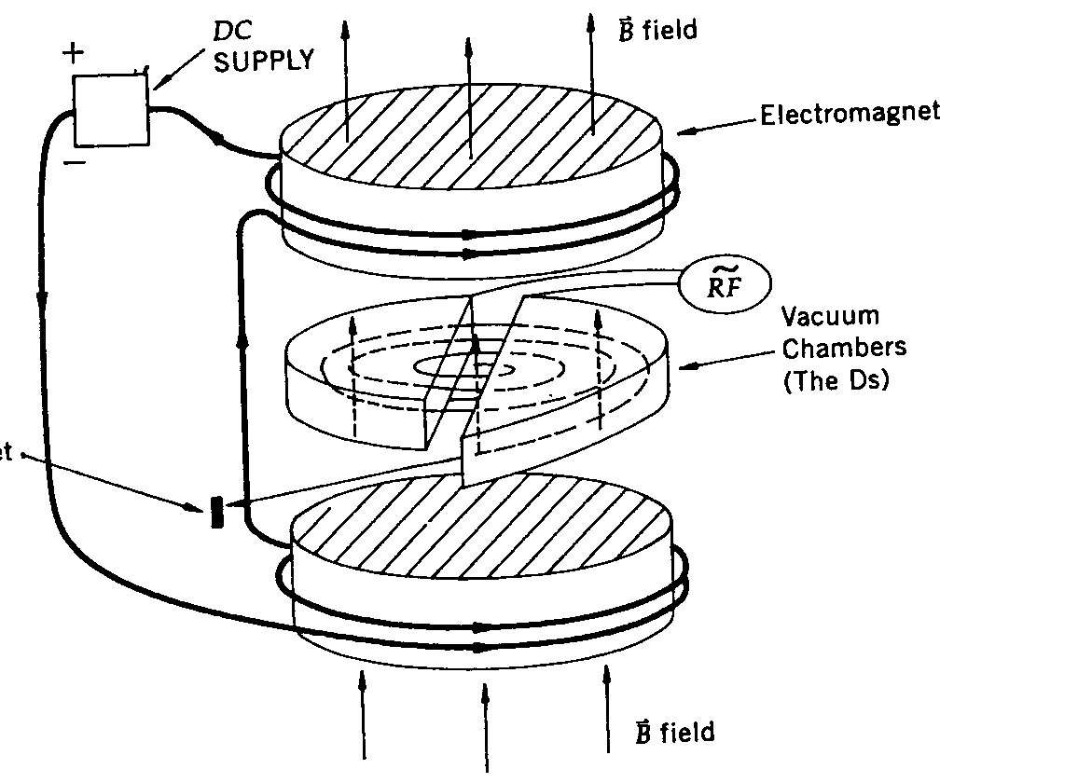
Resonance Accelerators: Cyclotron
Invented by E. Lawrence at Berkeley in 1930’s
While the D’s are connected to HV sources, there is no electric field inside the chamber due to Faraday effect
Strong electric field exists only in the gap between the D’s
An ion source is placed in the gap
The path is circular due to the perpendicular magnetic field
Ion does not feel any acceleration inside a D but gets bent due to magnetic field
When the particle exits a D, the direction of voltage can be changed and the ion gets accelerated before entering into the D on the other side
If the frequency of the alternating voltage is just right (cyclotron frequency), the charged particle gets accelerated continuously until it is extracted
The maximum energy is determined by the accelerator radius and the magnetic field strength

Slide 21
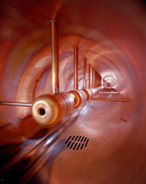
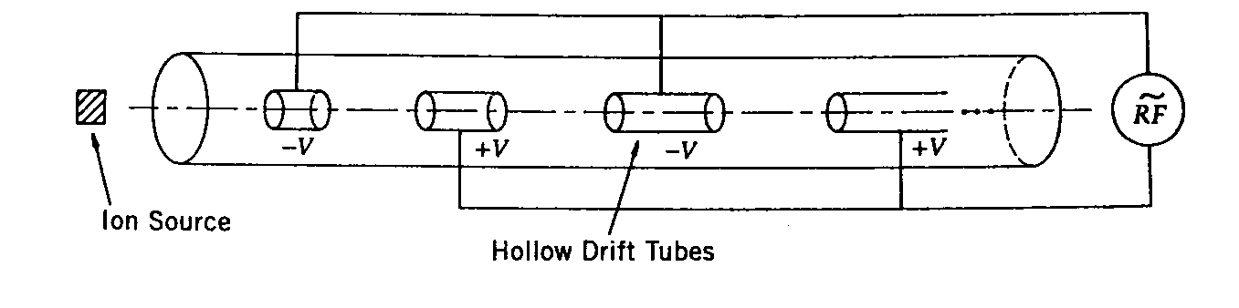
Resonance Accelerators: Linear Accelerator
Accelerates particles along a linear path using resonance principle
A series of metal tubes are located in a vacuum vessel and connected successively to alternating terminals of radio frequency oscillator
The directions of the electric fields changes before the particles exits the given tube
The tube length needs to get longer as the particle gets accelerated to keep up with the phase
These accelerators are used for accelerating light particles to very high energies

Slide 22
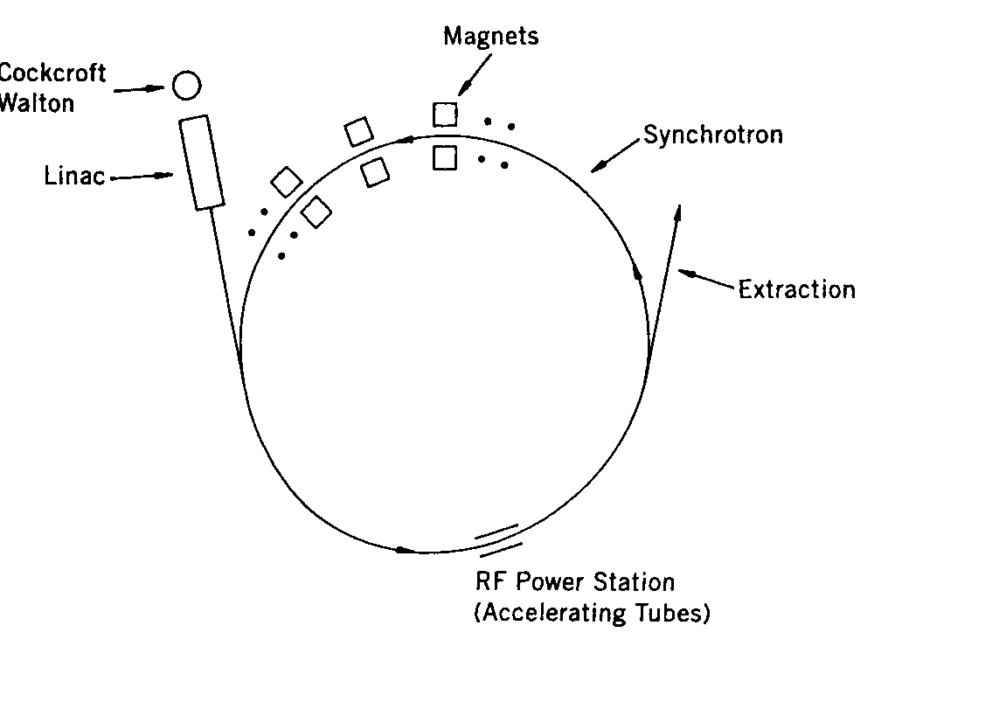
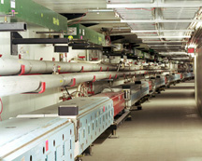
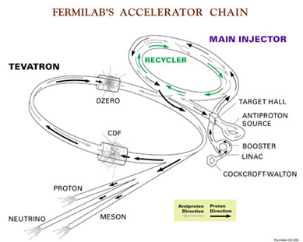
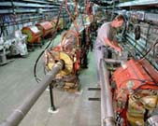
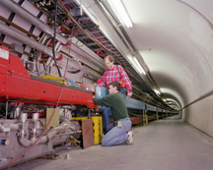
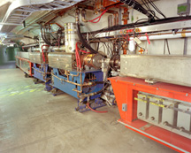
Synchroton Accelerators
Synchrotons use magnets arranged in a ring-like fashion with varying magnetic field and frequency
Multiple stages of accelerations are needed before reaching over GeV ranges of energies
RF power stations are located through the ring to pump electric energies into the particles

Slide 23
Comparisons between Tevatron and LHC
Tevatron: A proton-anti proton collider at 2TeV
  Need to produce anti-protons using accelerated protons at 150GeV
  Takes time to store sufficient number of anti-protons
    Need a storage accelerator for anti-protons
  Can use the same magnet and acceleration ring to circulate and accelerator particles
LHC: A proton-proton collier at 14TeV design energy
  Protons are easy to harvest
  Takes virtually no time to between a fresh fill of particles into the accelerator
  Must use two separate magnet and acceleration rings

Slide 24
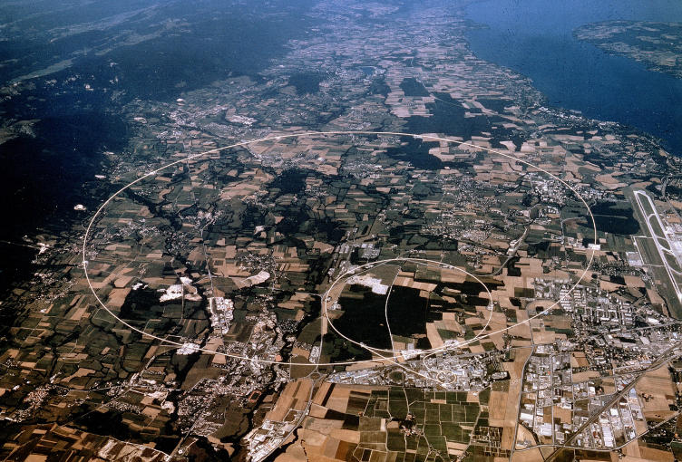
LHC @ CERN Aerial View
CMS
France
Geneva Airport
ATLAS
Swizerland

Slide 25
Particle Detectors
Subatomic particles cannot be seen by naked eyes but can be detected through their interactions within matter
What do you think we need to know first to construct a detector?
  What kind of particles do we want to detect?
    Charged particles and neutral particles
  What do we want to measure?
    Their momenta measured by tracking detectors and magnetic field
    Trajectories measured by tracking detectors
    Energies measured by the calorimeter
    Origin of interaction (interaction vertex) measured by a precision tracking det.
    Etc
  To what precision do we want to measure?
Depending on the answers to the above questions we use different detection techniques

Slide 26
Particle Detection Techniques
Charged Particle Tracks
Energy
Muon Tracks
Scintillating Fiber
Silicon Tracking
Calorimeter (dense)
Interaction
Point
B
EM
hadronic
Magnet
electron
photon
Wire Chambers
jet
muon
neutrino -- or any non-interacting particle missing transverse momentum
We know x,y starting momenta is zero, but
along the z axis it is not, so many of our measurements are in the xy plane, or transverse
Notes:
The Run 2 detector. Schematically how it works.
SVX and the like.

Slide 27
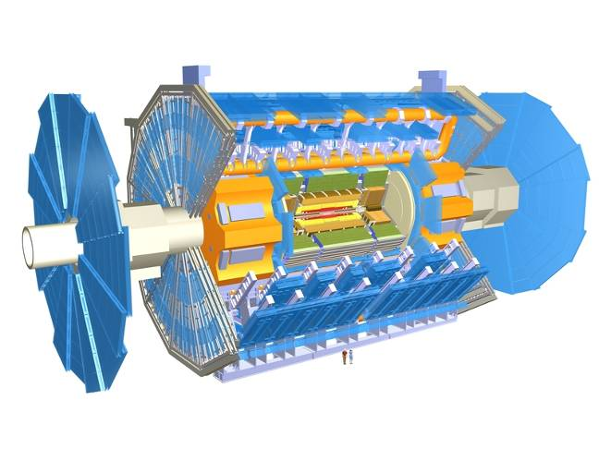
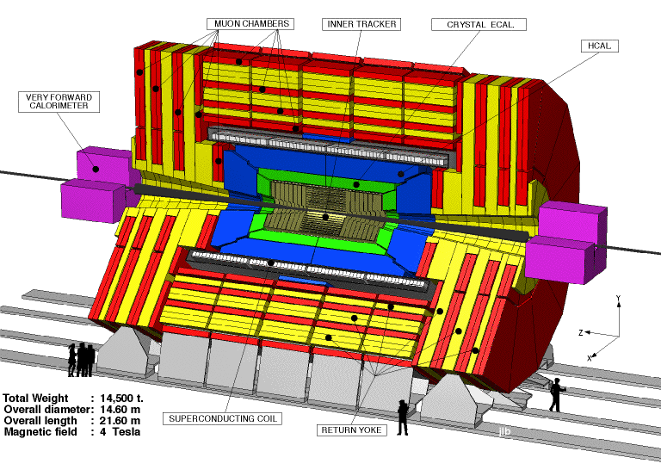
The ATLAS and CMS Detectors
Fully multi-purpose detectors with emphasis on lepton ID & precision E & P
Weighs 7000 tons and 10 story tall
Records 200 – 400 collisions/second
Records approximately 350 MB/second
Record over 2 PB per year ➔ 200*Printed material of the US Lib. of Congress

Slide 28
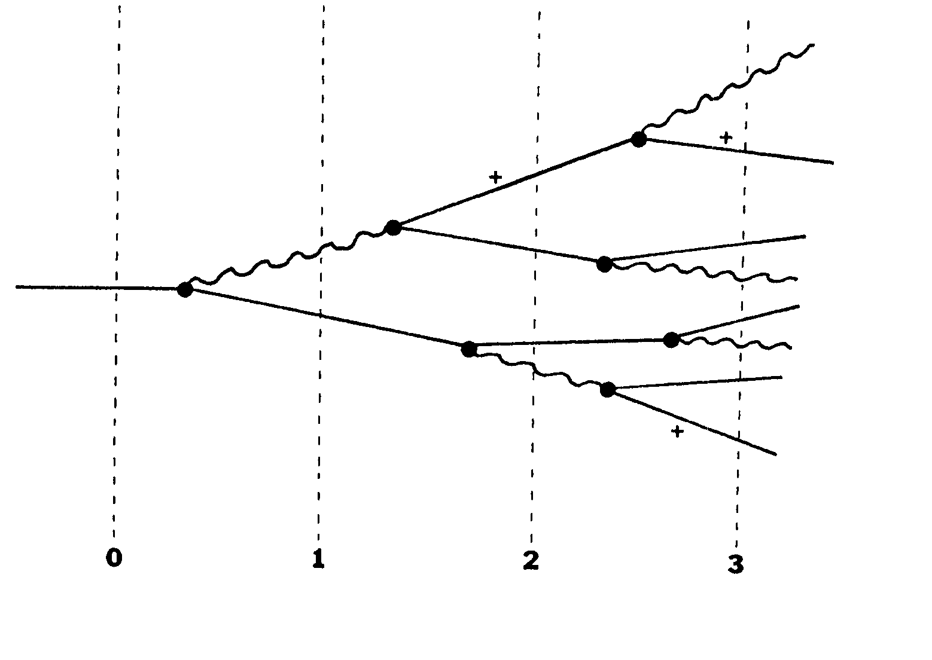
Electron Interactions in material (showering)
Photon, γ
Method of measuring the particle energy in a calorimeter!!

Slide 29
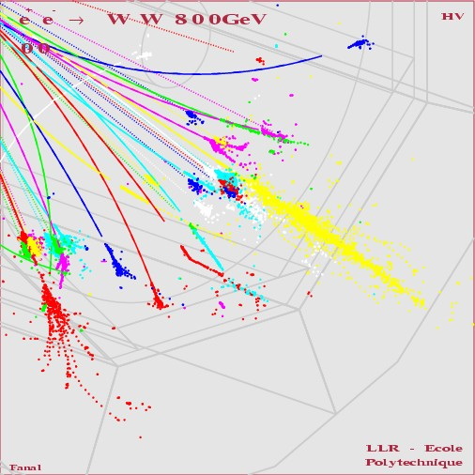
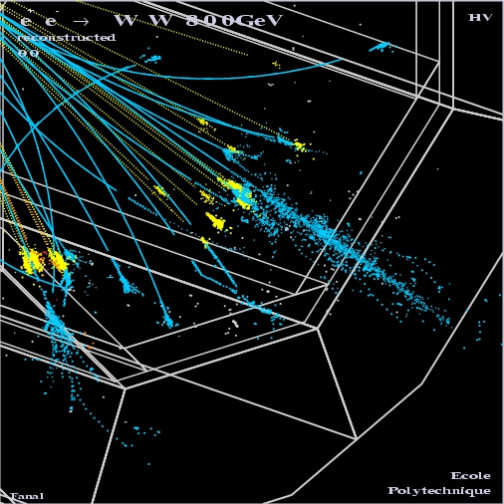
How particle showers look in detectors
Hadron
EM

Slide 30
Example Hadronic Shower (20GeV)

Slide 31
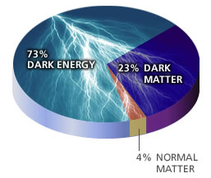
What’s the current hot issues?
Why is the mass range so large (0.1m_{p} – 175 m_{p})?
How do matters acquire mass?
  Higgs mechanism but where is the Higgs?
Why is the matter in the universe made only of particles?
Neutrinos have mass!! What are the mixing parameters, CP violations and mass ordering?
Why are there only three apparent forces?
Is the picture we present the real thing?
  What makes up the 96% of the universe?
  How about extra-dimensions?
Are there any other theories that describe the universe better?
  Does the super-symmetry exist?
Where is new physics?
  - Higgs mechanism, did we find the Higgs?

Slide 32
What is the Higgs and What does it do?
When there is perfect symmetry, one cannot tell directions!
Only when symmetry is broken, can one tell directions
Higgs field works to break the perfect symmetry and give mass
  This field exists right now amongst us so that we have mass
Sometimes, this field spontaneously generates a particle, the Higgs particle
So the Higgs particle is the evidence of the existence of the Higgs field!

Slide 33
How do we look for the Higgs?
Higgs particle is so heavy they decays into some other particles very quickly
When one searches for a new particle, you look for the easiest way to get at them
Of these the many signatures of the Higgs, some states are much easier to find, if it were the Standard Model one
  H→ γγ
  H → ZZ* → 4e, 4μ, 2e2μ, 2e2ν and 2μ2ν
  H→ WW*→2e2ν and 2μ2ν
  And many more complicated signatures

Slide 34
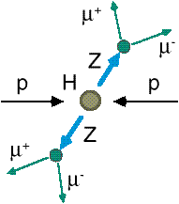
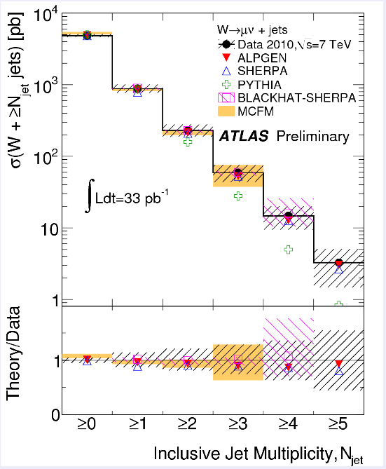
How do we look for the Higgs?
Identify the Higgs candidate events
Understand fakes (backgrounds)
Look for a bump!!
e⁺ (μ⁺)
e⁻ (μ⁻)
e⁺
e⁻

Slide 35
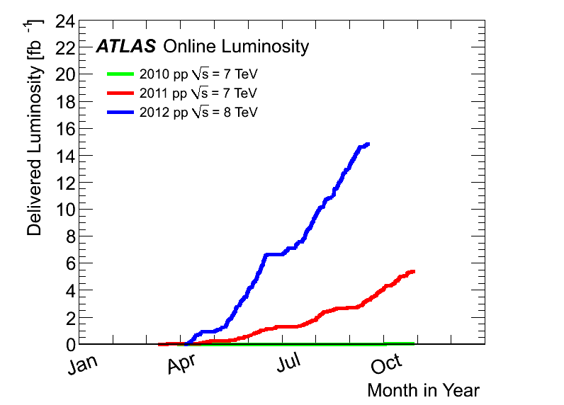
Amount of LHC Data
2012:16 ~17fb⁻¹
at 8 TeV thus far
~1fb⁻¹//week
Max inst. luminosity:
~ 7.7 x10³³ cm⁻² s⁻¹
4th July announcement
Superb performance!!
2011
5.6 fb⁻¹
at 7 TeV
2010
0.05 fb⁻¹
at 7 TeV

Slide 36
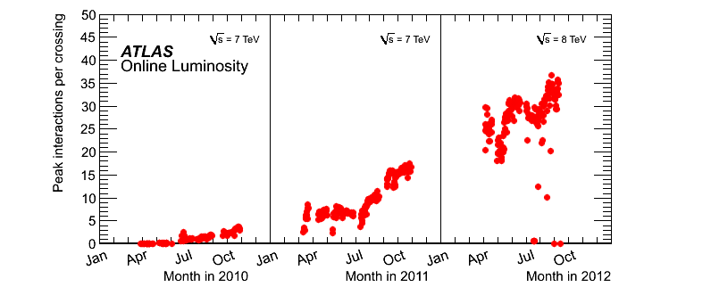
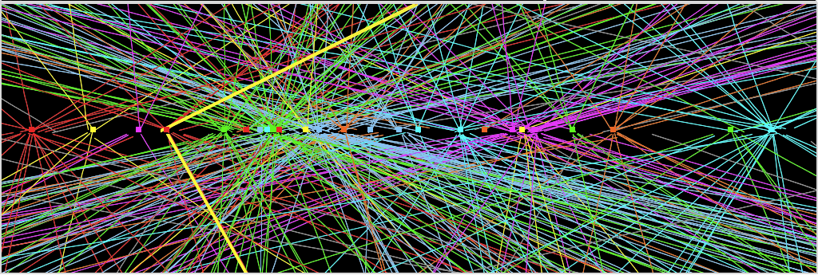
The BIG challenge in 2012: PILE-UP
Experiment’s
design value
(expected to be
reached at L=10³⁴ !)
Z→ μμ event from 2012 data with 25 reconstructed vertices
Z→ μμ

Slide 37
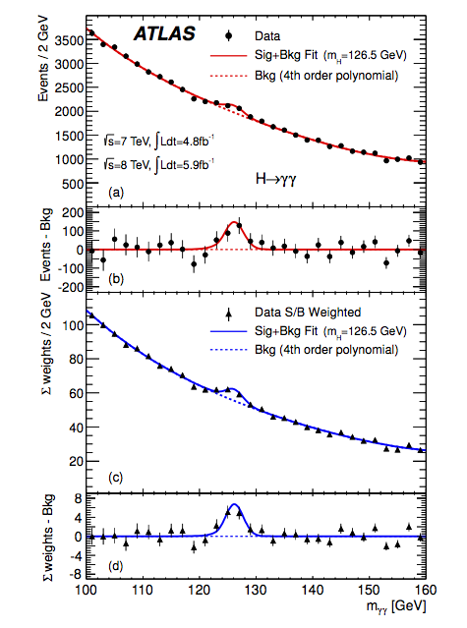
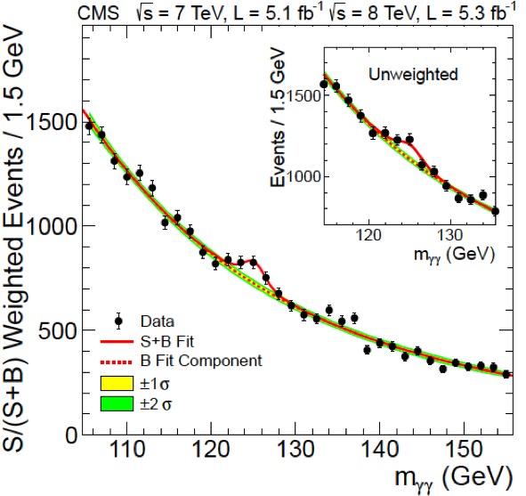
After all selections: 59059 events
“raw” mass spectrum
Data sample m_{H} of max local significance
significance obs. (exp. SM H)
2011 126 GeV 3.4 σ (1.6)
2012 127 GeV 3.2 σ (1.9)
2011+2012 126.5 GeV 4.5 σ(2.5) ATLAS
2011+2012 125.5GeV 4.1 σ(2.8) CMS
weighted: w_{i} ~S/B in each category i
peak above a large smooth background,
relies upon excellent mass resolution

Slide 38
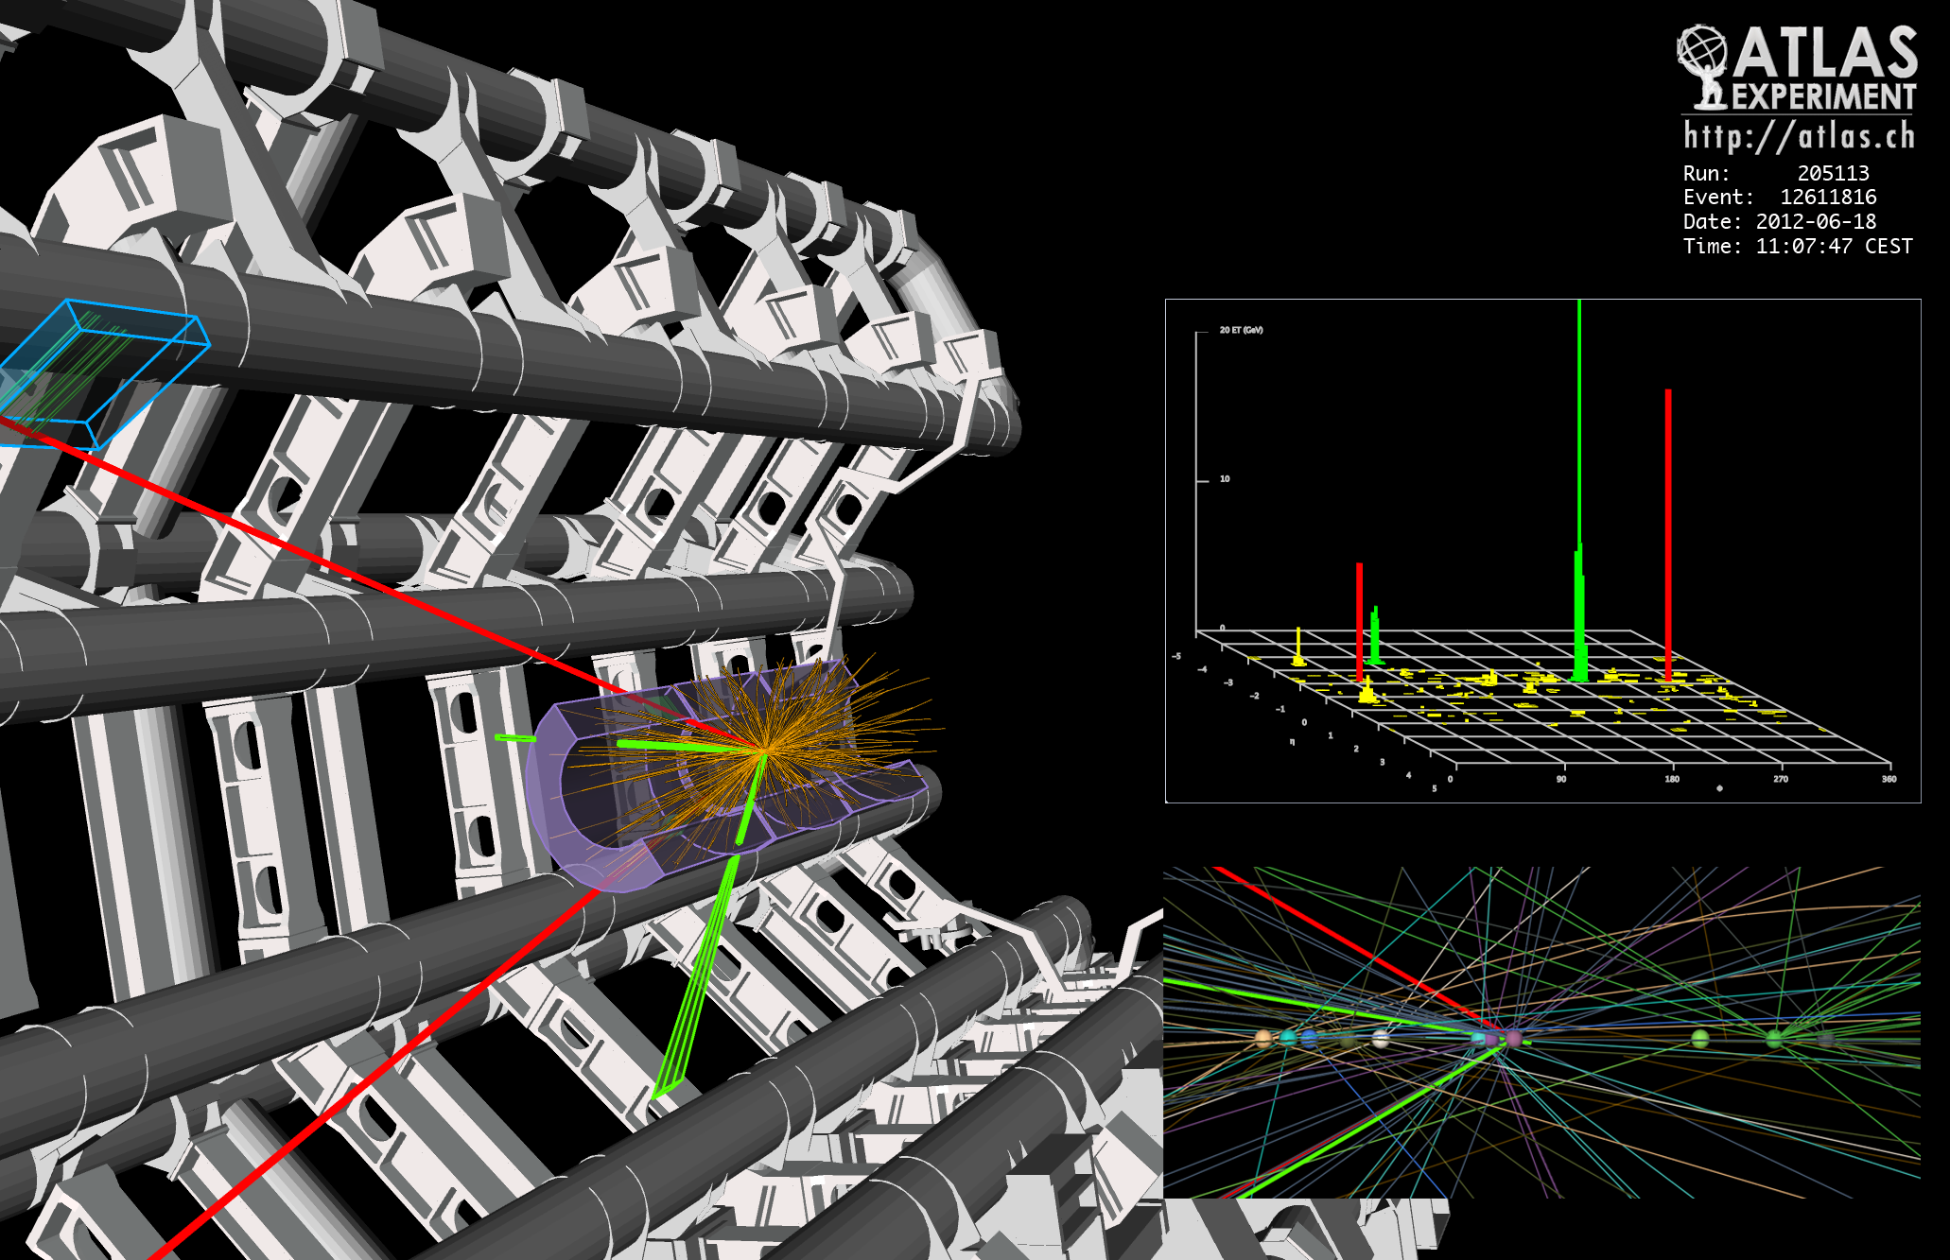
2e2μ candidate event w/ M2e2μ=123.9GeV
p_{T} (e,e,μ,μ)= 18.7, 76, 19.6, 7.9 GeV, m (e⁺e⁻)= 87.9 GeV, m(μ⁺μ⁻) =19.6 GeV
12 reconstructed vertices

Slide 39
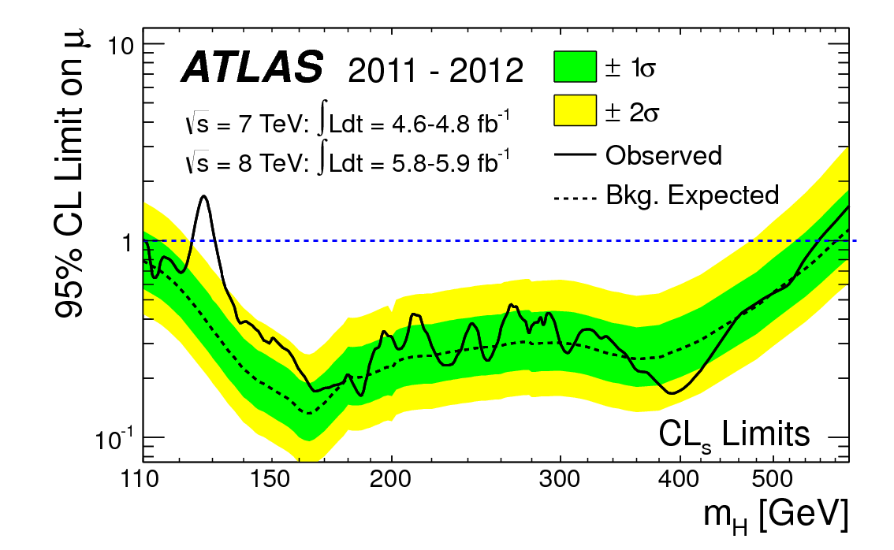
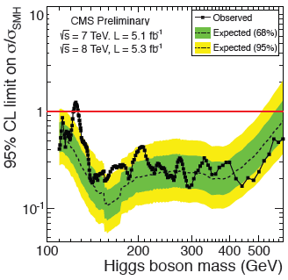
All Channel Combined Exclusion
Excluded at 95% CL:
112-122, 131-559 GeV
Only little sliver in 122 – 135 GeV and high mass left

Slide 40
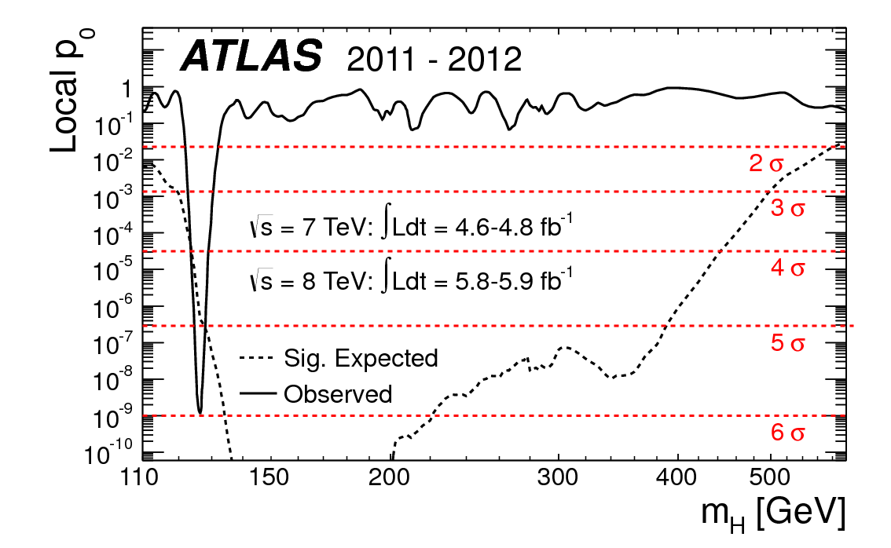
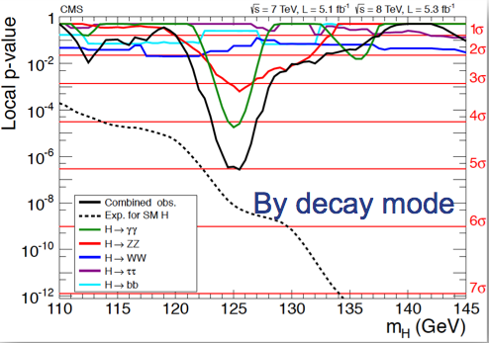
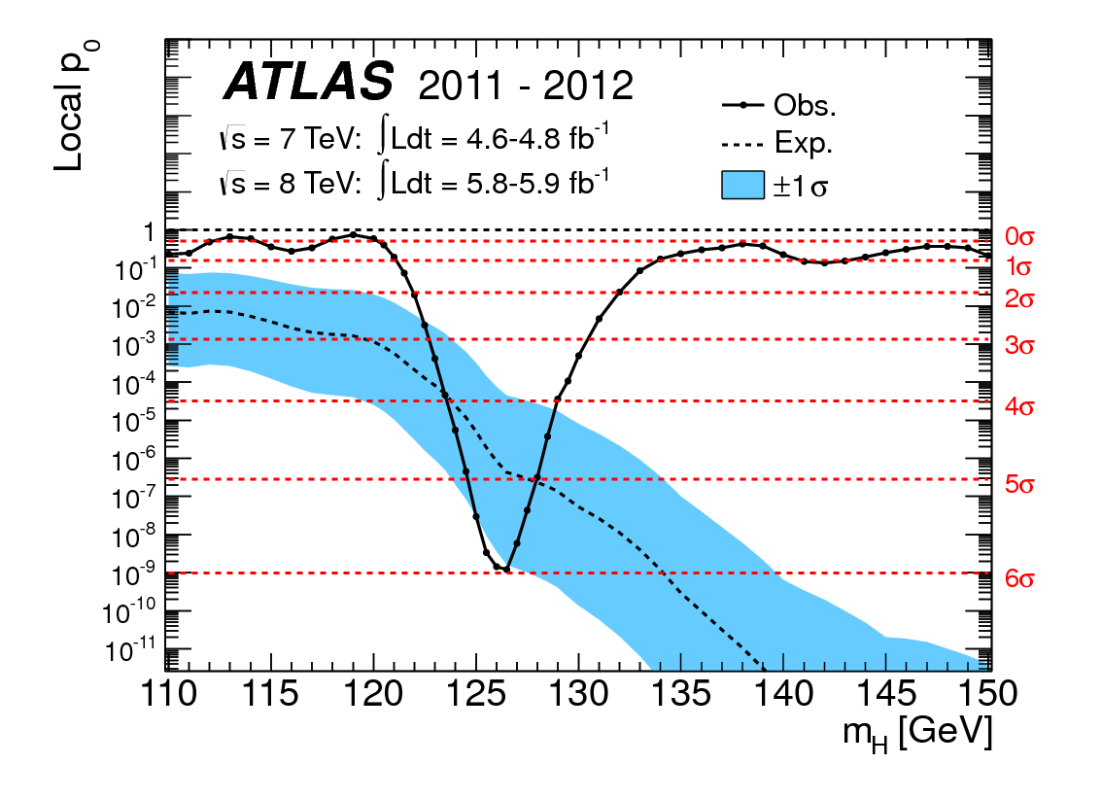
All Channel Combined Significance
ATLAS
CMS
5.9σ

Slide 41
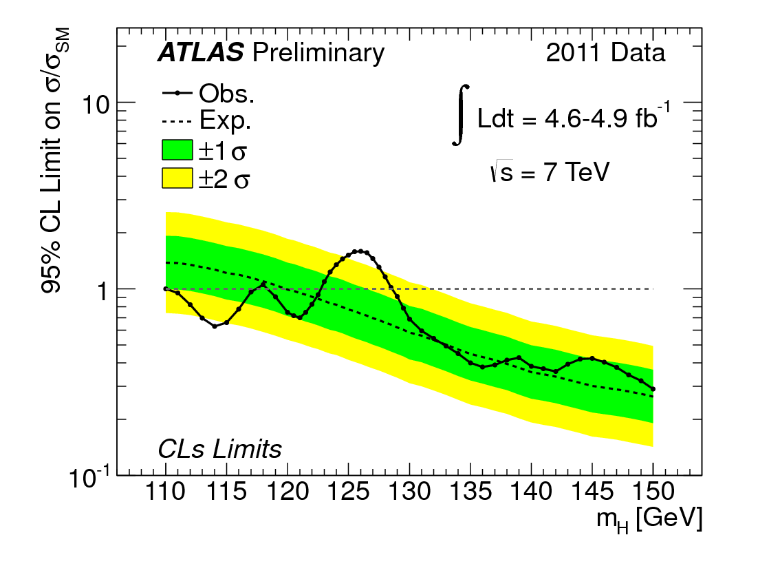
ATLAS and CMS Combined Higgs – end of 2011
Standard Model Higgs excluded in 110.0 <M_{H}<117.5 GeV, 118.5 <M_{H}< 122.5 GeV, and 129<M_{H}<539 GeV & 127.5<M_{H}<543GeV

Slide 42
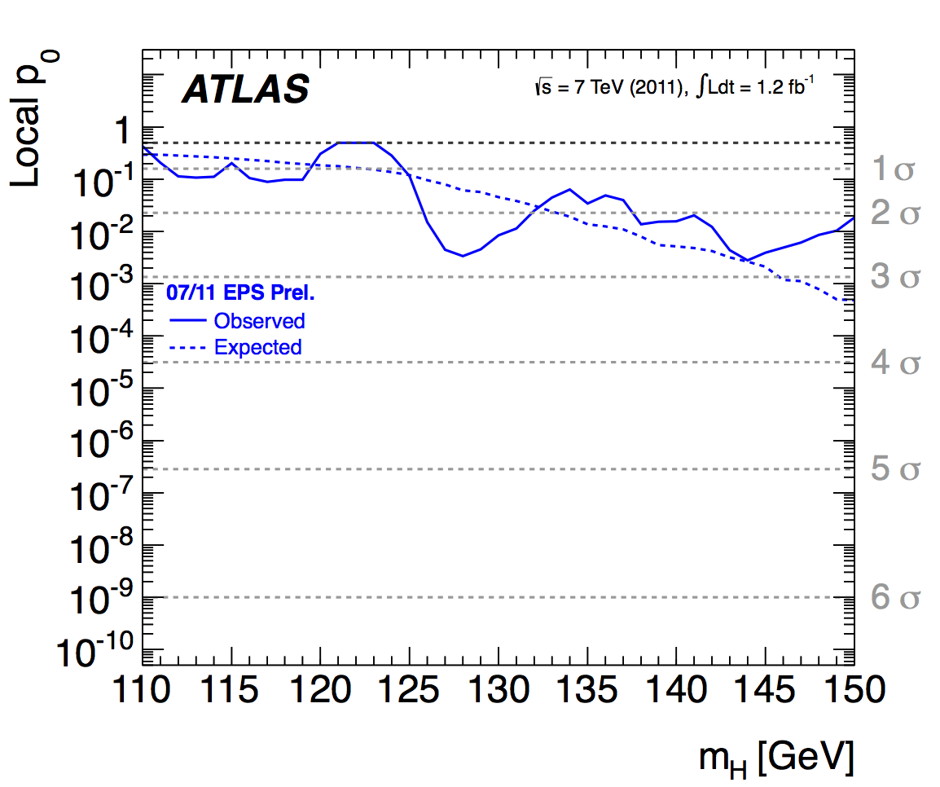
Evolution of the excess with time – Importance of a Large Data Set

Slide 43
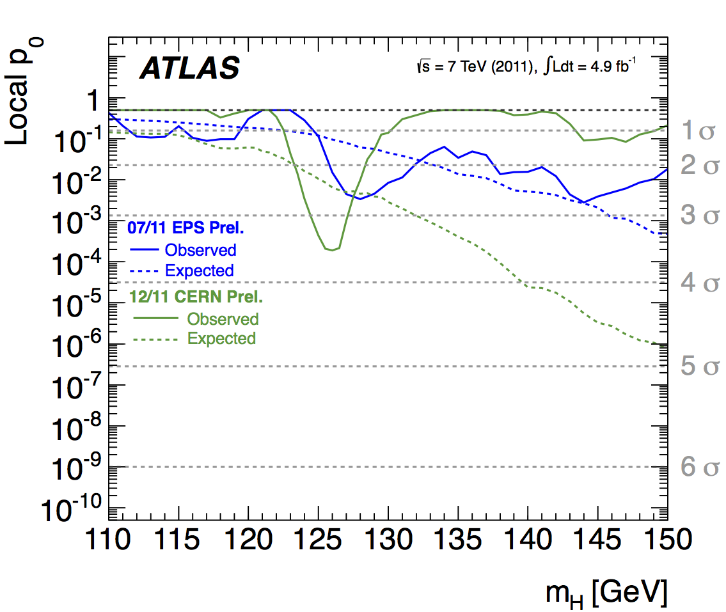
Evolution of the excess with time – Importance of a Large Data Set

Slide 44
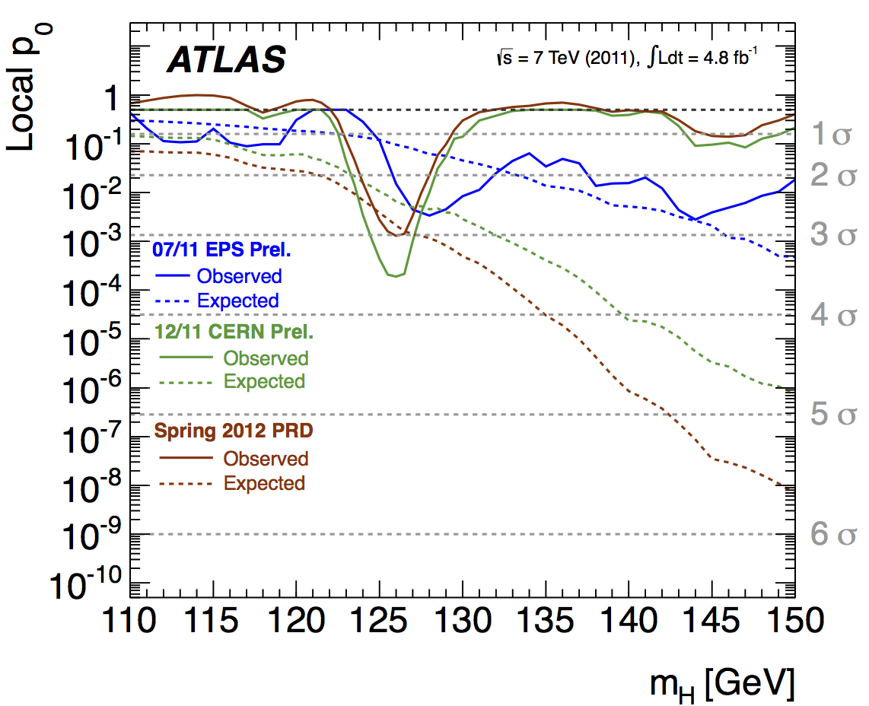
Evolution of the excess with time – Importance of a Large Data Set

Slide 45
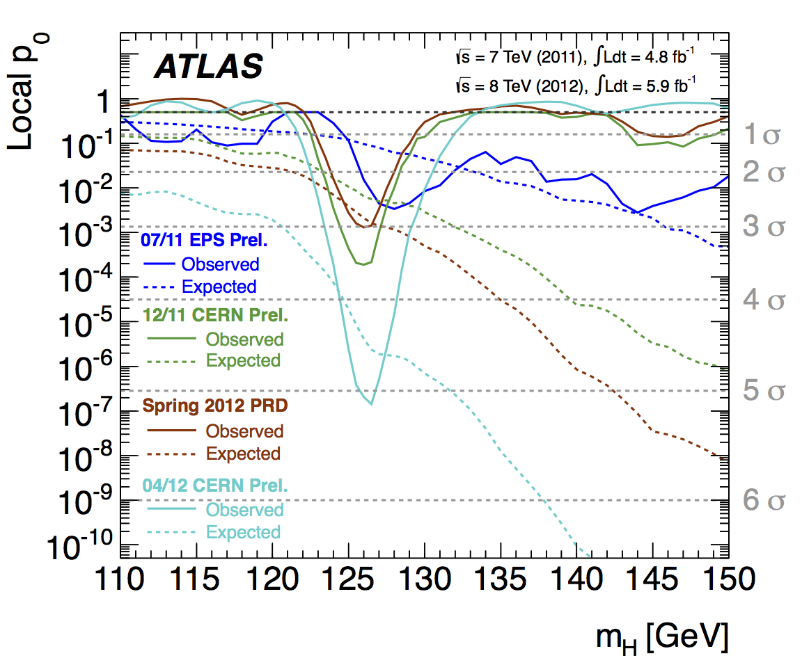
Evolution of the excess with time – Importance of a Large Data Set
07/12 CERN Prel.

Slide 46
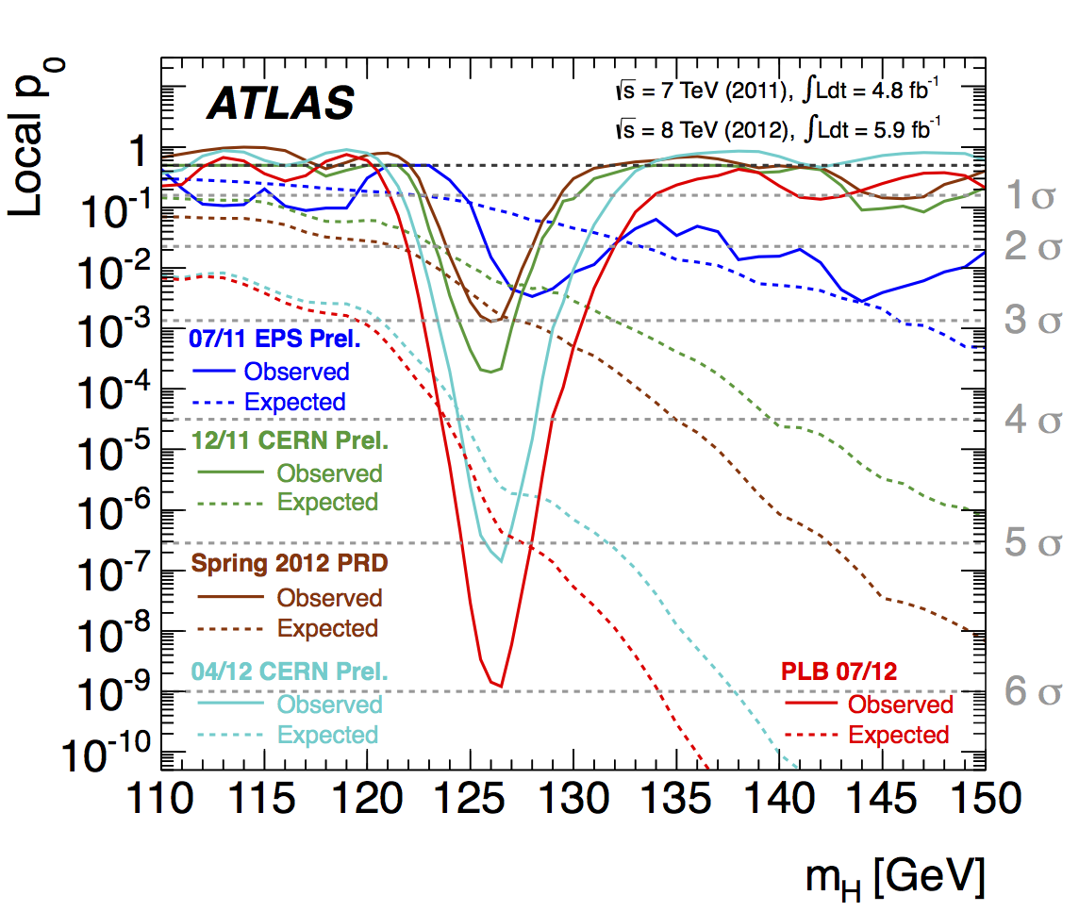
Evolution of the excess with time – Importance of a Large Data Set
07/12 CERN Prel.

Slide 47
So have we seen the Higgs particle?
The statistical significance of the finding is over 5 standard deviation
  Level of significance: 99.99994%
  We can be wrong once if we do the same experiment 1,740,000 times
So did we find the Higgs particle?
  We have discovered a new particle, the heaviest boson we’ve seen thus far
    Since this particle decays to two spin 1 particles, the possible spin states of this new boson is either 0 or 2!
  It has some properties consistent with the Standard Model Higgs particle
  We, however, do not have enough data to precisely measure all the properties – mass, life time, the rate at which this particle decays to certain other particles, etc – to definitively determine

Slide 48
So why is this discovery important?
This is the giant first in completing the Standard Model
Will help understand the origin of mass and the mechanism at which mass is acquired
Will help understand the origin and the structure of the universe and the inter-relations of the forces
Will help us make our lives better
Generate excitements and interests on science and train the next generation

Slide 49
Long Term LHC Plans
2012 run will end with ~23fb⁻¹
  Combined with 2011 run (5.6fb⁻¹), a total of ~29fb⁻¹
2013 – 2014: shutdown (LS1) to go to design energy (13 – 14TeV) at high inst. Luminosity
2015 – 2017: √s=13 – 14TeV, L~10³⁴, ~100fb⁻¹
2018: Shut-down (LS2)
2019 – 2021: √s~=13 – 14TeV, L~2x10³⁴, ~300fb⁻¹
2022 – 2023: Shut-down (LS3)
2023 – 2030(?): √s=13 – 14TeV, L~5x10³⁴ (HL-LHC), ~3000fb⁻¹

Slide 50
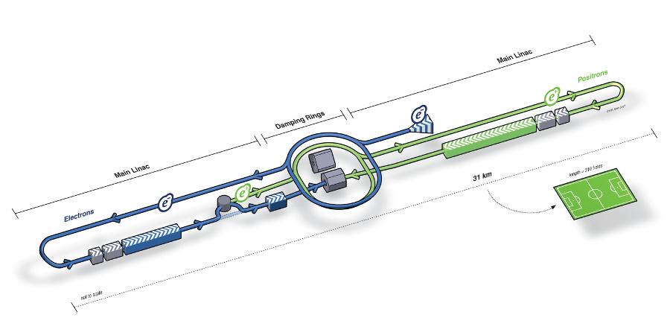
What next? Future Linear Collider
Now that we have found a new boson, precision measurement of the particle’s properties becomes important
An electron-positron collider on a straight line for precision measurements
10~15 years from now (In Dec. 2011, Japanese PM announced that they would bid for a LC in Japan)
  our Japanese colleagues have declared that they will bid for building a 250GeV machine in Japan!!
Takes 10 years to build the detector
L~31km
Circumference ~6.6km
~300 soccer fields

Slide 51
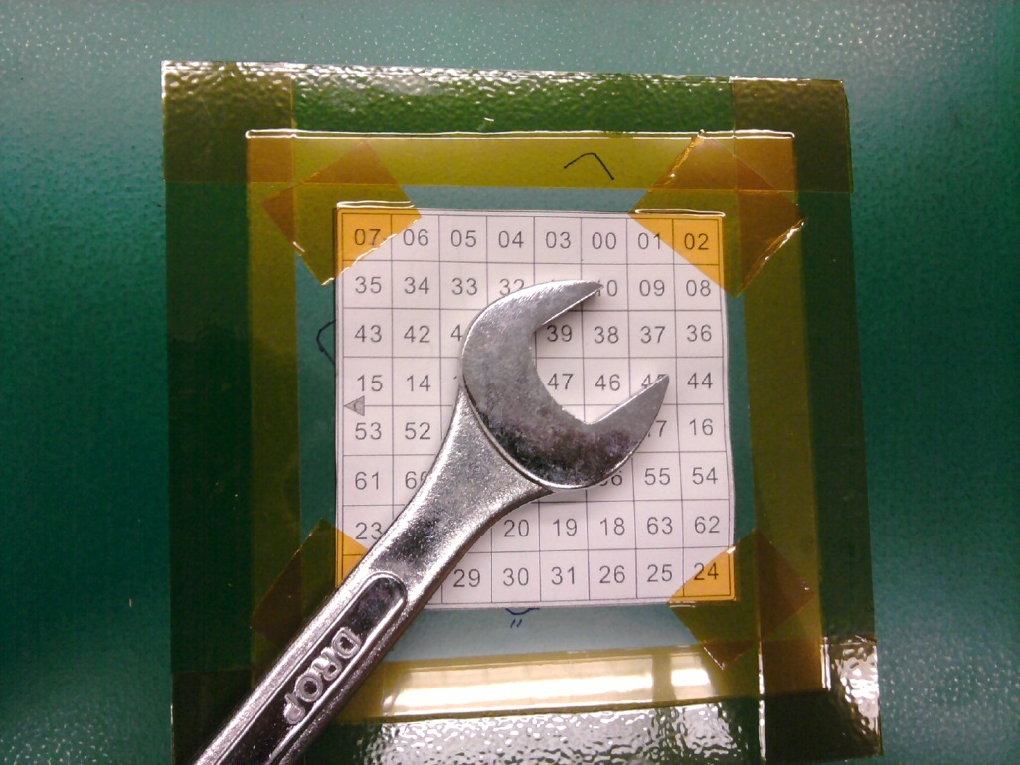
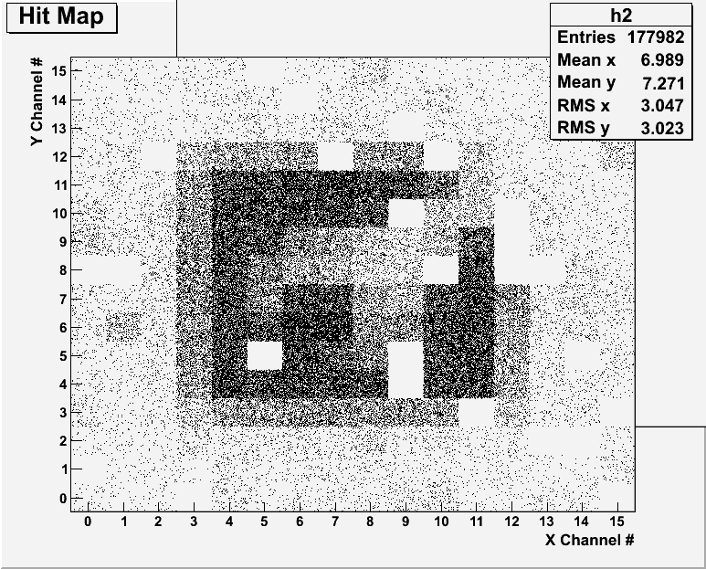
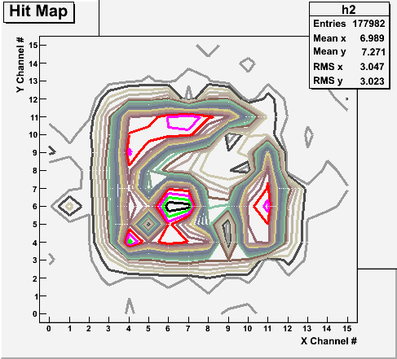
Bi-product of High Energy Physics Research
Can you see what the object is?
WWW Came from HEP!!!

Slide 52
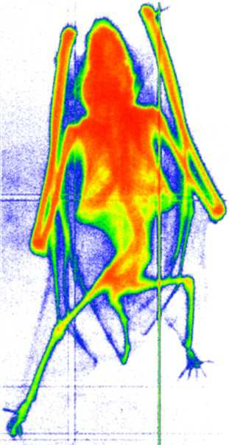
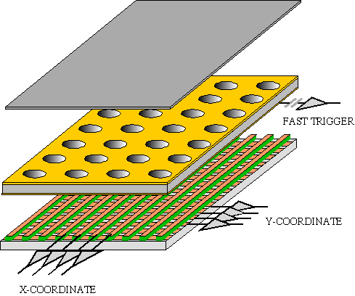
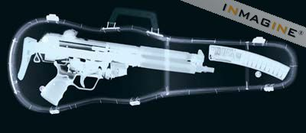
GEM Application Potential
FAST X-RAY IMAGING
Using the lower GEM signal, the readout can be self-triggered with energy discrimination:
9 keV absorption radiography of a small mammal (image size ~ 60 x 30 mm²)
A. Bressan et al,
Nucl. Instr. and Meth. A 425(1999)254
F. Sauli, Nucl. Instr. and Meth.A 461(2001)47

Slide 53
So what?
The LHC opened up a whole new kinematic regime
  The LHC performed extremely well in 2011 and 2012!
    Accumulated 23fb⁻¹ thus far, and still have a weeks to go – additional ~1fb⁻¹ expected!
Searches conducted with 4.8fb⁻¹ at 7TeV and 5.8fb⁻¹ at 8TeV of data
Observed a neutral boson couple to vector bosons and whose measured mass is
  At 5.9σ/5.0σ significance, corresponds to 1.7x10⁻⁹ bck fluctuation probability!
  Compatible with production and decay of SM Higgs boson
Excluded M_{H}=112 – 122 and 131 – 559GeV (ATLAS) @95% CL
Linear collider and advanced detectors are being developed for future precision measurements of Higgs and other newly discovered particles
Outcome and the bi-product of HEP research impacts our daily lives
  WWW came from HEP
  GEM will make a large screen low dosage X-ray imaging possible
Many technological advances happened through the last 100 years & coming 100 yrs
Continued and sufficient investment to forefront scientific endeavors are absolutely necessary for the future!

