Slide 1
PHYS 3313 – Section 001 Lecture #2
Wednesday, Aug. 28, 2013
Dr. Jaehoon Yu
Class Organization and Various Info.
Classical Physics
Kinetic Theory of Gas
Concept of Waves and Particles
Conservation Laws and Fundamental Forces
Atomic Theory of Matter
Unsolved Questions of 1895 and New Horizon
Unsolved Questions Today!

Slide 2
Announcements
Reading assignment #1:
Review Appendices 1, 2 and 9
Read and follow through Appendices 3, 5, 6 and 7 by Tuesday, Sept. 3
There will be a quiz next Wednesday, Sept. 4, on this reading assignment
A faculty research expo today at 4pm, SH101
A National Academy of Sciences member, Dr. David Nygren, will give a colloquium at 4:00pm, Wednesday, Nov. 6
Required attendance!
Triple extra credit points!!

Slide 3
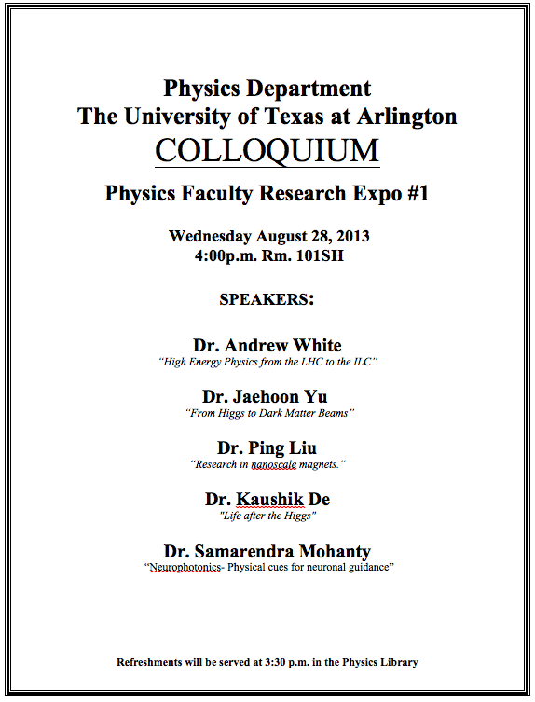

Slide 4
Special Project #1
Compute the electric force between the two protons separate the farthest in an intact U²³⁸ nucleus. Use the actual size of the U²³⁸ nucleus. (10 points)
Compute the gravitational force between the two protons separate the farthest in an intact U²³⁸ nucleus. (10 points)
Express the electric force in #1 above in terms of the gravitational force in #2. (5 points)
You must look up the mass of the proton, actual size of the U²³⁸ nucleus, etc, and clearly write them on your project report
You MUST have your own, independent answers to the above three questions even if you worked together with others. All those who share the answers will get 0 credit if copied.
Due for the submission is Monday, Sept. 9!

Slide 5
Information & Communication Source
Course web page: http://www-hep.uta.edu/%7Eyu/teaching/fall13-3313-001/fall13-3313-001.html
Contact information & Class Schedule
Syllabus
Homework
Holidays and Exam days
Evaluation Policy
Class Style & Communication
Other information
Primary communication tool is e-mail: Make sure that your e-mail at the time of course registration is the one you most frequently read!!
Office Hours: 2:30 – 3:40pm, Mondays and Wednesdays or by appointments

Slide 6
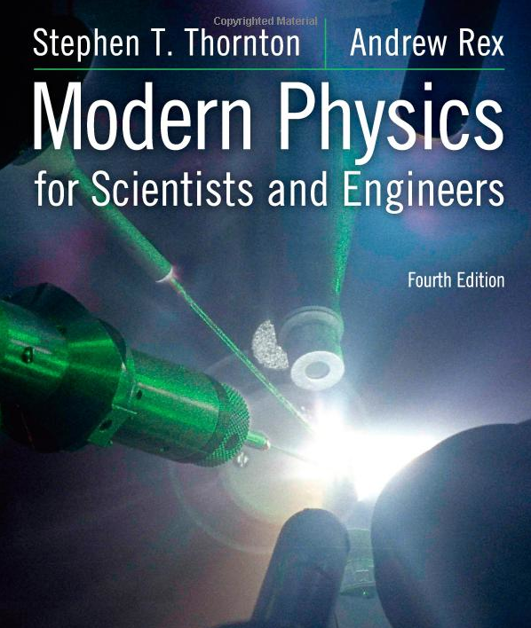
Textbook
Title: Modern Physics for Scientists and Engineers
4th edition
Authors: S.T. Thornton and A. Rex
ISBN: 978-1-133-10372-1

Slide 7
Evaluation Policy
Homework: 30%
Exams
Mid-term Exam (Wed., Oct. 16): 20%
Final Comprehensive Exam (11 – 1:30pm, Mon, Dec. 9): 25%
Missing an exam is not permissible unless pre-approved
No makeup test
You will get an F if you miss any of the exams without a prior approval
Group Research Project: 15%
Pop-quizzes: 10%
Extra credits: 10% of the total
Grading will be done on a sliding scale
55% of the grade is in your hand!!
100%

Slide 8
Homework
Solving homework problems is the only way to comprehend class material
Consists of a lot of reading, deriving and writing
Each homework carries the same weight
ALL homework grades will be used for the final grade
Home work will constitute 30% of the total
A good way of keeping your grades high
Strongly encouraged to collaborate
Just make sure to submit your own answers written in your OWN way!!

Slide 9
Attendances and Class Style
Attendances:
Will be taken randomly
Will be used for extra credits
Class style:
Lectures will be on electronic media
The lecture notes will be posted on the web AFTER each class
Will be mixed with traditional methods
Active participation through questions and discussions are STRONGLY encouraged ➔ Extra credit….
Communication between you and me is extremely important
If you have problems, please do not hesitate talking to me

Slide 10
Class Communication Listserv
An e-mail distribution list using the UTA Listserv system has been established:
PHYS3313-001-FALL13
Please subscribe to the list as soon as possible:
Send e-mail to listserv@uta.edu from your most frequently read e-mail account to subscribe as follows
Without CC to any other e-mail, No subject or signature
Put in the body of the message
Subscribe PHYS3313-001-FALL13 FirstName LastName
The system will send you e-mail for you to confirm your own subscription ➔ Please click the confirmation link
Extra credit points
Done by midnight Friday, Aug. 30: 5 points
Done by midnight Sunday, Sept. 1: 3 points

Slide 11
Extra credit
Up to 10% addition to the total
Could boost a B to A, C to B or D to C
What constitute for extra credit?
Random attendances
Physics Colloquium Participations
Mark Nov. 6 colloquium by a National Academy of Sciences speaker➔ 3 times the normal credit!!
Strong participation in the class discussions
Special projects (these are the biggies!)
Watch the valid planetarium shows
Many other opportunities

Slide 12
Valid Planetarium Shows
Regular running shows
Stars of the Pharaohs – Thursdays at 6:00, Saturdays at 5:30, Sundays at 1:30
Bad Astronomy – Fridays at 6:00, Saturdays at 2:30
Shows that need special arrangements
Astronaut
Black Holes (can watch up to 2 times!)
Experience the Aurora
IBEX
Ice Worlds
Magnificent Sun
Mayan Prophecies
Nano Cam
Time Space
Two Small Pieces of Glass
Unseen Universe: The Vision of SOFIA
Violent Universe
We Are Astronomers
How to submit for extra credit?
Obtain the ticket stub that is signed and dated by the planetarium star lecturer of the day
Collect the ticket stubs
Tape all of them on a sheet of paper with your name and ID written on it
Submit the sheet at the end of the semester when asked

Slide 13
What can you expect from this class?
All A’s would be perfect for you, wouldn’t it?
But easy come easy go
Must put in efforts to make it last and meaningful….
This class is going to be challenging!!
You will earn your grade in this class.
You will need to put in sufficient time and sincere efforts
Exams and quizzes will be tough!!
Problems might not look exactly like what you learned in the class
Just putting the right answer in a free response problem will not cut!!
But you have a great control of your grade in your hands, up to 55%!!!
Homework is 30% of the total grade!!
Means you will have many homework problems
Sometimes much more than any other classes
Sometimes homework problems will be something that you have yet to learn in class
Exam’s problems will be easier that homework problems but the same principles!!
Group research projects!
Extra credit 10%
I will work with you so that your efforts are properly rewarded

Slide 14
What do we want to learn in this class?
The physics that provided fundamentals to the technical progress for us
Learn concepts of quantum theory for microscopic phenomena and relativity for phenomena with high speed
Learn physical principles that we still exploit
Learn skills to express observations and measurements in mathematical language
Learn skills to research literatures and express your research in systematic manner in writing
Build up confidence in your physics abilities and to take on any challenges laid in front of you!!
Most importantly, let us have a lot of FUN!!

Slide 15
In this course, you will learn…
Concepts and derivation of many of the modern physics
Special relativity
Quantum theory
Atomic physics
Condensed Matter physics
Nuclear physics
Particle Physics
Focus on learning about the concepts with less complicated math
You will be able to understand what fundamental physics provides bases for the current technology

Slide 16
Why do Physics?
Exp.{
To understand nature through experimental observations and measurements (Research)
Establish limited number of fundamental laws, usually with mathematical expressions
Predict the nature’s course
Theory and Experiment work hand-in-hand
Theory works generally under restricted conditions
Discrepancies between experimental measurements and theory are good for improvements
Improves our everyday lives, even though some laws can take a while till we see them amongst us
Theory {
16

Slide 17
Brief History of Physics
AD 18th century:
Newton’s Classical Mechanics: A theory of mechanics based on observations and measurements, concepts of many kinematic parameters, including forces
First unification of forces – planetary forces and forces on the Earth
AD 19th Century:
Electricity, Magnetism, and Thermodynamics
Late AD 19th and early 20th century (Modern Physics Era, after 1895)
Physicists thought everything was done and nothing new could be discovered
17

Slide 18
State of Minds in late 19th Century
Albert A. Michelson, 1894
The more important fundamental laws and facts of physical science have all been discovered, and these are now so firmly established that the possibility of their ever being supplanted in consequence of new discoveries is exceedingly remote. Our future discoveries must be looked for in the sixth place of decimals!
William Thompson (Lord Kelvin), 1900
There is nothing new to be discovered in physics now. All that remains is more and more precise measurement.

Slide 19
Brief History of Physics
AD 18th century:
Newton’s Classical Mechanics: A theory of mechanics based on observations and measurements, concepts of many kinematic parameters, including forces
First unification of forces – planetary forces and forces on the Earth
AD 19th Century:
Electricity, Magnetism, and Thermodynamics
Late AD 19th and early 20th century (Modern Physics Era, after 1895)
Physicists thought everything was done and nothing new could be discovered
Concept of atoms did not quite exist
There were only handful of problems not well understood late 19th century became the basis for new discoveries in 20th century
That culminates in understanding of phenomena in microscopic scale and extremely high speed approaching the speed of light (3x10⁸m/s)
Einstein’s theory of relativity: Generalized theory of space, time, and energy (mechanics)
Quantum Mechanics: Theory of atomic phenomena
19

Slide 20
MECHANICS
CLASSICAL
PHYSICS
All these in just 200 years!!
ELECTRICITY
AND
MAGNETISM
THERMODYNAMICS
CONSERVATION LAWS

Slide 21
Triumph of Classical Physics: The Conservation Laws
Conservation of energy: The total sum of energy (in all its forms) is conserved in all interactions.
Conservation of linear momentum: In the absence of external forces, linear momentum is conserved in all interactions.
Conservation of angular momentum: In the absence of external torque, angular momentum is conserved in all interactions.
Conservation of charge: Electric charge is conserved in all interactions.

Slide 22
Mechanics
Galileo (1564-1642)
First great experimentalist
Principle of inertia
Established experimental foundations

Slide 23
Isaac Newton (1642-1727)
Three laws describing the relationship between mass and acceleration, concept of forces ➔ First unification of forces!!
Newton’s first law (law of inertia): An object in motion with a constant velocity will continue in motion unless acted upon by some net external force.
Newton’s second law: Introduces force (F) as responsible for the the change in linear momentum (p):
or
Newton’s third law (law of action and reaction): The force exerted by body 1 on body 2 is equal in magnitude and opposite in direction to the force that body 2 exerts on body 1.

Slide 24
Electromagnetism
Contributions made by:
Coulomb (1736-1806)
Oersted (1777-1851)
Young (1773-1829)
Ampère (1775-1836)
Faraday (1791-1867)
Henry (1797-1878)
Maxwell (1831-1879)
Hertz (1857-1894)

Slide 25
Culminates in Maxwell’s Equations
In the absence of dielectric or magnetic materials, the four equations developed by Maxwell are:
Gauss’ Law for electricity
A generalized form of Coulomb’s law relating electric field to its sources, the electric charge
Gauss’ Law for magnetism
A magnetic equivalent of Coulomb’s law relating magnetic field to its sources. This says there are no magnetic monopoles.
Faraday’s Law
An electric field is produced by a changing magnetic field
Generalized Ampére’s Law
A magnetic field is produced by an electric current or by a changing electric field

Slide 26
Thermodynamics
Deals with temperature, heat, work, and the internal energy of systems
Contributions made by:
Benjamin Thompson (1753-1814)
Sadi Carnot (1796-1832)
James Joule (1818-1889)
Rudolf Clausius (1822-1888)
William Thompson (1824-1907)

Slide 27
Primary Results of Thermodynamics
Introduced thermal equilibrium
The first law establishes heat as energy
Introduces the concept of internal energy
Interprets temperature as a measure of the internal energy
Generates limitations of the energy processes that cannot take place

