Slide 1
PHYS 3313 – Section 001 Lecture #3
Wednesday, Sept. 4, 2013
Dr. Jaehoon Yu
Kinetic Theory of Gas
Concept of Waves and Particles
Conservation Laws and Fundamental Forces
Atomic Theory of Matter
Unsolved Questions of 1895 and New Horizon
Unsolved Questions Today!

Slide 2
Announcements
Class e-mail distribution list subscription:
29/50 have subscribed to the list
Please subscribe to the list before 8pm tonight ( see page 10 of the 8/28 lecture note!)
I will send out a test message to confirm the communication
Please reply only to ME not to the entire class!! Check the recipient before clicking the send button!!
A faculty research expo-II today at 4pm, SH101

Slide 3
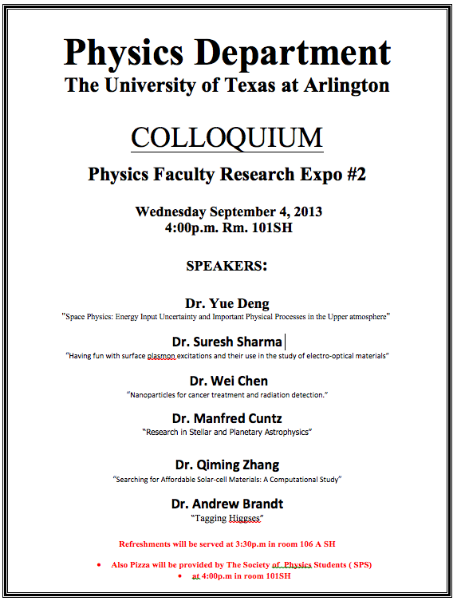

Slide 4
Special Project #1
Compute the electric force between the two protons separate the farthest in an intact U²³⁸ nucleus. Use the actual size of the U²³⁸ nucleus. (10 points)
Compute the gravitational force between the two protons separate the farthest in an intact U²³⁸ nucleus. (10 points)
Express the electric force in #1 above in terms of the gravitational force in #2. (5 points)
You must look up the mass of the proton, actual size of the U²³⁸ nucleus, etc, and clearly write them on your project report
You MUST have your own, independent answers to the above three questions even if you worked together with others. All those who share the answers will get 0 credit if copied.
Due for the submission is Monday, Sept. 9!

Slide 5
The Kinetic Theory of Gases
Contributions made by:
Robert Boyle (1627-1691) ➔ PV = constant (fixed T)
Jacques Charles (1746-1823) & Joseph Louis Gay-Lussac (1778-1823) ➔ V/T=constant (fixed P)
Culminates in the ideal gas equation for n moles of a “simple” gas:
(where R is the ideal gas constant, 8.31 J/mol · K)
We now know that gas consists of rapidly moving atoms and molecules, bouncing off each other and the walls!!

Slide 6
Additional Contributions
Amedeo Avogadro (1776-1856) ➔ Hypothesized in 1811 that the equal V of gases at the same T and P contain equal number of molecules (N_{A}=6.023x10²³ molecules/mol)
1 mole of Hydrogen molecule is 2g & 1 mole of carbon is 12g.
John Dalton (1766-1844) opposed due to confusion between his own atomic model and the molecules
Daniel Bernoulli (1700-1782) ➔ Kinetic theory of gases in 1738
By 1895, the kinetic theory of gases are widely accepted
Ludwig Boltzmann (1844-1906), James Clerk Maxwell (1831-1879) & J. Willard Gibbs (1939-1903) made statistical interpretation of thermodynamics bottom half of 19th century

Slide 7
Primary Results of Statistical Interpretation
Average molecular kinetic energy is directly related to absolute temperature
Internal energy U is directly related to the average molecular kinetic energy
Internal energy is equally distributed among the number of degrees of freedom (f ) of the system
(N_{A} = Avogadro’s Number)
And many others

Slide 8
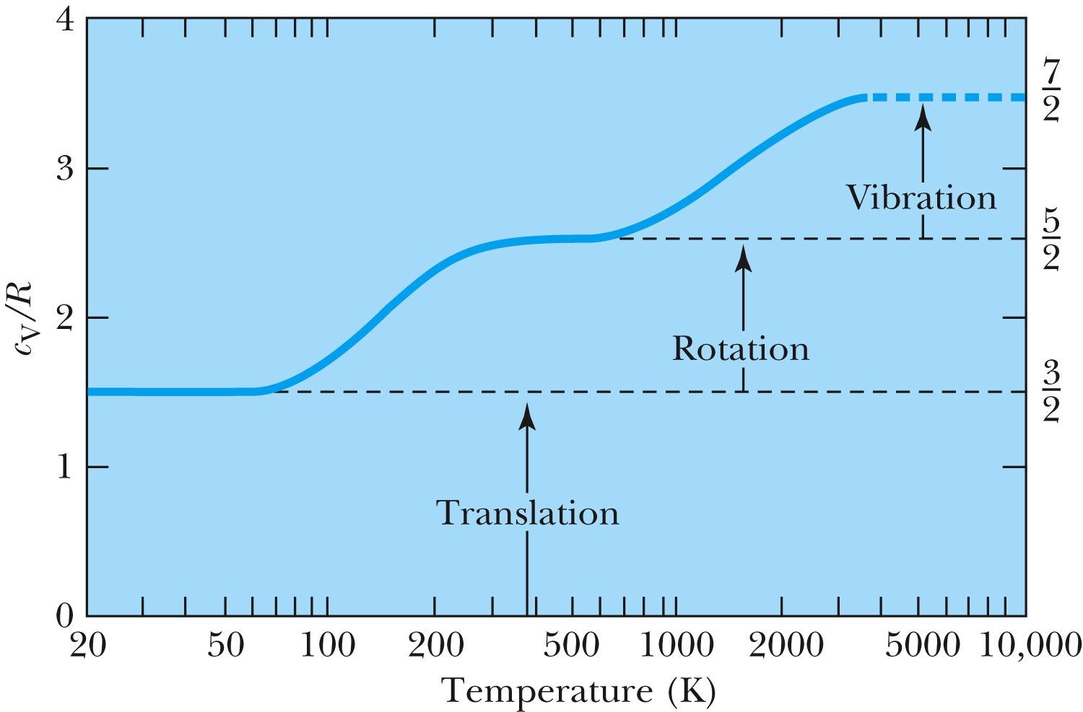
Experimental Demonstration of Equi-partition Principle

Slide 9
Concept of Waves and Particles
Two ways in which energy is transported:
Point mass interaction: transfers of momentum and kinetic energy: particles
Extended regions wherein energy transfers by way of vibrations and rotations are observed: waves

Slide 10
Particles vs. Waves
Two distinct phenomena describing physical interactions
Both required Newtonian mass
Particles in the form of point masses and waves in the form of perturbation in a mass distribution, i.e., a material medium
The distinctions are observationally quite clear
However, not so obvious for the case of visible light
Thus as the 17th century begins the major disagreement arose concerning the nature of light

Slide 11
The Nature of Light
Isaac Newton promoted the corpuscular (particle) theory
Published a book “Optiks” in 1704
Particles of light travel in straight lines or rays
Explained sharp shadows
Explained reflection and refraction
Christian Huygens (1629 -1695) promoted the wave theory
Presented the theory in 1678
Light propagates as a wave of concentric circles from the point of origin
Explained reflection and refraction
Could not explain “sharp” edges of the shadow
Thomas Young (1773 -1829) & Augustin Fresnel (1788 – 1829) ➔ Showed in 1802 and afterward that light clearly behaves as wave through two slit interference and other experiments
In 1850 Foucault showed that light travel slowly in water than air, the final blow to the corpuscular theory in explaining refraction

Slide 12
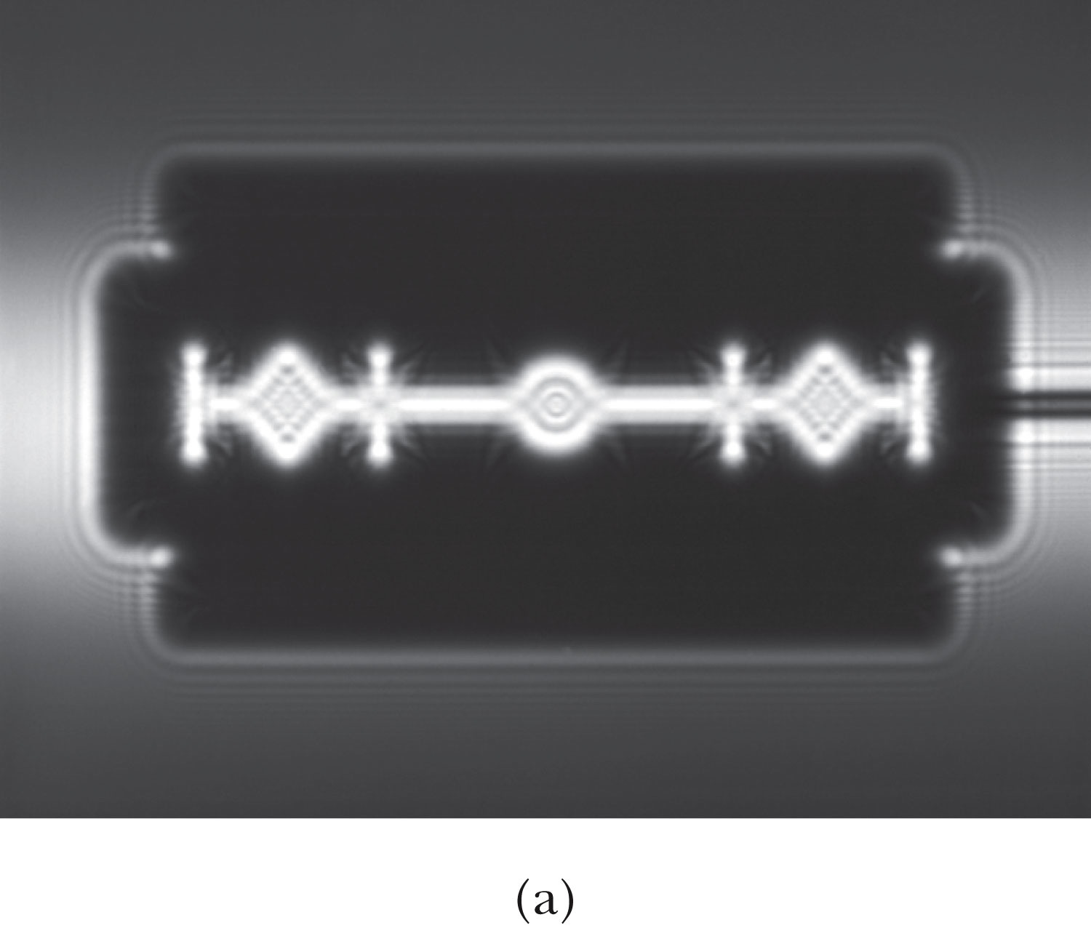
The Wave Theory Advances…
Contributions by Huygens, Young, Fresnel and Maxwell
Double-slit interference patterns
Refraction of light from the vacuum to a medium
Light was an electromagnetic phenomenon
Shadows are not as sharp as once thought with the advancement of experimental precision
Establishes that light propagates as a wave

Slide 13
The Electromagnetic Spectrum
Visible light covers only a small range of the total electromagnetic spectrum
All electromagnetic waves travel in vacuum with the speed c given by:
(where μ₀ and ε₀ are the respective permeability and permittivity of “free” space)

Slide 14
Conservation Laws and Fundamental Forces
Conservations laws are guiding principles of physics
Recall the fundamental conservation laws:
Conservation of energy
Conservation of linear momentum
Conservation of angular momentum
Conservation of electric charge
In addition to the classical conservation laws, two modern results include:
The conservation of baryons and leptons
The fundamental invariance principles for time reversal, distance, and parity

Slide 15
Also in the Modern Context…
The three fundamental forces are introduced
Gravitational:
Responsible for planetary motions, holding things on the ground, etc
Electroweak (unified at high energies)
Weak: Responsible for nuclear beta decay and effective only over distances of ~10⁻¹⁵ m
Electromagnetic: Responsible for all non-gravitational interactions, such as all chemical reactions, friction, tension….
(Coulomb force)
Strong: Responsible for “holding” the nucleus together and effective in the distance less than ~10⁻¹⁵ m

Slide 16
Relative Strength of Fundamental Forces

Slide 17
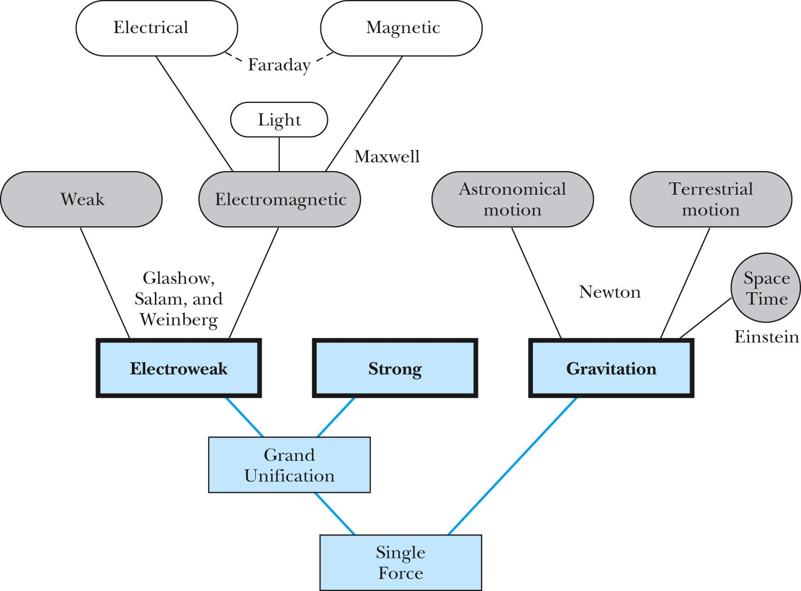
Unification of Forces
GUT, String theory
Not yet experimentally verified: p decays, magnetic monopole

Slide 18
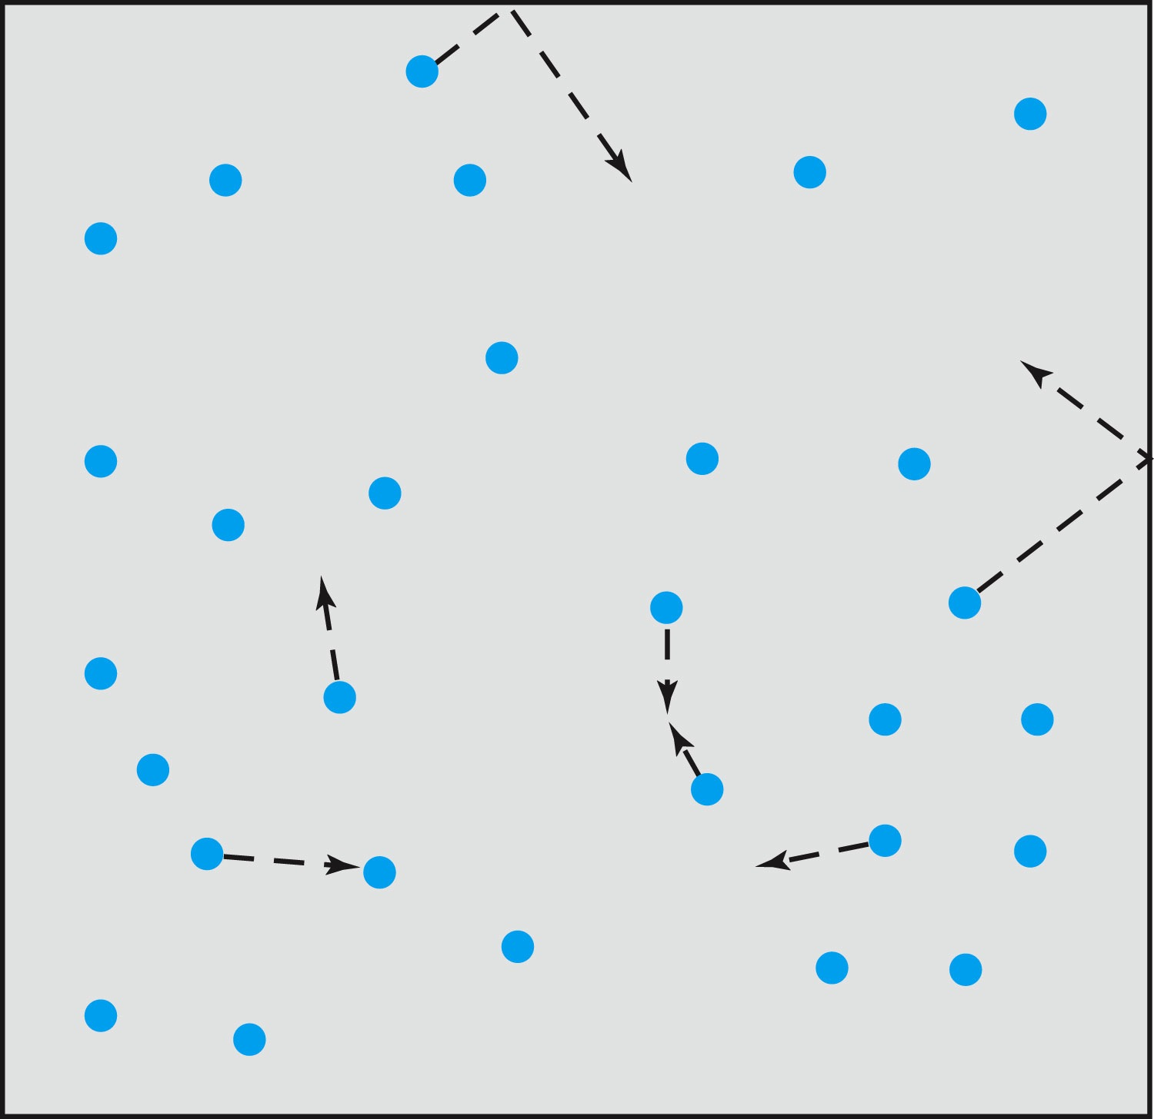
Relevance of Gas Concept to Atoms
The idea of gas (17th century) as a collection of small particles bouncing around with kinetic energy enabled concept of small, unseen objects
This concept formed the bases of existence something small that makes up matter

Slide 19
The Atomic Theory of Matter
Concept initiated by Democritus and Leucippus (~450 B.C.)
(first to use the Greek atomos, meaning “indivisible”)
In addition to fundamental contributions by Boyle, Charles, and Gay-Lussac, Proust (1754 – 1826) proposes the law of definite proportions
Dalton advances the atomic theory of matter to explain the law of definite proportions
Avogadro proposed that all gases at the same temperature, pressure, and volume contain the same number of molecules (atoms); viz. 6.02 × 10²³ atoms
Cannizzaro (1826 – 1910) makes the distinction between atoms and molecules advancing the ideas of Avogadro.

Slide 20
Further Advances in Atomic Theory
Maxwell derives the speed distribution of atoms in a gas
Robert Brown (1753 – 1858) observes microscopic “random” motion of suspended grains of pollen in water (Brownian motion)
Einstein in the 20th century explains this random motion using atomic theory

Slide 21
Opposition to the Atomic Theory
Ernst Mach (1838 – 1916) opposes the theory on the basis of logical positivism, i.e., atoms being “unseen” questions their reality
Wilhelm Ostwald (1853 – 1932) supports this premise but on experimental results of radioactivity, discrete spectral lines, and the formation of molecular structures

Slide 22
Overwhelming Evidence for Existence of Atoms
Max Planck (1858 – 1947) advances the concept to explain blackbody radiation by use of submicroscopic “quanta”
Boltzmann requires existence of atoms for advances in statistical mechanics
Albert Einstein (1879 – 1955) uses molecules to explain Brownian motion and determines the approximate value of their size and mass
Jean Perrin (1870 – 1942) experimentally verifies Einstein’s predictions

Slide 23
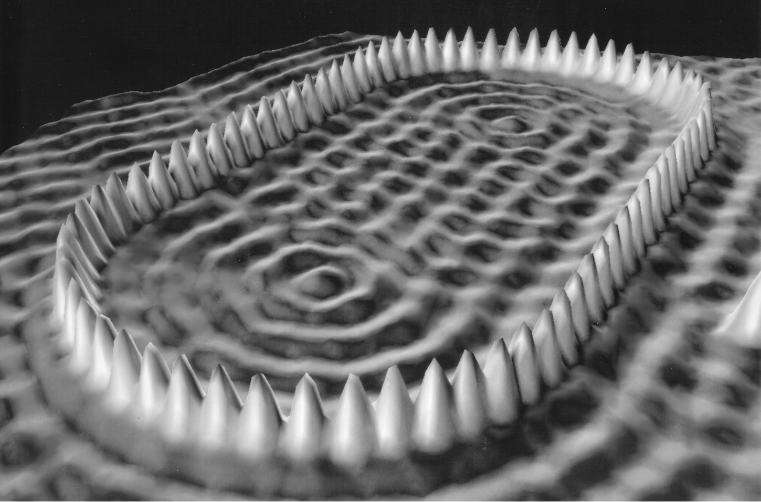
Unresolved Questions and New Horizons
The atomic theory controversy raises fundamental questions
It was not universally accepted
The constituents (if any) of atoms became a significant question
The structure of matter remained unknown with certainty
Experimental precisions were insufficient to discern this level of small scale

Slide 24
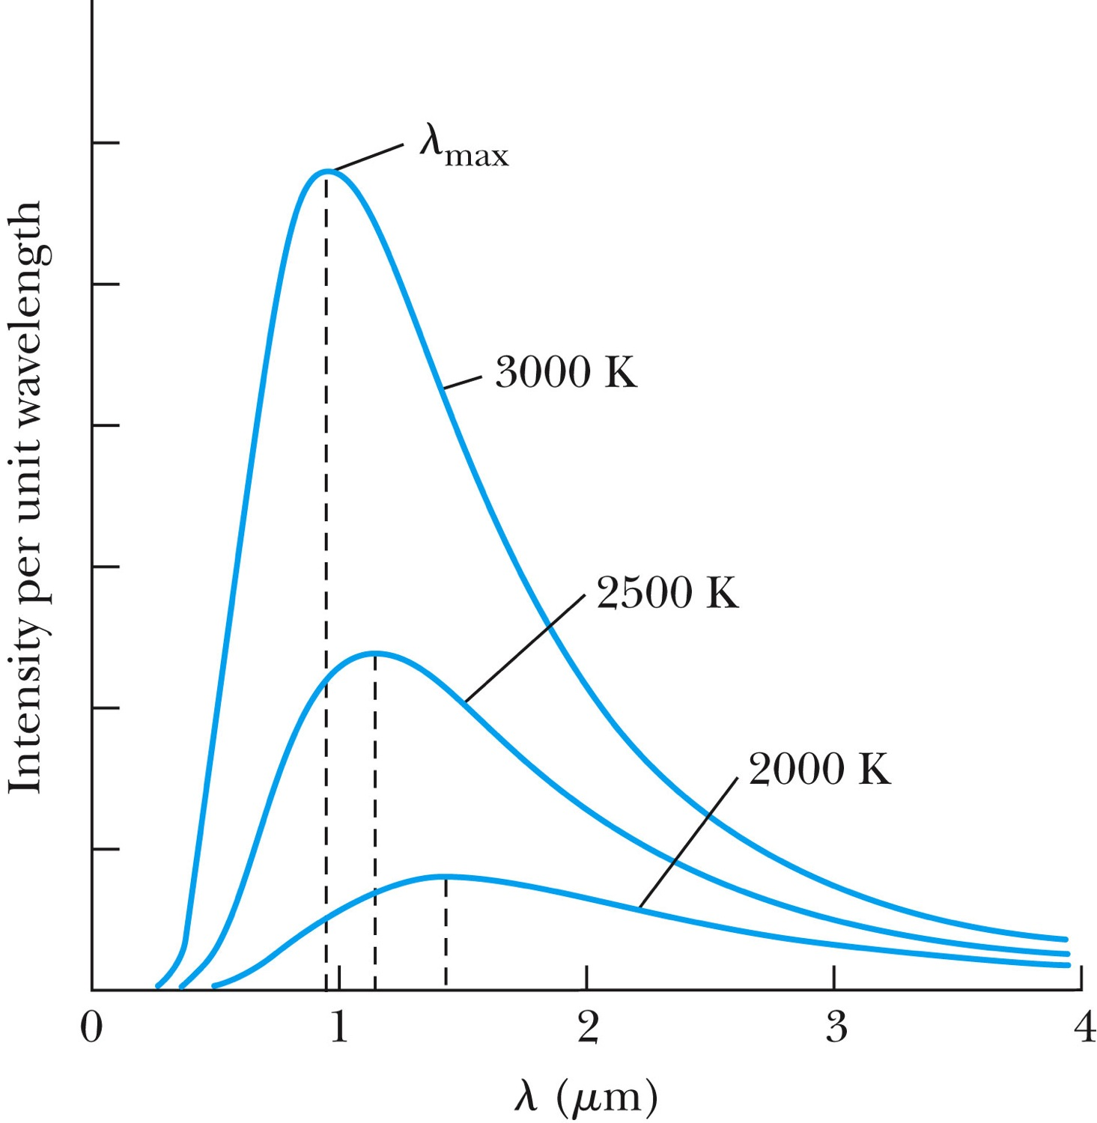
Further Complications
Three fundamental problems:
The (non) existence of a medium that transmits light waves from the sun
The observed differences in the electric and magnetic field between stationary and moving reference systems
The failure of classical physics to explain blackbody radiation in which characteristic spectra of radiation that cover the entire EM wavelengths were observed depending on temperature not on the body itself

Slide 25
Additional Discoveries Contribute to the Complications
Discovery of x-rays (1895, Rontgen)
Discovery of radioactivity (1896, Becquerel)
Discovery of the electron (1897, Thompson)
Discovery of the Zeeman effect (1896, Zeeman) dependence of spectral frequency on magnetic field

Slide 26
The Beginnings of Modern Physics
These new discoveries and the many resulting complications required a revision of the fundamental physical assumptions culminated in the successes of the classical foundations
To this end the introduction of the modern theory of relativity and quantum mechanics becomes the starting point of this most fascinating revision

Slide 27
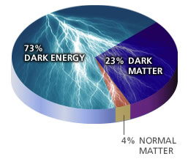
Unsolved Problems Today!
Why are there three families of quarks and leptons?
Why is the mass range so large (0.1m_{p} – 175 m_{p})?
How do matters acquire mass?
Is the new particle we’ve discovered the Higgs particle?
Why is the matter in the universe made only of particles?
What happened to anti-particles? Or anti-matters?
Do neutrinos have mass& what are the mixing parameters?
Why are there only three apparent forces?
Is the picture we present the real thing?
What makes up the 96% of the universe?
How about extra-dimensions?
How is the universe created?
Are there any other theories that describe the universe better?
Many more questions to be answered!!

