Slide 1
PHYS 3313 – Section 001 Lecture #4
Monday, Sept. 9, 2013
Dr. Jaehoon Yu
Galilean Transformation
Do we need Ether?
Michelson-Morley Experiment
Einstein’s postulates
Lorentz Transformations
Time Dilation & Length Contraction

Slide 2
Announcements
Class e-mail distribution list subscription:
Test message went out last week
If you have replied, please do so ASAP.
If you haven’t received my test message, check your spam box or re-register.
Reading assignments: CH 2.3 and 2.4
Today’s homework problems are (chapter 2 end of the chapter problems):
17, 21, 23, 24, 32, 59, 61, 66, 68, 81 and 96
Due is by the beginning of the class, next Monday, Sept. 16
Work in study groups together with other students but PLEASE do write your answer in your own way!

Slide 3
Research Projects
Each of the 12 research groups picks one research topic
Study the topic as a group, looking up references
Original theory or Original observation
Experimental proofs or Theoretical predictions + subsequent experimental proofs
Importance and the impact of the theory/experiment
Each member of the group writes a 10 page report, including figures (must not copy!!)
10% of the total grade
Can share the theme and facts but you must write your own!
Due Mon., Nov. 25, 2013
The group presents a 10min power point talk
5% of the total grade
Date and time will be announced close to the end of the semester

Slide 4
Group – Research Topic Association
Research Group Number | Research Topic
1 | 2
2 | 3
3 | 11
4 | 7
5 | 5
6 | 1
7 | 9
8 | 8
9 | 4
10 | 6
11 | 10
12 | 12

Slide 5
Research Topics
Black body radiation
Michelson–Morley experiment
The Photoelectric effect
Special Relativity
The property of molecules, Browning Motion
Compton Effect
Discovery of the electron
Radioactivity
Rutherford Scattering
Super-conductivity
The Unification of Electromagnetic and Weak forces
The Discovery of the Higgs-like particle

Slide 6
Newtonian (Classical) Relativity
It is assumed that Newton’s laws of motion must be measured with respect to (relative to) some reference frame.
A reference frame is called an inertial frame if Newton laws are valid in that frame.
Such a frame is established when a body, not subjected to net external forces, is observed moving in a rectilinear motion at a constant velocity
➔ Newtonian Principle of Relativity (Galilean Invariance): If Newton’s laws are valid in one reference frame, then they are also valid in another reference frame moving at a uniform velocity relative to the first system.

Slide 7
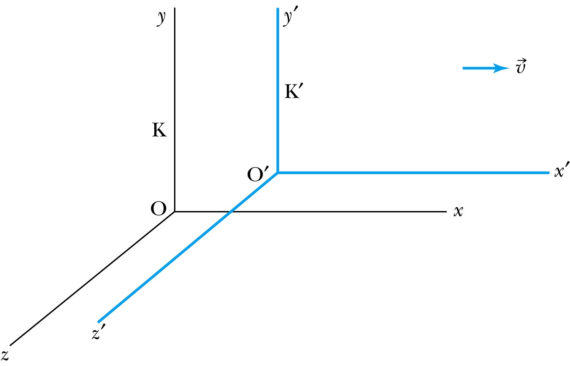
Inertial Frames K and K’
K is at rest and K’ is moving with velocity
All axes are parallel to each other
K and K’ are said to be INERTIAL COORDINATE SYSTEMS

Slide 8
The Galilean Transformation
For a point P
In system K: P = (x, y, z, t)
In system K’: P = (x’, y’, z’, t’)
P
x
K
K’
x’-axis
x-axis

Slide 9
Conditions of the Galilean Transformation
Parallel axes between the two inertial reference frames
K’ has a constant relative velocity in the x-direction with respect to K
Time (t) for all observers is a Fundamental invariant, i.e., the same for all inertial observers
Space and time are separate!!

Slide 10
The Inverse Relations
Step 1. Replace with
Step 2. Replace “primed” quantities with
“unprimed” and “unprimed” with “primed”

Slide 11
The Transition to Modern Relativity
Although Newton’s laws of motion had the same form under the Galilean transformation, Maxwell’s equations did not.
In 1905, Albert Einstein proposed a fundamental connection between space and time and that Newton’s laws are only an approximation.

Slide 12
They Needed Ether!!
The wave nature of the light suggested that there existed a propagation medium called the luminiferous ether or just ether.
The properties of ether
Very low density for planets to move through it without loss of energy
Sufficiently high elasticity to support the high velocity of light waves (c=?)

Slide 13
Ether as the Absolute Reference System
In Maxwell’s theory, the speed of light is given by
The velocity of light between moving systems must be a constant.
Can you see why?
Needed a system of medium that keeps this constant!
Ether proposed as the absolute reference system in which the speed of light is constant and from which other measurements could be made.
The Michelson-Morley experiment was an attempt to show the existence of ether.

Slide 14
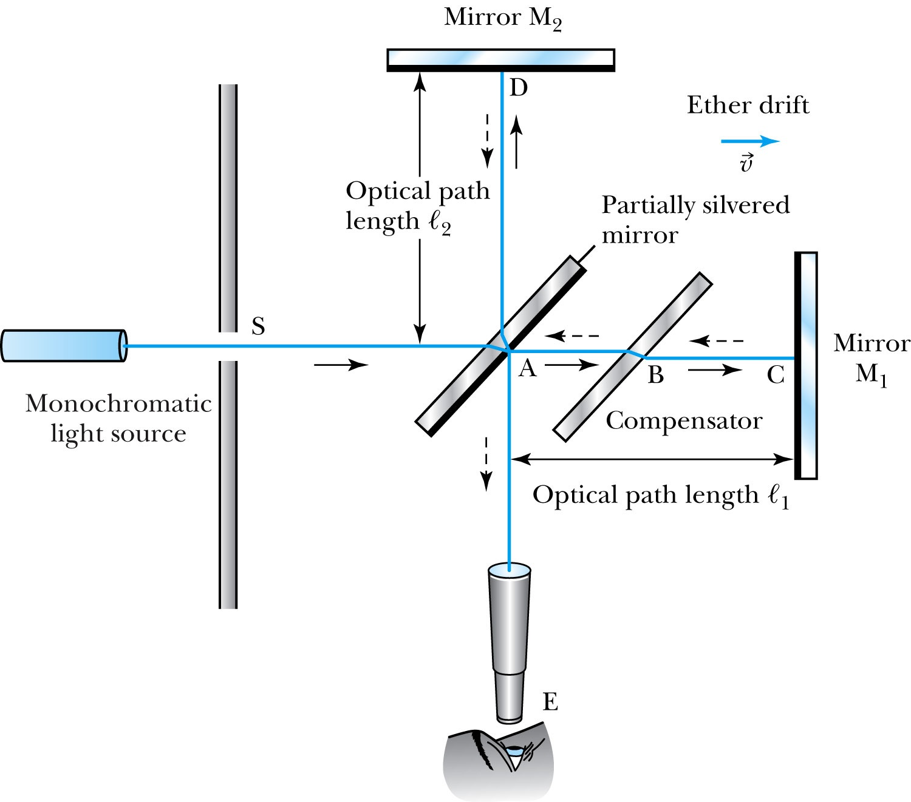
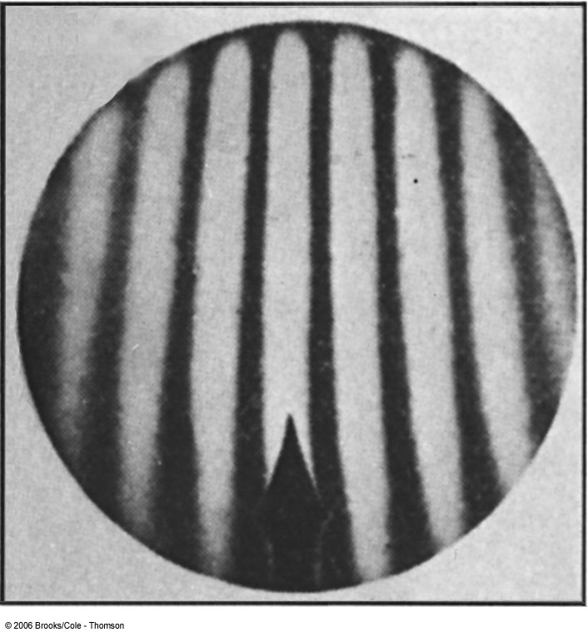
The Michelson-Morley Experiment
Albert Michelson (1852–1931) built an extremely precise device called the interferometer to measure the phase difference between two light waves traveling in orthogonal directions.

Slide 15
How does Michelson’s Interferometer work?
AC is parallel to the motion of the Earth inducing an “ether wind”
Light from source S is split by mirror A and travels to mirrors C and D in mutually perpendicular directions
After the reflection the beams recombine at A slightly out of phase due to the “ether wind” as viewed by telescope E.
Ether

Slide 16
The analysis – Galilean X-formation
Travel time t₁ for round trip over AC (the ether direction) is
Travel time t₂ for round trip over AD (perpendicular direction to ether) is
The time difference is

Slide 17
The analysis
After rotating the machine by 90º, the time difference becomes
The difference of the time differences
Since v (the Earth’s speed) is 10⁻⁴ of c, we can do binomial expansion of the above

Slide 18
The Results
Using the Earth’s orbital speed as:
together with
The time difference becomes
Although a very small number, it was within the experimental range of measurement for light waves.
Later with Morley, they increased the path lengths to 11m and improved precision better than a factor of 10
Yet, Michelson FAILED to “see” the expected interference pattern

Slide 19
Conclusions of Michelson Experiment
Michelson noted that he should be able to detect a phase shift of light due to the time difference between path lengths but found none.
He therefore concluded that the hypothesis of the stationary ether must be incorrect.
After several repeats and refinements with assistance from Edward Morley (1893-1923), again a null result.
Thus, ether does not seem to exist!
Many explanations ensued afterward but none worked out!
This experiment shattered the popular belief of light being waves

Slide 20
The Lorentz-FitzGerald Contraction
Another hypothesis proposed independently by both H. A. Lorentz and G. F. FitzGerald suggested that the length ℓ₁, in the direction of the motion was contracted by a factor of
Thus making the path lengths equal to account for the zero phase shift.
This, however, was an ad hoc assumption that could not be experimentally tested.

Slide 21
Einstein’s Postulates
Fundamental assumption: Maxwell’s equations must be valid in all inertial frames
The principle of relativity: The laws of physics are the same in all inertial systems. There is no way to detect absolute motion, and no preferred inertial system exists
Published a paper in 1905 at the age 26
Believed to be fundamental
The constancy of the speed of light: Observers in all inertial systems measure the same value for the speed of light in vacuum.

Slide 22
The Lorentz Transformations
General linear transformation relationship between P=(x, y, z, t) in frame S and P’=(x’,y’,z’,t’) in frame S’ ➔ these assume measurements are made in S frame and transferred to S’ frame
preserve the constancy of the speed of light between inertial observers
account for the problem of simultaneity between these observers
With the definitions and

Slide 23
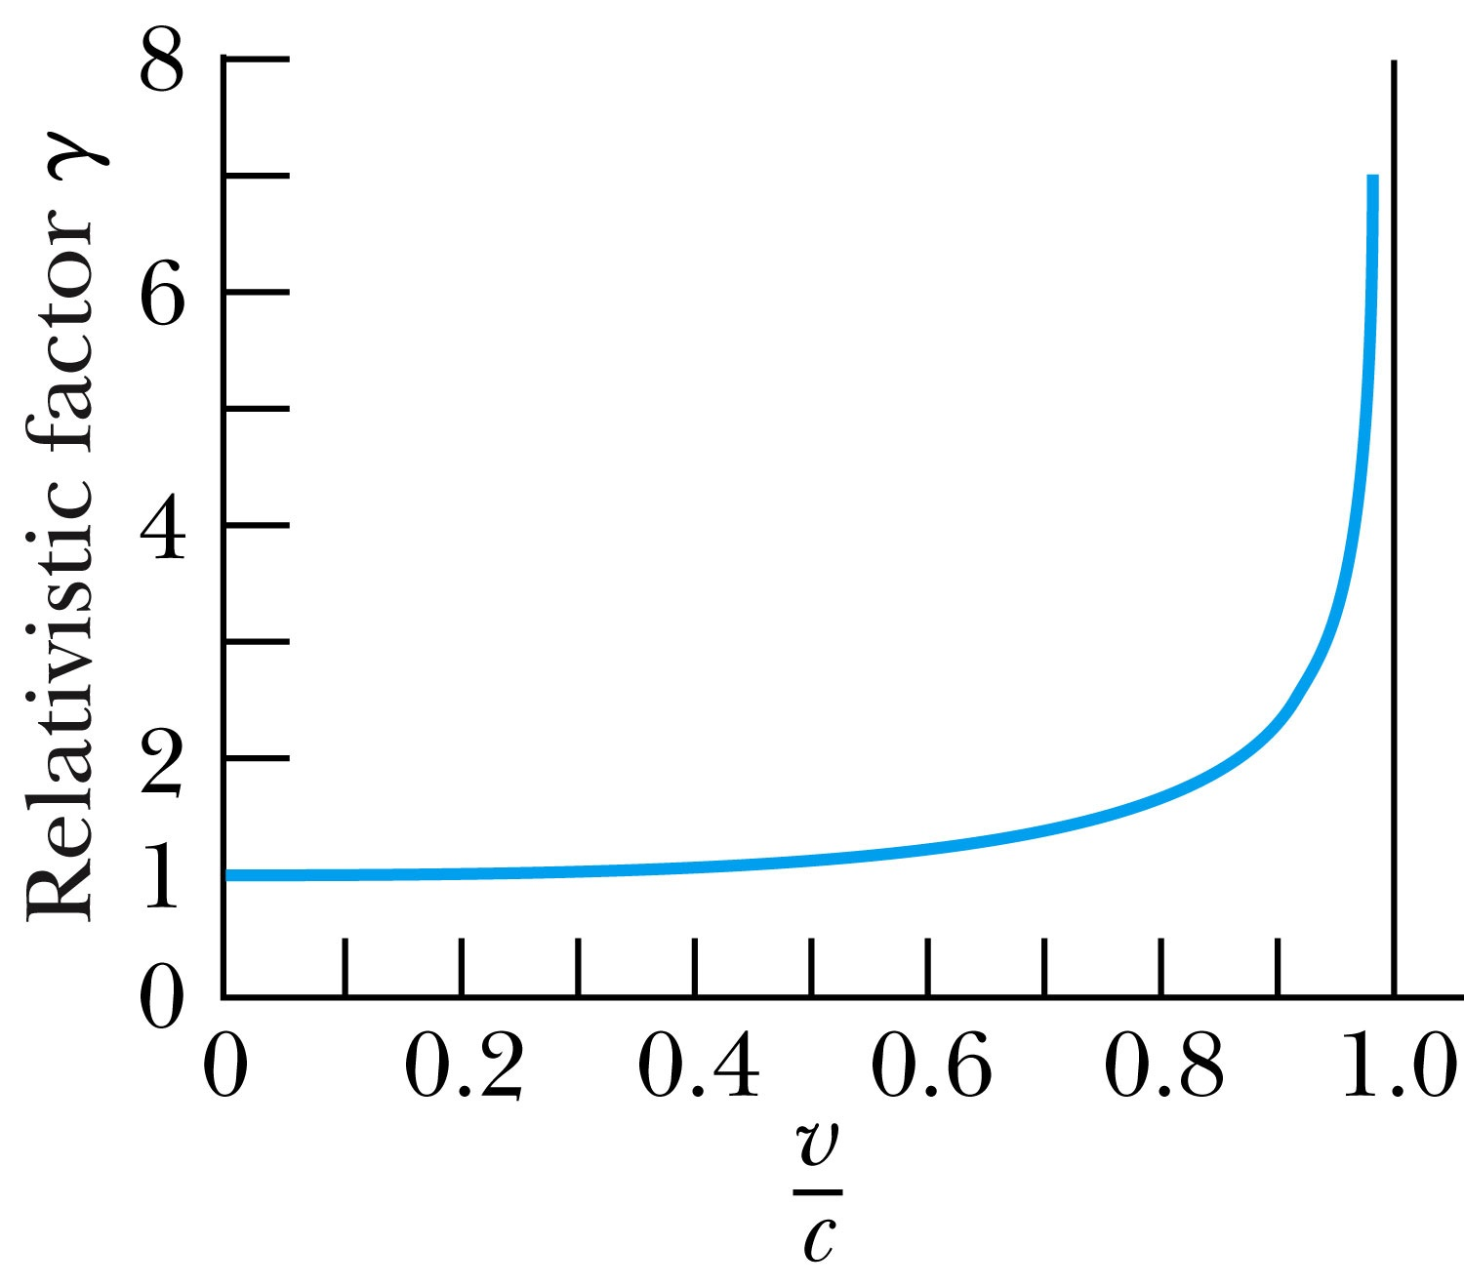
Properties of the Relativistic Factor γ
What is the property of the relativistic factor, γ?
Is it bigger or smaller than 1?
Recall Einstein’s postulate, β = v/c < 1 for all observers
γ= 1 only when v = 0

Slide 24
The complete Lorentz Transformations
Some things to note
What happens when β~0 (or v~0)?
The Lorentz x-formation becomes Galilean x-formation
Space-time are not separated
For non-imaginary x-formations, the frame speed cannot exceed c!

Slide 25
Time Dilation and Length Contraction
Direct consequences of the Lorentz Transformation:
Time Dilation:
Clocks in a moving inertial reference frame K’ run slower with respect to stationary clocks in K.
Length Contraction:
Lengths measured in a moving inertial reference frame K’ are shorter with respect to the same lengths stationary in K.

Slide 26
Time Dilation
To understand time dilation the idea of proper time must be understood:
proper time,T₀, is the time difference between two events occurring at the same position in a system as measured by a clock at that position.
Same location (spark “on” then off”)

Slide 27
Time Dilation
Is this a Proper Time?
spark “on” then spark “off”
Beginning and ending of the event occur at different positions

