Slide 1
PHYS 3313 – Section 001
Lecture #6
Monday, Sept. 16, 2013
Dr. Jaehoon Yu
The Twin Paradox
Space-time Diagram
The Doppler Effect
Relativistic Momentum and Energy
Relationship between relativistic quantities

Slide 2
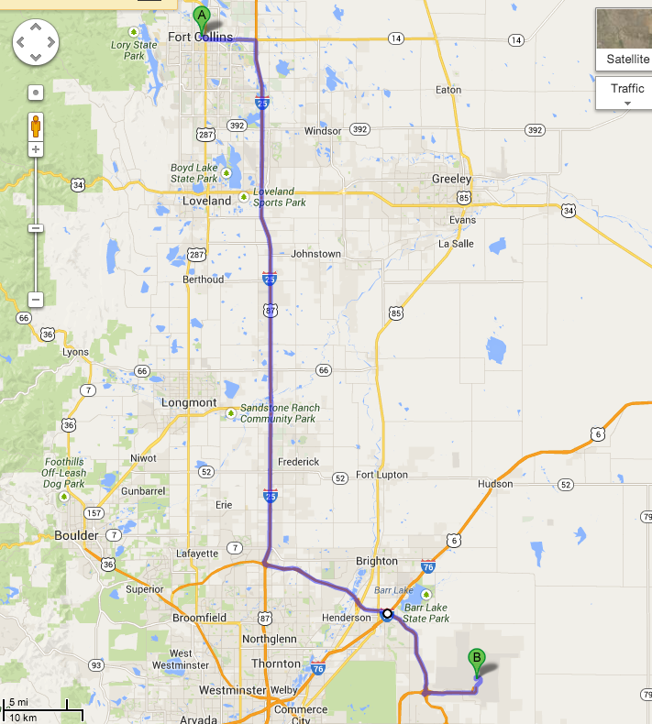
Dr. Yu’s adventurous trip to CO

Slide 3
Reminder: Special Project #2
Derive the three Lorentz velocity transformation equations. (10 points)
Derive the three reverse Lorentz velocity transformation equations. (10 points)
Prove that the space-time invariant quantity s²=x²-(ct)² is indeed invariant, i.e. s²=s’², in Lorentz Transformation. (5 points)
You must derive each one separately starting from the Lorentz spatial coordinate transformation equations to obtain any credit.
  Just switching the signs and primes will not cut!
  Must take the simplest form of the equations, using β and γ.
You MUST have your own, independent answers to the above three questions even if you worked together with others. All those who share the answers will get 0 credit if copied.
Due for the submission is Wednesday, Sept. 18!

Slide 4
Velocity Addition Summary
Galilean Velocity addition where and
From inverse Lorentz transform and
So
Thus
What would be the measured speed of light in S frame?
  Since we get
Observer in S frame measures c too! Strange but true!

Slide 5
Velocity Addition Example
Yu Darvish is riding his bike at 0.8c relative to observer. He throws a ball at 0.7c in the direction of his motion. What speed does the observer see?
What if he threw it just a bit harder?
Doesn’t help—asymptotically approach c, can’t exceed (it’s not just a postulate it’s the law)

Slide 6
Twin Paradox
The Set-up: Twins Mary and Frank at age 30 decide on two career paths: Mary (the Moving twin) decides to become an astronaut and to leave on a trip 8 light-years (ly) from the Earth at a great speed and to return; Frank (the Fixed twin) decides to stay on the Earth.
The Problem: Upon Mary’s return, Frank reasons, that her clocks measuring her age must run slow. As such, she will return younger. However, Mary claims that it is Frank who is moving and consequently his clocks must run slow.
The Paradox: Who is younger upon Mary’s return?

Slide 7
Twin Paradox cont’d
Let’s say, Mary is traveling at the speed of 0.8c
Frank will measure the Mary’s total travel time
  T=8ly/0.8c=10yrs
Mary’s clock will run slower due to relativity:
Thus, Frank claims that Mary will be 42 years old while he is 50 years old
Who is correct?

Slide 8
The Resolution
Frank’s clock is in an inertial system during the entire trip; however, Mary’s clock is not. As long as Mary is traveling at constant speed away from Frank, both of them can argue that the other twin is aging less rapidly.
When Mary slows down to turn around, she leaves her original inertial system and eventually returns in a completely different inertial system.
Mary’s claim is no longer valid, because she does not remain in the same inertial system. There is also no doubt as to who is in the inertial system. Frank feels no acceleration during Mary’s entire trip, but Mary does.
So Frank is correct! Mary is younger!

Slide 9
Space-time
When describing events in relativity, it is convenient to represent events on a space-time diagram.
In this diagram one spatial coordinate x specifies the position, and instead of time t, ct is used as the other coordinate so that both coordinates will have the same dimensions of length.
Space-time diagrams were first used by H. Minkowski in 1908 and are often called Minkowski diagrams. Paths in Minkowski space-time are called worldlines.

Slide 10
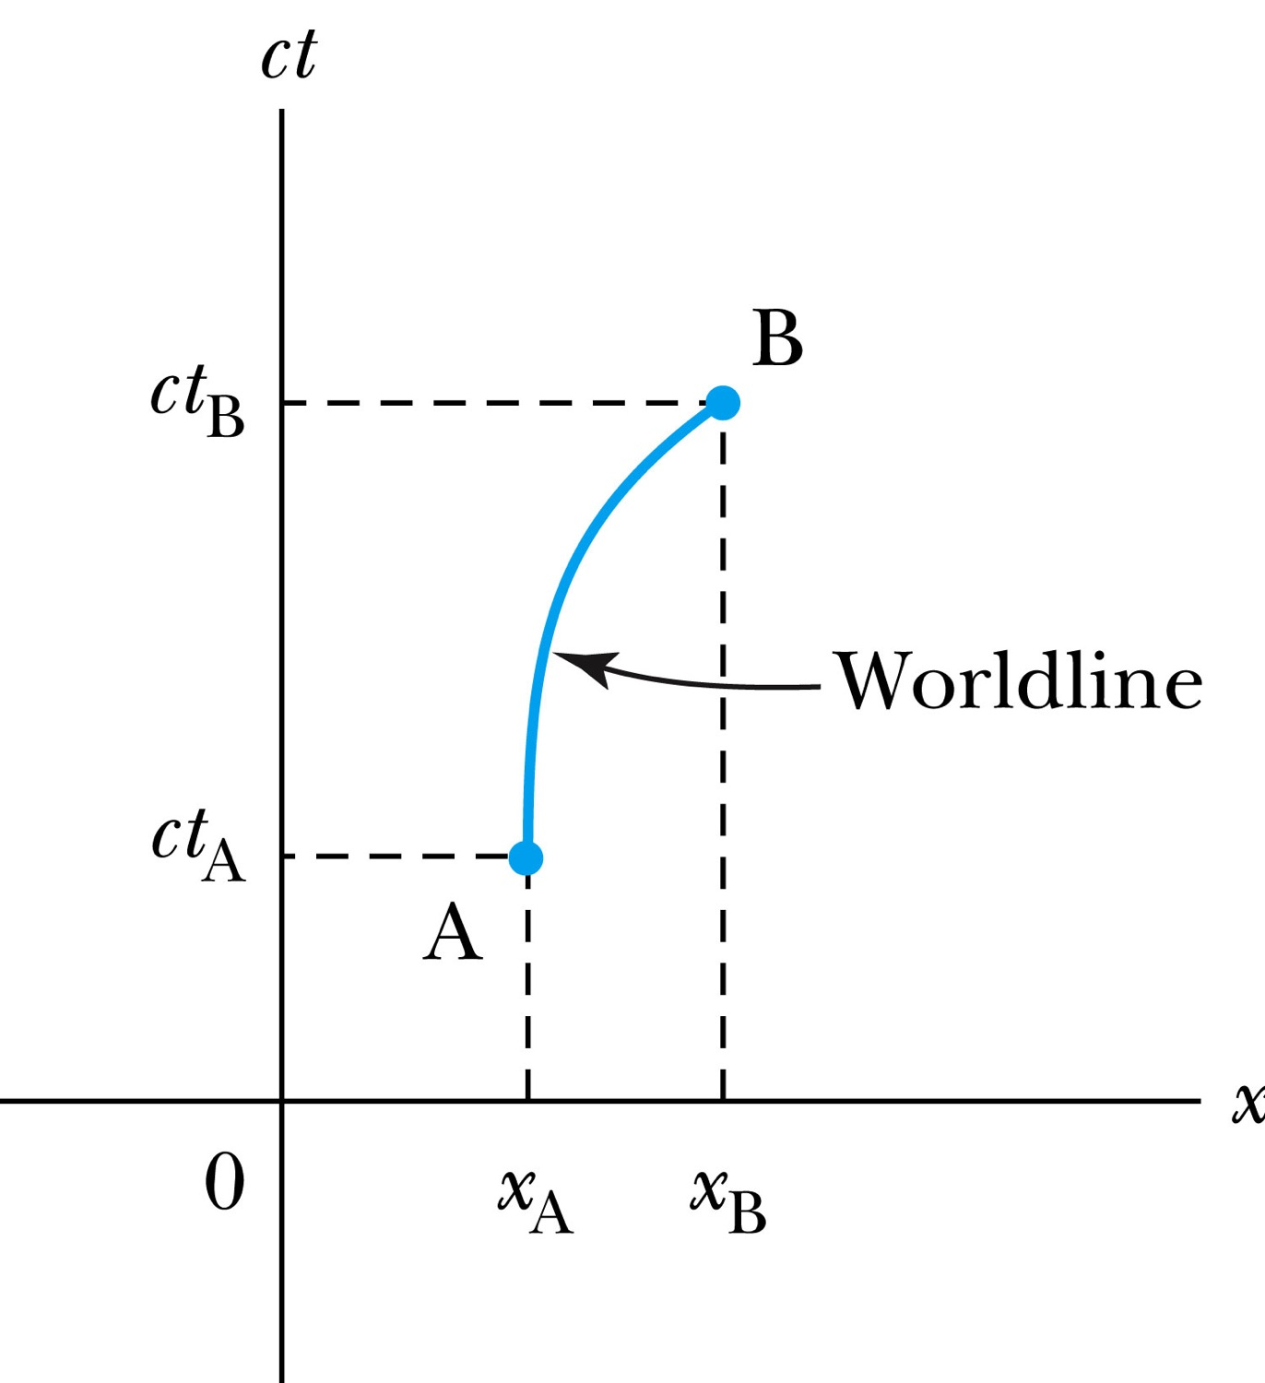
The Space-time Diagram
Notes:
Add the paragraph for Figure 2.21

Slide 11
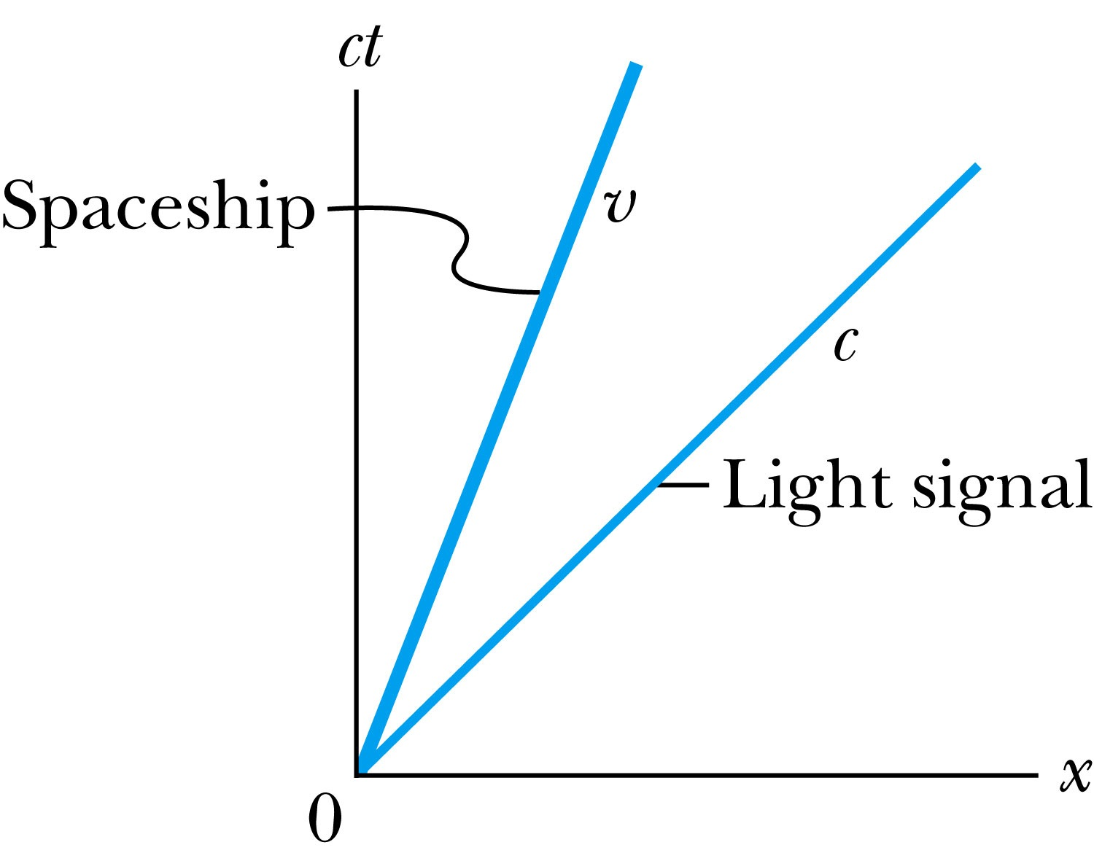
Particular Worldlines
How does the worldline for a spaceship running at the velocity v(<c) look?
How does the worldline for light signal look?
Notes:
Add the paragraph from Fig. 2.22

Slide 12
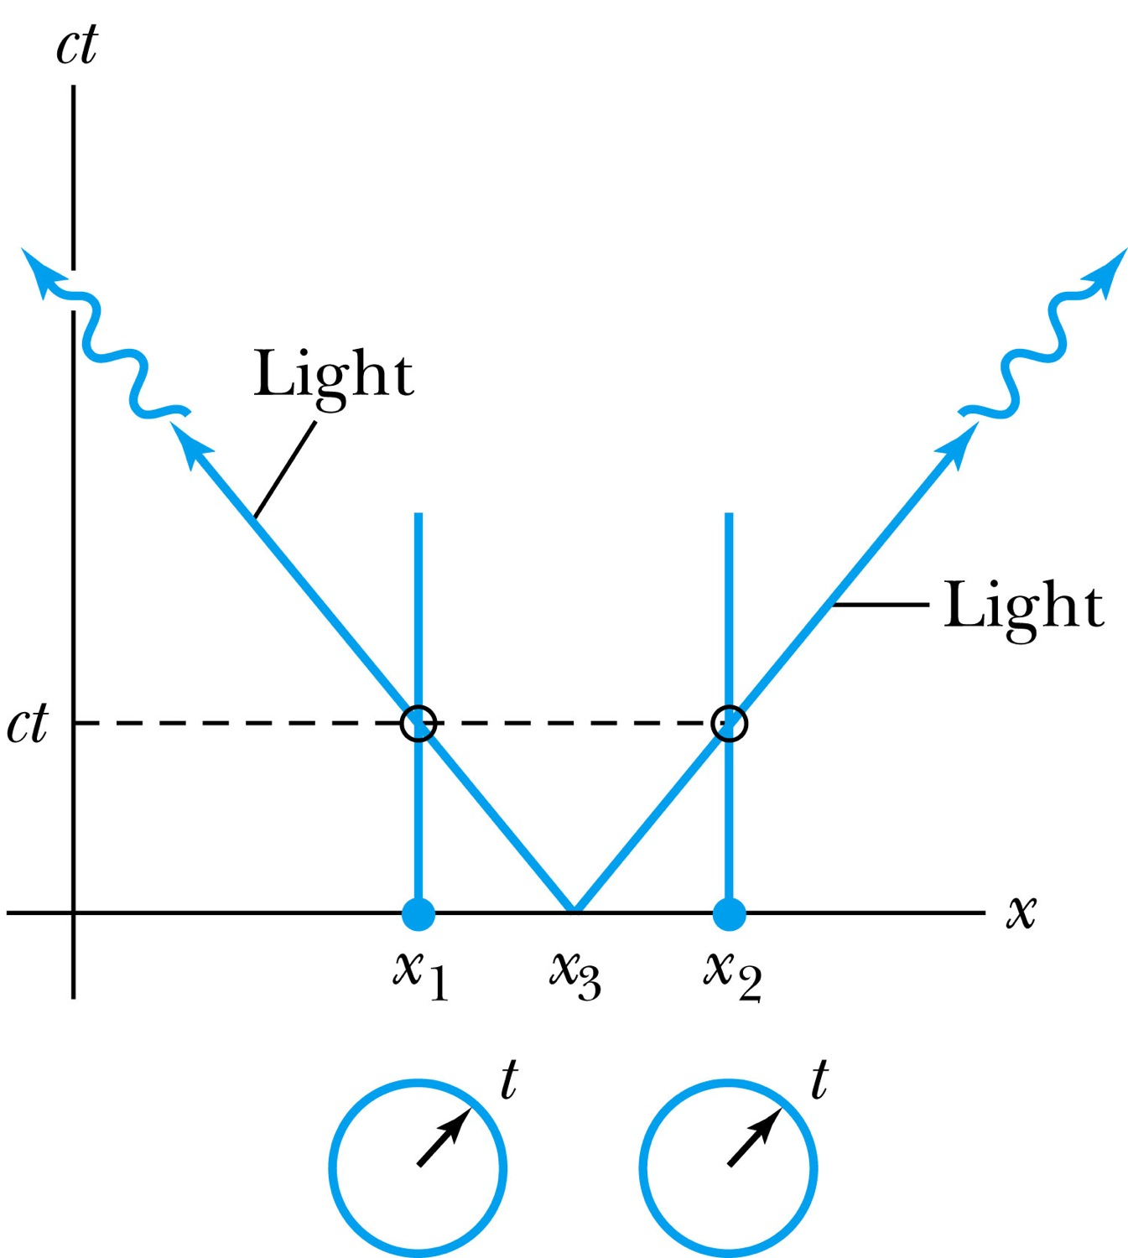
How about the time measured by two stationary clocks?
Notes:
Add paragraph from figure 2.23

Slide 13
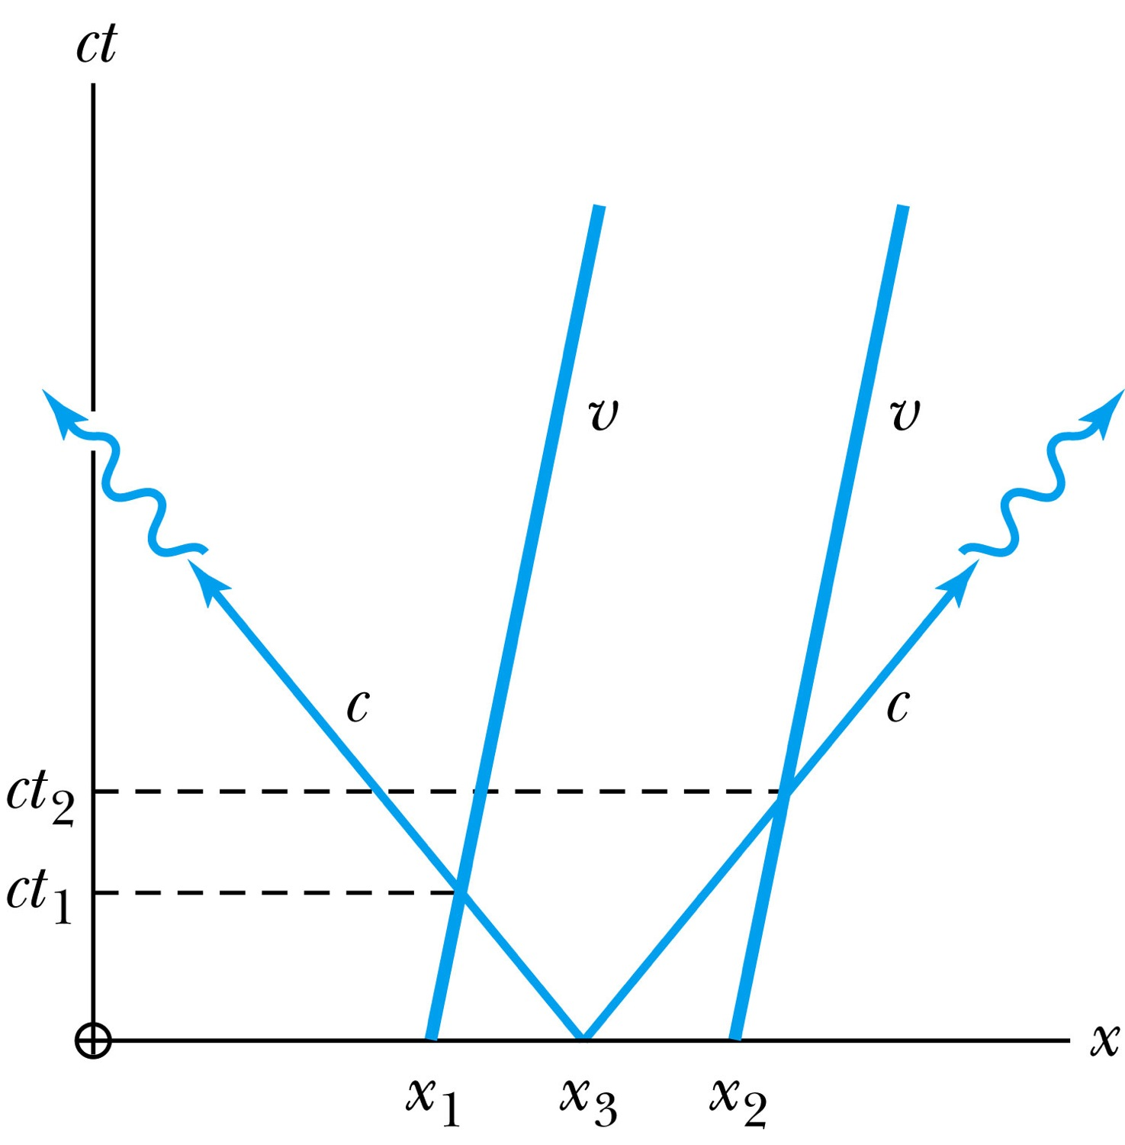
How about the time measured by moving clocks?
Notes:
Add paragraph from figure 2.24

Slide 14
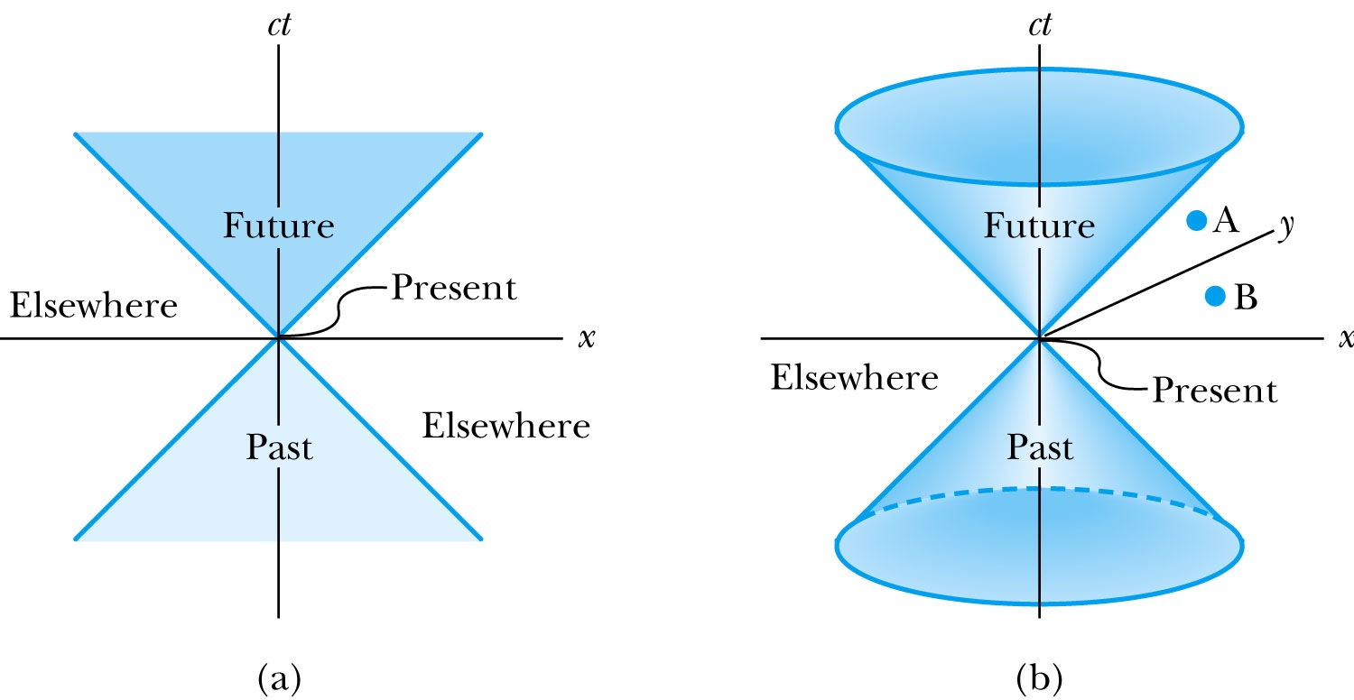
The Light Cone
Notes:
Add paragraph from Figure 2.25

Slide 15
Invariant Quantities: The Space-time Interval
Since all observers “see” the same speed of light, then all observers, regardless of their velocities, must see spherical wave fronts. Thus the quantity:
is invariant.
For any two events, the space-time interval between the two events is invariant in any inertial frame.

Slide 16
Space-time Invariants
There are three possibilities for the invariant quantity Δs²:
Δs² = 0: Δx² = c² Δt²: light-like separation
  Two events can be connected only by a light signal.
Δs² > 0: Δx² > c² Δt²: space-like separation
  No signal can travel fast enough to connect the two events. The events are not causally connected!!
Δs² < 0: Δx² < c² Δt²: time-like separation
  Two events can be causally connected.
  These two events cannot occur simultaneously!

Slide 17
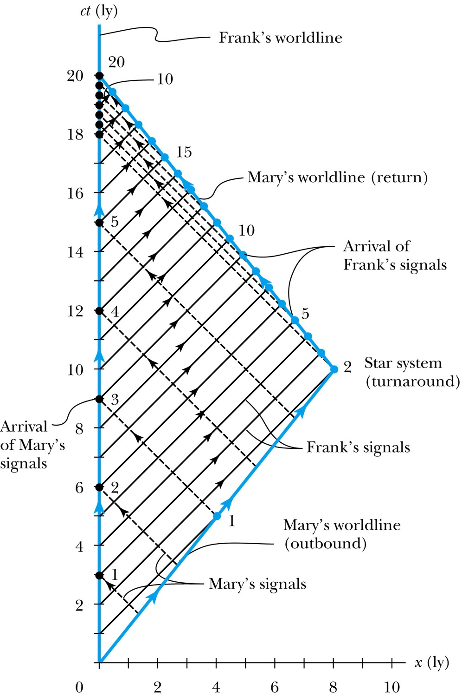
The Twin Paradox in Space-Time
Notes:
Figure 2.26 The spacetime diagram for Mary’s trip to the star system and back. Notice that Frank’s worldline is a vertical line at x = 0, and Mary’s two worldlines have the correct slope given by the magnitude c/v. The black dashed lines represent light signals sent at annual intervals from Mary to Frank. Frank’s annual signals to Mary are solid black. The solid dots denote the time when the light signals arrive.

Slide 18
The Doppler Effect
The Doppler effect of sound
  Increased frequency of sound as a source approaches a receiver
  Decreased frequency as the source recedes.
Also, the same change in sound frequency occurs when the source is fixed and the receiver is moving.
  The change in frequency of the sound wave depends on whether the source or receiver is moving.
Does this violate the principle of relativity?
  No
  Why not?
  Sounds wave is in a special frame of media such as air, water, or a steel plate in order to propagate;
Light does not need a medium to propagate!

Slide 19
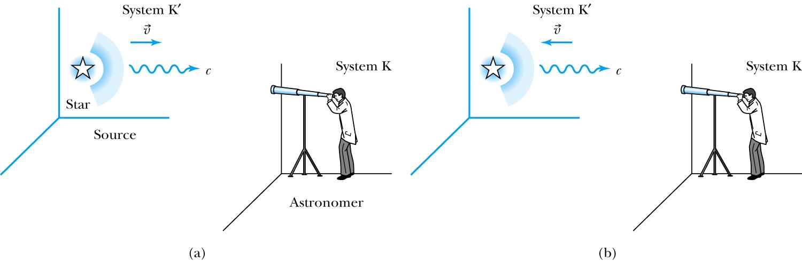
Recall the Doppler Effect
Notes:
Add paragraph from figure 2.27

Slide 20
The Relativistic Doppler Effect
Consider a source of light (a star) and a receiver (an astronomer) approaching one another with a relative velocity v.
Consider the receiver in system K and the light source in system K’ moving toward the receiver with velocity v.
The source emits n waves during the time interval T.
Because the speed of light is always c and the source is moving with velocity v, the total distance between the front and rear of the wave emitted during the time interval T is:
Length of wave train = cT − vT

Slide 21
The Relativistic Doppler Effect (con’t)
Because there are n waves emitted by the source in time period T, the wavelength measured by the stationary receiver is
And the resulting frequency measured by the receiver is
The number of waves emitted in the moving frame of the source is n=f₀T ‘₀ with the proper time T’₀=T/γ we obtain the measured frequency by the receiver as

Slide 22
Results of Relativistic Doppler Effect
When source/receiver is approaching with β = v/c the resulting frequency is
Higher than the actual source’s frequency, blue shift!!
When source/receiver is receding with β = v/c the resulting frequency is
Lower than the actual source’s frequency, red shift!!
If we use +β for approaching source/receiver and -β for receding source/receiver, relativistic Doppler Effect can be expressed
What can we use this for?

