Slide 1
PHYS 3313 – Section 001 Lecture #7
Wednesday, Sept. 18, 2013
Dr. Jaehoon Yu
Relativistic Momentum and Energy
Relationship between relativistic quantities
Quantization
Discovery of the X-ray and the Electron
Determination of Electron Charge

Slide 2
Announcements
Reading assignments: CH 3.3 (special topic – the discovery of Helium) and CH3.7
Colloquium this week: Dr. Samar Mohanty

Slide 3
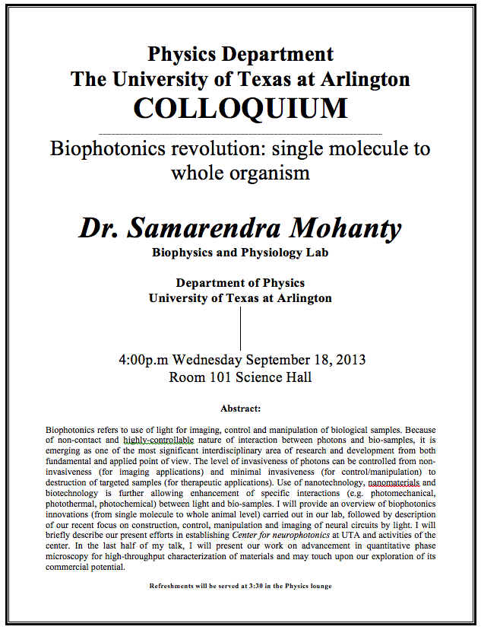

Slide 4
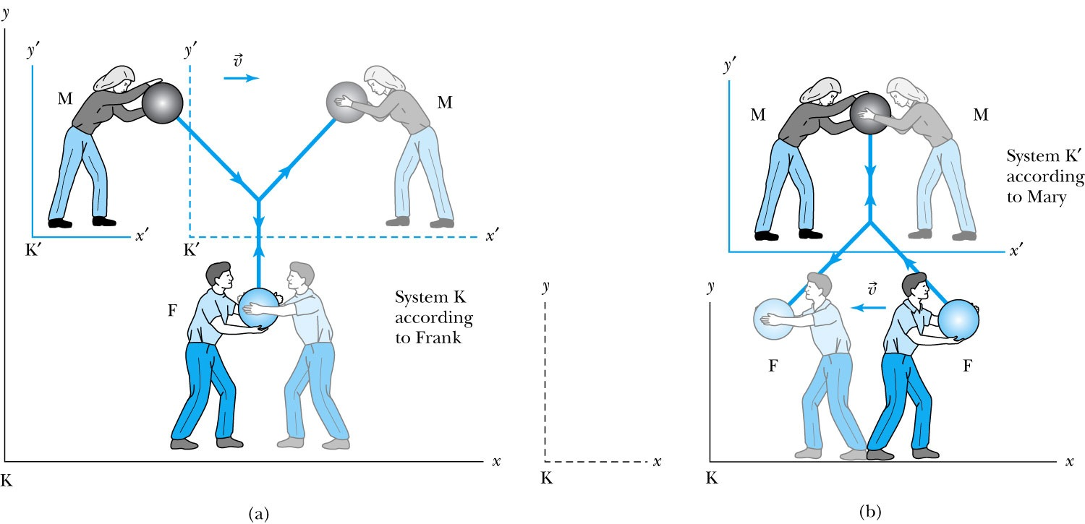
Relativistic Momentum
Most fundamental principle used here is the momentum conservation!
Frank is at rest in system K holding a ball of mass m.
Mary holds a similar ball in system K’ that is moving in the x direction with velocity v with respect to system K.
At one point they threw the ball at each other with exactly the same speed
Notes:
Add paragraph from figure 2.29

Slide 5
Relativistic Momentum
If we use the definition of momentum, the momentum of the ball thrown by Frank is entirely in the y direction
p_{Fy} = mu₀
The change of momentum as observed by Frank is
Δp_{F} = Δp_{Fy} = −2mu₀
Mary measures the initial velocity of her own ball to be
u’_{Mx} = 0 and u’_{My} = −u₀.
In order to determine the velocity of Mary’s ball as measured by Frank we use the velocity transformation equations:

Slide 6
Relativistic Momentum
Before the collision, the momentum of Mary’s ball as measured by Frank (in the Fixed frame) with the Lorentz velocity X-formation becomes
For a perfectly elastic collision, the momentum after the collision is
Thus the change in momentum of Mary’s ball according to Frank is
OMG! The linear momentum is not conserved even w/o an external force!!
What do we do?
Redefine the momentum in a fashion
Something has changed. Mass is now, mγ!! The relativistic mass!!
Mass as the fundamental property of matter is called the “rest mass”, m₀!
Notes:
Spaced a bit more evenly

Slide 7
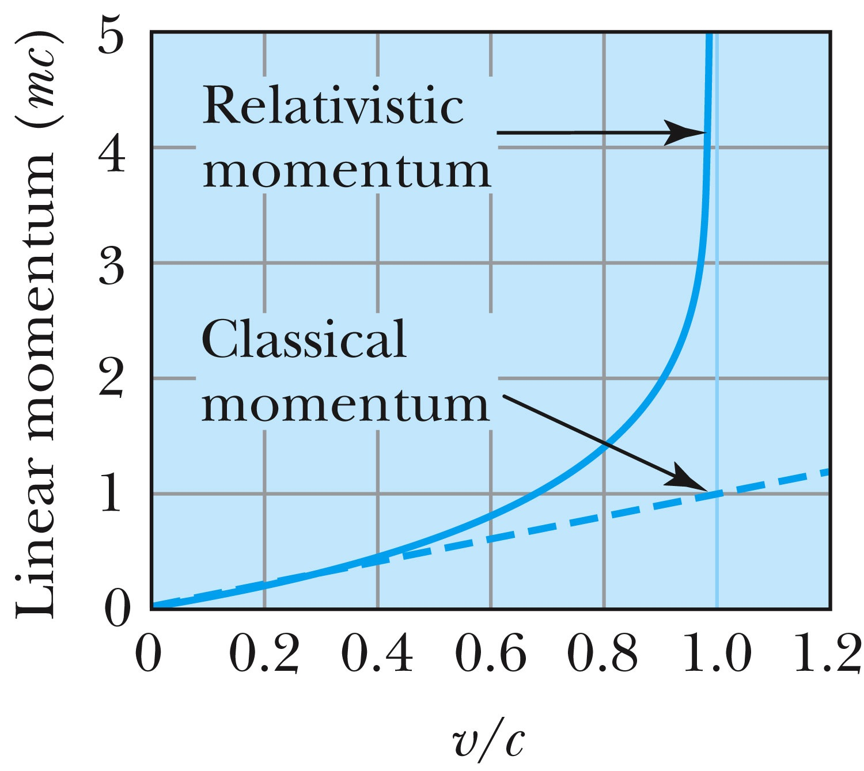
Relativistic and Classical Linear Momentum
Notes:
Add arrow head to the line from “Relativistic” to the graph
Possibly make the line from the “Classical” straight (as in figure 2.310
rather than curved, also add arrow head to this line pointing to the curve.

Slide 8
How do we keep momentum conserved in a relativistic case?
Redefine the classical momentum in the form:
This Γ(u) is different than the γ factor since it uses the particle’s speed u
➔ What? How does this make sense?
➔ Well the particle itself is moving with a relativistic speed, thus that must impact the measurements by the observer in rest frame!!
Now, the agreed value of the momentum in all frames is:
Resulting in the new relativistic definition of the momentum:
Notes:
Spaced a bit more evenly

Slide 9
Relativistic Energy
Due to the new idea of relativistic mass, we must now redefine the concepts of work and energy.
Modify Newton’s second law to include our new definition of linear momentum, and force becomes:
The work W done by a force F to move a particle from rest to a certain kinetic energy is
Resulting relativistic kinetic energy becomes
Why doesn’t this look anything like the classical KE?

Slide 10
Big note on Relativistic KE
Only is right!
and are wrong!

Slide 11
Total Energy and Rest Energy
Rewriting the relativistic kinetic energy:
The term mc² is called the rest energy and is denoted by E₀.
The sum of the kinetic energy and rest energy is interpreted as the total energy of the particle.

Slide 12
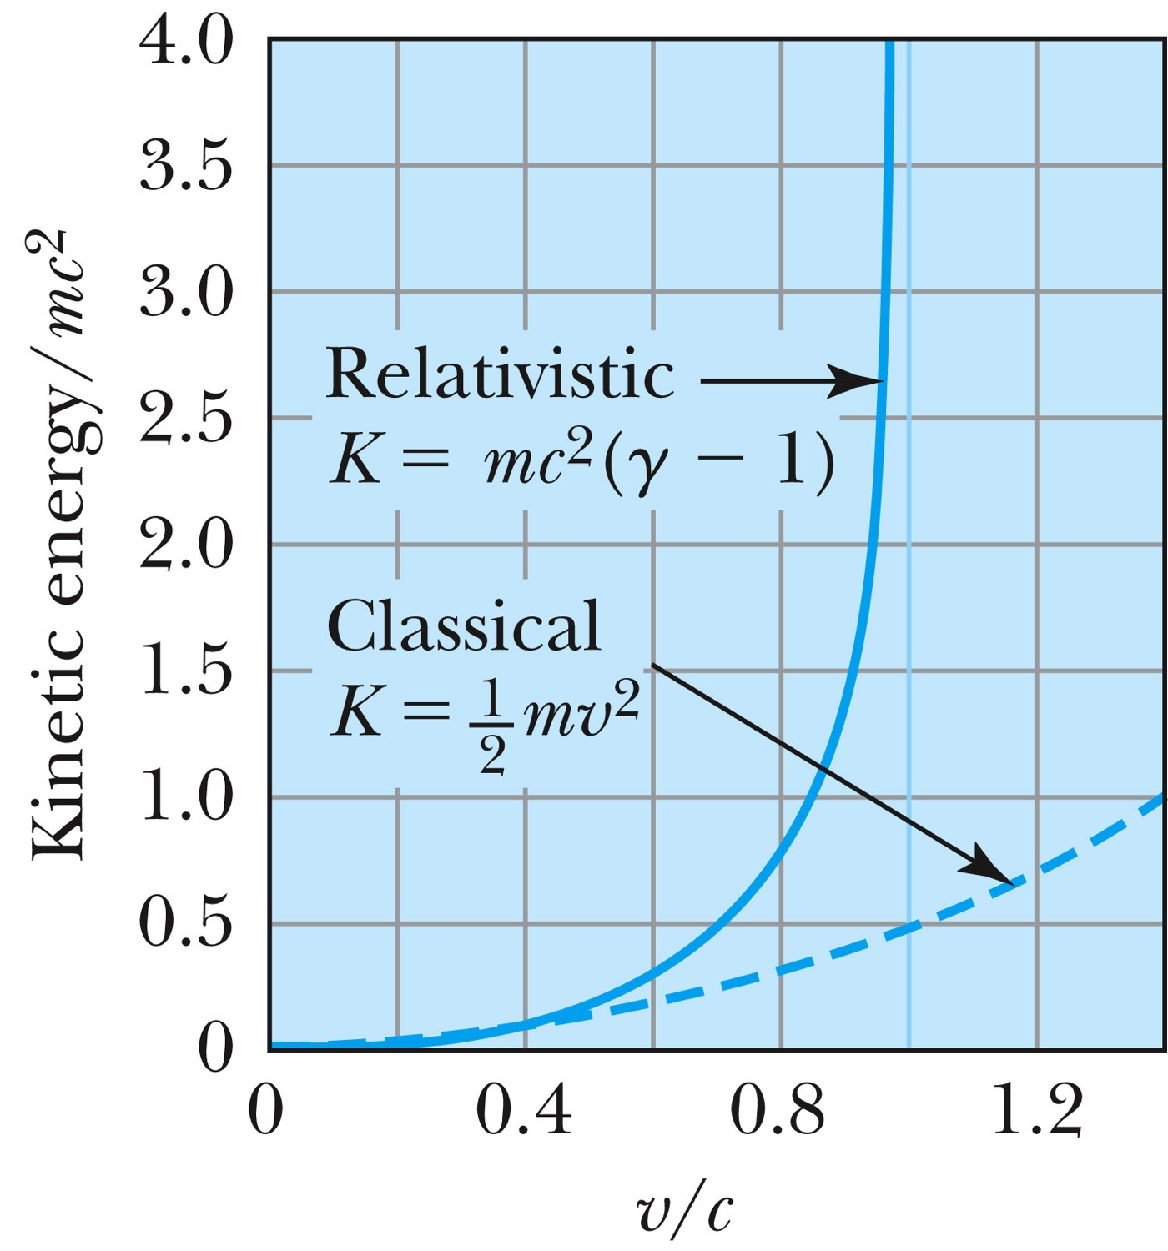
Relativistic and Classical Kinetic Energies
Notes:
Add arrow head to the line from “Relativistic” to the graph
Possibly make the line from the “Classical” straight (as in figure 2.310
rather than curved, also add arrow head to this line pointing to the curve.

Slide 13
Relationship of Energy and Momentum
We square this result, multiply by c², and rearrange the result.
Rewrite
Rewrite
Notes:
Title rewritten

Slide 14
Massless Particles have a speed equal to the speed of light c
Recall that a photon has “zero” rest mass and the equation from the last slide reduces to: E = pc and we may conclude that:
Thus the velocity, u, of a massless particle must be c since, as 0, and it follows that: u = c.
Notes:
Add this slide

Slide 15
Units of Work, Energy and Mass
The work done in accelerating a charge through a potential difference V is W = qV.
For a proton, with the charge e = 1.602 × 10⁻¹⁹ C being accelerated across a potential difference of 1 V, the work done is
1 eV = 1.602 × 10⁻¹⁹ J
W = (1.602 × 10⁻¹⁹)(1 V) = 1.602 × 10⁻¹⁹ J
eV is also used as a unit of energy.

Slide 16
Other Units
Rest energy of a particle: Example: Rest energy, E₀, of proton
Atomic mass unit (amu): Example: carbon-12

Slide 17
Binding Energy
The potential energy associated with the force keeping the system together ➔ E_{B}.
The difference between the rest energy of the individual particles and the rest energy of the combined bound system.

Slide 18
What does the word “Quantize” mean?
Dictionary: To restrict to discrete values
To consist of indivisible discrete quantities instead of continuous quantities
Integer is a quantized set with respect to real numbers
Some examples of quantization?
Digital photos
Lego blocks
Electric charge
Photon (a quanta of light) energy
Angular momentum
Etc…

Slide 19
Discovery of the X Ray and the Electron
X rays were discovered by Wilhelm Röntgen in 1895.
Observed X rays emitted by cathode rays bombarding glass
Electrons were discovered by J. J. Thomson.
Observed that cathode rays were charged particles

Slide 20
Cathode Ray Experiments
In the 1890s scientists and engineers were familiar with cathode rays, generated from one of the metal plates in an evacuated tube across a large electric potential
People thought cathode rays had something to do with atoms.
It was known that cathode rays could penetrate matter and their properties were under intense investigation during the 1890s.

Slide 21
Observation of x Rays
Wilhelm Röntgen studied the effect of cathode rays passing through various materials.
He noticed that a nearby phosphorescent screen glowed during some of these experiments.
These rays were unaffected by magnetic fields and penetrated materials more than cathode rays.
He called them x rays and deduced that they were produced by the cathode rays bombarding the glass walls of his vacuum tube

Slide 22
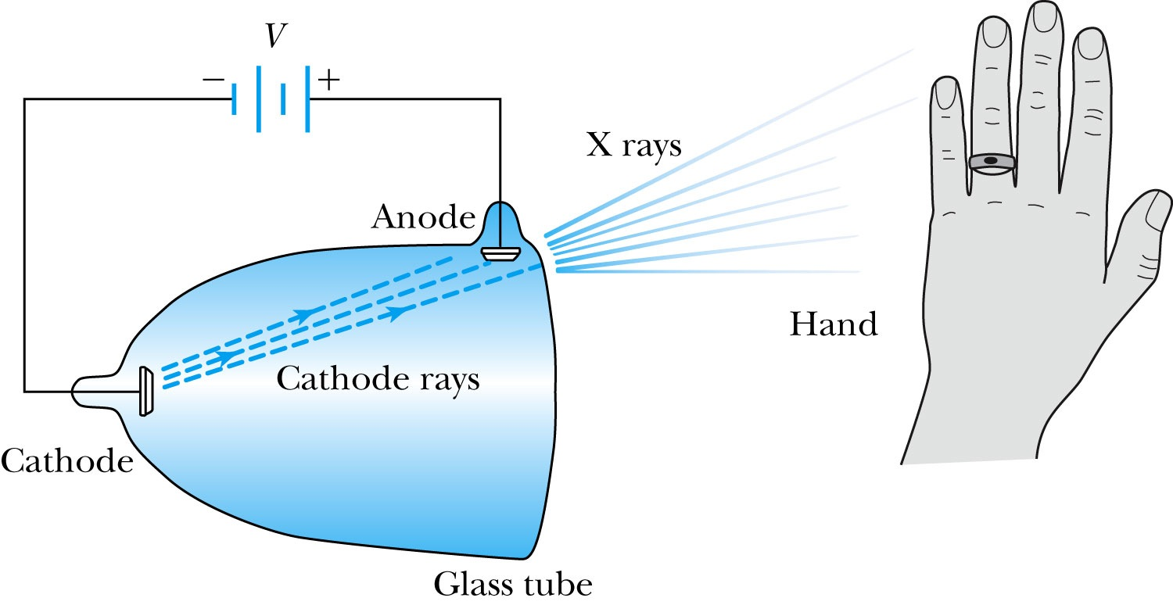
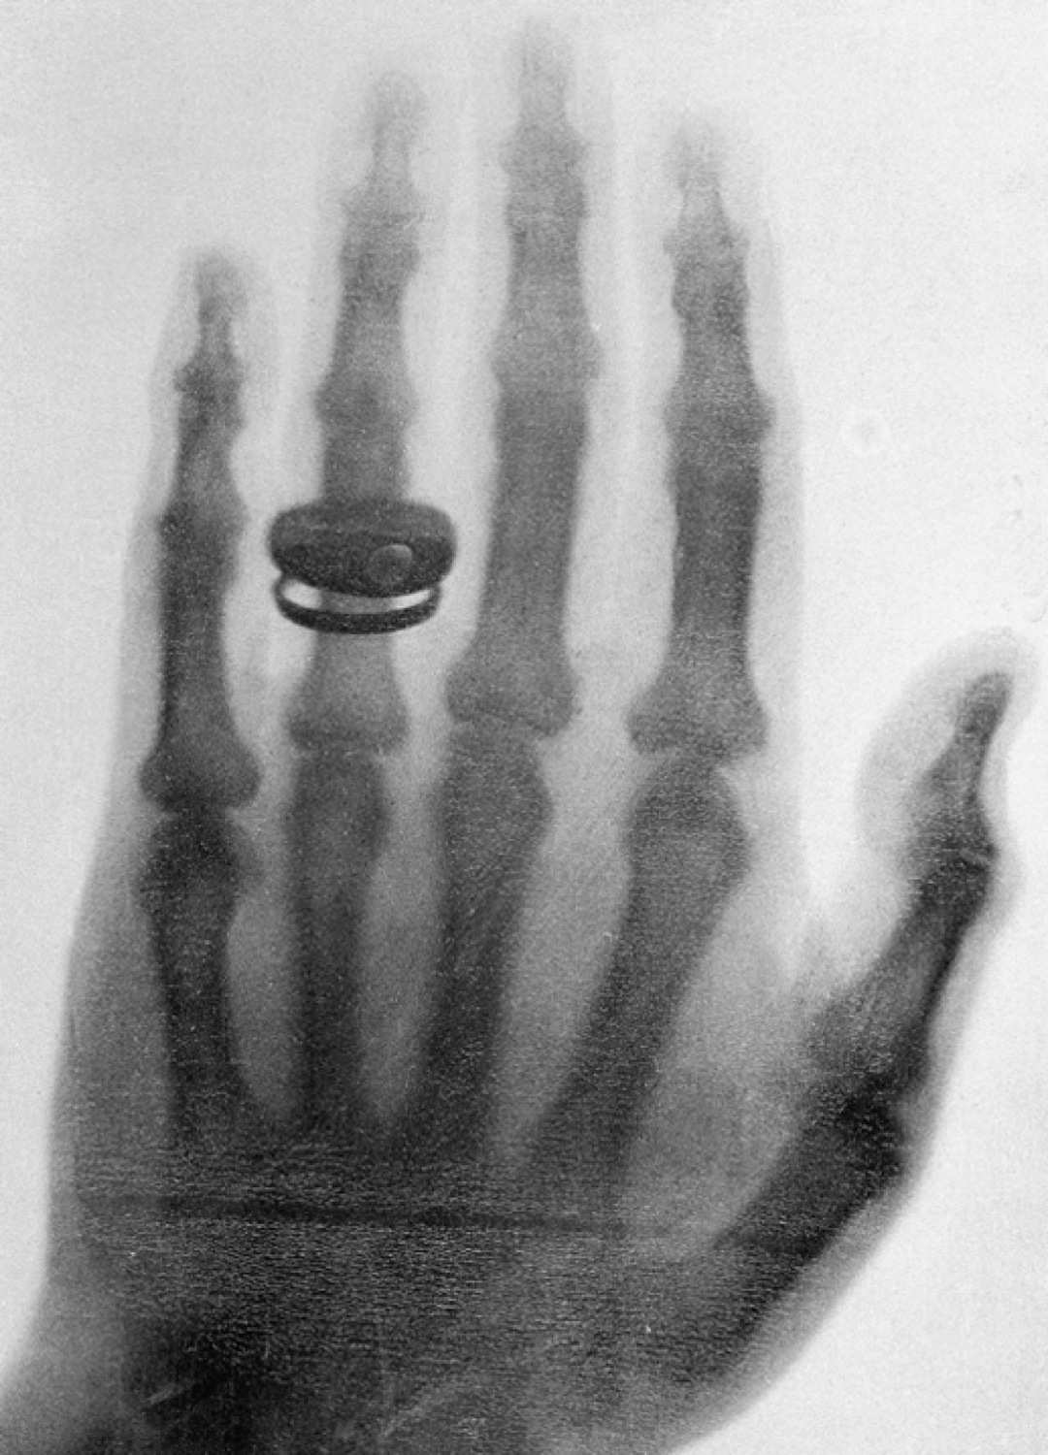
Röntgen’s X Ray Tube
Röntgen produced X-ray by allowing cathode rays to impact the glass wall of the tube.
Took image the bones of a hand on a phosphorescent screen.
Tremendous contribution to medical imaging, and Röntgen received the 1st Nobel Prize for this!

Slide 23
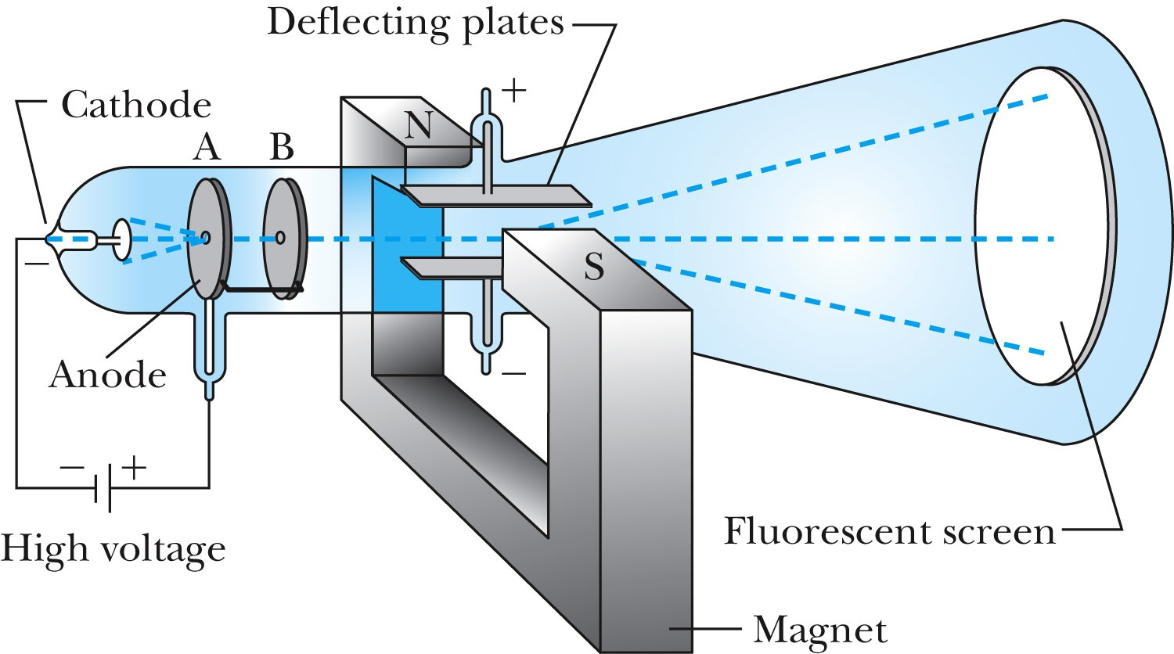
J.J. Thomson’s Cathode-Ray Experiment
Thomson showed that the cathode rays were negatively charged particles (electrons)! How?
By deflecting them in electric and magnetic fields.

Slide 24
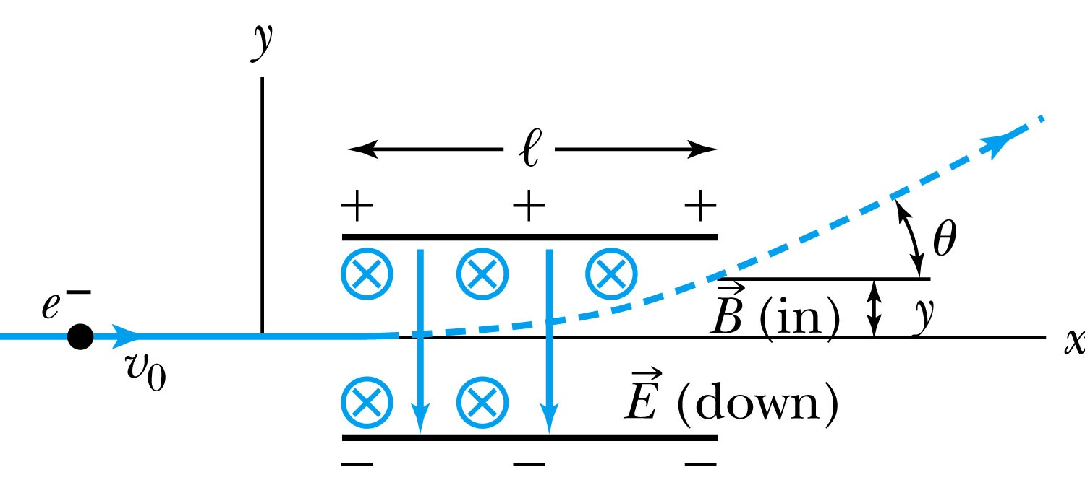
Thomson’s Experiment
Thomson measured the ratio of the electron’s charge to mass by sending electrons through a region containing a magnetic field perpendicular to an electric field.
Measure the deflection angle with only E!
Turn on and adjust B field till no deflection!
What do we know?
l, B, E and θ
What do we not know?
v₀, q and m

Slide 25
Calculation of q/m
An electron moving through the electric field w/o magnetic field is accelerated by the force:
Electron angle of deflection:
Adjust the perpendicular magnetic field till it balances E and keeps electrons from deflecting in y-direction
Charge to mass ratio:

Slide 26
Ex 3.1: Thomson’s experiment
In an experiment similar to Thomson’s, we use deflecting plates 5.0cm in length with an electric field of 1.2x10⁴V/m. Without the magnetic field, we find an angular deflection of 30º, and with a magnetic field of 8.8x10⁻⁴T we find no deflection. What is the initial velocity of the electron and its q/m?
First v₀ using E and B, we obtain:
q/m is then
What is the actual value of q/m using the known quantities?

