Slide 1
PHYS 3313 – Section 001 Lecture #8
Monday, Sept. 23, 2013
Dr. Amir Farbin
Discovery of Electron
Determination of Electron Charge
Line Spectra
Blackbody Radiation
Photoelectric Effect
Compton Effect
Pair production/Pair annihilation

Slide 2
Announcements
Reading assignments: CH3.9
Homework #2
CH3 end of the chapter problems: 2, 19, 27, 36, 41, 47 and 57
Due Wednesday, Oct. 2
Quiz #2 Monday, Sept. 30
Beginning of the class
Covers CH1.1 – what we finish Wednesday, Sept. 26

Slide 3
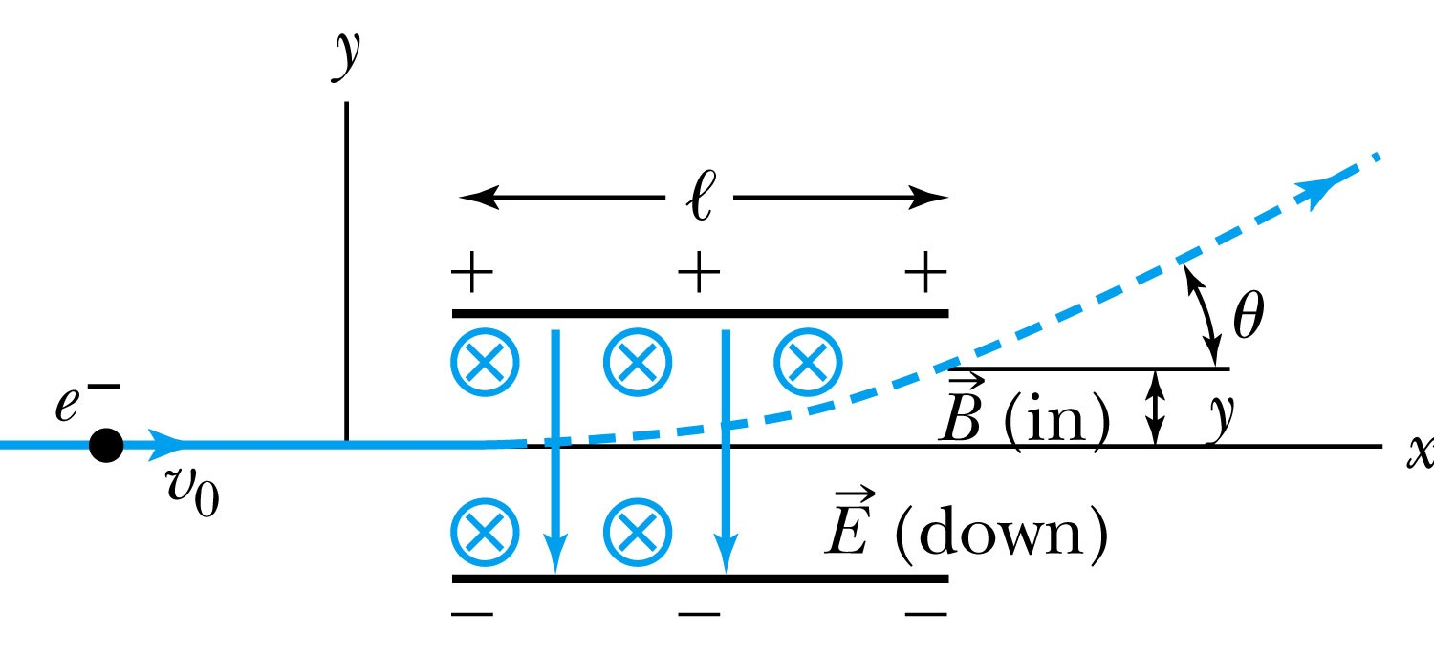
Thomson’s Experiment
Thomson measured the ratio of the electron’s charge to mass by sending electrons through a region containing a magnetic field perpendicular to an electric field.
Measure the deflection angle with only E!
Turn on and adjust B field till no deflection!
What do we know?
l, B, E and θ
What do we not know?
v₀, q and m

Slide 4
Calculation of q/m
An electron moving through the electric field w/o magnetic field is accelerated by the force:
Electron angle of deflection:
Adjust the perpendicular magnetic field till it balances E and keeps electrons from deflecting in y-direction
Charge to mass ratio:

Slide 5
Ex 3.1: Thomson’s experiment
In an experiment similar to Thomson’s, we use deflecting plates 5.0cm in length with an electric field of 1.2x10⁴V/m. Without the magnetic field, we find an angular deflection of 30º, and with a magnetic field of 8.8x10⁻⁴T we find no deflection. What is the initial velocity of the electron and its q/m?
First v₀ using E and B, we obtain:
q/m is then
What is the actual value of q/m using the known quantities?

Slide 6
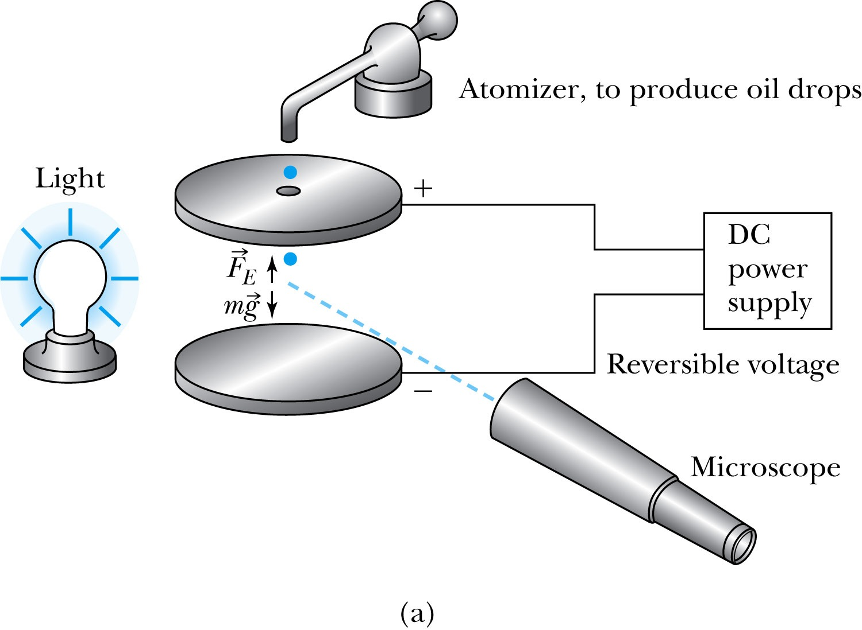
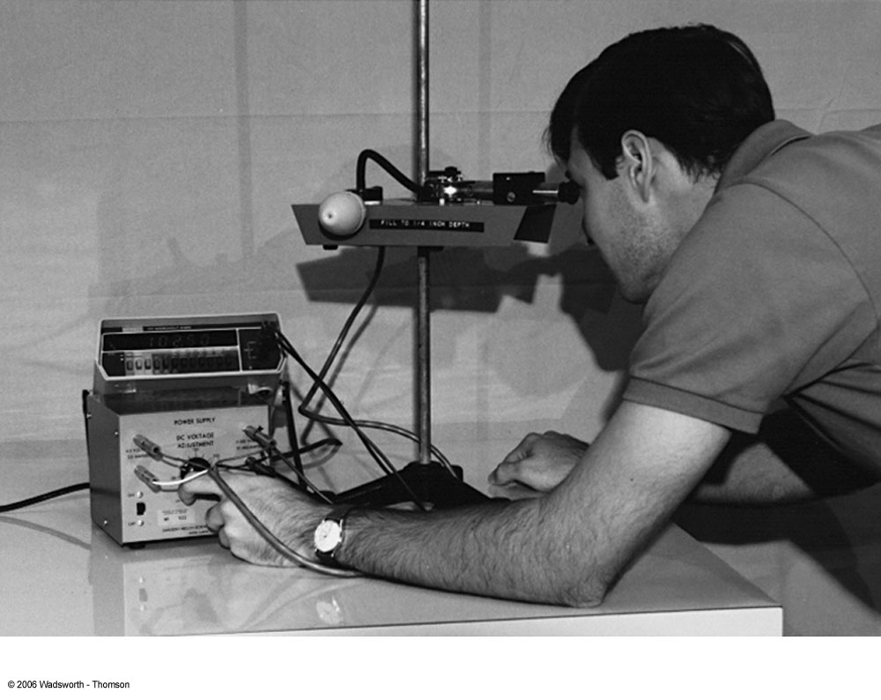
Determination of Electron Charge
Millikan (and Fletcher) in 1909 measured charge of electron, showed that free electric charge is in multiples of the basic charge of an electron

Slide 7
Calculation of the oil drop charge
Used an electric field and gravity to suspend a charged oil drop
So the magnitude of the charge on the oil drop
Mass is determined from Stokes’ relationship of the terminal velocity to the radius and density
Thousands of experiments showed that there is a basic quantized electron charge

Slide 8
Line Spectra
Chemical elements produce unique wavelengths of light when burned or excited in an electrical discharge.
Collimated light is passed through a diffraction grating with thousands of ruling lines per centimeter.
The diffracted light is separated at an angle θ according to its wavelength λ by the equation:
where d is the distance between rulings and n is an integer called the order number

Slide 9
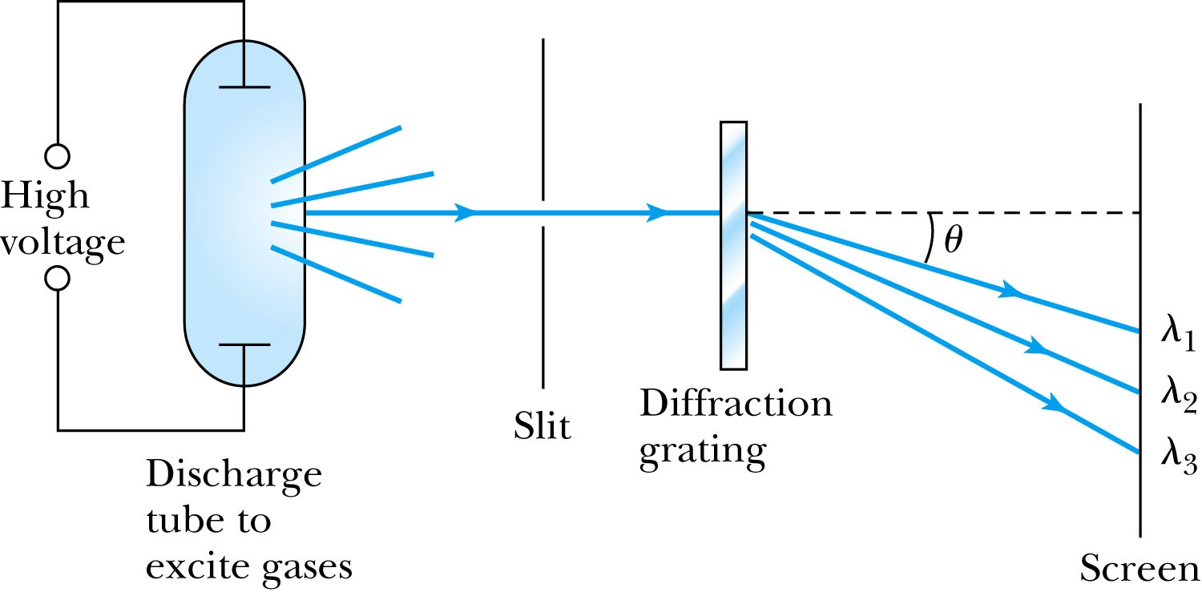
Optical Spectrometer
Diffraction creates a line spectrum pattern of light bands and dark areas on the screen.
Chemical elements and the composition of materials can be identified through the wavelengths of these line spectra

Slide 10
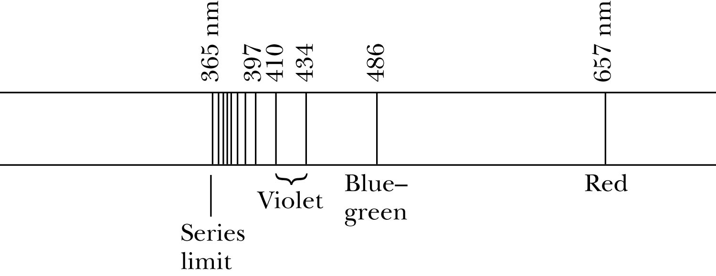
Balmer Series
In 1885, Johann Balmer found an empirical formula for wavelength of the visible hydrogen line spectra in nm:
(where k = 3,4,5… and k > 2)

Slide 11
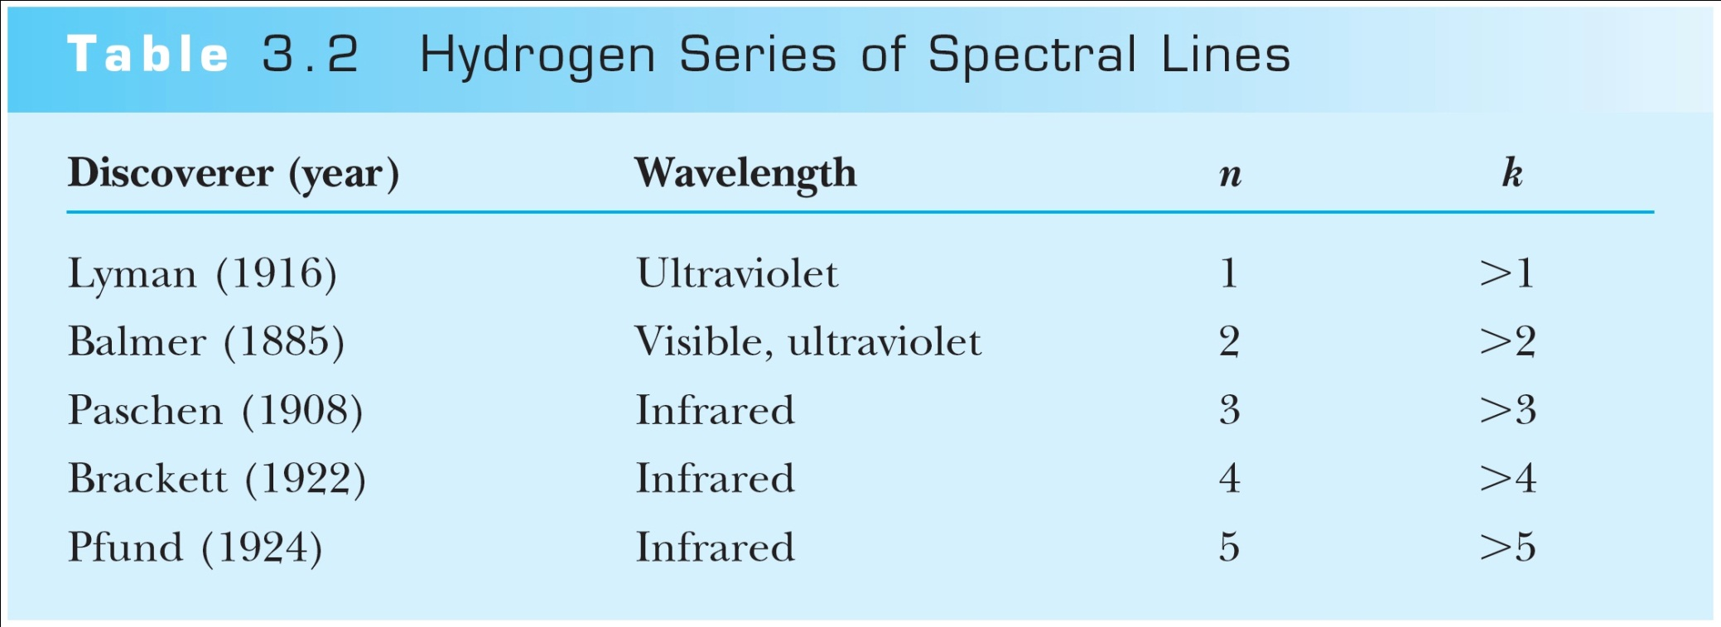
Rydberg Equation
Several more series of emission lines at infrared and ultraviolet wavelengths were discoverd, the Balmer series equation was extended to the Rydberg equation:
(n = 2)

Slide 12
Quantization
Current theories predict that charges are quantized in units (quarks) of ±e/3 and ±2e/3, but quarks are not directly observed experimentally.
The charges of particles that have been directly observed are always quantized in units of ±e.
The measured atomic weights are not continuous—they have only discrete values, which are close to integral multiples of a unit mass.

Slide 13
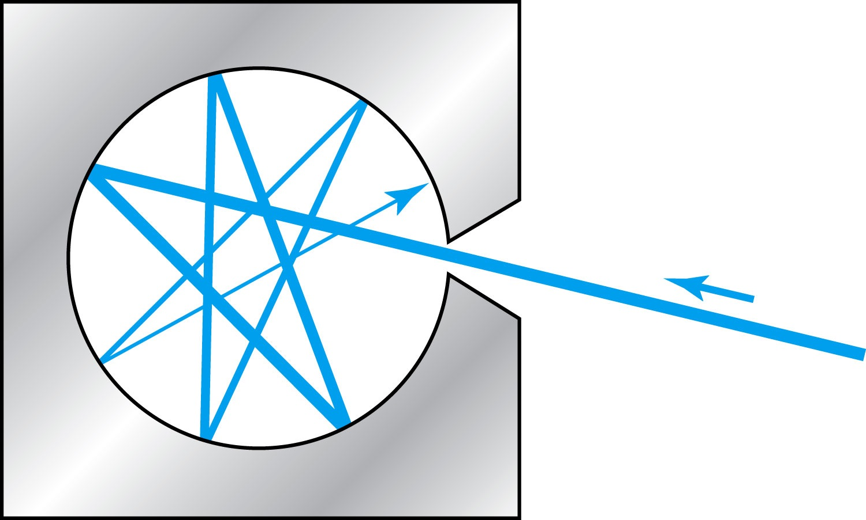
Blackbody Radiation
When matter is heated, it emits radiation.
A blackbody is an ideal object that has 100% absorption and 100% emission without a loss of energy
A cavity in a material that only emits thermal radiation can be considered as a black-body. Incoming radiation is fully absorbed in the cavity.
Blackbody radiation is theoretically interesting because
Radiation properties are independent of the particular material.
Properties of intensity versus wavelength at fixed temperatures can be studied

Slide 14
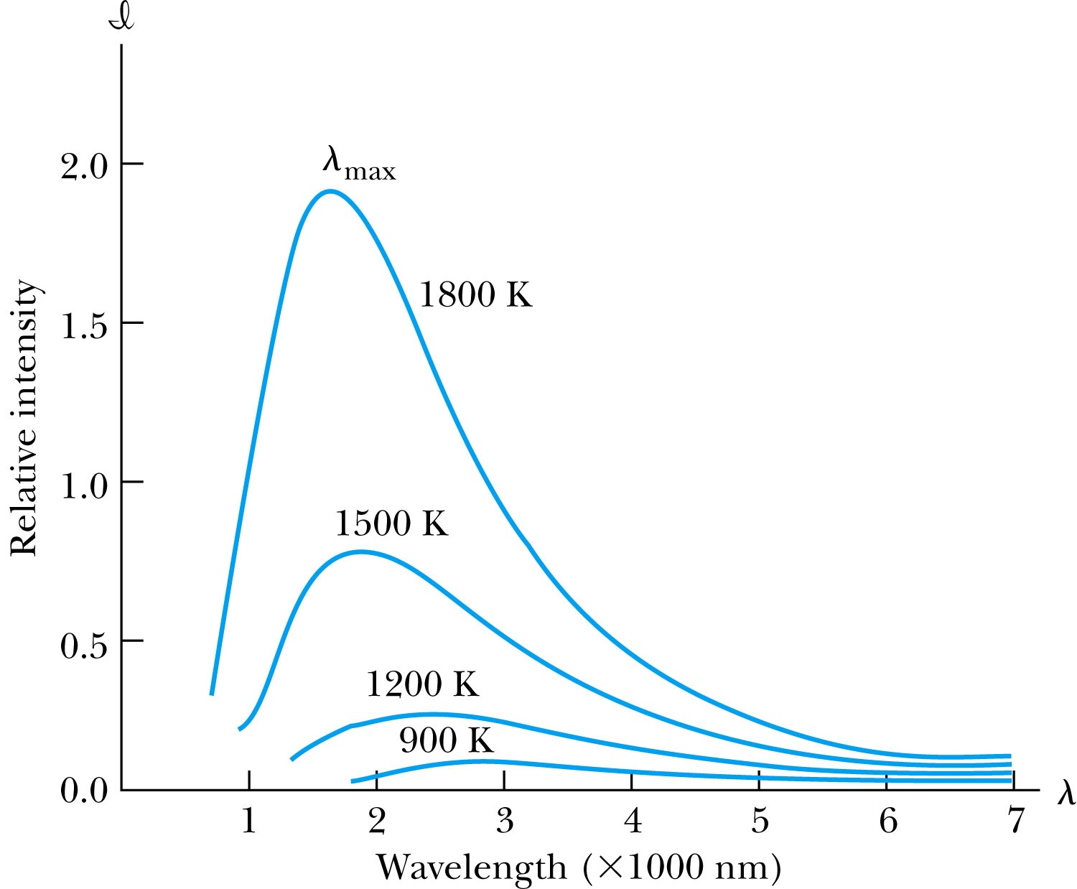
Wien’s Displacement Law
The intensity (λ, T) is the total power radiated per unit area per unit wavelength at a given temperature.
Wien’s displacement law: The maximum of the distribution shifts to smaller wavelengths as the temperature increases.
(where λ_{max} = wavelength of the peak)

Slide 15
Stefan-Boltzmann Law
The total power radiated increases with the temperature:
This is known as the Stefan-Boltzmann law, with the constant σ experimentally measured to be 5.6705×10⁻⁸ W / (m² · K⁴).
The emissivity ε (ε = 1 for an idealized blackbody) is the ratio of the emissive power of an object to that of an ideal blackbody and is always less than 1.

Slide 16
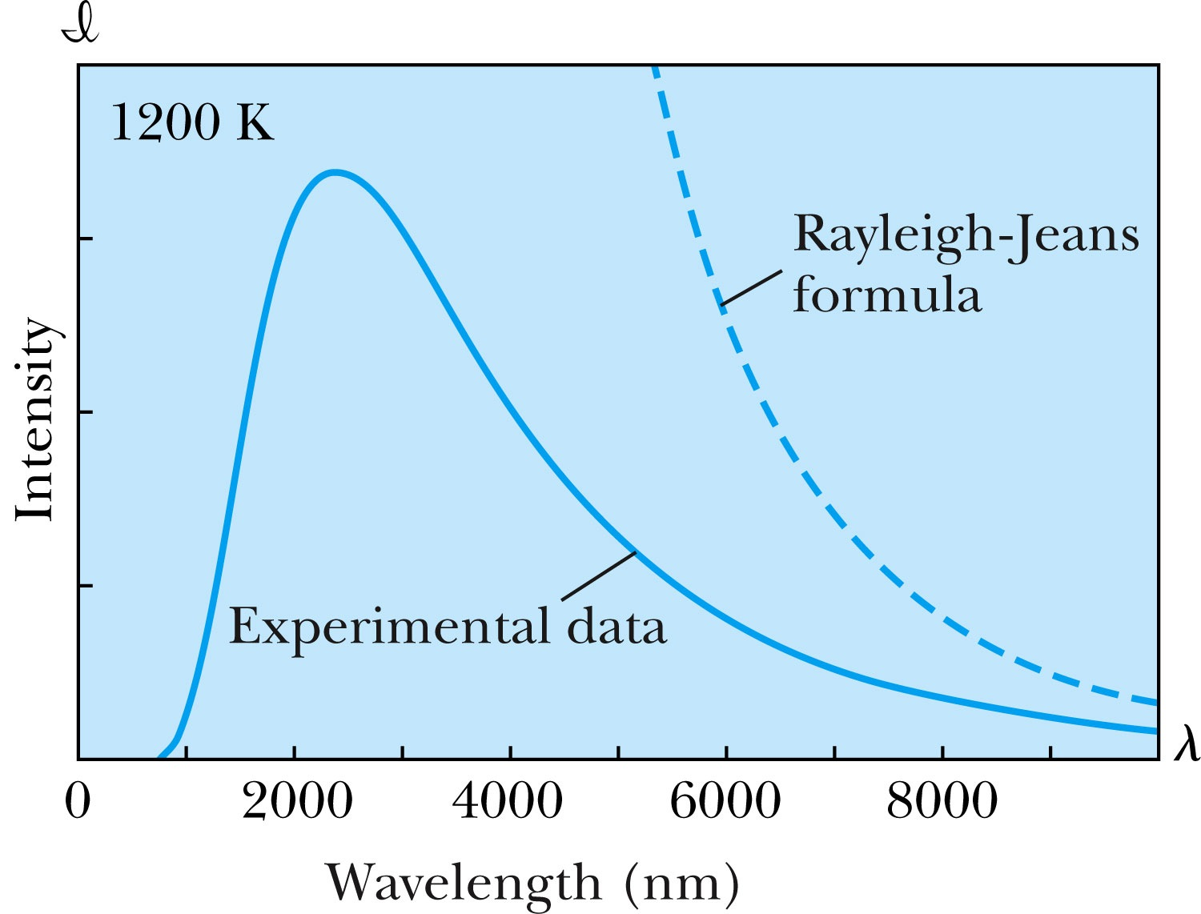
Rayleigh-Jeans Formula
Lord Rayleigh used the classical theories of electromagnetism and thermodynamics to show that the blackbody spectral distribution should be
Worked reasonably at longer wavelengths
it deviates badly at short wavelengths.
➔ “the ultraviolet catastrophe” a serious issue that couldn’t be explained

Slide 17
Planck’s Radiation Law
Planck assumed that the radiation in the cavity was emitted (and absorbed) by some sort of “oscillators” that were contained in the walls. He used Boltzman’s statistical methods to arrive at the following formula that fit the blackbody radiation data.
Planck made two modifications to the classical theory:
The oscillators (of electromagnetic origin) can only have certain discrete energies determined by E_{n} = nhf, where n is an integer, f is the frequency, and h is called Planck’s constant. h = 6.6261 × 10⁻³⁴ J·s.
The oscillators can absorb or emit energy ONLY in discrete multiples of the fundamental quantum of energy given by
Planck’s radiation law

Slide 18
Photoelectric Effect
Definition: Incident electromagnetic radiation shining on the material transfers energy to the electrons, allowing them to escape the surface of the metal. Ejected electrons are called photoelectrons
Other methods of electron emission:
Thermionic emission: Application of heat allows electrons to gain enough energy to escape.
Secondary emission: The electron gains enough energy by transfer from another high-speed particle that strikes the material from outside.
Field emission: A strong external electric field pulls the electron out of the material.

Slide 19
Classical Interpretation of Photoelectric Effect
Classical theory allows EM radiation to eject photoelectrons from matter
Classical theory predicts the energy of the photoelectrons increase proportion to the radiation intensity
Thus, KE of the photoelectrons must be proportional to the intensity of light not the current
Time for an experiment!

Slide 20
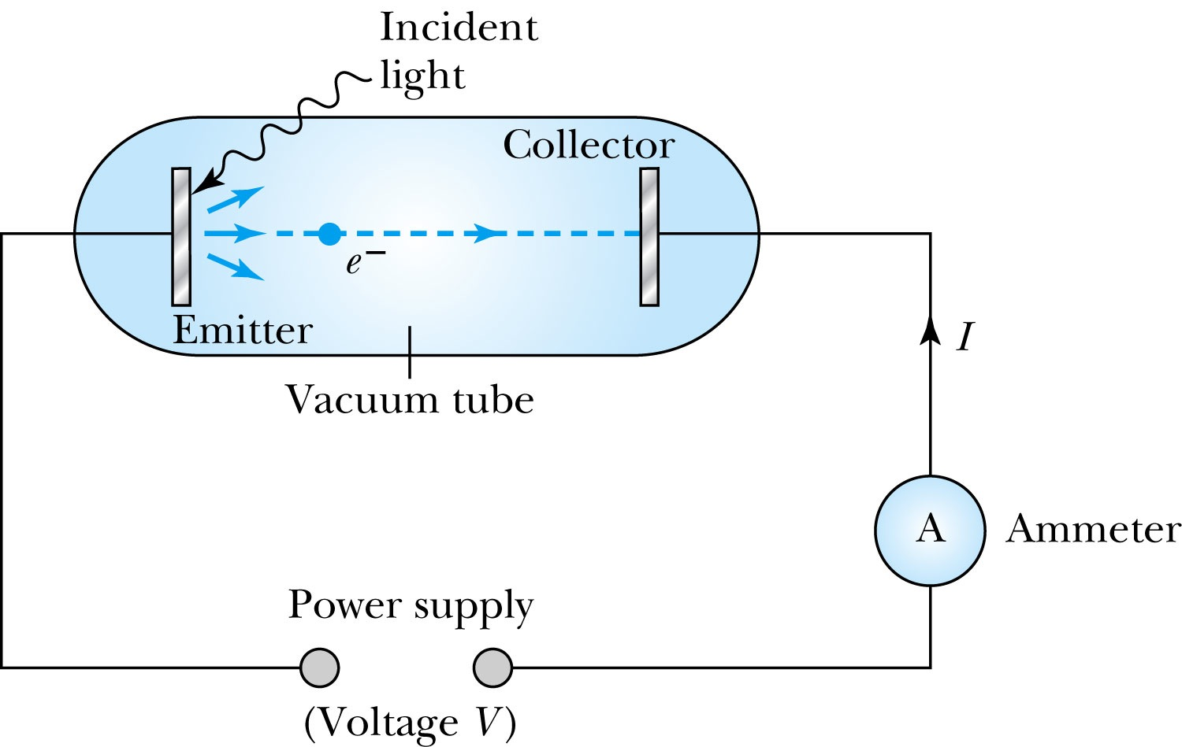
Photoelectric Effect Experimental Setup
Hmm.. Something does not make sense!!
Anode
Photocathode
V increased reverse direction to stop I

Slide 21
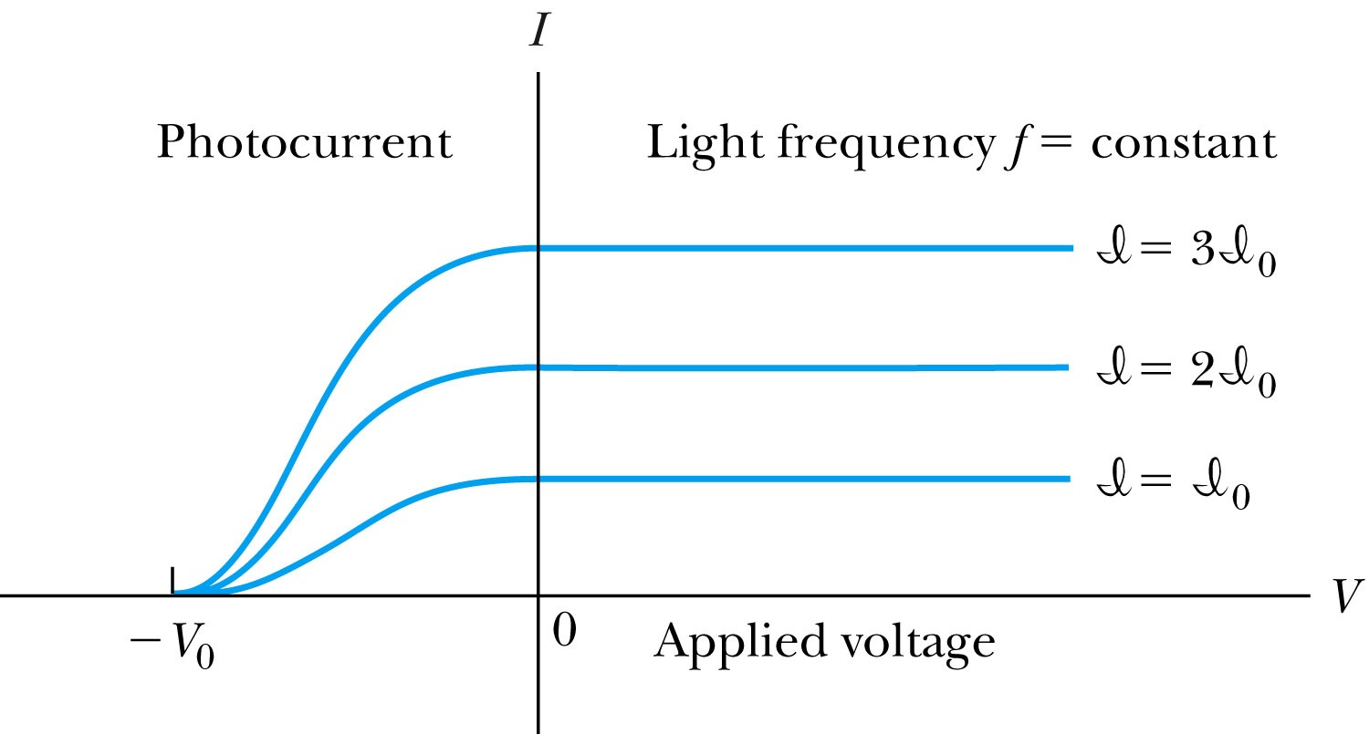
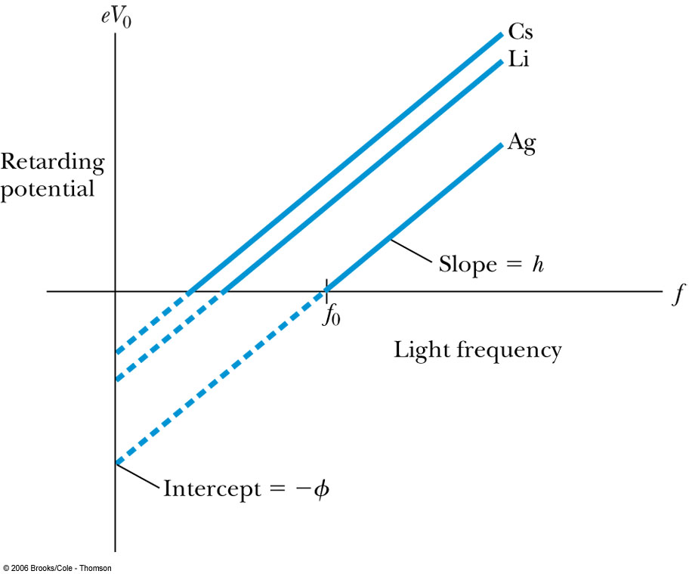
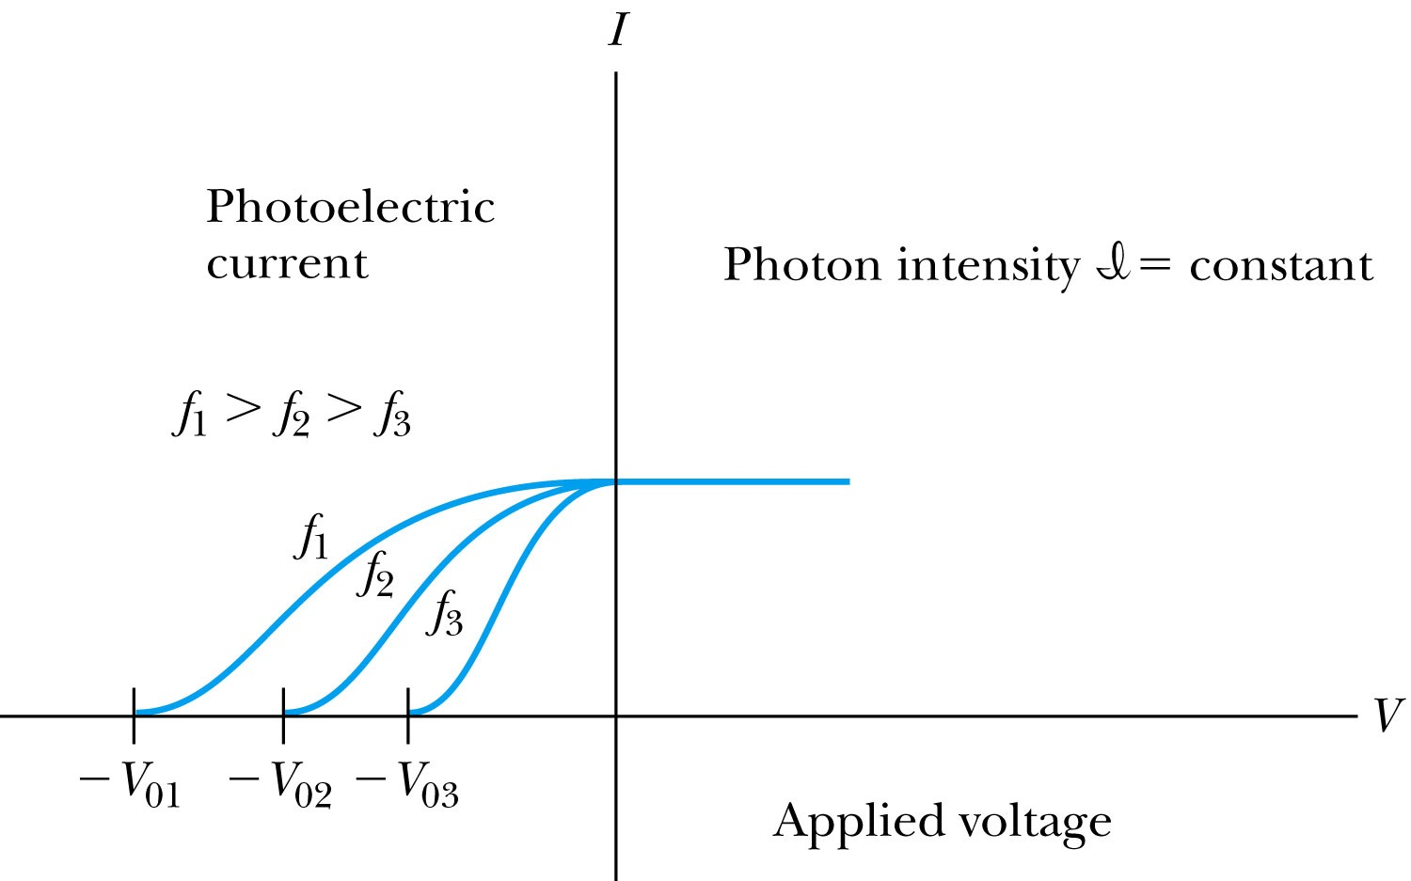
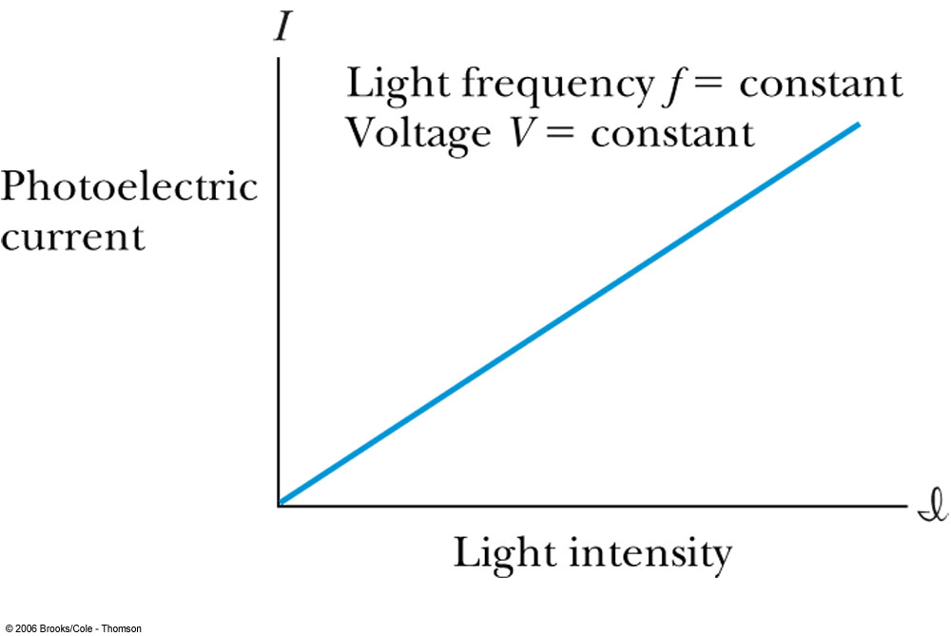
Experimental Observations
KE proportional to frequency!!
The same V₀,but higher current
The same current!!
Number of photoelectrons proportional to light intensity!!

Slide 22
Summary of Experimental Observations
Light intensity does not affect the KE of the photoelectrons
The max KE of the photoelectrons, for a given emitting material, depends only on the frequency of the light
The smaller the work function φ of the emitter material, the smaller is the threshold frequency of the light that can eject photoelectrons.
When the photoelectrons are produced, their number is proportional to the intensity of light.
The photoelectrons are emitted almost instantly following illumination of the photocathode, independent of the intensity of the light. ➔ Totally unexplained by classical physics

Slide 23
Einstein’s Theory of Photoelectric Effect
Einstein suggested that the electromagnetic radiation field is quantized into particles called photons. Each photon has the energy quantum:
where f is the frequency of the light and h is Planck’s constant.
The photon travels at the speed of light in a vacuum, and its wavelength is given by

Slide 24
Einstein’s Theory
Conservation of energy yields:
where φ is the work function of the metal
The energy can then be written
The retarding potentials measured the KE of the most energetic photoelectrons.

Slide 25
Quantum Interpretation
KE of the electron depend only on the light frequency and the work function φ of the material not the light intensity at all
Einstein in 1905 predicted that the stopping potential was linearly proportional to the light frequency, with a slope h, the same constant found by Planck.
From this, Einstein concluded that light is a particle with energy:
Was he already thinking about particle/wave duality?

Slide 26
Ex 3.11: Photoelectric Effect
Light of wavelength 400nm is incident upon lithium (=2.93eV). Calculate (a) the photon energy and (b) the stopping potential V₀.
Since the wavelength is known, we use plank’s formula:
The stopping potential can be obtained using Einstein’s formula for photoelectron energy

Slide 27
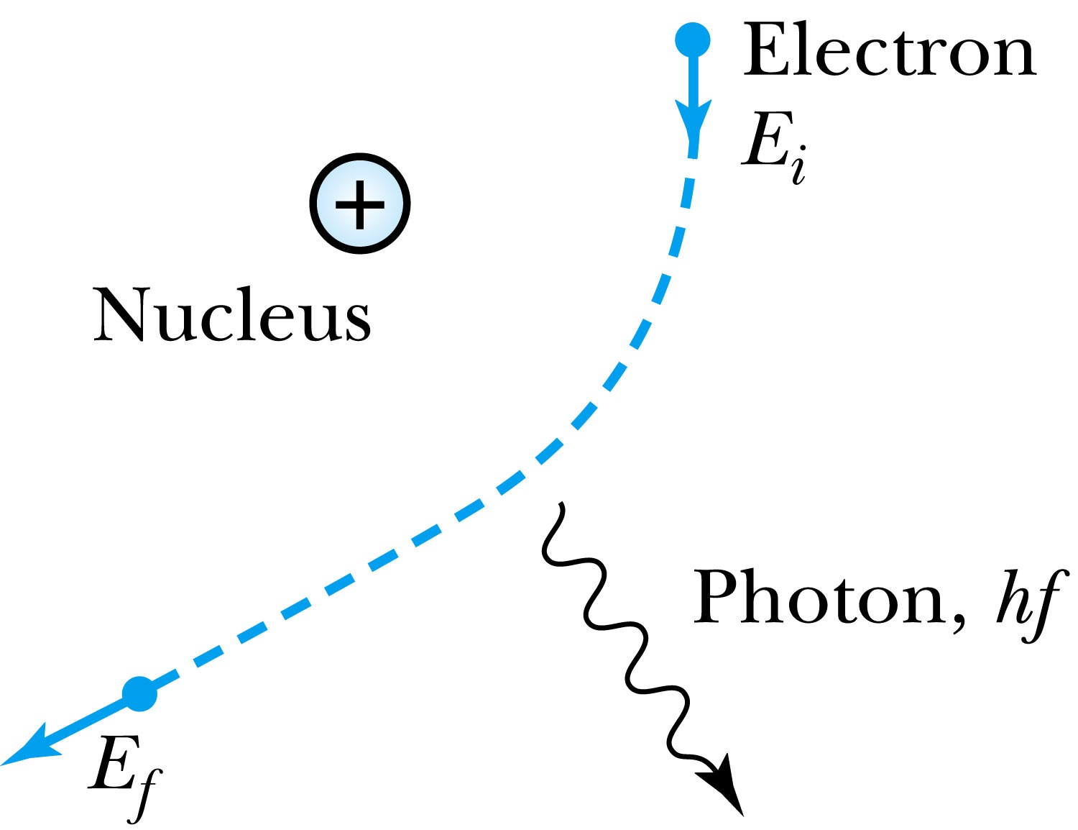
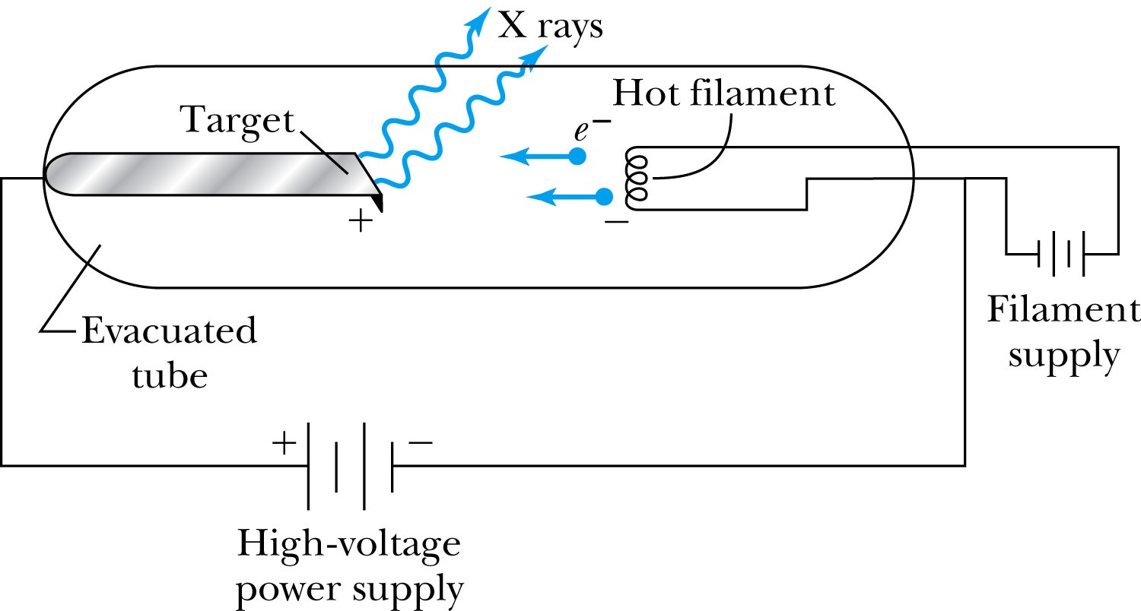
X-Ray Production
Bremsstrahlung (German word for braking radiation): Radiation of a photon from an energetic electron passing through matter due to an acceleration
Since linear momentum must be conserved, the nucleus absorbs very little energy, and it is ignored. The final energy of the electron is determined from the conservation of energy to be
An electron that loses a large amount of energy will produce an X-ray photon.
Current passing through a filament produces copious numbers of electrons by thermionic emission.
These electrons are focused by the cathode structure into a beam and are accelerated by potential differences of thousands of volts until they impinge on a metal anode surface, producing x rays by bremsstrahlung as they stop in the anode material

Slide 28
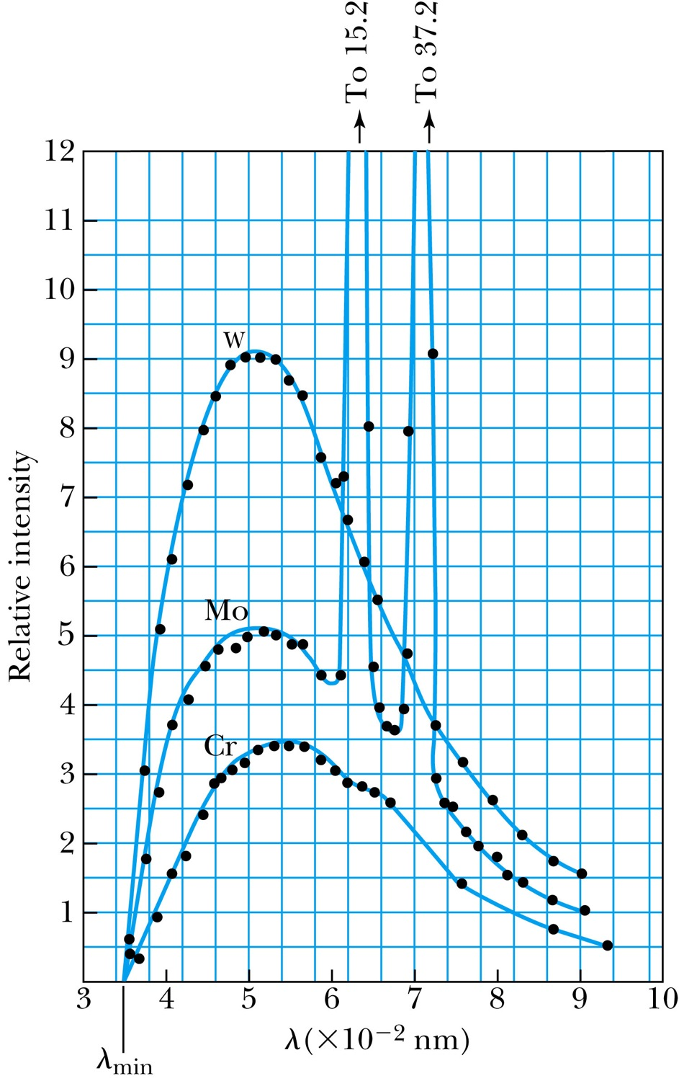
Inverse Photoelectric Effect.
Conservation of energy requires that the electron KE equal the maximum photon energy
Work function neglected since it’s small compared to the potential energy of the electron.
This is the Duane-Hunt limit
The photon wavelength depends only on the accelerating voltage
The same for all targets.

