Slide 1
PHYS 3313 – Section 001
Lecture #9
Wednesday, Sept. 25, 2013
Dr. Jae Yu
Compton Effect
Pair production/Pair annihilation
Atomic Model of Thomson
Rutherford Scattering Experiment and Rutherford Atomic Model

Slide 2
Announcements
Result of Quiz #1
  Class average: 13.5/65
    Equivalent to 20.8/100
  Top score: 54/65
Reminder of Homework #2
  CH3 end of the chapter problems: 2, 19, 27, 36, 41, 47 and 57
  Due Wednesday, Oct. 2
Quiz #2 coming Monday, Sept. 30
  Beginning of the class
  Covers CH1.1 – what we finish today
Colloquium today
  Dr. M. Huda of UTA Physics

Slide 3
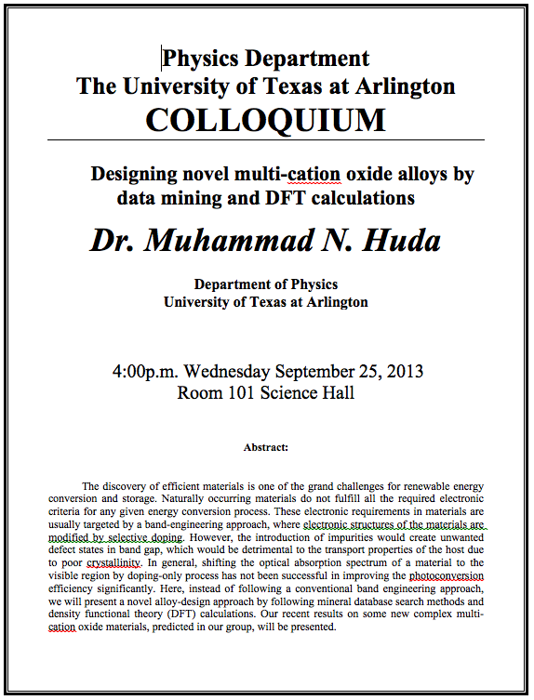

Slide 4
Special Project #3
A total of N_{i} incident projectile particle of atomic number Z₁ kinetic energy KE scatter on a target of thickness t and atomic number Z₂ and has n atoms per volume. What is the total number of scattered projectile particles at an angle θ? (20 points)
Please be sure to clearly define all the variables used in your derivation! Points will be deducted for missing variable definitions.
This derivation must be done on your own. Please do not copy the book, internet or your friends’.
Due is Wednesday, Oct. 9.

Slide 5
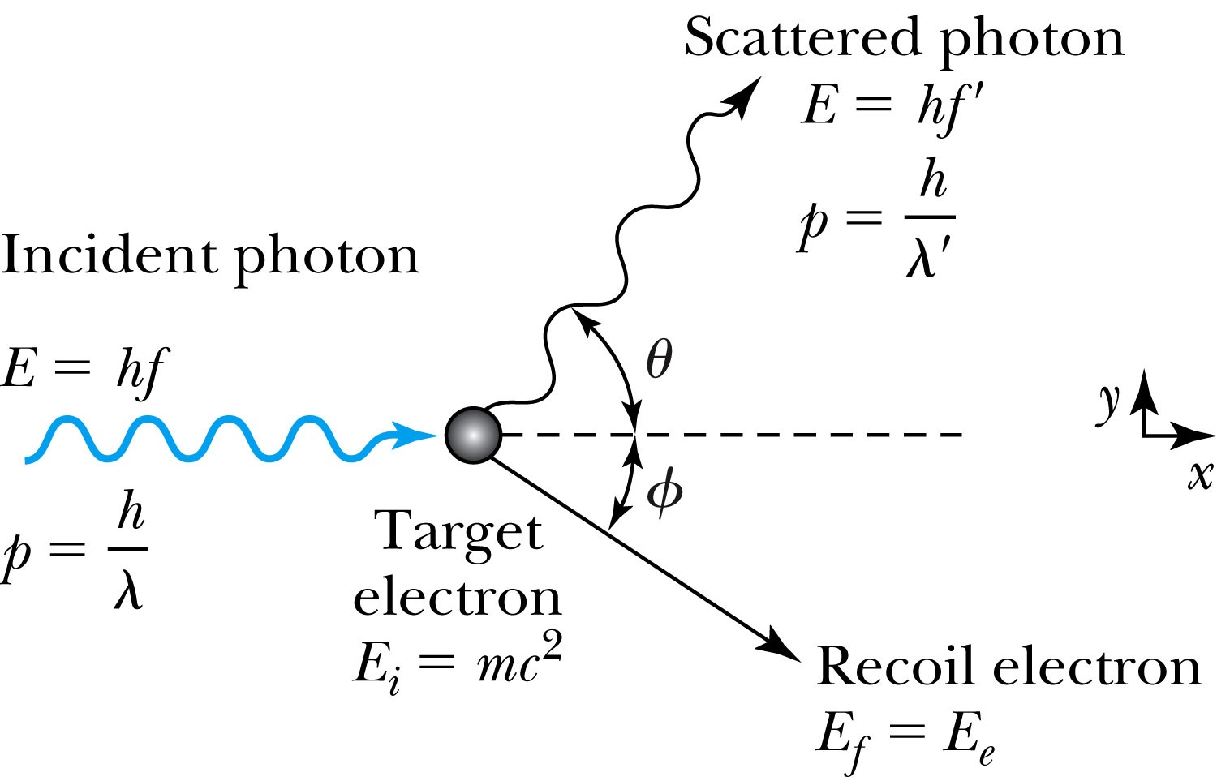
Compton Effect
When a photon enters matter, it is likely to interact with one of the atomic electrons.
The photon is scattered from only one electron
The laws of conservation of energy and momentum apply as in any elastic collision between two particles. The momentum of a particle moving at the speed of light is
The electron energy can be written as
Change of the scattered photon wavelength is known as the Compton effect:

Slide 6
Pair Production and Annihilation
If a photon can create an electron, it must also create a positive charge to balance charge conservation.
In 1932, C. D. Anderson observed a positively charged electron (e⁺) in cosmic radiation. This particle, called a positron, had been predicted to exist several years earlier by P. A. M. Dirac.
A photon’s energy can be converted entirely into an electron and a positron in a process called pair production.
  Can only happen inside a material
  How much energy do you think is needed?

Slide 7
Pair Production in Empty Space?
Energy conservation for pair production in empty space
Momentum conservation yields
Thus max momentum exchange
Recall that the total energy for a particle can be written as
However this yields a contradiction:
and hence the conversion of energy in empty space is impossible and thus pair production cannot happen in empty space

Slide 8
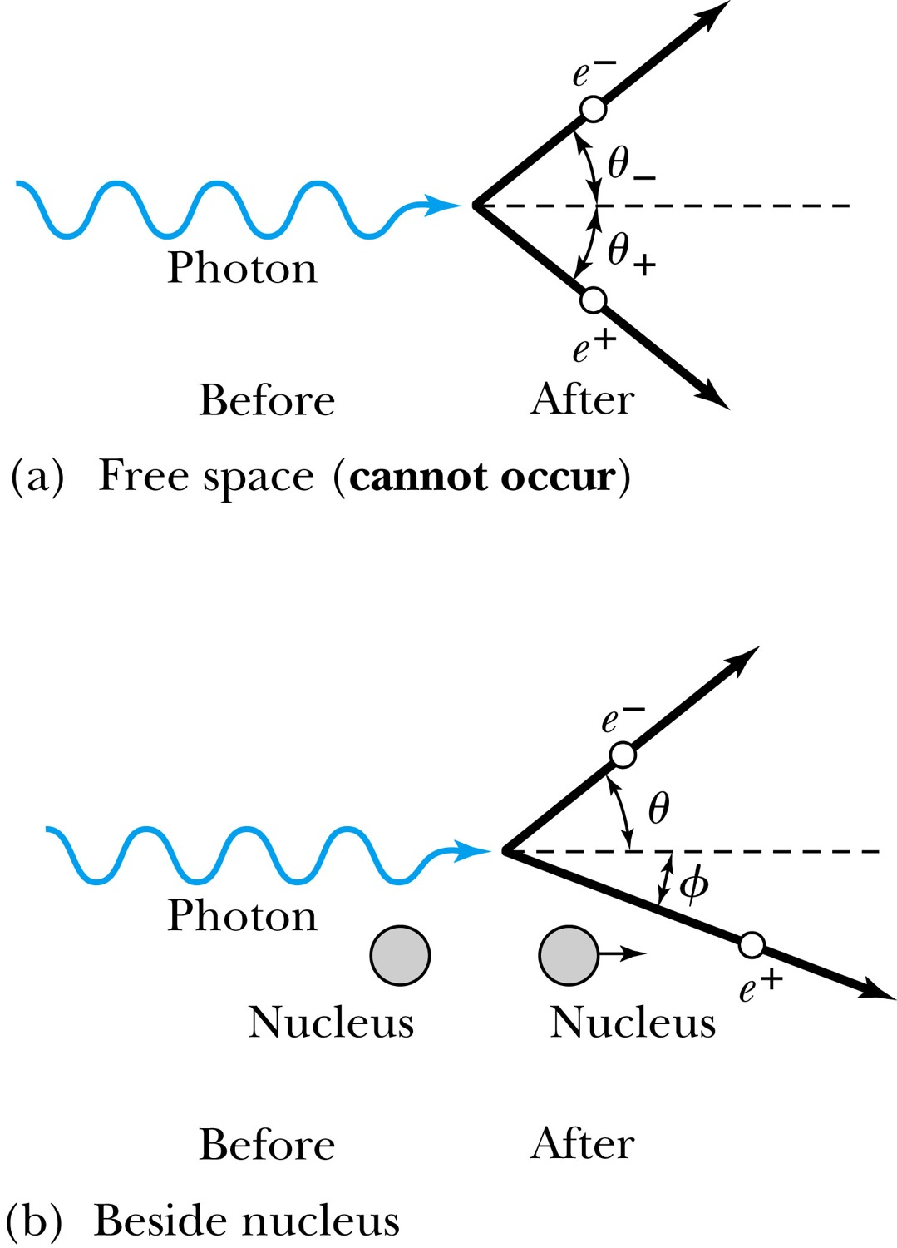
Pair Production in Matter
Since the relations and contradict each other, a photon can not produce an electron and a positron in empty space.
In the presence of matter, the nucleus absorbs some energy and momentum.
The photon energy required for pair production in the presence of matter is

Slide 9
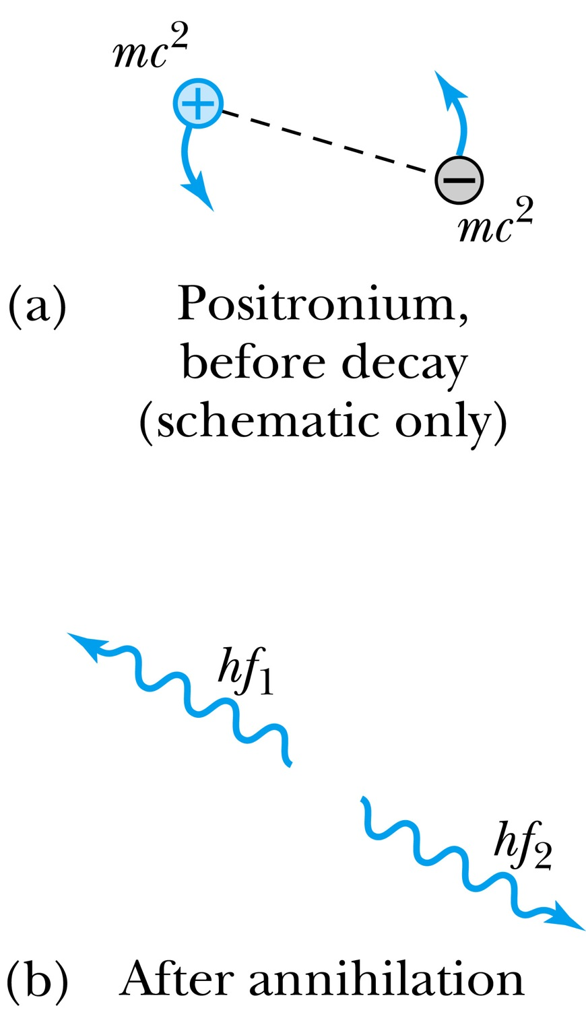
Pair Annihilation
A positron going through matter will likely annihilate with an electron.
A positron is drawn to an electron and form an atom-like configuration called positronium.
Pair annihilation in empty space will produce two photons to conserve momentum. Annihilation near a nucleus can result in a single photon.
Conservation of energy:
Conservation of momentum:
The two photons will be almost identical, so that
The two photons from positronium annihilation will move in the opposite directions with an energy of:

Slide 10
The Atomic Models of Thomson and Rutherford
Pieces of evidence that scientists had in 1900 to indicate that the atom was not a fundamental unit
There are simply too many kinds of atoms (~70 known at that time), belonging to a distinct chemical element
  Too many to be fundamental!!
Atoms and electromagnetic phenomena seem to be intimately related
The issue of valence ➔ Why certain elements combine with some elements but not with others?
  Is there a characteristic internal atomic structure?
The discoveries of radioactivity, x rays, and the electron

Slide 11
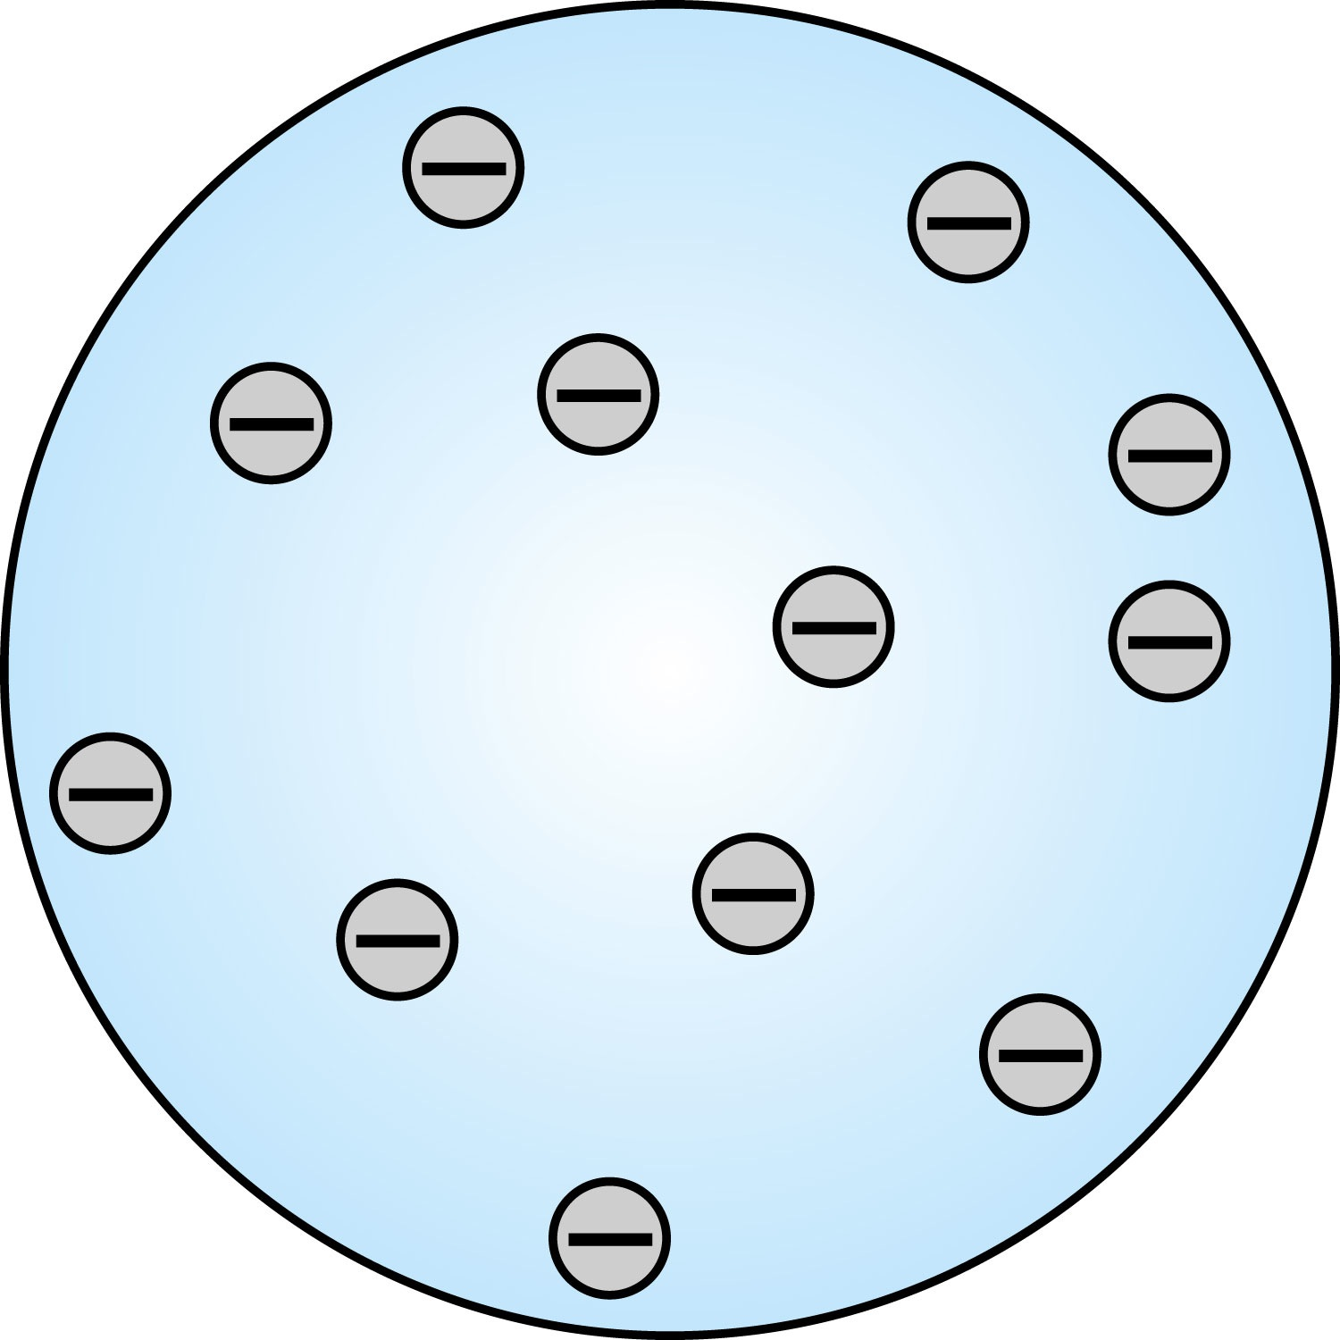
Thomson’s Atomic Model
Thomson’s “plum-pudding” model
  Atoms are electrically neutral and have electrons in them
  Atoms must have an equal amount of positive charges in it to balance electron negative charges
  So how about positive charges spread uniformly throughout a sphere the size of the atom with, the newly discovered “negative” electrons embedded in a uniform background.
Thomson thought when the atom was heated the electrons could vibrate about their equilibrium positions and thus produce electromagnetic radiation.

Slide 12
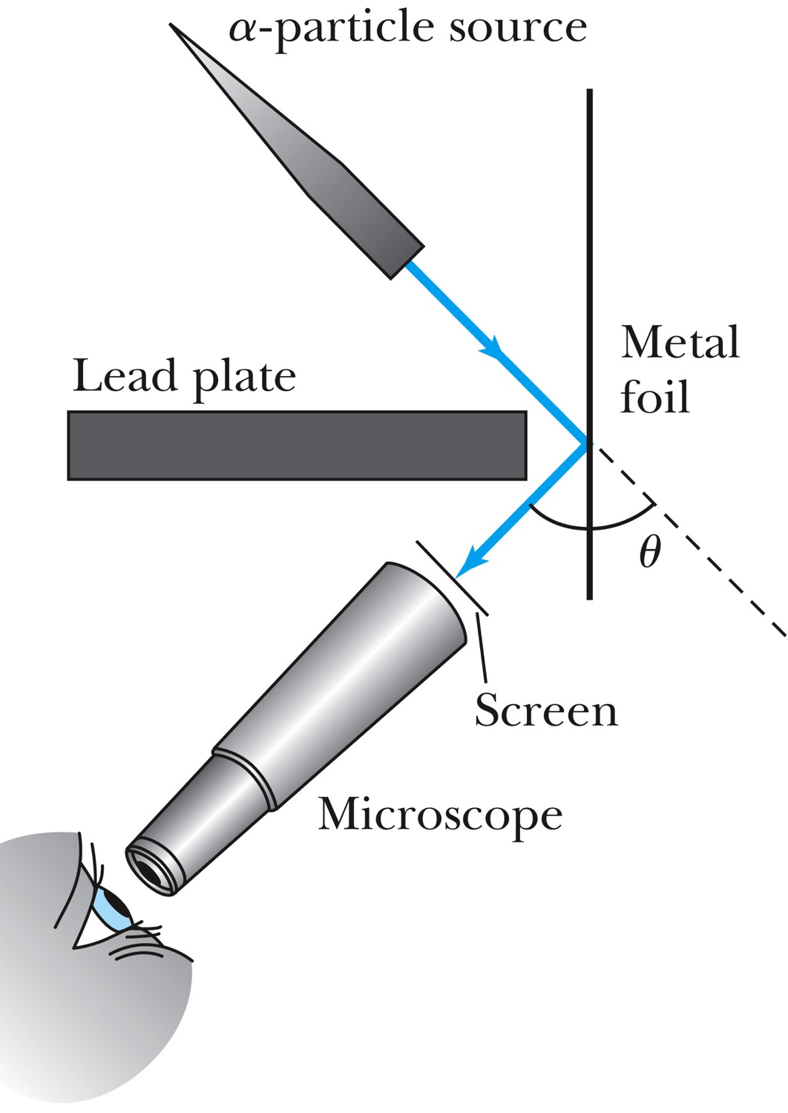
Experiments of Geiger and Marsden
Rutherford, Geiger, and Marsden conceived a new technique for investigating the structure of matter by scattering a particles from atoms.
Geiger showed that many a particles were scattered from thin gold-leaf targets at backward angles greater than 90°.

Slide 13
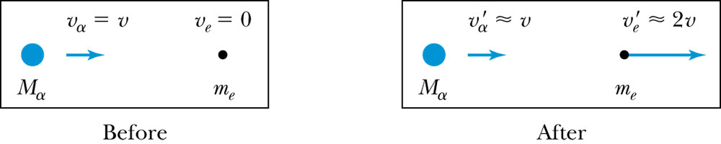
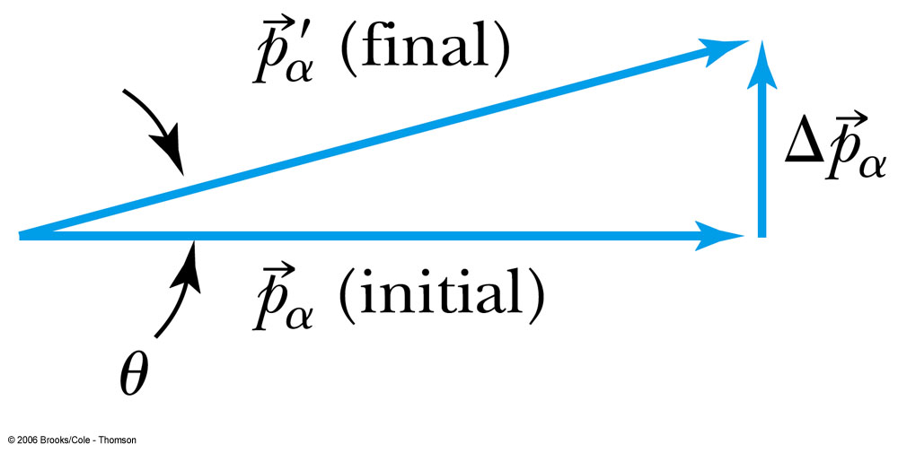
Ex 4.1: Maximum Scattering Angle
Geiger and Marsden (1909) observed backward-scattered (θ>=90º) α particles when a beam of energetic α particles was directed at a piece of gold foil as thin as 6.0x10⁻⁷m. Assuming an α particle scatters from an electron in the foil, what is the maximum scattering angle?
The maximum scattering angle corresponds to the maximum momentum change
Using the momentum conservation and the KE conservation for an elastic collision, the maximum momentum change of the α particle is
Determine θ by letting Δp_{max} be perpendicular to the direction of motion.

