Slide 1
PHYS 3313 – Section 001 Lecture #10
Monday, Sept. 30, 2013
Dr. Amir Farbin
Atomic Model of Thomson
Rutherford Scattering Experiment and Rutherford Atomic Model
The Classic Atomic Model
The Bohr Model of the Hydrogen Atom
Bohr Radius

Slide 2
Announcements
Reminder of Homework #2
CH3 end of the chapter problems: 2, 19, 27, 36, 41, 47 and 57
Due Wednesday, Oct. 2
Mid-term exam
In class on Wednesday, Oct. 16
Covers from CH1.1 through what we finish on Oct. 9 + appendices
Mid-term exam constitutes 20% of the total
Please do NOT miss the exam! You will get an F if you miss it.
Bring your own HANDWRITTEN formula sheet – one letter size sheet, front and back
No solutions for any problems
No derivations of any kind
Can have values of constants

Slide 3
Remind: Special Project #3
A total of N_{i} incident projectile particle of atomic number Z₁ kinetic energy KE scatter on a target of thickness t and atomic number Z₂ and has n atoms per volume. What is the total number of scattered projectile particles at an angle θ? (20 points)
Please be sure to clearly define all the variables used in your derivation! Points will be deducted for missing variable definitions.
This derivation must be done on your own. Please do not copy the book, internet or your friends’.
Due is Wednesday, Oct. 9.

Slide 4
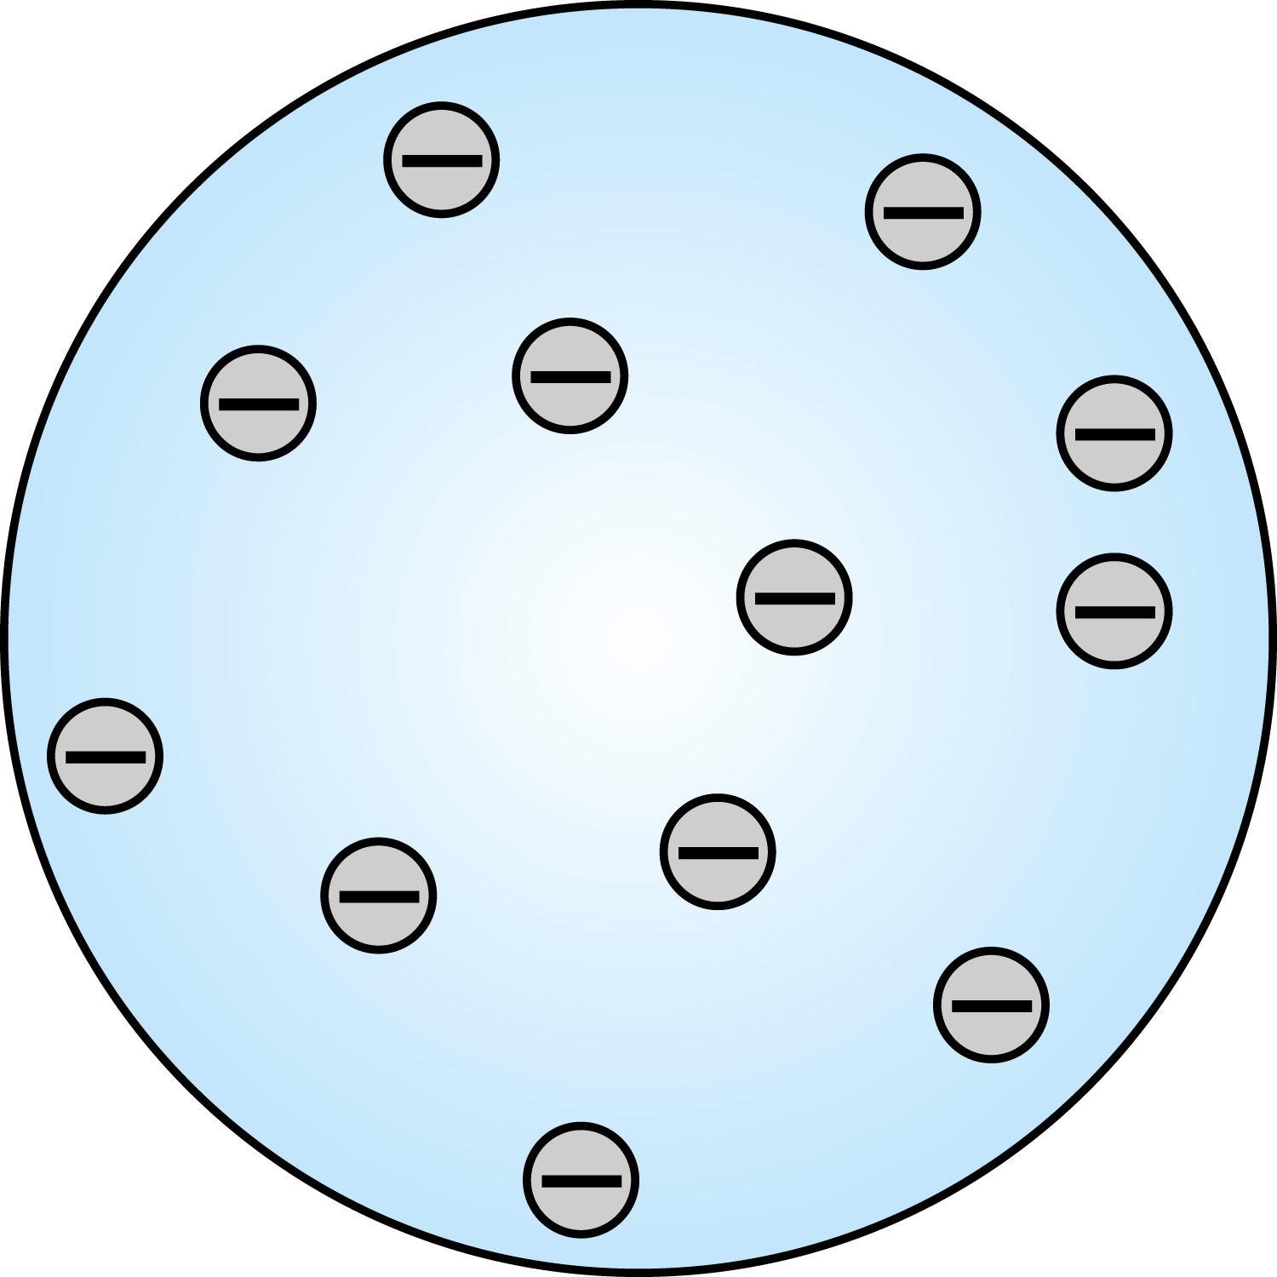
Thomson’s Atomic Model
Thomson’s “plum-pudding” model
Atoms are electrically neutral and have electrons in them
Atoms must have an equal amount of positive charges in it to balance electron negative charges
So how about positive charges spread uniformly throughout a sphere the size of the atom with, the newly discovered “negative” electrons embedded in a uniform background.
Thomson thought when the atom was heated the electrons could vibrate about their equilibrium positions and thus produce electromagnetic radiation.

Slide 5
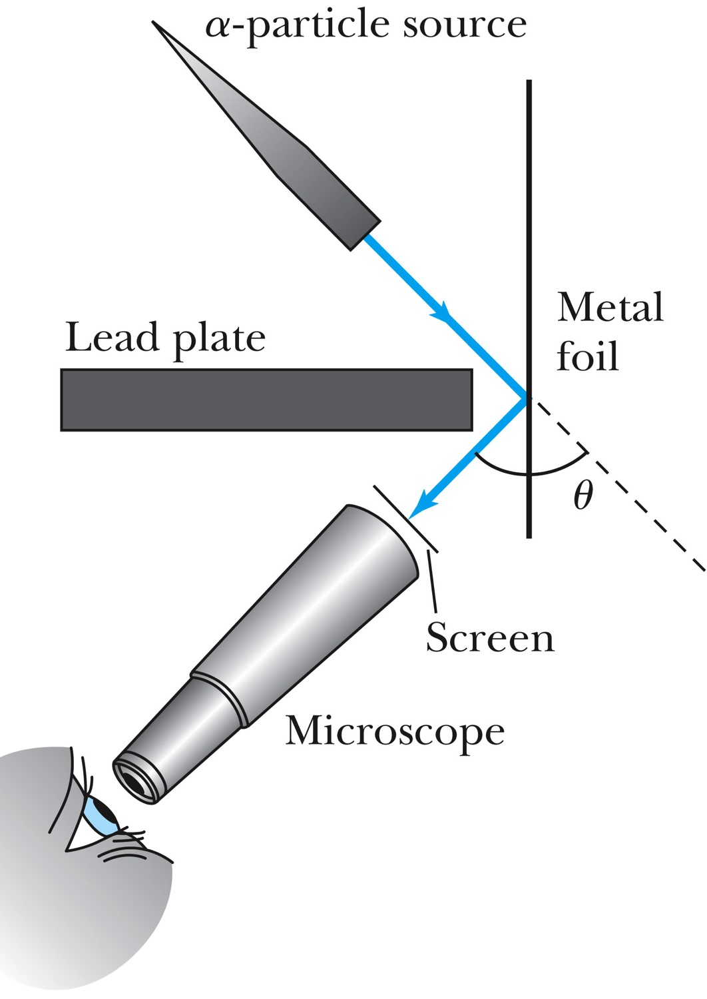
Experiments of Geiger and Marsden
Rutherford, Geiger, and Marsden conceived a new technique for investigating the structure of matter by scattering a particles from atoms.
Geiger showed that many a particles were scattered from thin gold-leaf targets at backward angles greater than 90°.

Slide 6
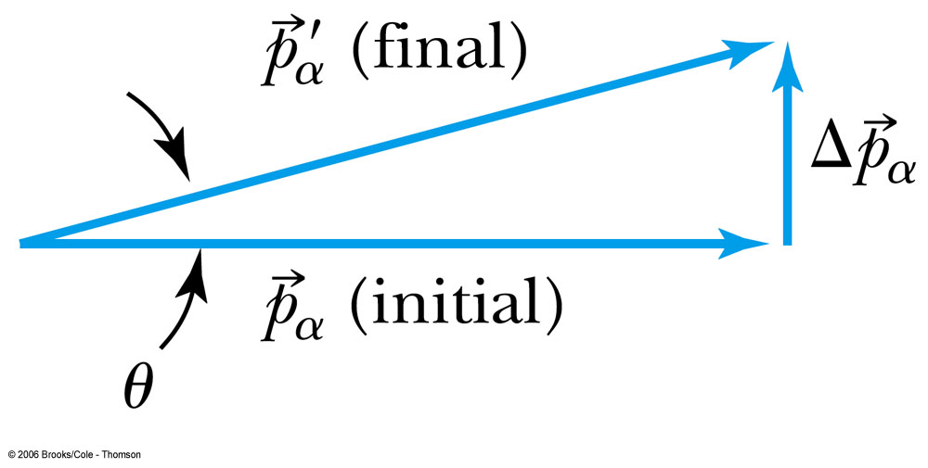
Ex 4.1: Maximum Scattering Angle
Geiger and Marsden (1909) observed backward-scattered (θ>=90º) α particles when a beam of energetic α particles was directed at a piece of gold foil as thin as 6.0x10⁻⁷m. Assuming an α particle scatters from an electron in the foil, what is the maximum scattering angle?
The maximum scattering angle corresponds to the maximum momentum change
Using the momentum conservation and the KE conservation for an elastic collision, the maximum momentum change of the α particle is
Determine θ by letting Δp_{max} be perpendicular to the direction of motion.

Slide 7
Multiple Scattering from Electrons
If an α particle were scattered by many electrons and N electrons results in <θ>_{total} ~ √Nθ
The number of atoms across the thin gold layer of 6 × 10⁻⁷ m:
Assume the distance between atoms is
and there are
That gives

Slide 8
Rutherford’s Atomic Model
<θ>_{total}~6.8º even if the α particle scattered from all 79 electrons in each atom of gold
The experimental results were inconsistent with Thomson’s atomic model.
Rutherford proposed that an atom has a positively charged core (nucleus) surrounded by the negative electrons.

Slide 9
Assumptions of Rutherford Scattering
The scatterer is so massive that it does not recoil significantly; therefore the initial and final KE of the α particle are practically equal.
The target is so thin that only a single scattering occurs.
The bombarding particle and target scatterer are so small that they may be treated as point masses and charges.
Only the Coulomb force is effective.

Slide 10
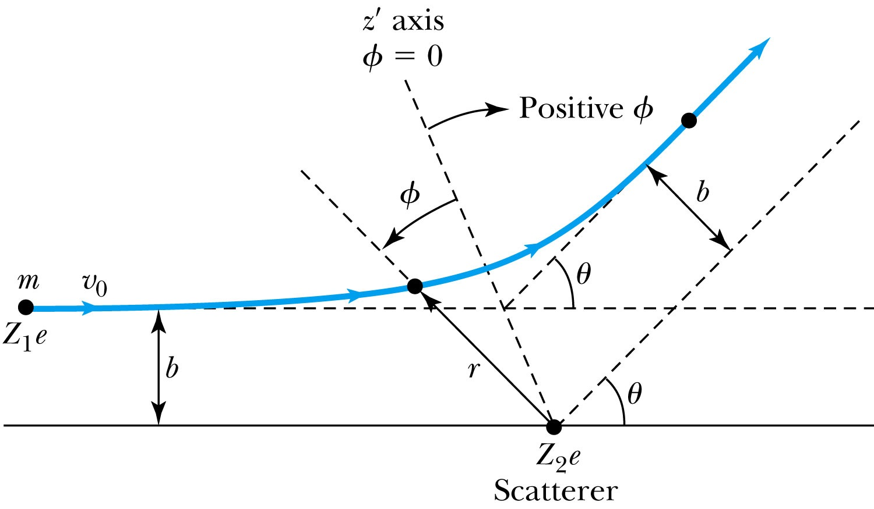
Rutherford Scattering
Scattering experiments help us study matter too small to be observed directly by measuring the angular distributions of the scattered particles
What is the force acting in this scattering?
There is a relationship between the impact parameter b and the scattering angle θ.
When b is small,
r gets small.
Coulomb force gets large.
θ can be large and the particle can be repelled backward.

Slide 11
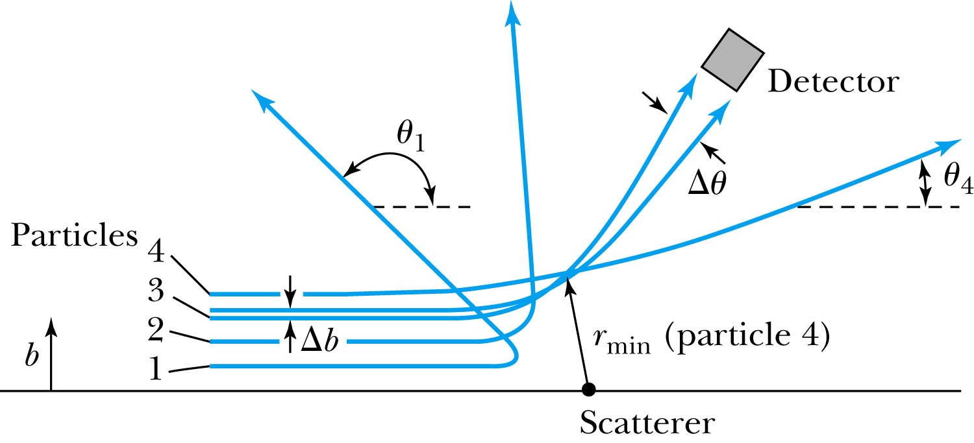
The Relationship Between the Impact Parameter b and the Scattering Angle
The relationship between the impact parameter b and scattering angle Δθ. Particles with small impact parameters approach the nucleus most closely (r_{min}) and scatter to the largest angles. Particles within a certain range of impact parameters b will be scattered within Δθ.

Slide 12
Rutherford Scattering
What are the quantities that can affect the scattering?
What was the force again?
The Coulomb force
The charge of the incoming particle (Z₁e)
The charge of the target particle (Z₂e)
The minimum distance the projectile approaches the target (r)
Using the fact that this is a totally elastic scattering under a central force, we know that
Linear momentum is conserved
KE is conserved
Angular momentum is conserved
From this, impact parameter

Slide 13
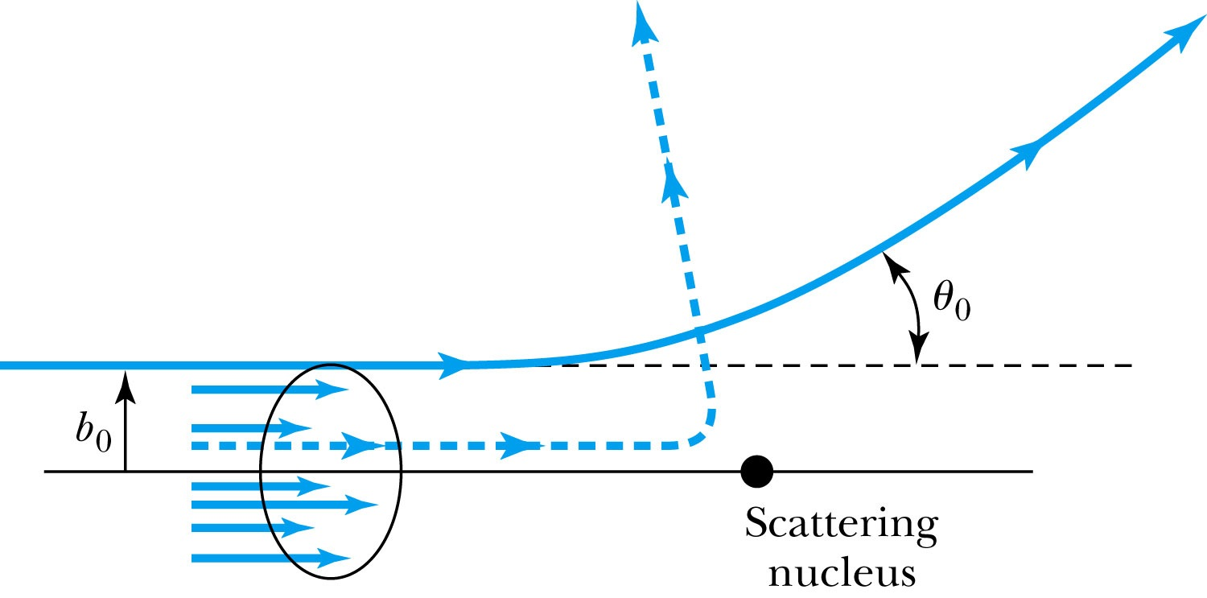
Rutherford Scattering - probability
Any particle inside the circle of area πb₀² will be similarly scattered.
The cross section σ = πb² is related to the probability for a particle being scattered by a nucleus.
The fraction of the incident particles scattered is
The number of scattering nuclei per unit area .
t: target thickness
n: atomic number density

Slide 14
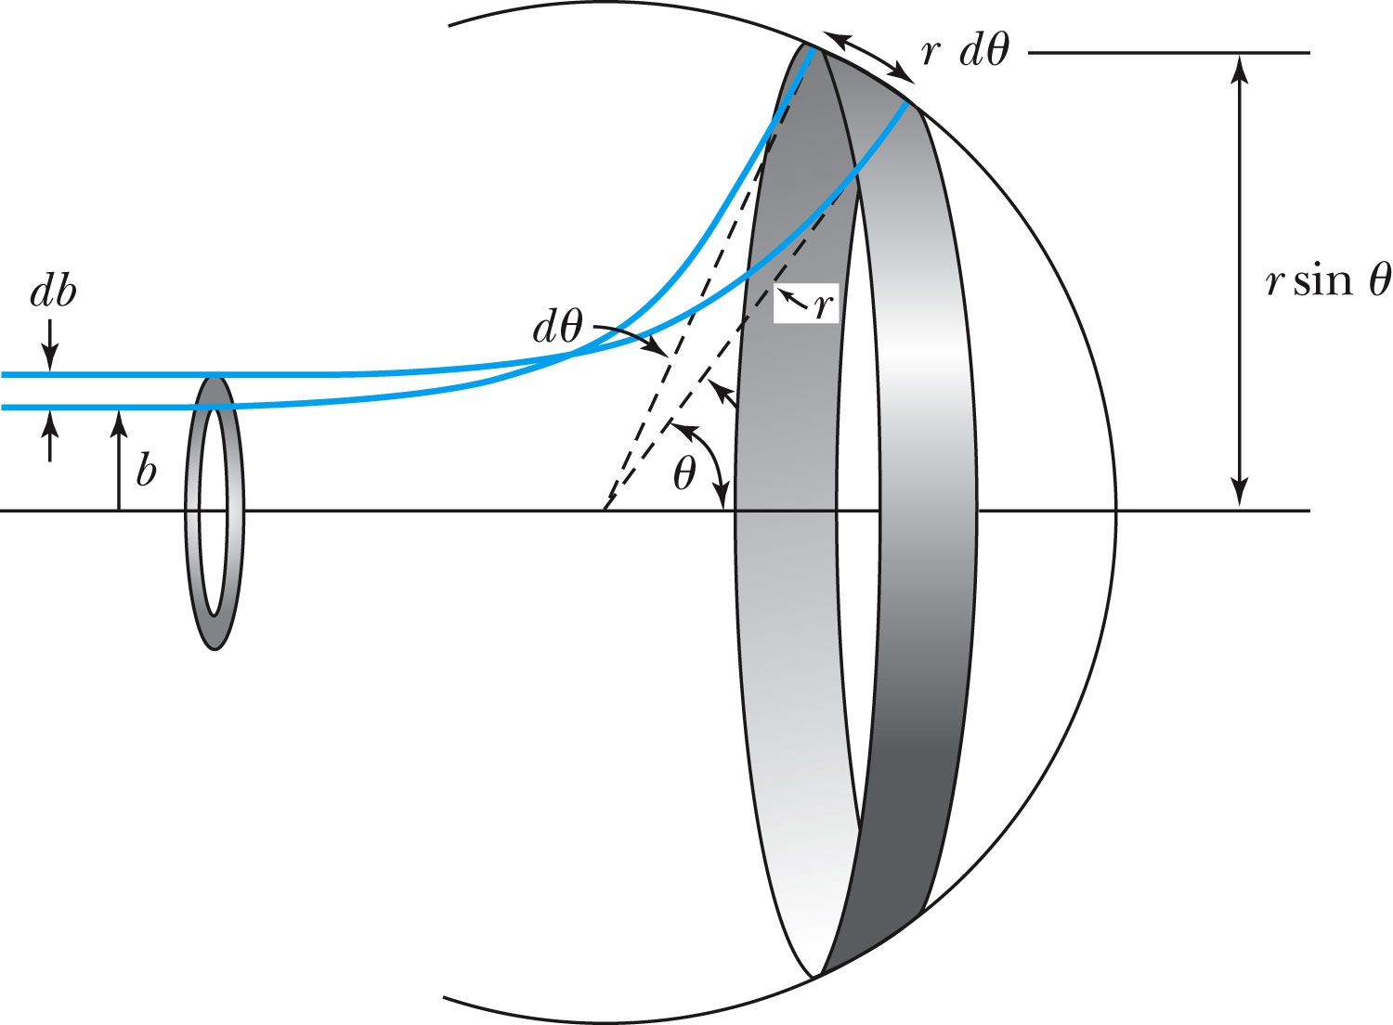
Rutherford Scattering Equation
In an actual experiment, a detector is ποσιτιονεδ φρομ θ to θ + dθ that corresponds to incident particles between b and b + db.
The number of particles scattered into the the angular coverage per unit area is

Slide 15
The Important Points
The scattering is proportional to the square of the atomic numbers of both the incident particle (Z₁) and the target scatterer (Z₂).
The number of scattered particles is inversely proportional to the square of the kinetic energy of the incident particle.
For the scattering angle θ, the scattering is proportional to 4th power of sin(θ/2).
The Scattering is proportional to the target thickness for thin targets.

Slide 16
The Classical Atomic Model
As suggested by the Rutherford Model an atom consisted of a small, massive, positively charged nucleus surrounded by moving electrons. This then suggested consideration of a planetary model of the atom.
Let’s consider atoms as a planetary model.
The force of attraction on the electron by the nucleus and Newton’s 2nd law give
where v is the tangential speed of an electron.
The total energy is

Slide 17
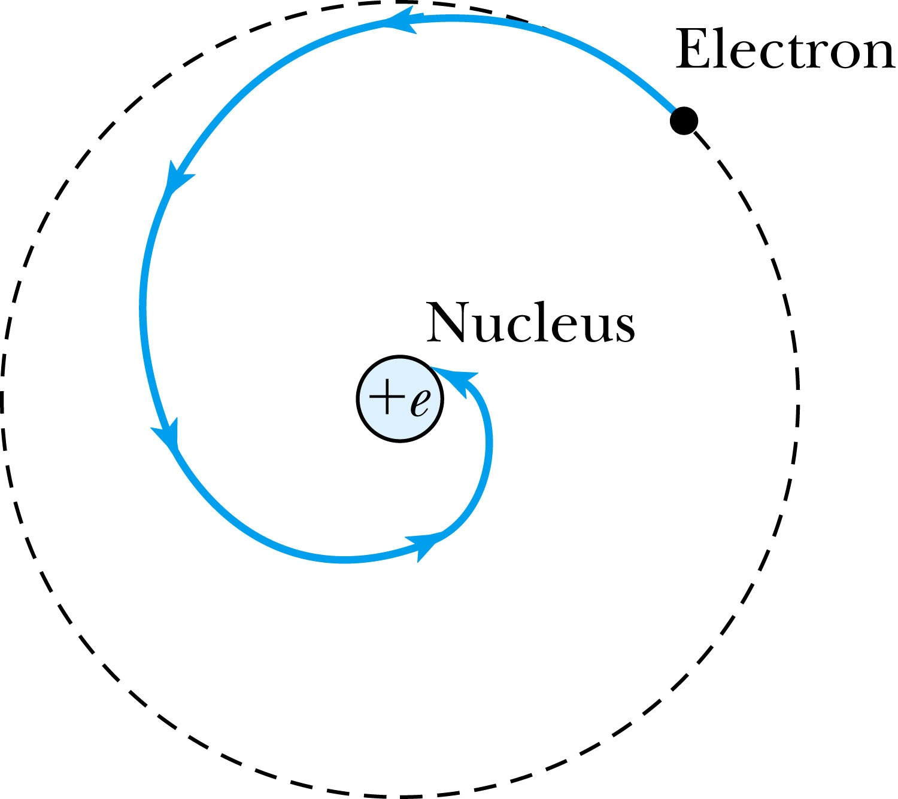
The Planetary Model is Doomed
From classical E&M theory, an accelerated electric charge radiates energy (electromagnetic radiation) which means total energy must decrease. ➔Radius r must decrease!!
Electron crashes into the nucleus!?
Physics had reached a turning point in 1900 with Planck’s hypothesis of the quantum behavior of radiation.

Slide 18
The Bohr Model of the Hydrogen Atom – The assumptions
“Stationary” states or orbits must exist in atoms, i.e., orbiting electrons do not radiate energy in these orbits. These orbits or stationary states are of a fixed definite energy E.
The emission or absorption of electromagnetic radiation can occur only in conjunction with a transition between two stationary states. The frequency, f, of this radiation is proportional to the difference in energy of the two stationary states:
E = E₁ − E₂ = hf
where h is Planck’s Constant
Bohr thought this has to do with fundamental length of order ~10⁻¹⁰m
Classical laws of physics do not apply to transitions between stationary states.
The mean kinetic energy of the electron-nucleus system is quantized as K = nhf_{orb}/2, where f_{orb} is the frequency of rotation. This is equivalent to the angular momentum of a stationary state to be an integral multiple of h/2π

Slide 19
How did Bohr Arrived at the angular momentum quantization?
The mean kinetic energy of the electron-nucleus system is quantized as K = nhf_{orb}/2, where f_{orb} is the frequency of rotation. This is equivalent to the angular momentum of a stationary state to be an integral multiple of h/2π.
Kinetic energy can be written
Angular momentum is defined as
The relationship between linear and angular quantifies
Thus, we can rewrite

Slide 20
Bohr’s Quantized Radius of Hydrogen
The angular momentum is
So the speed of an orbiting e can be written
From the Newton’s law for a circular motion
So from above two equations, we can get

Slide 21
Bohr Radius
The radius of the hydrogen atom for stationary states is
Where the Bohr radius for a given stationary state is:
The smallest diameter of the hydrogen atom is
OMG!! The fundamental length!!
n = 1 gives its lowest energy state (called the “ground” state)

Slide 22
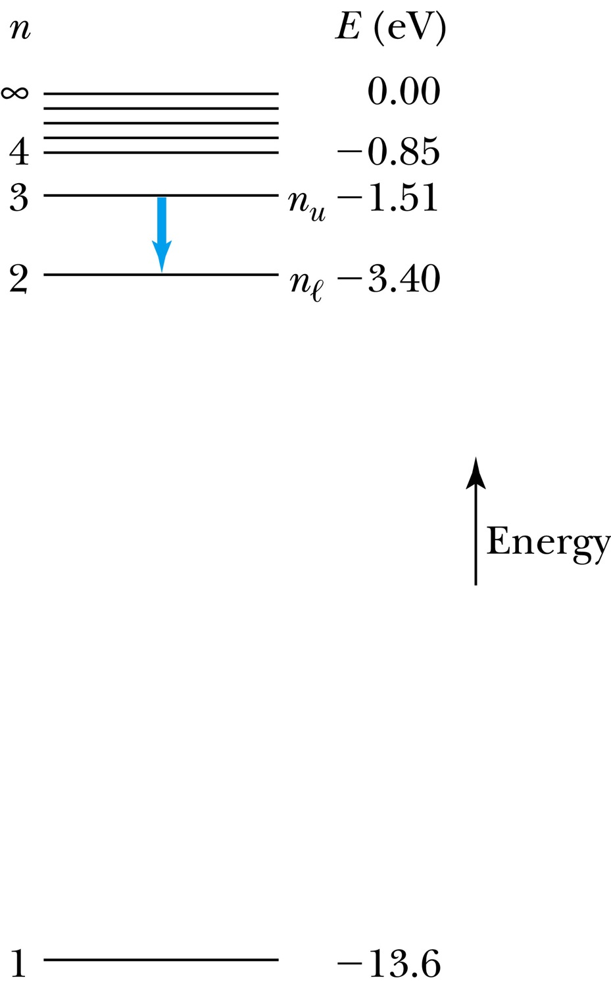
The Hydrogen Atom
The energies of the stationary states
where E₀ is the ground state energy
Emission of light occurs when the atom is in an excited state and decays to a lower energy state (n_{u} → n_{ℓ}).
where f is the frequency of a photon.
R∞ is the Rydberg constant.

Slide 23
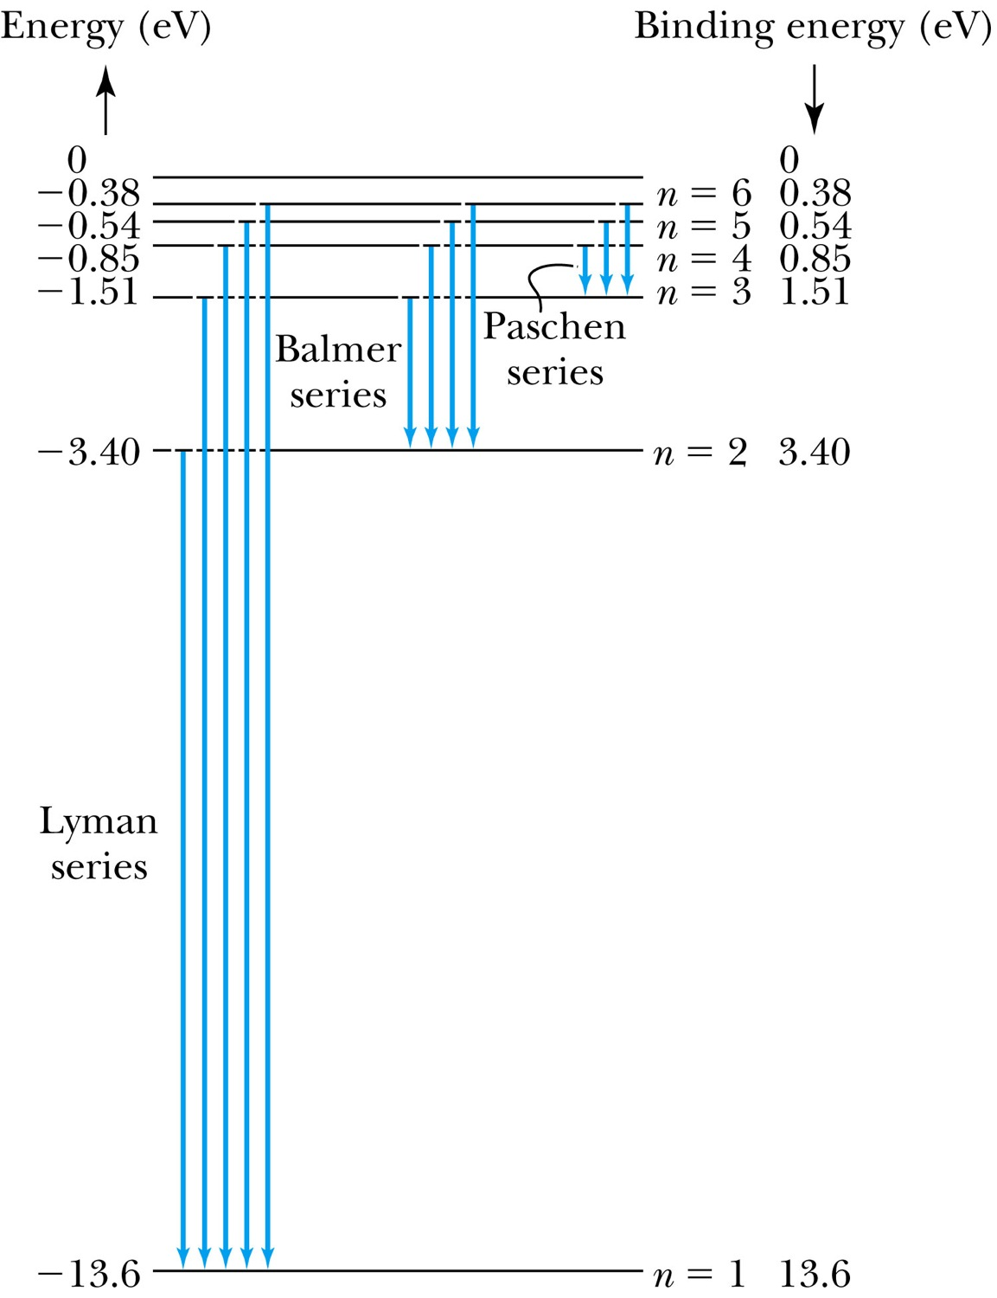
Transitions in the Hydrogen Atom
Lyman series: The atom will remain in the excited state for a short time before emitting a photon and returning to a lower stationary state. All hydrogen atoms exist in n = 1 (invisible).
Balmer series: When sunlight passes through the atmosphere, hydrogen atoms in water vapor absorb the wavelengths (visible).

