Slide 1
PHYS 3313 – Section 001 Lecture #11
Wednesday, Oct. 2, 2013
Dr. Amir Farbin
Importance of Bohr’s Model
X-ray Scattering
Bragg’s Law
De Broglie Waves
Bohr’s Quantization
Electron Scattering
Wave Properties

Slide 2
Announcements
Reading assignments: CH4.6 and CH4.7
Mid-term exam
In class on Wednesday, Oct. 16
Covers from CH1.1 through what we finish on Oct. 9 + appendices
Mid-term exam constitutes 20% of the total
Please do NOT miss the exam! You will get an F if you miss it.
Bring your own HANDWRITTEN formula sheet – one letter size sheet, front and back
No solutions for any problems
No derivations of any kind
Can have values of constants
Homework #3
End of chapter problems on CH4: 5, 14, 17, 21, 23 and 45
Due: Monday, Oct. 14
Colloquium this week
4pm, Wednesday, Oct. 2, SH101

Slide 3
Importance of Bohr’s Model
Demonstrated the need for Plank’s constant in understanding atomic structure
Assumption of quantized angular momentum which led to quantization of other quantities, r, v and E as follows
Orbital Radius:
Orbital Speed:
Energy levels:

Slide 4
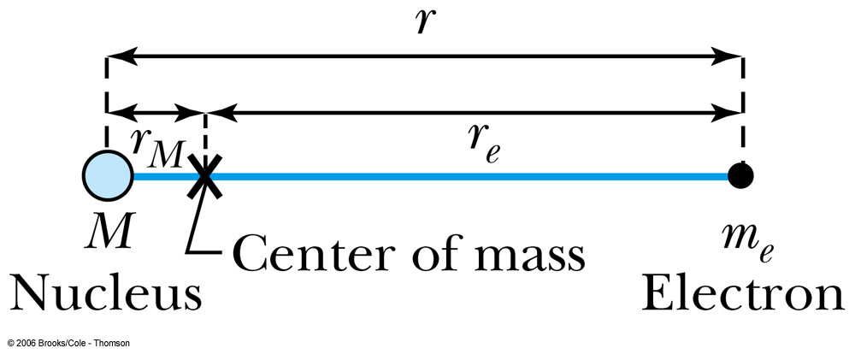
Successes and Failures of the Bohr Model
The electron and hydrogen nucleus actually revolved about their mutual center of mass ➔ reduced mass correction!!
All we need is to replace m_{e} with atom’s reduced mass.
The Rydberg constant for infinite nuclear mass, R∞ is replaced by R.

Slide 5
Limitations of the Bohr Model
The Bohr model was a great step of the new quantum theory, but it had its limitations.
Works only to single-electron atoms
Even for ions ➔ What would change?
The charge of the nucleus
Could not account for the intensities or the fine structure of the spectral lines
Fine structure is caused by the electron spin
Could not explain the binding of atoms into molecules

Slide 6
Characteristic X-Ray Spectra and Atomic Number
Shells have letter names:
K shell for n = 1
L shell for n = 2
The atom is most stable in its ground state.
When a transition occurs in a heavy atom, the radiation emitted is an x ray.
It has the energy E (x ray) = E_{u} − E_{ℓ}.
An electron from higher shells will fill the inner-shell vacancy at lower energy.

Slide 7
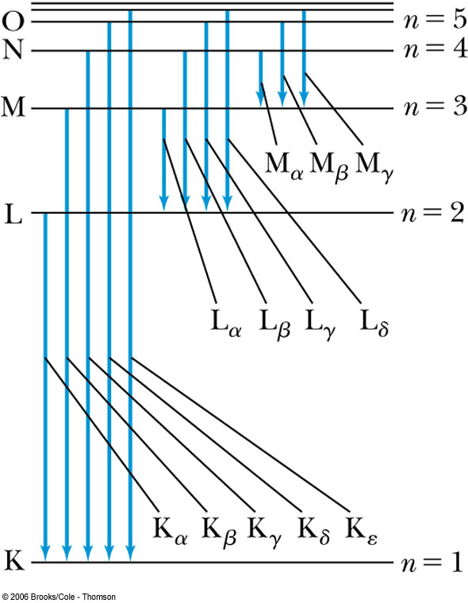
Atomic Number
L shell to K shell K_{α} x ray
M shell to K shell K_{β} x ray
Atomic number Z = number of protons in the nucleus
Moseley found a relationship between the frequencies of the characteristic x ray and Z.
This holds for the K_{α} x ray

Slide 8
Moseley’s Empirical Results
The x ray is produced from n = 2 to n = 1 transition.
In general, the K series of x ray wavelengths are
Moseley’s research clarified the importance of the electron shells for all the elements, not just for hydrogen.

Slide 9
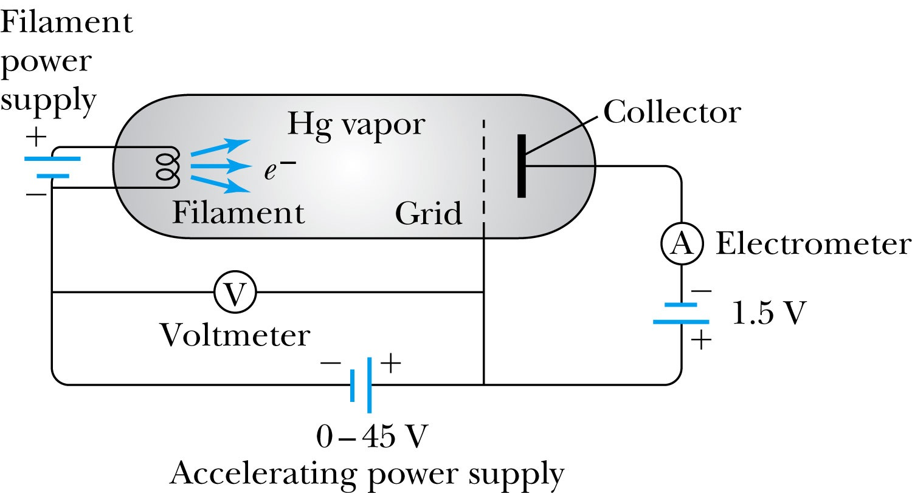
Atomic Excitation by Electrons
Franck and Hertz studied the phenomenon of ionization.
Accelerating voltage is below 5 V
electrons did not lose energy
Accelerating voltage is above 5 V
sudden drop in the current

Slide 10
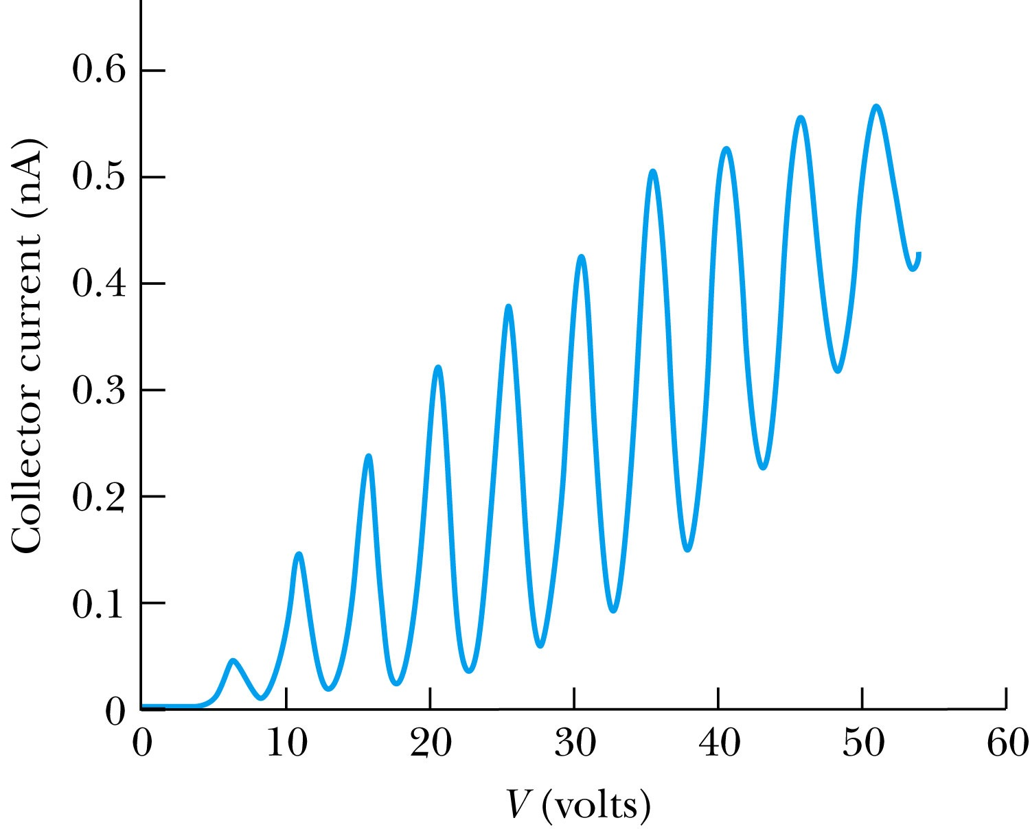
Atomic Excitation by Electrons
Ground state has E₀ to be zero.
First excited state has E₁.
The energy difference E₁ − 0 = E₁ is the excitation energy.
Hg has an excitation energy of 4.88 eV in the first excited state
No energy can be transferred to Hg below 4.88 eV because not enough energy is available to excite an electron to the next energy level
Above 4.88 eV, the current drops because scattered electrons no longer reach the collector until the accelerating voltage reaches 9.8 eV and so on.

Slide 11
Importance of Bohr’s Model
Demonstrated the need for Plank’s constant in understanding atomic structure
Assumption of quantized angular momentum which led to quantization of other quantities, r, v and E as follows
Orbital Radius:
Orbital Speed:
Energy levels:

Slide 12
Successes and Failures of the Bohr Model
The electron and hydrogen nucleus actually revolved about their mutual center of mass ➔ reduced mass correction!!
All we need is to replace m_{e} with atom’s reduced mass.
The Rydberg constant for infinite nuclear mass, R∞ is replaced by R.

Slide 13
Limitations of the Bohr Model
The Bohr model was a great step of the new quantum theory, but it had its limitations.
Works only to single-electron atoms
Even for ions ➔ What would change?
The charge of the nucleus
Could not account for the intensities or the fine structure of the spectral lines
Fine structure is caused by the electron spin
When a magnetic field is applied, spectral lines split
Could not explain the binding of atoms into molecules

Slide 14
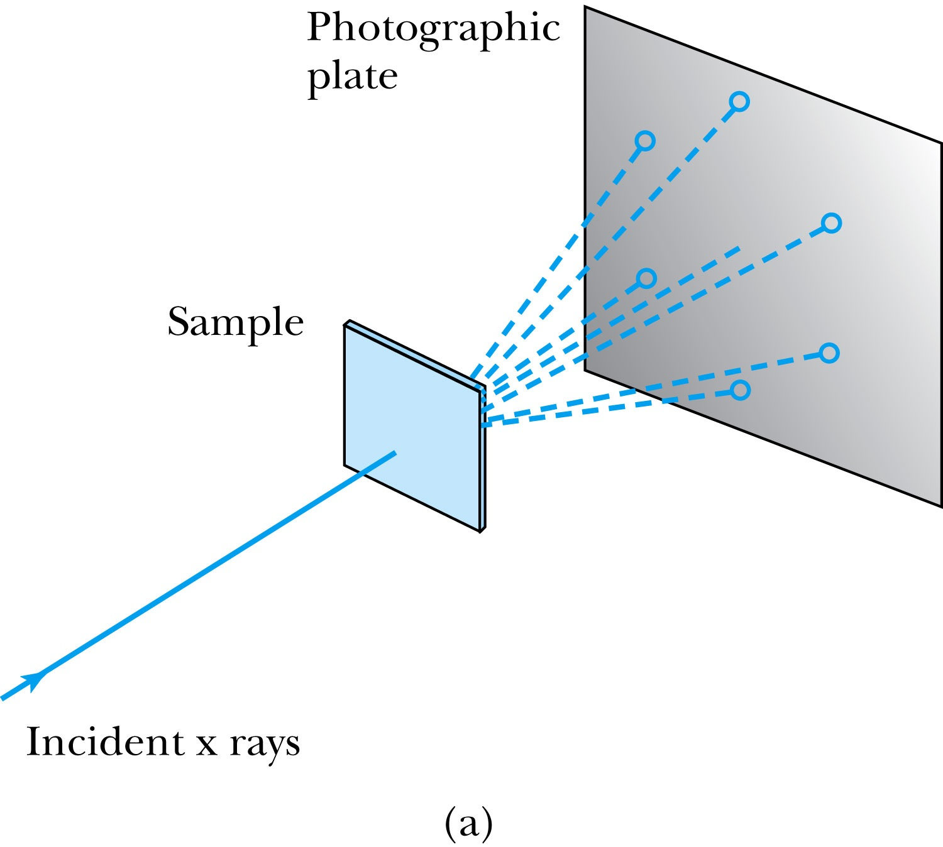
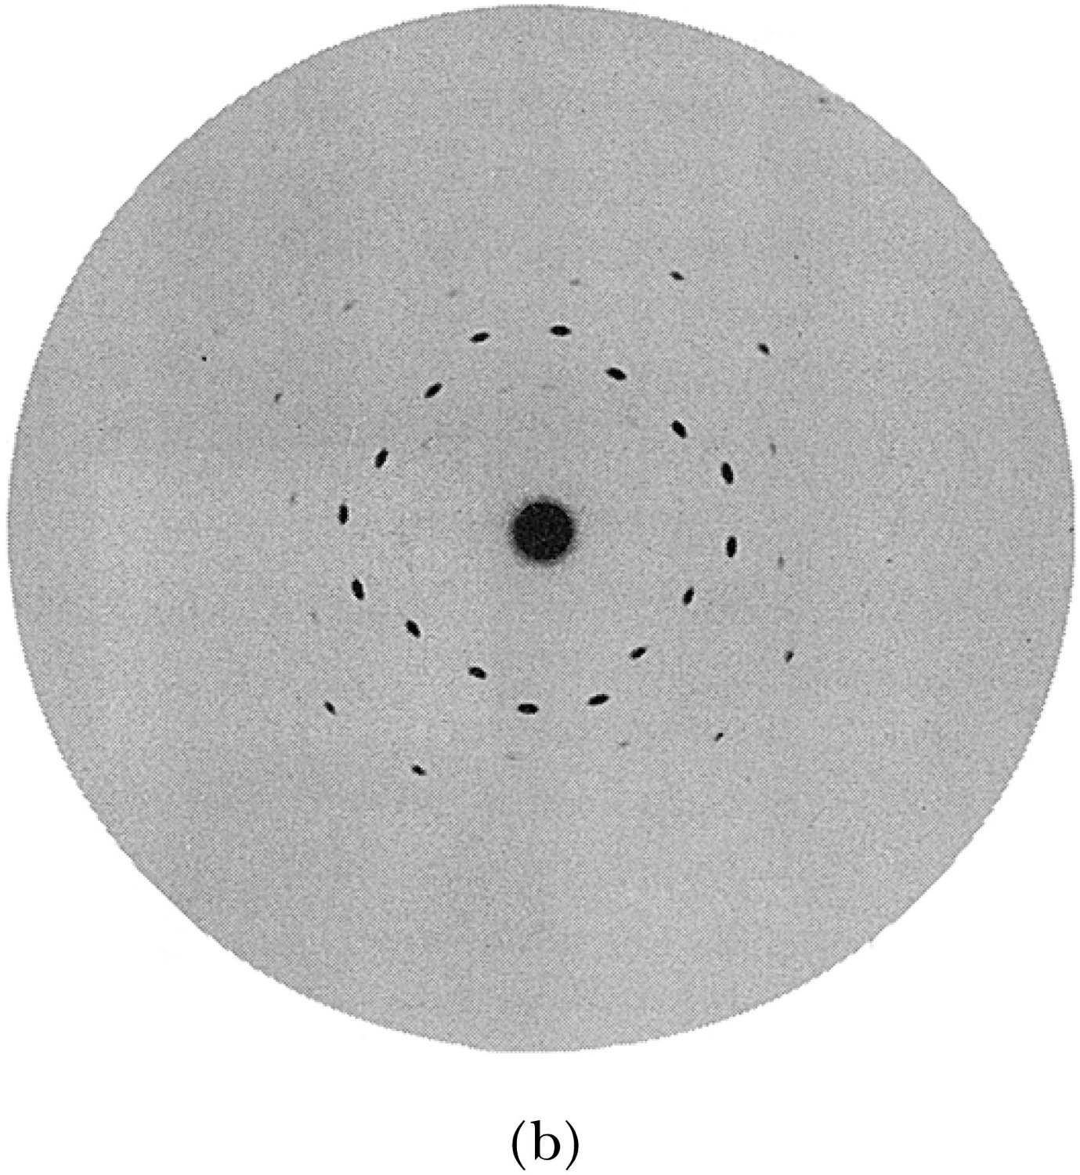
X-Ray Scattering
Max von Laue suggested that if x rays were a form of electromagnetic radiation, interference effects should be observed. (Wave property!!)
Crystals act as three-dimensional gratings, scattering the waves and producing observable interference effects.

Slide 15
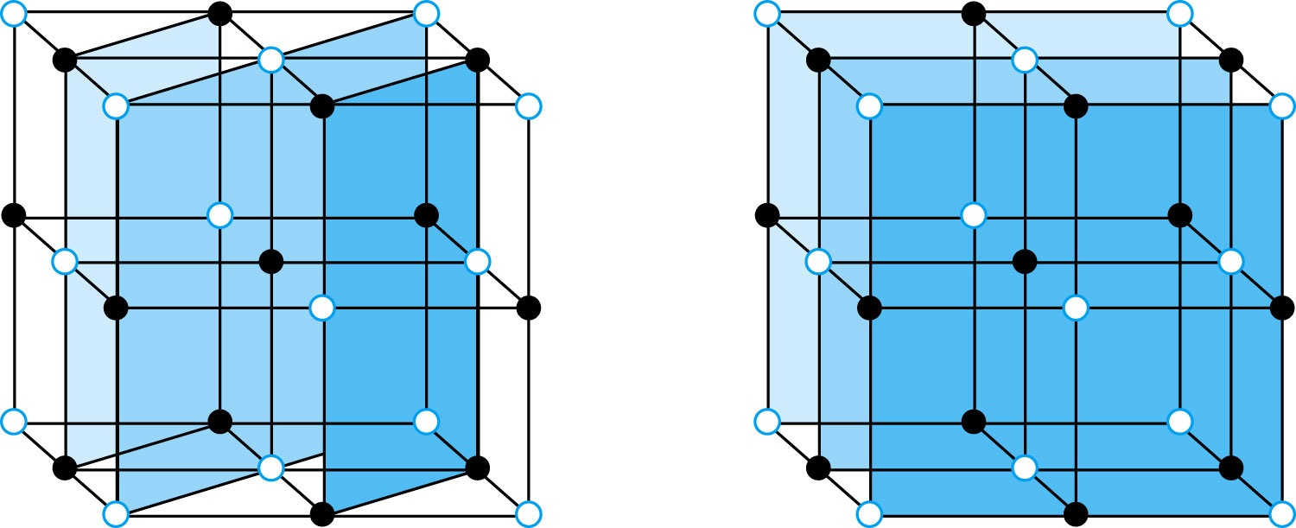
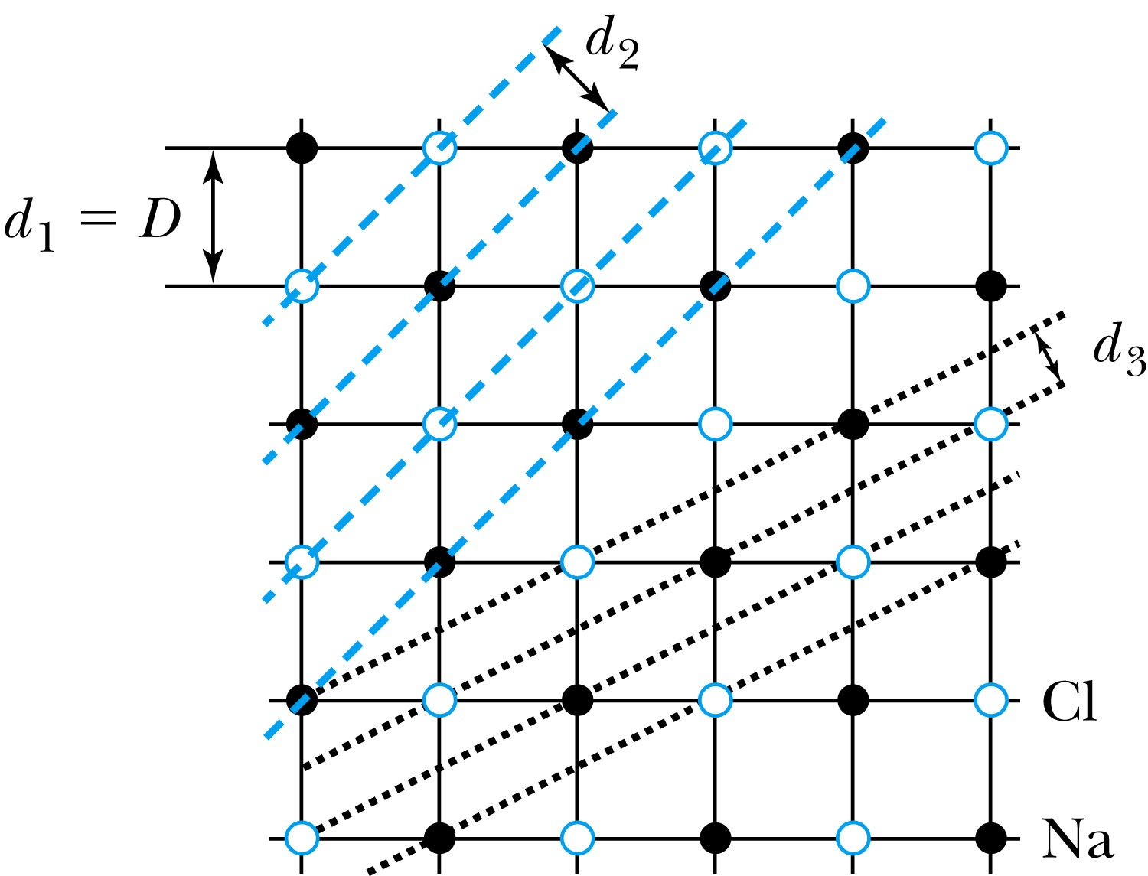
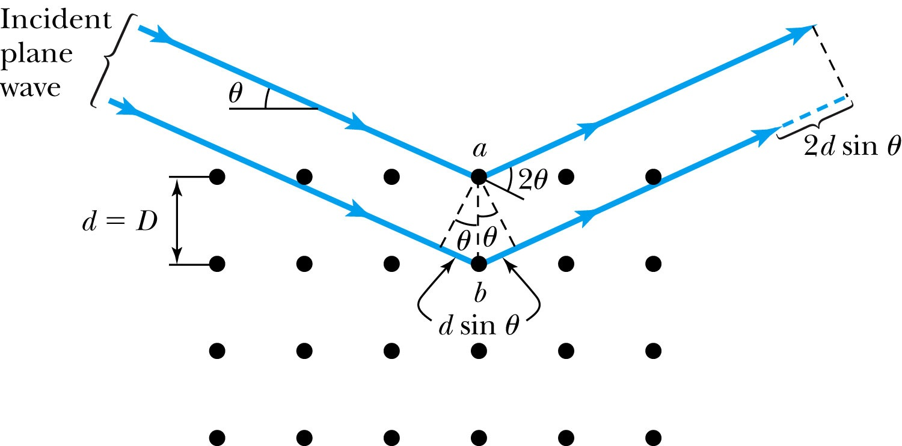
Bragg’s Law
William Lawrence Bragg interpreted the x-ray scattering as the reflection of the incident x-ray beam from a unique set of planes of atoms within the crystal.
There are two conditions for constructive interference of the scattered x rays:
The angle of incidence must equal the angle of reflection of the outgoing wave. (total reflection)
The difference in path lengths between two rays must be an integral number of wavelengths.
Bragg’s Law:
nλ = 2d sin θ
(n = integer)

Slide 16
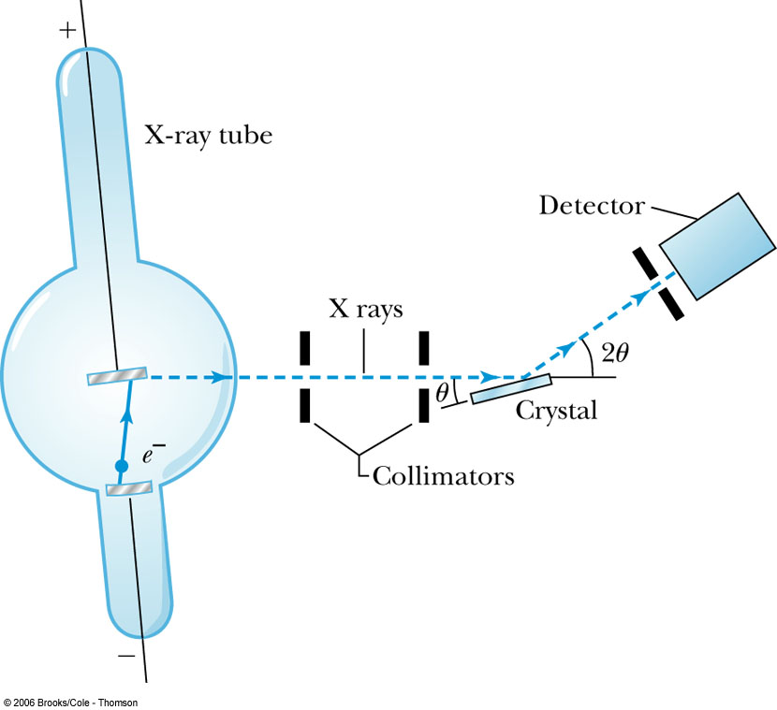
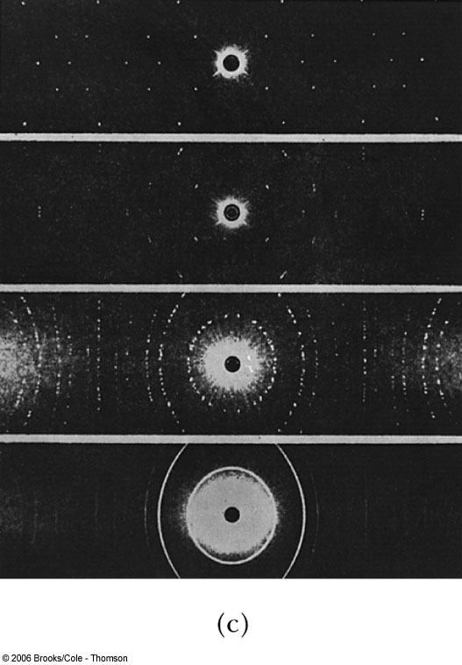
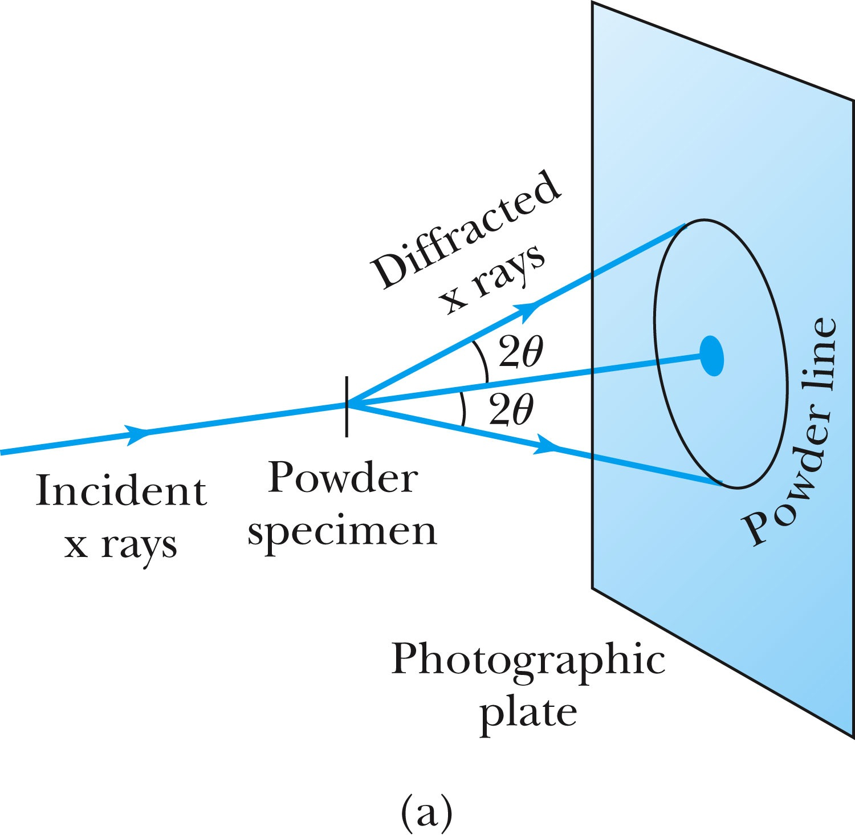
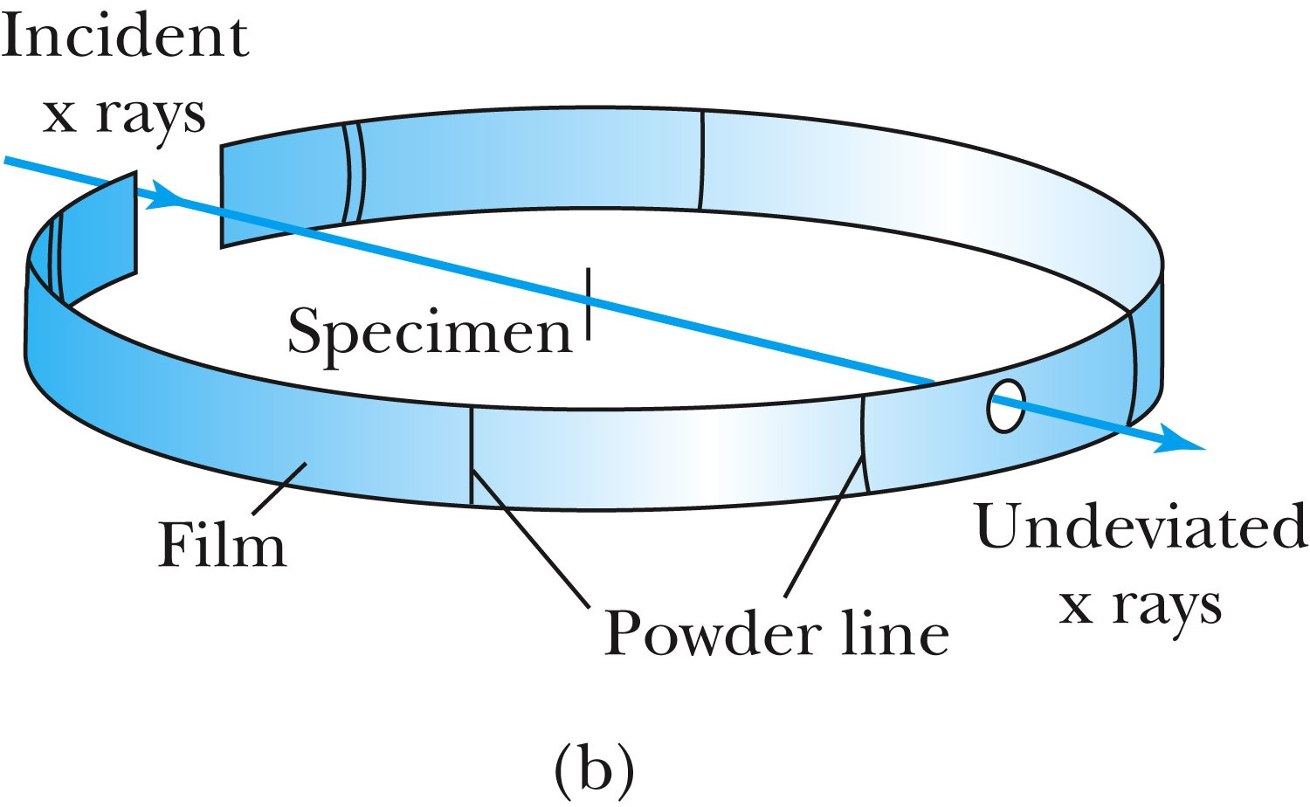
The Bragg Spectrometer
A Bragg spectrometer scatters x rays from several crystals. The intensity of the diffracted beam is determined as a function of scattering angle by rotating the crystal and the detector.
When a beam of x rays passes through the powdered crystal, the dots become a series of rings due to random arrangement.

Slide 17
Ex 5.1: Bragg’s Law
X rays scattered from rock salt (NaCl) are observed to have an intense maximum at an angle of 20º from the incident direction. Assuming n=1 (from the intensity), what must be the wavelength of the incident radiation?
Bragg’s law: nλ = 2d sin θ
What do we need to know to use this? The lattice spacing d!
We know n=1 and 2θ=20º.
We use the density of NaCl to find out what d is.

Slide 18
De Broglie Waves
Prince Louis V. de Broglie suggested that mass particles should have wave properties similar to electromagnetic radiation ➔ many experiments supported this!
Thus the wavelength of a matter wave is called the de Broglie wavelength:
Since for a photon, E = pc and E = hf, the energy can be written as

Slide 19
Bohr’s Quantization Condition
One of Bohr’s assumptions concerning his hydrogen atom model was that the angular momentum of the electron-nucleus system in a stationary state is an integral multiple of h/2π.
The electron is a standing wave in an orbit around the proton. This standing wave will have nodes and be an integral number of wavelengths.
The angular momentum becomes:

Slide 20
Ex 5.2: De Broglie Wavelength
Calculate the De Broglie wavelength of (a) a tennis ball of mass 57g traveling 25m/s (about 56mph) and (b) an electron with kinetic energy 50eV.
What is the formula for De Broglie Wavelength?
(a) for a tennis ball, m=0.057kg.
(b) for electron with 50eV KE, since KE is small, we can use non-relativistic expression of electron momentum!
What are the wavelengths of you running at the speed of 2m/s? What about your car of 2 metric tons at 100mph? How about the proton with 14TeV kinetic energy?
What is the momentum of the photon from a green laser?

Slide 21
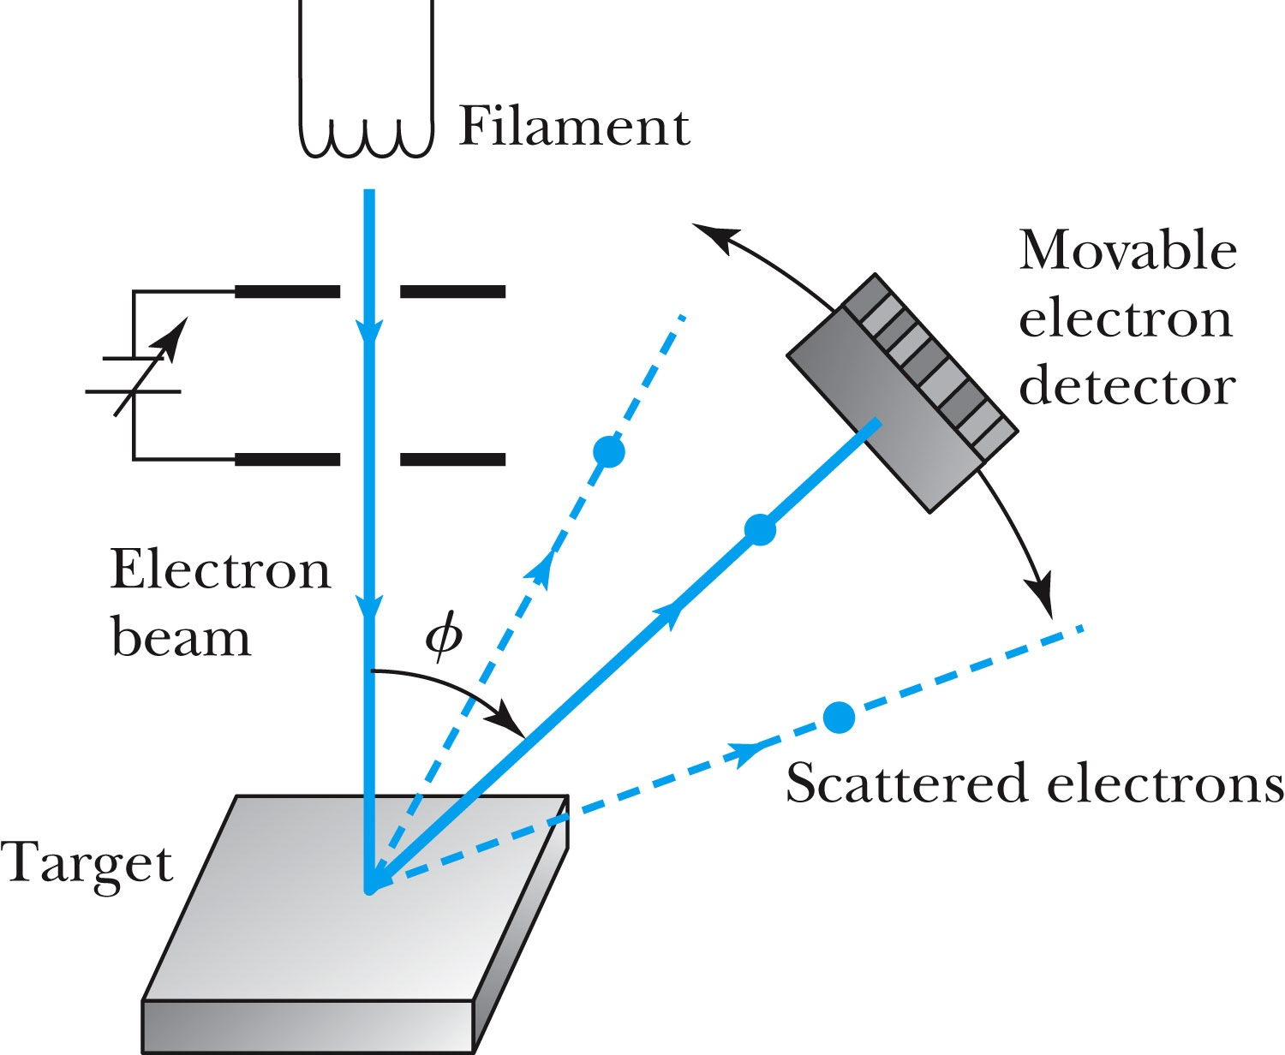
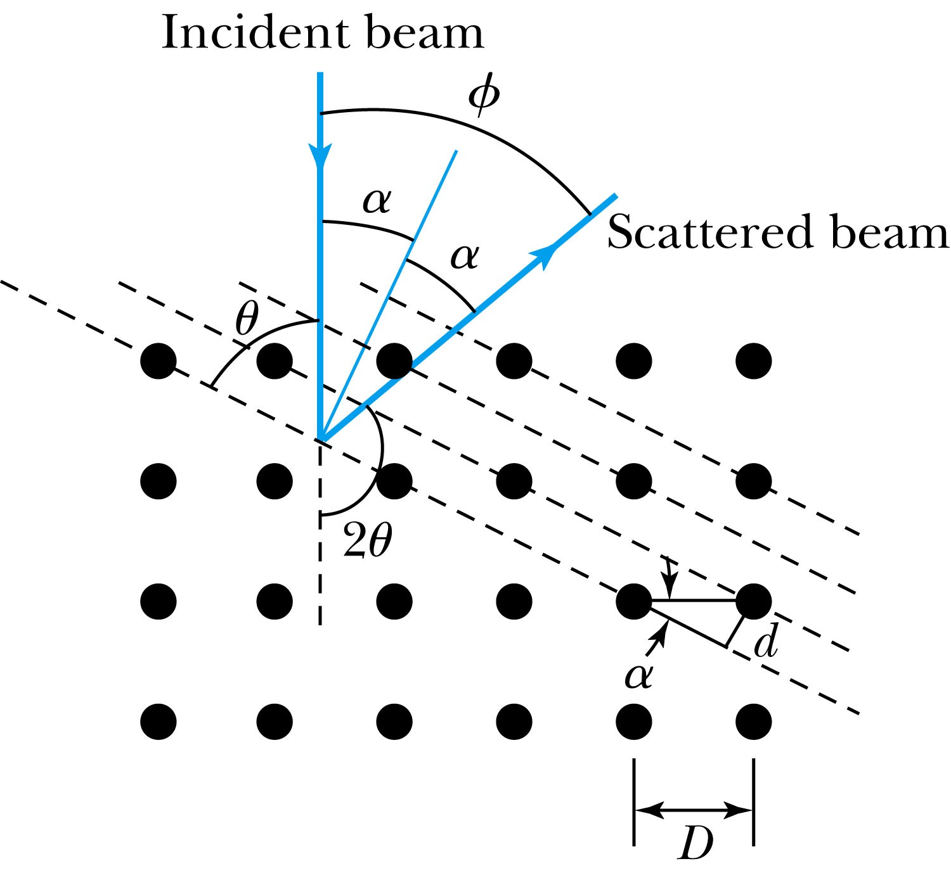
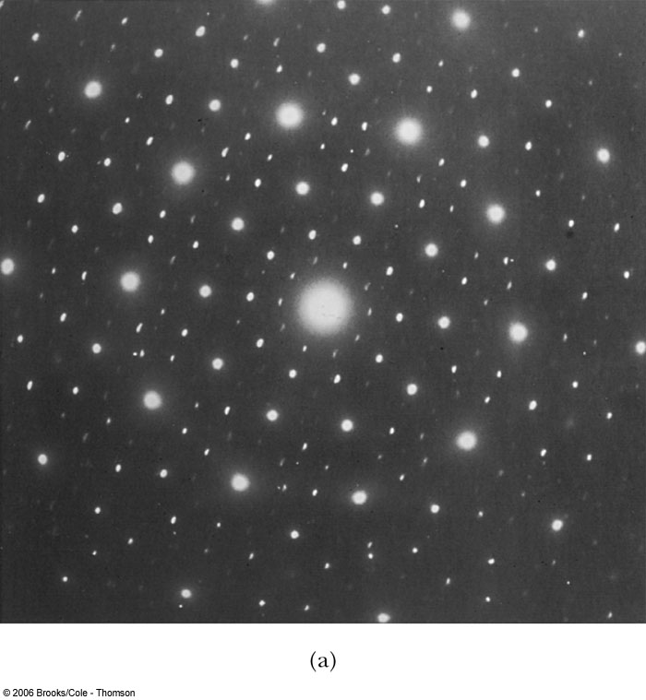
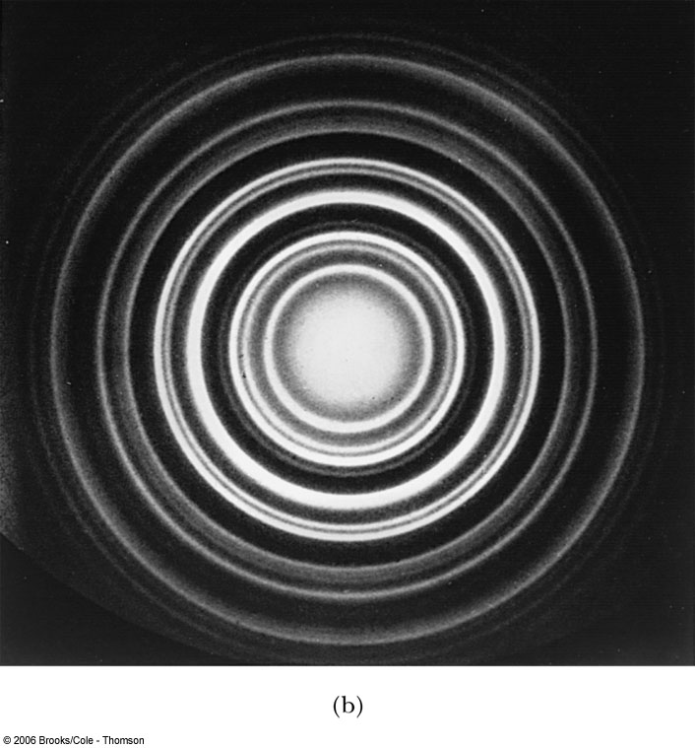
Electron Scattering
Davisson and Germer experimentally observed that electrons were diffracted much like x rays in nickel crystals. ➔ direct proof of De Broglie wave!
George P. Thomson (1892–1975), son of J. J. Thomson, reported seeing the effects of electron diffraction in transmission experiments. The first target was celluloid, and soon after that gold, aluminum, and platinum were used. The randomly oriented polycrystalline sample of SnO₂ produces rings as shown in the figure at right.

Slide 22
Photons, which we thought were waves, act particle like (eg Photoelectric effect or Compton Scattering)
Electrons, which we thought were particles, act particle like (eg electron scattering)
De Broglie: All matter has intrinsic wavelength.
Wave length inversely proportional to momentum
The more massive… the smaller the wavelength… the harder to observe the wavelike properties
So while photons appear mostly wavelike, electrons (next lightest particle!) appear mostly particle like.
How can we reconcile the wave/particle views?

Slide 23
Wave Motion
De Broglie matter waves suggest a further description. The displacement of a wave is
This is a solution to the wave equation
Define the wave number k and the angular frequency ω as:
The wave function is now:

Slide 24
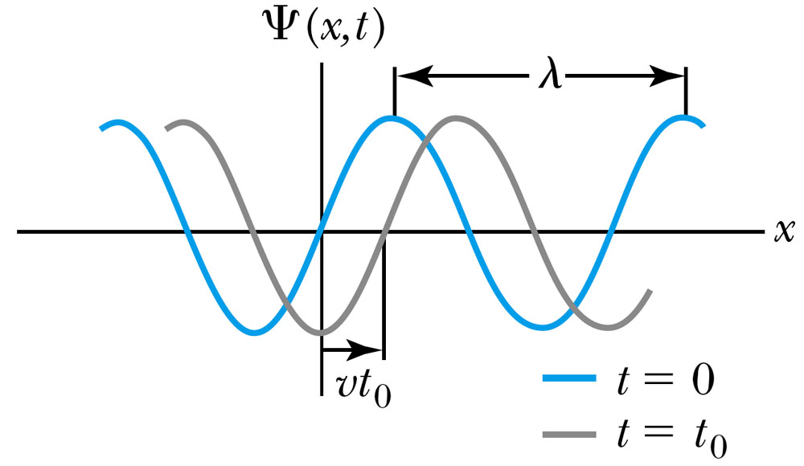
Wave Properties
The phase velocity is the velocity of a point on the wave that has a given phase (for example, the crest) and is given by
A phase constant Φ shifts the wave:
.
(When φ=π/2)

Slide 25
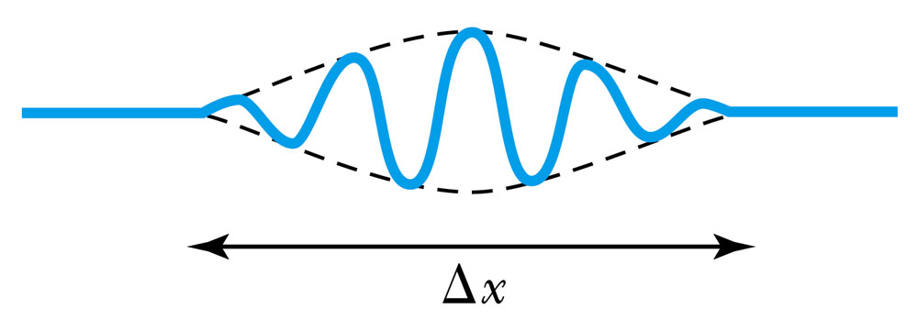
Principle of Superposition
When two or more waves traverse the same region, they act independently of each other.
Combining two waves yields:
The combined wave oscillates within an envelope that denotes the maximum displacement of the combined waves.
When combining many waves with different amplitudes and frequencies, a pulse, or wave packet, can be formed, which can move at a group velocity:

Slide 26
Fourier Series
Adding 2 waves isn’t localized in space… but adding lots of waves can be.
The sum of many waves that form a wave packet is called a Fourier series:
Summing an infinite number of waves yields the Fourier integral:

Slide 27
Wave Packet Envelope
The superposition of two waves yields a wave number and angular frequency of the wave packet envelope.
The range of wave numbers and angular frequencies that produce the wave packet have the following relations:
A Gaussian wave packet has similar relations:
The localization of the wave packet over a small region to describe a particle requires a large range of wave numbers. Conversely, a small range of wave numbers cannot produce a wave packet localized within a small distance.

Slide 28
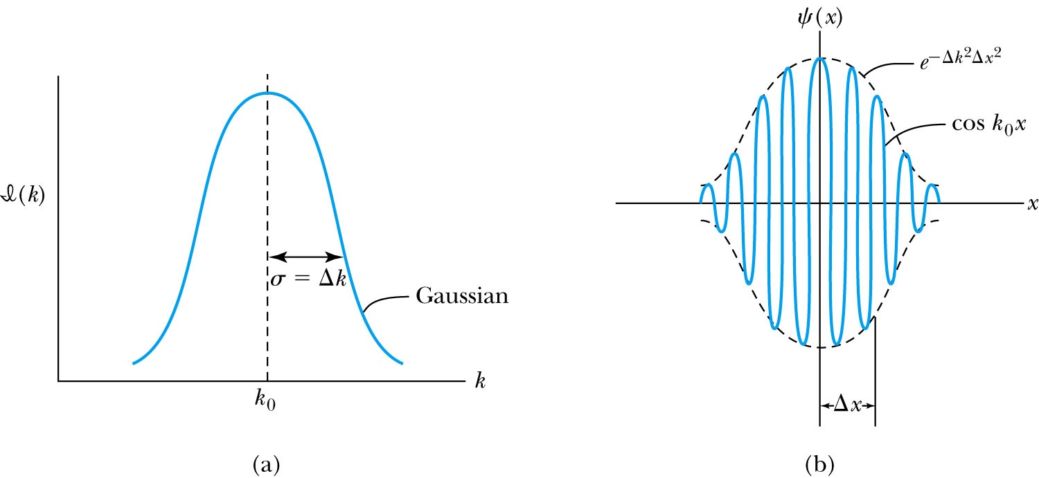
Gaussian Function
A Gaussian wave packet describes the envelope of a pulse wave.
The group velocity is

