Slide 1
PHYS 3313 – Section 001
Lecture #12
Monday, Oct. 7, 2013
Dr. Amir Farbin
Wave Motion & Properties
Superposition Principle
Wave Packets
Gaussian Wave Packets
Dispersion
Wave–Particle Duality
Uncertainty Principle
Schrodinger Equation

Slide 2
Announcements
Mid-term exam
  In class on Wednesday, Oct. 16
  Covers from CH1.1 through what we finish on Oct. 9 + appendices
  Mid-term exam constitutes 20% of the total
  Please do NOT miss the exam! You will get an F if you miss it.
  Bring your own HANDWRITTEN formula sheet – one letter size sheet, front and back
    No solutions for any problems
    No derivations of any kind
    Can have values of constants
Reminder: Homework #3
  End of chapter problems on CH4: 5, 14, 17, 21, 23 and 45
  Due: Monday, Oct. 14

Slide 3
Photons, which we thought were waves, act particle like (eg Photoelectric effect or Compton Scattering)
Electrons, which we thought were particles, act particle like (eg electron scattering)
De Broglie: All matter has intrinsic wavelength.
  Wave length inversely proportional to momentum
  The more massive… the smaller the wavelength… the harder to observe the wavelike properties
  So while photons appear mostly wavelike, electrons (next lightest particle!) appear mostly particle like.
How can we reconcile the wave/particle views?

Slide 4
Wave Motion
De Broglie matter waves suggest a further description. The displacement of a wave is
This is a solution to the wave equation
Define the wave number k and the angular frequency ω as:
The wave function is now:

Slide 5
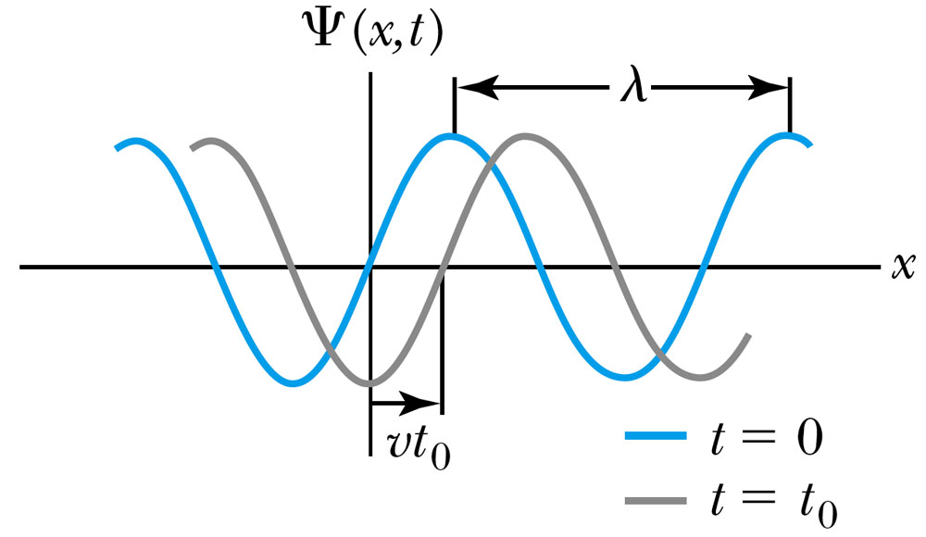
Wave Properties
The phase velocity is the velocity of a point on the wave that has a given phase (for example, the crest) and is given by
A phase constant Φ shifts the wave:
.
(When φ=π/2)

Slide 6
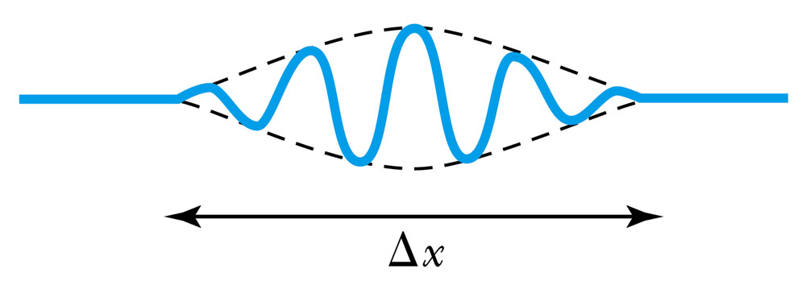
Principle of Superposition
When two or more waves traverse the same region, they act independently of each other.
Combining two waves yields:
The combined wave oscillates within an envelope that denotes the maximum displacement of the combined waves.
When combining many waves with different amplitudes and frequencies, a pulse, or wave packet, can be formed, which can move at a group velocity:

Slide 7
Fourier Series
Adding 2 waves isn’t localized in space… but adding lots of waves can be.
The sum of many waves that form a wave packet is called a Fourier series:
Summing an infinite number of waves yields the Fourier integral:

Slide 8
Wave Packet Envelope
The superposition of two waves yields a wave number and angular frequency of the wave packet envelope.
The range of wave numbers and angular frequencies that produce the wave packet have the following relations:
A Gaussian wave packet has similar relations:
The localization of the wave packet over a small region to describe a particle requires a large range of wave numbers. Conversely, a small range of wave numbers cannot produce a wave packet localized within a small distance.

Slide 9
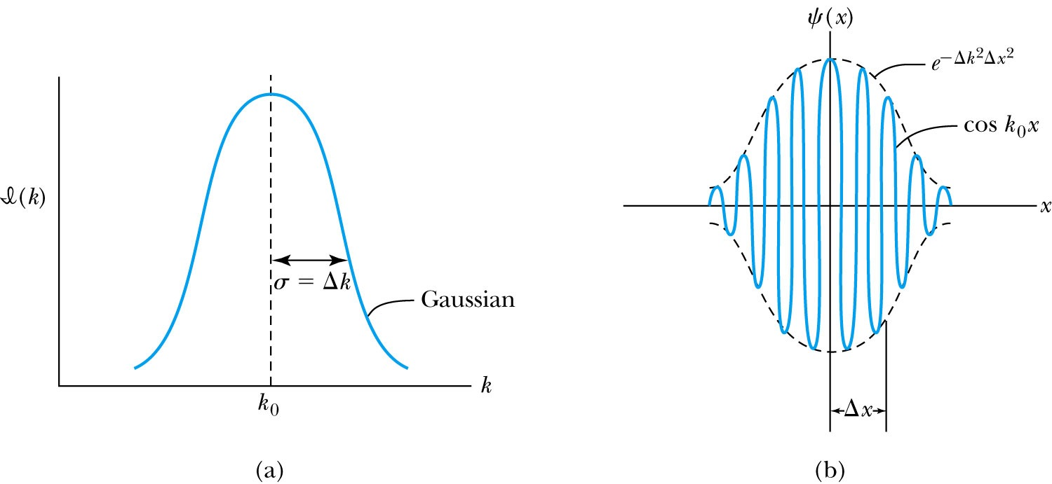
Gaussian Function
A Gaussian wave packet describes the envelope of a pulse wave.
The group velocity is

Slide 10
Dispersion
Considering the group velocity of a de Broglie wave packet yields:
The relationship between the phase velocity and the group velocity is
Hence the group velocity may be greater or less than the phase velocity. A medium is called nondispersive when the phase velocity is the same for all frequencies and equal to the group velocity.

Slide 11
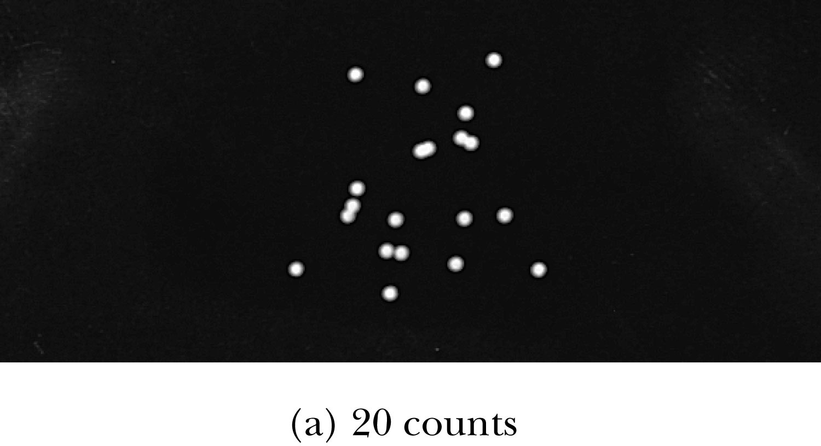
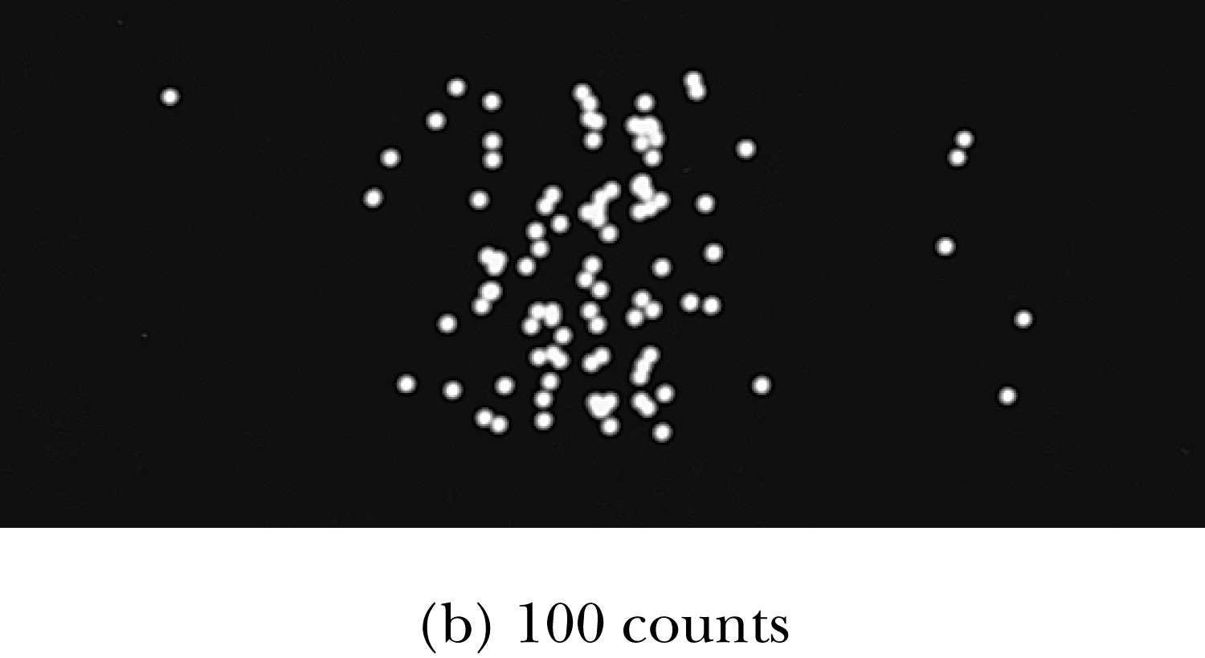
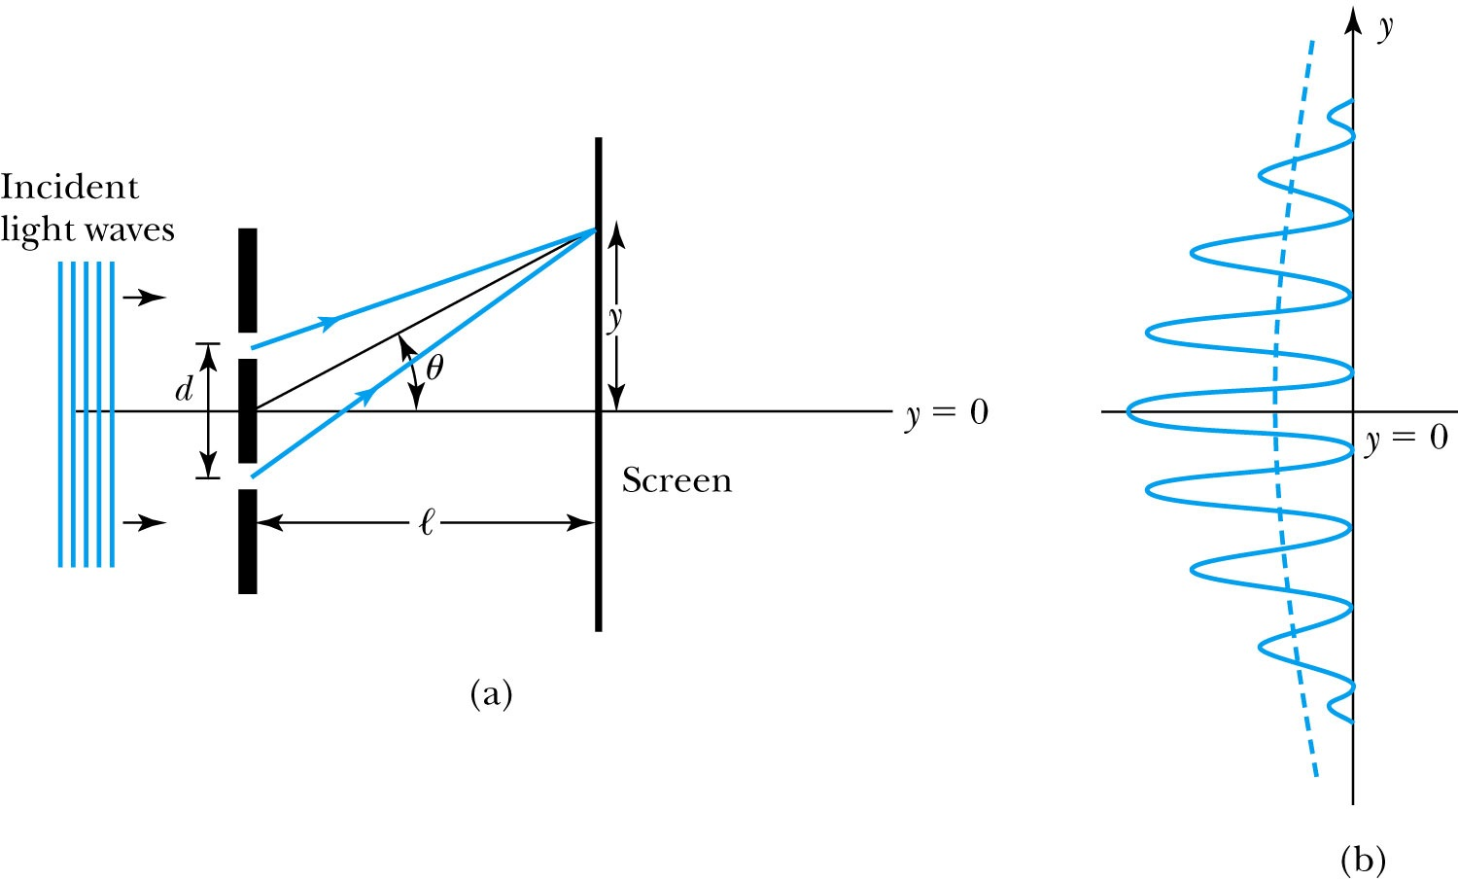
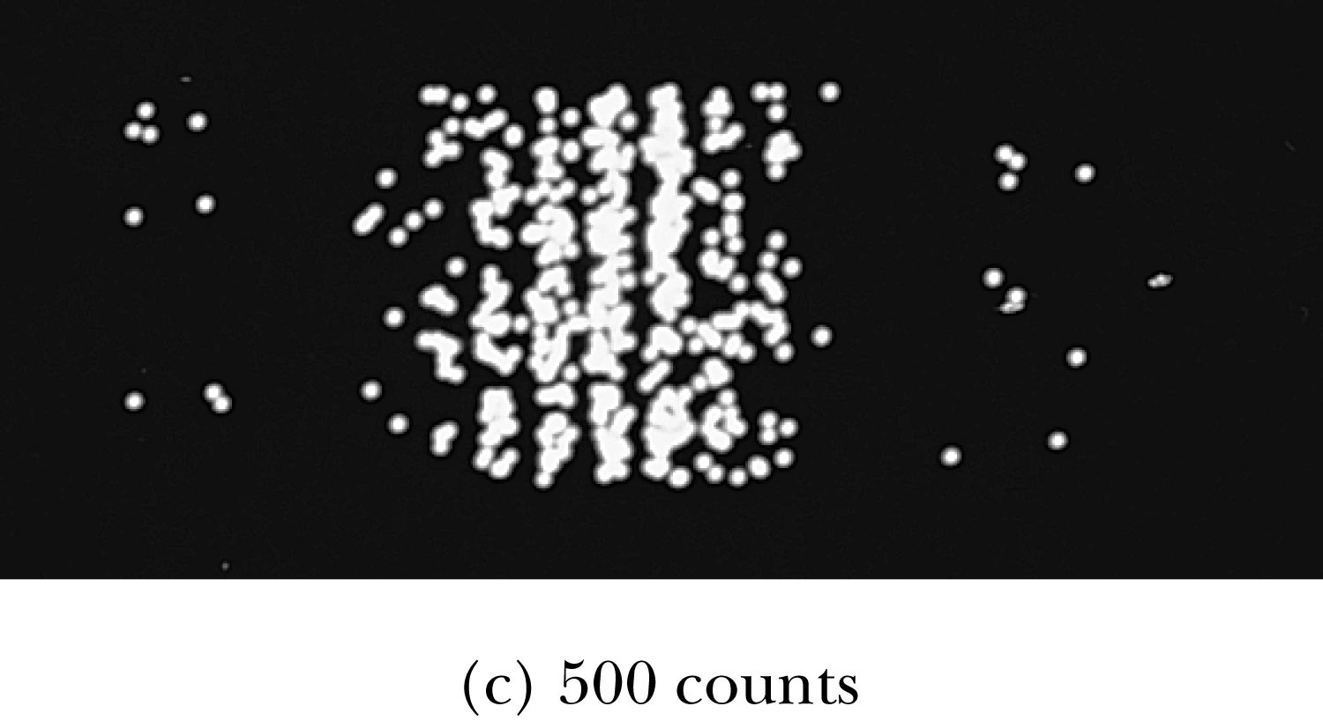
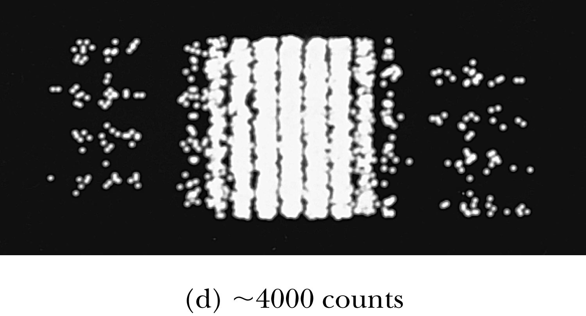
Waves or Particles?
Young’s double-slit diffraction experiment demonstrates the wave property of light.
However, dimming the light results in single flashes on the screen representative of particles.

Slide 12
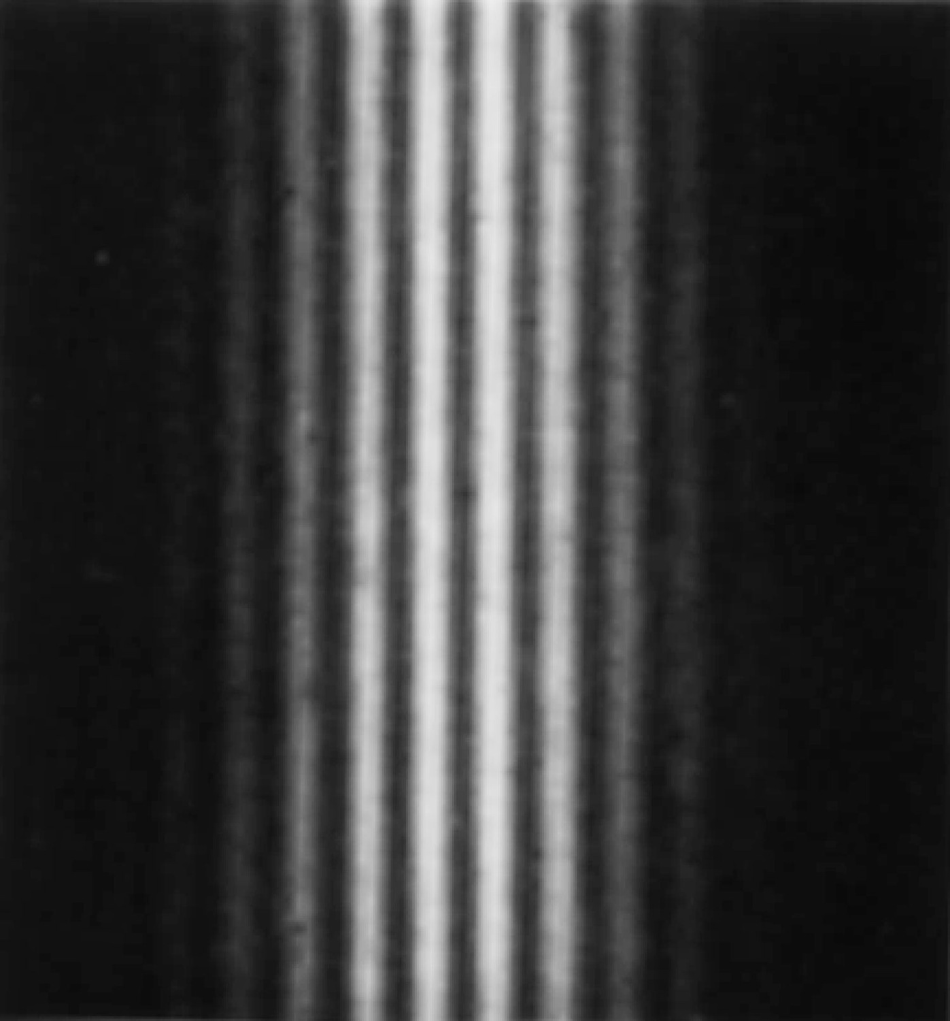
Electron Double-Slit Experiment
C. Jönsson of Tübingen, Germany, succeeded in 1961 in showing double-slit interference effects for electrons by constructing very narrow slits and using relatively large distances between the slits and the observation screen.
This experiment demonstrated that precisely the same behavior occurs for both light (waves) and electrons (particles).

Slide 13
Which slit?
To determine which slit the electron went through: We set up a light shining on the double slit and use a powerful microscope to look at the region. After the electron passes through one of the slits, light bounces off the electron; we observe the reflected light, so we know which slit the electron came through.
Use a subscript “ph” to denote variables for light (photon). Therefore the momentum of the photon is
The momentum of the electrons will be on the order of .
The difficulty is that the momentum of the photons used to determine which slit the electron went through is sufficiently great to strongly modify the momentum of the electron itself, thus changing the direction of the electron! The attempt to identify which slit the electron is passing through will in itself change the interference pattern.

Slide 14
Wave particle duality solution
The solution to the wave particle duality of an event is given by the following principle.
Bohr’s principle of complementarity: It is not possible to describe physical observables simultaneously in terms of both particles and waves.
Physical observables are the quantities such as position, velocity, momentum, and energy that can be experimentally measured. In any given instance we must use either the particle description or the wave description.

Slide 15
Uncertainty Principle
It is impossible to measure simultaneously, with no uncertainty, the precise values of k and x for the same particle. The wave number k may be rewritten as
For the case of a Gaussian wave packet we have
Thus for a single particle we have Heisenberg’s uncertainty principle:

Slide 16
Energy Uncertainty
If we are uncertain as to the exact position of a particle, for example an electron somewhere inside an atom, the particle can’t have zero kinetic energy.
The energy uncertainty of a Gaussian wave packet is
combined with the angular frequency relation
Energy-Time Uncertainty Principle: .

Slide 17
Probability, Wave Functions, and the Copenhagen Interpretation
The wave function determines the likelihood (or probability) of finding a particle at a particular position in space at a given time.
The total probability of finding the electron is 1. Forcing this condition on the wave function is called normalization.

Slide 18
The Copenhagen Interpretation
Bohr’s interpretation of the wave function consisted of 3 principles:
    The uncertainty principle of Heisenberg
    The complementarity principle of Bohr
    The statistical interpretation of Born, based on probabilities determined by the wave function
Together these three concepts form a logical interpretation of the physical meaning of quantum theory. According to the Copenhagen interpretation, physics depends on the outcomes of measurement.

Slide 19
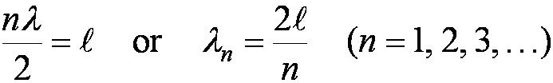
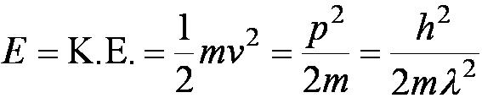
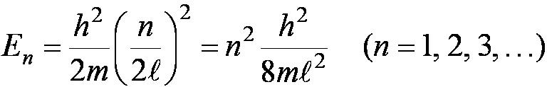
Particle in a Box
A particle of mass m is trapped in a one-dimensional box of width l.
The particle is treated as a wave.
The box puts boundary conditions on the wave. The wave function must be zero at the walls of the box and on the outside.
In order for the probability to vanish at the walls, we must have an integral number of half wavelengths in the box.
The energy of the particle is .
The possible wavelengths are quantized which yields the energy:
The possible energies of the particle are quantized.

Slide 20
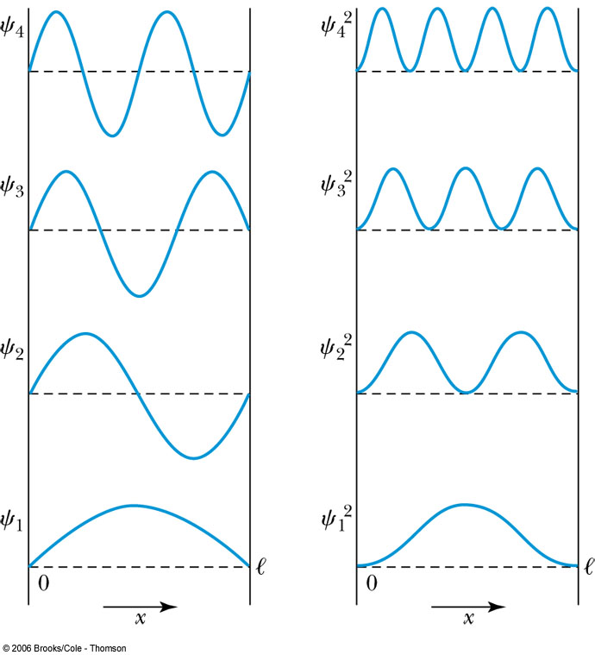

Probability of the Particle
The probability of observing the particle between x and x + dx in each state is
Note that E₀ = 0 is not a possible energy level.
The concept of energy levels, as first discussed in the Bohr model, has surfaced in a natural way by using waves.

Slide 21

The Schrödinger Wave Equation
The Schrödinger wave equation in its time-dependent form for a particle of energy E moving in a potential V in one dimension is
The extension into three dimensions is
where is an imaginary number

Slide 22
General Solution of the Schrödinger Wave Equation
The general form of the solution of the Schrödinger wave equation is given by:
which also describes a wave moving in the x direction. In general the amplitude may also be complex. This is called the wave function of the particle.
The wave function is also not restricted to being real. Notice that the sine term has an imaginary number. Only the physically measurable quantities must be real. These include the probability, momentum and energy.

Slide 23
Normalization and Probability
The probability P(x) dx of a particle being between x and X + dx was given in the equation
Here Ψ* denotes the complex conjugate of Ψ
The probability of the particle being between x₁ and x₂ is given by
The wave function must also be normalized so that the probability of the particle being somewhere on the x axis is 1.

Slide 24
Properties of Valid Wave Functions
Boundary conditions
In order to avoid infinite probabilities, the wave function must be finite everywhere.
In order to avoid multiple values of the probability, the wave function must be single valued.
For finite potentials, the wave function and its derivative must be continuous. This is required because the second-order derivative term in the wave equation must be single valued. (There are exceptions to this rule when V is infinite.)
In order to normalize the wave functions, they must approach zero as x approaches infinity.
Solutions that do not satisfy these properties do not generally correspond to physically realizable circumstances.

Slide 25
Time-Independent Schrödinger Wave Equation
The potential in many cases will not depend explicitly on time.
The dependence on time and position can then be separated in the Schrödinger wave equation. Let,
which yields:
Now divide by the wave function:
The left side of this last equation depends only on time, and the right side depends only on spatial coordinates. Hence each side must be equal to a constant. The time dependent side is

Slide 26
Time-Independent Schrödinger Wave Equation(con’t)
We integrate both sides and find:
where C is an integration constant that we may choose to be 0. Therefore
This determines f to be where
This is known as the time-independent Schrödinger wave equation, and it is a fundamental equation in quantum mechanics.

Slide 27
Stationary State
Recalling the separation of variables:
and with f(t) = the wave function can be written as:
The probability density becomes:
The probability distributions are constant in time. This is a standing wave phenomena that is called the stationary state.

Slide 28
Comparison of Classical and Quantum Mechanics
Newton’s second law and Schrödinger’s wave equation are both differential equations.
Newton’s second law can be derived from the Schrödinger wave equation, so the latter is the more fundamental.
Classical mechanics only appears to be more precise because it deals with macroscopic phenomena. The underlying uncertainties in macroscopic measurements are just too small to be significant.

Slide 29
Expectation Values
The expectation value is the expected result of the average of many measurements of a given quantity. The expectation value of x is denoted by <x>
Any measurable quantity for which we can calculate the expectation value is called a physical observable. The expectation values of physical observables (for example, position, linear momentum, angular momentum, and energy) must be real, because the experimental results of measurements are real.
The average value of x is

Slide 30
Continuous Expectation Values
We can change from discrete to continuous variables by using the probability P(x,t) of observing the particle at a particular x.
Using the wave function, the expectation value is:
The expectation value of any function g(x) for a normalized wave function:

Slide 31
Momentum Operator
To find the expectation value of p, we first need to represent p in terms of x and t. Consider the derivative of the wave function of a free particle with respect to x:
With k = p / ħ we have
This yields
This suggests we define the momentum operator as .
The expectation value of the momentum is

Slide 32
Position and Energy Operators
The position x is its own operator as seen above.
The time derivative of the free-particle wave function is
Substituting ω = E / ħ yields
The energy operator is
The expectation value of the energy is

Slide 33

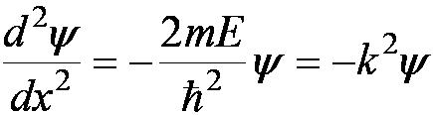


Infinite Square-Well Potential
The simplest such system is that of a particle trapped in a box with infinitely hard walls that the particle cannot penetrate. This potential is called an infinite square well and is given by
Clearly the wave function must be zero where the potential is infinite.
Where the potential is zero inside the box, the Schrödinger wave equation becomes where .
The general solution is .

Slide 34
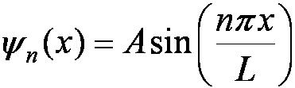
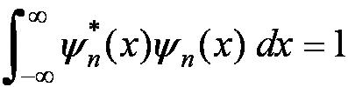
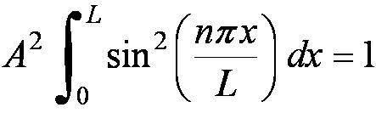
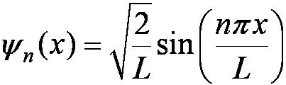
Quantization
Boundary conditions of the potential dictate that the wave function must be zero at x = 0 and x = L. This yields valid solutions for integer values of n such that kL = nπ.
The wave function is now
We normalize the wave function
The normalized wave function becomes
These functions are identical to those obtained for a vibrating string with fixed ends.

Slide 35
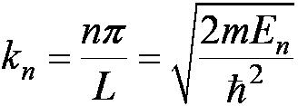
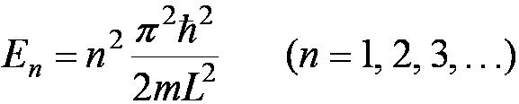
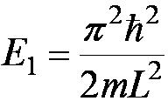
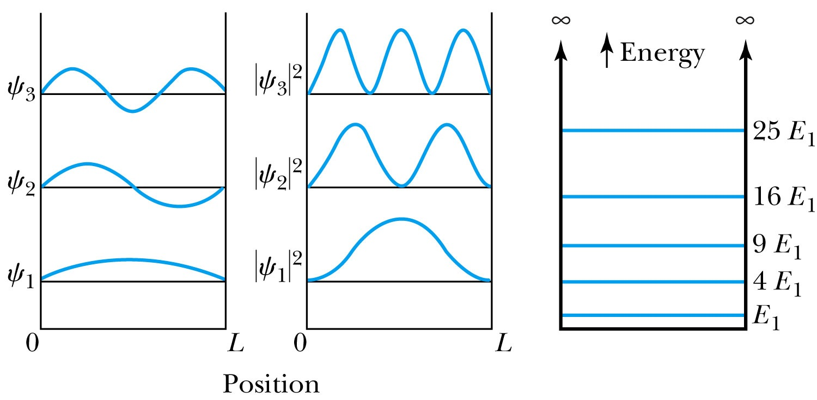
Quantized Energy
The quantized wave number now becomes
Solving for the energy yields
Note that the energy depends on the integer values of n. Hence the energy is quantized and nonzero.
The special case of n = 1 is called the ground state energy.

Slide 36
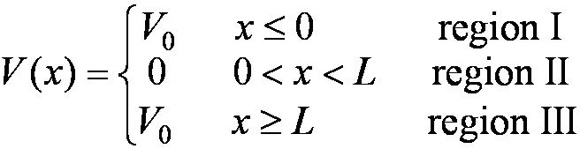
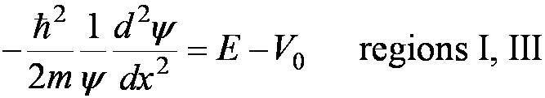

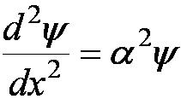
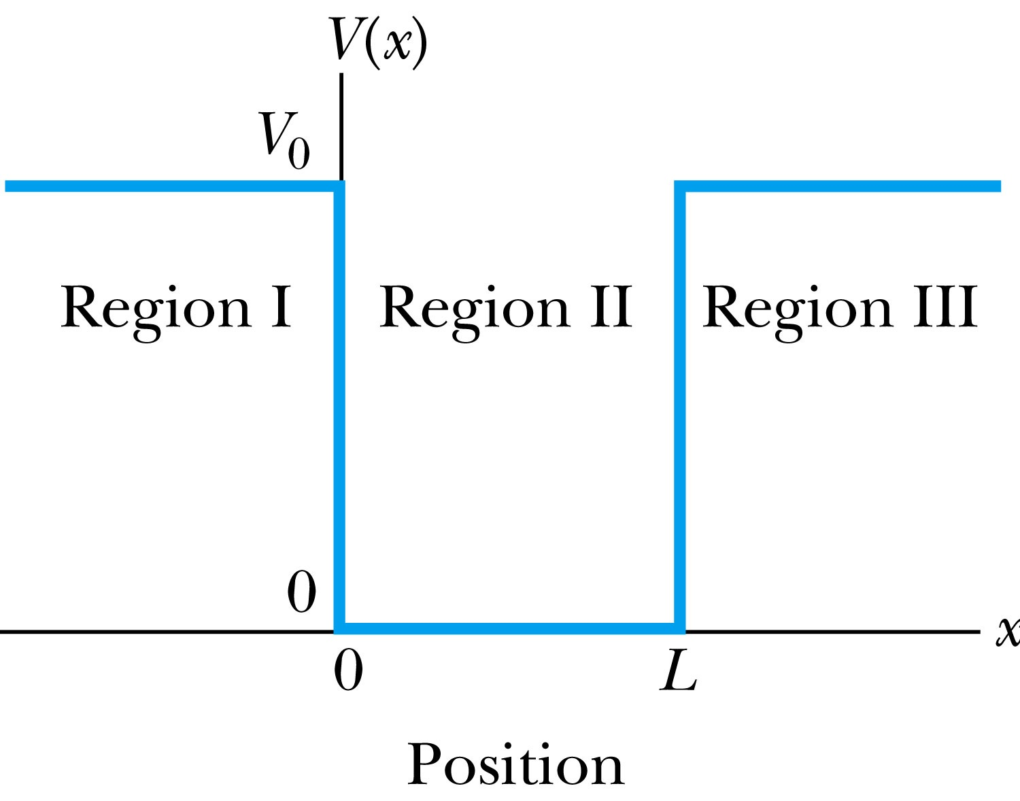
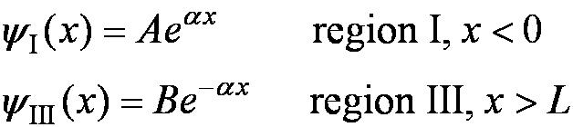
Finite Square-Well Potential
The finite square-well potential is
The Schrödinger equation outside the finite well in regions I and III is
or using
yields . The solution to this differential has exponentials of the form e^{αx} and e^{-αx}. In the region x > L, we reject the positive exponential and in the region x < L, we reject the negative exponential.

Slide 37
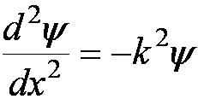

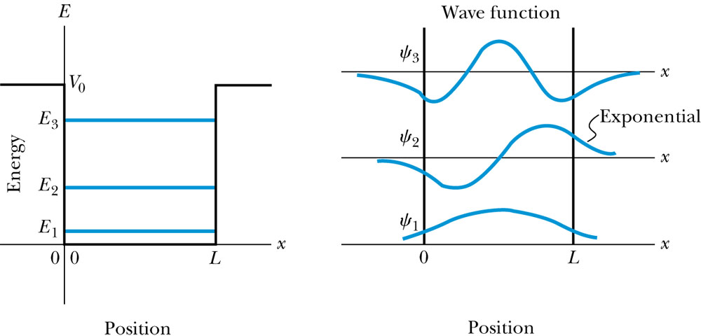
Finite Square-Well Solution
Inside the square well, where the potential V is zero, the wave equation becomes where
Instead of a sinusoidal solution we have
The boundary conditions require that
and the wave function must be smooth where the regions meet.
Note that the
wave function is
nonzero outside
of the box.

Slide 38
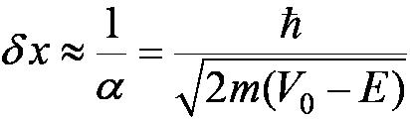
Penetration Depth
The penetration depth is the distance outside the potential well where the probability significantly decreases. It is given by
It should not be surprising to find that the penetration distance that violates classical physics is proportional to Planck’s constant.

Slide 39
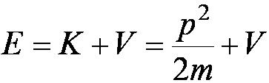
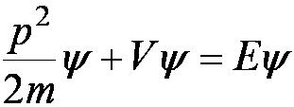

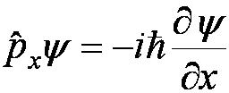
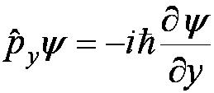
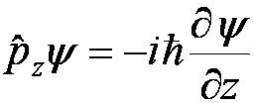
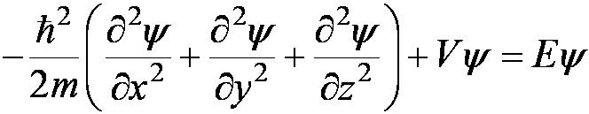
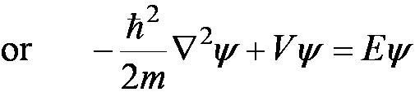
Three-Dimensional Infinite-Potential Well
The wave function must be a function of all three spatial coordinates. We begin with the conservation of energy
Multiply this by the wave function to get
Now consider momentum as an operator acting on the wave function. In this case, the operator must act twice on each dimension. Given:
The three dimensional Schrödinger wave equation is

Slide 40
Degeneracy
Analysis of the Schrödinger wave equation in three dimensions introduces three quantum numbers that quantize the energy.
A quantum state is degenerate when there is more than one wave function for a given energy.
Degeneracy results from particular properties of the potential energy function that describes the system. A perturbation of the potential energy can remove the degeneracy.

Slide 41
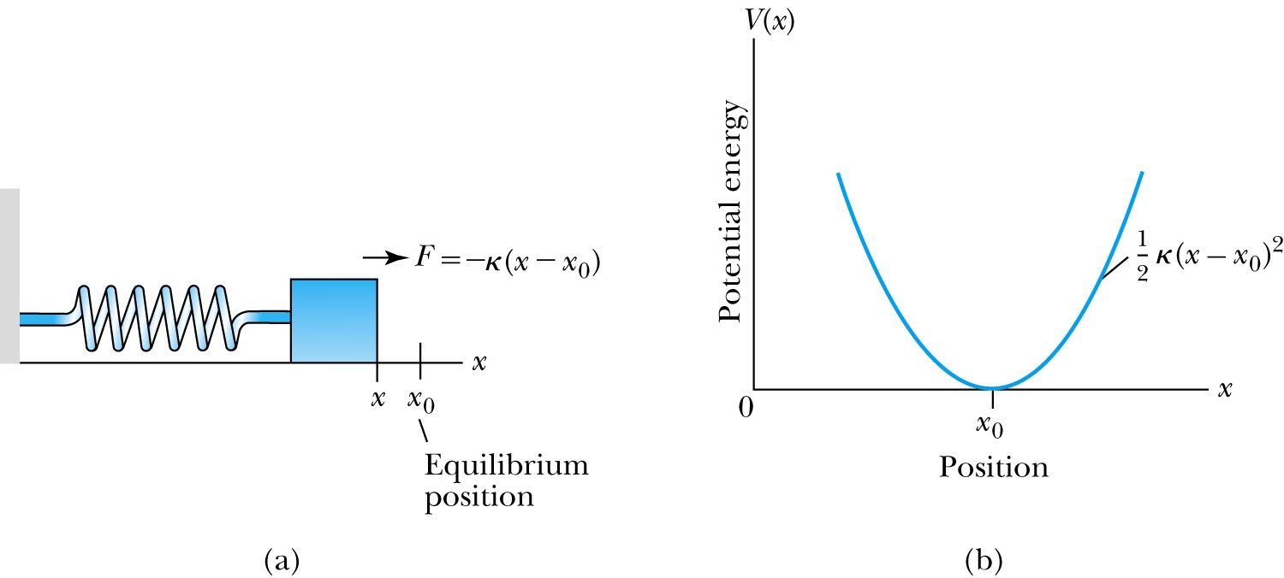
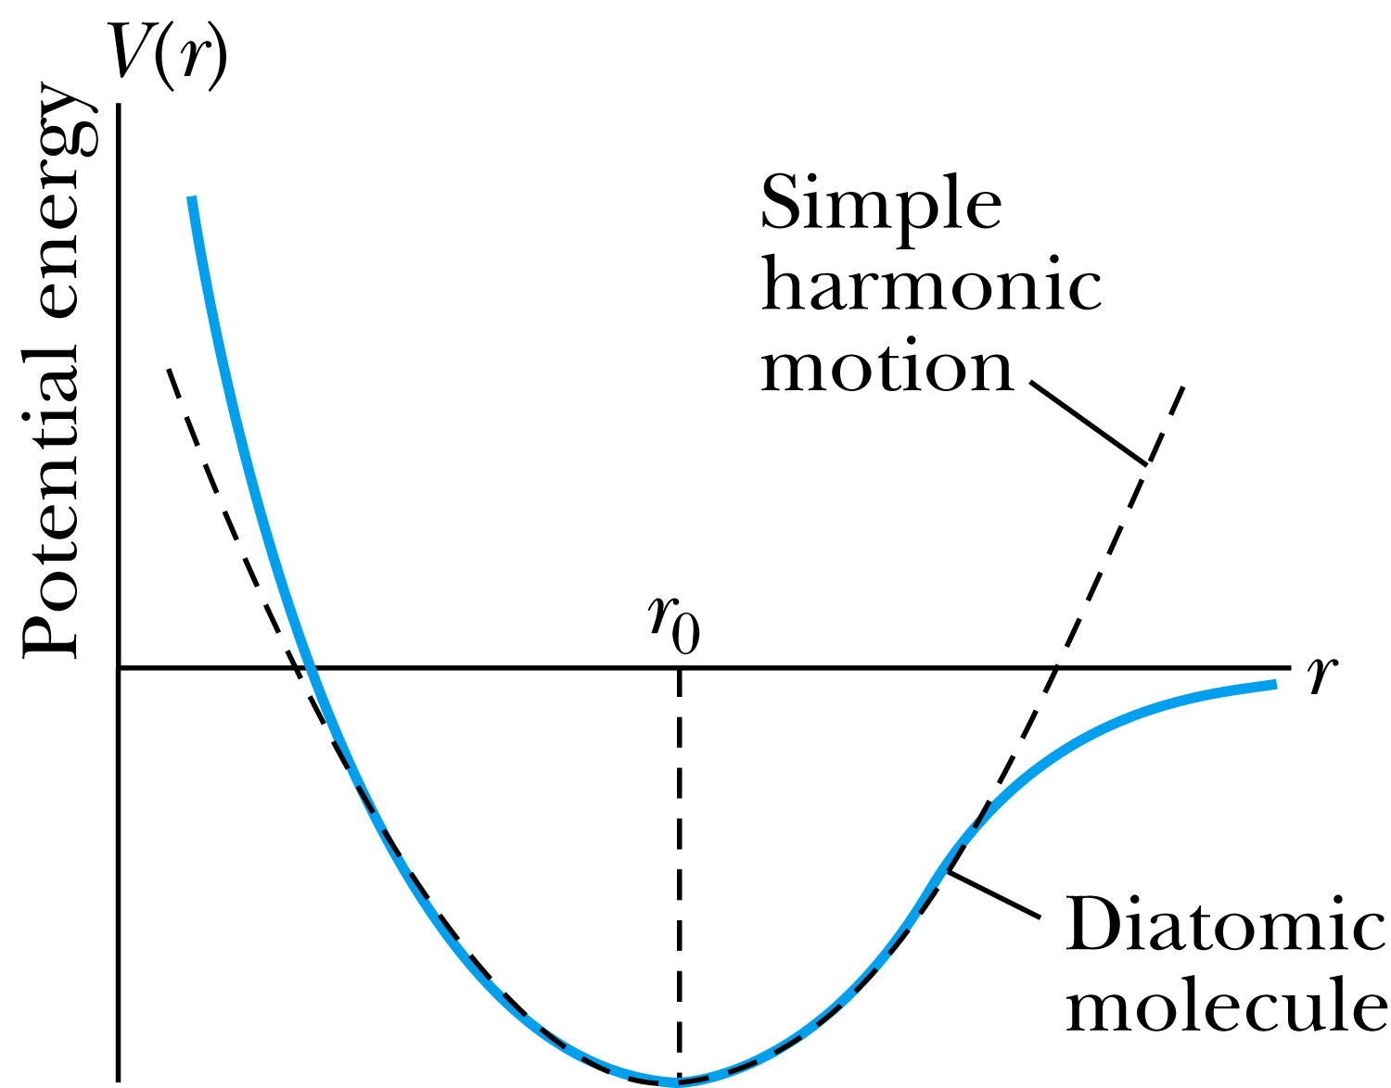

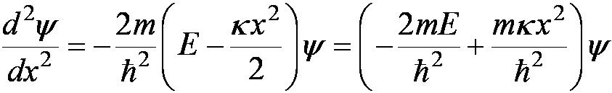
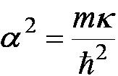
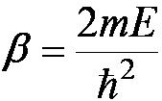
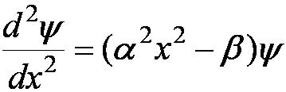
Simple Harmonic Oscillator
Simple harmonic oscillators describe many physical situations: springs, diatomic molecules and atomic lattices.
Consider the Taylor expansion of a potential function:
Redefining the minimum potential and the zero potential, we have
Substituting this into the wave equation:
Let and which yields .

Slide 42
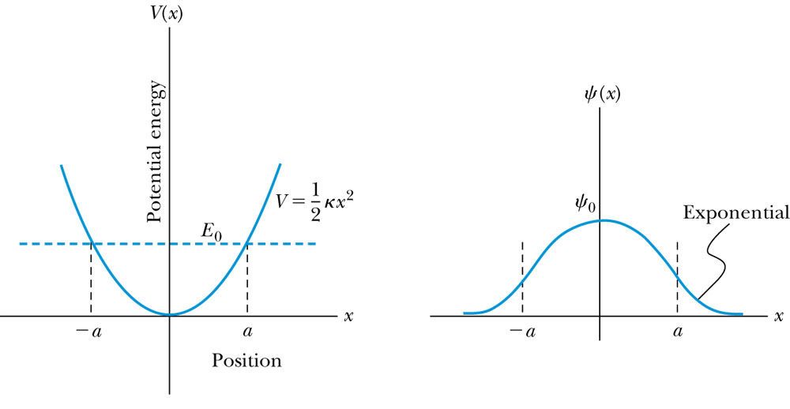

Parabolic Potential Well
If the lowest energy level is zero, this violates the uncertainty principle.
The wave function solutions are where H_{n}(x) are Hermite polynomials of order n.
In contrast to the particle in a box, where the oscillatory wave function is a sinusoidal curve, in this case the oscillatory behavior is due to the polynomial, which dominates at small x. The exponential tail is provided by the Gaussian function, which dominates at large x.

Slide 43
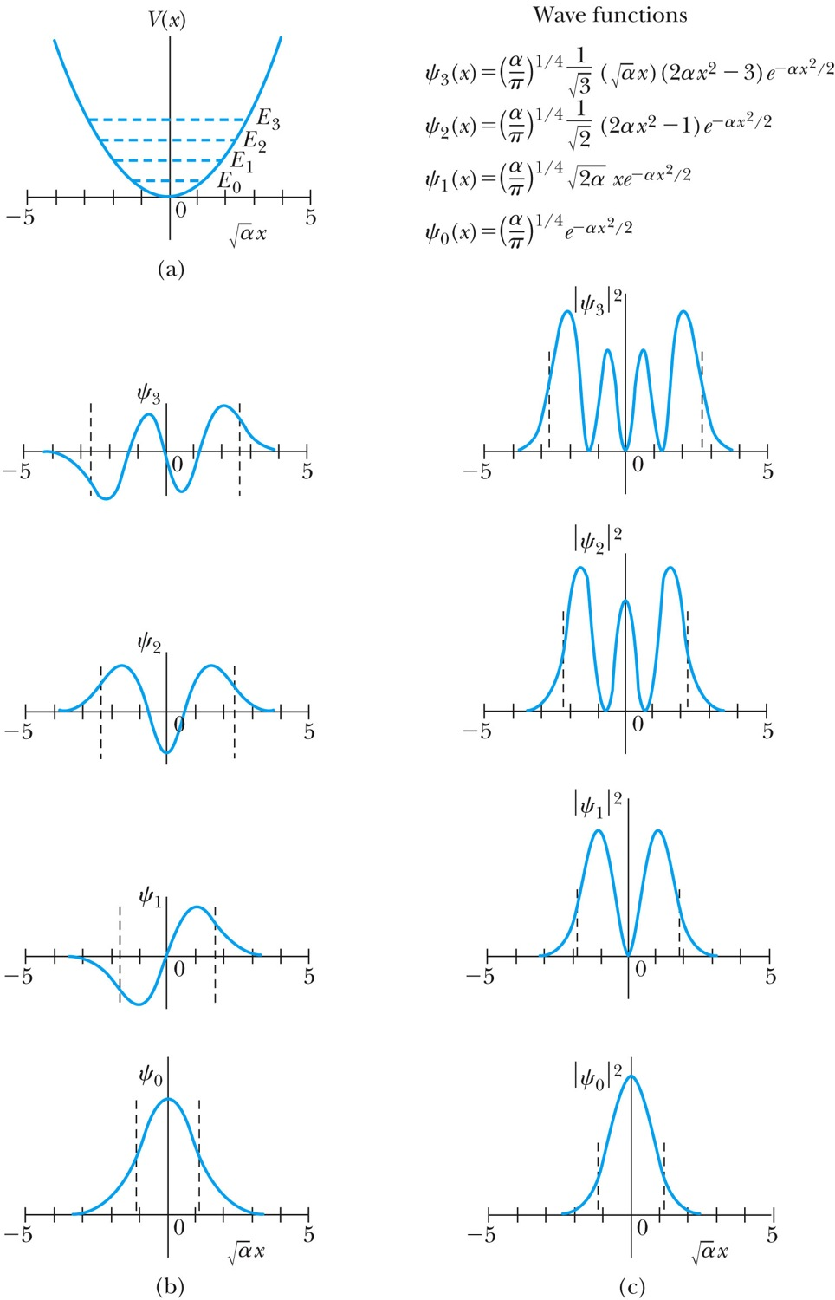
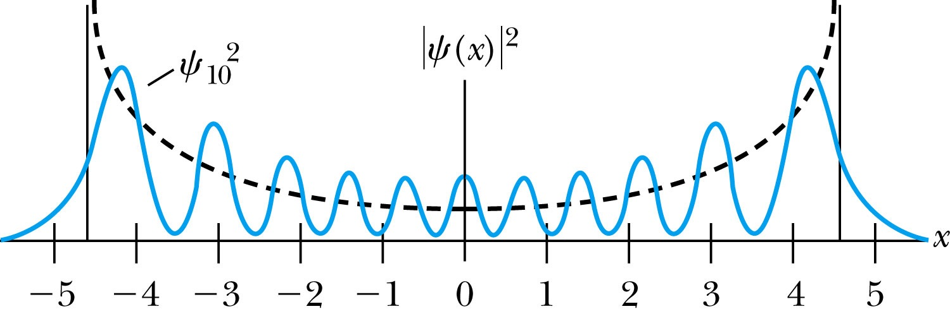

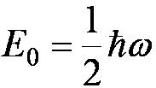
Analysis of the Parabolic Potential Well
The energy levels are given by
The zero point energy is called the Heisenberg limit:
Classically, the probability of finding the mass is greatest at the ends of motion and smallest at the center (that is, proportional to the amount of time the mass spends at each position).
Contrary to the classical one, the largest probability for this lowest energy state is for the particle to be at the center.

Slide 44
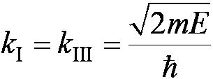
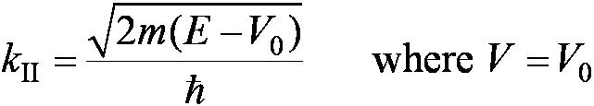
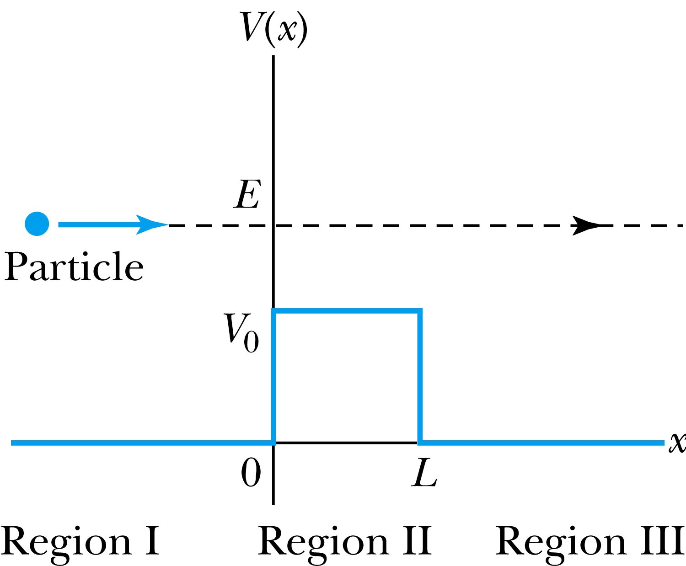

6.7: Barriers and Tunneling
Consider a particle of energy E approaching a potential barrier of height V₀ and the potential everywhere else is zero.
We will first consider the case when the energy is greater than the potential barrier.
In regions I and III the wave numbers are:
In the barrier region we have

Slide 45
At The Barrier an Incident Particle Experiences Reflection and Transmission
Figure 6.13 The incident particle in Figure 6.12 can be either transmitted or reflected.

Slide 46



Reflection and Transmission
The wave function will consist of an incident wave, a reflected wave, and a transmitted wave.
The potentials and the Schrödinger wave equation for the three regions are as follows:
The corresponding solutions are:
As the wave moves from left to right, we can simplify the wave functions to:

Slide 47


Probability of Reflection and Transmission
The probability of the particles being reflected R or transmitted T is:
The maximum kinetic energy of the photoelectrons depends on the value of the light frequency f and not on the intensity.
Because the particles must be either reflected or transmitted we have: R + T = 1
By applying the boundary conditions x → ±∞, x = 0, and x = L, we arrive at the transmission probability:
Notice that there is a situation in which the transmission probability is 1.

Slide 48



Tunneling
Now we consider the situation where classically the particle does not have enough energy to surmount the potential barrier, E < V₀.
The quantum mechanical result, however, is one of the most remarkable features of modern physics, and there is ample experimental proof of its existence. There is a small, but finite, probability that the particle can penetrate the barrier and even emerge on the other side.
The wave function in region II becomes
The transmission probability that
describes the phenomenon of tunneling is

Slide 49



Uncertainty Explanation
Consider when κL >> 1 then the transmission probability becomes:
This violation allowed by the uncertainty principle is equal to the negative kinetic energy required! The particle is allowed by quantum mechanics and the uncertainty principle to penetrate into a classically forbidden region. The minimum such kinetic energy is:

Slide 50

Analogy with Wave Optics
If light passing through a glass prism reflects from an internal surface with an angle greater than the critical angle, total internal reflection occurs. However, the electromagnetic field is not exactly zero just outside the prism. If we bring another prism very close to the first one, experiments show that the electromagnetic wave (light) appears in the second prism The situation is analogous to the tunneling described here. This effect was observed by Newton and can be demonstrated with two prisms and a laser. The intensity of the second light beam decreases exponentially as the distance between the two prisms increases.

Slide 51

Potential Well
Consider a particle passing through a potential well region rather than through a potential barrier.
Classically, the particle would speed up passing the well region, because K = mv² / 2 = E + V₀.
According to quantum mechanics, reflection and transmission may occur, but the wavelength inside the potential well is smaller than outside. When the width of the potential well is precisely equal to half-integral or integral units of the wavelength, the reflected waves may be out of phase or in phase with the original wave, and cancellations or resonances may occur. The reflection/cancellation effects can lead to almost pure transmission or pure reflection for certain wavelengths. For example, at the second boundary (x = L) for a wave passing to the right, the wave may reflect and be out of phase with the incident wave. The effect would be a cancellation inside the well.

Slide 52

Alpha-Particle Decay
The phenomenon of tunneling explains the alpha-particle decay of heavy, radioactive nuclei.
Inside the nucleus, an alpha particle feels the strong, short-range attractive nuclear force as well as the repulsive Coulomb force.
The nuclear force dominates inside the nuclear radius where the potential is approximately a square well.
The Coulomb force dominates
outside the nuclear radius.
The potential barrier at the nuclear
radius is several times greater than
the energy of an alpha particle.
According to quantum mechanics,
however, the alpha particle can
“tunnel” through the barrier. Hence
this is observed as radioactive decay.

