Slide 1
PHYS 3313 – Section 001 Lecture #12
Monday, Oct. 21, 2013
Dr. Jaehoon Yu
The Schrödinger Wave Equation
Probability Density
Wave Function Normalization
Time-Independent Schrödinger Wave Equation
Expectation Values
Operators – Position, Momentum and Energy

Slide 2
Announcements
Mid-term exam results
Class average: 45.2/96
Equivalent to 47/100
Top score: 96/96
Mid-term grade discussion moved to Monday, Oct. 28
Reminder Homework #4
End of chapter problems on CH5: 8, 10, 16, 24, 26, 36 and 47
Due: This Wednesday, Oct. 23
Reading assignments
CH6.1 – 6.7 + the special topic
Colloquia this week
4pm today, SH101, Dr. C. Guo of U. of Rochester
4pm Wednesday, SH101, Dr. X. Chu, U. of Colorado

Slide 3
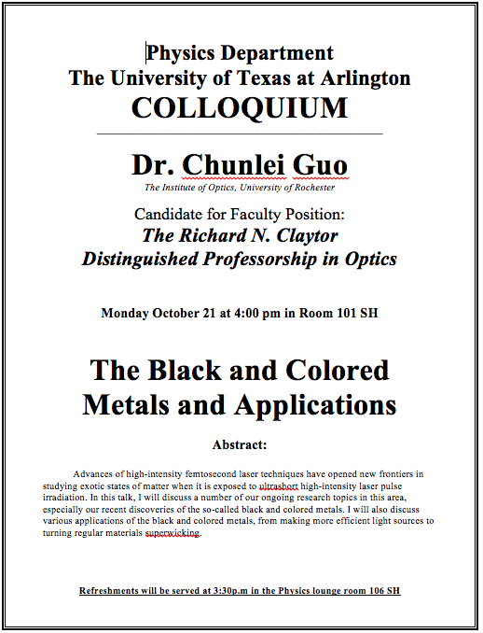

Slide 4
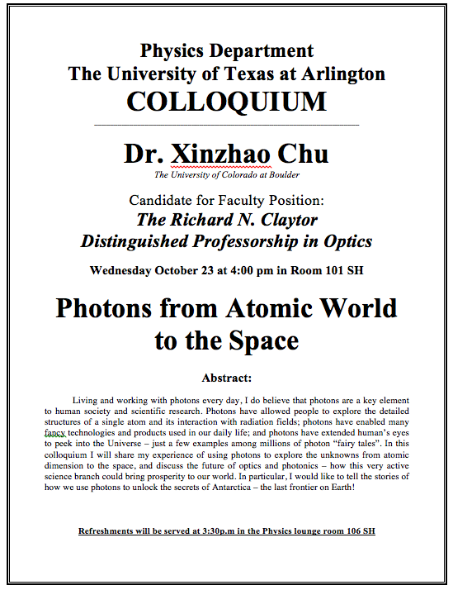

Slide 5
Research Projects
Each of the 12 research groups picks one research topic
Study the topic as a group, looking up references
Original theory or Original observation
Experimental proofs or Theoretical predictions + subsequent experimental proofs
Importance and the impact of the theory/experiment
Each member of the group writes a 10 page report, including figures (must not copy!!)
10% of the total grade
Can share the theme and facts but you must write your own!
Due Mon., Nov. 25, 2013
The group presents a 10min power point talk
5% of the total grade
Date and time will be announced close to the end of the semester

Slide 6
Group – Research Topic Association
Research Group Number | Research Topic
1 | 2
2 | 3
3 | 11
4 | 7
5 | 5
6 | 1
7 | 9
8 | 8
9 | 4
10 | 6
11 | 10
12 | 12

Slide 7
Research Topics
Black body radiation
Michelson–Morley experiment
The Photoelectric effect
Special Relativity
The property of molecules, Browning Motion
Compton Effect
Discovery of the electron
Radioactivity
Rutherford Scattering
Super-conductivity
The Unification of Electromagnetic and Weak forces
The Discovery of the Higgs-like particle

Slide 8
Special Project #4
Prove that the wave function Ψ=A[sin(kx-ωt)+icos(kx-ωt)] is a good solution for the time-dependent Schrödinger wave equation. Do NOT use the exponential expression of the wave function. (10 points)
Determine whether or not the wave function Ψ=Ae^{-α|x|} satisfy the time-dependent Schrödinger wave equation. (10 points)
Due for this special project is Monday, Oct. 28.
You MUST have your own answers!

Slide 9
The Schrödinger Wave Equation
Erwin Schrödinger and Werner Heinsenberg proposed quantum theory in 1920
The two proposed very different forms of equations
Heinserberg: Matrix based framework
Schrödinger: Wave mechanics, similar to the classical wave equation
Paul Dirac and Schrödinger later on proved that the two give identical results
The probabilistic nature of quantum theory is contradictory to the direct cause and effect seen in classical physics and makes it difficult to grasp!

Slide 10
The Schrödinger Wave Equation
The Schrödinger wave equation in its time-dependent form for a particle of energy E moving in a potential V in one dimension is
The extension into three dimensions is
where is an imaginary number

Slide 11
Ex 6.1: Wave equation and Superposition
The wave equation must be linear so that we can use the superposition principle to. Prove that the wave function in Schrodinger equation is linear by showing that it is satisfied for the wave equation Ψ (ξ,τ)=αΨ₁ (ξ,τ)+βΨ₂ (ξ,τ) where a and b are constants and Ψ₁ (ξ,τ) and Ψ₂ (ξ,τ) describe two waves each satisfying the Schrodinger Eq.
Rearrange terms

Slide 12
General Solution of the Schrödinger Wave Equation
The general form of the solution of the Schrödinger wave equation is given by:
which also describes a wave propagating in the x direction. In general the amplitude may also be complex. This is called the wave function of the particle.
The wave function is also not restricted to being real. Only the physically measurable quantities (or observables) must be real. These include the probability, momentum and energy.

Slide 13
Ex 6.2: Solution for Wave Equation
Show that Ae^{i(kx-ωt)} satisfies the time-dependent Schrodinger wave Eq.
So Ae^{i(kx-ωt)} is a good solution and satisfies Schrodinger Eq.

Slide 14
Ex 6.3: Bad Solution for Wave Equation
Determine Ψ (ξ,τ)=Asin(kx-ωt) is an acceptable solution for the time-dependent Schrodinger wave Eq.
This is not true in all x and t. So Ψ (x,t)=Asin(kx-ωt) is not an acceptable solution for Schrodinger Eq.

Slide 15
Normalization and Probability
The probability P(x) dx of a particle being between x and X + dx was given in the equation
Here Ψ* denotes the complex conjugate of Ψ
The probability of the particle being between x₁ and x₂ is given by
The wave function must also be normalized so that the probability of the particle being somewhere on the x axis is 1.

Slide 16
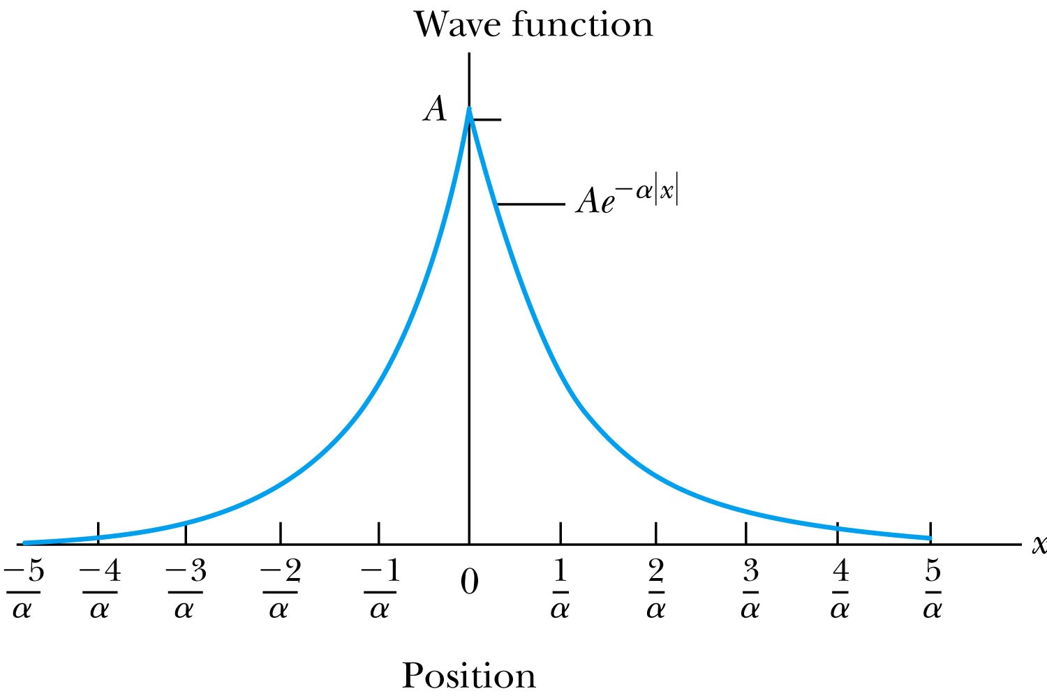
Ex 6.4: Normalization
Consider a wave packet formed by using the wave function that Ae^{-α|ξ|}, where A is a constant to be determined by normalization. Normalize this wave function and find the probabilities of the particle being between 0 and 1/α, and between 1/α and 2/α.
Probability density
Normalized Wave Function

Slide 17
Ex 6.4: Normalization, cont’d
Using the wave function, we can compute the probability for a particle to be with 0 to 1/α and 1/α to 2/α.
For 0 to 1/α:
For 1/α to 2/α:
How about 2/α:to ∞?

